Slide 1

Use of Photochemical Grid Models to Assess Single-Source Impacts
Ralph Morris, Tanarit Sakulyanontvittaya,
Darren Wilton and Lynsey Parker
ENVIRON International Corp., Novato, CA
11th Annual CMAS Conference
Chapel Hill, North Carolina
October 15-17, 2012

Slide 2
Background
Long Range Transport (LRT) models estimate incremental air quality (AQ) concentration and related values (AQRV) at Class I areas for distances > 50 km
  e.g., PSD, BART and NEPA
  AQRVs include visibility and acid deposition (S and N)
1998 Interagency Workgroup on Air Quality Modeling (IWAQM)
  Recommends CALPUFF for far-field Class I assessments
2003 EPA modeling guidance
  Recommends CALPUFF for far-field air quality assessments of inert pollutants
  Secondary PM_{2.5} is important for far-field AQ/RV
  But CALPUFF not an EPA-preferred model for secondary PM_{2.5}

Slide 3
Background
2009 EPA/IWAQM Phase II Reassessment Report
  Addresses lack of recommended settings for regulatory applications of CALMET/CALPUFF
    “Anything goes” – options set to achieve desired result
  Recommended CALMET options to “pass through” WRF/MM5 meteorology to CALPUFF
August 2009 EPA Clarification Memo
  New recommended CALMET settings
EPA has developed the Mesoscale Model Interface Tool (MMIF)
  Pass through WRF/MM5 meteorology to CALPUFF as much as possible

Slide 4
Background
EPA is examining alternative LRT models for far-field AQ/RV issues
  Considering photochemical grid models (PGMs)
PGM reluctance in the past:
  Bigger/complex databases, higher computational requirements
  Multiple model runs (zero-out run for single source)
  More modeling expertise to use
  Grid resolution issues (e.g., miss max plume concentrations)
Overriding considerations:
  Treats ozone – a pollutant of increasing importance
  Contains state-of-science gas/PM chemistry
  Currently used for NEPA single-source assessments

Slide 5
Purpose
Perform single-source Class I AQ/RV demonstration for example test sources
Use a PGM, compare results to CALPUFF
  Maximum PSD pollutant concentrations
  Maximum visibility impacts
  Maximum annual sulfur and nitrogen deposition

Slide 6
Overview of Approach
Select 2 existing western PGM/MM5 databases
  2005 4 km Four Corners Air Quality Task Force (FCAQTF)
  2006 12 km Utah-Colorado (UT-CO)
Select existing test sources
  Electrical Generating Units (EGUs) of various sizes (point source)
  Oil and Gas production sources (point and area)
Model single-source AQ/RV impacts at Class I areas using multiple models/configurations
  CAMx PGM
  CALPUFF V5.8
  CALMET and MMIF meteorological inputs

Slide 7
Modeling Differences
CALPUFF Gaussian puff formulation
  Class I areas represented by hundreds of receptors
  Touted as resolving higher peak plume concentrations
    Is this really true at longer downwind distances?
  POSTUTIL (NO₃ repartitioning) not used in these analyses
CAMx Eulerian grid formulation
  Resolves AQ/RV impacts at grid resolution
    12 and 4 km in these applications
    Does this under estimate maximum impacts?
  Plume-in-Grid (PiG) module used to treat early point source plume growth and chemistry
    Addresses non-linear resolution-dependent chemistry
  Use PM Source Apportionment Technology (PSAT) to track contributions from single sources
    Alleviates multiple zero-out runs

Slide 8
Class I Areas Defined by 12 km Grid

Slide 9
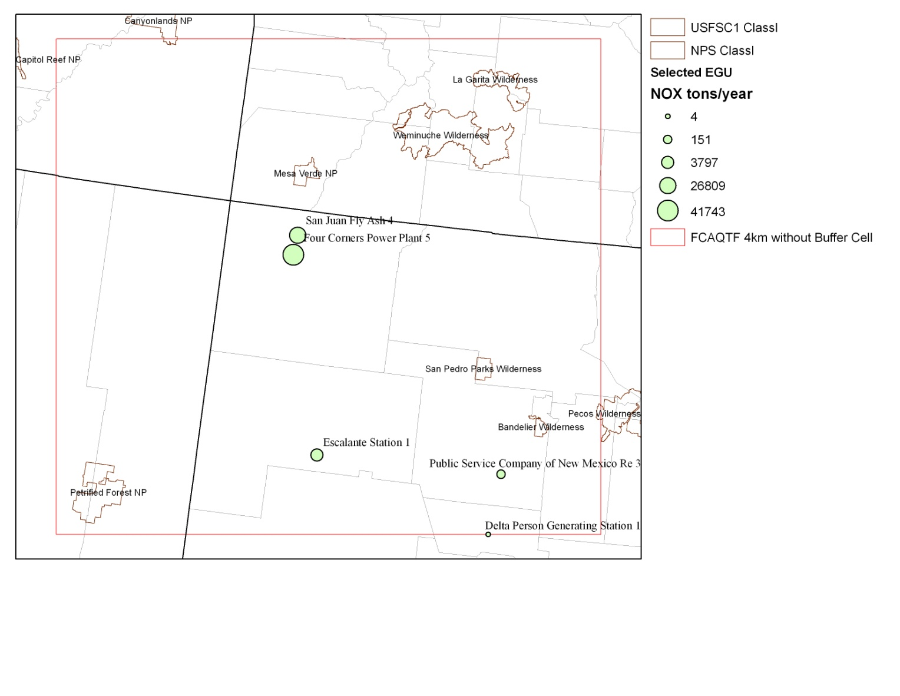
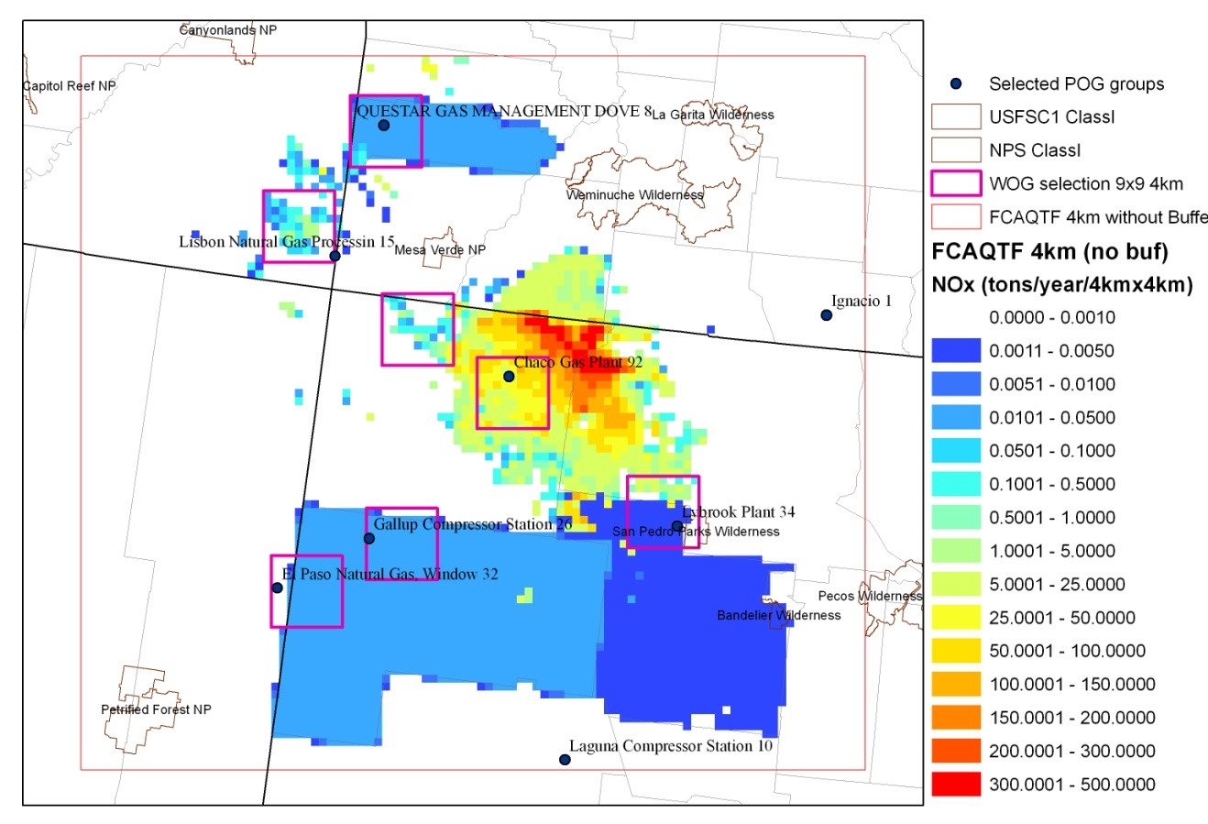
2005 4 km FCAQTF
5 EGU Point Sources
  NO_{X}: 4 – 42,000 TPY
  SO₂: 0.1 – 12,500 TPY
9 O&G Gridded Sources
  9 x 9 array of 4 km cells
  NO_{X}: 175 – 291,800 TPY
  SO₂: 0 - 127 TPY

Slide 10
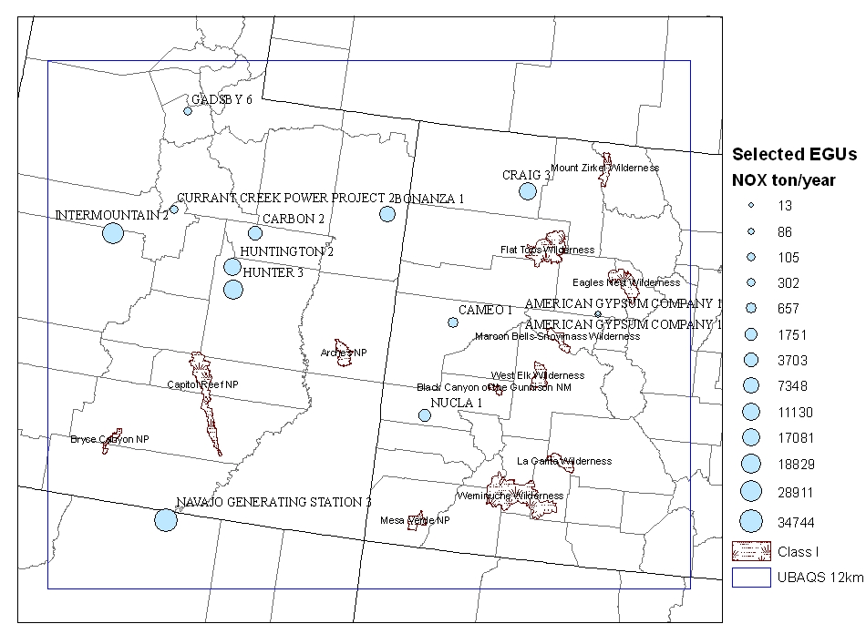
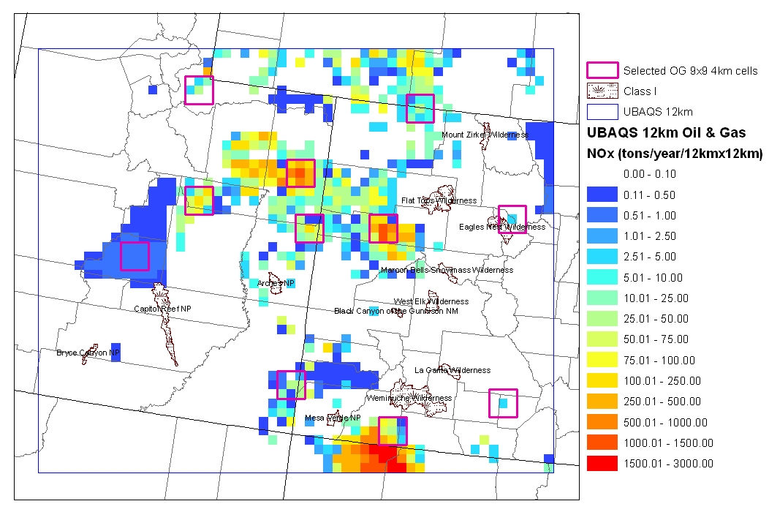
2006 12 km UT-CO
13 EGU Point Sources
  NO_{X}: 13 – 34,700 TPY
  SO₂: 0 – 17,300 TPY
11 O&G Gridded Sources
  3 x 3 array of 12 km cells
  NO_{X}: 51 – 10,30 TPY
  SO₂: 0 - 14 TPY
10

Slide 11
Max 24-hour SO₂ – 2005 4 km FCAQTF
CAMx vs CALPUFF/MET
CAMx vs CALPUFF/MIFF
CALPUFF/MET vs MIFF

Slide 12
Max 24-hour SO₂ – 2006 12 km UT-CO
CAMx vs CALPUFF/MET
CAMx vs CALPUFF/MIFF
CALPUFF/MET vs MIFF
CALPUFF/MET: 12 km vs 4 km

Slide 13
Max 24-hour SO₂ Summary
2005 4 km FCAQTF
  CAMx > CALPUFF/MET > CALPUFF/MMIF
  CAMx is closer to CALPUFF/MET
    Surprising – CAMx and CALPUFF/MMIF share same met
  CAMx estimated highest annual SO₂ from FCPP at Mesa Verde NP (~50 km away)
    Surprising – grid cells thought to produce lower concentrations than receptors
2006 12 km UT-CO
  CALPUFF/MET ~ CALPUFF/MMIF > CAMx
  CAMx grid resolution may play a role
    But different year, different/farther source-receptor couples add complexity
  CALPUFF/MET 4 km = 12 km

Slide 14
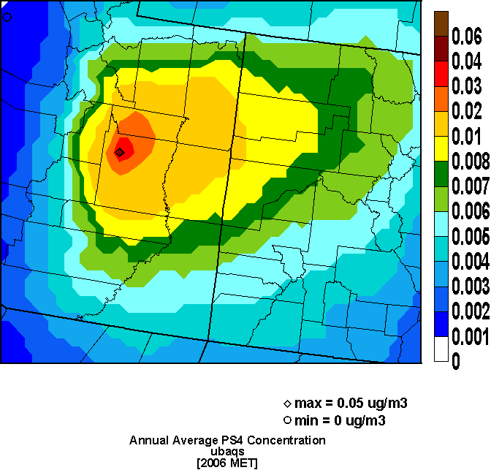
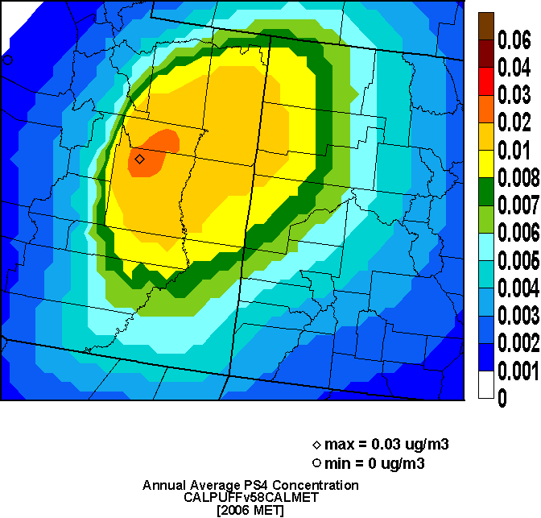
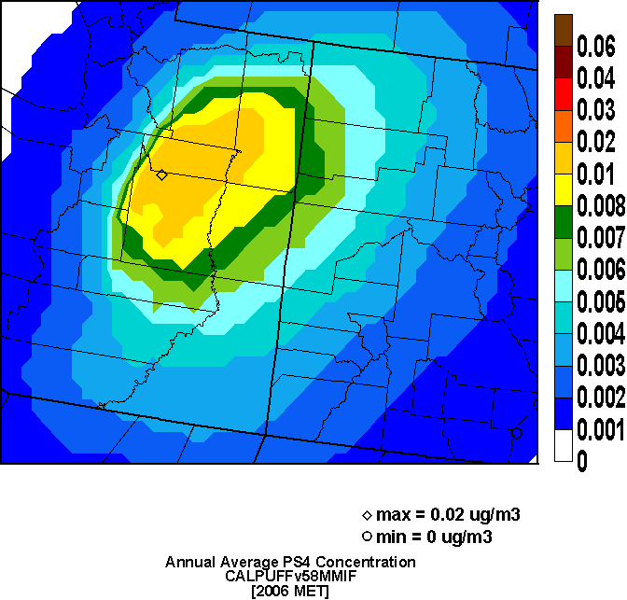
CAMx
2006 12 km UT-CO
Annual SO4
from EGU1
CALPUFF/MET
CALPUFF/MIFF
14

Slide 15
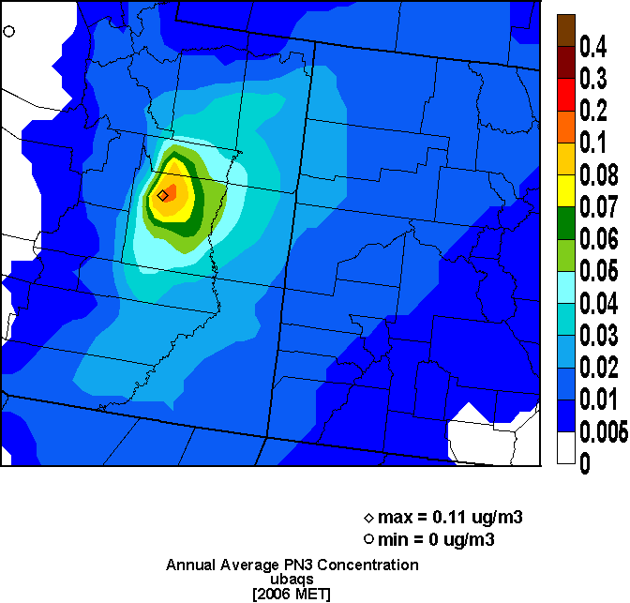
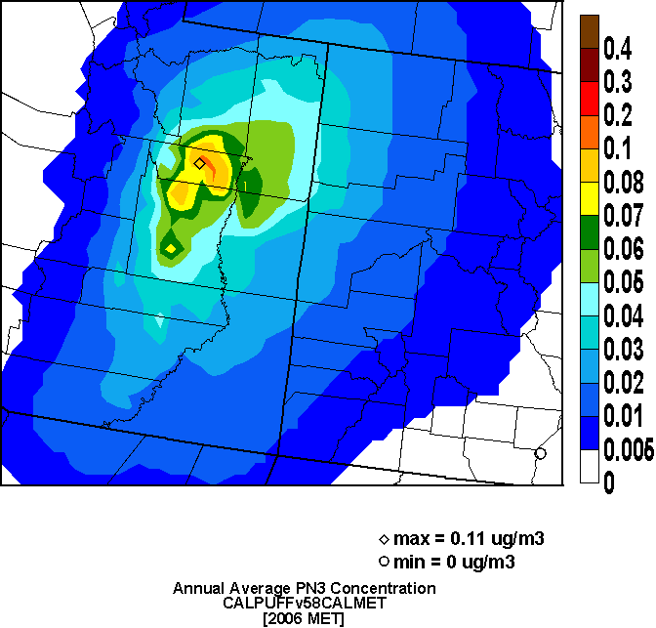
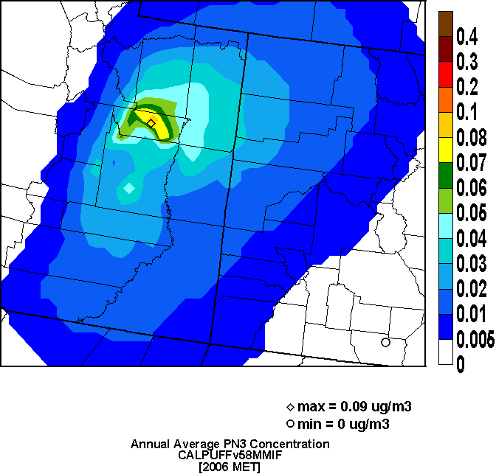
CAMx
2006 12 km UT-CO
Annual PNO3
from EGU1
CALPUFF/MET
CALPUFF/MIFF
15

Slide 16
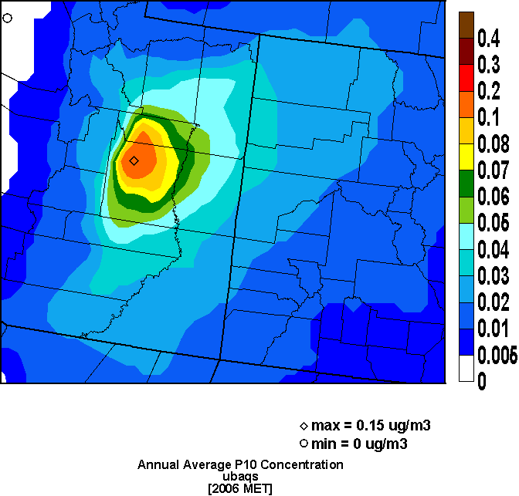
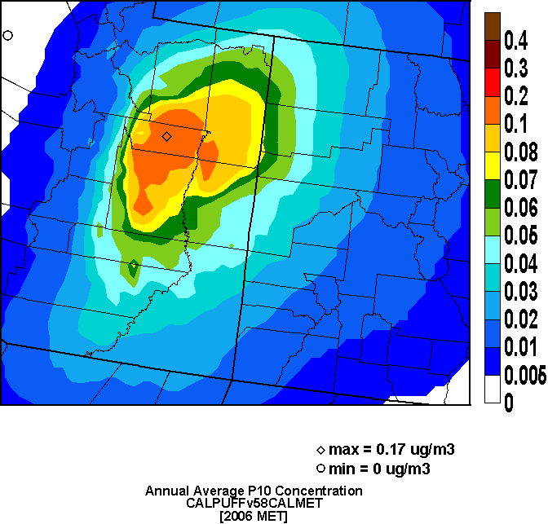
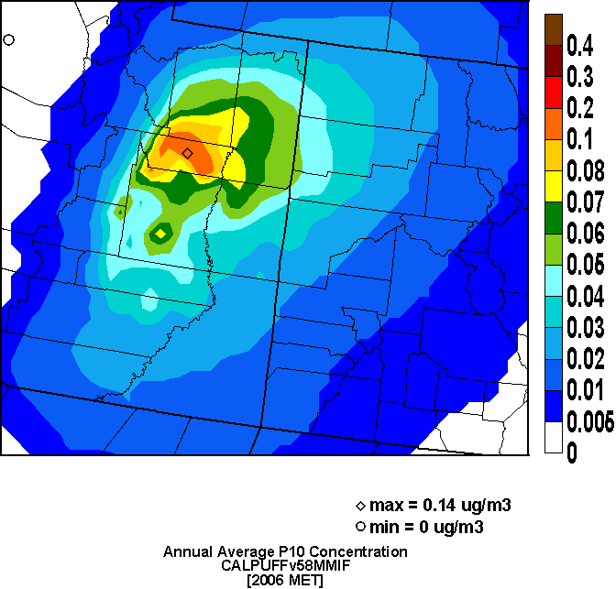
CAMx
2006 12 km UT-CO
Annual PM10
from EGU1
CALPUFF/MET
CALPUFF/MIFF
16

Slide 17
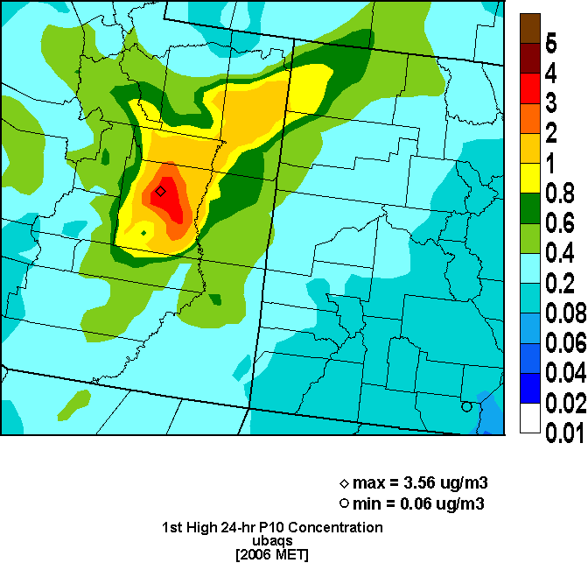
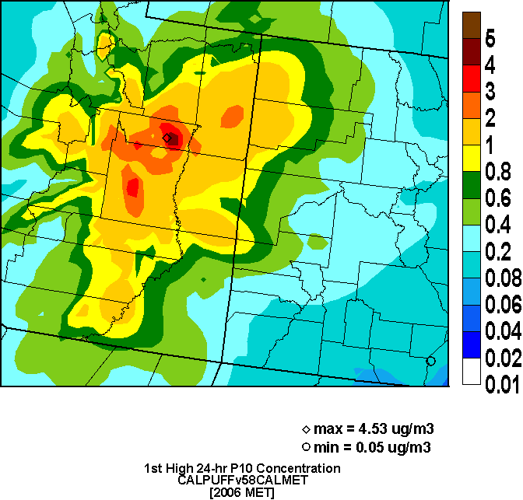
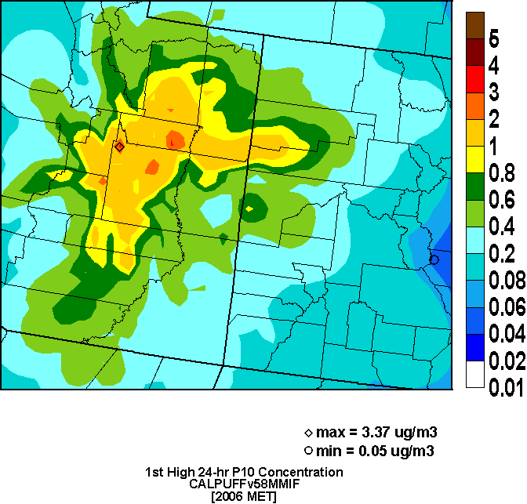
CAMx
2006 12 km UT-CO
Max 24-hour PM10
from EGU1
CALPUFF/MET
CALPUFF/MIFF
17

Slide 18
Max 24-hour Visibility – 2005 4 km FCAQTF
CAMx vs CALPUFF/MET
CAMx vs CALPUFF/MIFF
CALPUFF/MET vs MIFF

Slide 19
Max 24-hour Visibility – 2006 12 km UT-CO
CAMx vs CALPUFF/MET
CAMx vs CALPUFF/MIFF
CALPUFF/MET vs MIFF
CALPUFF/MET: 12 km vs 4 km

Slide 20
Spatial Variability Across Class I Areas
Spatial variability not always greater in CALPUFF
  Little spatial variability > 100 km from the source
225 km
190 km
45 km
235 km
170 km
140 km

Slide 21
Visibility Summary
Used latest IMPROVE equation
  Extinction due to SO₄, PNO₃, EC, OA, Crustal (no NO₂)
  Monthly average f(RH) values
CALPUFF makes more PNO₃ than CAMx
  Constant 1 ppb background ammonia in CALPUFF
  CALPUFF does not account for chemistry of puff overlap
Little spatial variability for distant Class I areas (> 100 km)
2005 4 km FCAQTF
  CALPUFF/MET = 1.4 x CALPUFF/MMIF (40% higher)
  CALPUFF/MET = 2.0 x CAMx (100% higher)
2006 12 km UT-CO
  CALPUFF/MET ~ CALPUFF/MMIF > CAMx
  CALPUFF/MET 12 km = 4 km

Slide 22
Nitrogen Deposition – 2005 4 km FCAQTF
CAMx = ∑ N Species
CALPUFF = NOx + HNO₃ + NO₃ + NH₄
CAMx = 2.0 x CALPUFF/MET/MMIF
CALPUFF/MET ~ CALPUFF/MMIF
CAMx carries more NO₃ as HNO₃ (CALPUFF tends toward PNO₃)
  HNO₃ has higher dry deposition rate

Slide 23
Conclusions
Demonstrate utility of PGM’s for single source AQ/AQRV impacts
  Better chemistry, 3-D long-range transport/dispersion
Results for inert/linear pollutants not so different
  PGM resolution may play a role at short distances (<100 km)
  High receptor density makes no difference at farther distances
  Surprisingly, CAMx most dissimilar to CALPUFF/MMIF for 2005 gas SO₂ concentrations
Visibility/deposition differences arise from HNO₃/PNO₃ partitioning
  HNO₃ has higher dry deposition rate
  More PNO₃ → larger visibility impact, lower N deposition
  Partitioning of NO₃ during transport is important
    POSTUTIL does not remedy this issue

Slide 24
Acknowledgements
Work funded by EPA OAQPS Air Quality Modeling Group under sub-contract to UNC/Institute of the Environment
Final report will be posted on SCRAM

