Slide 1
Observation-constrained probabilistic evaluation of modeled concentrations and sensitivities
Daniel Cohan and Antara Digar
CMAS Conference
October 16, 2012

Slide 2
Causes of Uncertainty in Modeled Concentrations & Sensitivities
Uncertainty in
Air Quality Model
Structural Uncertainty
Model/User Errors
Parametric Uncertainty
Imperfections in numerical representations of atmospheric processes:
Emission model
Chemical mechanism
Transport schemes
Meteorology model
Error in model input parameters:
  Emission rates
  Reaction rate constants
  Boundary conditions
  Deposition velocities

Slide 3
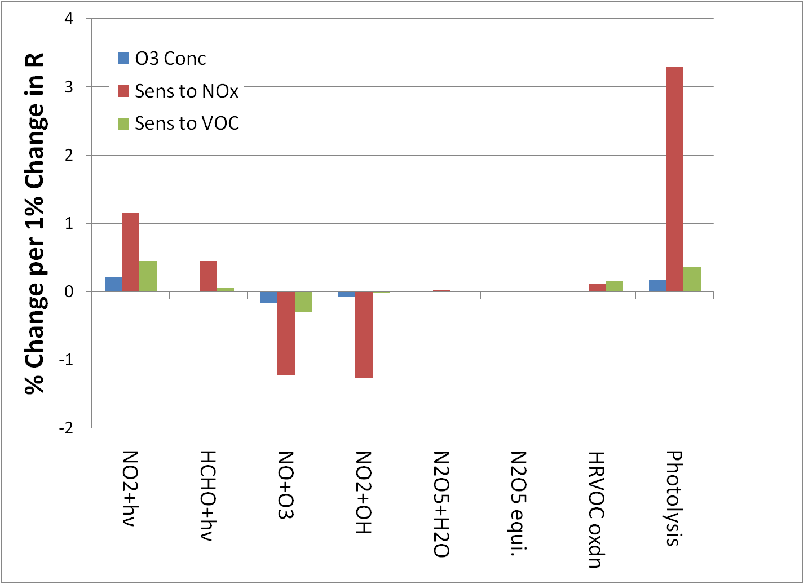
O₃ sensitivities more responsive than concentrations to uncertain reaction rates
8-hour results averaged over episode for 2-km Houston domain
Cohan et al., Atmos. Environ. (2010), 3101-3109

Slide 4
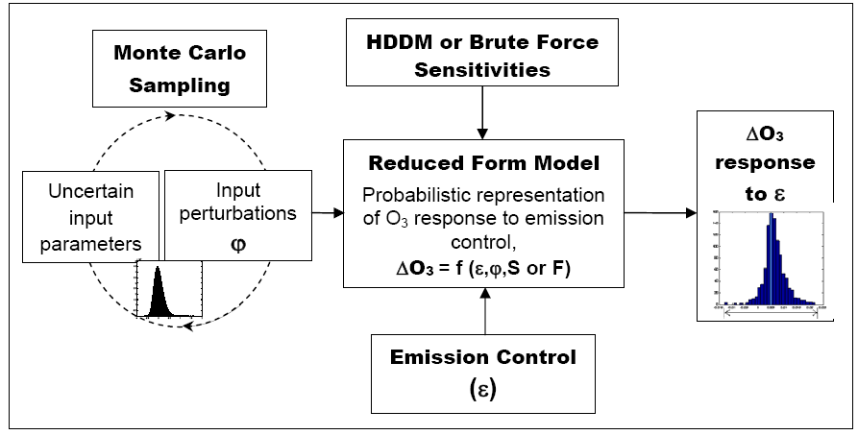

Reduced Form Model approach to characterize parametric uncertainty
Taylor Series Expansions:
Digar et al., ES&T 2011

Slide 5
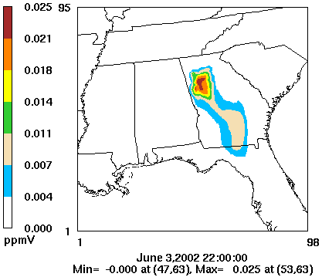
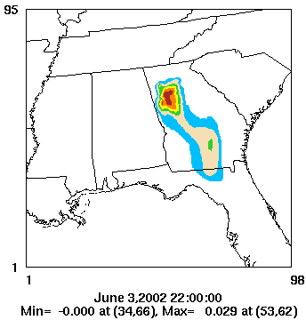
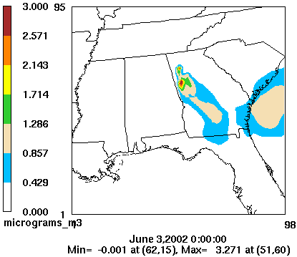
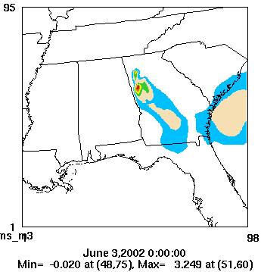
Performance of Reduced Form Model
Brute Force
Reduced Form Model
8-hour Ozone
Impact of -50% Atlanta NO_{x} if E_{NOx}, E_{VOC}, and J_{phot} all +50%
24-hour PM Sulfate
Impact of -50% Atlanta SO₂ if E_{SO2}, E_{NH3}, and J_{phot} all +50%
R² > 0.99, NME < 10% in each case
Digar and Cohan, ES&T 2010

Slide 6
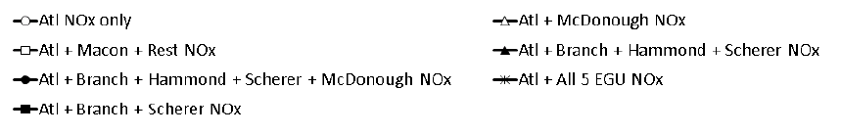
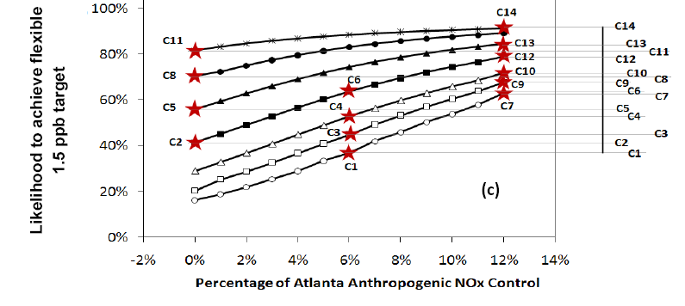
Retrospective case study: Likelihood of achieving 1.5 ppb target in Atlanta
Digar et al., ES&T 2011a

Slide 7
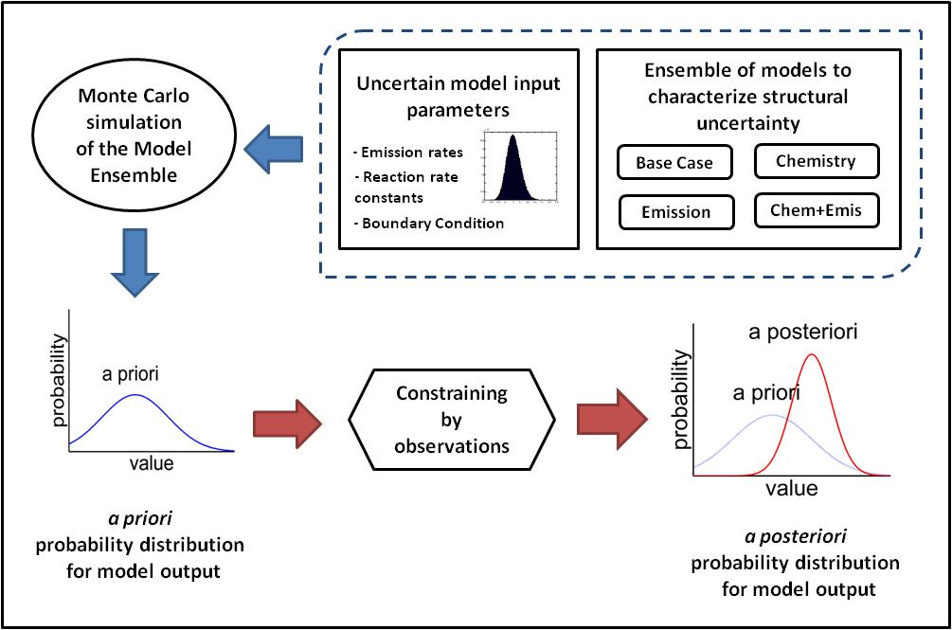
Observation-Constrained Monte Carlo with structural & parametric uncertainties
constrained
constrained
Digar et al., JGR in revision

Slide 8
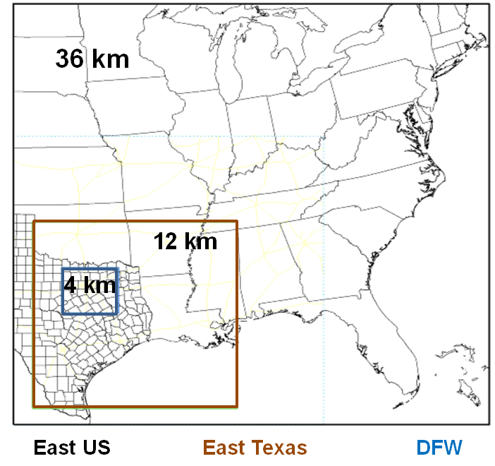
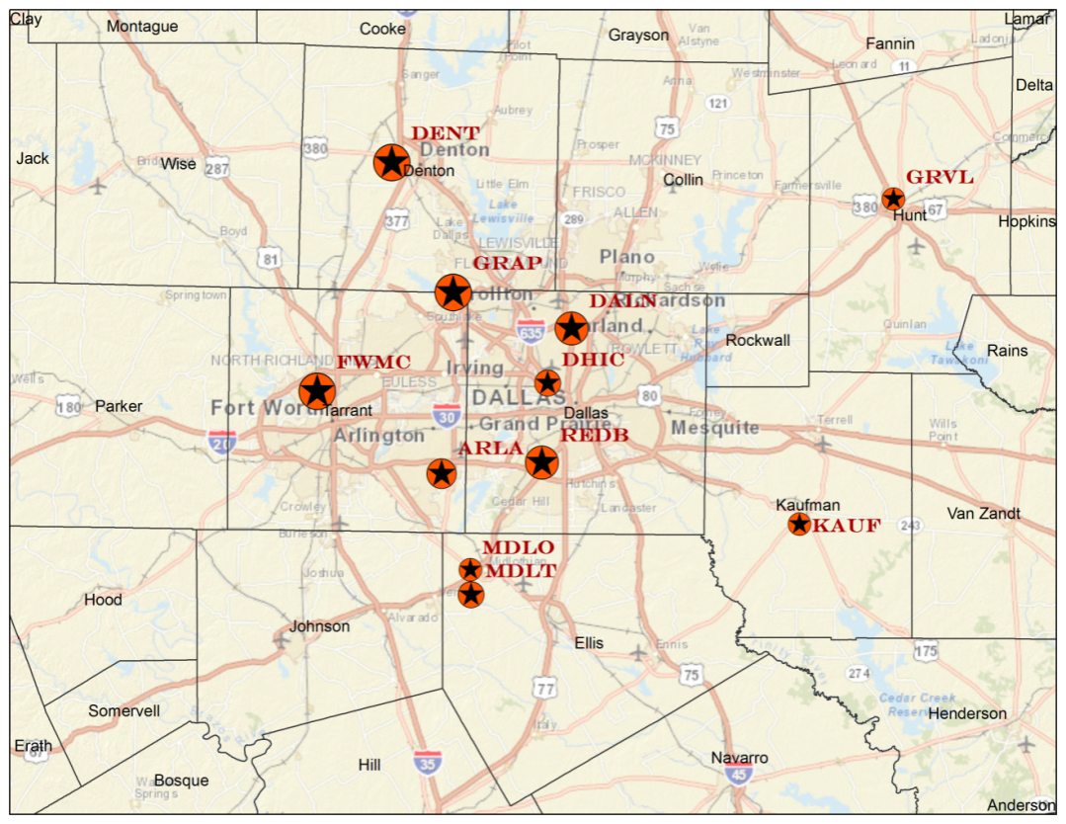
Modeling and Observations
(8-h O₃ & 24-h NO_{X})
Note: NO_{X} concentrations were bias-corrected for interference with other nitrogen species based on the work of Lamsal et al., JGR, 2008.

Slide 9
Uncertainties Considered
Structural Scenarios
  MOZART* and GEOS-Chem boundary conditions
  GloBEIS* and MEGAN biogenic emissions
  CB-05* and CB-6 chemical mechanisms
  Slinn* and Zhang deposition schemes
Parametric Uncertainties
  Emissions: Domain-wide NO_{x}, BVOC, and AVOC
  Chemical reaction rate constants: R(OH+NO₂), R(NO+O3), R(VOCs+OH), J(photolysis)
  Boundary conditions: O₃, NO_{x}, HNO₃, PAN, HONO, N₂O₅
*: Default

Slide 10
DFW sensitivities under each structural case
All show predominately NO_{x}-limited
CB-6 favors VOC sensitivity
MEGAN favors NO_{x} sensitivity
Boundary conditions do not affect sensitivities
Zhang deposition affects sensitivities only at night
Similar trends for Houston sensitivities (Aug-Sept episode)
MEGAN
CB-6
CB-6
MEGAN
Zhang

Slide 11
Metric 1 (Bayesian Inference Method)
Likelihood that a model prediction (C) is correct given observation (O),
M = 4000
For 8-hr O₃, σ = 7.2 ppb
For 24-hr NOx, σ = 8.2 ppb
Based on 5 years of data (2004 – 2008)
Bergin et al. 1999
Assumption: errors in the interpolated observed concentrations are independent & normally distribution with mean zero
Episode-average
8-hr O₃ and 24-hr NOx
at 11 sites
N = 11
A posteriori probability for C (applying Bayes’ Theorem),
Prior probability,

Slide 12
Metric 2 (EPA Screening)
Screening cases that pass all of the following test criteria for 8-hr Ozone,
Mean Normalized Gross Error
-5% < MNGE < +5%
Mean Normalized Bias
MNB < 30%
-15% < UPA < +15%
Unpaired Peak Accuracy
8-hr O₃ at all sites and days
N = 289
Note: MNB and MNGE were computed for model results (Model) when O₃ observations (Obs) were greater than the recommended threshold of 60 ppb [USEPA, 2007]

Slide 13
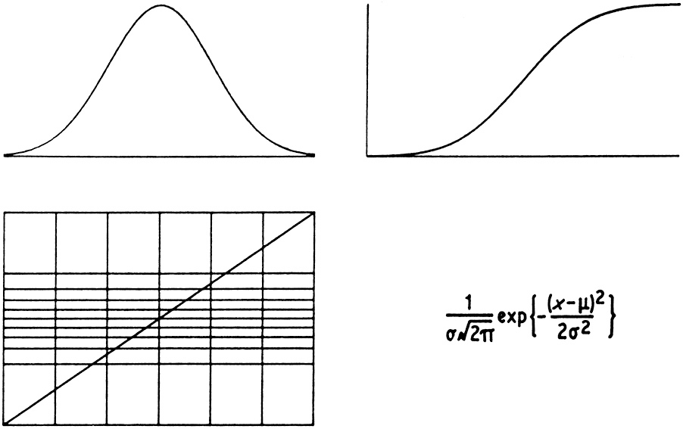
Metric 3 (Cramer-von Mises)
The Cramér-von Mises (CvM) criterion [Anderson, 1962] provides a non-parametric test of the null hypothesis (H₀) that two samples are drawn from the same (unspecified) distribution
F(y_{i})
G(x_{i})
CDF of x
CDF of y
N
Model Predictions
(x)
G(y)
N Observations
(y)
F(x)
x₁
x₂
y_{i}
x_{n}
y₁
y₂
x_{i}
y_{n}
For each m^{th} simulation,
One rejects the null hypothesis that F(x)≡G(y) if T is too large
We select only those cases that yields p-values > 0.1, for both of the two observational constraints (O₃ and NO_{X})
8-hr O₃ (N = 289)
and 24-hr NOx (N = 303)
at all sites and days

Slide 14
Episode-Average 8-hr Ozone
Prediction at Denton
Metric | O₃ Concentration (ppb) Obs = 70.11 ppb
 | a priori (μ ± σ) | a posteriori (μ ± σ)
Metric 1 | 65.51 ± 7.33 | 65.53 ± 2.16
Metric 2 |  | 69.04 ± 2.03
Metric 3 |  | 68.85 ± 1.87

Slide 15
Observation-constrained distribution of NO_{x} Emission Scaling Factors
ENO_{X}
Higher NOx emissions were needed to better match with observations (particularly for Metrics 2 and 3)
Digar et al., JGR in revision

Slide 16
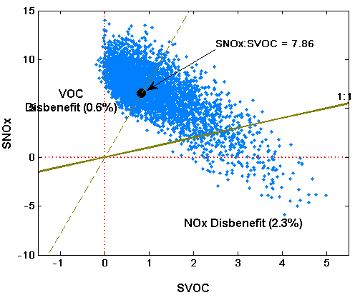
A priori ozone sensitivity ratios at Denton monitor
Digar et al., JGR in revision

Slide 17
Observation-constrained sensitivity ratio S_{O3,NOx}/S_{O3,VOC}
Cumulative Distribution Functions for Ratio (SNOx : SVOC)
Negative shift in the posterior CDFs (particularly for Metric 2 and 3) indicate slight preference towards SVOC, although the region is predominantly NO_{x}-limited (i.e. SNOx : SVOC > 1.0 )
Digar et al., JGR in revision

Slide 18
Conclusions
Efficient reduced form model for probabilistic characterization of concentrations and sensitivities
Observation-based constraints can adjust distributions of input parameters, concentrations, and sensitivities
Limitations:
  Results depend on choice of observational metric
  Does performance vs observed concentrations indicate better inputs and sensitivities, or compensating errors?
  RFM only as good as the underlying model
Future research could link uncertainty analysis with dynamic evaluation

Slide 19
Acknowledgments
Dr. Xue Xiao
Dr. Kristen Foley, US EPA
Dr. Greg Yarwood and Dr. Bonyoung Koo, ENVIRON
TCEQ
Funding:
  US EPA STAR Grant #R833665
  NSF CAREER Award
  Texas Air Quality Research Program

