Slide 1
High NO_{x} emissions bias of the EPA NEI 2005: two case studies over Los Angeles and Houston
2012 CMAS meeting
Yunsoo Choi, Assistant Professor
Department of Earth and Atmospheric Sciences, University of Houston
NOAA Air quality forecasting and NASA OMI satellite group members
Acknowledge: TEMIS GOME-2 satellite and EPA AQS group members
October 16, 2012

Slide 2
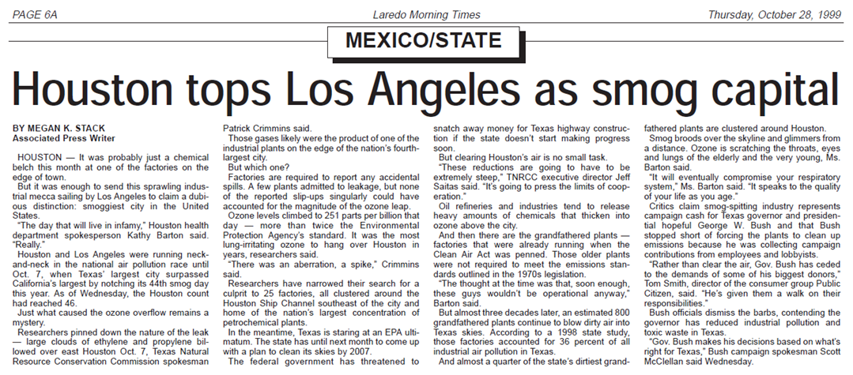

LA and Houston are a Smog Capital
http://airwolf.lmtonline.com/news/archive/1028/pagea6.pdf
Air pollutants have an adverse impact on human health [US EPA]
http://texasvox.files.wordpress.com/2010/02/hou-smog.jpg

Slide 3
Motivation
A “bottom-up” emissions are produced through SMOKE modeling system, which considers the estimates of various levels of activities for each source (e.g., area sources, biogenic sources, point source and mobile sources).
NO_{x} emissions uncertainties are up to a factor of two (e.g., Hanna et al., 2001; Napelenok et al., 2008).
Wondering how the NO_{x} emission uncertainty is identified, which region/urban city has the largest, and how the uncertainty impacts on surface NO_{x} and O₃.
A “top-down” approach utilizing remote sensing is a need.

Slide 4
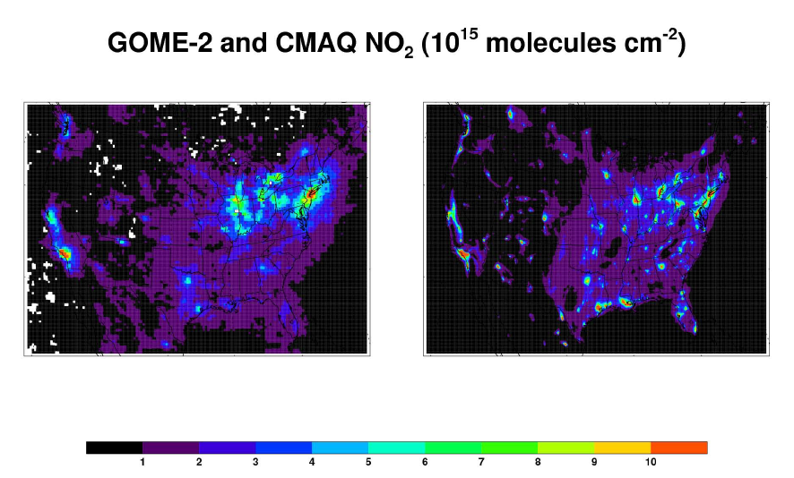
Uncertainty of NO_{x} emission inventory
Uncertainty of NO_{x} emission inventory?
Which region has the largest uncertainty?

Slide 5
Satellite derived NO_{x} emission
Assuming that NO_{x} concentrations are proportional to NO_{x} emissions.
NO_{x} emissions are adjusted by comparing satellite and CMAQ NO₂ column.
New emission = emission X
Ω(GOME-2)/Ω(CMAQ)
National Emission Inventory (NEI) 2005
GOME-2 adjusted emissions

Slide 6
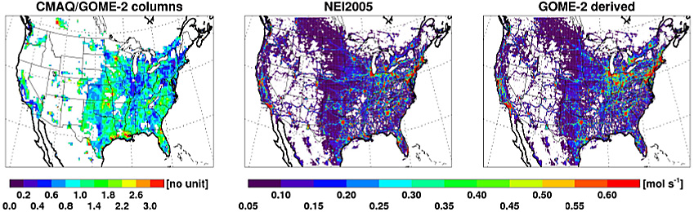
GOME-2 adjusted emission inventory
[Choi et al., ACP, 2012]
NO emissions particularly decrease in the urban areas over the southern US and in Los Angeles.

Slide 7
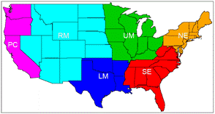
NEI2005(blue) and GOME-2 emissions(red)
[In preparation for publication]
NO_{x} emissions from NEI2005 over Low Middle US are high biased.

Slide 8
O₃ sensitivity over chemical regimes
NO_{x} sensitive:
VOC >> NO_{x}
decrease O₃
decrease NO_{x}
NO_{x} saturated:
VOC << NO_{x}
increase O₃

Slide 9
Emission impacts on daytime NO_{x} over LA
Circle: CMAQ – AQS obs
Both NO_{x} emissions and surface NO_{x} concentrations over LA are significantly reduced, which mitigates the discrepancies between surface NO_{x} of model and observation.

Slide 10
Emission impacts on daytime O₃ over LA
Circle: AQS obs
Circle: CMAQ – AQS obs
CMAQ underpredicts surface O₃ over LA and the impact of the large NO_{x} emissions reduction increases surface O₃, which mitigates the discrepancy between surface O₃ of model and observation.

Slide 11
Emission impacts on NO_{x} over Houston
Circle: CMAQ – AQS obs
The large NO_{x} emissions reduction decrease surface NO_{x} concentrations over Houston, which mitigates the discrepancy between surface NO_{x} of model and observations.

Slide 12
Emission impacts on O₃ over Houston
Circle: AQS obs
Circle: CMAQ – AQS obs
CMAQ overepredicts surface O₃ and the large NO_{x} emissions reduction increases surface O₃ over Houston, which worsen the discrepancy between surface O₃ of model and observation.

Slide 13
Conclusion and future works
The high bias of EPA NEI 2005 is shown over the Low Middle US.
CMAQ with GOME-2 derived emissions mitigates the discrepancy between simulated and observed surface NO_{x} over both Los Angeles and Houston.
Large NO_{x} emission reduction mitigates surface O₃ discrepancies over Los Angeles, but worsens them over Houston. Another cause for high overestimated surface O₃ over Houston needs to be found.
We will utilize data assimilation to derive physically reasonable emission inventory and investigate how NEI 2008 and TCEQ emission are different from NEI2005 over Texas.

