Slide 1
Chemical Data Assimilation with CMAQ and MODIS Aerosol Optical Depth Observations
Tianfeng Chai ^{1,2}, Hyun-Cheol Kim^{1,2}, Pius Lee¹, and Li Pan^{1,3}
1: NOAA OAR/ARL, NCWCP, College Park, MD
2: Earth Resources Technology, Laurel, MD
3: Cooperative Institute for Climate and Satellites, University of Maryland, College Park, Maryland

Slide 2
Introduction
CMAQ PM2.5 predictions are much worse than ozone predictions during the NAQFC experimental runs and need improvement
Preliminary tests that assimilate AIRNow PM2.5 with CMAQ using GSI show positive impact, but do not last long
An earlier MODIS AOD assimilation test using Optimal Interpolation shows minimal impact on PM2.5 predictions
Aerosol vertical profiles from DISCOVER-AQ field experiments were planned to be used to improve the AOD assimilation before an updated AOD tests show promising results

Slide 3

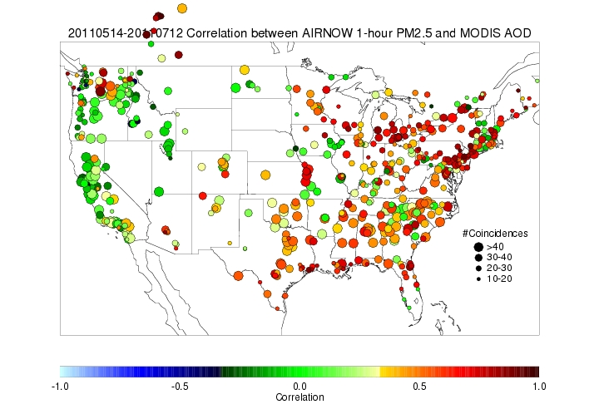
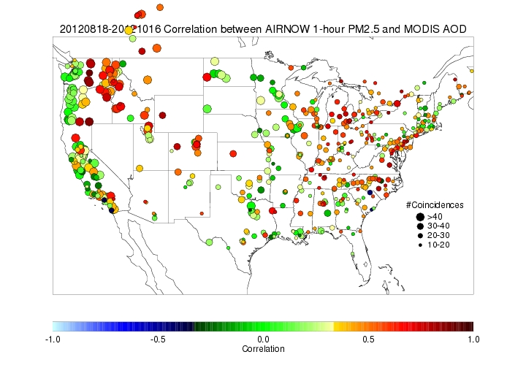
MODIS (Moderate Resolution Imaging Spectroradiometer) AOD
Orbit: | 705 km, 10:30 a.m. descending node (Terra) or 1:30 p.m. ascending node (Aqua)
Swath Dimensions: | 2330 km (cross track) by 10 km (along track at nadir)
Spatial Resolution: | 250 m (bands 1-2) 500 m (bands 3-7) 1000 m (bands 8-36)
http://terra.nasa.gov/About/
http://www.star.nesdis.noaa.gov/smcd/spb/aq

Slide 4
CMAQ AOD assimilation setup
Model: CMAQ 4.7.1,
Domain: CONUS, 442x265 grid, 12 km, 22 layers
Observations: Terra AOD (total and fine mode)
Time period: Jul. 1, 2011 – Jul. 12, 2011
Assimilation method: Optimal Interpolation
Major updates:
Updated model from CMAQ4.6 to CMAQ4.7.1 and removed Raleigh extinction in AOD calculation
AOD re-gridding method has been updated
AOD assimilation is now continuous, with earlier observations affecting all later day simulations
Both fine mode and total AOD are assimilated

Slide 5
Optimal Interpolation (OI)
OI is a sequential data assimilation method. At each time step, we solve an analysis problem
We assume observations far away (beyond background error correlation length scale) have no effect in the analysis
In the current study, the data injection takes place at 1700Z daily

Slide 6
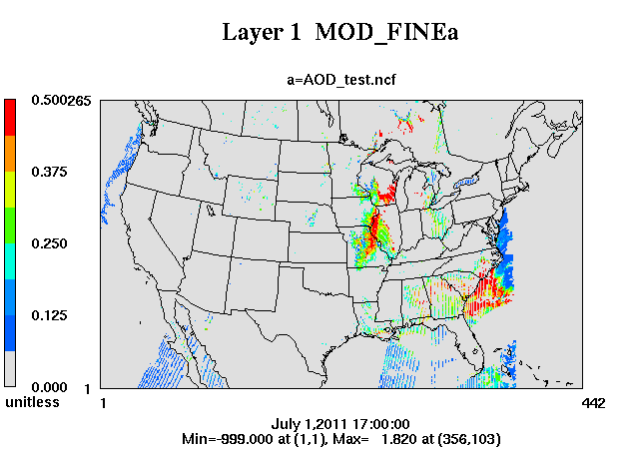
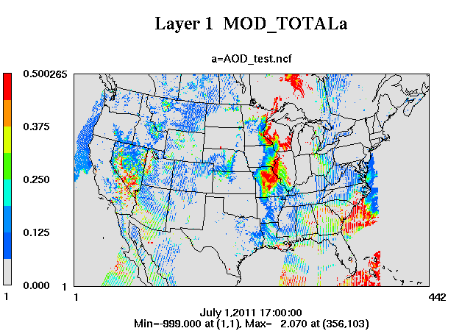
MODIS total and fine mode AOD

Slide 7
CMAQ AOD from Mie & Recon

Slide 8
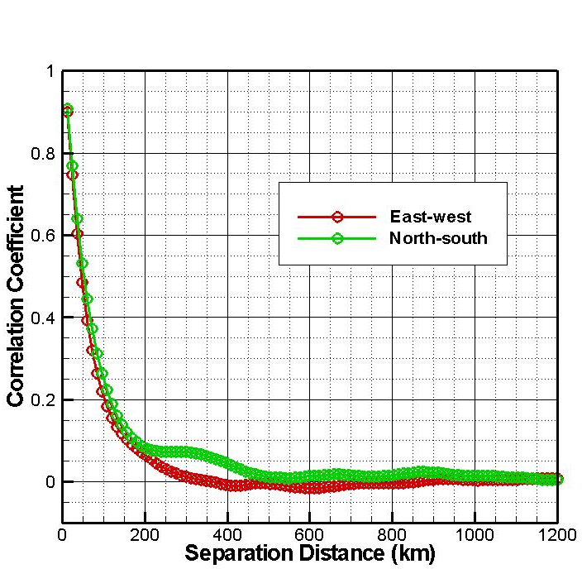
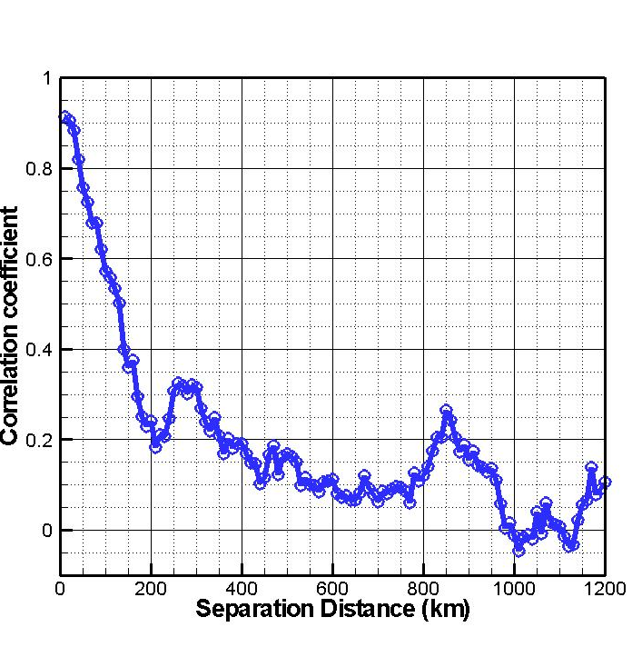
Horizontal Error Statistics
AOD error statistics results through Hollingsworth-Lönnberg approach
AOD error statistics results w/ NMC

Slide 9
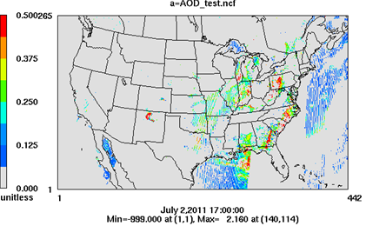
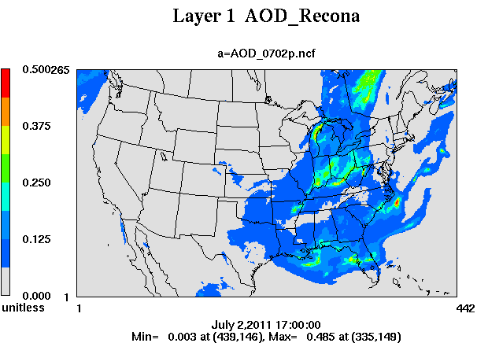
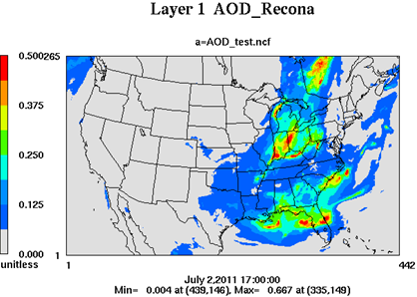
7/2/2011
Observation Input
OI
Background Input
Analysis output

Slide 10
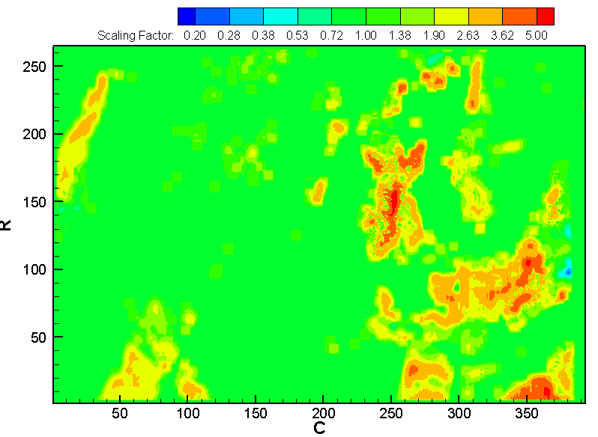
Scaling factors (analysis/forecast ) are used to adjust 49 parameters in 22 layers
ASO4I, ANO3I, ANH4I, AORGPAI, AECI, ACLI (6)
ASO4J, ANO3J, ANH4J, AORGPAJ, AECJ, ANAJ, ACLJ, A25J (8)
AORGAT: AXYL1J, AXYL2J, AXYL3J, ATOL1J, ATOL2J, ATOL3J, ABNZ1J, ABNZ2J, ABNZ3J, AALKJ, AOLGAJ (11)
AORGBT: AISO1J, AISO2J, AISO3J, ATRP1J, ATRP2J, ASQTJ, AOLGBJ (7)
AORGCT: AORGCJ (1)
ASO4K, ANO3K, ANH4K, ANAK, ACLK, ACORS, ASOIL (7)
NUMATKN, NUMACC, NUMCOR (3)
SRFATKN, SRFACC, SRFCOR (3)
AH2OJ, AH2OI, AH2OK (3)

Slide 11
MODIS fine mode AOD assimilation tests
Base case: CMAQ4.7.1 without any data assimilation
OI forecast: CMAQ results after assimilating previous day AOD observations
OI Analysis: CMAQ results after assimilating same day AOD, for next day forecast

Slide 12
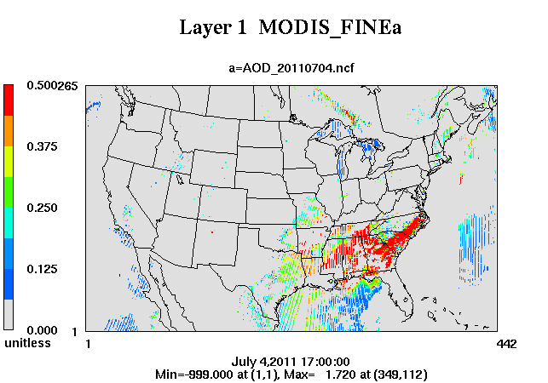
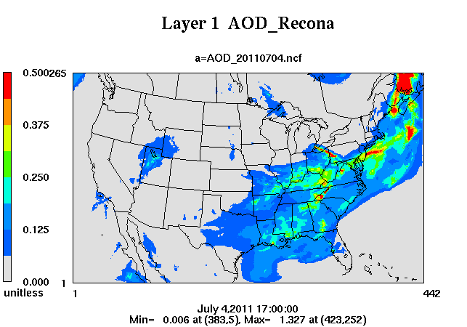
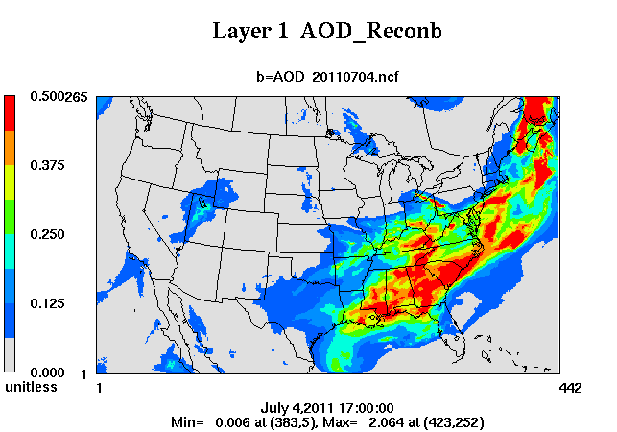
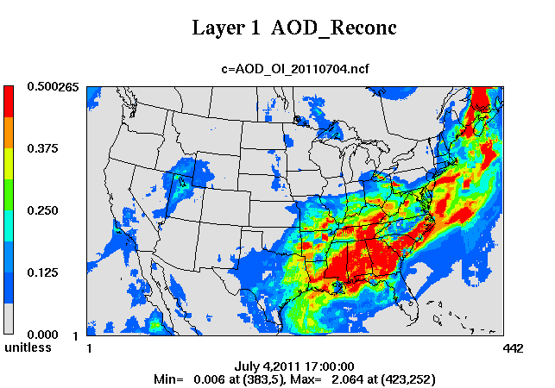
7/4/11
Base Case
Forecast
Analysis

Slide 13
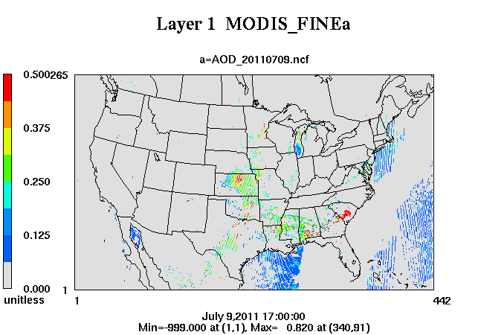
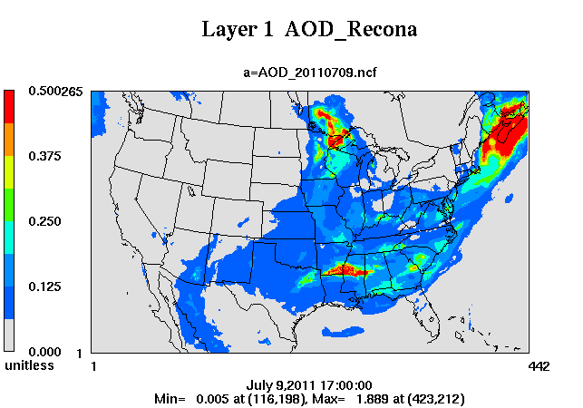
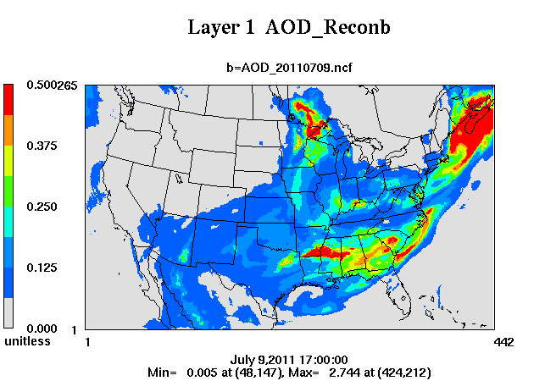
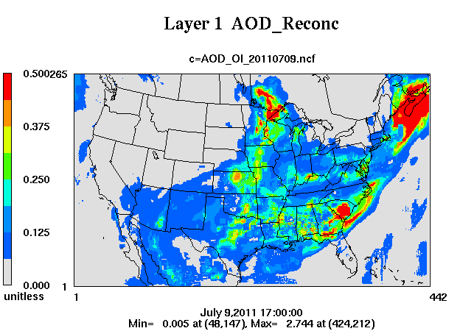
7/9/11
Base Case
Forecast
Analysis

Slide 14
Total AOD assimilation tests
Base case: CMAQ4.7.1 without any data assimilation
OI forecast: CMAQ results after assimilating previous day AOD observations
OI Analysis: CMAQ results after assimilating same day AOD, for next day forecast
Fine mode AOD assimilation
Total AOD assimilation

Slide 15
Total AOD assimilation tests
Base case: CMAQ4.7.1 without any data assimilation
OI forecast: CMAQ results after assimilating previous day AOD observations
OI Analysis: CMAQ results after assimilating same day AOD, for next day forecast
Fine mode AOD assimilation
Total AOD assimilation

Slide 16
PM2.5 Predictions after AOD assimilation
Mean Obs: CONUS and daily averaged AIRNow observations
Mean_base: Base case without assimilation
Mean_OI_f: After assimilation of fine mode AOD
Mean_OI_t: After assimilation of total AOD

Slide 17
Summary and future work
Assimilating MODIS AOD using OI method is able to improve AOD predictions/forecasts
AOD assimilation helps improve PM2.5 simulations
In terms of their impact on PM2.5 predictions during the test period, assimilation of total AOD has a better performance than assimilation of fine mode AOD
Assimilation of both AIRNow surface measurement and MODIS AOD will be tested
Utilization of aerosol speciation and their vertical profiles in chemical data assimilation will be explored

Slide 18

Acknowledgement:
This work is partially supported through NASA Air Quality Applied Sciences Team (AQAST) Tiger Team project.

Slide 19
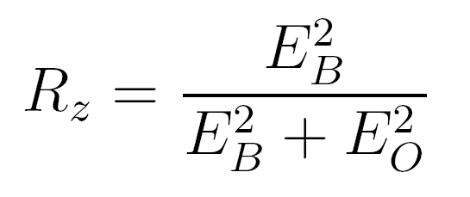
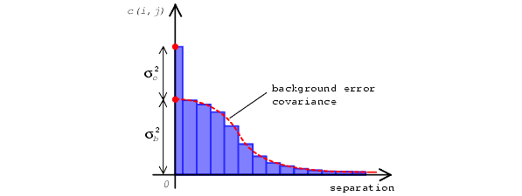
Estimate Model Error Statistics w/ Hollingsworth-Lonnberg Method
At each data point, calculate differences between forecasts (B) and observations (O)
Pair up data points, and calculate the correlation coefficients between the two time series
Plot the correlation as a function of the distance between the two stations,
Notes:
Calculate differences between forecasts (B) and observations (O) at each AIRNOW station as a time series
Pair up AIRNOW stations, and calculate the correlation coefficients between the two time series at the paired stations
Plot the correlation as a function of the distance between the two stations,
Intercept Rz can be used to calculate the ratio between model error (EB) and and observational error (including representative error)
Horizontal length scale can be inferred as well

