Slide 1


Cost-effective dynamical downscaling:
An illustration of downscaling CESM with the WRF model
Jared H. Bowden and Saravanan Arunachalam
11th Annual CMAS Conference
Chapel Hill, NC
October 15 - 17, 2012

Slide 2
Cost-effective dynamical downscaling:
An approach to simulate changes in the meteorology as the climate changes
Our challenge:
  Emissions available only for limited years
    E.g. 2005 and 2025 for assessing impacts of aviation growth on future air quality (Woody et al, 2012)
  Regional climate change projections should be centered near these years to be consistent with the emission estimates.
  Modeling multiple years to decades (as typically done for regional climate statistics) can become computationally burdensome (high cost).
Question:
  Given limitations, how do we select years to model to provide a low cost approach?
  What are the potential limitations (effectiveness) of dynamically downscaling select years?

Slide 3
Choice of years
  Criteria: Select years from the GCM data that have the largest temperature and precipitation changes between the contemporary and future climate from 30 year periods of interest (typical climatology).
  Application dependencies:
    Each application may require additional subjectivity.
    For us, additional limitations because of emission years.
    Our Solution: Select years centered around the emissions (+/- 5 years)
    For 2005 (last year GCM data available for contemporary climate) use years 2001-2005.
    For 2025, choice of years include 2021-2030

Slide 4
Dynamical Downscaling
CESM (1.25° x 1°) are downscaled using WRFv3.4.1.
Two different GCM simulations are downscaled
  contemporary climate period ending in 2005 (includes known natural and anthropogenic forcing)
  RCP scenario with a total radiative forcing increase of 4.5 W/m2 by 2100 (middle of the road scenario).
Downscale to 36-km over the CONUS.
An important option chosen for the dynamical downscaling is spectral nudging to keep the large-scale atmospheric circulation (wavelengths > 1400-km) consistent in WRF with CESM.

Slide 5
CESM climate compared to observations
2-m Temperature
Precipitation
Obs.
)
CESM
GCM 2-m Temperature Bias:
Too warm over the Great Plains
GCM 2-m Precipitation Bias:
Too wet over the western US

Slide 6
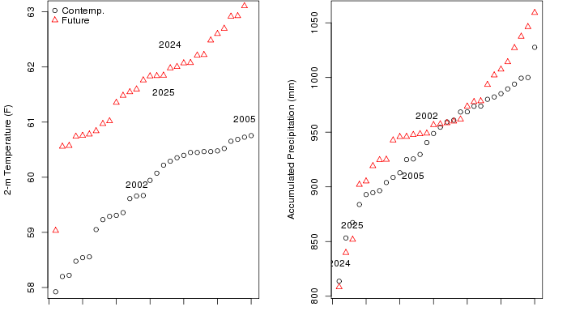
Years selected from GCM (CONUS average):
2002 (cool/wet) and 2024 (warm/dry)
Coolest
Year
Warmest
Year
Driest
Year
Wettest
Year
Note that each year in the future is typically warmer and wetter for the CONUS.

Slide 7
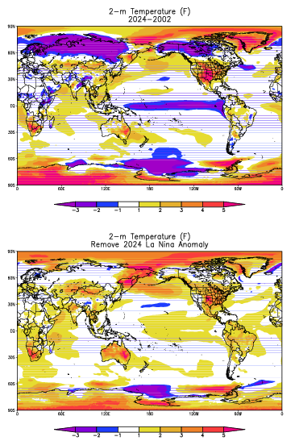
For extreme years, the climate change signal impact from natural variability may be significant.
2-m Temperature Anomaly
2024
La Nina event selected from future climate.
Limitation: Other natural variability impacts
the CONUS climate.

Slide 8
CESM Climate Change
(2016-2045) minus (1976-2005) vs. circa 2024-2002
JFM
30 year average
2024-2002
JAS
Most of CONUS experiences much larger increases in 2-m temperature
than using the 30-year average.
Limitation/Effect: Modeling upper threshold of climate change

Slide 9
CESM vs. WRF
Seasonal Climate Change for 2-m Temp.
CESM
WRF
Downscaling illustrates significant regional/local differences.

Slide 10
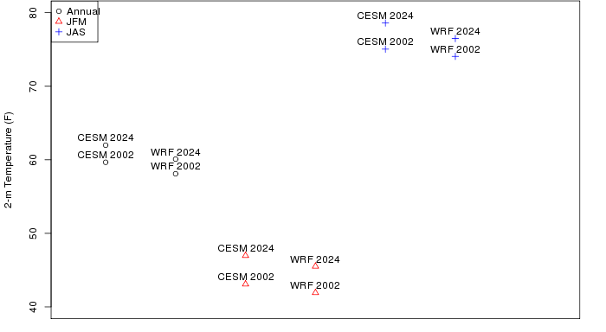
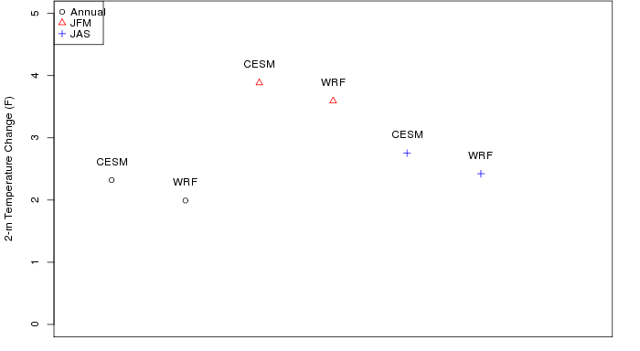
CONUS average 2-m Temperature
Effect: WRF is cooler than CESM and the projected climate change is cooler with WRF.

Slide 11
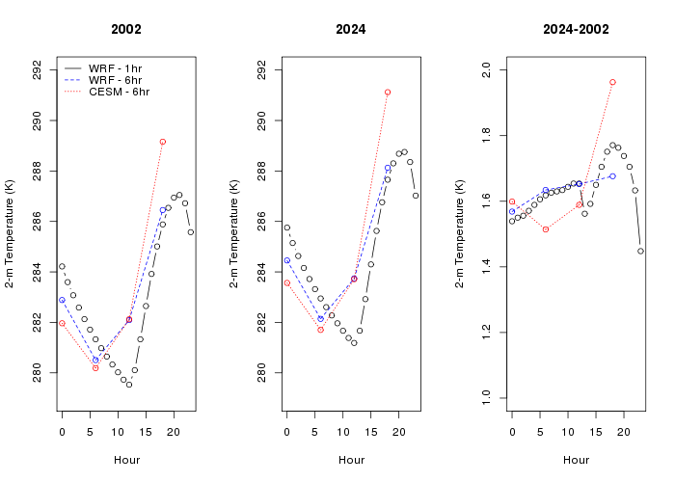
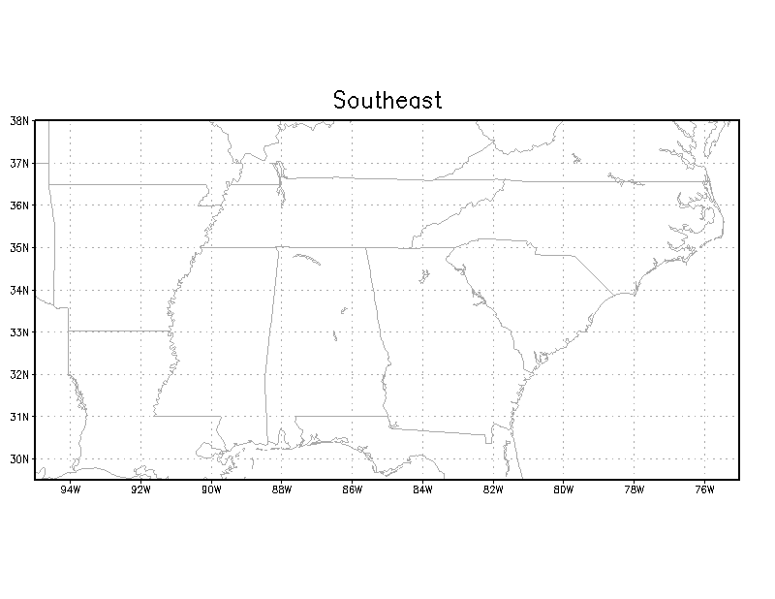
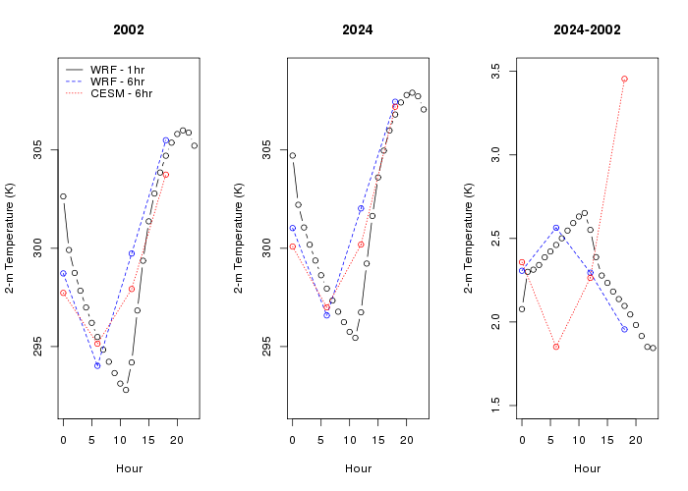
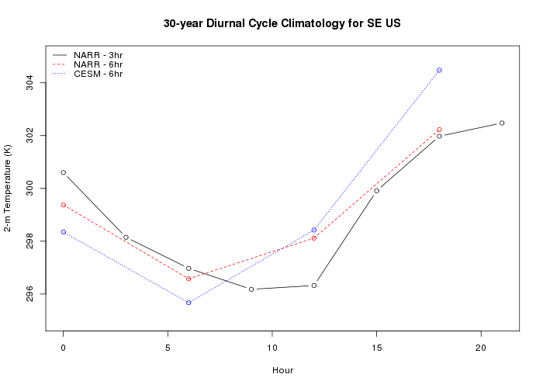
Diurnal 2-m Temperature Cycle: Southeast
JFM
JAS
Effect: Projected changes in afternoon temperatures much larger in the GCM than in WRF.
GCM evaluation (30 yr. climatology) indicates that GCM afternoon temperatures are too warm.

Slide 12
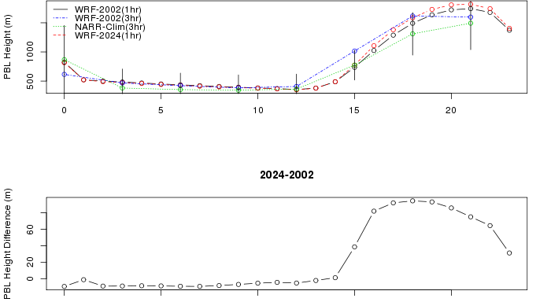
WRF PBL Heights
WRF PBL heights within 1 std. dev. of 30-yr climatology (WRF compares well).
Anticipate an increase in PBL heights during the afternoon hours. Despite the increase
and this being an extreme year, the PBL heights for the projected climate do not exceed
1 std. dev. from the observed climate.

Slide 13
Summary
The low cost is associated with downscaling select years.
Limitations of cost-effective dynamical downscaling:
  There are many because we are trying to simulate potential changes in the meteorology as the climate changes with a single year. This technique has demonstrated that our approach can generate seasonal average changes two to three times larger than average climate change. This is a consequence of both natural variability and climate change.
  Major limitation is model evaluation. We can not evaluate WRF climate statistics (single year simulated) but instead limited to comparing back to CESM. Unfortunately, CESM model diagnostics available limit comparisons (i.e. PBL heights).
Is this technique effective/reliable way to simulate potential meteorological changes as the climate changes?
  Method is effective if concerned with upper threshold of changes in the meteorology as the climate changes, which is usually the case for most air quality applications.
  Downscaling is potentially more reliable because WRF simulates cooler summer-time afternoon temperatures than CESM which shows overestimation when compared with 30-year climatology.
  Downscaling is effective at capturing variability in magnitudes of regional/local climate change.
  Downscaling is effective method to produce reasonable PBL heights, which is a major concern for our (air quality) application. Despite an increase in PBL heights, the average projected changes do not exceed the observed deviations.
Results indicate that using this approach may be a cost-effective way to simulate the meteorology as the climate changes for any application.
Next Steps: Use downscaled meteorology in air quality model to assess impacts of air quality changes in future year due to changes in aircraft emissions as well as in meteorology

Slide 14
Acknowledgements
The Partnership for Air Transportation Noise and Emissions Reduction is an FAA/NASA/Transport Canada/US DOD/EPA-sponsored Center of Excellence.
This work was funded by FAA and Transport Canada under 09-CE-NE-UNC Amendment Nos. 001-004.
The Investigation of Aviation Emissions Air Quality Impacts project is managed by Christopher Sequeira.
Opinions, findings, conclusions and recommendations expressed in this material are those of the author(s), and do not necessarily reflect the views of PARTNER sponsor organizations.

