Slide 1

Estimating Single Source Impacts on Secondary Pollutants (O3, PM2.5)
Kirk Baker
U.S. Environmental Protection Agency

Slide 2
Motivation for Estimating Single Source Secondary Impacts
New Source Review (NSR) and Prevention of Significant Deterioration (PSD) programs
  Assess the air quality impacts of new or modified sources
  EPA granted Sierra Club petition with commitment to update Appendix W to address O3 and secondary PM2.5 impacts
  Interpollutant trading (NSR offset) provisions
National Environmental Policy Act (NEPA)
  Assess the environmental impacts of new or modified sources
Title VI of 1964 Civil Rights Act
  Complaints related to permits issued to facilities that receive Federal funding have disproportionate environmental impacts on certain communities

Slide 3
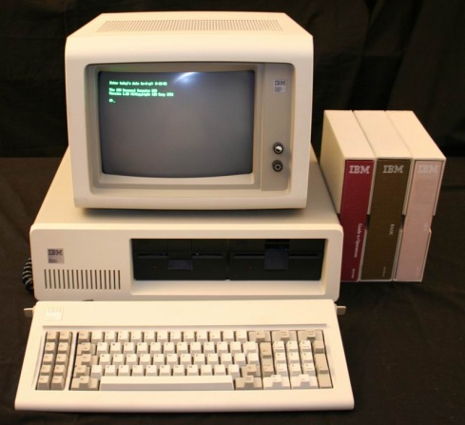
What tools?
Air quality models exist to assess urban-scale impacts of primarily emitted pollutants from single sources for permit related purposes (AERMOD)
What tools are appropriate for estimating the impacts of secondarily formed pollutants (PM2.5 and ozone) from single sources on urban and regional scales?
  Photochemical box models
    OZIPR
  Lagrangian models
    CALPUFF
    SCIPUFF/SCICHEM
    HYSPLIT & FLEXPART
  Photochemical transport models
    CMAQ and CAMx
How are these different approaches are comparable and how best to apply models for permit modeling?
Tools must be able to be applied for a minimum of an entire year or ozone season

Slide 4
Questions and Evaluation Challenges
How far away from a source are the highest impacts of primary and secondary PM2.5 and ozone? Does this change based on stack characteristics or co-emissions?
How well are near-field and long-range pollutant transport characterized by Lagrangian and Eulerian modeling systems?
How well do Eulerian and Lagrangian modeling systems characterize plume chemistry?
How well do Lagrangian modeling systems characterize the chemical and physical environment around the plume?

Slide 5
Regional Inert Tracer Field Experiments
Inert tracer release experiments provide a useful independent evaluation of long range transport and dispersion algorithms
  A known amount of tracer gas is released
  Release characteristics are typically well known
  Measured at downwind receptor sites
New EPA report details the evaluation of multiple LRT dispersion modeling systems using multiple tracer field studies: CALPUFF, SCIPUFF, HYSPLIT, FLEXPART, CAMx, and CALGRID
  Draft final report “Documentation of CALPUFF and Other Long Range Transport Models using Tracer Test Experiment Data” http://www.epa.gov/ttn/scram/reports/EPA-454_R-12-003.pdf
Notes:
Several used by US EPA for 1998 evaluation study of CALPUFF v5.8
Savannah River Laboratory 1975 (SRL75)
Great Plaines 1980 (GP80)
1983 Cross-Appalachia Tracer Experiment (CAPTEX) used extensively to test MM5 and WRF FDDA
1994 European Tracer Experiment (ETEX)

Slide 6
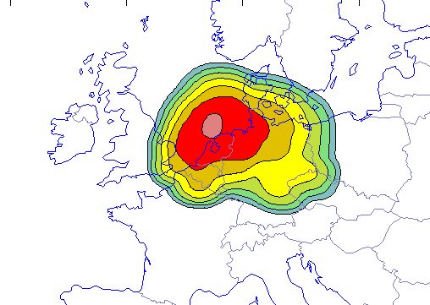
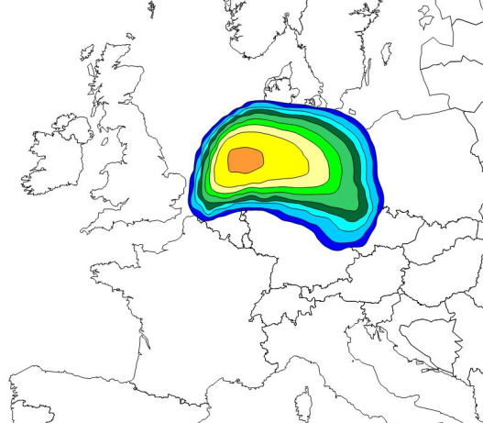
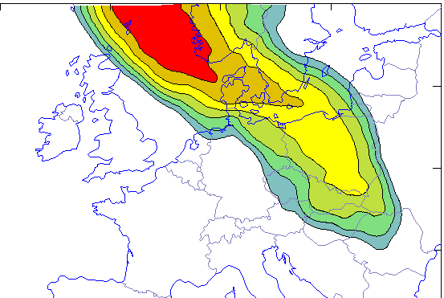
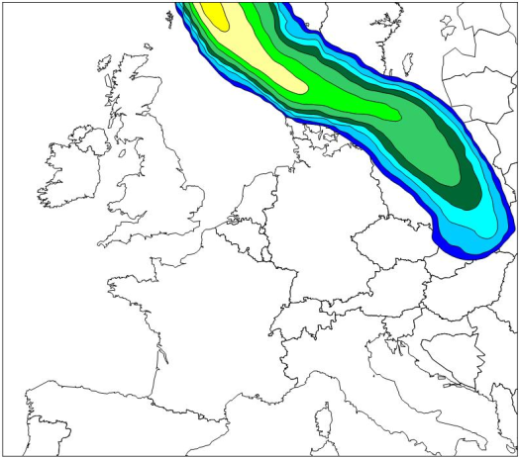
ETEX 1994
Observations (+36 hours) SCIPUFF CAMx
Observations (+60 hours) SCIPUFF CAMx
*Figures courtesy of ENVIRON

Slide 7
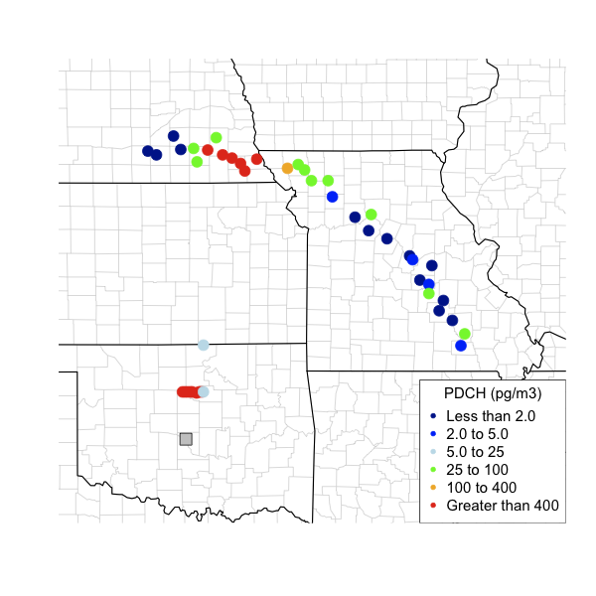
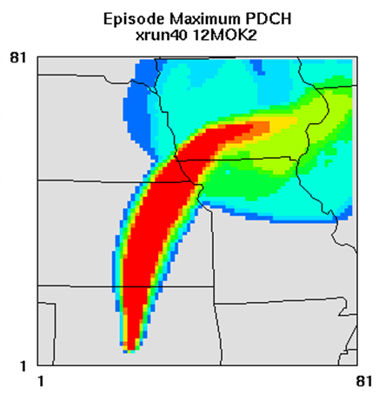
Great Plains 1980
Maximum field measurements of tracers shown at left for all monitors in the study and maximum model estimates (CAMx) at right)
Notes:
CAMx using YSU Kz values (left) does well at capturing plume placement
Kz values using OB70 approach (right) advect mass too far to the SE at 600 km arc
Performance of tracer suggest underlying WRF wind fields are well characterized

Slide 8
Using a chemical transport model (CTM)
Need to isolate the contribution/impacts of single sources
  Source apportionment
  Brute force emissions adjustment
  HDDM
Need techniques or an approach for situations when sources and key receptors are in very close proximity (within the same grid cell or in neighboring grid cells)
  Sub-grid plume treatment (CAMx PiG, CMAQ APT)
  Nesting to finer grids

Slide 9
Isolating Single Source Impacts in a CTM
Photochemical models used: CMAQ v.4.7.1 and CAMx v5.40
Domains (34 layers): 36 km CONUS → 12 → 4 km
1999 hour specific CEM emissions for TVA Cumberland
1999 hour specific biogenics estimated with BEIS model
2001 NEI based anthropogenic emissions
Meteorological inputs generated using the WRF model version 3.3
Notes:
Application of photochemical modeling systems for single source O3 and PM2.5 assessments using a plume measurement field study (1999 TVA helicopter observations)
Source sensitivity: CMAQ and CAMx brute force and DDM emissions sensitivity
Source contribution: CMAQ and CAMx source apportionment
CAMx flexi-nesting & sub-grid plume treatment
When available, CMAQ sub-grid plume treatment (APT approach developed by EPRI)

Slide 10
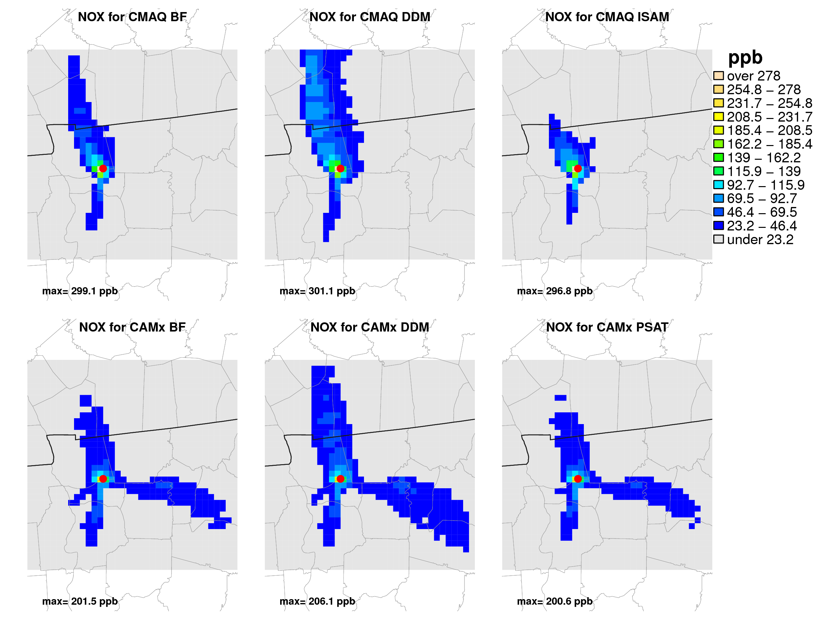
Similar spatial patterns of single source impacts using multiple models and techniques
*red dot indicates source location
2 week (July 1999) episode maximum impact on NOX (NO+NO2) from source NOX

Slide 11
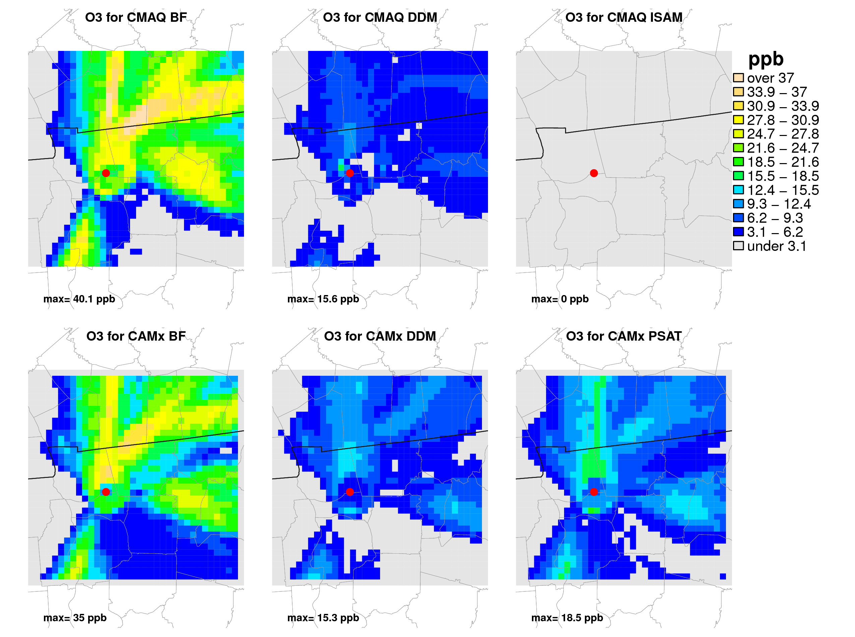
Less consistency between model attribution approaches, evaluation with field measurements important
Ozone tracking has not been implemented yet in CMAQ
*red dot indicates source location
2 week (July 1999) episode maximum impact on ozone from source NOX

Slide 12
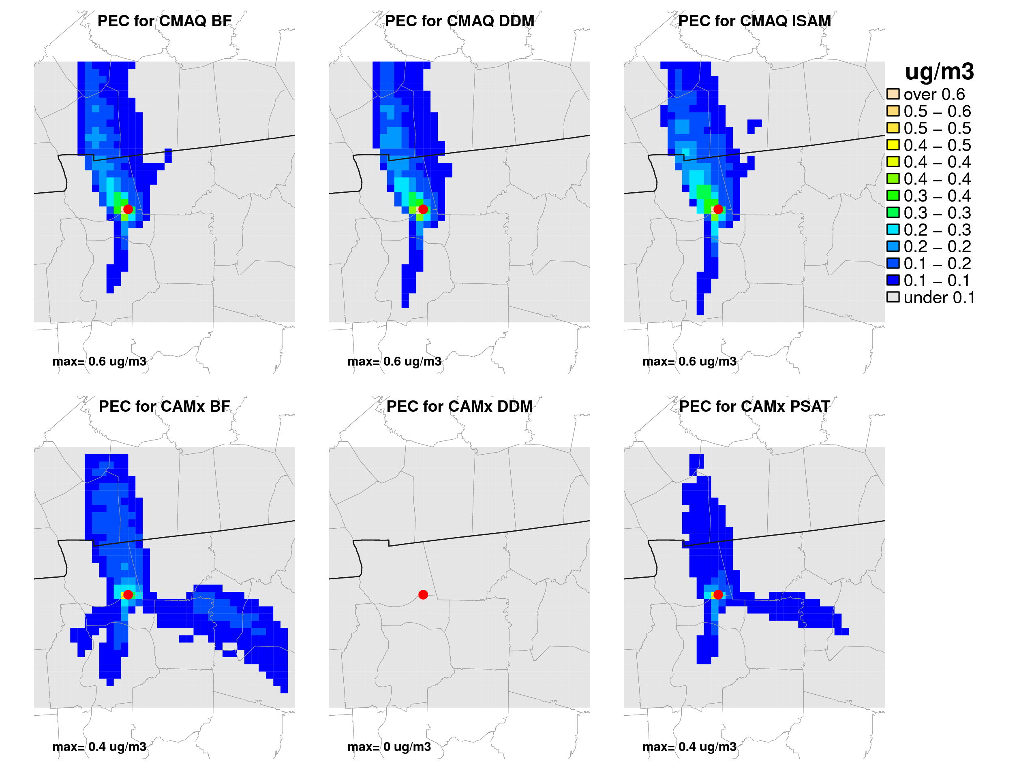
2 week (July 1999) episode maximum impact on elemental carbon from source EC
*red dot indicates source location
Current version of CAMx (5.40) only includes DDM for gases

Slide 13
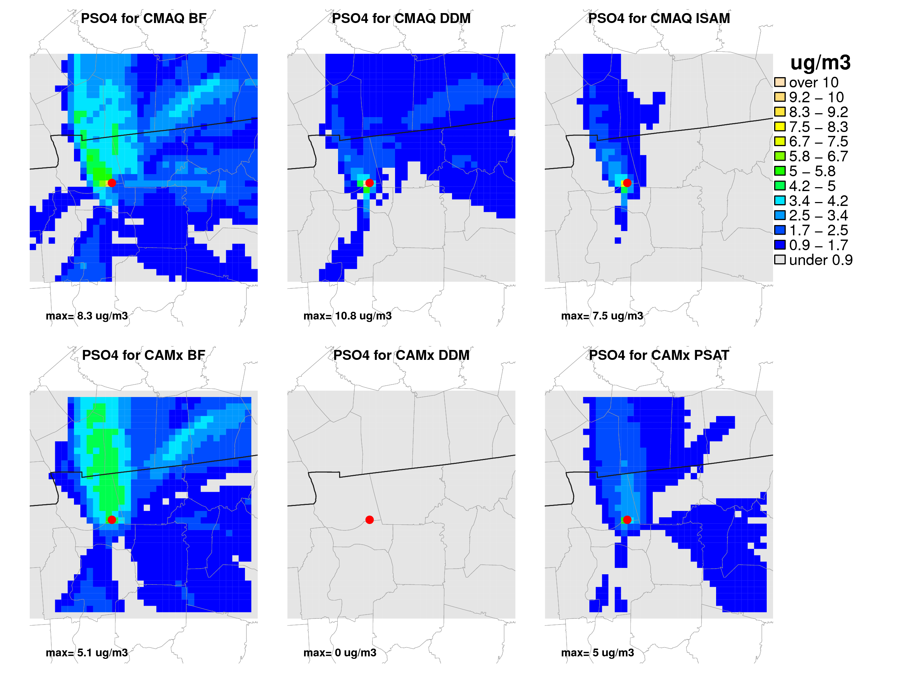
2 week (July 1999) episode maximum impact on PM2.5 sulfate from source SOX
*red dot indicates source location
Current version of CAMx (5.40) only includes DDM for gases

Slide 14
Source/Receptor Proximity Issues in CTM
Sub-grid plume treatment and sub-grid sampling provide information about source concentration at receptors within the same cell as the source
Plot shows PiG puffs using 2 different approaches to estimating wind shear impacts on the plume
The PiG plume continues to be far wider than aircraft measurements suggest.
Plot courtesy of ENVIRON. Taken from Evaluation of Chemical Dispersion Models using Atmospheric Plume Measurements from Field Experiments, EPA Contract No: EP-D-07-102, WA No: 4-06 and 5-08

Slide 15
Source/Receptor Proximity Issues in CTM
200 m high-resolution grid sensitivitiy shown with color contours
While the standard PiG run tracks the centerline well, it is about six times wider than the high resolution plume.
The PiG puff width with all shear-induced growth removed matches the high resolution results better.
What is an appropriate configuration of sub-grid plume treatment for multi-year regulatory modeling applications?
Plot courtesy of ENVIRON. Taken from Evaluation of Chemical Dispersion Models using Atmospheric Plume Measurements from Field Experiments, EPA Contract No: EP-D-07-102, WA No: 4-06 and 5-08
Notes:
Comparison of the train of CAMx PiG puff dimensions (ellipses) against the high resolution NO₂ plume (colored contours in ppb) in CAMx layer 5 at 2200 LST October 10. Puffs are the same as shown in Figure 4-12.
Another high resolution test was conducted in which all explicit horizontal diffusion was set to zero. The resulting NO_{x} plume was not significantly altered by this change, suggesting that plume spread is dictated by grid resolution and numerical diffusion associated with the advection solver (PPM in this case) under these nocturnal stable conditions.

Slide 16
Single Source Screening Level Tool
Are screening level tools for single source estimates of secondary PM2.5 and ozone feasible?
A screening tool would ideally provide a quick, reasonable, credible, and appropriately conservative assessment of single source secondary impacts before more complex applications are required
ENVIRON presented a reduced form single source screening model that estimates ozone impacts from single source emissions of VOC and/or NOX based on CAMx-HDDM
  http://www.epa.gov/ttn/scram/10thmodconf/presentations/2-21-Morris_Ozone_Screen_New_Srcs_EPA_10th_AQMC_Mar_2012.pdf
OAQPS plans to explore this approach for ozone and PM2.5 to support single source NSR/PSD screening assessments
This modeling may provide some information for developing appropriate interpollutant trading ratios for PM2.5

Slide 17
Future Directions
Evaluate single source models on a 1) theoretical fit for purpose basis and 2) operationally against field studies (or other innovate approaches)
Compromises may be necessary between approaches used to capture field measurements and multi-year regulatory modeling requirements
Need to identify credible “screening level” approach for single source secondary impacts on ozone and PM2.5
Need to continue to evaluate fine scale modeling (<= 4km) and sub-grid plume treatment approaches

