Slide 1


A New Interface to Model Global Commercial Aircraft Emissions from the FAA Aviation Environmental Design Tool (AEDT) in Air Quality Models
B.H. Baek, Saravanan Arunachalam, Matt Woody, Pradeepa Lakshimi, Mohammad Omary, Frank Binkowski
Gregg Fleming
Volpe National Transportation System Center

Slide 2
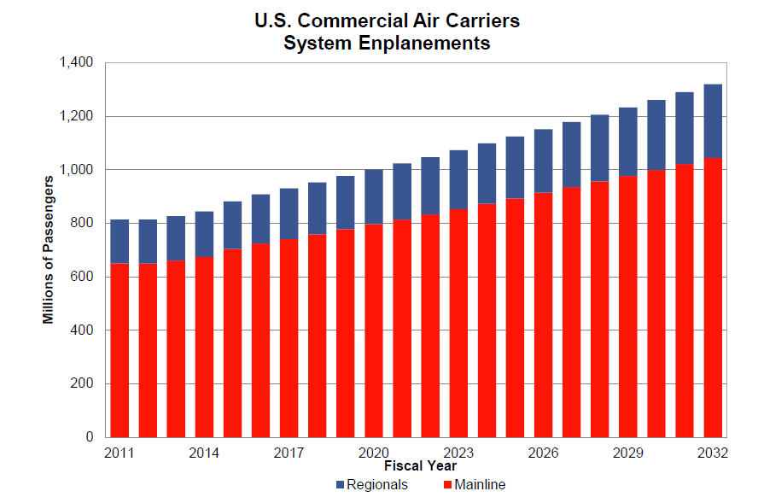
Motivation
725 million passengers, 67 million tons of cargo, 18 million flights in the U.S. in 2011 (FAA, 2012a).
3.1% per year passenger growth from 2011 to 2032 (FAA, 2012b)
1 billion passengers in 2024 (FAA, 2012b)
PM_{2.5} Non-attainment areas (1997 Standard) and Major U.S. Airports
Aviation emissions include CO, NO_{x}, SO₂, VOCs (SOA precursors) and PM_{2.5} (primary organics, elemental carbon, sulfate aerosol)
Notes:
U.S. population = 311 million

Slide 3
Motivation
  Vital to understand the impacts of aviation emissions on ambient air quality to protect the public health.
  Current representation of aviation emissions in existing air quality models includes several simplified assumptions
  Treated as area sources [AreaToPoint in SMOKE].
  Improved spatial representation up to LTO altitude
  [EDMS2Inv Interface Modeling] (Baek et al., 2010)

Slide 4
Objectives
  Commercial aircrafts are the major emitters in aviation emissions.
Critical to accurately evaluate and quantify the relative impacts of full-trajectory commercial aircrafts emissions that ranges from landing-and-takeoff (LTO) at airports to cruising in upper elevations of the atmosphere into grid-based air quality models.
Not uniformly emitted over the Earth and substantial temporal variability.
Develop a new interface AEDTproc to process link-based commercial aircraft emissions from Aviation Environmental Design Tool (AEDT) model that dynamically models aircraft performance in space and time to calculate fuel burn and emissions from gate-to-gate for all commercial aviation activity from all airports to create air quality model ready data

Slide 5

Full Flight Aircraft Trajectory

Slide 6
AEDT
Dynamically models aircraft performance in space and time to calculate fuel burn and emissions from gate-to-gate for all commercial aviation activity from all airports.
Each aircraft’s departure and arrival airport names, Engine types, and no of Engines.
Each aircraft link contains Information on date and hour, starting point of segment such as latitude/longitude coordinates, altitude, pressure, fuel burn in unit of kg, and inventory pollutants.
Inventory Pollutants: CO, HC, NO_{x}, POC, and PEC.
Fuel burn is subsequently used to compute SO₂ and PSO₄.

Slide 7
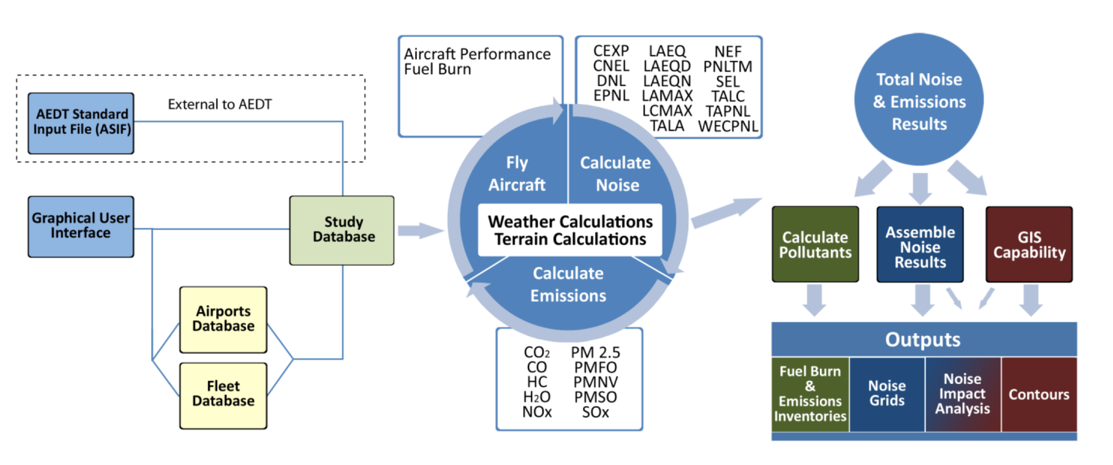
AEDT

Slide 8
AEDT Flight Input Data
Field | Description
FLIGHT_ID | Unique integer key representing each flight
DEP_AIRPORT | Departure Airport Code (Mostly ICAO, Sometimes IATA/Other)
DEP_COUNTRY | ISO 2 Letter Code for the Departure Country
ARR_AIRPORT | Arrival Airport Code (Mostly ICAO, Sometimes IATA/Other)
ARR_COUNTRY | ISO 2 Letter Code for the Arrival Country
ACTYPE | Generic Aircraft Type (Mostly ICAO, Sometimes IATA/Other)
ACCODE | AEDT Specific Aircraft Type
ENG_CODE | Mostly ICAO EED UID, Sometimes AEDT Specific Engine Code
NUM_ENGINES | Number of Engines in the aircraft

Slide 9
AEDT Segment Input Data
Field | Units | Description
FLIGHT_ID | N/A | Unique integer key representing each flight
SEGMENT_NO | N/A | Sequence number for the Segment
LATITUDE | Degrees | Latitude at the beginning of the Segment
LONGITUDE | Degrees | Longitude at the beginning of the Segment
ALTITUDE | Feet MSL | Altitude MSL at the beginning of the Segment
SEGMENT_MONTH | N/A | Month at the beginning of the Segment
SEGMENT_DAY | N/A | Day at the beginning of the Segment
SEGMENT_YEAR | N/A | Year at the beginning of the Segment
SEGMENT_HOUR | N/A | Hour at the beginning of the Segment (GMT)
SEGMENT_MIN | N/A | Minute at the beginning of the Segment (GMT)
SEGMENT_SEC | N/A | Second at the beginning of the Segment (GMT)
EMISSIONS_MODE | N/A | Describes the Flight Mode for the Segment
TEMPERATURE | Kelvin | Ambient Temperature for the Segment (mid point)
PRESSURE | Pascal | Ambient Pressure for the Segment (mid point)
HUMIDITY | Percentage | Relative Humidity for the Segment (mid point)
SPEED | Knots | True airspeed at beginning of the Segment
SEGMENT_TIME | Seconds | Time on Segment
TRACK_DISTANCE | Nautical Miles | Total Ground Projected Track Distance
THRUST | Pound | Corrected Net Thrust Per Engine at the beginning of the Segment
WEIGHT | Kilograms | Aircraft Weight at beginning of the Segment
FUELBURN | Kilograms | Total Fuelburn for the Segment
CO, HC, NOX, POC,PEC, CO2, SOx | Grams | Mass of CO, HC, NOx, POC, PEC, CO2, SOx emissions for the Segment

Slide 10
AEDT Emissions Mode
Emissions Mode | Value | Description
Taxi | 0 | Starting and ending altitude = 0 ft AFE (Altimeter Field Elevation ) Thrust setting = Taxi, aircraft weight >= takeoff weight
Takeoff Ground Roll | 1 | Starting and ending altitude = 0 ft AFE Thrust setting = MaxTakeoff
Takeoff Airborne | 2 | Starting altitude >= 0 ft AFE; Ending altitude > 0 ft AFE Thrust setting = MaxTakeoff
Terminal Climb | 3 | Starting altitude > 0 ft AFE Ending altitude >= starting altitude and <= 10,000 ft AFE Thrust setting = MaxClimb
En Route Climb | 4 | Starting altitude >= 10,000 ft AFE Ending altitude >= starting altitude and <= cruise altitude
Cruise | 5 | Starting altitude = cruise altitude Ending altitude = cruise altitude
En Route Descent | 6 | Starting altitude <= cruise altitude Ending altitude < cruise altitude and <= starting altitude and >= 10,000 ft
Approach | 7 | Starting altitude <= 10,000 ft AFE, starting altitude > 0 ft Ending altitude <= starting altitude, ending altitude >= 0 ft
Landing Ground Roll | 8 | Starting and ending altitude = 0 ft AFE Thrust type = Approach
Landing Ground Roll with Reverse Thrust | 9 | Starting and ending altitude = 0 ft AFE Thrust type = Reverse
Taxi in | 10 | Starting and ending altitude = 0 ft AFE, Thrust setting = Taxi, aircraft weight < takeoff weight

Slide 11
AEDT Pollutants
Model Species | LTO | Above LTO
NO | 76% of NOx | 90% of NOx
NO2 | 23% of NOx | 9% of NOx
HONO | 1% of NOx | 1% of NOx
PEC | PEC | 0.03 * Fuel Burn
POC | POC | 0.03 * Fuel Burn
SO2 | FSC/1000 * [(100-E)/100] * Fuel Burn * (64/32)
SO4 | FCS/1000 * (E/100) * Fuel Burn * (98/32)
TOG | 1.16 * HC
*FSC (Fuel Sulfur Concentration) = 600 in mg/kg-fuel
*E = 2.0 in % of the fuel sulfur is emitted

Slide 12
AEDTproc
Notes:
Airport elevation is used to calculate AGL altitude. Used terrain height from MCIP to calculate AGL during cruising.
For a proper LTO height It is critical for Denver airport due to the elevation height

Slide 13
TOG Chemical Speciation
Model Species | Turbine Engine Mass Fraction | Turbine Engine M.W. | Piston Engine Mass Fraction | Piston Engine M.W.
ALD2 | 0.0435 | 43.6298 | 0.0444 | 43.3667
ALDX | 0.0585 | 35.2256 | 0.0264 | 37.2487
CH4 | N/A | N/A | 0.1095 | 16.0425
ETH | 0.1546 | 28.0532 | 0.155 | 28.0532
ETHA | 0.0052 | 30.0690 | 0.0091999 | 30.069
ETOH | N/A | N/A | 4.00E-05 | 28.7623
FORM | 0.1389 | 29.3904 | 0.1543 | 29.8843
IOLE | 0.0246 | 56.1063 | 0.0090426 | 56.1092
MEOH | 0.0181 | 32.0419 | 4.46E-06 | 14.3811
OLE | 0.0876 | 28.5737 | 0.0848 | 29.894
PAR | 0.3729 | 14.3326 | 0.1818 | 15.4652
TOL | 0.0223 | 98.1480 | 0.0175 | 96.2053
UNR | 0.0430 | 13.4366 | 0.1961 | 27.7326
XYL | 0.0278 | 105.7999 | 0.0119 | 104.3208

Slide 14
Horizontal and Vertical Allocations
1st Segment: 4 Grid cells intersected
2nd Segment: 5 Grid cells intersected
3rd Segment: 3 Grid cells intersected
4th Segment: 2 Grid cells intersected

Slide 15
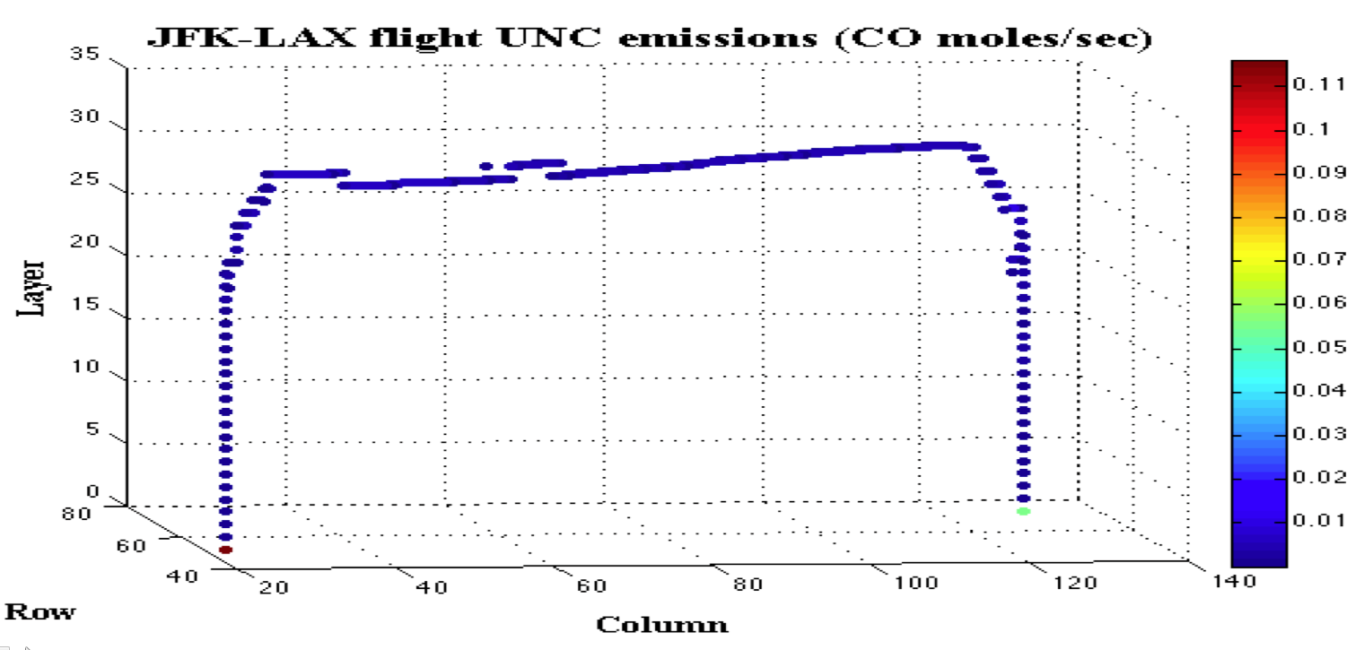
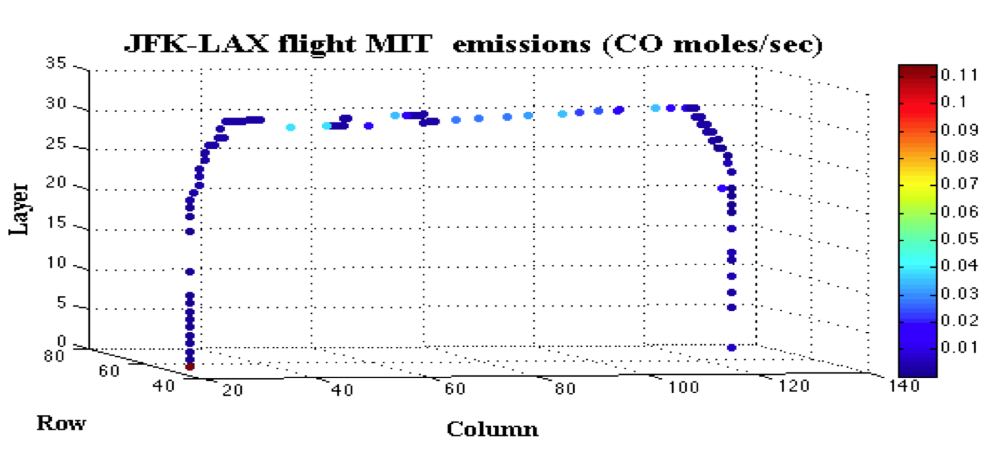

Slide 16
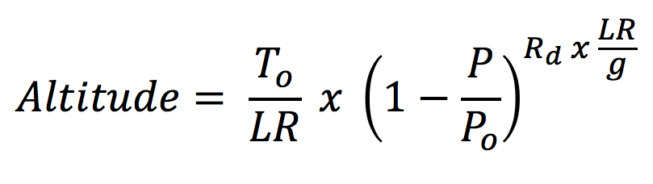
Altitude Calculation
AEDT Altitude
AEDT Pressure-based Altitude above LTO
T_{o} =the sea level standard temperature
LR = the temperature lapse rate
P = Atmospheric pressure
P_{o} = he sea level standard atmospheric pressure
R_{d} = the specific gas constant for dry air
G = the Earth-surface gravitational acceleration.
For the International Standard Atmosphere (ISA)
T_{o} = 288.15 K, LR = 0.0065 K/m, P_{o} = 1013.25 hPa, R_{d} = 287.05307 J/(kg K), and g = 9.80065 m/s².

Slide 17
Altitude Adjustment

Slide 18
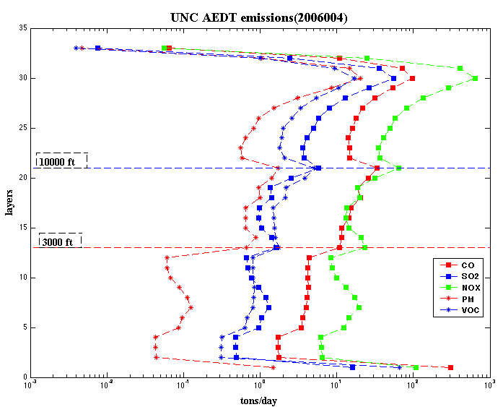
Comparison of surface layer and cruise altitude layer emissions:
CO_{surface} > CO_{cruise}
VOC_{surface} > VOC_{cruise}
SO2_{surface} < SO2_{cruise}
PM_{surface} < PM_{cruise}
NOx_{surface} < NOx_{cruise}

Slide 19
AEDTproc
CUTOFF_ALTITUDE [default: 70,000]
  : Determines the cutoff height in unit of feet. This option will allow users to discard AEDT data above cutoff height.
LTO_ALTITUDE [Default: 10,000]
  : Determines the LTO height in unit of feet. The definition of LTO height impacts the NOx speciation profile that converts NOx to NO, NO2 and HONO and equations to estimate PEC and POC.
SIGMA_VERT_ALLOC_YN [default: Y]
  : Determines whether sigma-layer vertical allocation or not. If this flag is set to Y, user must provide MET_CRO_2D input file to provide surface pressure (PRSFC) and top pressure (VGTOP) data to compute sigma layer.

Slide 20
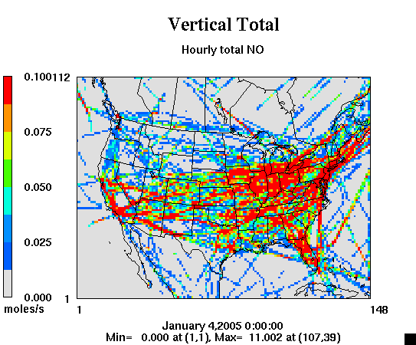

Slide 21
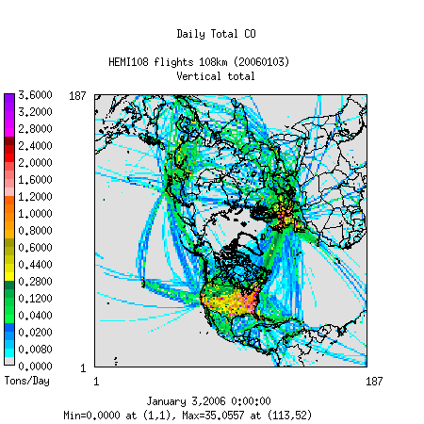

Slide 22
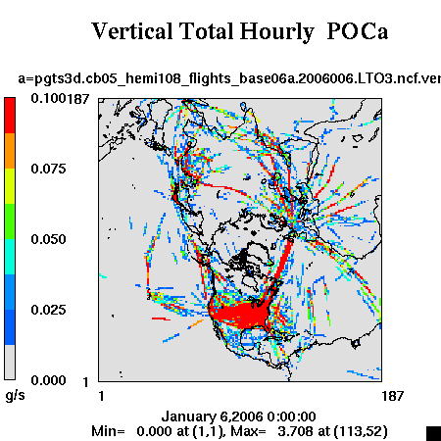

Slide 23
Acknowledgements
The emissions inventories used for this work were provided by US DOT Volpe Center and are based on data provided by the US Federal Aviation Administration and EUROCONTROL in support of the objectives of the International Civil Aviation Organization Committee on Aviation Environmental Projection CO2 Task Group. Any opinions, finding, and conclusions or recommendations expressed in this material are those of the author(s) and do not necessarily reflect the views of the US DOT, Volpe Center, the US FAA, EUROCONTROL or ICAO.
The Partnership for Air Transportation Noise and Emissions Reduction is an FAA/NASA/Transport Canada/US DOD/EPA-sponsored Center of Excellence.
This work was funded by FAA and Transport Canada under 07-C-NE-UNC Amendment Nos. 001 to 004, and 09-CE-NE-UNC Amendment Nos. 001-004.
The Investigation of Aviation Emissions Air Quality Impacts project is managed by Christopher Sequeira.
Opinions, findings, conclusions and recommendations expressed in this material are those of the author(s), and do not necessarily reflect the views of PARTNER sponsor organizations.

