Slide 1
Examining the impact of aerosol direct effects in the coupled WRF-CMAQv5.0 modeling system
K. Wyat Appel
11th Annual CMAS Conference
October 16, 2012

Slide 2
Acknowledgments
David Wong (Two-way code)
Shawn Roselle
Jon Pleim
Rohit Mathur
Christian Hogrefe (spectral density)
Chao Wei (Two-way simulations)

Slide 3
Motivation
Conventional CMAQ air quality simulations utilize meteorological inputs that are run independently of the Chemical Transport Model (CTM)
The coupled WRF-CMAQ system runs the meteorological model and CTM together, which allows for communication (feedback) between the two models
feedback is important for including the effects that aerosols have on the meteorological fields (e.g. solar radiation)
more realistic representation of the atmosphere
In this work, the coupled WRF-CMAQ modeling system is used to:
examine impact of aerosol direct effects on model estimates (performing simulations with and without aerosol direct effects)

Slide 4
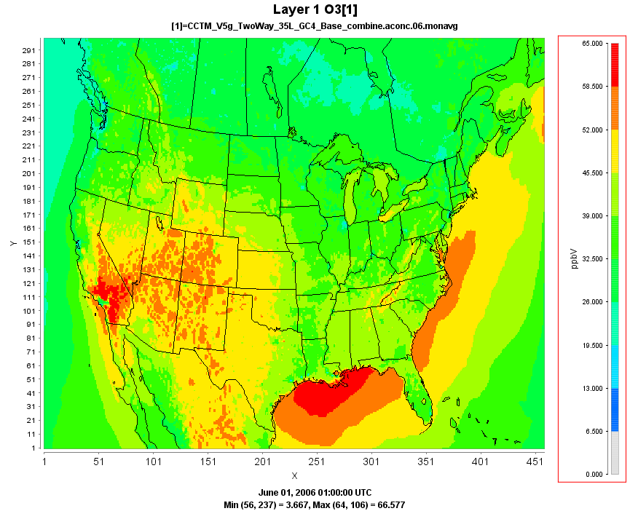
CMAQ Coupled Simulations
CMAQv5.0 Modeling System
- 12km CONUS AQMEII domain
- CB05 chemistry
- GEOS-Chem boundary conditions
- lightning NO emissions included
- wind-blown dust
January and June 2006
- coupled w/ aerosol direct effects (F)
- coupled w/o aerosol direct effects (NF)
Coupled model simulations (w/ feedback) require approximately 4.5 hours/day (128 procs) or 5.5 hours/day (96 procs)
Coupled model simulations w/o feedback require approximately 1.5 hours/day with 128 processors

Slide 5
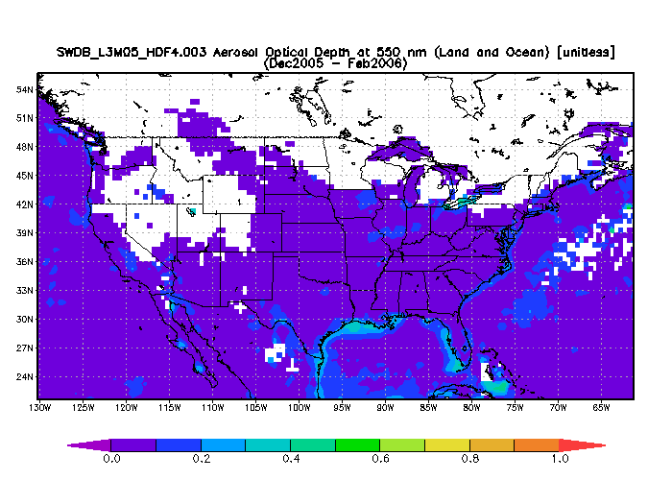
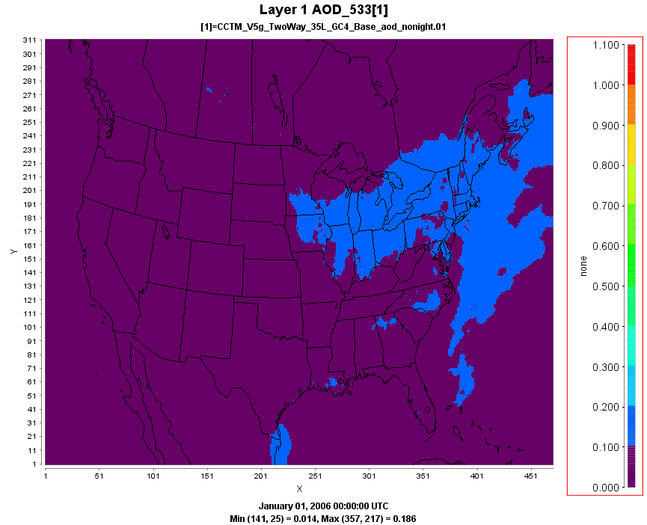
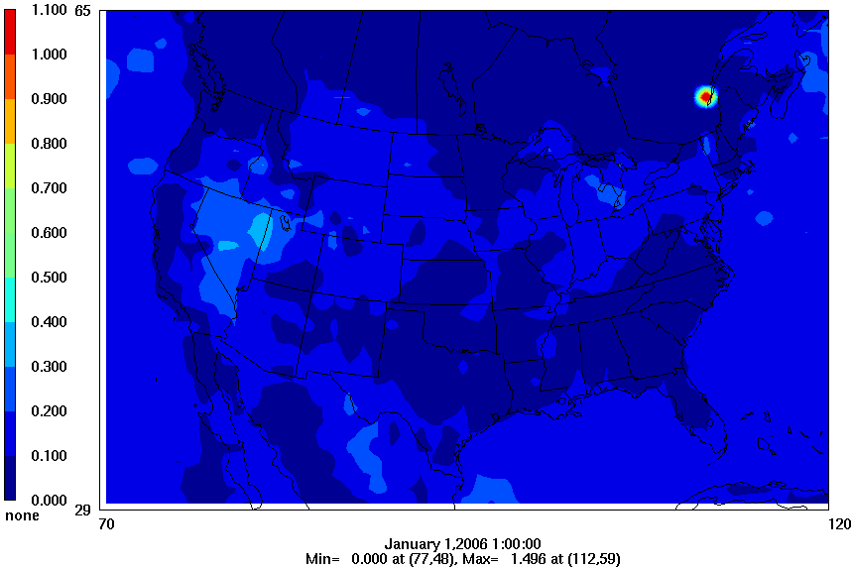
January AOD (550 nm)
Monthly Average
SeaWiFS
Coupled WRF-CMAQ w/ FB
MODIS
Notes:
White areas represent missing satellite data due to the presence of clouds. Primarily an issue over Canada and in the Northwest.
AOD is fairly well represented in January.

Slide 6
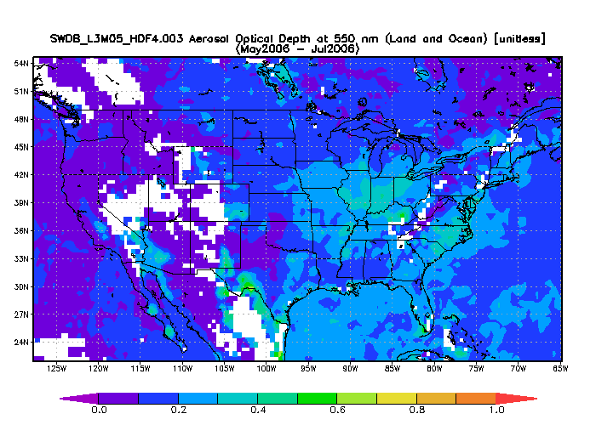
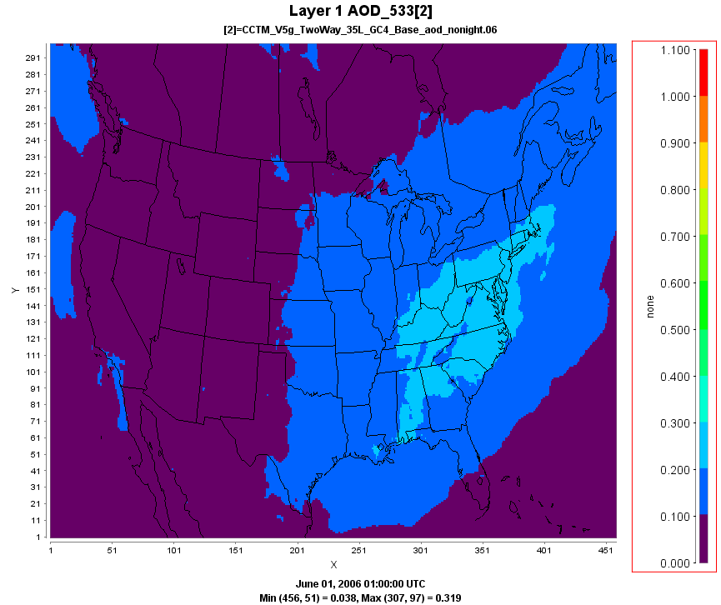
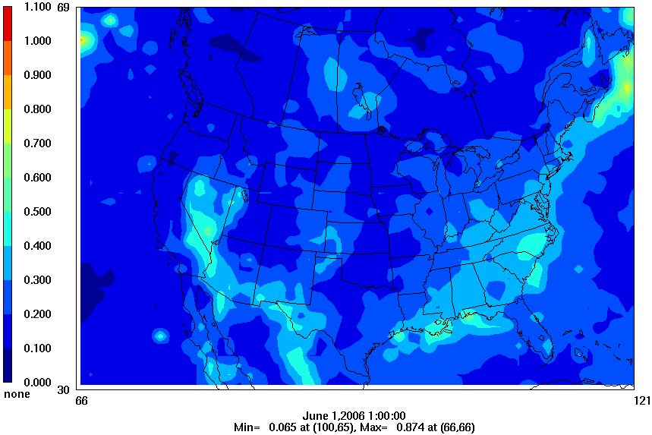
June AOD (550 nm)
Monthly Average
SeaWiFS
Coupled WRF-CMAQ w/ FB
MODIS
Notes:
The pattern of AOD in June is consistent with the observed AOD pattern, however the magnitude seems to be underestimated, particularly over the Great Lakes and along the gulf coast.

Slide 7
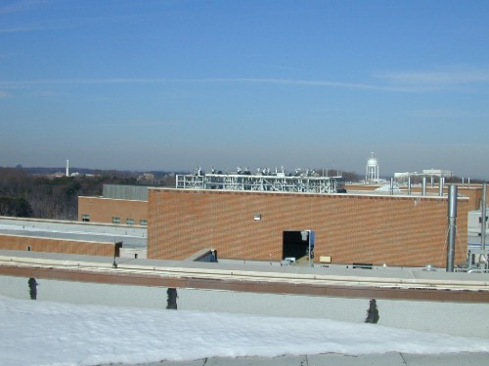
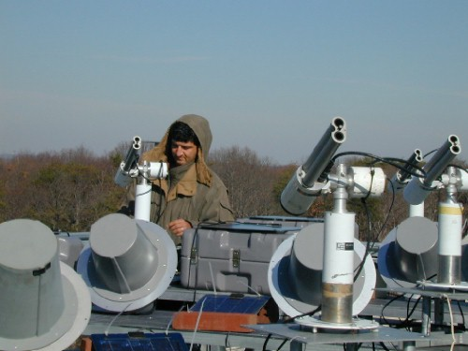
AERONET
AEerosol RObotic NETwork
Provides measurements of Aerosol Optical Depth (among other measurements)
Basic AOD instrument is a sun photometer measuring direct solar radiation
Two U.S. sites used here
- Bondville, IL (40.05N, 88.37W)
- Goddard Space Flight Center, Greenbelt,
MD (38.99N, 76.84W)
Level 2.0 data used with pre- and post- field calibration applied, cloud screened and quality assured
http://aeronet.gsfc.nasa.gov/new_web/index.html

Slide 8
AOD - January/February
Daily Average PM_{2.5} (near Bondville)
Daily Average PM_{2.5} (near GSFC)
Note that AOD is vertically integrated, while the PM2.5 shown here is just for the surface.
Notes:
The modeled AOD at Bondville tends to be overestimated in January and early February, but matches the observed AOD very well in late February.
The green trace represents the modeled PM2.5 at the surface.

Slide 9
AOD – June/July
Daily Average PM_{2.5} (near Bondville)
Daily Average PM_{2.5} (near GSFC)
Notes:
In June, the model tends to underestimate the observed AOD at Bondville.

Slide 10
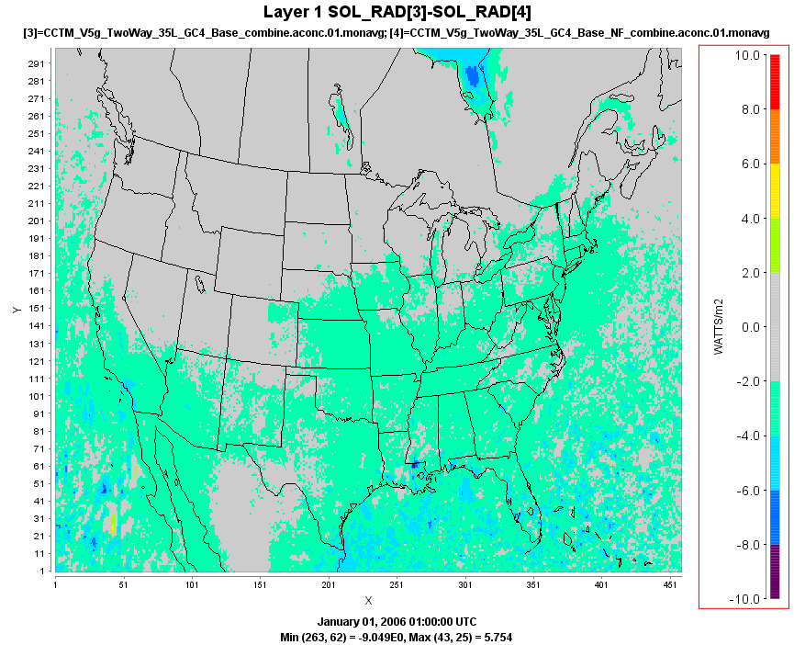
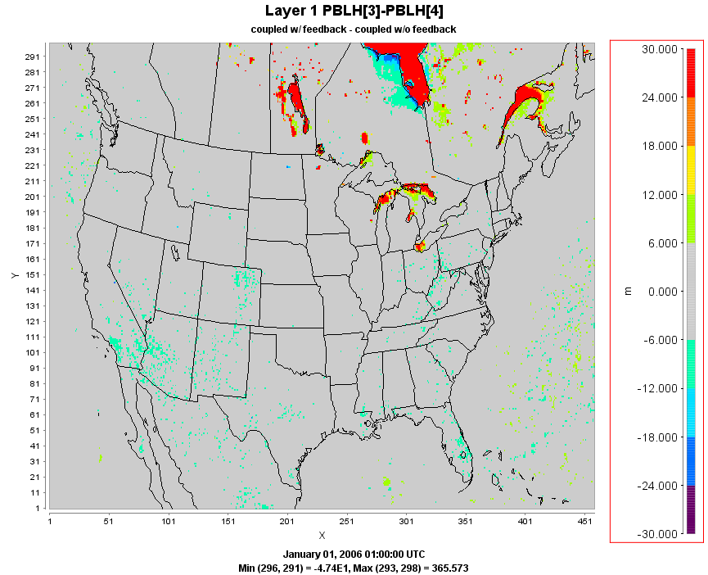
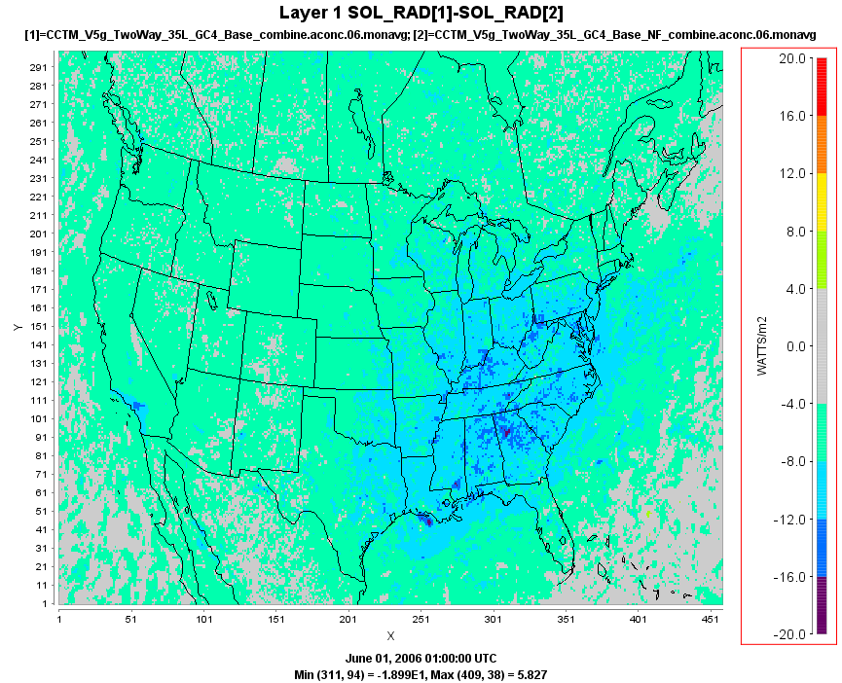
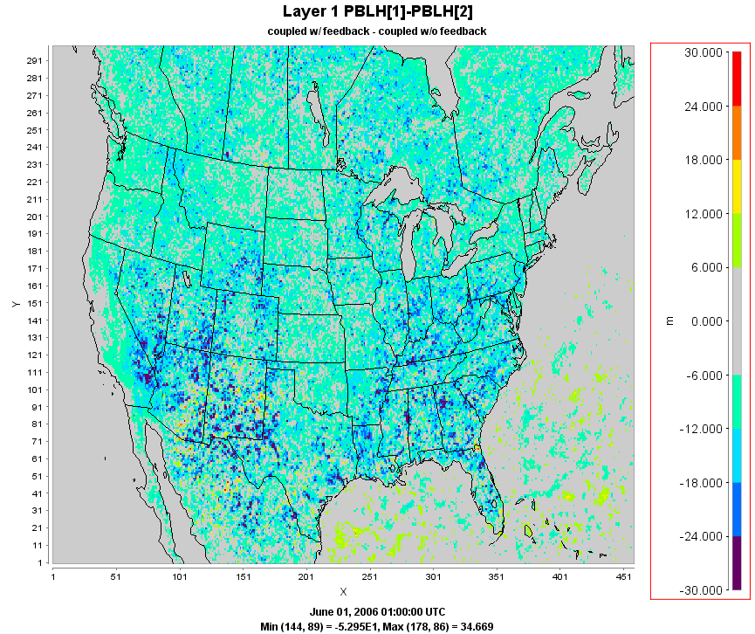
January Solar Radiation (F-NF)
January PBL height (F-NF)
10.0
30
8.0
24
6.0
18
4.0
12
2.0
6
0.0
0
- 2.0
- 6
- 4.0
- 12
- 6.0
- 18
- 8.0
- 24
Issue w/ water temperature
- 10.0
- 30
June Solar Radiation (F-NF)
June PBL height (F-NF)
20
30
16
24
12
18
8
12
4
6
0
0
- 4
- 6
- 8
- 12
- 12
- 18
- 16
- 24
- 20
- 30
Notes:
Solar radiation decreases in the simulation with feedback effects as the aerosols reflect the incoming solar radiation. The effect is larger in June than January.
On average, a 2-3 watts/m2 decrease in January and 8 to 10 watts/m2 decrease in June.

Slide 11
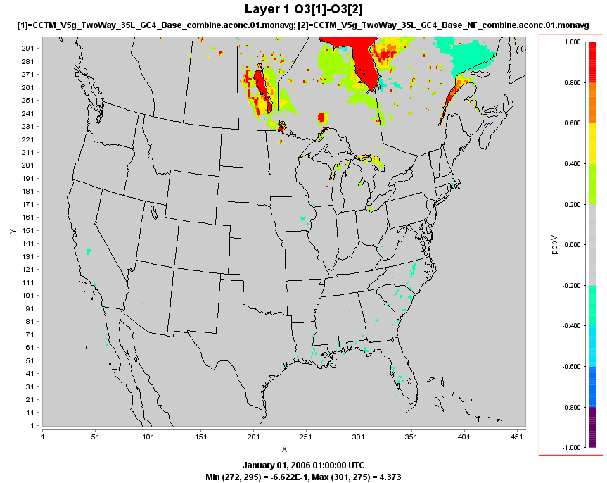
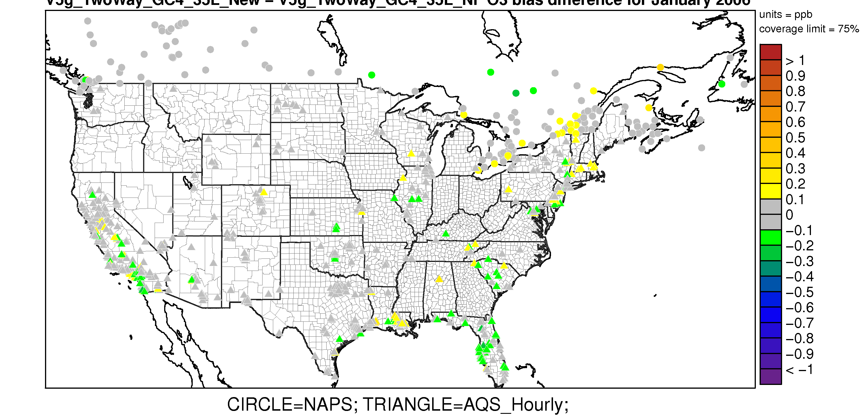
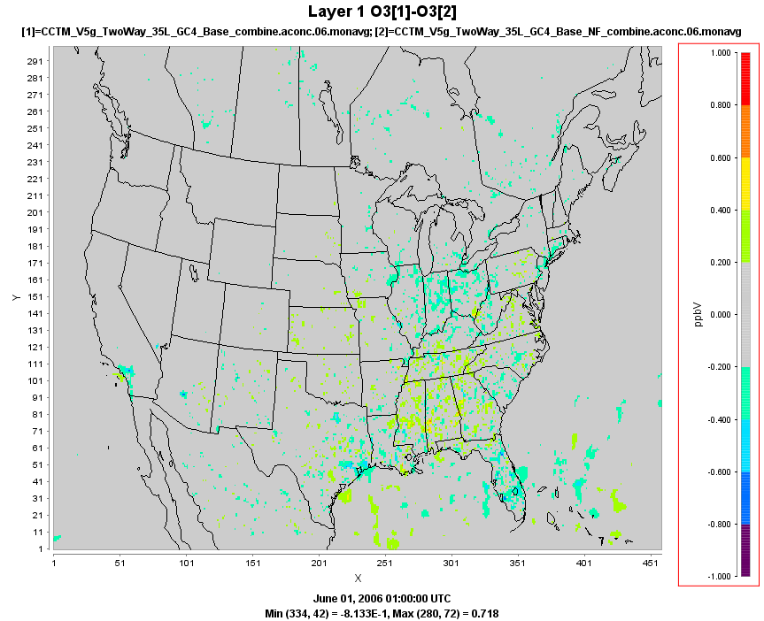
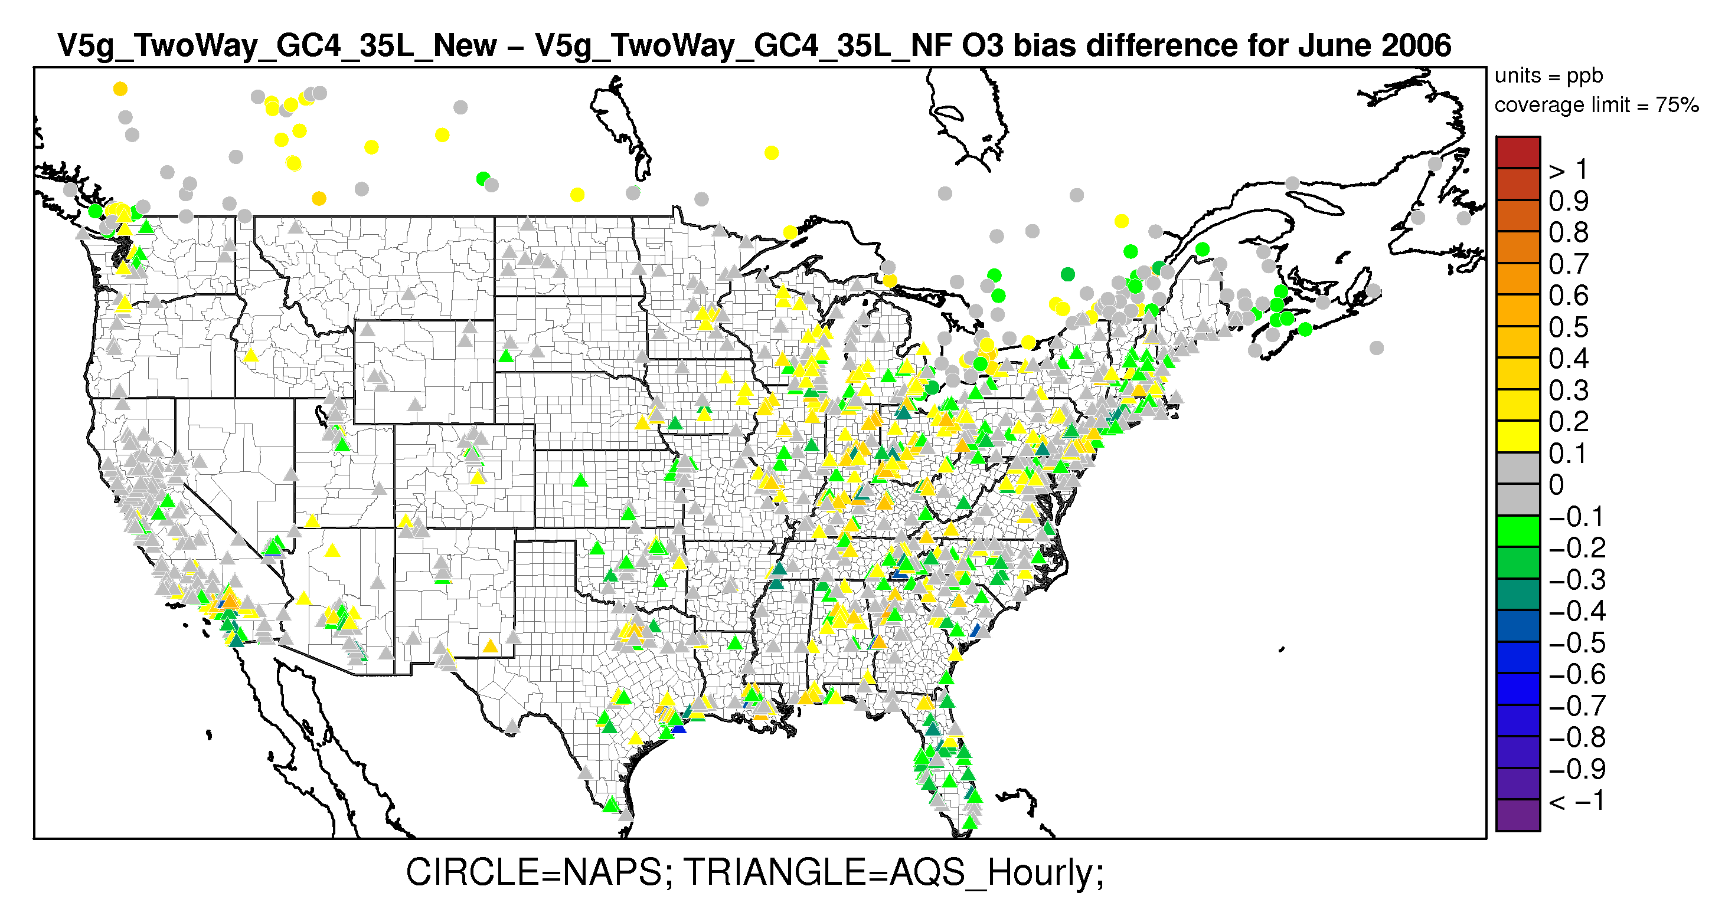
January Ozone (F-NF)
Ozone (Hourly)
0.5
0.4
January Bias Difference (F-NF)
0.3
0.2
0.1
0
- 0.1
- 0.2
- 0.3
- 0.4
- 0.5
June Ozone (F-NF)
1.0
June Bias Difference (F-NF)
0.8
0.6
0.4
0.2
0
- 0.2
- 0.4
- 0.6
- 0.8
- 1.0
Notes:
Ozone largely unchanged in January.
In June, small increases and decreases occur mainly in the eastern U.S. Note that these are monthly average values.

Slide 12
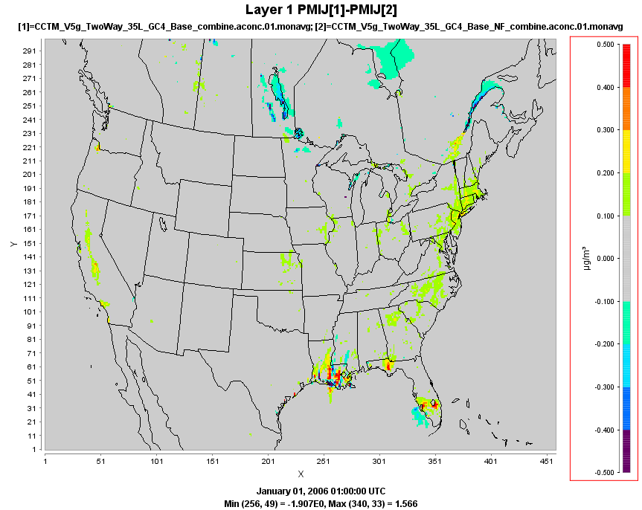
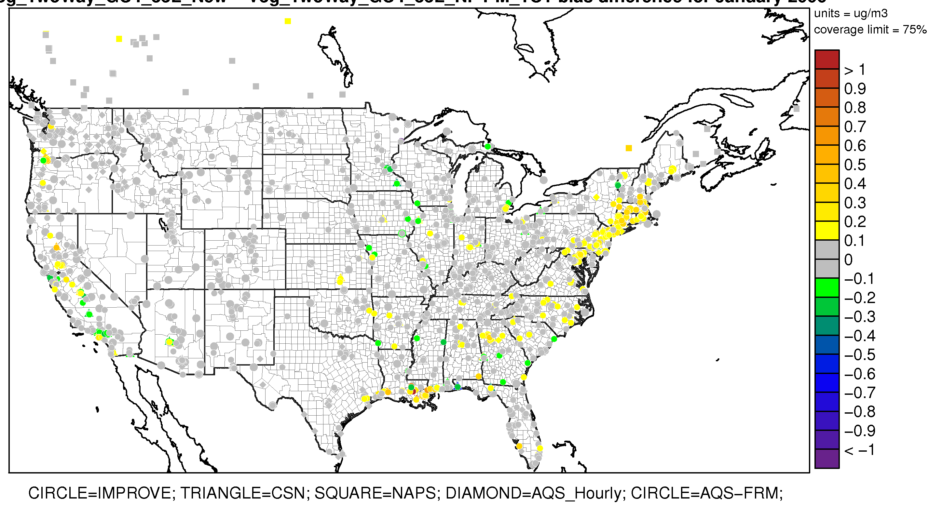
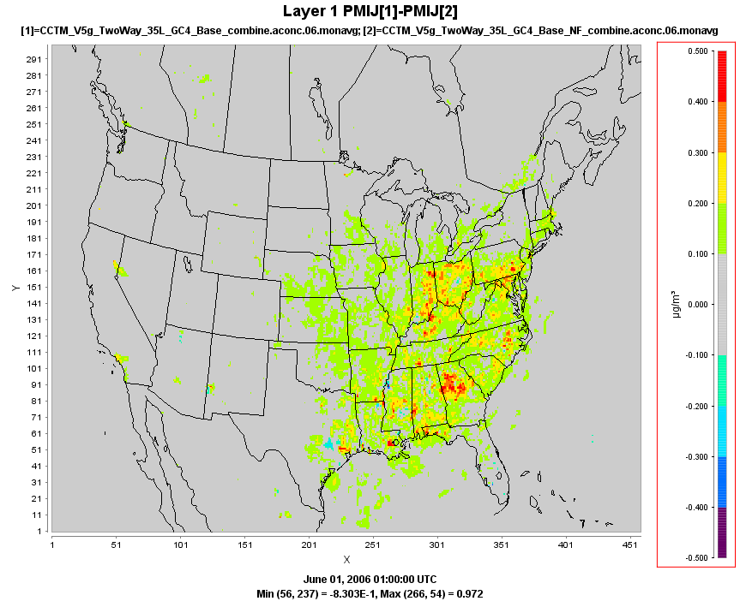
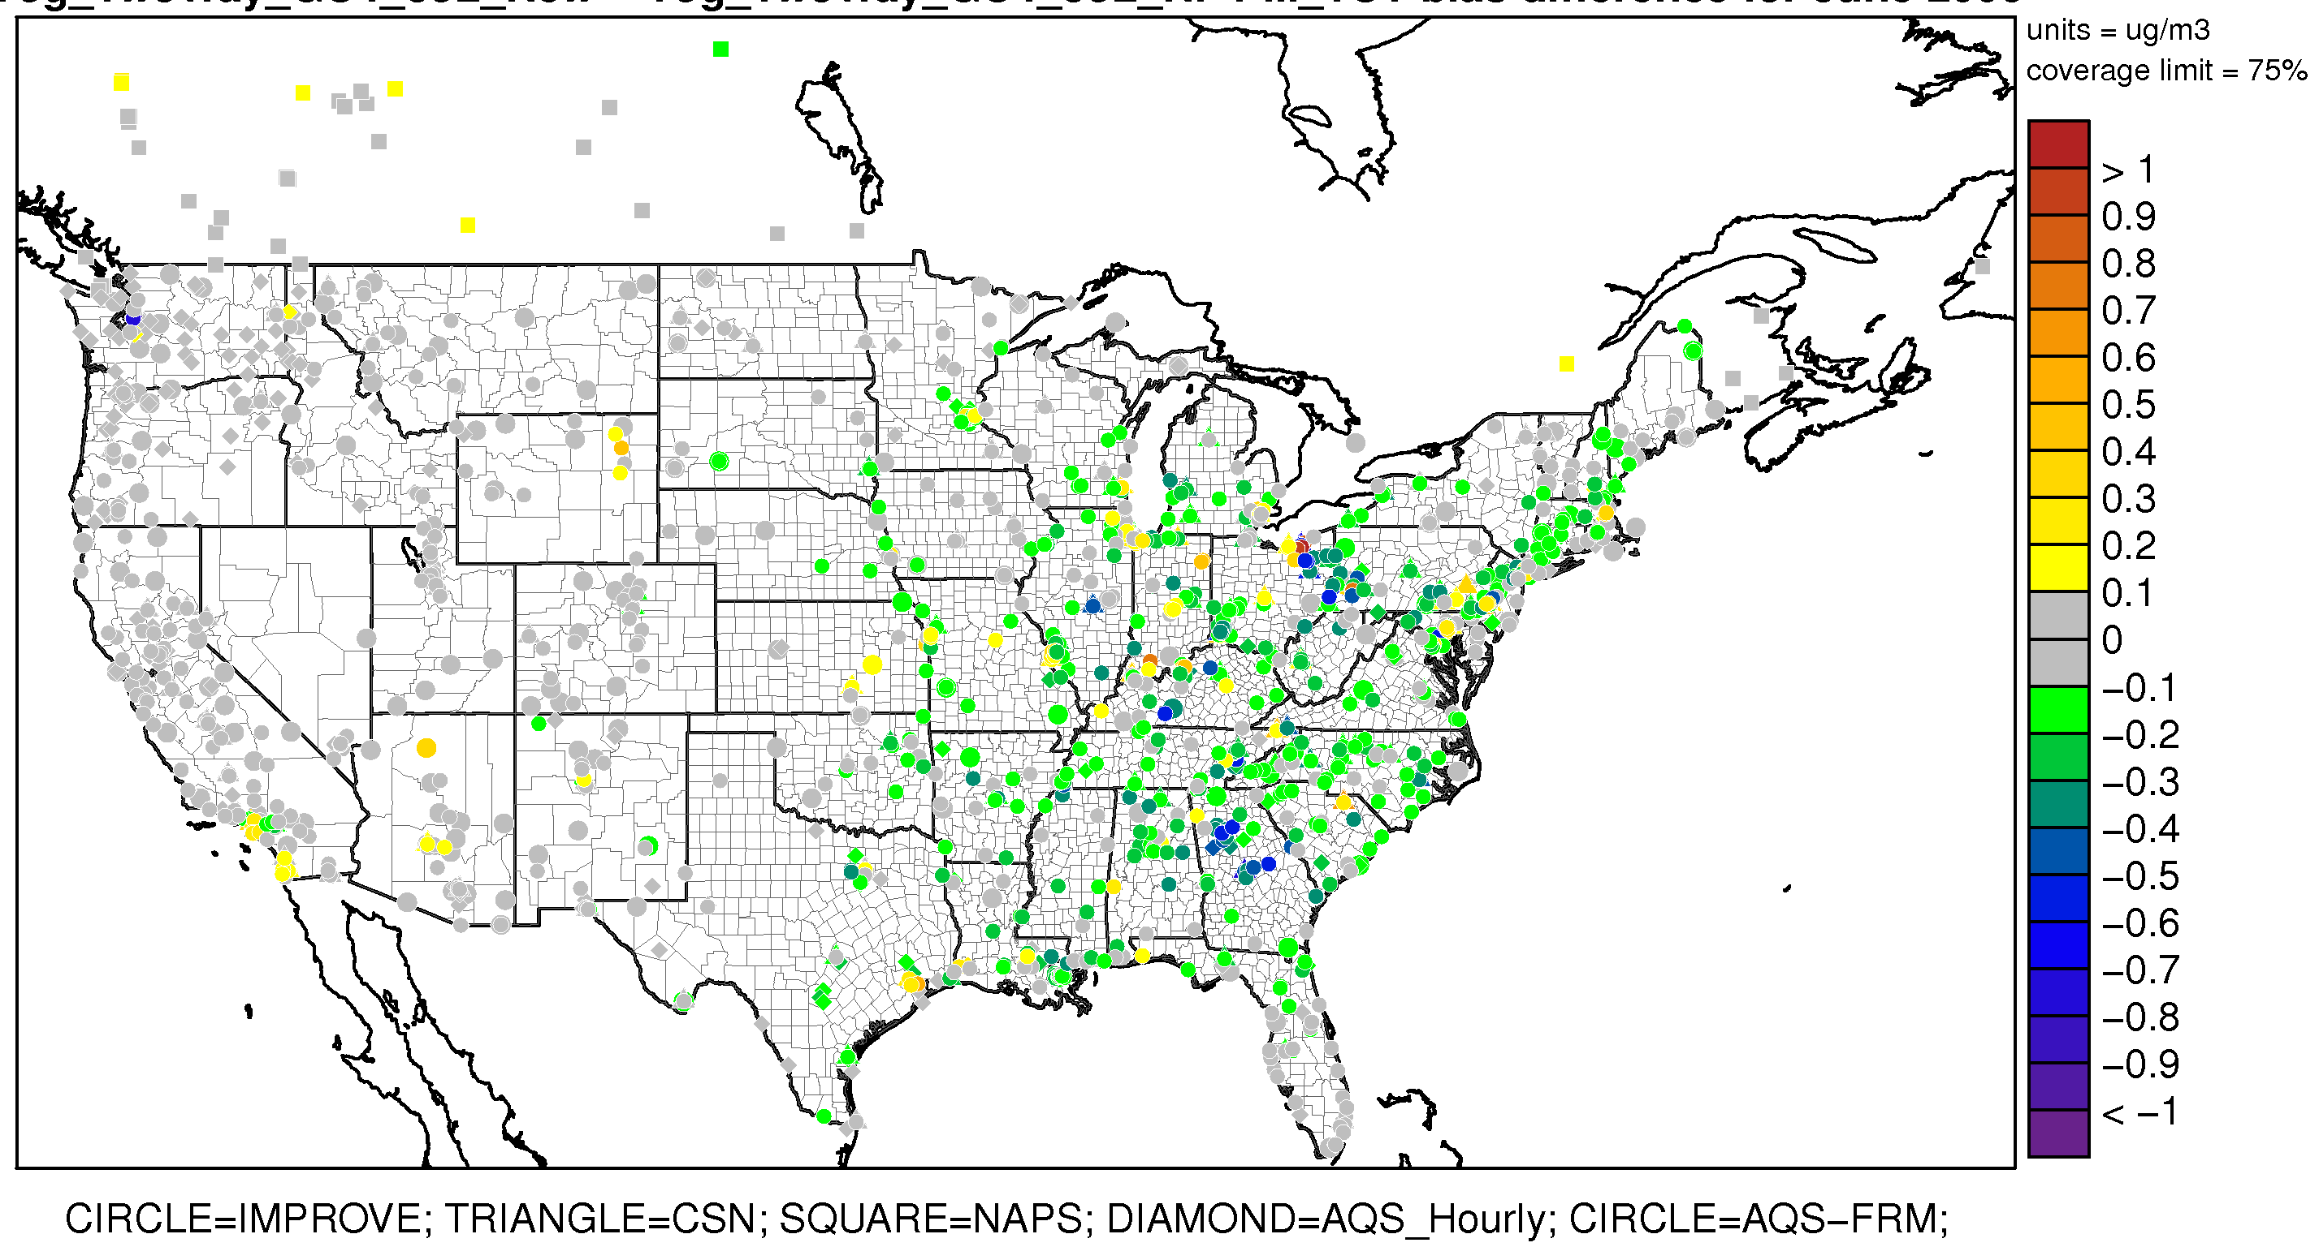
January PM_{2.5} (F-NF)
Monthly Average PM_{2.5}
0.5
0.4
January Bias Difference (F-NF)
0.3
0.2
0.1
0
- 0.1
- 0.2
- 0.3
- 0.4
- 0.5
June PM_{2.5} (F-NF)
0.5
June Bias Difference (F-NF)
0.4
0.3
0.2
0.1
0
- 0.1
- 0.2
- 0.3
- 0.4
- 0.5
PM_{2.5} bias reduced in simulation with aerosol feedback
Notes:
PM2.5 increases in both January and June due to the reduced mixing heights. The change is largest in June, with differences as high as 0.5 ug/m3 on a monthly average.
The result is a slight increase in bias in January, as PM2.5 is typically overestimated in the winter, and an overall decrease in bias in the summer, as PM2.5 is underestimated in the summer.

Slide 13
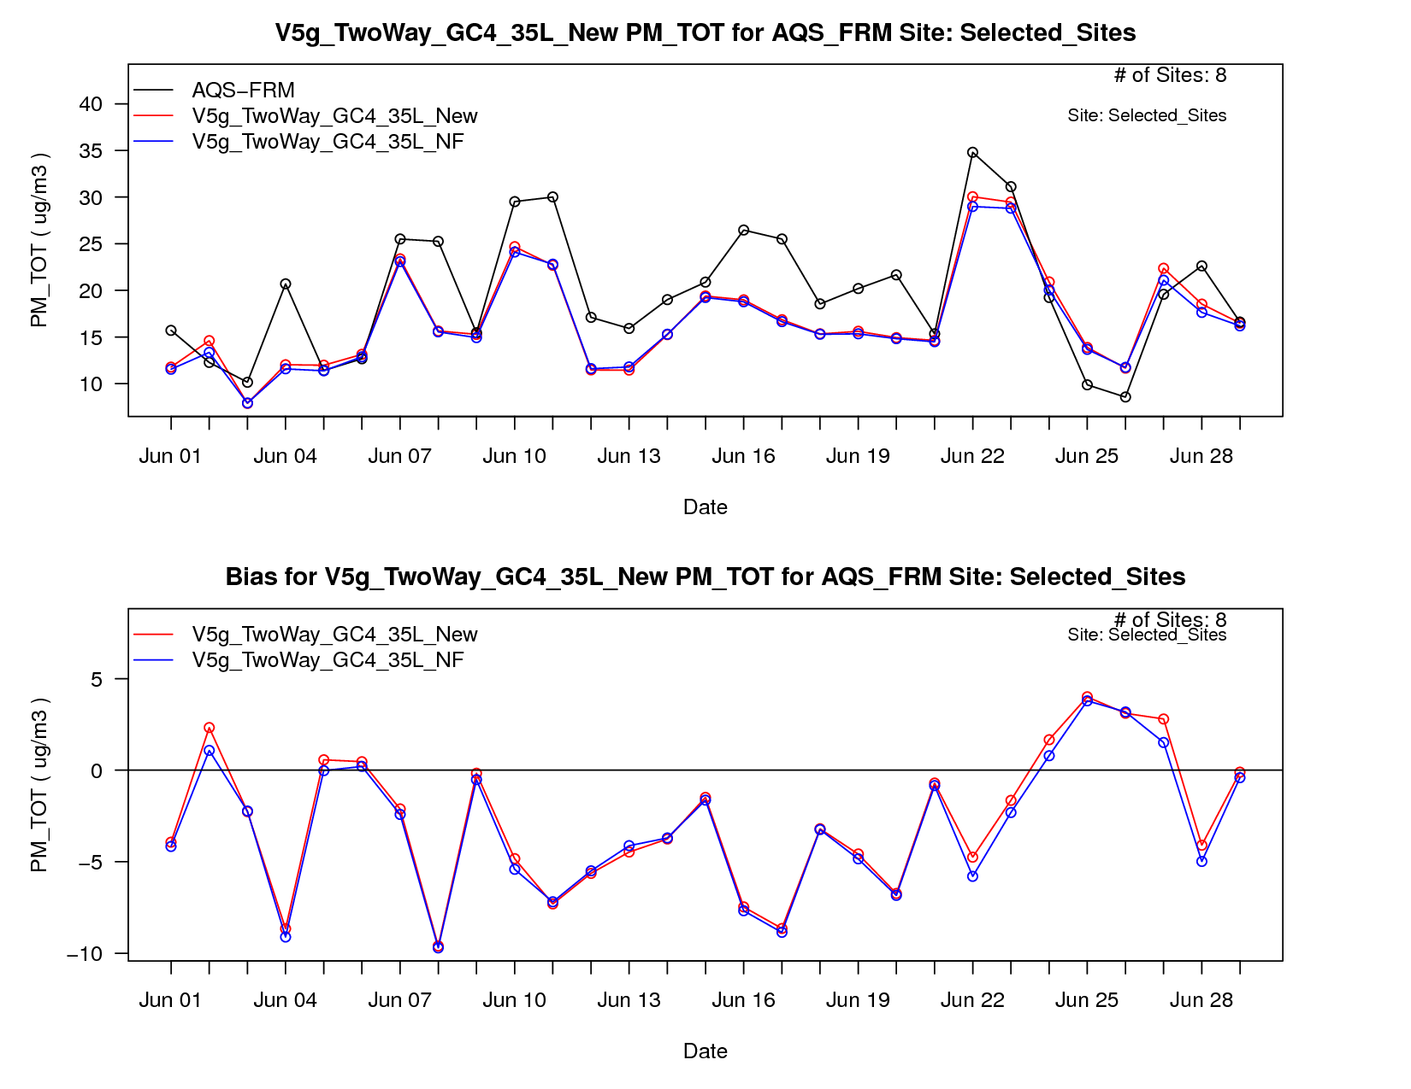
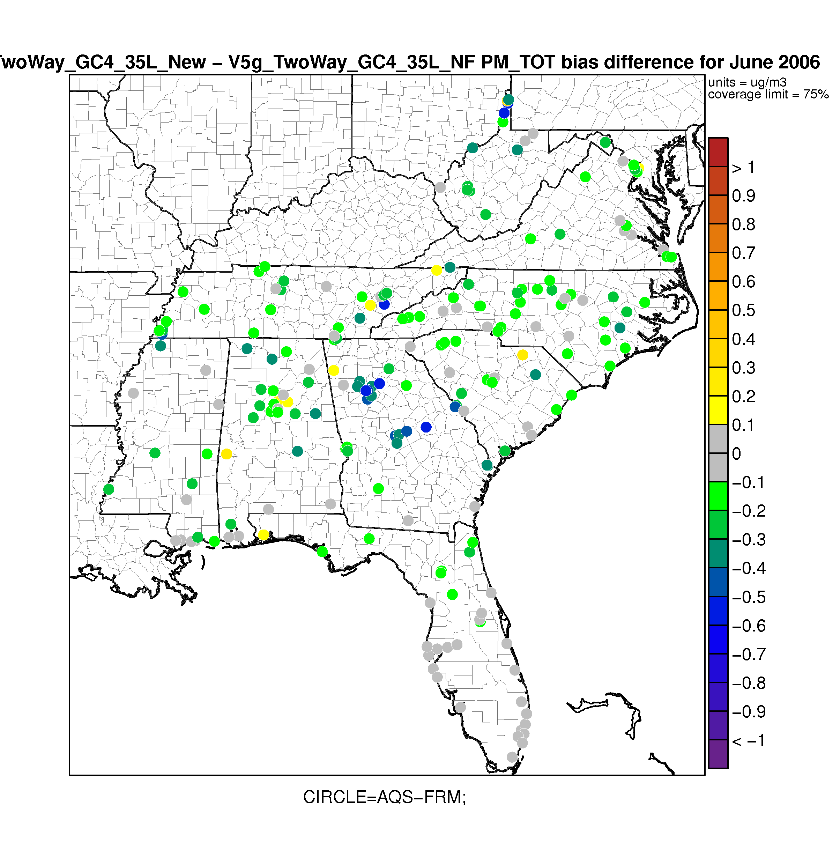
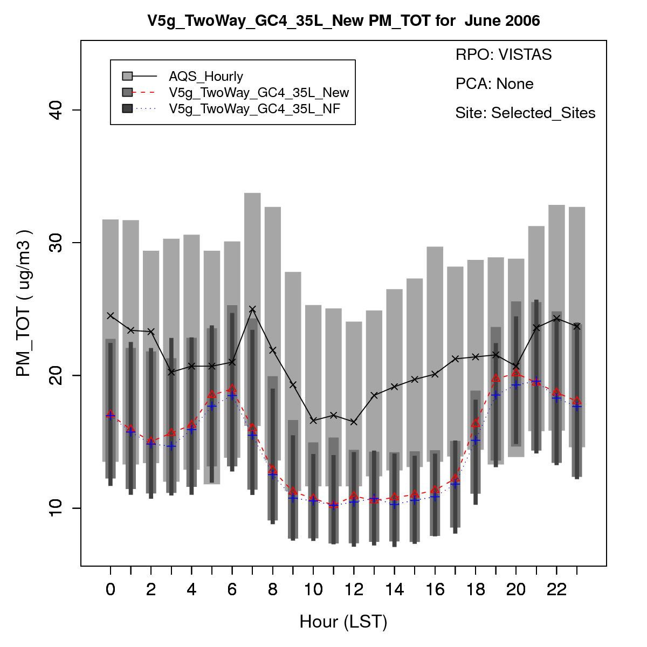
Monthly Average PM_{2.5}
Increase in PM_{2.5} due to lower PBL heights from decreased solar insolation as a result of the direct feedback effects from particles.

Slide 14
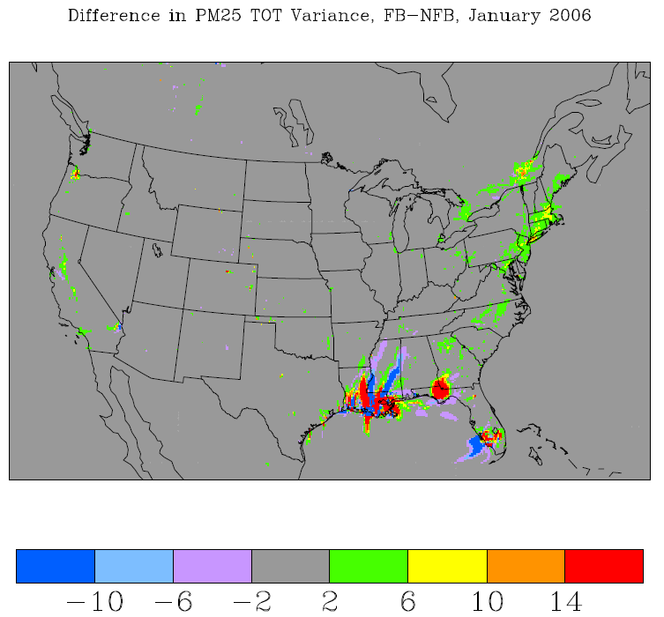
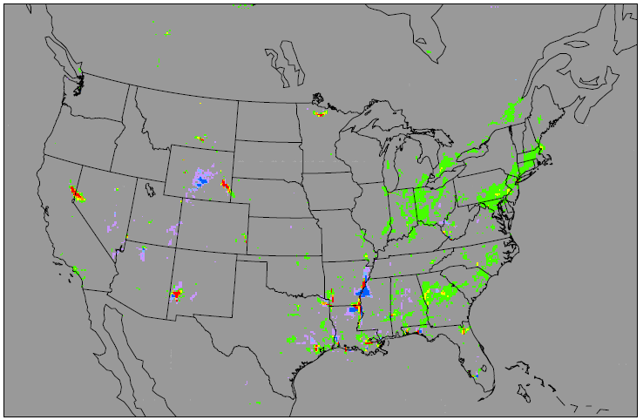
PM_{2.5} Variance (F-NF)
CMAQ typically underestimates the variance as compared to observations
Including radiative feedback effects is expected to increase the variance in the model estimates
Differences in variance tend to be largest in areas of largest variance, which in turn tend to be largest in areas of the highest monthly average concentrations
Most differences are positive indicating that the feedback run has more variance than no-feedback run
January
June
(µg/m³)²

Slide 15
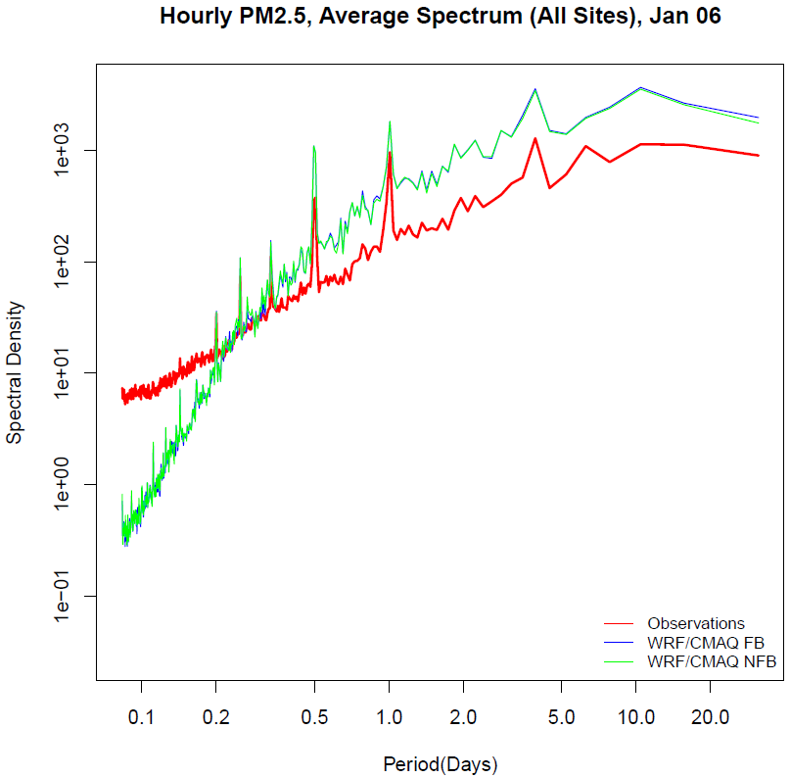
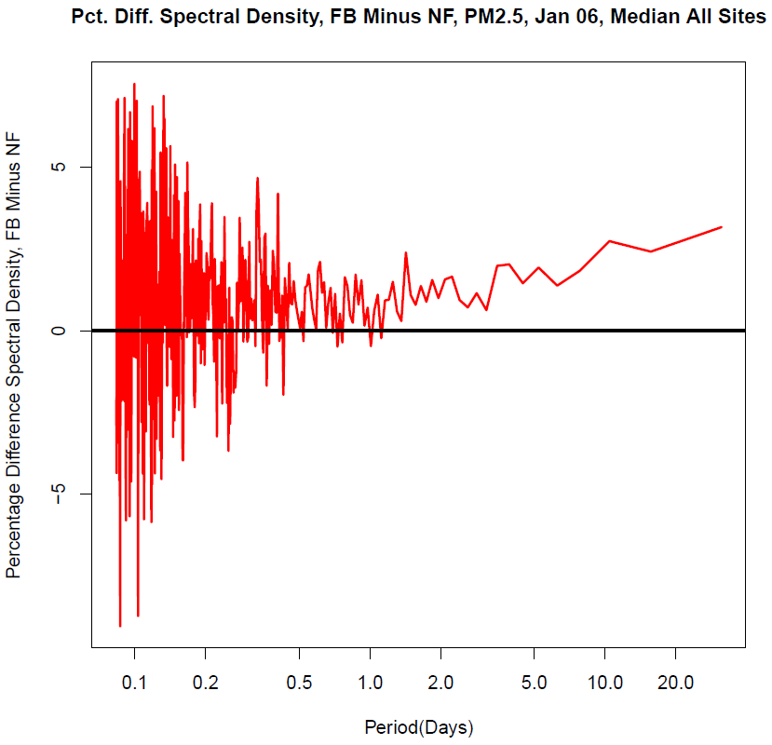
PM_{2.5} Spectral Density - January
Average Spectrum for Hourly PM_{2.5}
Difference in Median Spectral Density (F-NF)
Spectral density is higher in the simulation with feedback than w/o feedback, which is an improvement compared to the observed power spectrum.
Notes:
WRF/CMAQ (both coupled and un-coupled) underestimates the spectral density at high frequencies (i.e. hourly).
The coupled WRF/CMAQ model simulation with feedback produces slightly more spectral density (more variable) at lower frequencies than the simulation without feedback in January.

Slide 16
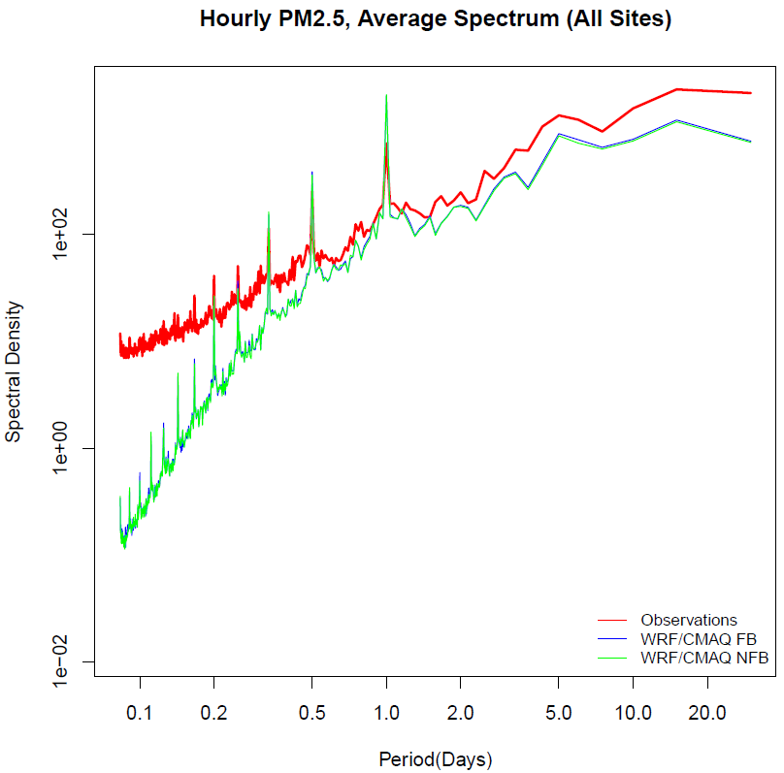
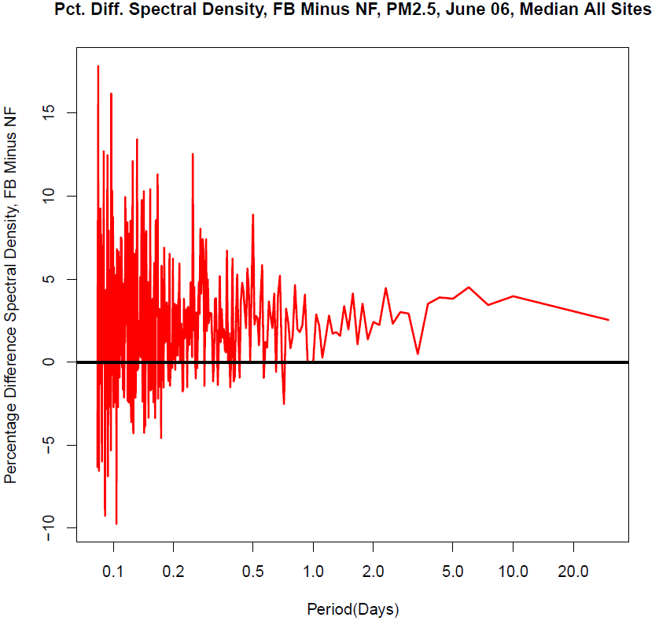
PM_{2.5} Spectral Density - June
Average Spectrum for Hourly PM_{2.5}
Difference in Median Spectral Density (F-NF)
Again, the spectral density is higher in the simulation with feedback than w/o feedback.
Notes:
Similar to January, the spectral density is higher in the simulation with feedback than without in June.

Slide 17
Is nudging of met variables reducing the impact of radiative feedback?
Re-ran feedback and no-feedback simulations using smaller soil and air nudging coefficients

Slide 18
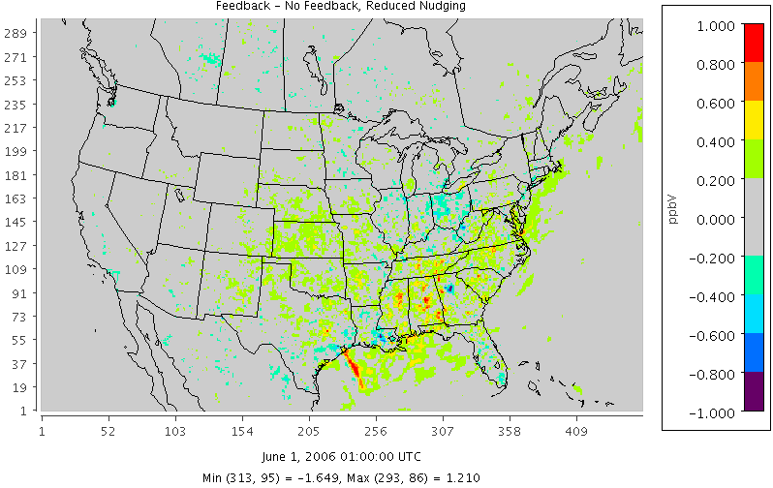
Effect of Reduced Nudging Strength – O₃
F-NF, standard nudging
F-NF, reduced nudging
Simulation with reduced nudging strength shows greater difference between Feedback and No-Feedback simulations, indicating greater impact from radiative effects.

Slide 19
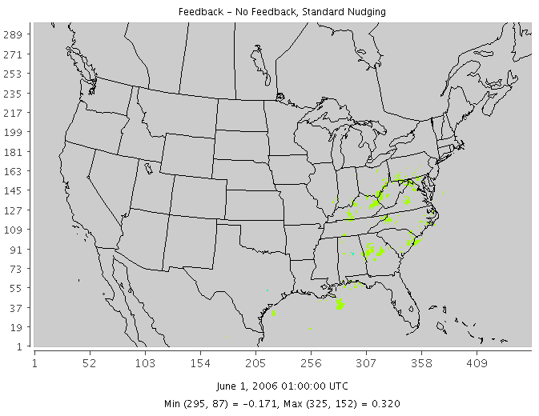
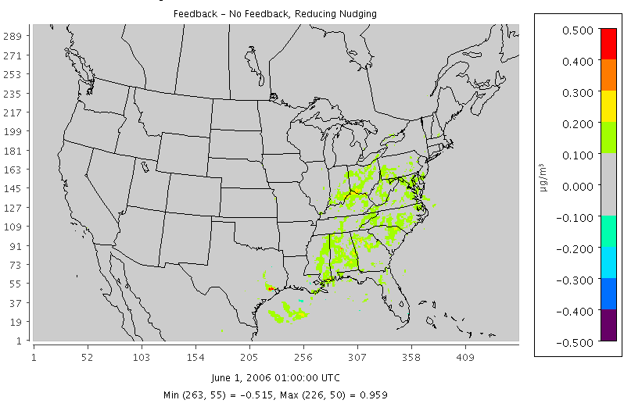
Effect of Reduced Nudging Strength – SO₄
F-NF, standard nudging
F-NF, reduced nudging
Again, simulations with reduced nudging strength shows larger differences than the simulations with the standard nudging strengths.

Slide 20
Highlights
Impact of aerosol direct effects apparent in the coupled WRF-CMAQ modeling system
The feedback effects appear to mostly improve the CMAQ model estimates in the summertime (June)
The feedback effect in the wintertime (January) is relatively small
Feedback effects increase the variability in the model estimates of PM_{2.5}
Reducing the nudging strength in WRF allows for greater feedback effect from aerosols

Slide 21
Future Work
Complete annual coupled WRF-CMAQ simulation
perform full annual operational evaluation
Examine differences between the coupled WRF-CMAQ w/o feedback effects and the un-coupled WRF-CMAQ system
some difficulty setting up consistent model simulations
need to create consistent method of running WRF-CMAQ together
Continue further testing of altering nudging strengths

Slide 22
Thanks!

Slide 23
Extra Slides

Slide 24
Aerosol Optical Depth (AOD)
Measure of transparency
AOD is defined as the negative natural log of the fraction of radiation that is NOT scattered or absorbed along a path
Therefore, AOD is dimensionless, and not a length
Here we are using the TTAUXAR_04 from the wrfout file which represents the 533 nm wavelength
The next several slides show comparisons of modeled AOD against satellite and ground based observations of AOD

Slide 25
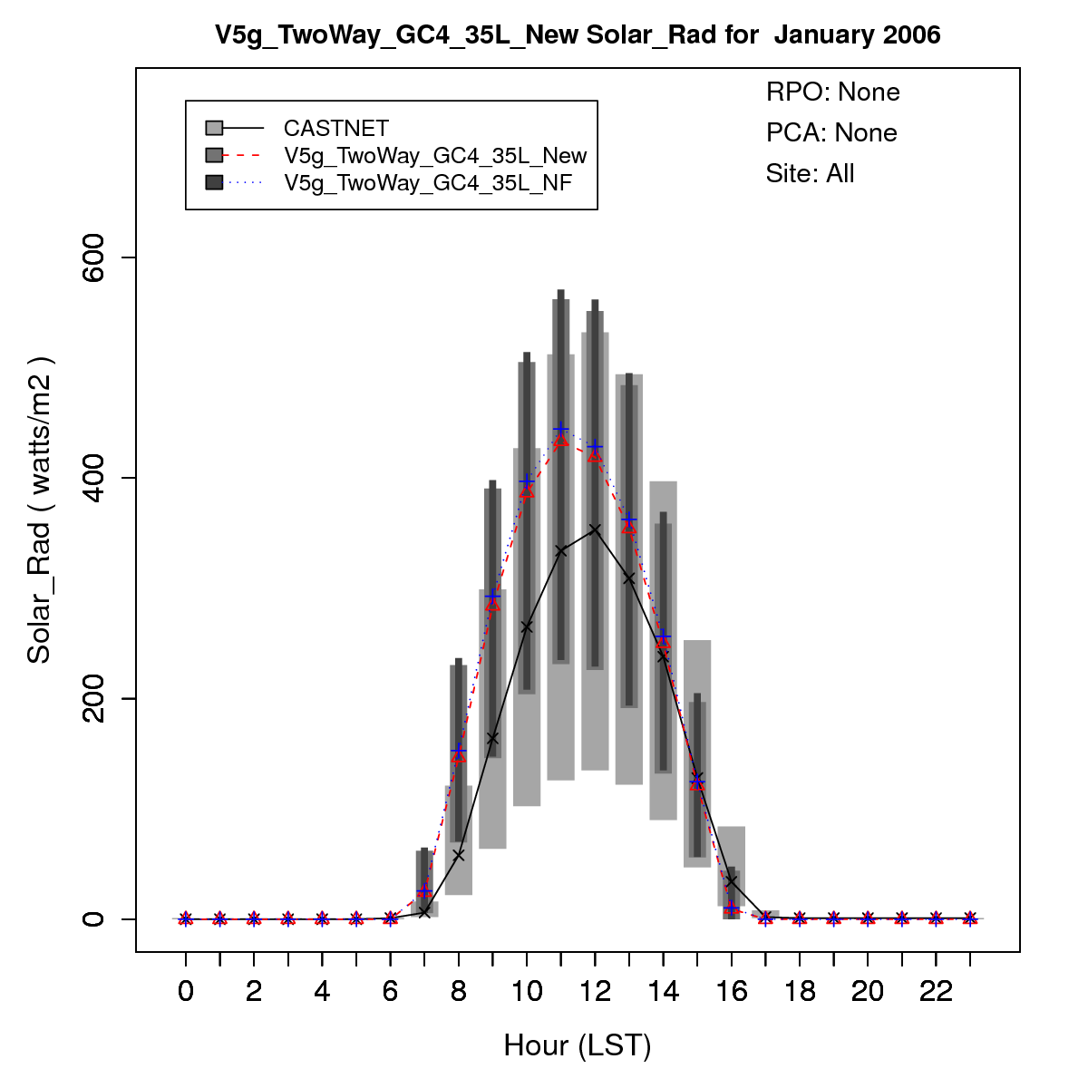
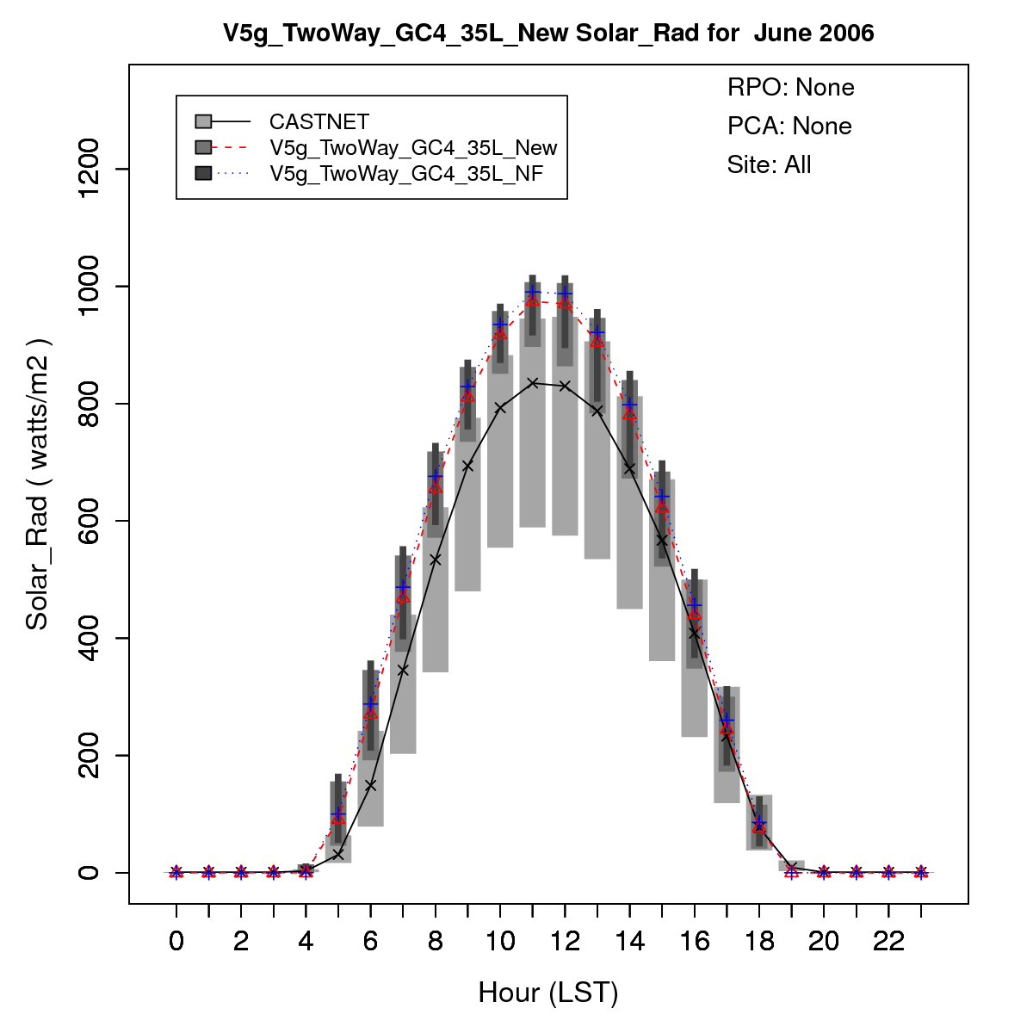
Solar Radiation
January (F – NF)
June (F – NF)

Slide 26
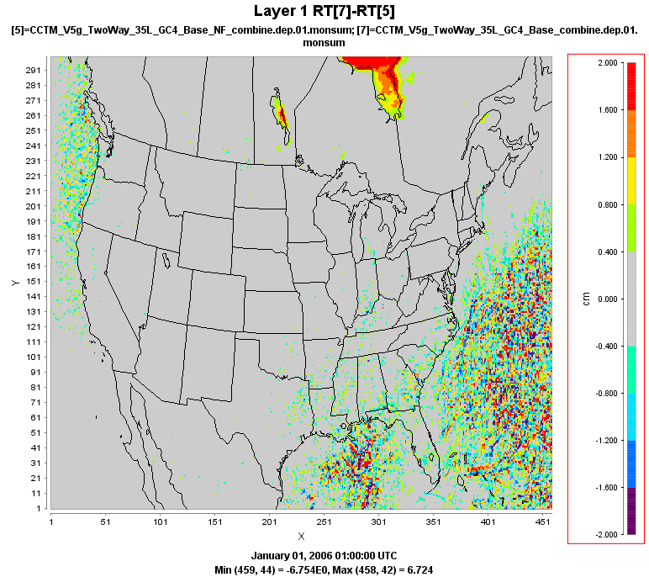
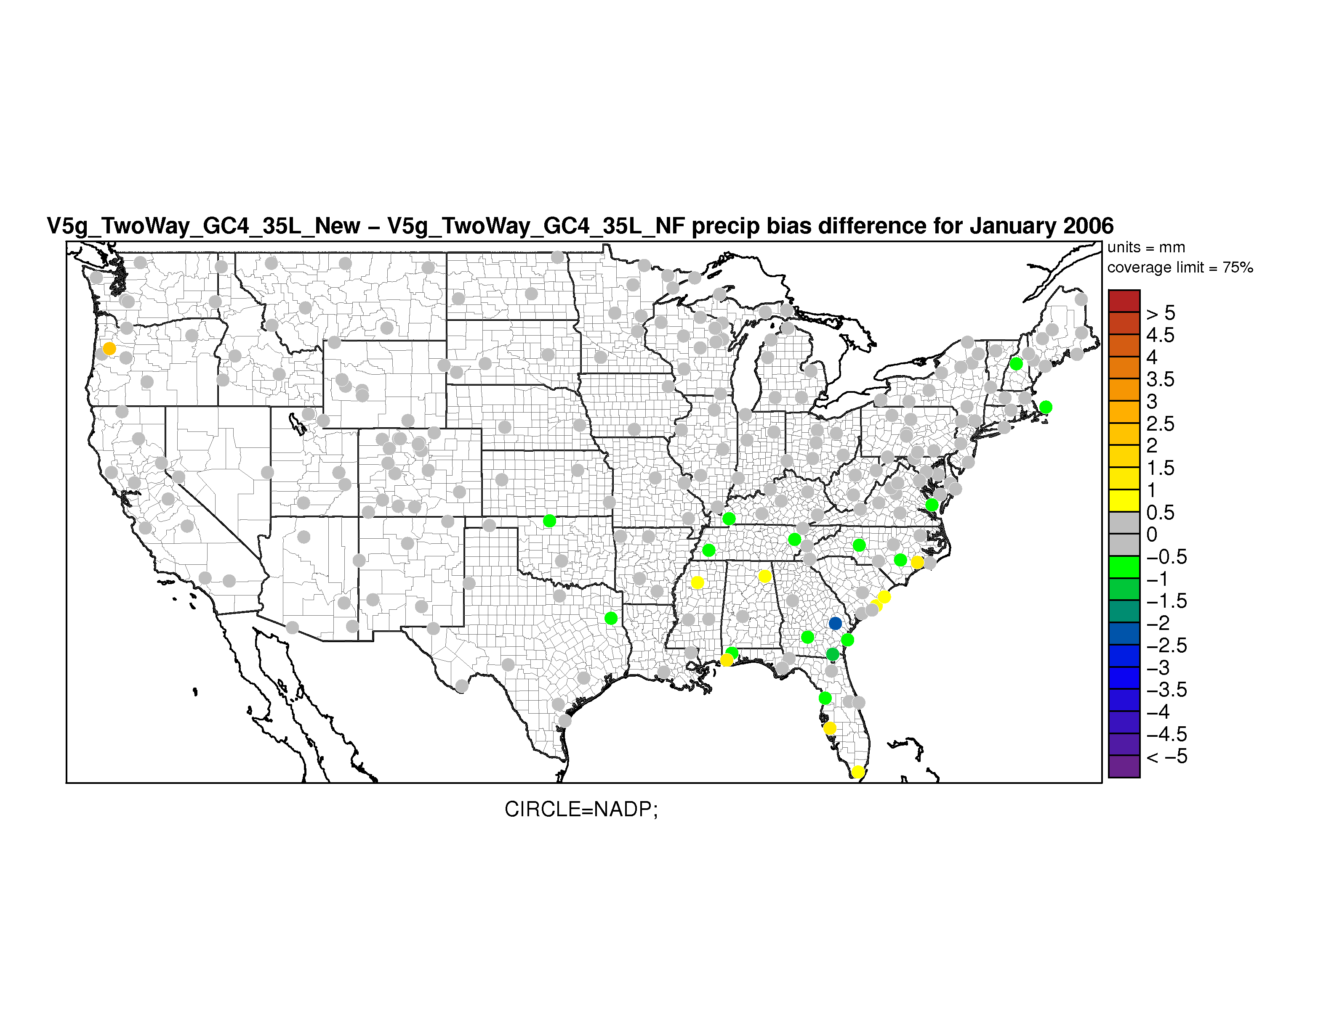
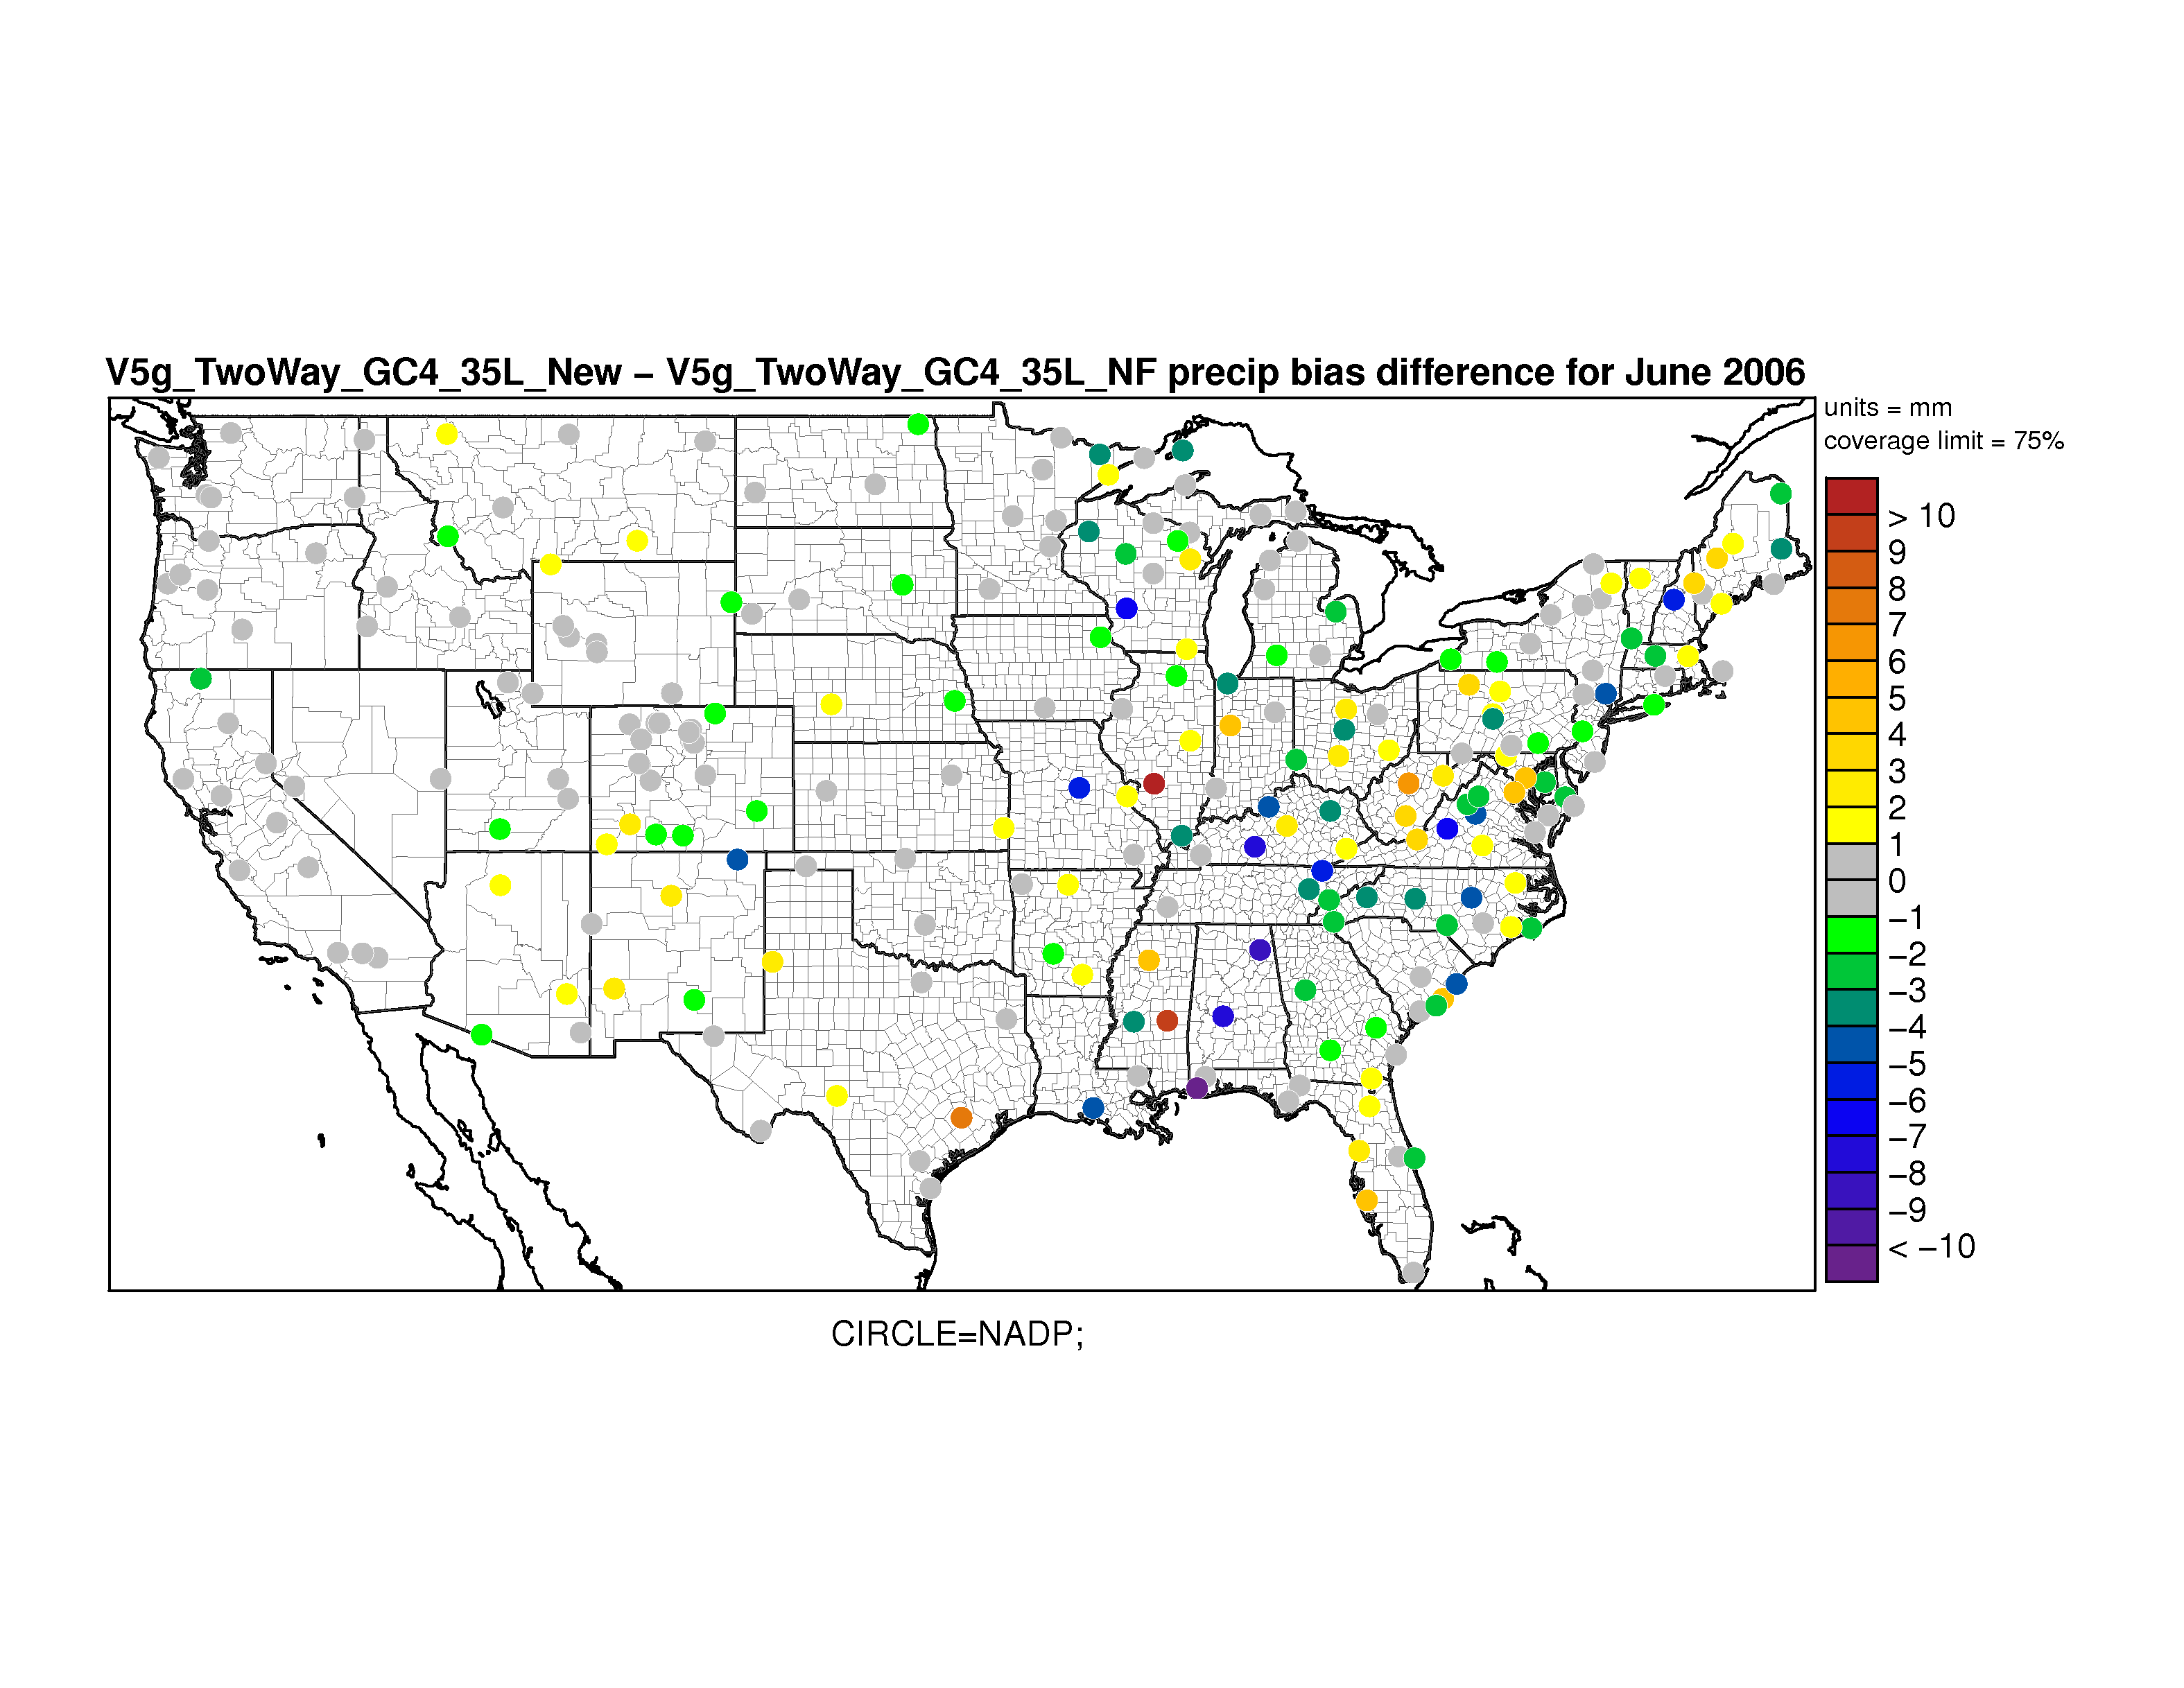
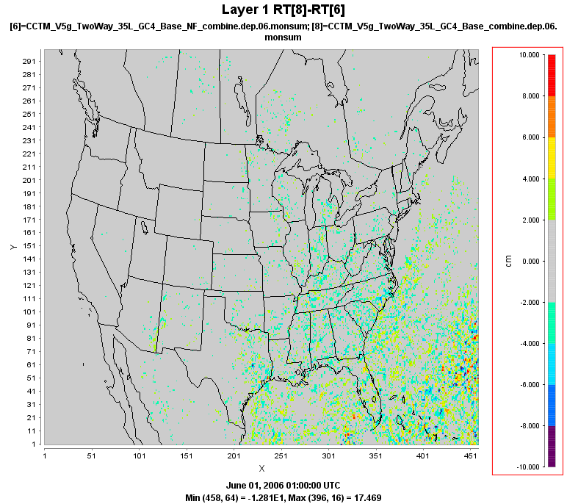
January Precipitation (F-NF)
Precipitation
January Bias Difference (F-NF)
June Precipitation (F-NF)
June Bias Difference (F-NF)
Notes:
Precipitation is generally unchanged over land. Some differences over the Atlantic Ocean and Gulf of Mexico in January.

Slide 27
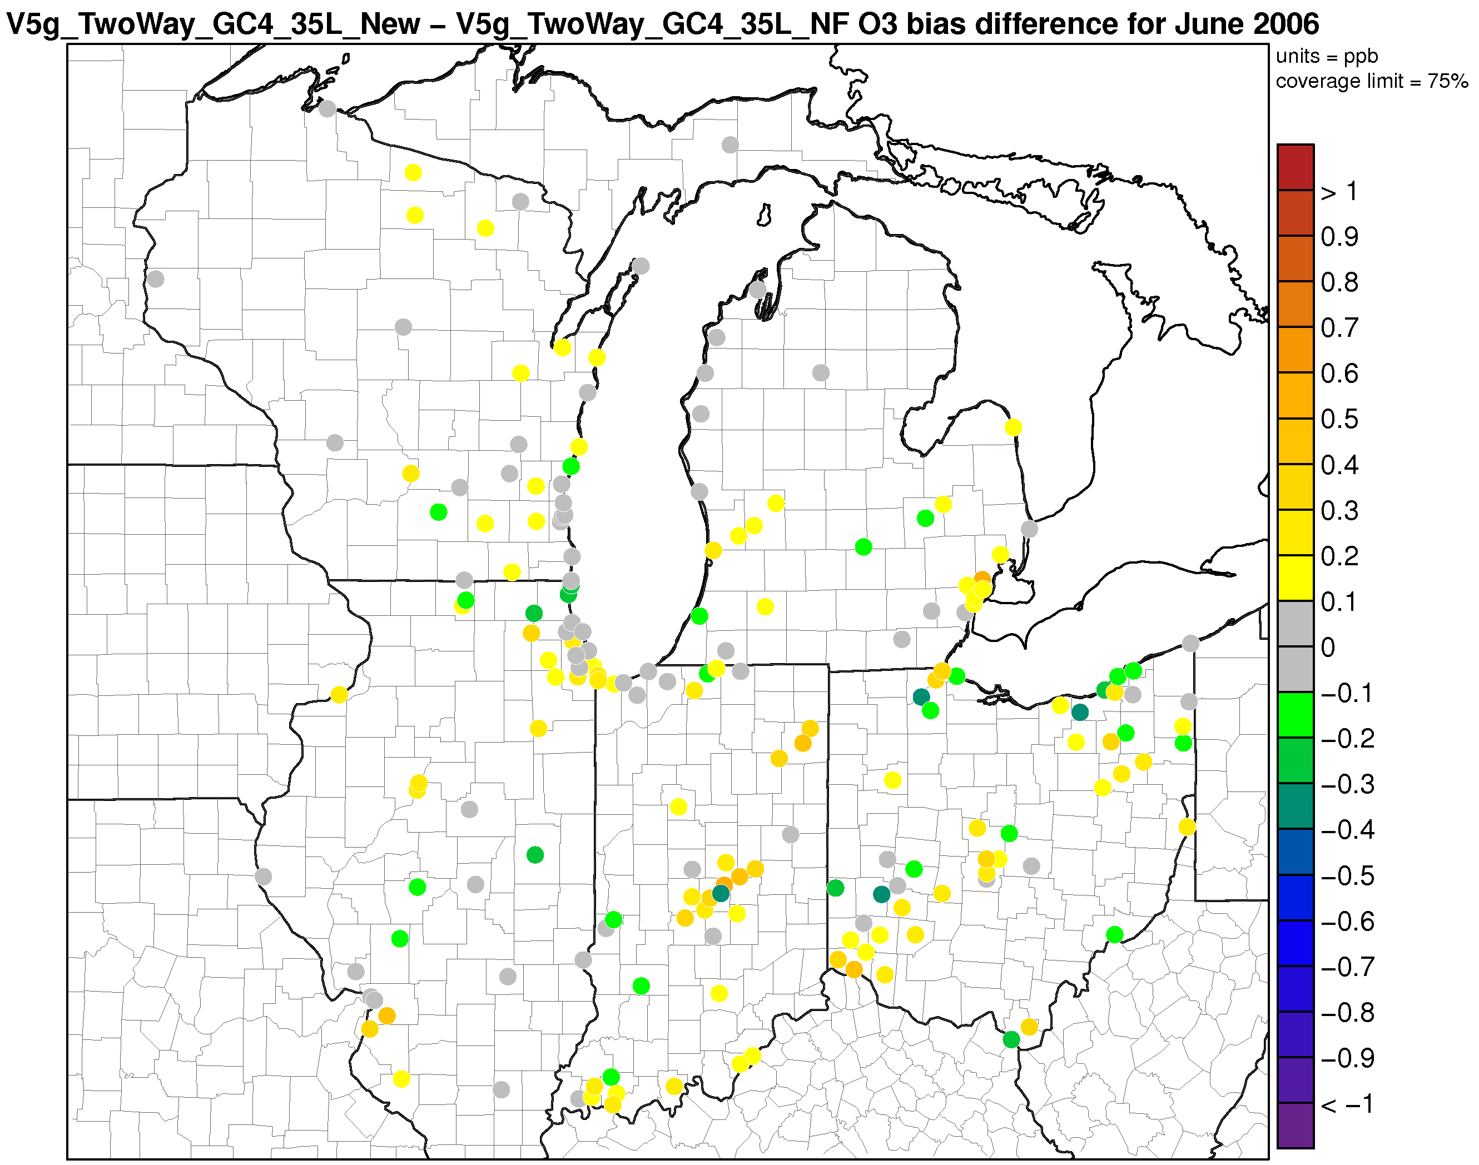
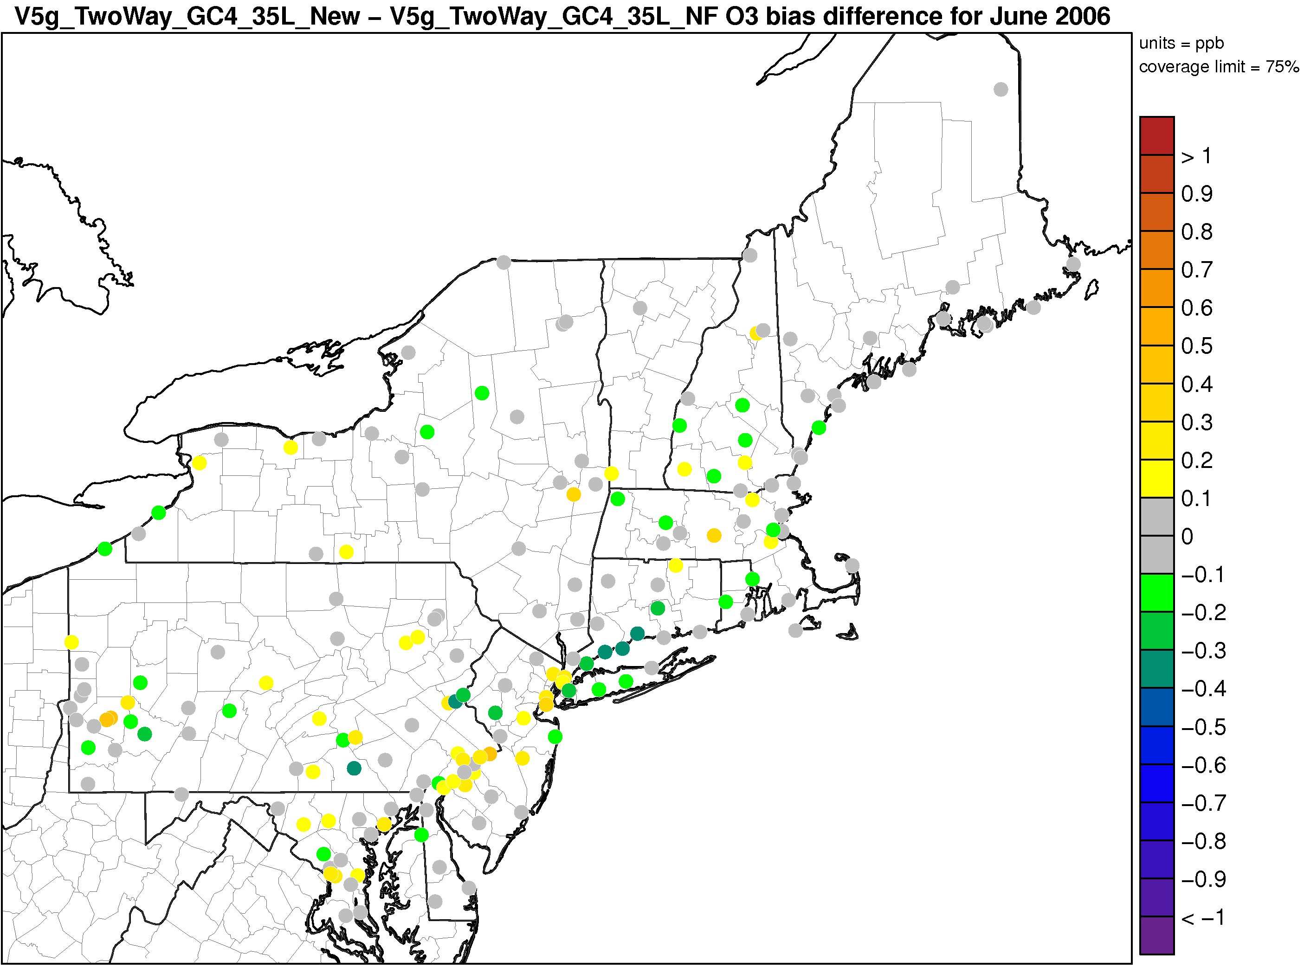
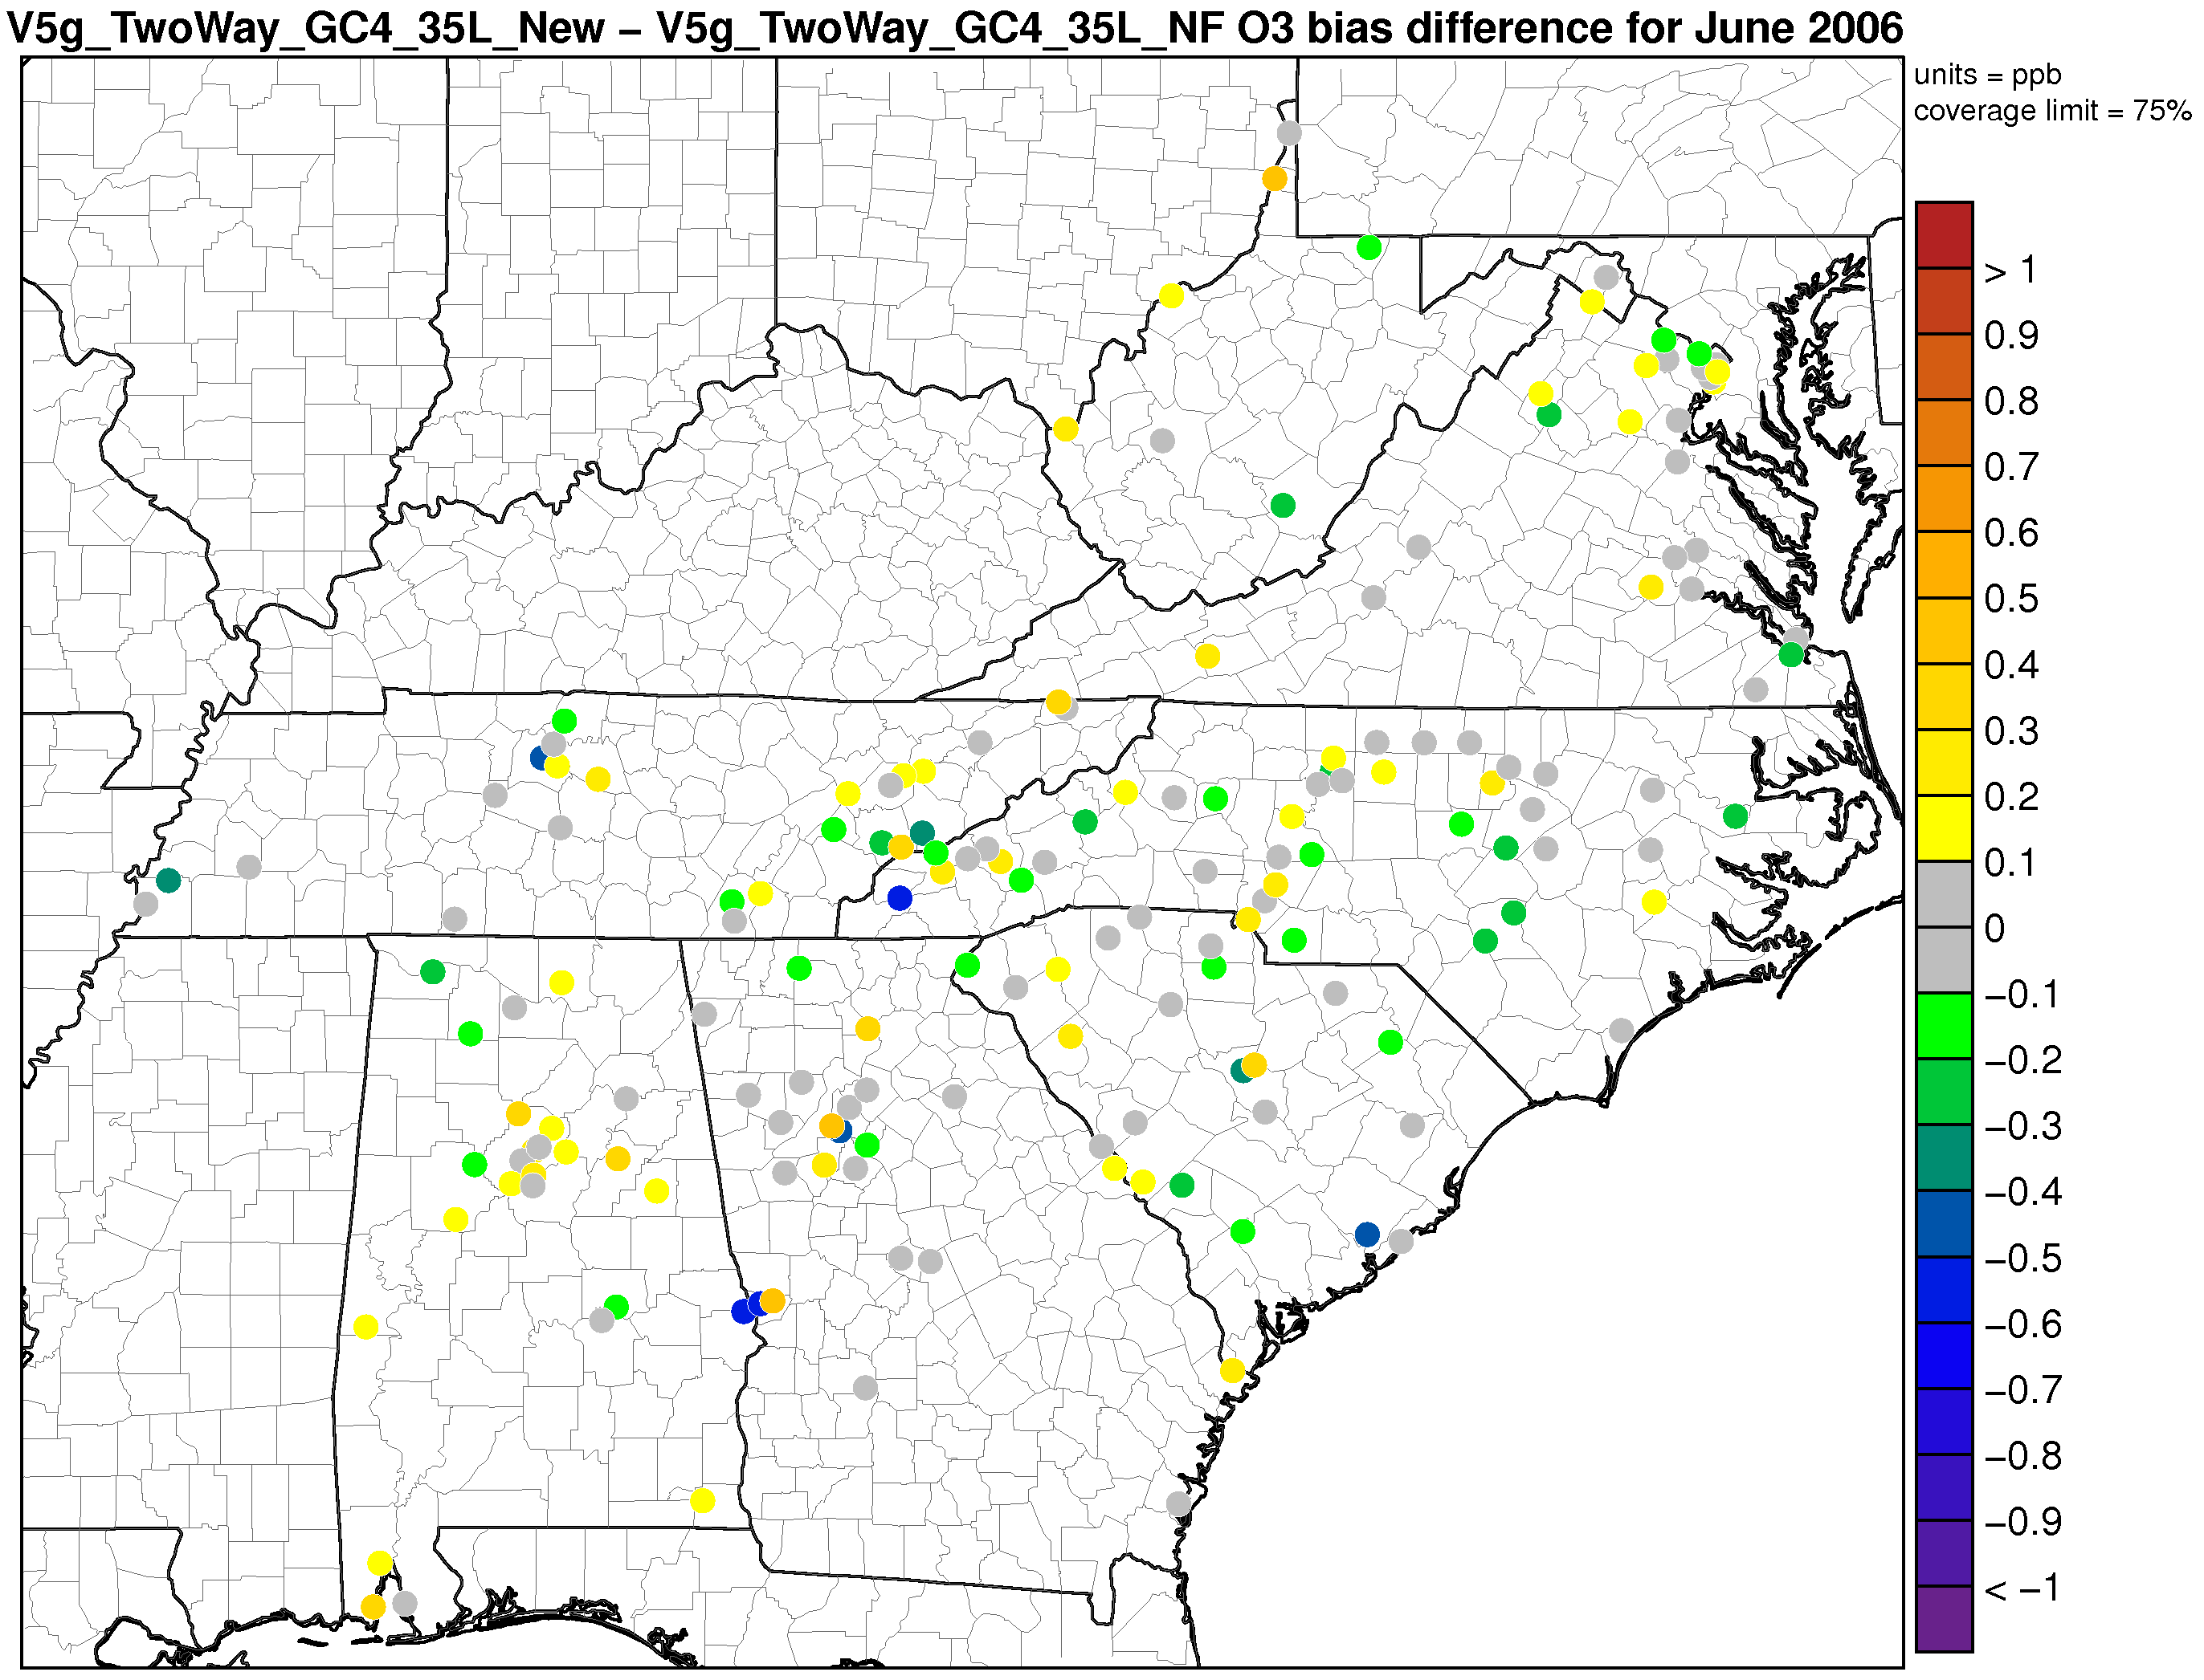
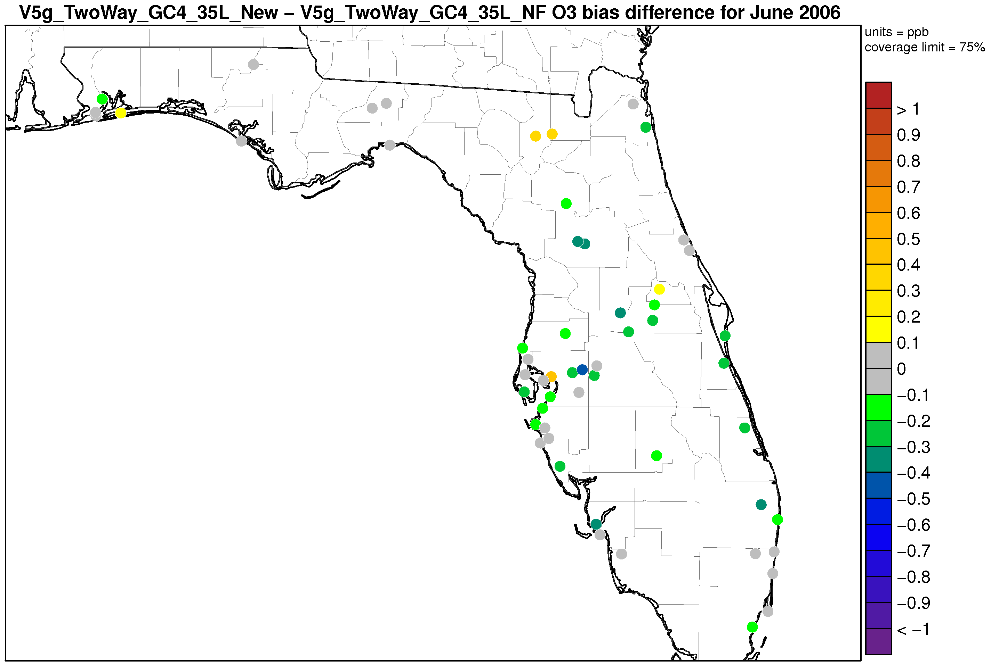
Great Lakes Ozone Bias Diff. (F-NF)
Northeast Ozone Bias Diff. (F-NF)
Mid-Atlantic Ozone Bias Diff. (F-NF)
Florida Ozone Bias Diff. (F-NF)
Notes:
The change in bias is mixed, with the bias at some sites decreasing slightly, while at other sites the bias increases slightly. Overall, there does not appear to be one consistent pattern to the change in bias.

Slide 28
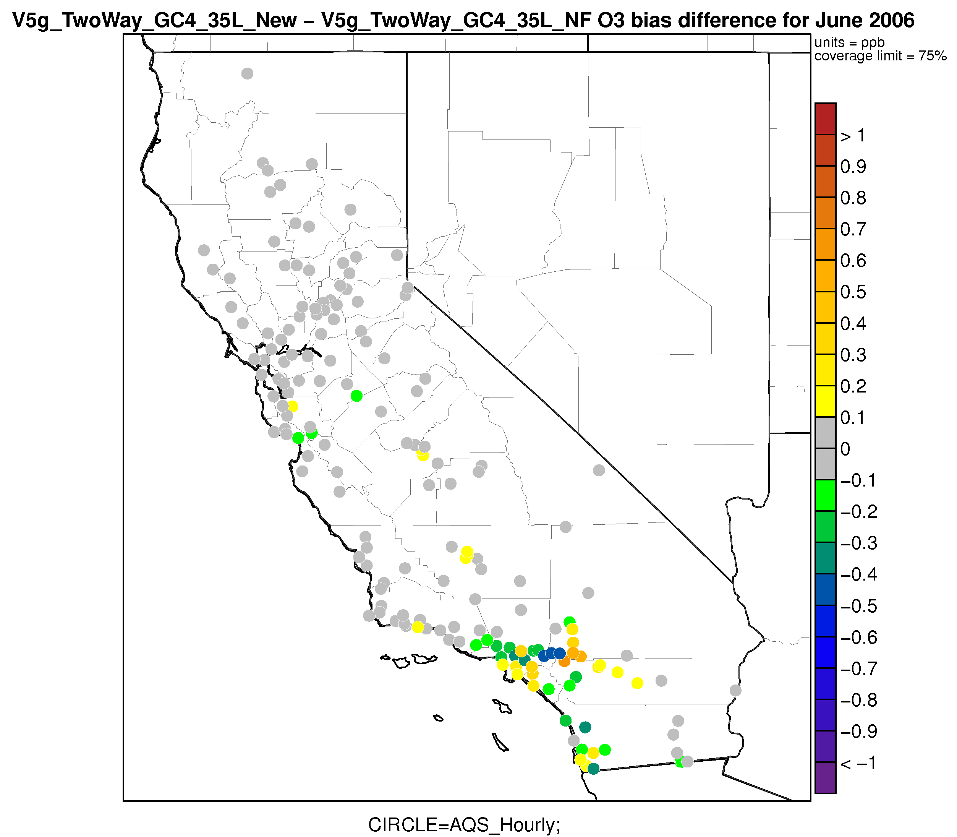
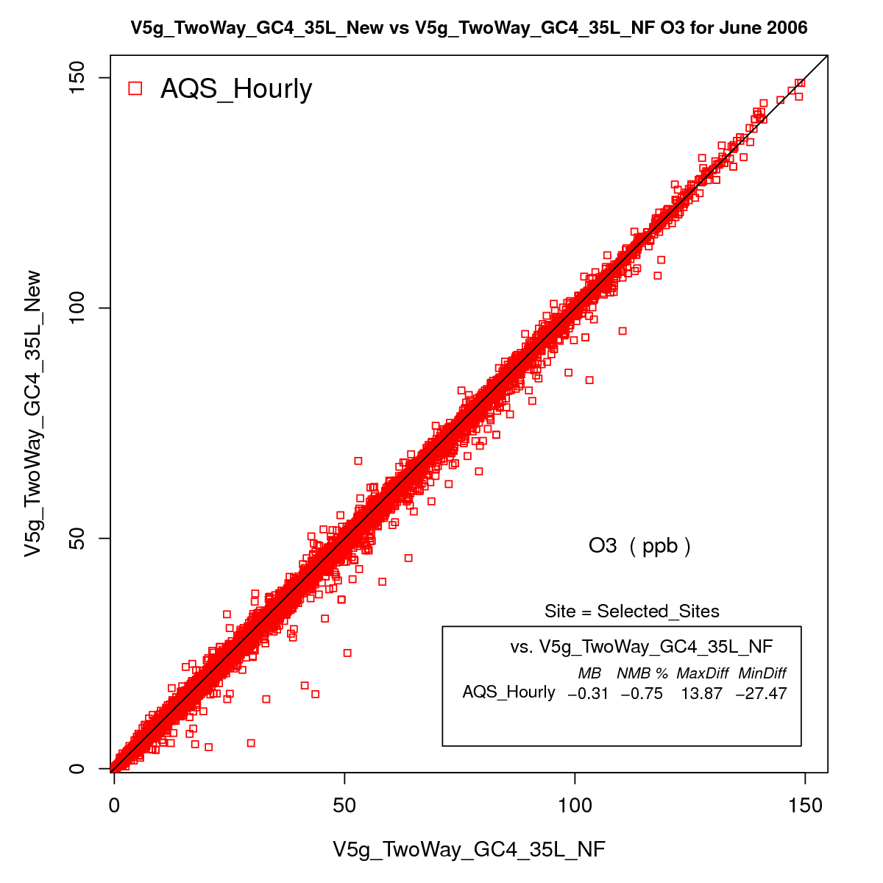
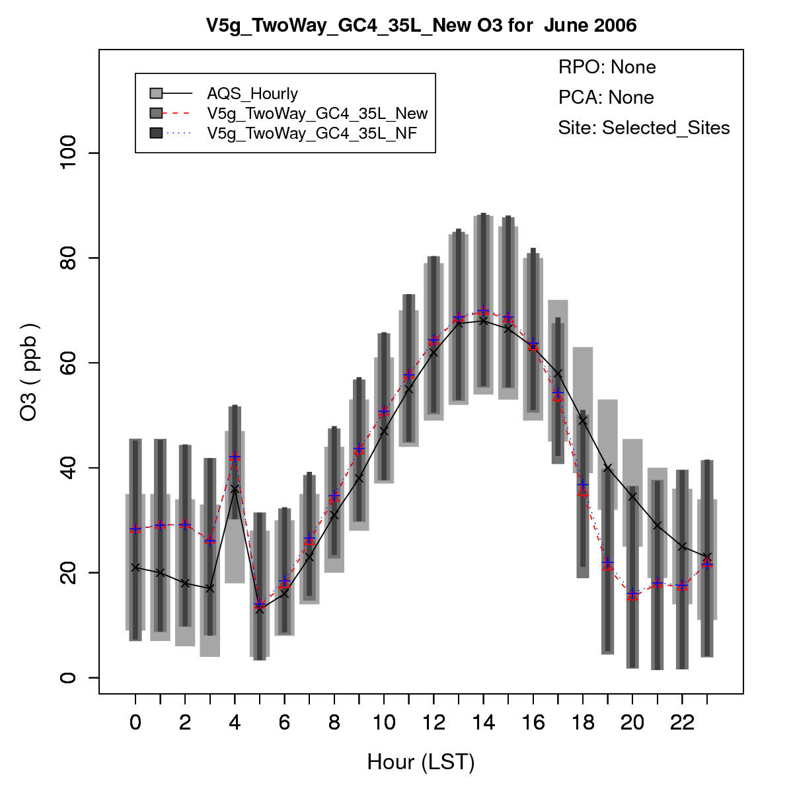
Los Angeles
Monthly Averaged Hourly Ozone
Notes:
Los Angeles has several sites where the change in bias is relatively large (almost 1ppb on a monthly average). The model-to-model scatter plot shows that the change in ozone in generally scattered around the 1-to-1 line.
There is a slight overall improvement in the diurnal ozone profile for the sites in and around L.A., although the change is small.

Slide 29
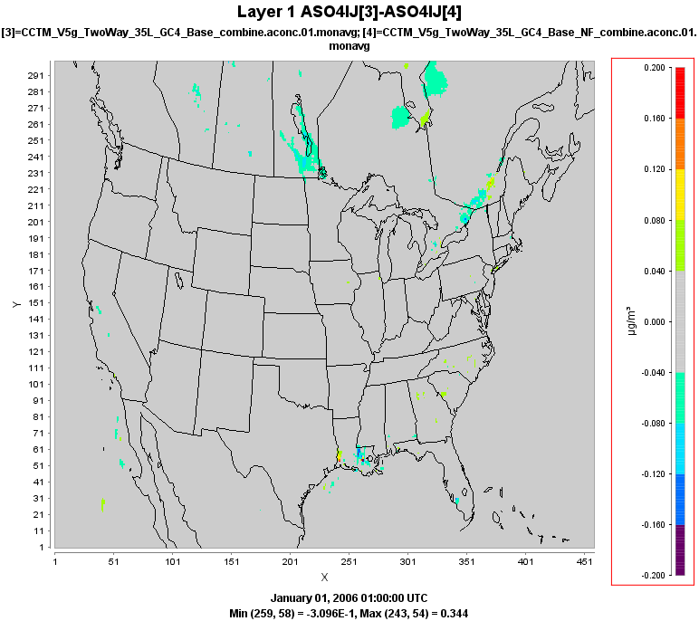
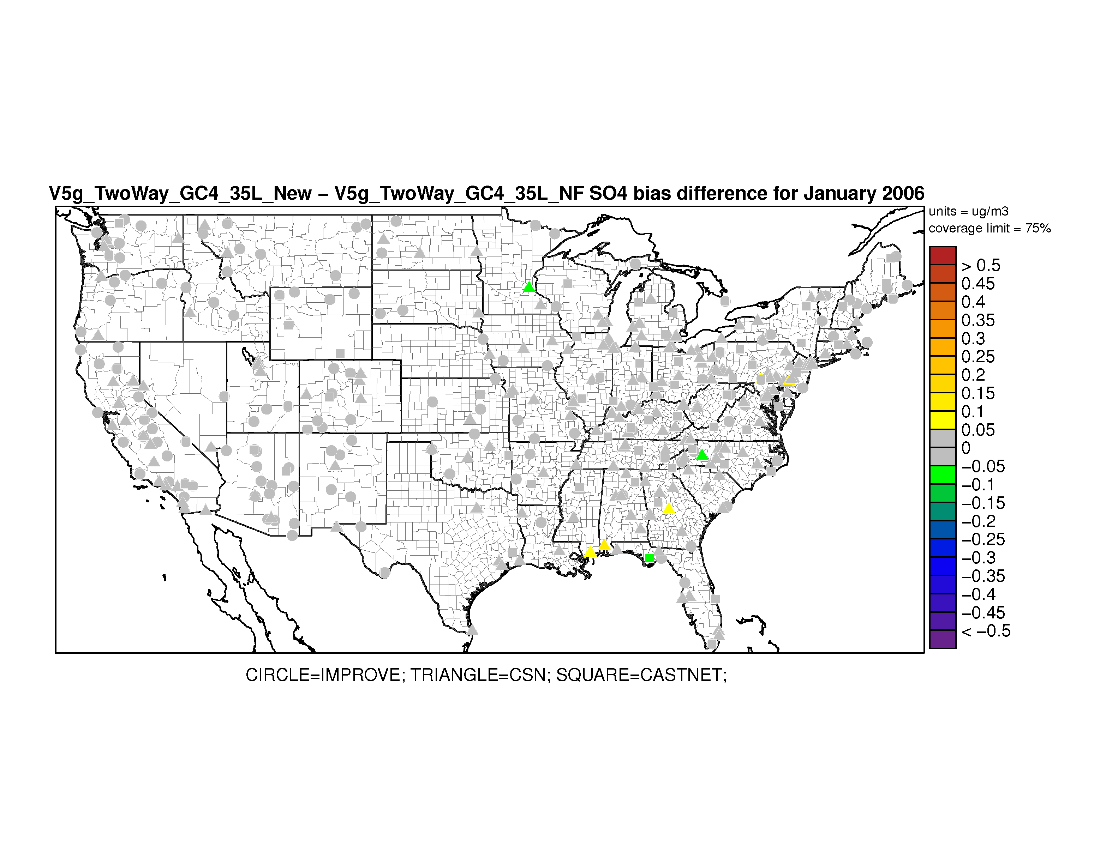
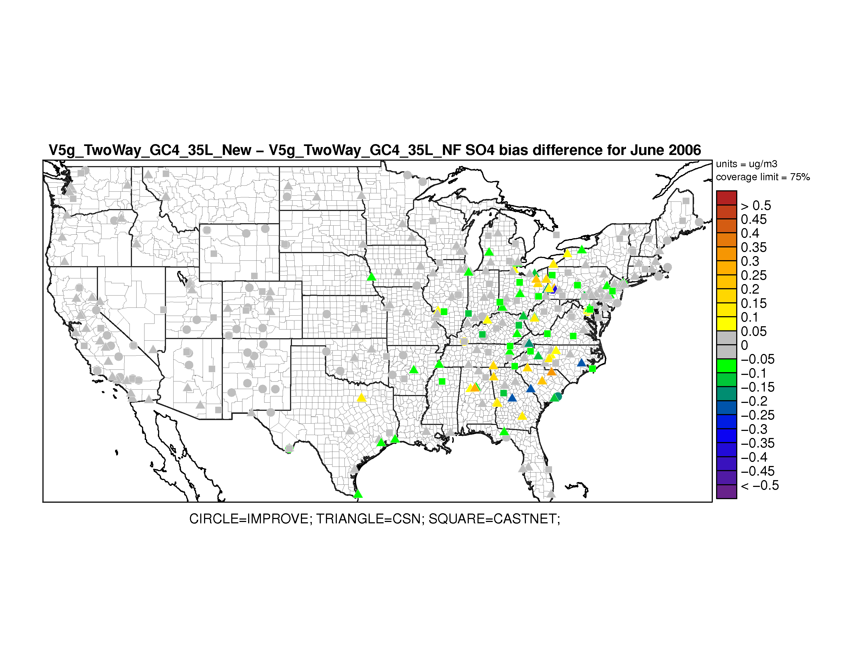
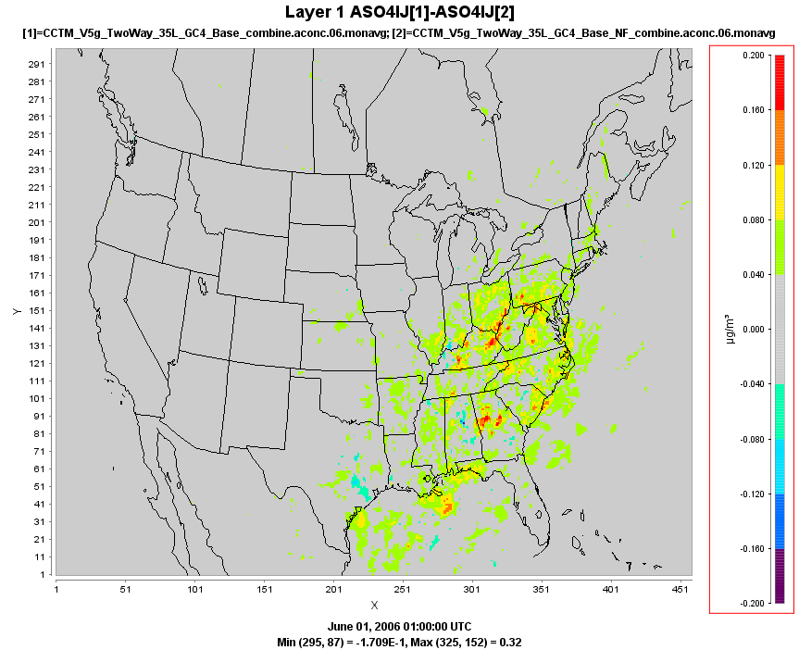
January Sulfate (F-NF)
Sulfate
January Bias Difference (F-NF)
June Sulfate (F-NF)
June Bias Difference (F-NF)
Sulfate bias reduced in simulation with aerosol feedback
Notes:
Sulfate increases in June, resulting in mostly a small improvement in bias.

Slide 30
January Organic Carbon (F-NF)
Organic Carbon
January Bias Difference (F-NF)
June Organic Carbon (F-NF)
June Bias Difference (F-NF)
Notes:
Organic carbon increases in both January and June due to the lower mixing heights. This generally results in an improvement in bias in June and a small increase in bias in January.

Slide 31
Coupled vs. Un-coupled CMAQ
Significant differences in a number of the meteorological fields, including temperature, PBL height and solar radiation
These differences are not solely the result of running WRF-CMAQ without restarts
It’s likely some other difference(s) exists in the WRF or CMAQ codes
However, those difference have not been identified yet

Slide 32
WRF-CMAQ w/o Feedback Effects vs. Un-coupled WRF-CMAQ

Slide 33
Coupled WRF-CMAQ w/o Feedback vs.
Un-coupled WRF-CMAQ
Compare simulations with the coupled WRF-CMAQ w/o feedback effects and the un-coupled WRF-CMAQ system.
Intent was to configure the coupled WRF-CMAQ simulation exactly the same as the un-coupled simulation.
This would allow for direct comparison between the two simulations, with the presumption that the results should be nearly identical.
However, although the simulations utilize the same inputs and are configured using the same WRF and CMAQ options, there are differences.
For example, the coupled WRF-CMAQ is run as one continuous simulations, while the WRF used in the un-coupled simulation is run in 5 ½ day increments.

Slide 34
January surface temperature (NF-UC)
January Solar Radiation (NF-UC)
June surface temperature (NF-UC)
June Solar Radiation (NF-UC)

Slide 35
January Ozone (NF-UC)
Ozone (Hourly)
January Bias Difference (NF-UC)
June Ozone (NF-UC)
June Bias Difference (NF-UC)

Slide 36
January PM_{2.5} (NF-UC)
PM_{2.5}
January Bias Difference (NF-UC)
June PM_{2.5} (NF-UC)
June Bias Difference (NF-UC)

