Slide 1
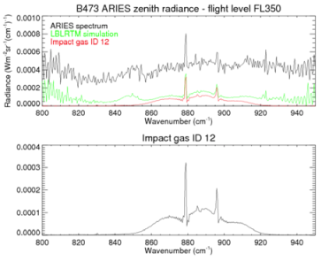
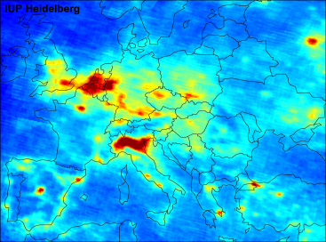
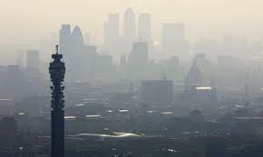
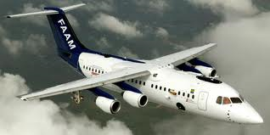
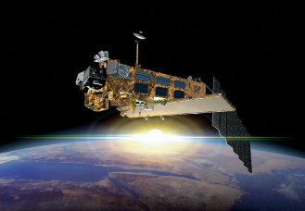
Airborne measurements of AQ over London during the ClearFlo Campaign
Grant Allen, S. Newman, A. Vance, D. O’Sullivan, J. Lee, J. Muller, S. O’Shea, B. Jones, D. Moore
grant.allen@manchester.ac.uk

Slide 2
Scope
The ClearFLo project
Measurements and early analysis from the airborne campaign
FTIR Remote sensing retrieval validation
Future top-down emission inventories aided by CMAQ…?

Slide 3
Clean Air For London: ClearfLo
A consortium of
University of Reading
University of York
University of Leeds
University of Salford
CEH Edinburgh
UEA
University of Leicester
University of Manchester
Kings College London
University of Birmingham
University of Hertfordshire
UK Met Office
Coordinated by
National Centre for Atmospheric Science
Special acknowledgements to NERC for funding and the UK Met Office for flight hours

Slide 4
Remote sensing and tomographics
FAAM Flights
Surface measurements
Insitu gas + aerosol
CMAQ, WRF-CHEM, MACC etc
ClearfLo
Thermodynamics sondes, sodar, lidar
Satellite Obs
GOSAT, IASI etc

Slide 5
Ambition of ClearfLo
Integrated measurements
Measure time evolving 3D meteorology and detailed composition for London over a seasonal cycle
Long term continuous measurements, plus intensives in Winter and Summer 2012 (Olympics), 2 weeks each
Integrated modelling + data analysis
Bridge gap between synoptic & street scales
Tools to tackle 21st century AQ issues

Slide 6
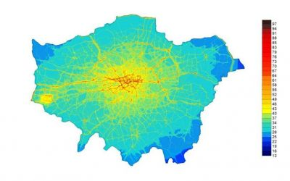
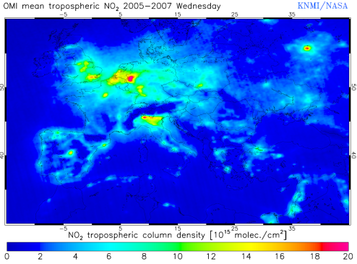
Air quality: The missing link
Emission sources
Urban modelling
Regional models
Global models
1 m
10 m
100 m
1 km
10 km
100 km
In situ sampling
Fixed remote sensing
Intermediate scale
THE MISSING LINK
Satellites
ClearFLo
Airborne/satellite
Model limits: Processes/modelling at small scales not easily extrapolated to large scales
Model physics: Modulation by chemical background and meteorology
Measurement: Poor coverage in situ versus poor spatio-temporal resolution of satellites
A solution: Airborne remote sensing measurements at the intermediate scale from which to test models which link the urban and regional length scales; and from which to validate larger-scale satellite retrievals.

Slide 7
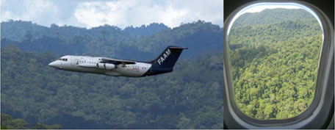
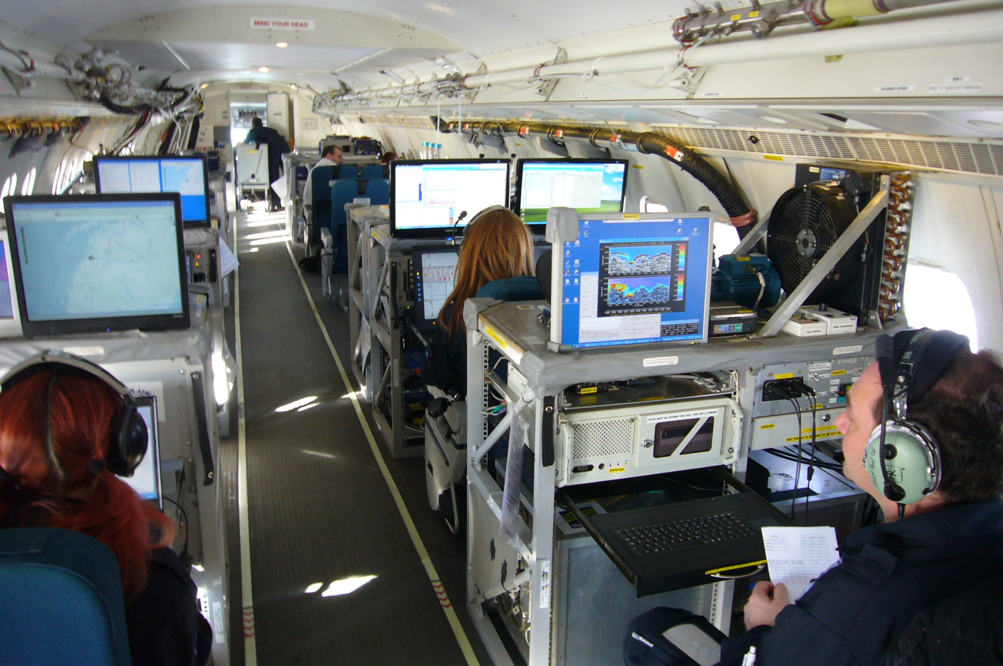
FAAM Aircraft measurements
Converted BAe-146 passenger jet
Operated by NERC / UKMO
20 scientists and crew
Up to 25 instruments:
Thermodynamics and turbulence
NOx, O₃, CO, PAN
QCL: N₂O, CH₄
TDL: CH₄, H₂O
CIMS: HNO₃, HCOOH, HCN
FTIR – see later…
AMS: Speciated aerosol
CPC: PM10, PM2.5
PCASP: Aerosol size spectra
Cloud microphysics
Radiation
Dropsondes

Slide 8
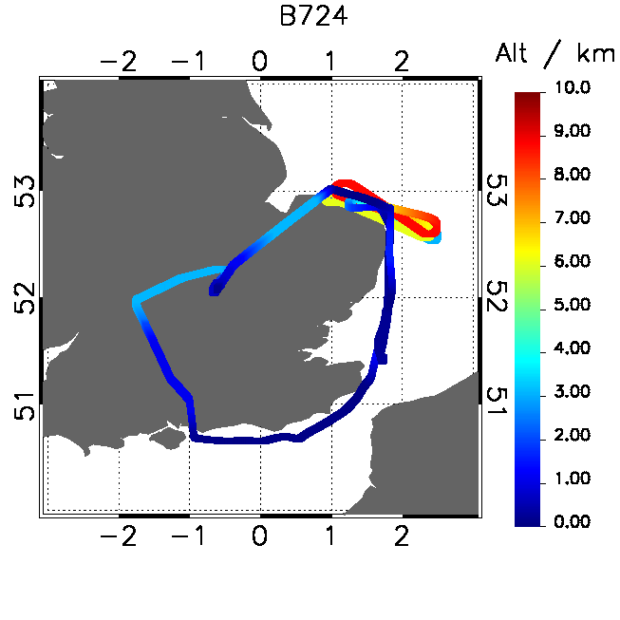
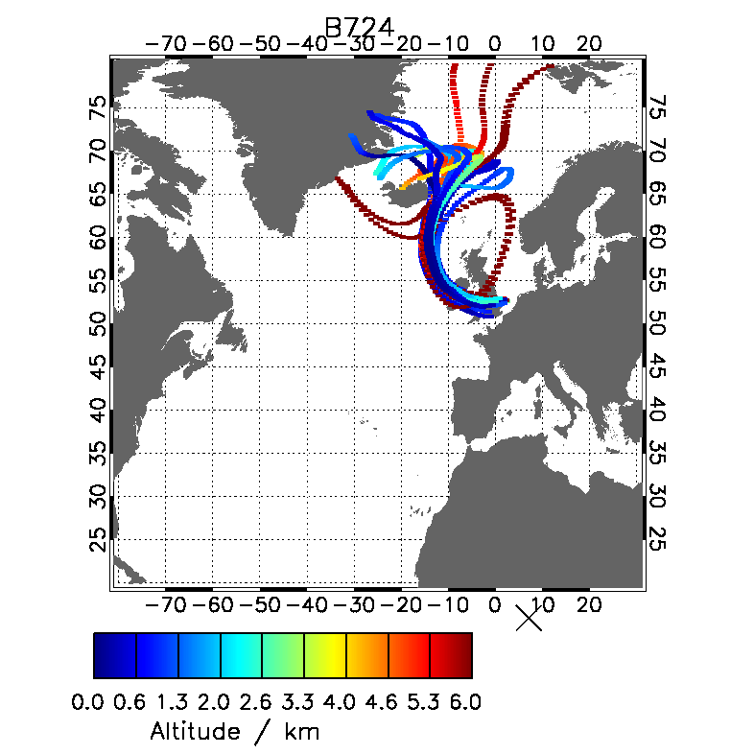
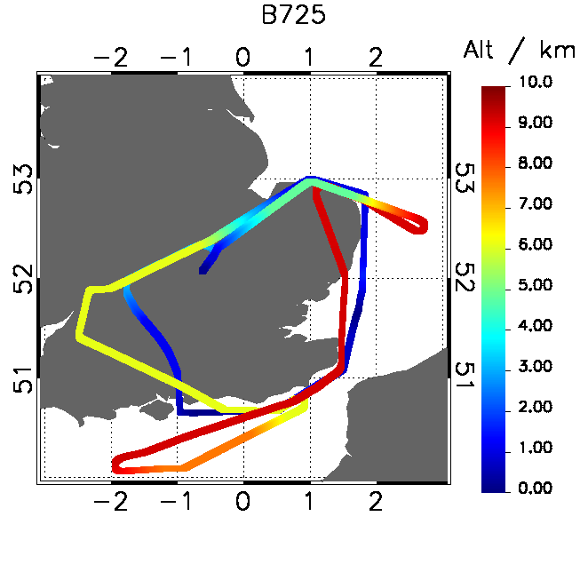
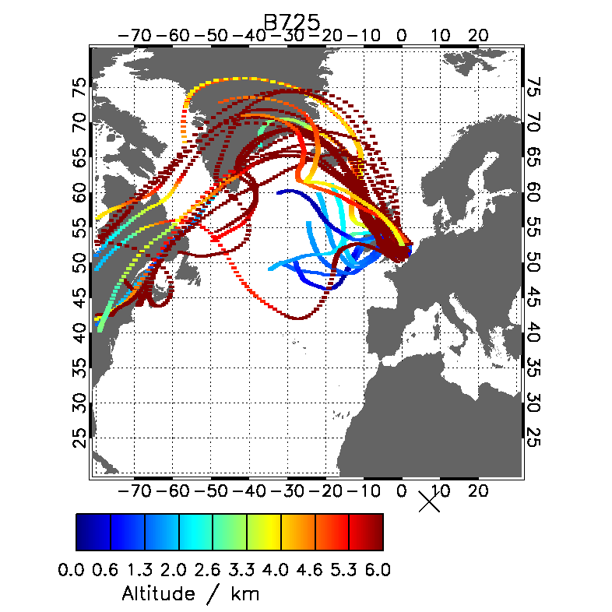
ClearFlo sampling and airmass history
2 case studies are presented here:
B724 - 30 Jul 2012
Westerly, clean N. Atlantic/Arctic recent airmass history
Well-mixed PBL (~1500 m) with deep convection later on
B725 – 9 August 2012
Mix of westerly maritime air at low levels and long-range UT transported air from the Eastern USA.
High pressure, capped PBL (~1000 m), cloud-free

Slide 9
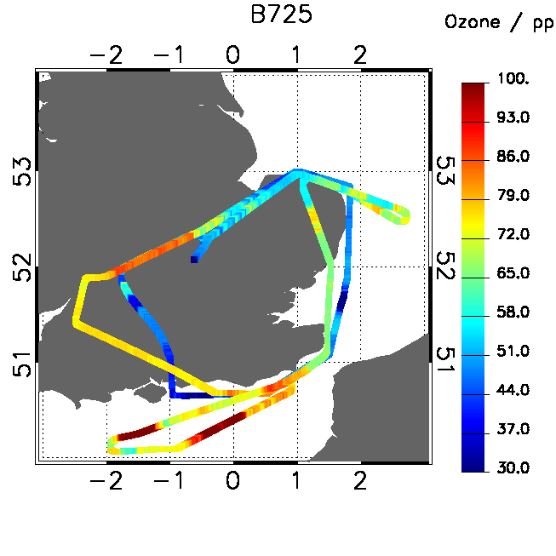
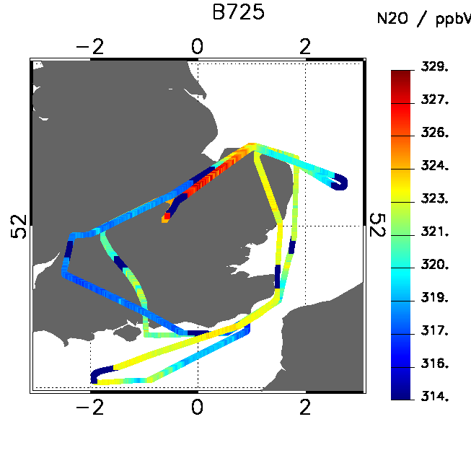
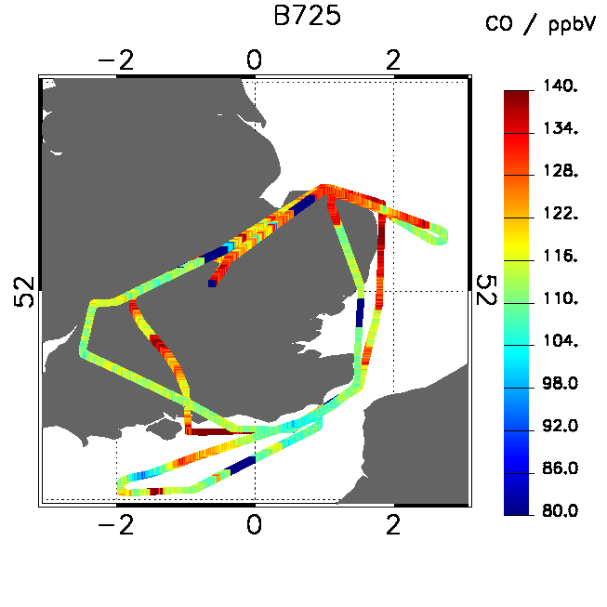
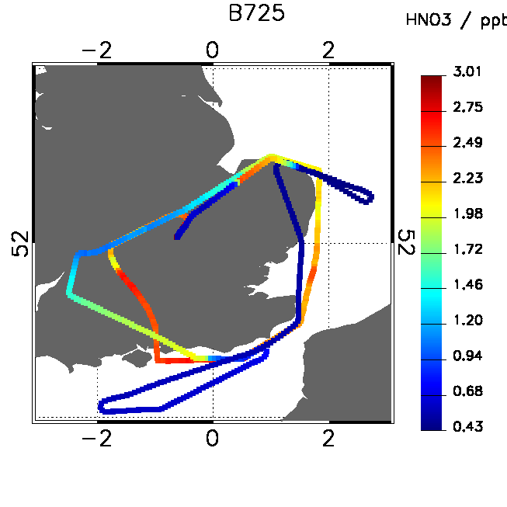
B725 – 9 August 2012
Ozone depleted after passing over London (NOx measurements not available)
Ozone enhanced over the English Channel at high altitude – US transported air
CO enhanced in London plume and in the UT where coincident with ozone enhancement (aged air)
N2O enhanced over intense agricultural zones at low alt
Nitric acid enhanced in the London plume but some washout

Slide 10
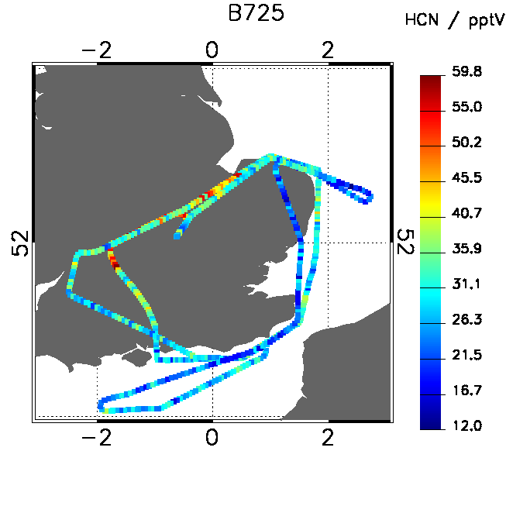
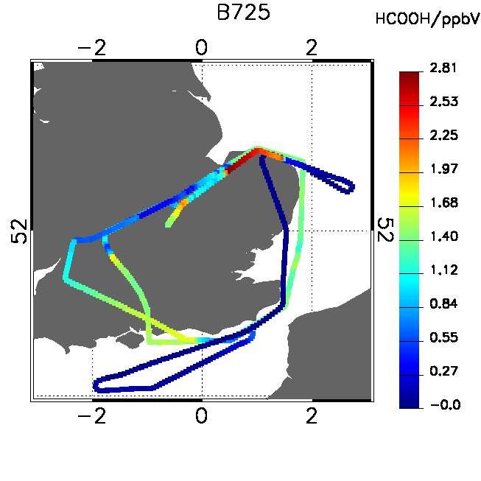
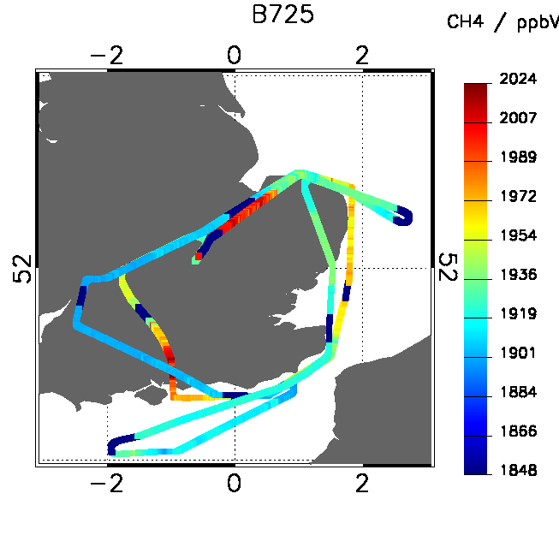
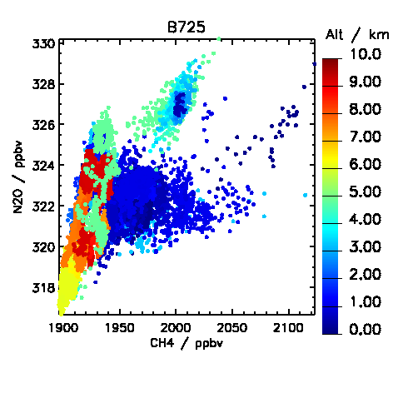
Other tracers
Formic acid – primary and secondary sources
Methane enhanced in London plume and depleted in the UT
HCN shows plumes suspected to be from waste incinerators but shows no urban increment

Slide 11
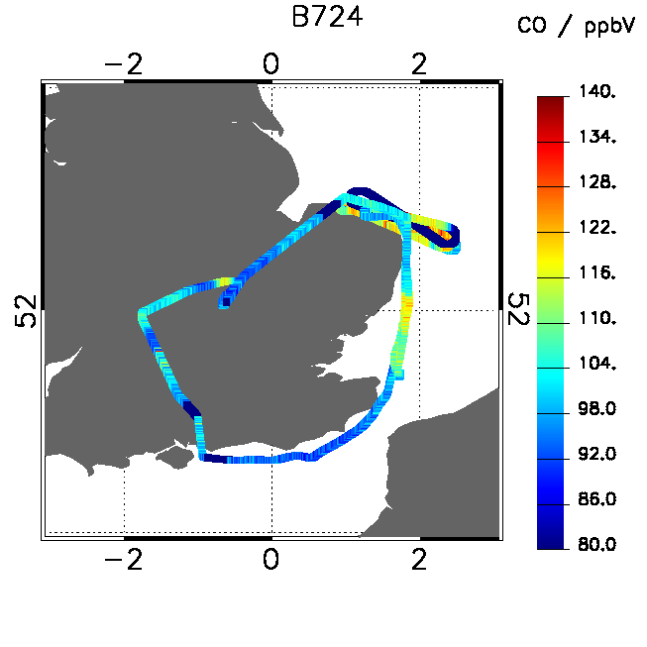
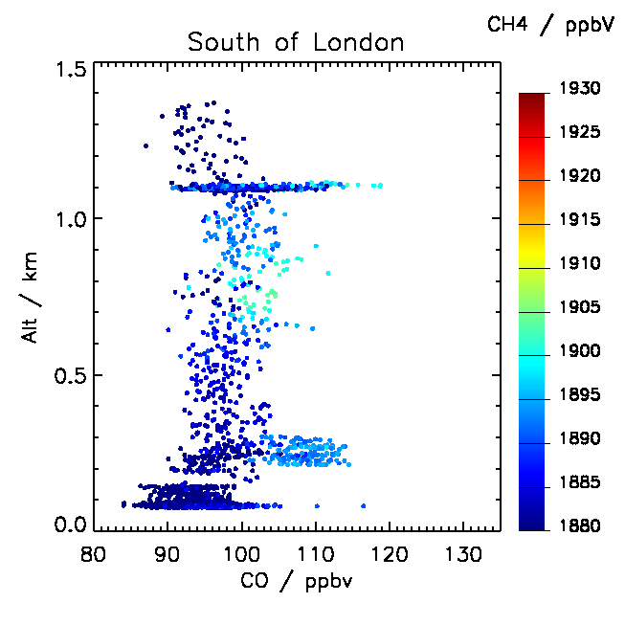
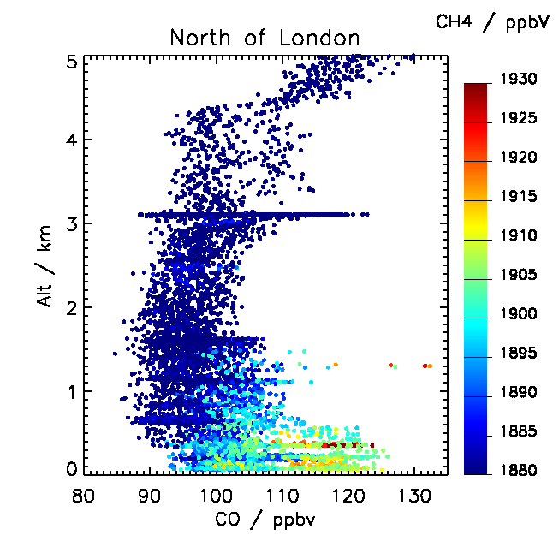
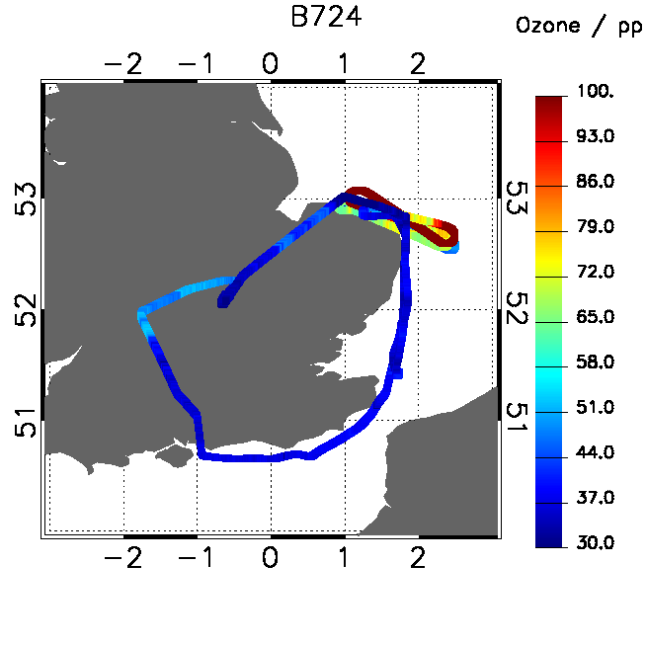
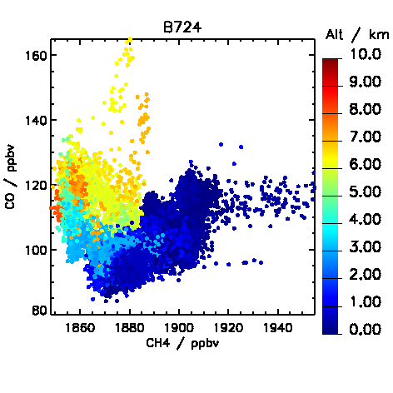
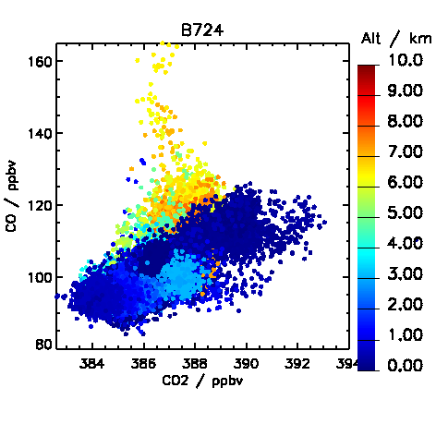
B724 – 30 July 2012

Slide 12
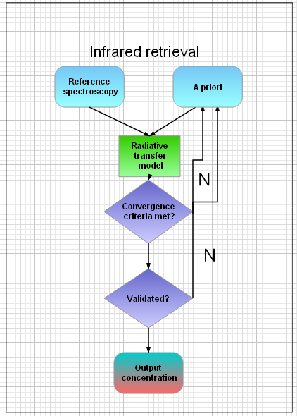
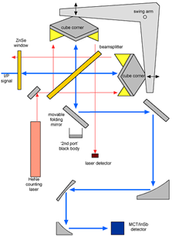
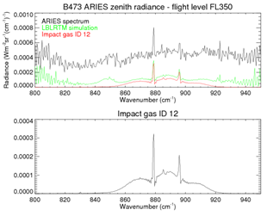
The ARIES Instrument Airborne Research Interferometer Evaluation System
ARIES spectrum + fitted residual
ARIES Schematic
Developed and operated by UK Met Office
Flown on the NERC FAAM BAe-146 research aircraft
>1000 hrs of data collected globally
Sole global instrument for IASI CalVal

Slide 13
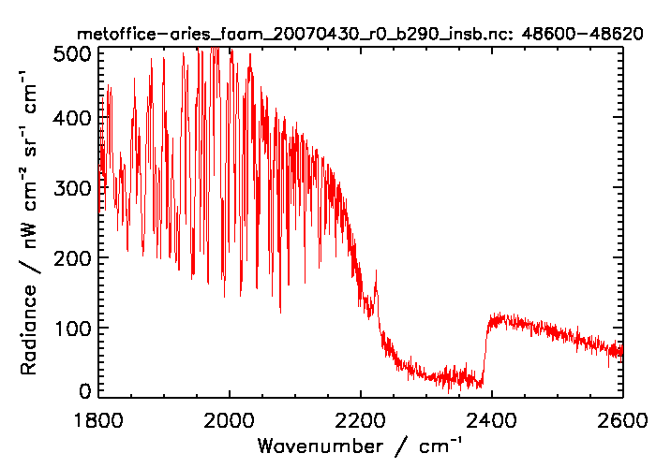
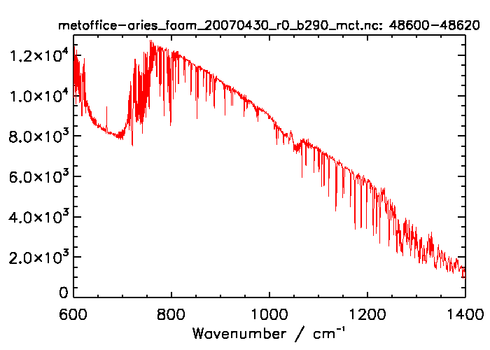
ARIES: Target trace gases
Candidate Gas | Spectral Signature | LOD¹ | Accuracy² *(at EU Policy limit) †(at typical urban median conc.)
NO₂ | 760-840 cm⁻¹ | >10 ppbv | 5% (106 ppb) *
Ozone | 1400 – 1800 cm⁻¹ | >4 ppbv | 0.5% (60 ppb) *
CH₄ | 1250-1350 cm⁻¹ | >10 ppbv | 0.5% (2 ppm) †
C₂H₆ | 800-850 cm⁻¹ | >1 ppbv / 50% | 2% (30 ppb) †
PAN | 750-850- cm⁻¹ | >50 pptv | 5% (1 ppb) †
N₂O | 850 – 920 cm⁻¹ | > 100 pptv | 10% (350 ppt) †
¹LOD calculated as fitted conc. at spectral peak > 2×NESR at 1 cm⁻¹ for 4 co-added scans
²Sources: Huang et al., 2002; Shorter et al.; 1996, DEFRA. Accuracy calculated as 1 standard deviation idealised retrieval uncertainty due to random (noise) error at stated concentration.
Simultaneous retrieval
Retrievable at typical PBL concentrations
Accuracy exceeds current NAEI uncertainty for all gases

Slide 14
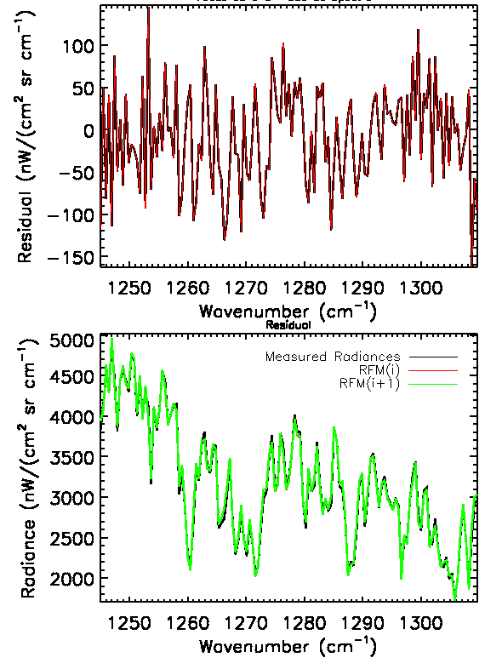
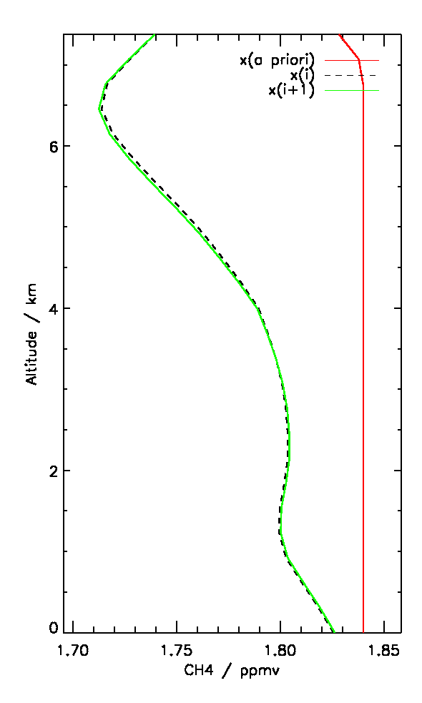
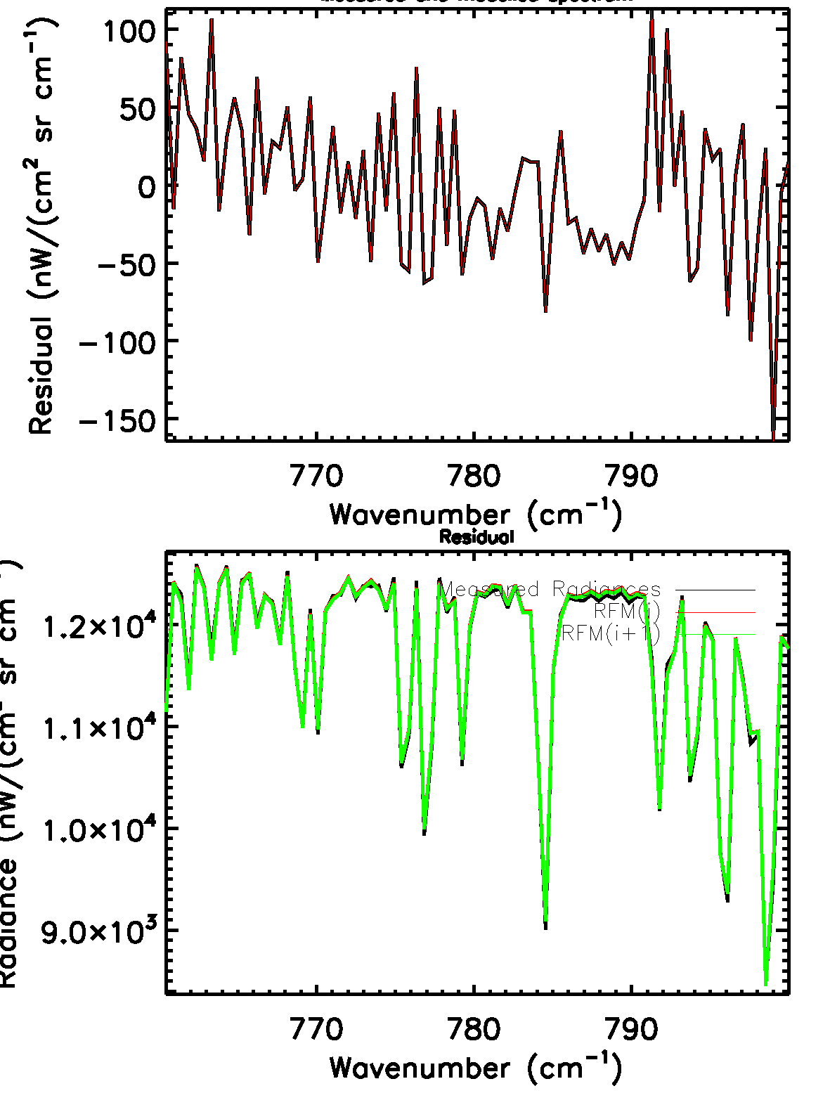
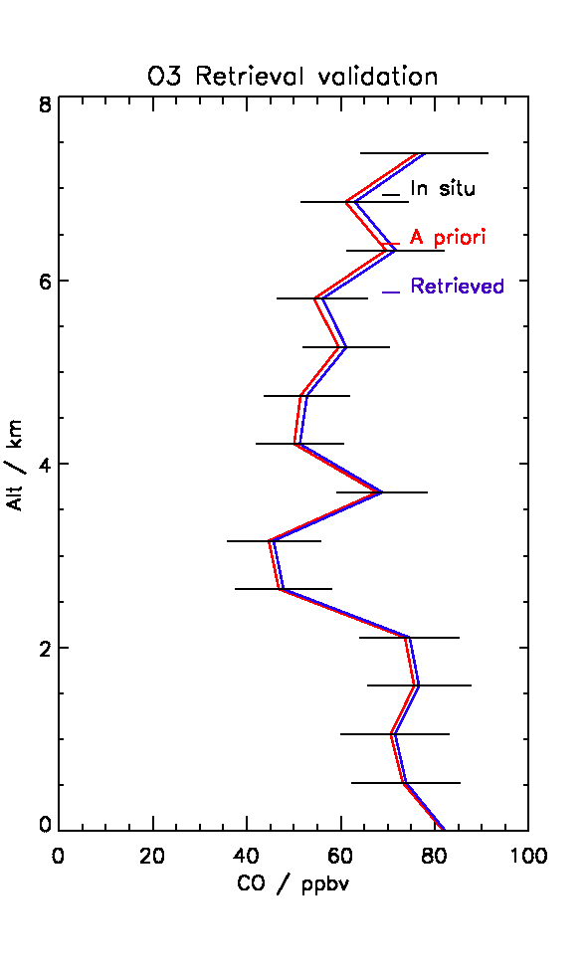
Methane
Left: Spectral fits, residuals and retrieved vertical profiles of Methane
Below: Spectral fits, residuals and retrieved vertical profiles of Ozone
The quality of the retrieval is indicated by residuals that are less than the NESR (~30 nW/cm²/Sr) and validated against in situ profiles

Slide 15
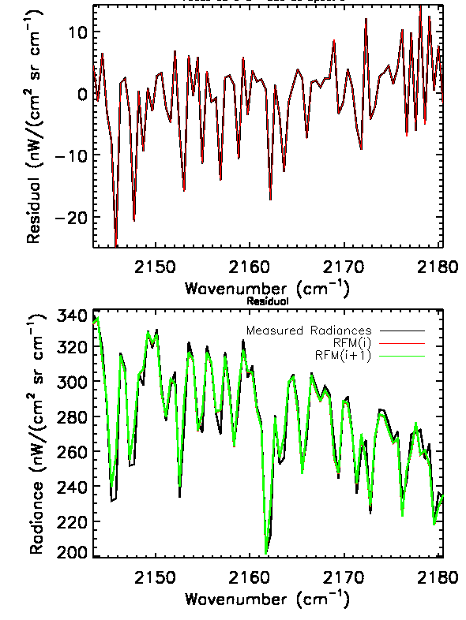
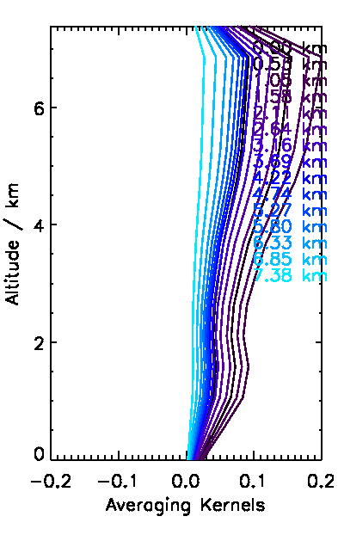
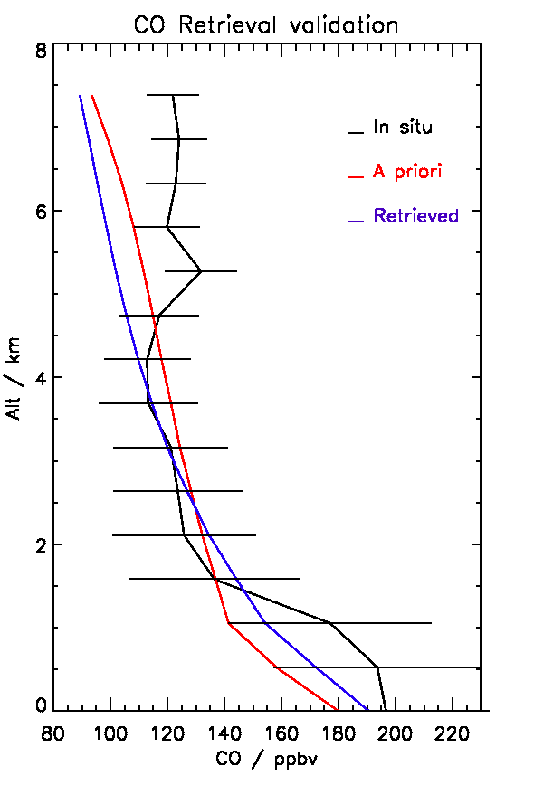
Carbon Monoxide Validation
Residuals well within the measurement noise
Good vertical sensitivity
Excellently validated profiles against in situ data

Slide 16
Summary and future work
25 Hours of 3D mapping of trace gases over London during ClearFlo, plus 4 years of detailed surface data
60 more hours to come…
Novel vertical profiles of many more gases from FTIR at unprecedented accuracy
How can this be used to full potential?
Inverse modelling?
Bulk Lagrangian analysis (flux closure)?
Thank you

