Slide 1
A screening method for ozone impacts of new sources based on high-order sensitivity analysis of CAMx simulations for Sydney
Greg Yarwood
(gyarwood@environcorp.com)
    10th Annual CMAS Conference, October 24-26, 2011
    Chapel Hill, North Carolina

Slide 2
Acknowledgements
Sponsored by the New South Wales Office of Environment & Heritage (OEH)
  59-69 Goulburn St, Sydney NSW 2000, Australia
  http://www.environment.nsw.gov.au/
Contributors
  ENVIRON US: Greg Yarwood, Edward Tai, Prakash Karamchandani
  ENVIRON Australia: Yvonne Scorgie
  OEH: Nick Agapides, Kelsey Bawden, Jason Spencer, Toan Trieu

Slide 3
Outline
Motivation
3-D Modeling of new source ozone impacts
Screening Tool
Framework for evaluating ozone impacts
Summary

Slide 4
Motivation
The Sydney Greater Metropolitan Region exceeds applicable ozone standards
  1-hr average of 100 ppb
  4-hr average of 80 ppb
Need methods to quantify ozone impacts of proposed new sources
  Photochemical grid modeling is scientifically rigorous but resource intensive
  Need a technically sound screening tool to efficiently evaluate which new sources require photochemical grid modeling
Need a framework to evaluate when ozone impacts are significant

Slide 5
Overview of Methodology
Reviewed literature to identify defensible methods
  Photochemical grid modeling
Model several prototypical new sources using a photochemical grid model (CAMx) for Sydney
Use a sensitivity method (HDDM) in CAMx to develop a parametric model of the prototypical source impacts
  O₃ impact = f(NO_{X} emissions, VOC emissions, source location)
Implement the parametric model in a screening tool (spreadsheet) that can extend results for prototypical sources to any new source
  Screening Tool
Develop criteria to evaluate impacts using a tiered approach
  Level 1 – screening tool sufficient for sources with “small” impact
  Level 2 – photochemical modeling required for sources with “large” impact

Slide 6
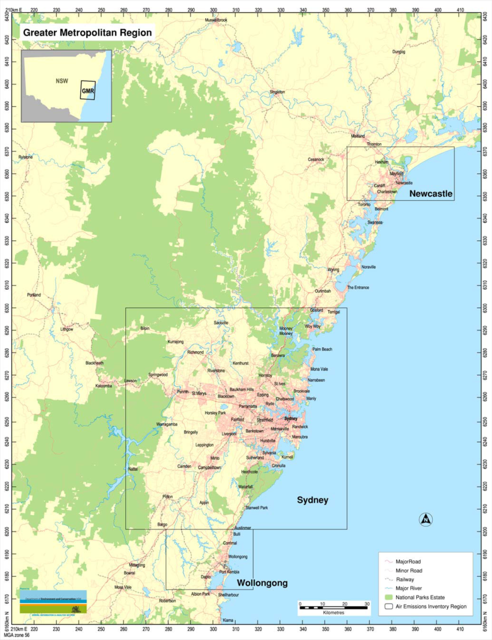
CAMx Model Application for Sydney GMR
Domain
  3 km grid (70 by 90)
  25 levels to 8,000m
Episodes
  Two summer periods
    Dec 2003 / Jan 2004
    Dec 2003 / Jan 2004
CAMx version 5.3
  CB05 chemistry
Meterorology
  TAPM prognostic model
Emissions
  OEH anthropogenic
  MEGAN biogenic
Boundary conditions
  MOZART4
Newcastle
Sydney
Wollongong

Slide 7
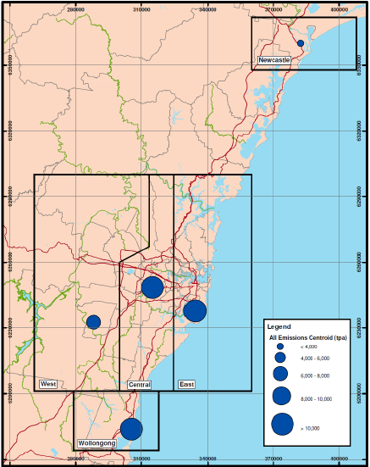
Prototypical “new sources”
Locations and magnitude based on analysis of existing sources
5 locations selected
  Newcastle
  Sydney East, Central, West
  Wollongong
Each 500 tonnes/annum
  VOC + NOx combined
  VOC/NOx ratio of 1.24
Stack parameters that produce minimal plume rise for maximum impact

Slide 8
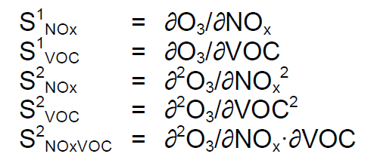
Parametric model using HDDM sensitivity
The high-order decoupled direct method (HDDM) computes O₃ sensitivity to selected emissions within CAMx
  Computes first and second order derivatives
Taylor series describes source impact (ΔO₃)
  Second order accuracy

Slide 9
Evaluating the HDDM parametric model
Compare source impacts by the DDM parametric model to brute force differences
  DDM parametric model impact
  Brute force impact
  O₃ with new source – base case O₃ without source

Slide 10
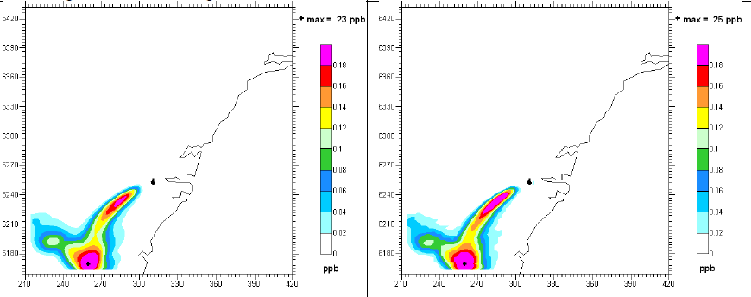
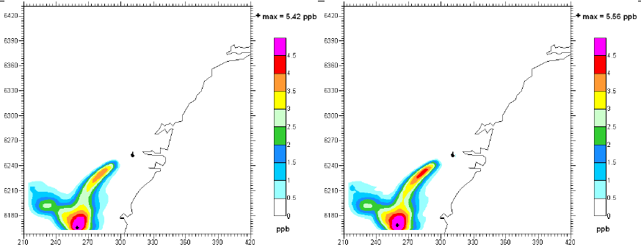
Evaluation: Location of source impacts
HDDM
Brute Force
500
Tonnes/yr
Central Sydney source
Source used to develop method
0.23 ppb
0.25 ppb
12,500
Tonnes/yr
25 x larger source
5.42 ppb
5.56 ppb

Slide 11
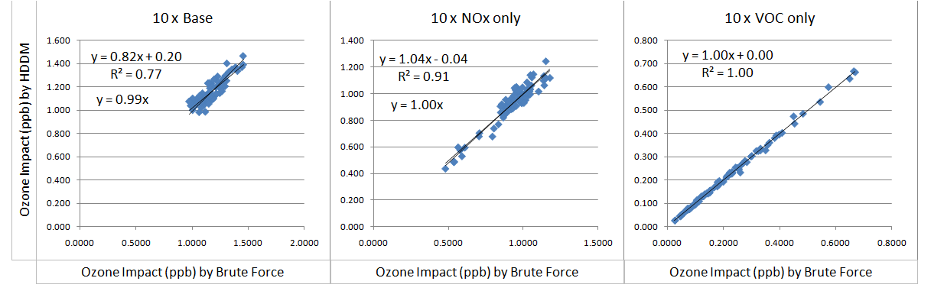
Evaluation: Different source VOC/NOx ratios
Scatter plot the brute force vs. HDDM result for 300 grid cells with the greatest O₃ impact
  5000 tonne/yr source in Central Sydney emitting VOC + NOx, VOC only and NOx only
Very good agreement even when VOC/NOx ratio is changed
  Screening tool accurately describes non-linearity in O₃ formation
  Good accuracy for sources 25 x larger used to develop the method
  Used to set upper bound on range of applicability
Only NOx emitted
Only VOC emitted
VOC + NOx emitted

Slide 12
Criteria for Evaluating Ozone Impacts
Factors to consider
  Magnitude of source impact
  Source located in O₃ attainment or nonattainment area
  In all cases, sources must satisfy other regulator requirements
Criteria established (not yet final)
  Significant Impact Level (SIL)
  Source impact below 0.5 ppb not measureable ➔ level 1 analysis is sufficient
  Maximum Allowable Impact (MAI)
  MAI = 1 ppb for nonattainment areas
  For attainment areas, MAI = 25% of the difference between measured maximum O₃ and the level of the standard
      e.g. standard = 80 ppb; measured max O₃ = 60 ppb; MAI = 5 ppb
  Source impact below MAI ➔ level 1 analysis is sufficient

Slide 13
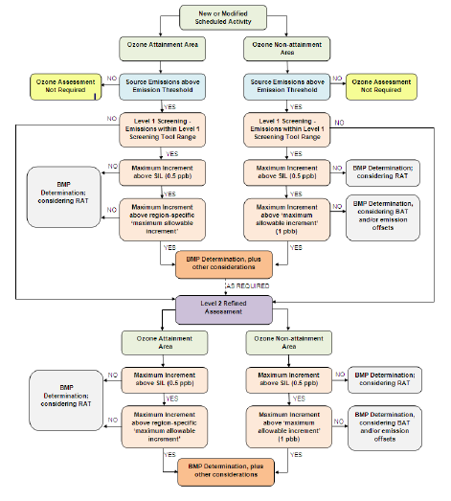
Criteria for Evaluating Ozone Impacts
Flow chart to guide source proponents through the evaluation
Level 1:
Use Screening Tool
Level 2:
Use a model like CAMx

Slide 14
Screening Tool: Spreadsheet Macro
Source data input
Ozone impacts compared to SIL
Maximum Allowable Impact (MAI) for source location
Compare maximum impact to the MAI

Slide 15
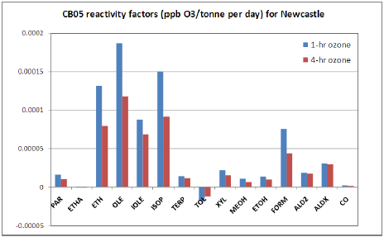
Screening Tool: VOC Speciation
Option to input source-specific VOC
Reactivity adjustment applied using VOC reactivity factors calculated for each source location using HDDM

Slide 16
Summary
An efficient screening method developed
  Scientifically defensible and robust
  Defined range of applicability
  Suitable for “smaller” sources
  Use to focus resources on sources that require more detailed evaluation
This method could be applied in other regions
  Parameters in the screening tool are location specific and would need to be re-derived
  Develop parameters for new location using a photochemical grid model
Evaluation framework developed
  In tune with local ozone standards and regulatory practices
    Not yet finalized
  Concepts could be adapted for new locations and jurisdictions

