Slide 1
Coupling a sub-grid scale plume model for biomass burns with adaptive grid CMAQ: part 2
Aika Yano
Fernando Garcia-Menendez
Yongtao Hu
M. Talat Odman
Gary Achtemeier (USDA Forest Service)
10th Annual CMAS Conference
25 October, 2011

Slide 2
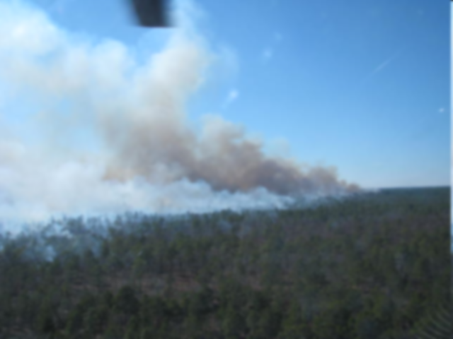
Motivation
U.S. EPA lists prescribed burning as the 3rd largest source of fine particulate matter.
Smoke plume must be preserved in order to predict downwind concentration accurately in CMAQ
Use of sub grid model and adaptive grid can help resolve smoke plume in CMAQ

Slide 3
Objective
Find out the ideal relationship between sub-grid model coupling and grid adaptation for burn plumes.
Effectiveness of the coupling method, handover, on both uniform and adaptive grid.
Different methods of inserting smoke emissions
Ground level concentration vs. all vertical layer concentration adaptation (adapt in 2D)
Adaptive weighting function parameters
Frequency of tracer/wall analysis

Slide 4
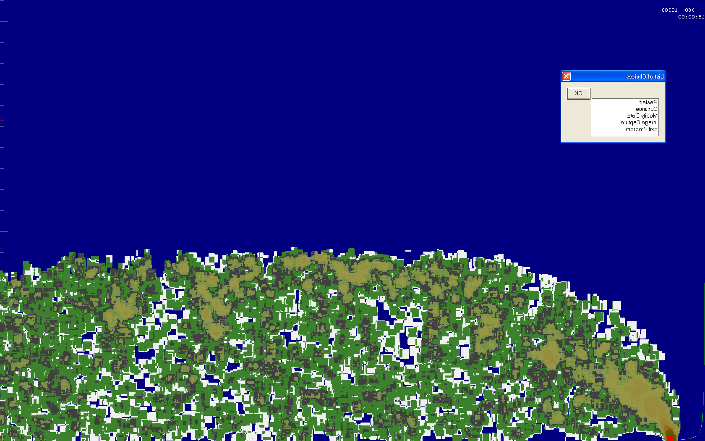
Column Injection
Set distance

Slide 5
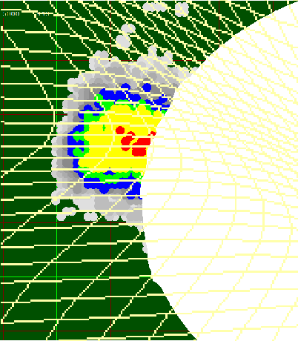
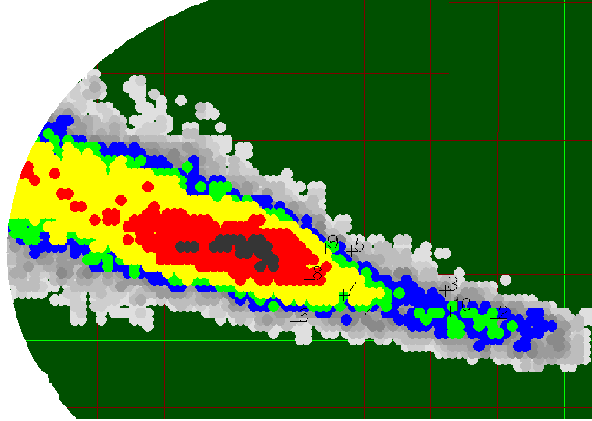
Handover
Into CMAQ
Remain in Daysmoke
Notes:
Now that the wall is determined,
all the parcels that didn’t reach the wall remain as 1kg parcels to be calculate its trajectory inside Daysmoke
Parcels beyond the wall is converted into concentrations and get passed on to CGRID

Slide 6
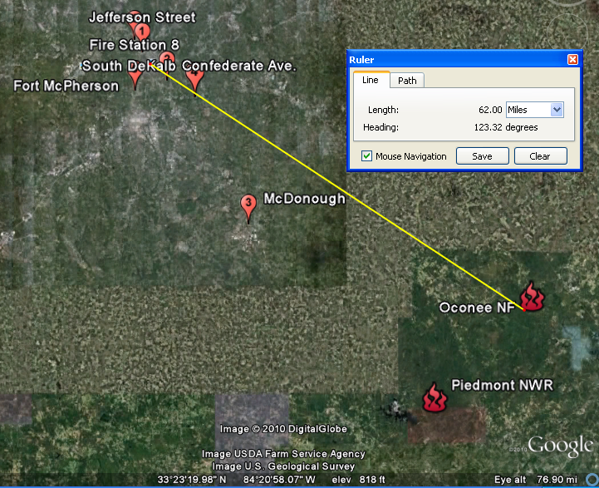
Atlanta Smoke Case
Feb. 28 2007
Oconee NF (1542 acres) 5 yr old
10:00 am - 3:00 pm total 5hr
Piedmont NWR (1460 acres) 1 yr old
11:00 am - 2:00 pm
total 3hr
Notes:
Case study done for the two national parks’ prescribed burns occurred back in Feb 28 2007 in GA.

Slide 7
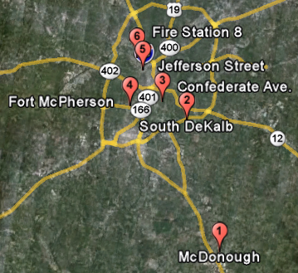
Handover with uniform grid
 | uniform CMAQ | uniform handover CMAQ
Mean fractional error | 76.27% | 69.35%
Notes:
Circle 4 sites
About 7% decrease in the error

Slide 8
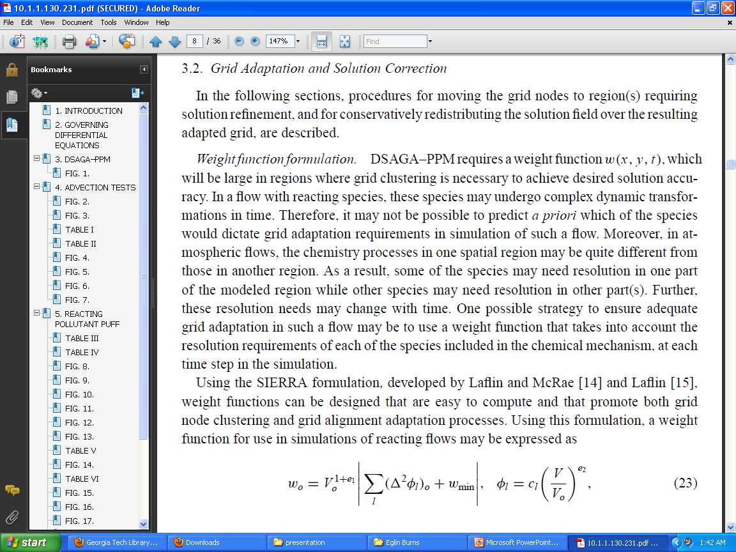
Adaptive grid weighting function

Slide 9
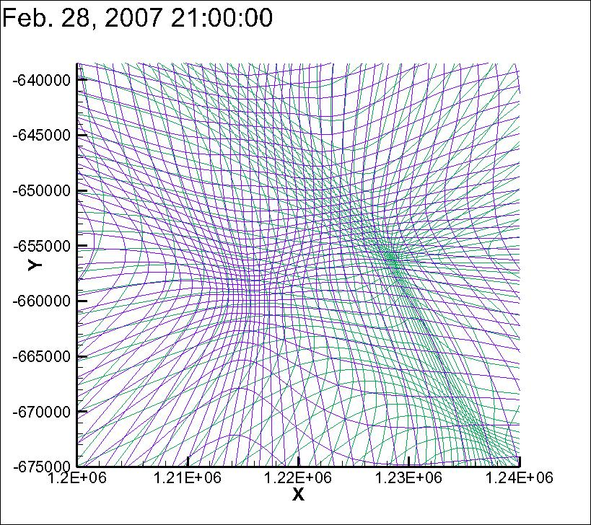
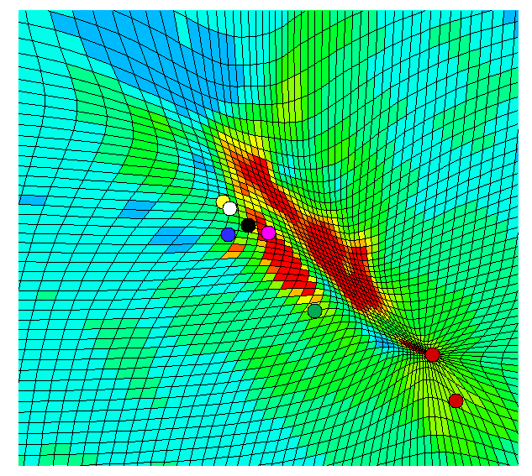
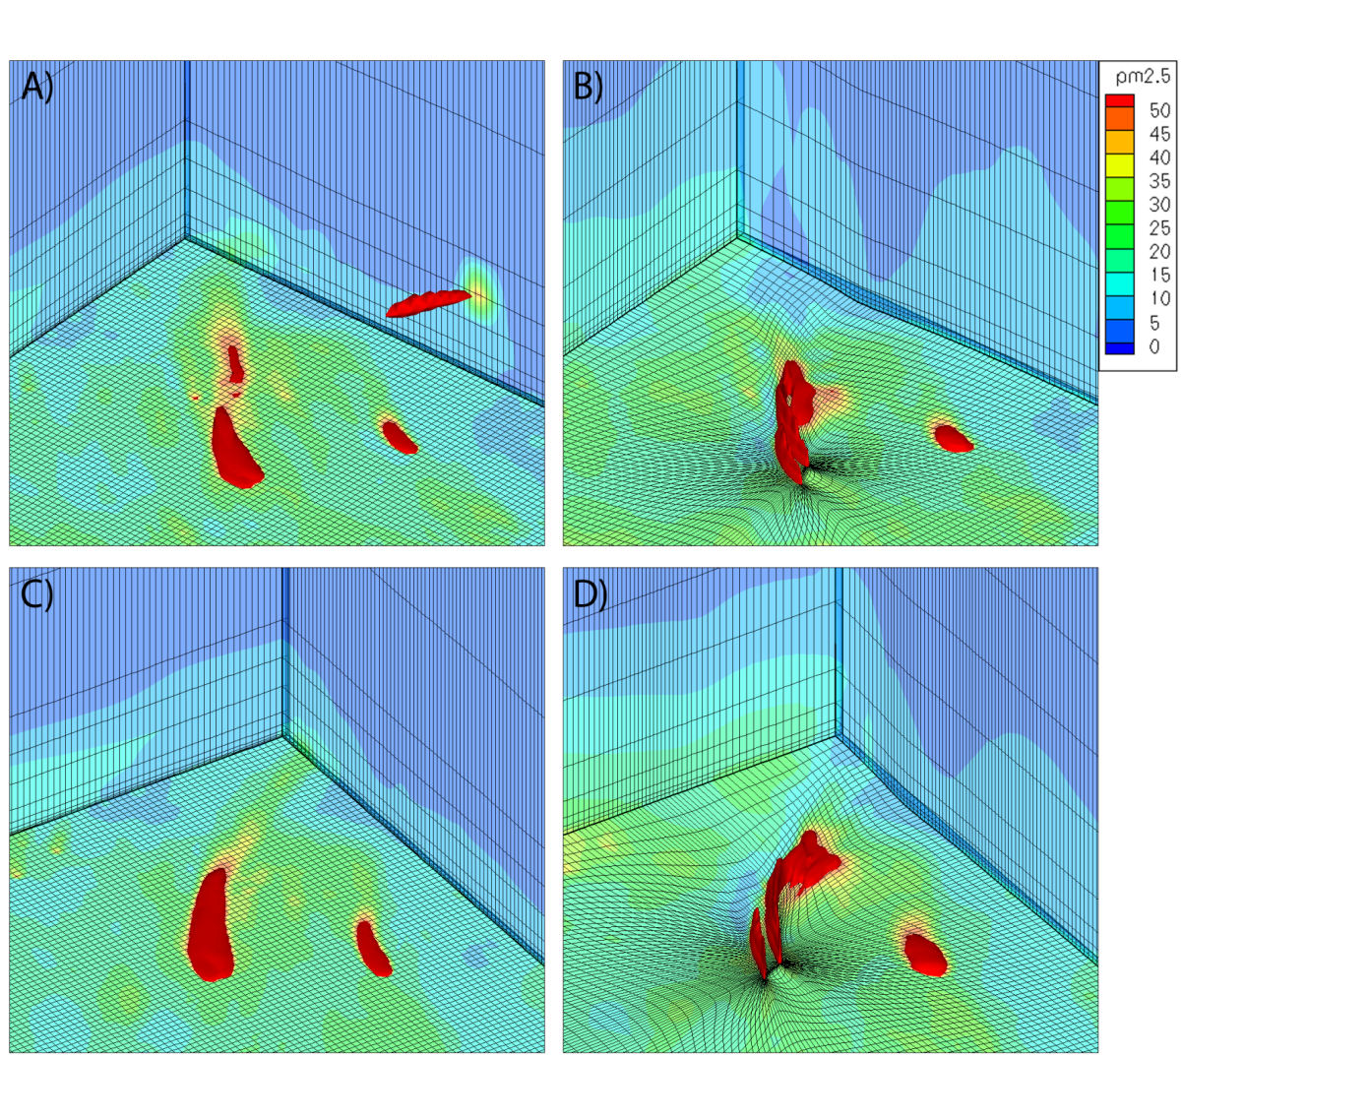
Surface only vs. all layers concentration adaptation
 | surface adaptation | all layer adaptation
Mean fractional error | 80.47% | 76.82%
3.6% improvement
Notes:
Red farther away from fire, therefore purple adapts away from the fire, green considers the high concentrations up at the top of the plume

Slide 10
Global vs. Output time step handover analysis
 | global handover | handover per output
Mean fractional error | 65.08% | 65.19%

Slide 11
Plume modeling criteria
Uniform | vs | Adaptive grid
All layer adaption | vs | Surface layer adaption
Colum Injection | vs | Handover
Global time step handover | vs | Output time step handover

Slide 12
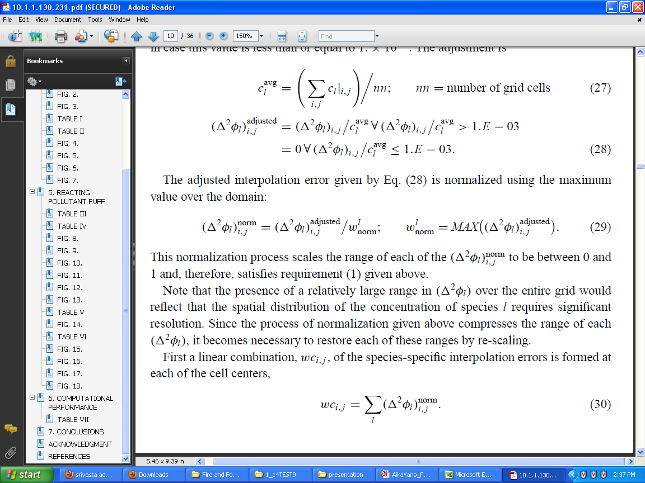
Adaptive grid weight function
Notes:
If e1 is negative then smaller cells will be weighted more than larger cells and vice versa.
Thus, choosing e1 to be negative may cause smooth flow features to be under-resolved.
The parameter e2 ¸ 0 provides control over the rate of change of the cell volumes in the
grid. If e2 > 0 then evacuation of grid nodes from regions of uniform concentration will
be inhibited and grid orthogonality will be promoted.
number of smoothing iterations=15?

Slide 13

Areal adaptation: e1
Smoothing factor: NSMTH
C reduced
Smaller cells weighted more
$$∇$$
Mean Fractional Error

Slide 15
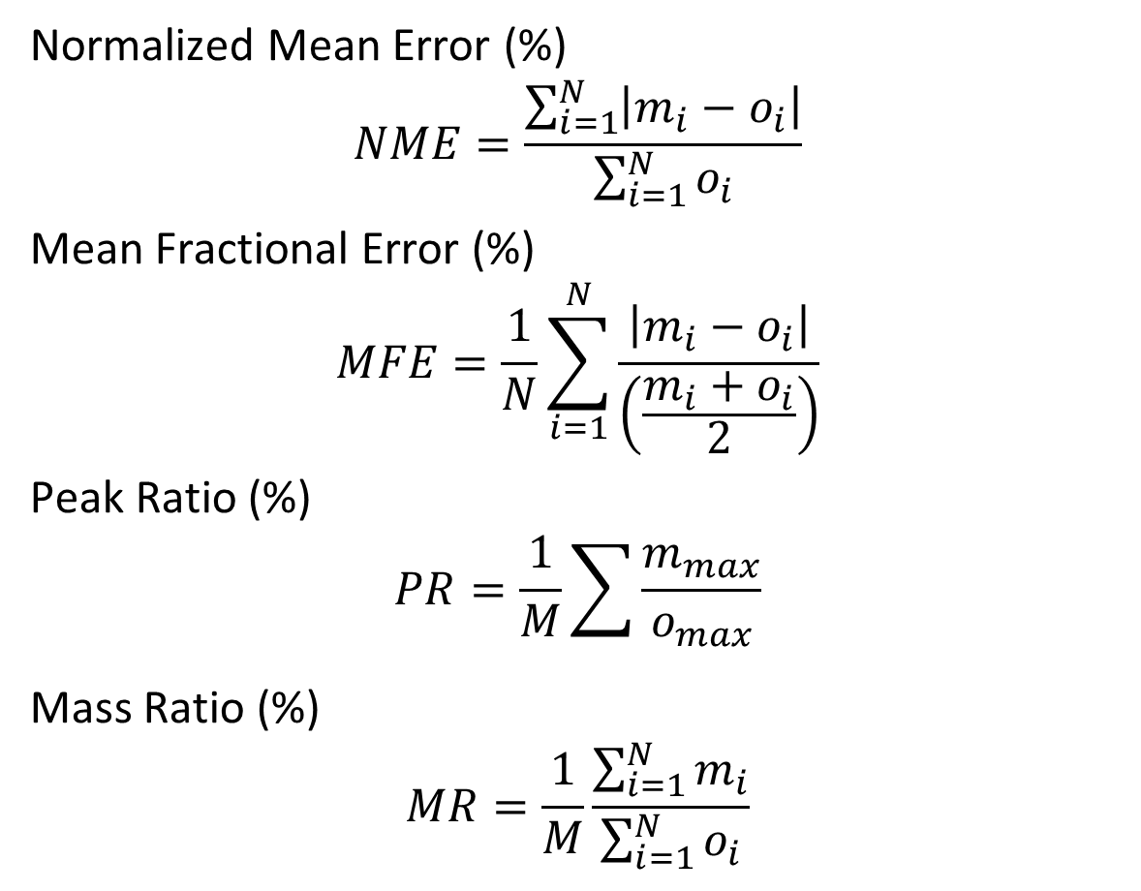
Judging criteria
Normalized Mean Error (%)
$$NME=\frac{\sum_{i=1}^{N}{\left|m_{i}−o_{i}\right|}}{\sum_{i=1}^{N}{o_{i}}}$$
Mean Fractional Error (%)
$$MFE=\frac{1}{N}\sum_{i=1}^{N}{\frac{\left|m_{i}−o_{i}\right|}{\left(\frac{m_{i}+o_{i}}{2}\right)}}$$
Peak Ratio (%)
$$PR=\frac{1}{M}\sum{\frac{m_{max}}{o_{max}}}$$
Mass Ratio (%)
$$MR=\frac{1}{M}\frac{\sum_{i=1}^{N}{m_{i}}}{\sum_{i=1}^{N}{o_{i}}}$$

Slide 16
Error analysis (NSMTH,e1)

Slide 17
NSMTH=6, e1=-0.5 using global time step handover analysis with adaptive grid CMAQ models this burn case plume the best.

Slide 18
Summary
Boundary between sub grid model to CMAQ should be determined by analysis on error due to unresolved plume concentration
Optimal parameters for grid adaptation were determined for prescribed burning plumes
Similar analysis to be done for other burn cases

Slide 19




Acknowledgements
Strategic Environmental Research and Development Program
Joint Fire Science Program
Georgia Department of Natural Resources, Environmental Protection Division
US Forest Service, Southern Research Station

Slide 21
Adaptive Grid

