Slide 1
An Assessment of Aviation-related Hazardous Air Pollutants from a U.S. airport using CMAQ
Lakshmi Pradeepa Vennam,
Saravanan Arunachalam and William Vizuete
University of North Carolina at Chapel Hill
October 24-26, 2011
10th Annual CMAS User’s Conference, Chapel Hill, NC

Slide 2
OUTLINE
Impacts of Aviation
HAPs Background
CMAQ Modeling
Results and Discussion
  Temporal and Spatial trends
  Model Evaluation
  CMAQ comparison with NATA
Conclusions

Slide 3
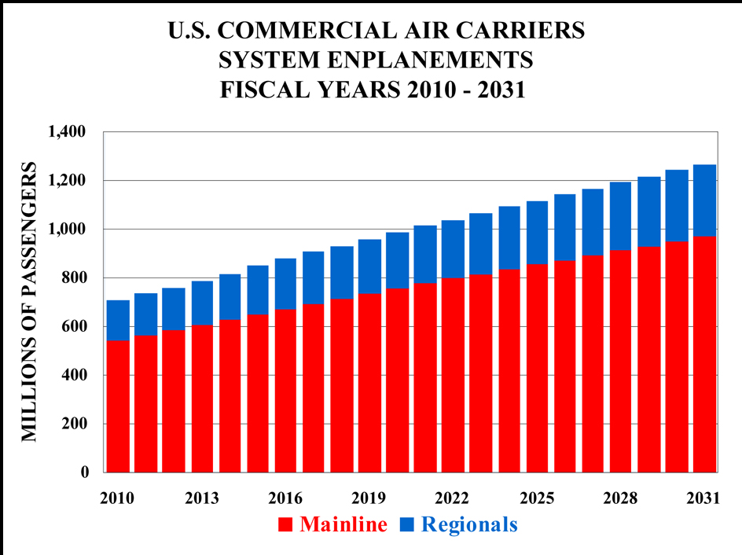
Impacts of Aviation
Aviation is one of the fastest growing sector in transportation
Various environmental impacts:
-Noise
-Air Quality
-Water Quality
-Climate change
Peer-reviewed literature to-date concentrated on emissions, air quality impacts and modeling of PM_{2.5}(Arunachalam et.al. 2011,Woody et.al.2011, Unal et.al.2005),CO,NO_{x} (Schurmann et.al. 2007), O₃(Pison and Menut 2004)
Inadequate attention to Aviation related Hazardous Air Pollutants (HAPs) (ACRP, 2008)
Source: FAA Aerospace Forcasts FY 2011-2031, http://www.faa.gov
Need to study the air quality impacts of aviation, particularly HAPs
Notes:
Last 35 years – 6 fold increase
Local air quality is the major constraint
Emerging air quality concern is the potential for aviation to contribute HAPs to the local environment.
Limited attention is given to the HAPs due to lower contribution, sparse monitoring data, complexity in speciation of HAPs from VOC and hydrocarbons.

Slide 4
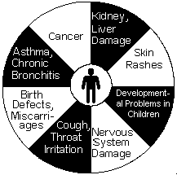
HAPs Background
Definition: The Clean Air Act defines the pollutants that are known or suspected to cause serious health effects as Hazardous Air Pollutants (HAPs) or Air Toxics
188 pollutants
HAPs are reactive, persistent, bio-accumulative
  Key HAPs determined from aviation risk
  prioritization(Levy et al, 2008 ,PARTNER Report) are:
  Formaldehyde, Acetaldehyde, Acrolein
  Benzene, 1,3-Butadiene, Toluene, Xylene
Source: www.epa.gov
HAPs present in lower concentrations, but health risk involved is high
Notes:
Some of PARTNER studies determined certain key HAPs from the aviation risk prioritization
Studies emphasized that Formaldehyde appears to be the most prevalent HAP in the aircraft exhaust followed by the acetaldehyde, benzene and toluene.

Slide 5
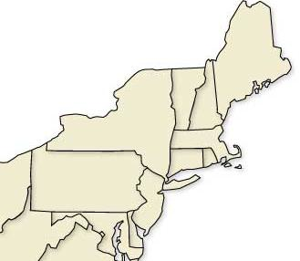
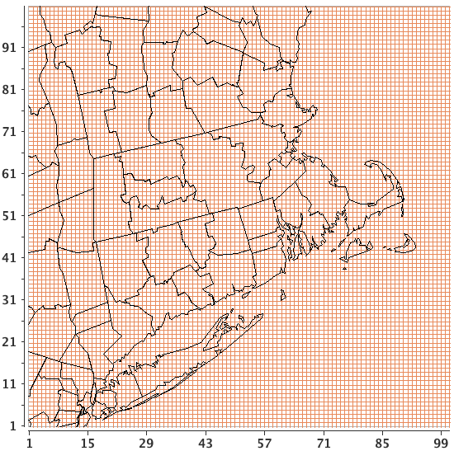
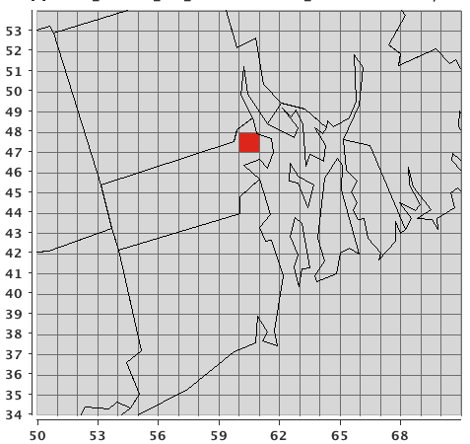
CMAQ Domain
T.F.Green airport (PVD) in Rhode Island, Medium sized airport
  47th largest airport in Nation
  2.5 Million enplanements per year
4-km CMAQ resolution with 100 x 100 grid cells
4k
Enlarged view of CMAQ 4km i.e., 100 x 100 grid cells map
Location of PVD airport
Northeast US map with CMAQ 4km grid

Slide 6
CMAQ Modeling..
Non-aviation emissions (NEI)
SMOKE
(Grid based input)
Aviation emissions(EDMS)
EDMSInv(4D representation)
CMAQ
(CB05 – extended explicit air toxics chemistry)
Two scenarios
Base case(all background sources, except aviation)
Sensitivity case(all sources, aviation sources)
Meteorology
WRF (annual 2005)
Analysis focus on HAPs:
HAP - VOCs(Benzene, 1,3-Butadiene,Toluene,Xylene)
HAP – Carbonyls(Formaldehyde, Acetaldehyde, Acrolein)

Slide 7
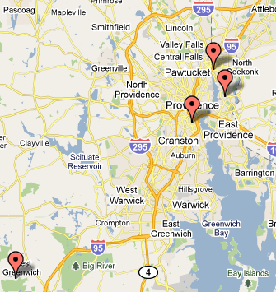
Monitoring Sites
4 EPA-AQS Permanent sites, Far-away sites from Airport
Pawtucket
Providence
5 Airport Sites, RI DEM(Rhode Island Department of Environmental Management)
E.Providence
W.Greenwich
RIDEM study conducted for the period (April 2005- August 2006)

Slide 8
Temporal variability:
HAP-VOCs: winter summer
HAP- Carbonyls: winter summer
All sources HAP-VOCs : summer to winter 2 – 3 times increase, Toluene is high (due to mobile sources)
Airport HAP-VOCs: 1- 2% all sources, summer to winter modest increase, benzene is high (Timko et.al., 2010, Herndon et.al.,2006)
Notes:
Airport- HAPs – 1-1.5 times increase, i.e., around 30% increase. Benzene is most predominantly emitted pollutant among the aromatics from the aircraft.

Slide 9
Carbonyls….
Acetaldehyde, Acrolein have similar trend as Formaldehyde
Primary: Winter > Summer due to dependency of temperature on the aircraft emissions (Herndon et.al., 2009, APEX 1,2,3, EXCAVATE)
Primary > Secondary for all carbonyls emissions from airport sources (High Formaldehyde emissions)
Primary Carbonyls > Secondary Carbonyls in the case of airport sources
Notes:
Therefore all the aviation related HAPs show high concentrations in winter than in summer. And as the primary emissions are more, if we think in Policy perspective it is easy to regulate with some modifications in aircraft engines and the composition of the fuel.

Slide 10
Spatial variability:
HAPs at airport site less than Urban site [ Urban > Airport > Rural]
High Formaldehyde concentrations near runaway site (Fieldview)
Urban
Suburban
Airport sites
Rural
High underprediction in case of Acrolein at all sites
Monitoring data uncertainties (Leucken et al, 2006).
Highly reactive – challenge for analytical methods.
High degradation of Acrolein and its derivatives – improper handling (Seaman et al, 2006).
Notes:
As mentioned before the 4 AQS sites are mainly considered to make a comparison with the airport sites.

Slide 11
Model Evaluation
HAPs | Average NMB (%) | Average NME (%)
Benzene | 9 | 51
Butadiene | -19 | 54
Toluene | 15 | 57
Xylene | 4 | 59
Acetaldehyde | -12 | 36
Acrolein | -92 | 93
Formaldehyde | -51 | 53

Slide 12
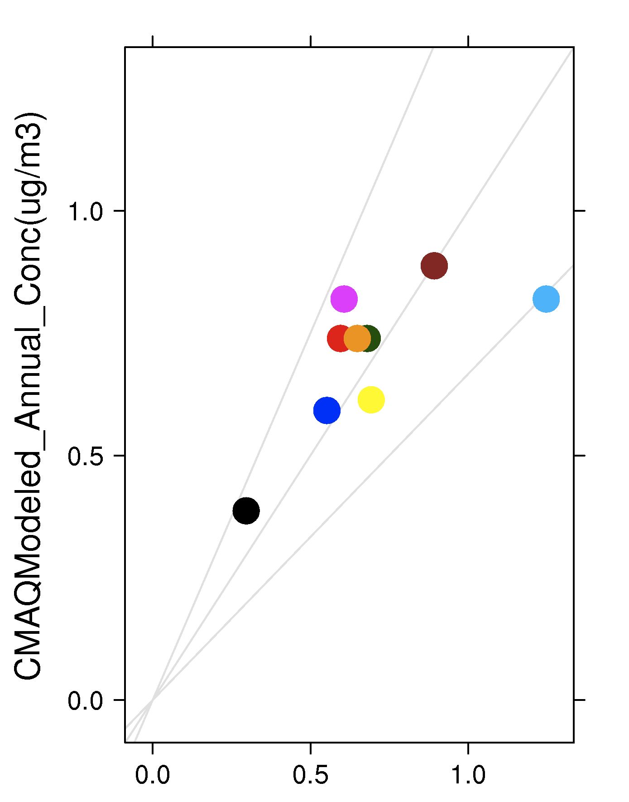
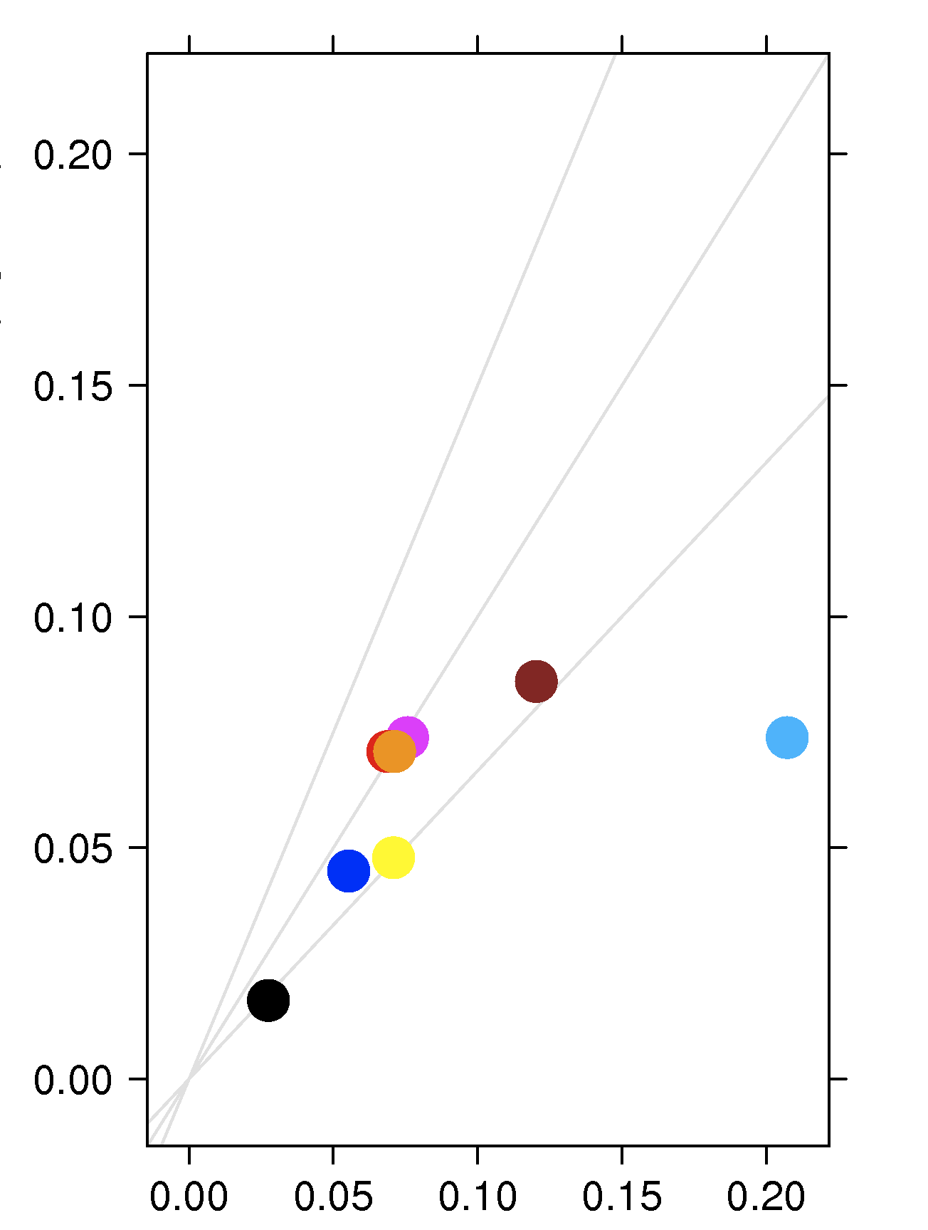
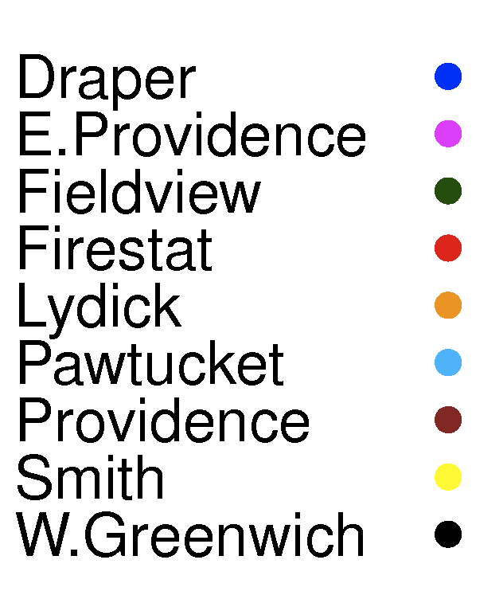
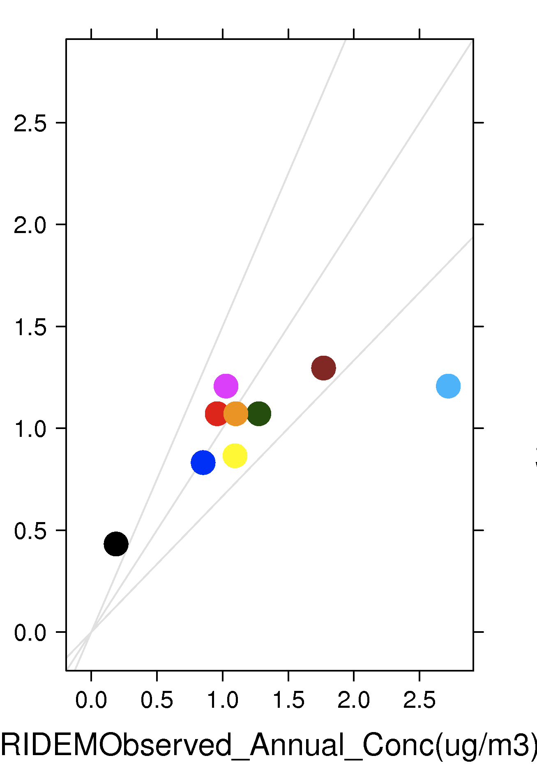
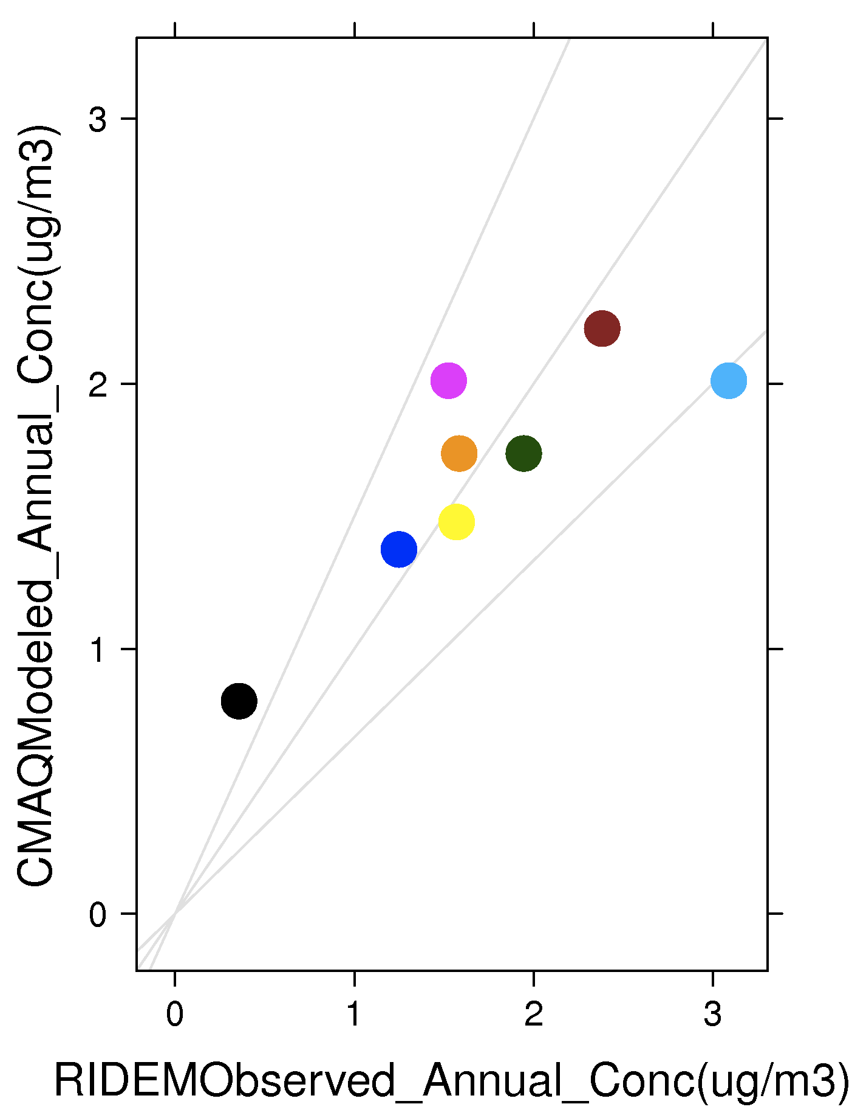
Model Performance based on Sites:
BENZENE
1,3-BUTADIENE
TOLUENE
XYLENE

Slide 13
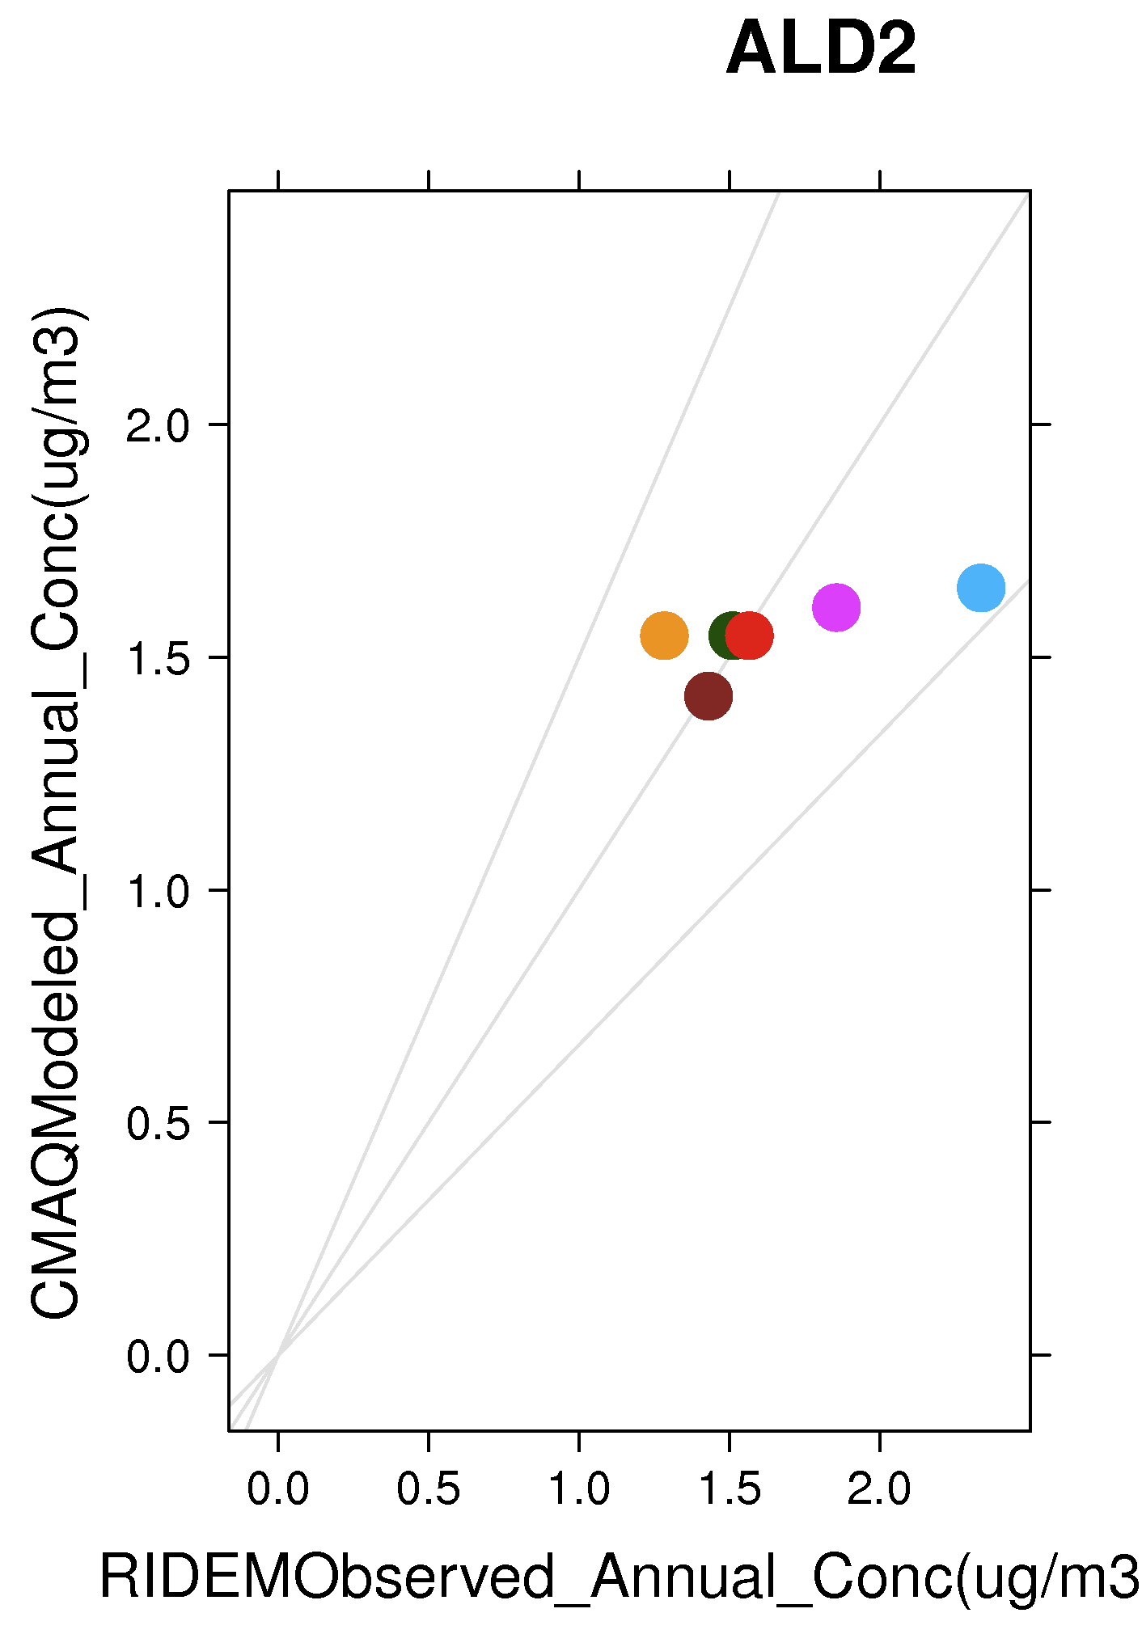
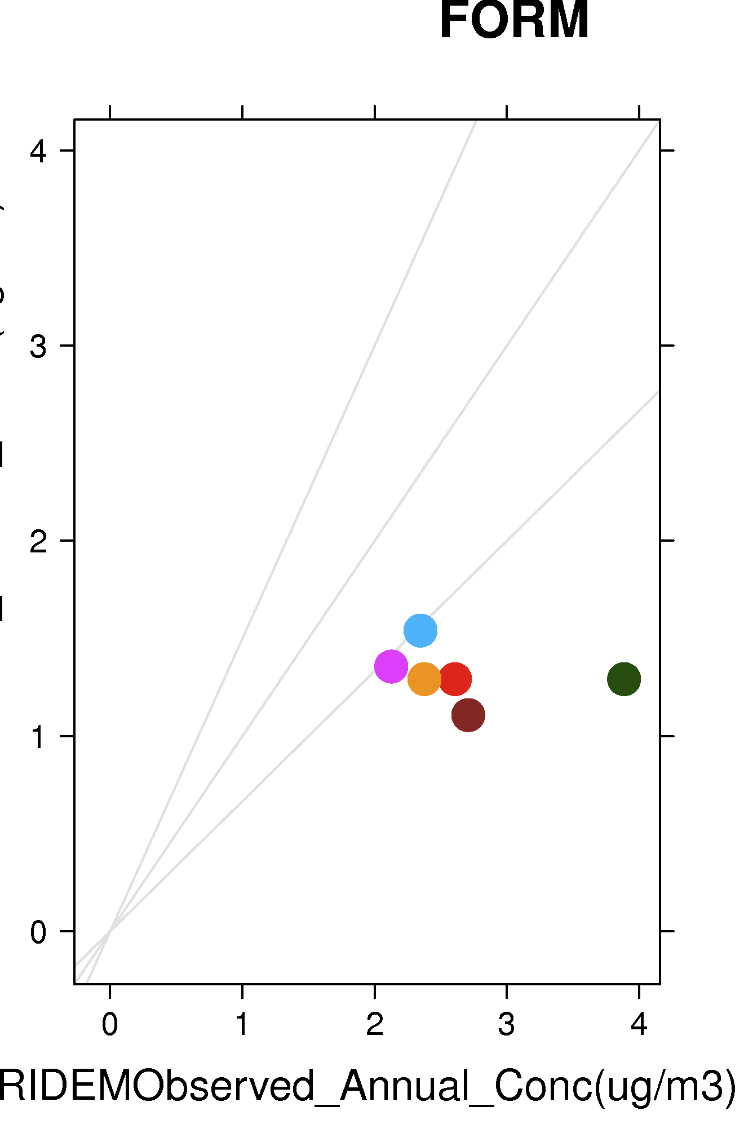
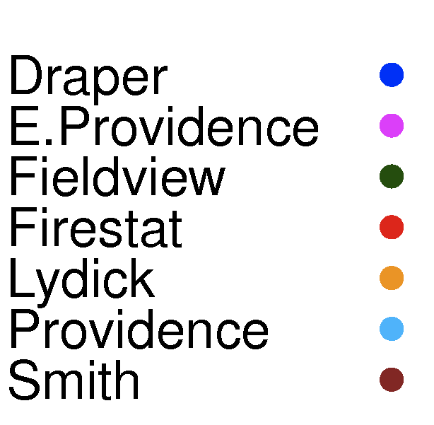
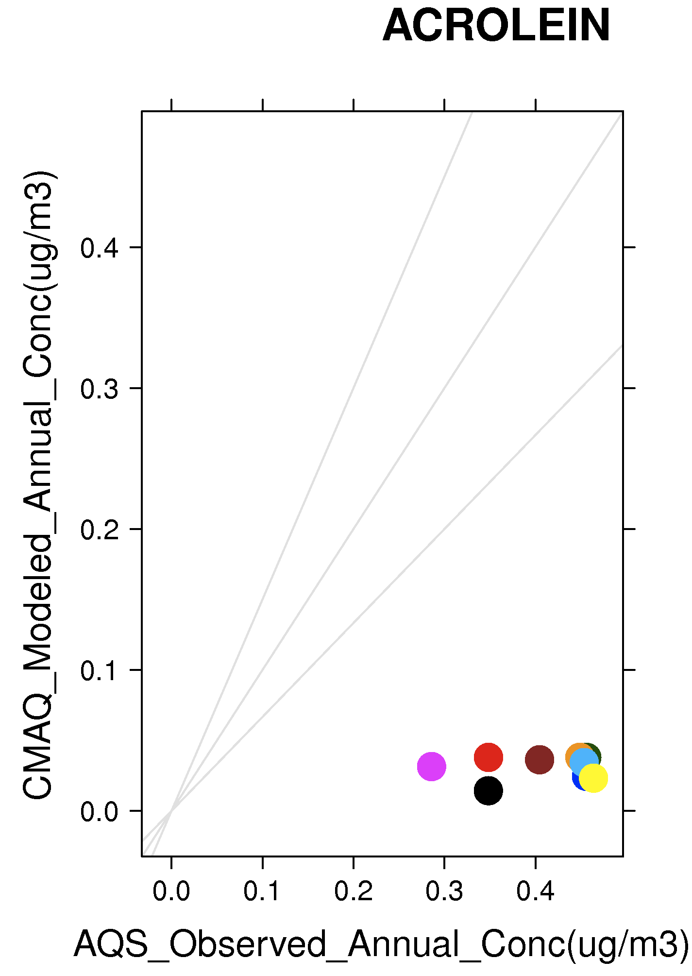
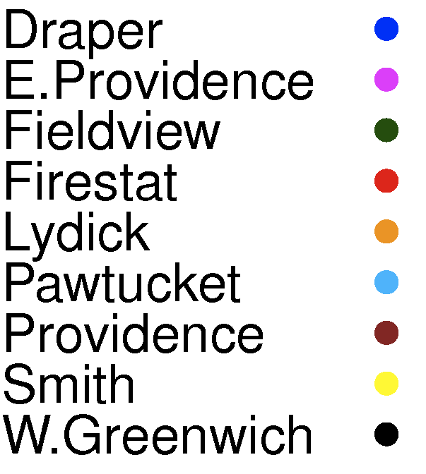

Slide 14
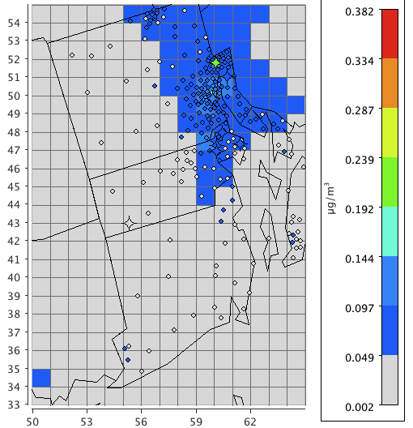
Comparison of CMAQ with NATA:
1-3,Butadiene CMAQ conc with NATA and RIDEM overlay
NATA: National Air Toxics Assessment, comprehensive evaluation of Air toxics in U.S by EPA
NATA 2005 used Gaussian Dispersion Model (AERMOD)
CMAQ-12k is used to calculate secondary formation in NATA
Comparison of CMAQ concentrations(all sources) with an overlay of NATA census tract(diamonds in figure) and RIDEM obs data (stars)
For highly reactive pollutants such as 1,3-Butadiene, CMAQ shows better performance
For highly reactive pollutants, chemistry-transport model (CMAQ) performs better than NATA.

Slide 15
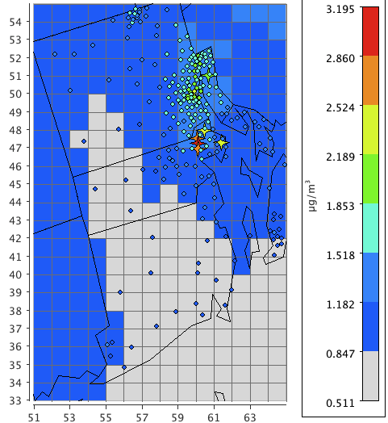
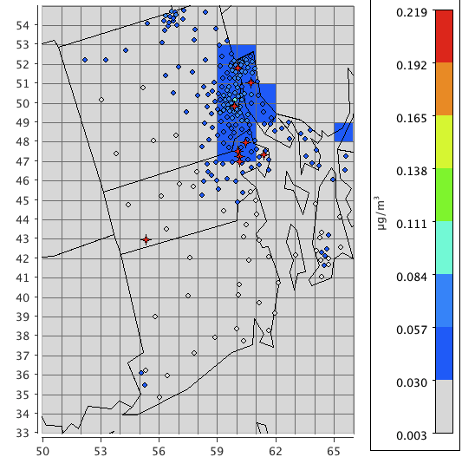
FORMALDEHYDE
ACROLEIN
Both NATA and CMAQ underpredict formaldehyde and acrolein
Formaldehyde: Underprediction in the airport grid cell
Acrolein: Underprediction at all sites

Slide 16
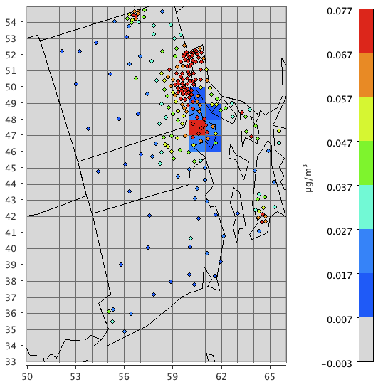
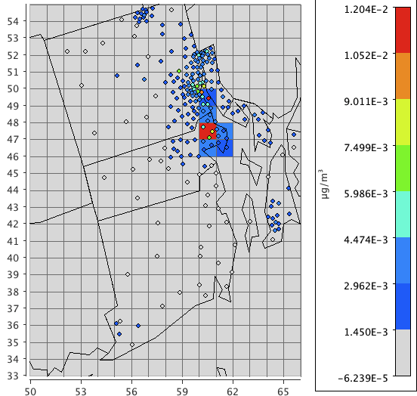
Comparison of NATA(nonroad) to CMAQ airport values:
FORM (CMAQ_airport with NATA nonroad overlay)
ACRO (CMAQ_airport with NATA nonroad overlay)
In general, airport contributions are should be less than the non-road
In the airport grid cell, CMAQ airport concentrations are same as NATA non-road concentration.
Possibility of NATA underpredicting the nonroad concentrations

Slide 17
Conclusions
CMAQ able to predict trends similar to sampling and monitoring studies (Herndon et al, 2006, 2009, APEX1,2,3 and EXCAVATE) conducted near airports
  Higher hydrocarbon ( Formaldehyde) concentrations during idling and take off seen at Fieldview (runway site)
  Primary carbonyl concentrations more than the secondary for airport sources
  CMAQ able to predict the dependency of aircraft concentrations on temperature
  HAPs at airport sites less than the urban sites except Formaldehyde
Model is able to predict most of the HAPs with an error between 30- 60% except for Acrolein (high uncertainty)
CMAQ performing better than NATA for highly reactive HAPs

Slide 18
References
Arunachalam.S ., Wang, B., Baek,B.H., Levy, J.I. Effect of Chemistry – Transport Model Scale and Resolution on Population Exposure to PM_{2.5} from Aircraft Emissions during Landing and Takeoff, Atmospheric Environment, 45 (2011) 1294 – 3300.
Woody.M ., B.H.Baek., Adelman Z., Omary M., Lam F.Y., West J.J., Arunachalam S., 2011. An Assessment of Aviation’s contribution to Current and Future Fine Particulate Matter in United states, Atmospheric Environment, 45 , 3424-3433.
Unal A., Hu,Y., Chang, M.E., Odman, M.T., Russell, G.A., 2005. Airport related emissions and impacts on air quality: Application to the Atlants International Airport, Atmospheric Environment, 39, 5787-5798.
FAA 2011. FAA National forecast FY 2011-2031 by Nan Shellabarger. Available at: http://www.faa.gov/news/conferences_events/aviation_forecast_2011/agenda/media/shellabarger.pdf
D.J., Luecken, W.T., Hutzell, G.L., Gipson, 2006. Development and analysis of air quality modeling simulations for hazardous air pollutants. Atmospheric Environment 40, 5087- 5096
Herndon S,C., Rogers T., Dunlea E,J., Jayne J,T., Maike-Lye R., Knighton B., 2006. Hydrocarbon Emissions from In-Use Commercial Aircraft during Airport Operations. Environ.Sci.Technol 40, 4406-4413.
Seaman V,Y., Bernett D,H., Cahill T,M., 2007. Origin, Ocurrence, and Source Emission Rate of Acrolein in Residential Indoor Air. Environ. Sci. Technol, 2007, 41, 6940-6946.
Characterization of Emissions from Commercial Aircraft Engines during the Aircraft Particle Emissions eXperiment (APEX) 1 to 3, U.S EPA, October 2009
Timko ,M,T., Herndon,S,C., Wood,E,C., Onasch,T,B., Northway,M,J., Jayne,J,T., Canagaratna,M,R., Miake-Lye,R,C., 2010, Gas Turbine Engine Emissions – Part I: Volatile Organic Compounds and Nitrogen Oxides, Journal of Engineering for Gas Turbines and Power, 2010, Vol.132.

Slide 19
Acknowledgements
Rhode Island Department of Environmental Management (RIDEM)
Deborah Luecken, USEPA
The Partnership for Air Transportation Noise and Emissions Reduction is an FAA/NASA/Transport Canada/US DOD/EPA-sponsored Center of Excellence.
This work was funded by FAA and Transport Canada under 07-C-NE-UNC Amendment Nos. 001 to 004, and 09-CE-NE-UNC Amendment Nos. 001-003.
The Investigation of Aviation Emissions Air Quality Impacts project is managed by Christopher Sequeira.
Any opinions, findings, and conclusions or recommendations expressed in this material are those of the author(s) and do not necessarily reflect the views of the sponsors.

