Slide 1


Understanding fine particle episodes in the Upper Midwest during the 2009 LADCO Winter Nitrate Study using CMAQ and CAMx: model performance, processes, and response to emissions controls
Charles Stanier – University of Iowa
charles-stanier@uiowa.edu
319-335-1399
CENTER FOR GLOBAL AND REGIONAL ENVIRONMENTAL RESEARCH

Slide 2
Co-authors and Acknowledgements
University of Iowa
  Scott Spak
  Gregory Carmichael
  Charles Stanier
  Jaemeen Baek
  Sang Rin Lee
  Yoo Jung Kim
  Timothy Rohlf
  Sinan Sousan
  Ashish Singh
University of Illinois
  Nicole Riemer
EPRI
  Stephanie Shaw
  Naresh Kumar
Measurements
  Eric Edgerton (ARA Inc)
  Mike Caughey (ISWS)
  Wisconsin DNR staff
  Joe Leair, Jerry Medinger, Dan Nickolie, Mary Mertes, Bruce Rodger, and Bart Sponseller
  Site operators by John Hillery, Janel Hanrahan, Laura Carnahan
LADCO (Lake Michigan Air Directors Consortium)
  Michael Koerber
  Donna Kenski
  Mark Janssen
  Abigail Fontaine
Wisconsin DNR
  Michael Majewski
  Bill Adamski
Funding
  LADCO
  Electric Power Research Institute

Slide 3
Motivation?
Recurrent cold weather PM_{2.5} episodes greatly influence air quality in this region.
Similarities to California’s Central Valley (Pun and Seigneur 1999; McMurry, Shepherd et al. 2004) and to Northwestern Europe and the Po Valley of Italy (Schaap, van Loon et al. 2004; Putaud, Van Dingenen et al. 2010).
What is known?
  Episodes are tightly coupled with meteorological conditions.
  Ammonium nitrate comprises a large fraction of the PM_{2.5} during episodes.
  Chu 2004; McMurry, Shepherd et al. 2004; Blanchard and Tanenbaum 2008; Klatzman, Rutter et al. 2009; LADCO 2009; Pitchford, Poirot et al. 2009.

Slide 4
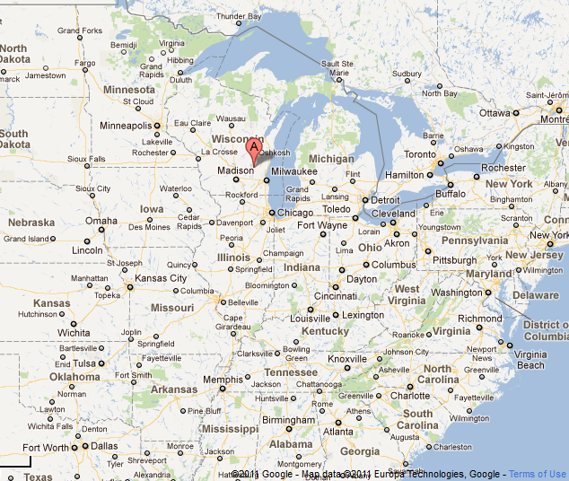
LADCO Winter Nitrate Study
(Jan 1 – Mar 31, 2009)

Slide 5
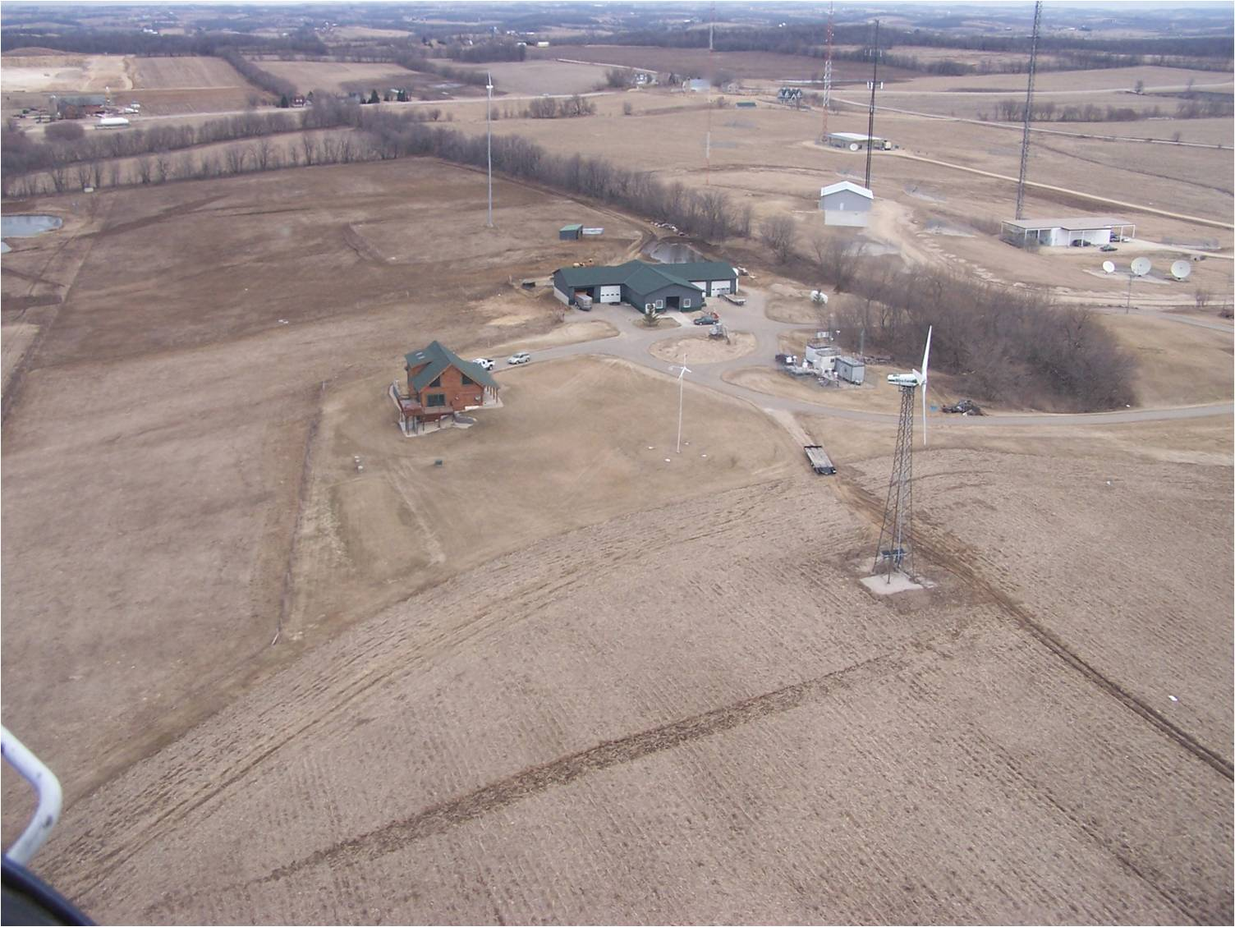
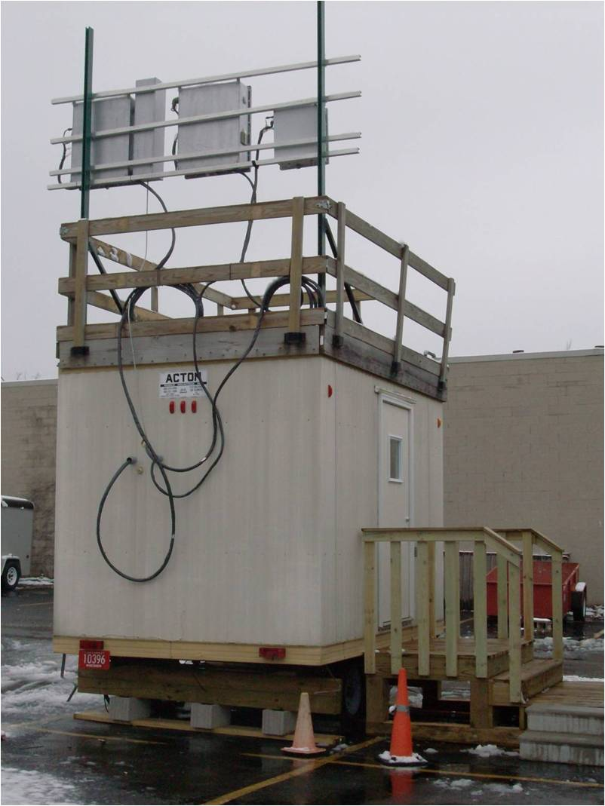
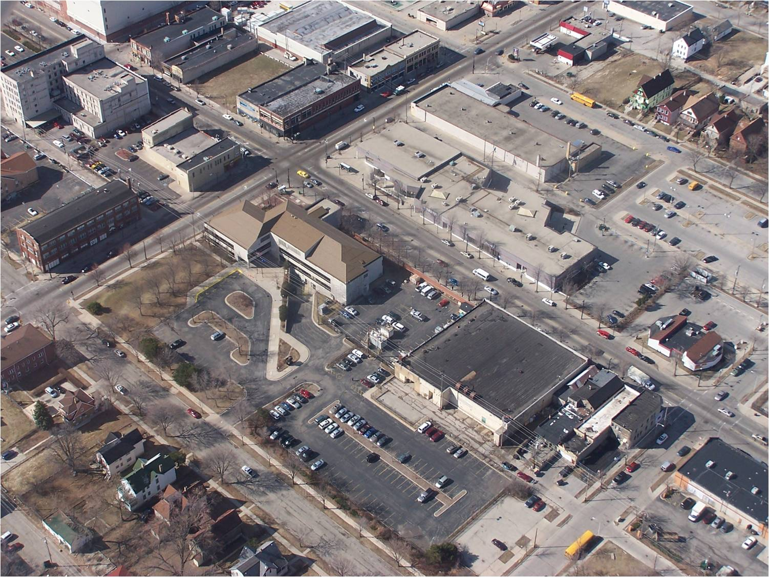
Species | Averaging time (hr) | Species | Averaging time (hr)
PM_{2.5} | 1hr | PM_{2.5} | 24hr 1 in 3days
SO₄ | 1hr | NH₄ | 24hr 1 in 3days
NO₃ | 1hr | NO₃ | 24hr 1 in 3days
NH₄ | 1hr | SO₄ | 24hr 1 in 3days
HNO₃ | 1hr | OC | 24hr 1 in 3days
NH₃ | 1hr | EC | 24hr 1 in 3days
NO_{y} | 1hr | O₃ | 1hr
NOx (note 6) | 1hr | Relative Humidity | 1hr
SO2 (note 7) | 1hr | Surface pressure | 1hr
Temperature | 1hr | Visibility | 1hr
Wind Speed | 1hr | Precipitation | 1hr
Wind direction | 1hr | HNO₃ | 24hr
NH₃ | 24hr | H₂SO₃, H₂SO₄ | 24hr

Slide 6
Science Questions for the Study
Composition: Typical chemical composition during episodes and non-episodes?
Urban-rural contrast: Differences in PM_{2.5} concentrations (frequency and severity), chemical composition, and source regions?
Meteorology: What meteorological conditions favor winter-time episodes? How can we best use this information to improve wintertime episode forecasting?
Nitrate formation chemistry: What do the data tell us the nitrate formation chemistry leading to events?
Sensitivity of episodes: How sensitive are concentrations to hypothetical changes in total nitrate, total ammonia, and total sulfate? What sources categories have leverage on episodes? Do local sources have influence?
3D Model skill: Can photochemical modeling accurately predict PM_{2.5} concentrations during the observed winter-time episodes?

Slide 7
60
40
PM_{2.5} (µg m⁻³)
20
0
Jan
Feb
Mar
Parameter | Milwaukee (Urban) | Mayville (Rural)
PM_{2.5} (µg m⁻³) | 17.1 | 11.7
Total nitrate (µg m⁻³) | 5.6 | 4.8
Total ammonia (µg m⁻³) | 3.3 | 3.3
Gas ammonia (ppb) | 2.3 | 2.4
Nitrate aerosol / total nitrate | 78% | 69%
NO_{y} (ppb) | 27 | 6.3
Temperature (°C) | -3 | -5
Ozone (ppb) | 22 | 31
OC (µg m⁻³) | 3.6 | 3.2
EC (µg m⁻³) | 0.5 | 0.3
Gas Ratio (d’less) | 1.5 | 1.7

Slide 8
Detailed view of an episode
Agreement between multiple independent measurements

Slide 9
Composition
PM_{2.5} (µg m⁻³)
PM_{2.5} fraction
Gas ratios (ammonia availability) ranges 1.0-1.7. Lowest at the rural site during episodes. Evidence of gas ratio ↓ during episodes at multiple sites in the region.

Slide 10
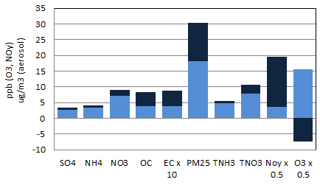
Urban-Rural Contrast During Episodes
Some excess in total nitrate, but nitrate and ammonium appear predominantly regional.
For aerosol species, urban excess of OC during episodes is significant.

Slide 11
Meteorology
Episodes began under similar synoptic conditions – arrival of a surface low pressure system.
Episodes were marked by inversions with warm, moist air and low wind speeds.
Snow cover and fog were both correlated with episode occurrence.
Regional snow cover was present over southeastern Wisconsin and northern Illinois at the onset of late winter episodes and usually melted by episode end.

Slide 12
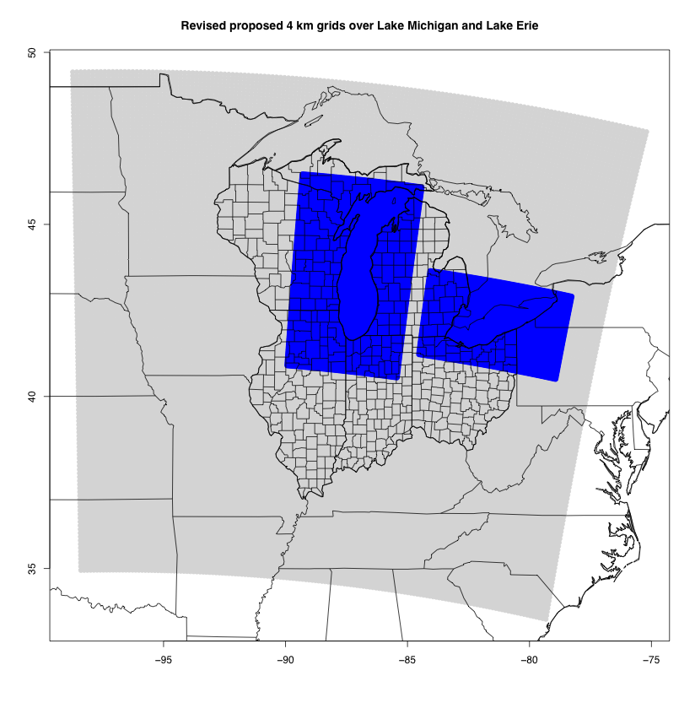
Model Configuration
Community Multiscale Air Quality Model (CMAQ) v4.7.1
  CB05 gas phase / AERO5 aerosol module
  ACM2 PBL closure
  Mass-conserving advection
  14 vertical layers
LADCO’s 12 km regional modeling grid
  Hourly boundary conditions from a 36 km simulation (with the same configuration) covering the continental United States.
Meteorology
  WRF 3.1.1 with the RPO configuration selected by Iowa DNR, SESARM, and LADCO
  ACM2 PBL closure
  Pleim-Xu land surface module
  RRTM radiation
  Morrison microphysics
  Kain-Fritsch cumulus
  Boundary meteorology from the North American Regional Reanalysis 3-hourly
  Analysis nudging on NARR above the PBL (no direct observational nudging)
Emissions
  LADCO’s 2008 emissions inventory used for 12km domain.
  Day-specific biomass burning emissions from MODIS fire detection products.
  NEI with day- specific biomass burning will be used for 36 km continental simulations.
Process Analysis
  Chemical and process rates stored for all layers up to 550 m, with focus on NOy processing and N2O5 heterogeneous chemistry

Slide 13
Model Skill
Network | Species | Observed | Model
AQS | Ozone | 29.8 | 35.0
Improve | PM_{2.5} | 7.0 | 8.6
 | SO₄ | 1.8 | 2.6
STN | PM_{2.5} | 12.1 | 15.4
 | NO₃ | 3.0 | 3.0
 | NH₄ | 1.7 | 2.0
 | SO₄ | 2.4 | 3.6

Slide 14
Model Skill
Total ammonia underprediction during almost all periods and sites.
Shows as deficit in gas phase ammonia.
Nitrate underprediction during episodes.
Systematic OC underprediction (not shown) but offset by CMAQ other inorganics

Slide 15
Reaction | Reactants | Products
R1 | NO₂ + hν | NO + O
R3 | O₃ + NO | NO₂
R4 | O + NO₂ | NO
R5 | O + NO₂ | NO₃
R6 | O + NO | NO₂
R7 | NO₂ + O₃ | NO₃
R14 | NO₃ | NO₂ + O
R15 | NO₃ | NO
R16 | NO₂ + NO | 2 NO₂
R17 | NO₃ + NO₂ | NO + NO₂
R18 | NO₃ + NO₂ | N₂O₅
R19 | N₂O₅ + H₂O | 2 HNO₃
R20 | N₂O₅ + H₂O + H₂O | 2 HNO₃
R21 | N₂O₅ | NO₃ + NO₂
R22 | NO + NO + O₂ | 2 NO₂
R23 | NO + NO₂ + H2O | HONO
R24 | NO + OH | HONO
R25 | HONO | NO + OH
R26 | OH + HONO | NO₂
R27 | HONO + HONO | NO + NO₂
R28 | NO₂ + OH | HNO₃
R29 | OH + HNO₃ | NO₃
R30 | HO₂ + NO | OH + NO₂
R31 | HO₂ + NO₂ | PNA
R32 | PNA | HO₂ + NO₂
R33 | OH + PNA | NO₂
R46 | NO₃ + O | NO₂
R47 | NO₃ + OH | HO₂ + NO₂
R48 | NO₃ + HO₂ | HNO₃
R49 | NO₃ + O₃ | NO₂
R50 | NO₃ + NO₃ | 2 NO₂
R51 | PNA | 0.61HO₂ + 0.61NO₂ + 0.39OH + 0.39NO₃
R52 | HNO₃ | OH + NO₂
R53 | N₂O₅ | NO₂ + NO₃
R89 | PAN | C₂O₃ + NO₂
R90 | PAN | C₂O₃ + NO₂
Integrated
Reaction
Rate
Analysis

Slide 16
Nitrate formation analysis by process analysis
Daytime
Averages 0.075 ppb/hr in surface layer
NO₂ + OH → HNO₃ (R1)
NO₂ + O₃ → NO₃ + O₂ (R2)
NO₃+NO₂ ↔ N₂O₅ (R3)
N₂O₅ → NO₂ + NO₃ (R4)
NO₃ + VOC→ organic products (R5)
N₂O₅ + H₂O → 2HNO₃ (R6)
Nighttime
Averages
0.044 ppb/hr
in surface layer
RH and composition dependent accommodation
coefficient, uncertain

Slide 17
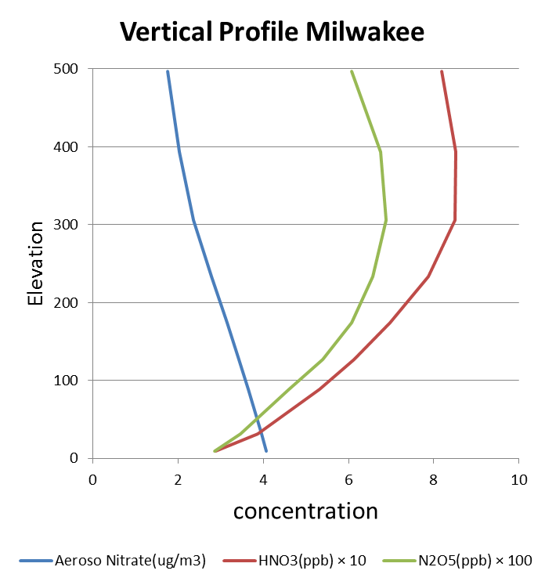
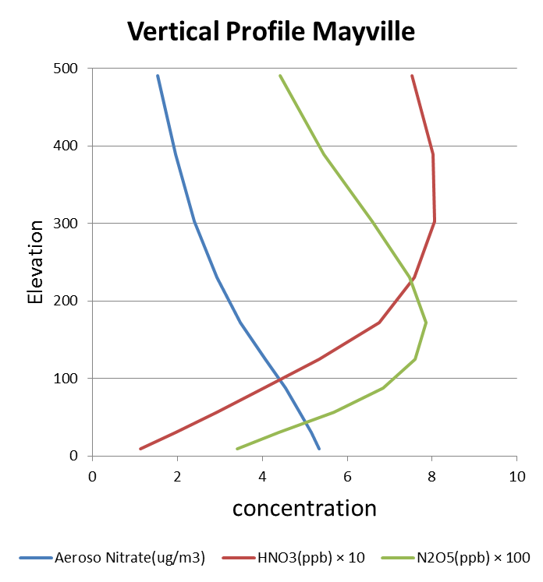

Slide 18
Emissions Sensitivity: Emissions Scenarios
30% NO_{x} from base case
30% NH₃ from base case
2015 Proxy Case
  Simulate near-term changes in mobile NO_{x} & simulate approximation of implementation of Cross State Air Pollution Rule (CSAPR) effect on coal-fired power plant NO_{x} & SO_{x} emissions
  -70% EGU SO₂
  -10% EGU NO_{x}
  -30% mobile NO_{x}
Additional scenarios: add all-sector reductions to the 2015 Proxy Case
  - 30% NH₃
  - 30% NO_{x}
  - 30% NH₃ & - 30% NO_{x}

Slide 19
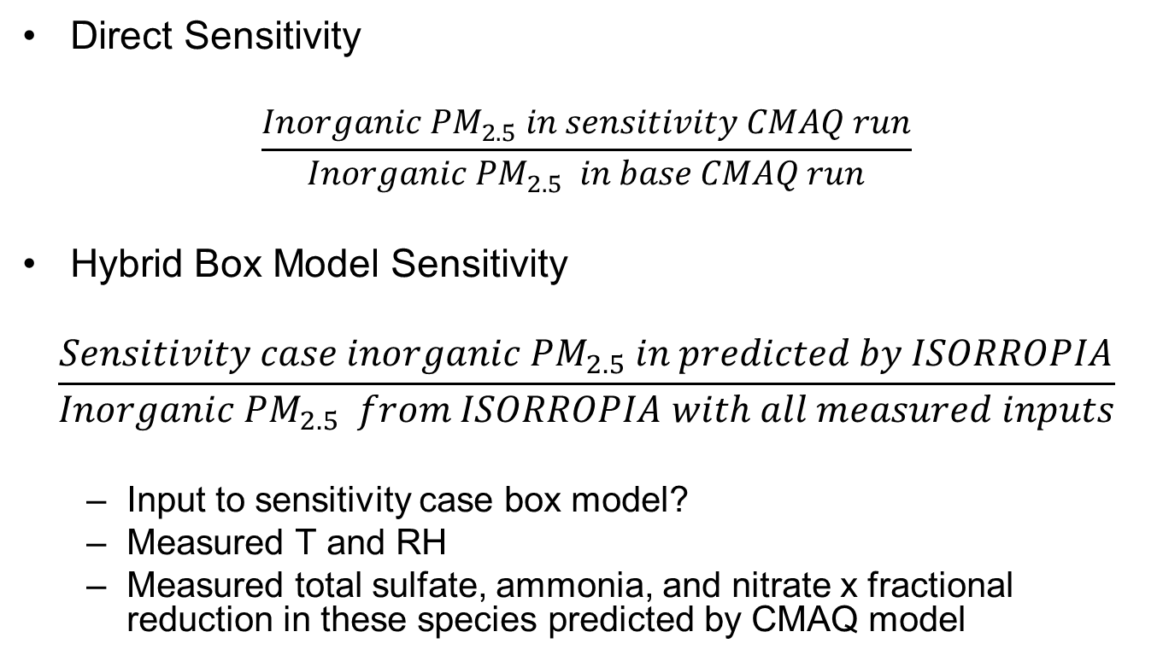
Emissions Sensitivity Methods
Direct Sensitivity
$$\frac{Inorganic {PM}_{2.5} in sensitivity CMAQ run}{Inorganic {PM}_{2.5} in base CMAQ run}$$
Hybrid Box Model Sensitivity
$$\frac{Sensitivity case inorganic {PM}_{2.5} in predicted by ISORROPIA}{Inorganic {PM}_{2.5} from ISORROPIA with all measured inputs}$$
  Input to sensitivity case box model?
  Measured T and RH
  Measured total sulfate, ammonia, and nitrate x fractional reduction in these species predicted by CMAQ model

Slide 20
Thermodynamic Sensitivity / Model Skill

Slide 21
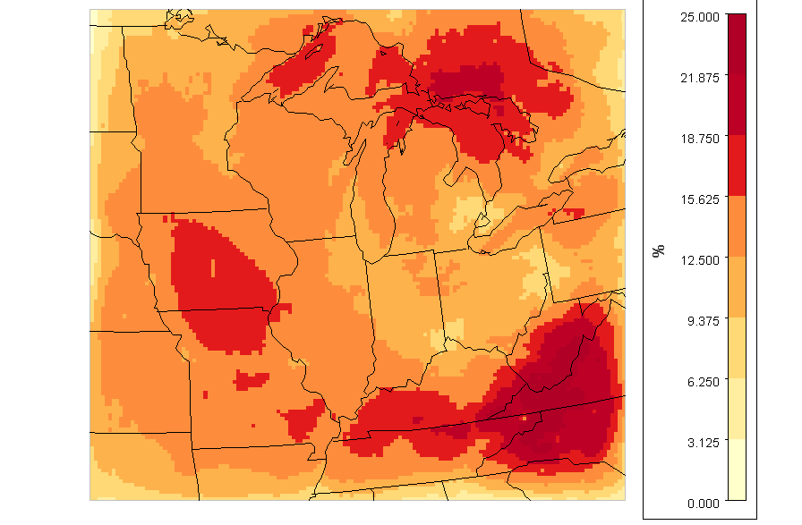
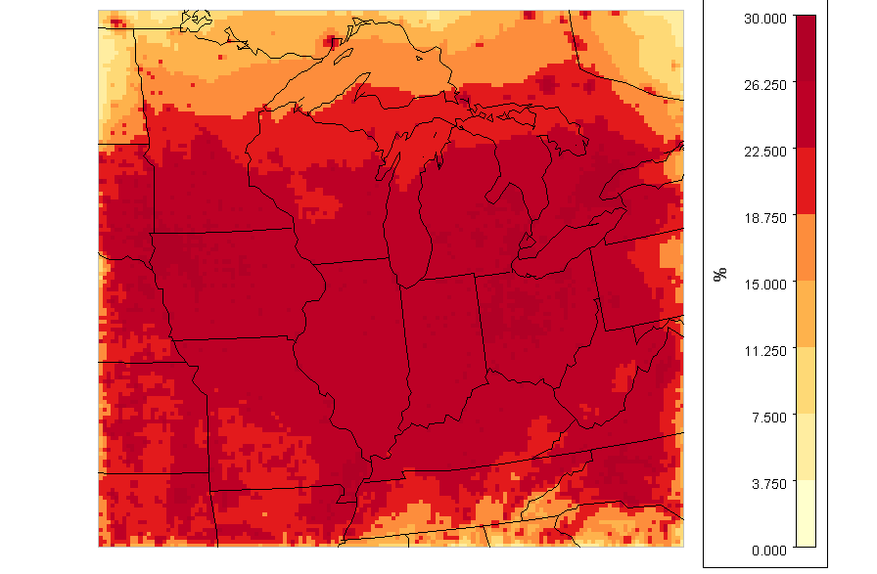
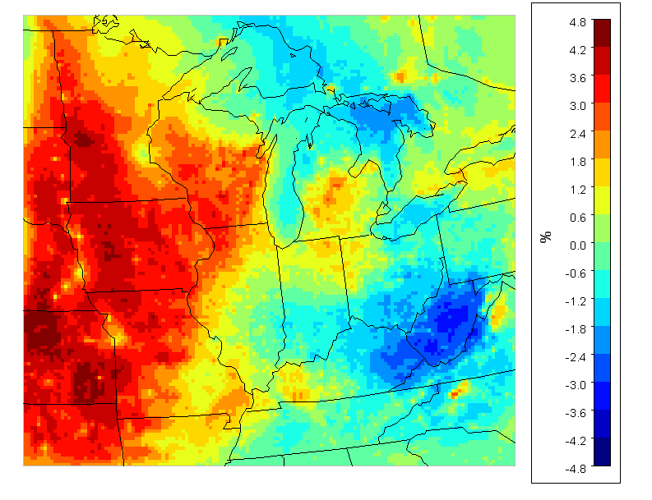
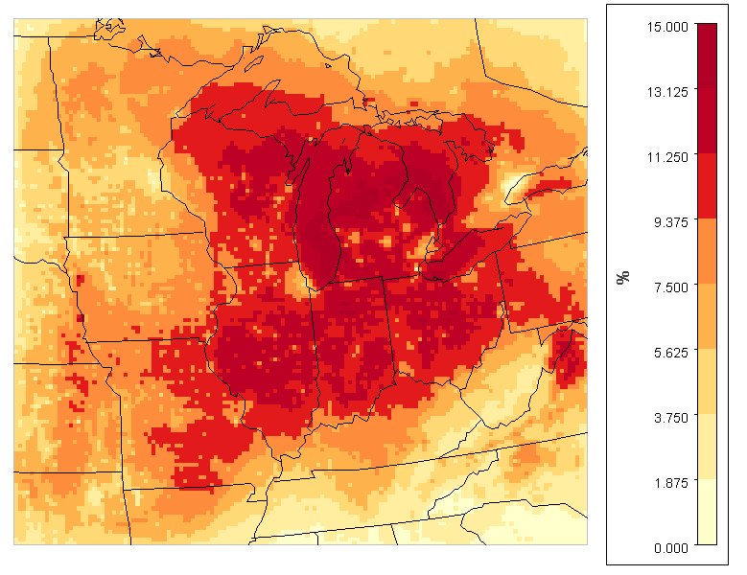
Graphing % Reduction TNO₃ Case: 30% NO_{x} Cut
Graphing % Reduction TNH₃ Case: 30% NH₃ Cut
30% NO_{x} Cut only reduces TNO₃ by less than 12%
30% NH₃ Cut reduces TNH₃ by 22% or more
Graphing % Reduction PM_{2.5}
Case: 30% NO_{x} Cut
Graphing % Reduction PM_{2.5}
Case: 30% NH₃ Cut
PM ↓
PM ↑
30% NH₃ Cut reduces PM_{2.5} by 10-15%

Slide 22
Conclusions – A refined conceptual model of wintertime episodes in the Upper Midwest
Composition: Confirming results from past studies. Database of time-resolved concentrations now available.
Urban-rural contrast: More episodes recorded at urban site. Urban primary pollutant enhancement quantified. Urban secondary enhancement <20% of inorganic total on average.
Primary sources? Local primary OC important. Role of primary local NO_{x} under investigation with CMAQ.
Meteorology: Meteorology critical to episode occurrence and prediction. Stagnant low pressure systems, warmer than average temperatures, low wind speeds, low mixing heights. Snow cover, snow melt, and fog correlated with episodes.
Nitrate formation chemistry: Both daytime and nighttime pathways important.
Sensitivity of episodes: Direct modeled sensitivity from CMAQ is fairly accurate despite low NH₃ bias. System responds to either reductions in total nitrate or total ammonia, but NO_{x} controls inefficient at delivering total nitrate reduction in NO_{x} source regions. Impact of local vs. regional NO_{x} reductions under investigation.
3D Model skill: Fairly skilled, especially on average. Mixed skill for timing and intensity of individual episodes.

Slide 23
Thank You!
Full reports on LADCO Winter Nitrate Study available at ladco.org and on Stanier group website
Questions?

Slide 24
Nitrate formation analysis by process analysis
Daytime
Averages 0.075 ppb/hr in surface layer
NO₂ + OH → HNO₃ (R1)
NO₂ + O₃ → NO₃ + O₂ (R2)
NO₃+NO₂ ↔ N₂O₅ (R3)
N₂O₅ → NO₂ + NO₃ (R4)
NO₃ + VOC→ organic products (R5)
N₂O₅ + H₂O → 2HNO₃ (R6)
Nighttime
Averages
0.044 ppb/hr
in surface layer
RH and composition dependent accommodation
coefficient, uncertain

Slide 25
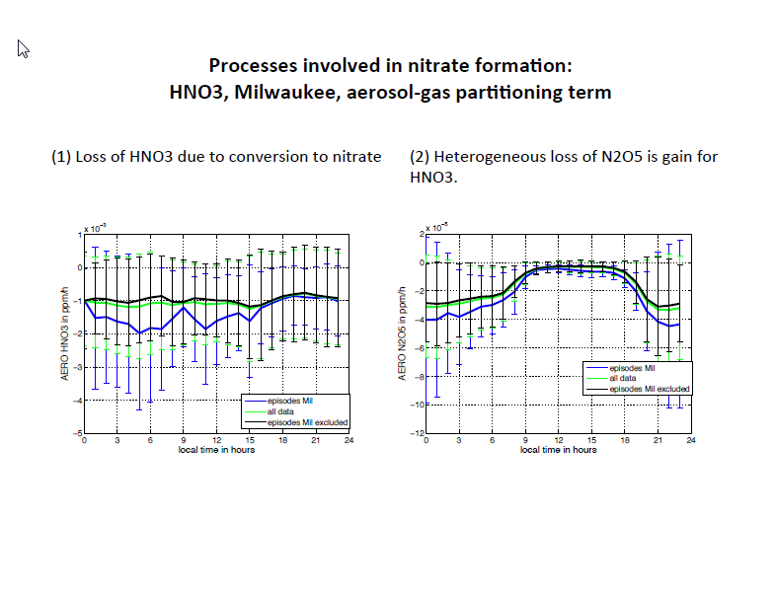
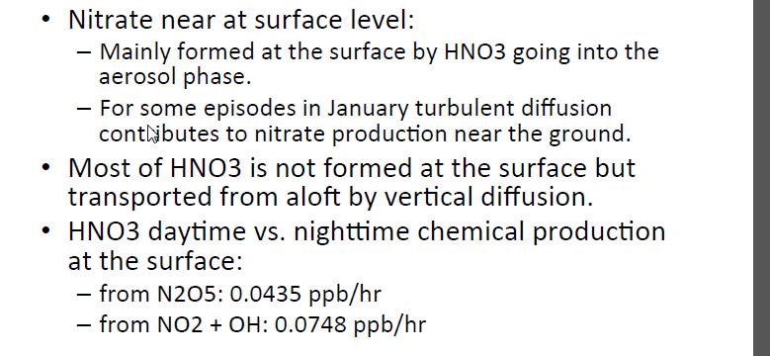

Slide 26
Model Skill Continued… Gas Ratio Prediction Skill
Measurements 1.0 – 1.7. Model low on ammonia, but also low on sulfate and nitrate. Model range 1.1 – 1.5.

Slide 27
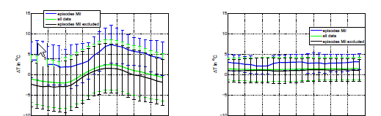
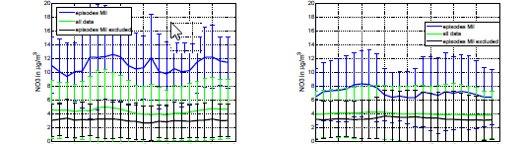
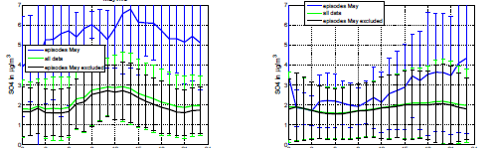
Model Skill … Additional Evaluation Using Diurnal Patterns
Model Observations
Temp.
Nitrate
Sulfate

Slide 28
Ammonia Availability
NH3 rich
NH3 poor

Slide 29
Approach
Run ISORROPIA for every hour of the study using 400 different cases with varying reductions in
  Total ammonia (10), total sulfate (4), and total nitrate (10)
Make contour plots showing ammonia vs. nitrate sensitivity for constant sulfate cases.

Slide 32
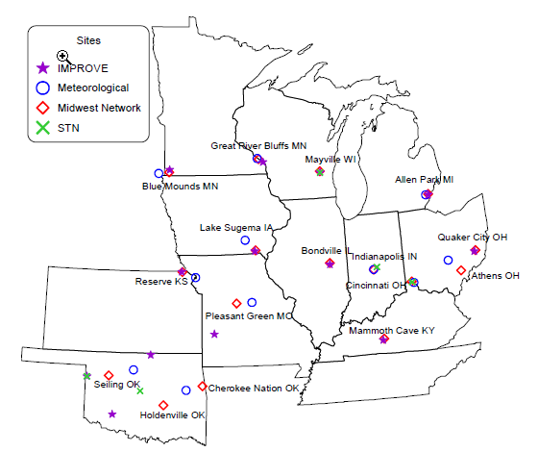
Comparison to Blanchard Midwest Ammonia Monitoring Project

Slide 33
1A
Mayville study-study comparison
a
Milwaukee (d-e-f)
2A
b
e
Mayville episodes
d
5A
f
3A
1E
c
4A
3E
4E
5E
Great River Bluffs MN (A=DJF avg; E=Feb 3, 2005 episode)
Mayville WI (A=DJF avg)
Lake Sugema IA (A=DJF avg; E=Feb 3, 2005 episode)
Bondville IL (A=DJF avg; E=Feb 3, 2005 episode)
Allen Park MI (A=DJF avg; E=Feb 3, 2005 episode)
a Mayville (JFM avg; no episodes)
b Mayville (JFM avg; all hours)
c Mayville (JFM avg; episodes)
d Milwaukee (JFM avg; no episodes)
e Milwaukee (JFM avg; all hours)
f Milwaukee (JFM avg; episodes)
Lake Sugema

Slide 34
I
1A
Mayville study-study comparison
II
a
Milwaukee (d-e-f)
2A
b
e
Mayville episodes
d
5A
f
III
3A
1E
c
4A
3E
4E
5E
IV
Great River Bluffs MN (A=DJF avg; E=Feb 3, 2005 episode)
Mayville WI (A=DJF avg)
Lake Sugema IA (A=DJF avg; E=Feb 3, 2005 episode)
Bondville IL (A=DJF avg; E=Feb 3, 2005 episode)
Allen Park MI (A=DJF avg; E=Feb 3, 2005 episode)
a Mayville (JFM avg; no episodes)
b Mayville (JFM avg; all hours)
c Mayville (JFM avg; episodes)
d Milwaukee (JFM avg; no episodes)
e Milwaukee (JFM avg; all hours)
f Milwaukee (JFM avg; episodes)
Lake Sugema
I nitrate sens > ammonia sens
II balanced sensitivity
III ammonia sens > nitrate sens
IV only sensitive to ammonia

Slide 35
Future Work
Modeling episodes at 12 km with CMAQ
Look at sensitivity in model versus measured sensitivity
Look at skill for total ammonia and total nitrate
Investigate skill for total nitrate (and NOx and NOy) temporal and spatial patterns
Investigate link between O3 and nitrate formation

Slide 36
Supporting slides

Slide 42
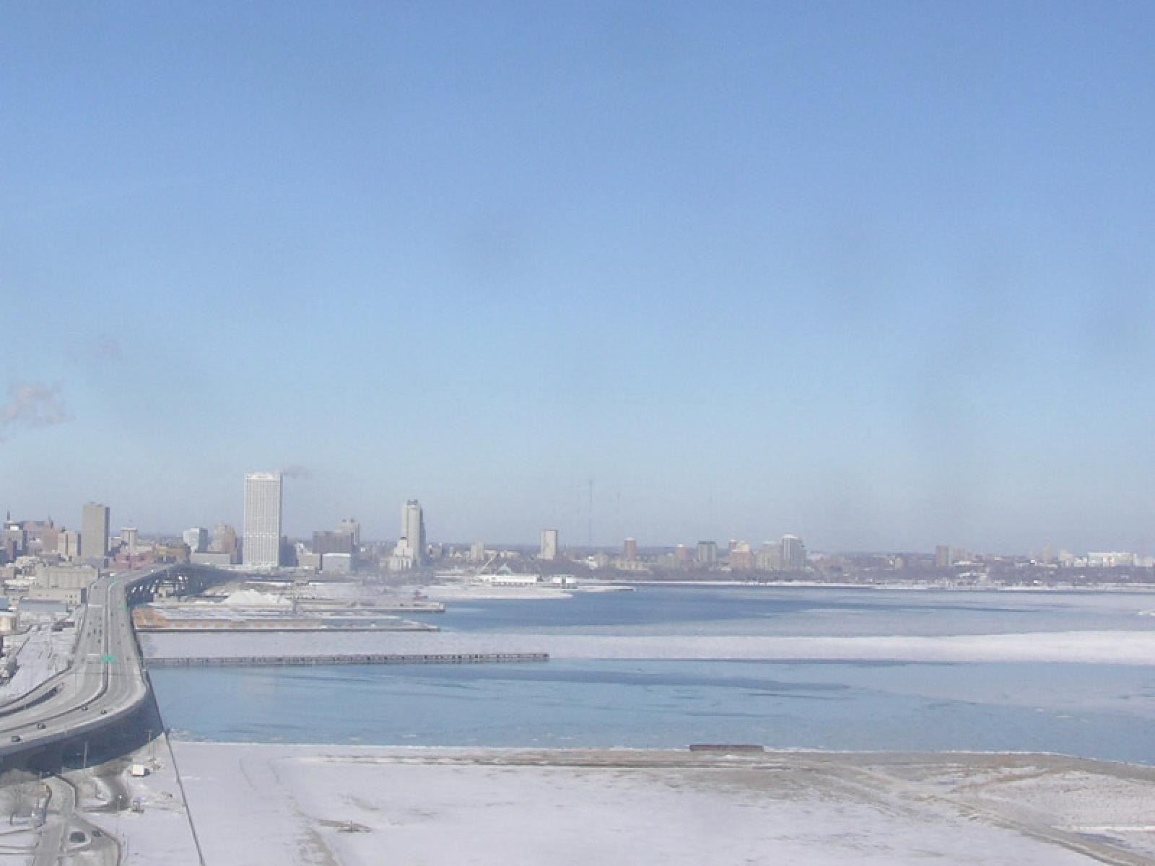
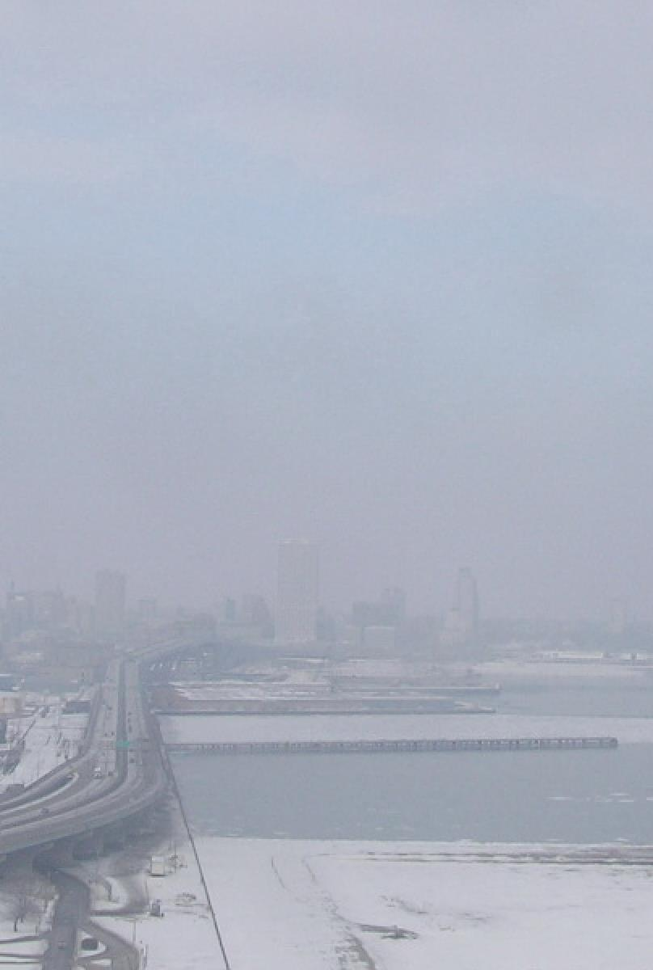
January 22 (11 am) January 24 (11 am)
2009 2009

Slide 45
Gases
NOx
Ammonia
Nitric Acid
Local Reaction
NOx → Nitric Acid
NOx
Reacted NOx
Nitric Acid
Nitrogen Leaving the Balance as Gas
Regionally Transported Pollutants
PM
Ammonia
Facility Specific
Emissions Within ~3 km
PM NOx Ammonia
Emissions from Local Counties
Ammonium
Nitrate PM
ammonia
Nitric acid
Human Exposure to Mixed PM
weather
Regional “Other” PM – Ammonium Sulfate, Organics
Local Primary PM – e.g. Vehicle & Industry Emissions

Slide 46
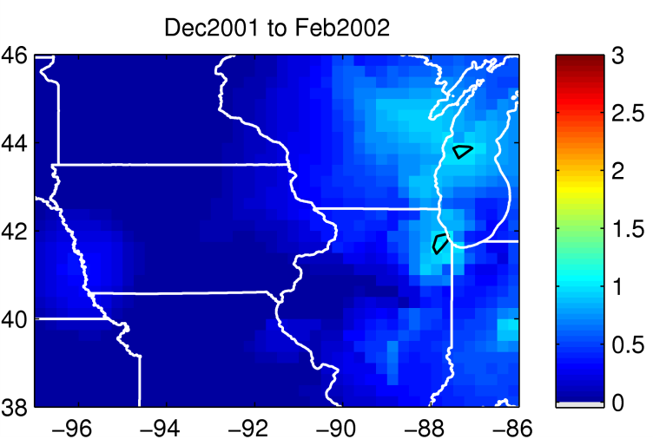
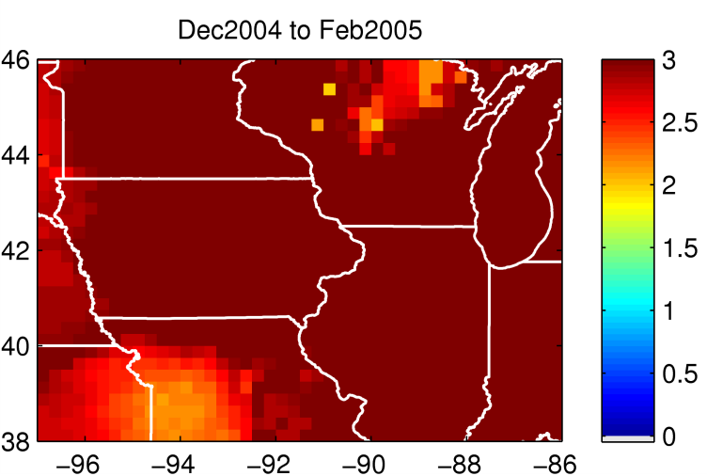
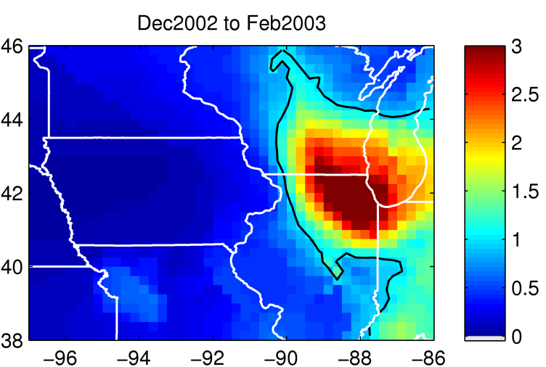
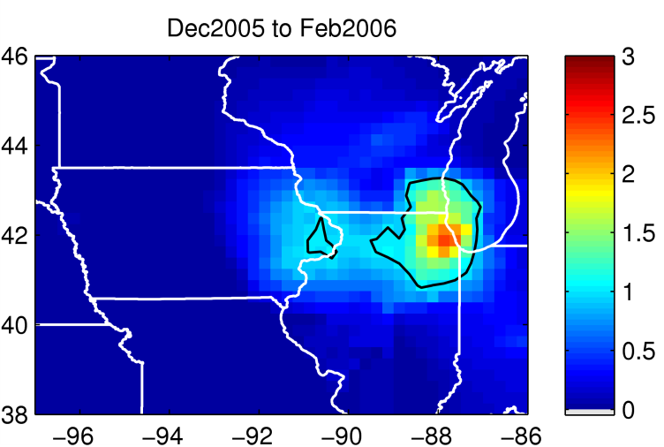
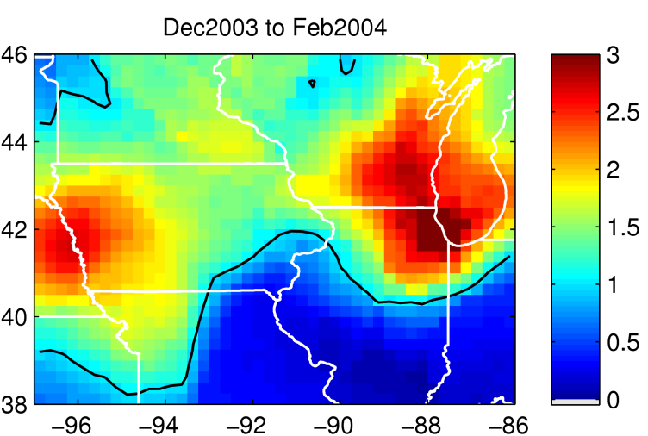
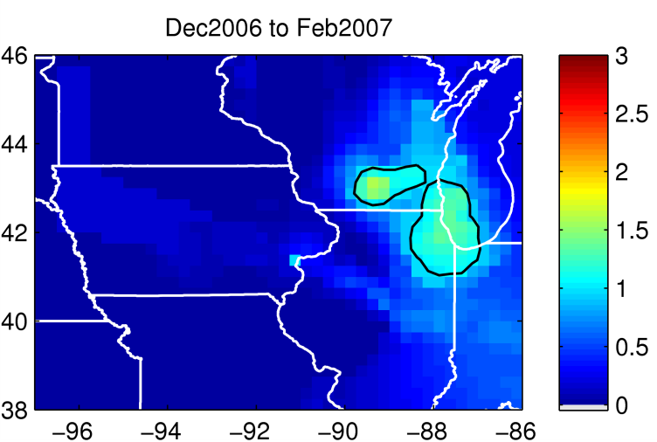
Each winter is very different

Slide 47
Species | Ox State | Compound Class
N2O5 | +5 | NOy
HNO3 | +5 | NOy
NO3- ion | +5 | NOy
PAN | +5 | NOy
NO3 radical | +5 | NOy
HONO | +3 | NOy
NO2 | +4 | NOx & NOy
NO | +2 | NOx & NOy
NH4+ ion | -3 | RN
NH3 | -3 | RN

Slide 53
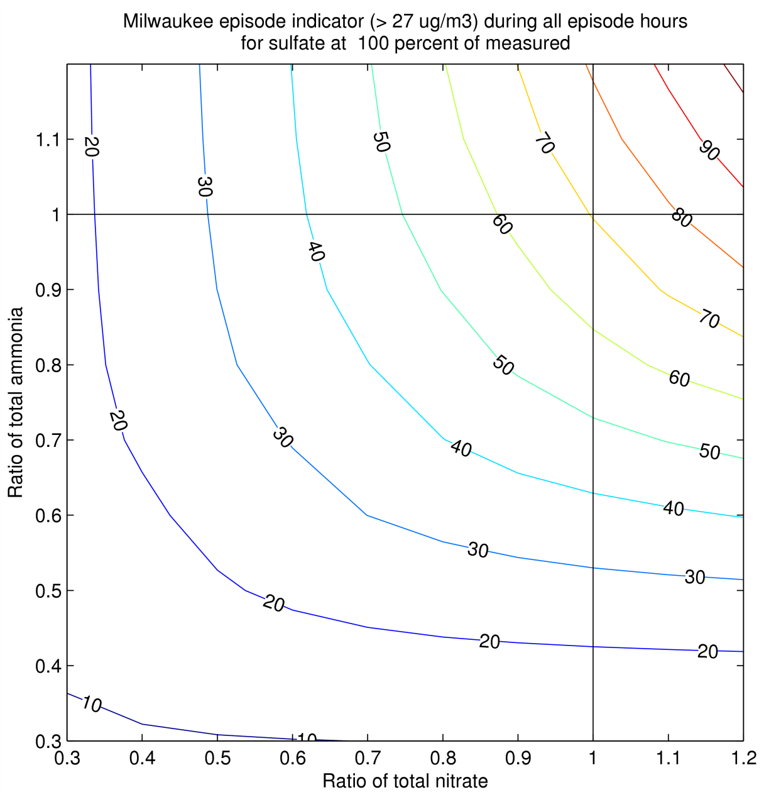

Slide 54
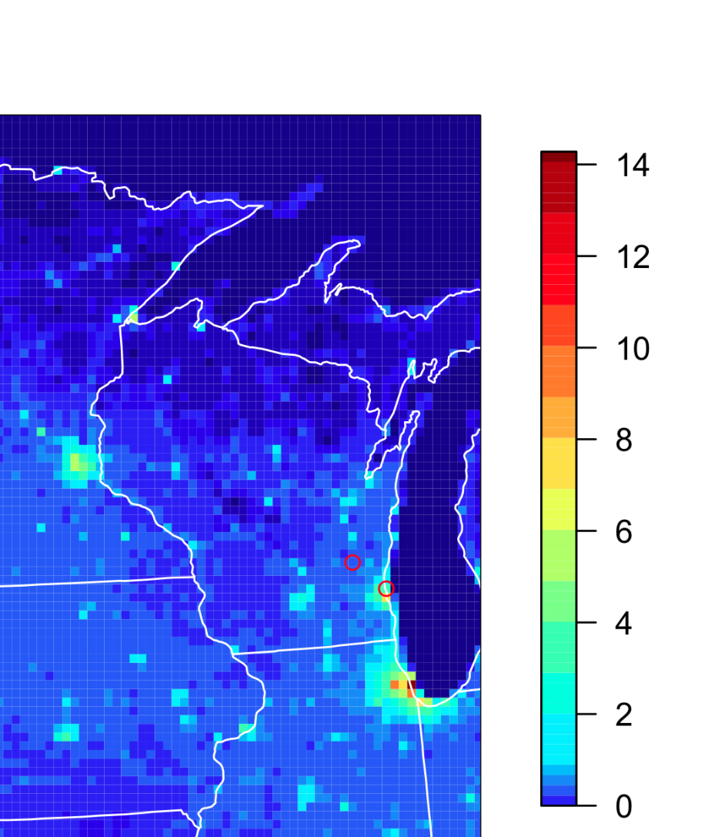
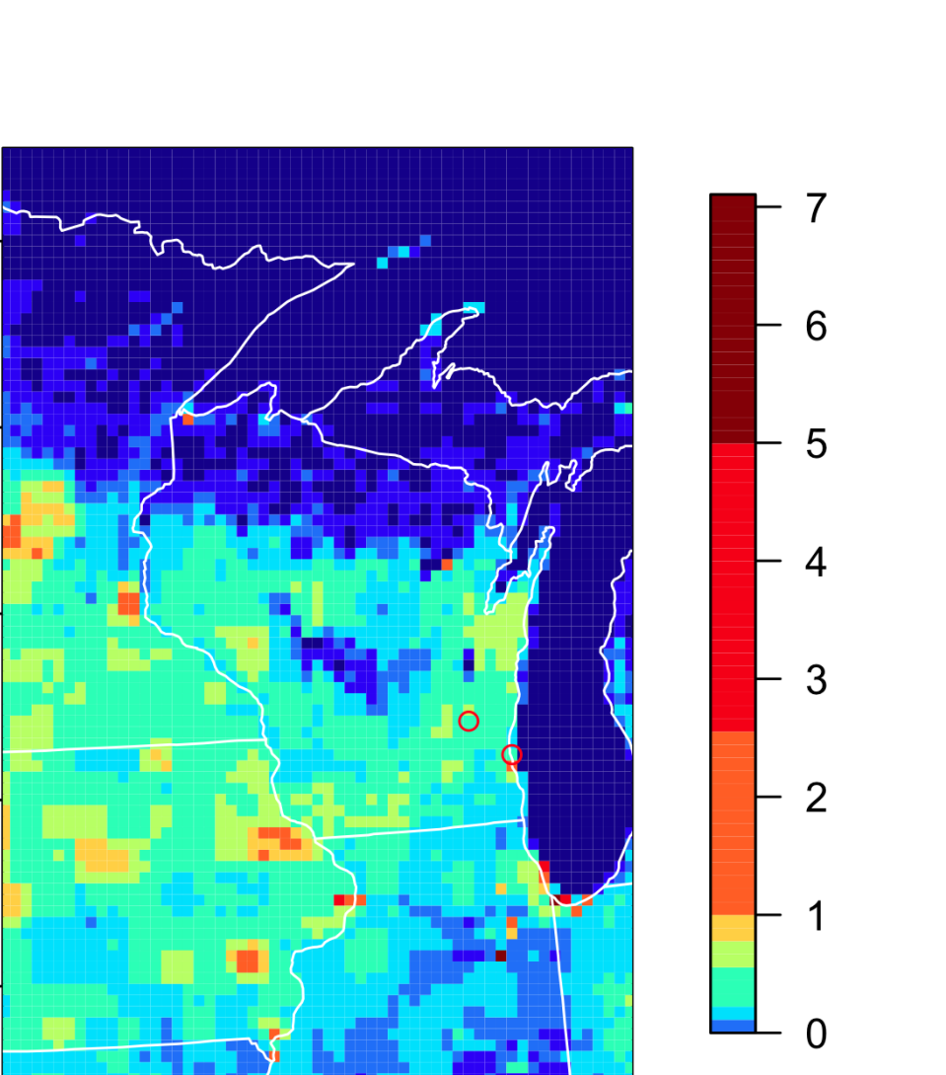
Monthly mean emissions (2001 NEI)
BC
NH3

Slide 55
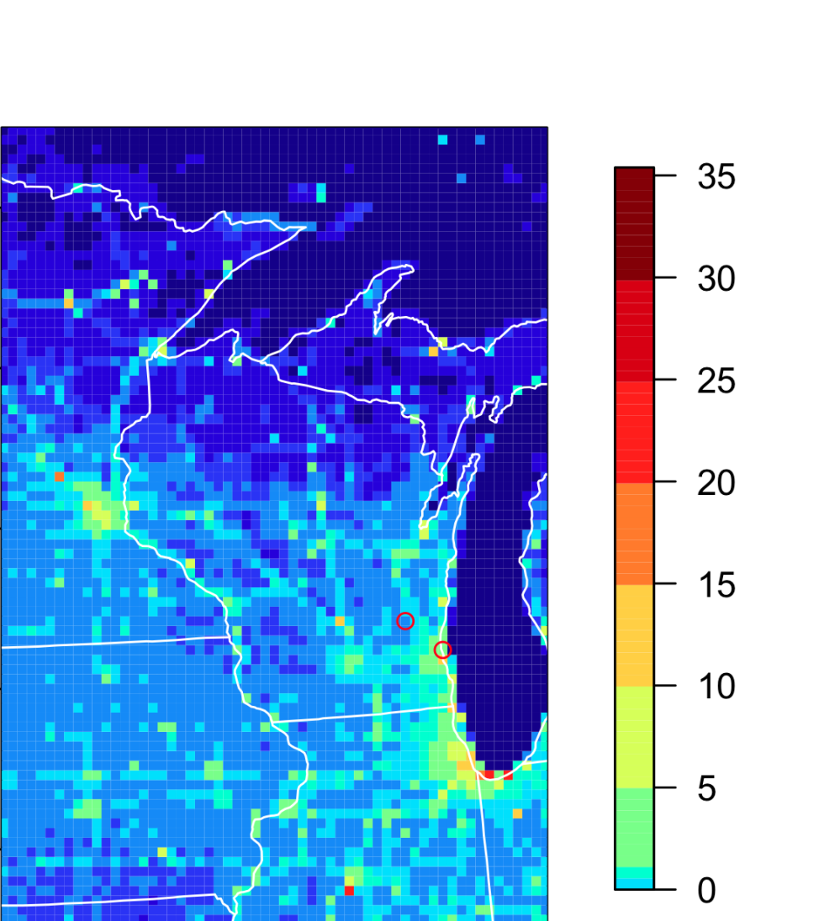
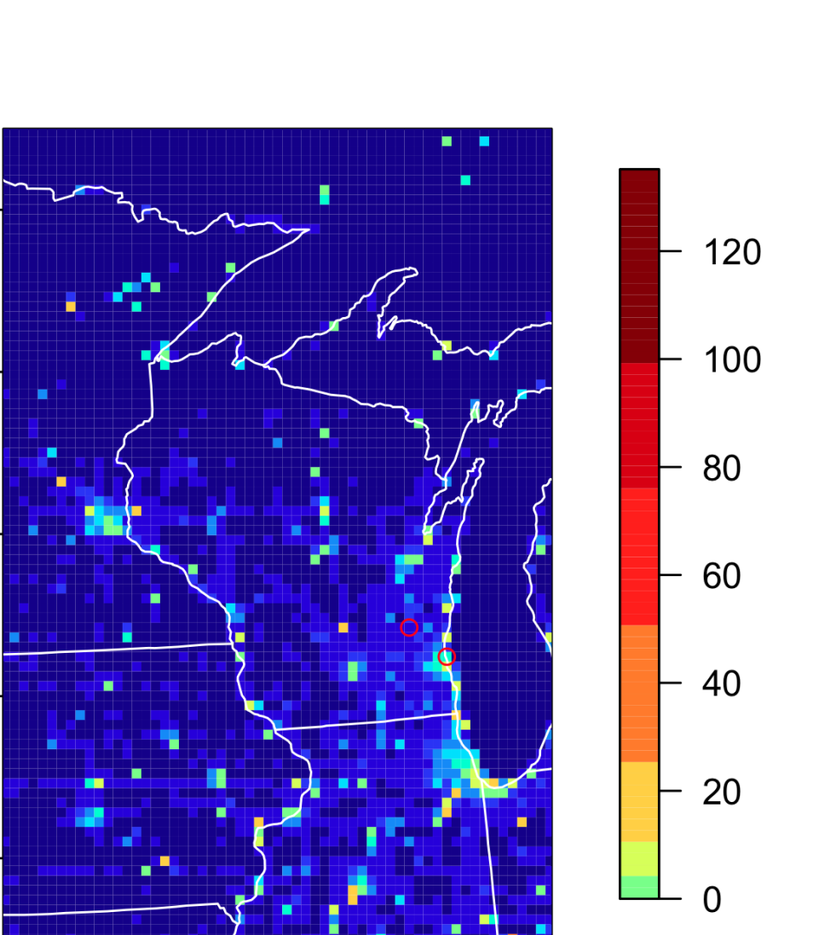
Monthly mean emissions (2001 NEI)
NOx
SO2

