Slide 1
Expansion of the National
Air Quality Forecast Capability
Ivanka Stajner¹, Jeff McQueen², Pius Lee³, Roland Draxler³,
Phil Dickerson⁴, Kyle Wedmark^{1,5}, Tim McClung¹
1) NOAA NWS/OST, 2) NOAA NWS/NCEP, 3) NOAA ARL, 4) EPA, 5) Noblis
- Background on NAQFC
- Progress in 2011:
Ozone, Smoke, Dust, PM2.5
- Looking Ahead
CMAS, Special session on Air Quality Modeling Applications in memory of Daewon Byun
Chapel Hill, October 24, 2011

Slide 2
National Air Quality Forecast Capability
Current and Planned Capabilities, 10/11
Improving the basis for AQ alerts
Providing AQ information for people at risk
FY11 Prediction Capabilities:
Operations:
Ozone nationwide: expanded from EUS to
CONUS (9/07), AK (9/10) and HI (9/10)
Smoke nationwide: implemented over CONUS
(3/07), AK (9/09), and HI (2/10)
Experimental testing:
  Ozone predictions
  Dust predictions over CONUS
Developmental testing:
Ozone upgrades
Components for particulate matter (PM) forecasts
2009: smoke
2010: ozone
6
2007: O_{3,}& smoke
2005: O₃
2010
smoke
ozone
Near-term Operational Targets:
Higher resolution prediction
Longer range:
Quantitative PM_{2.5} prediction

Slide 3
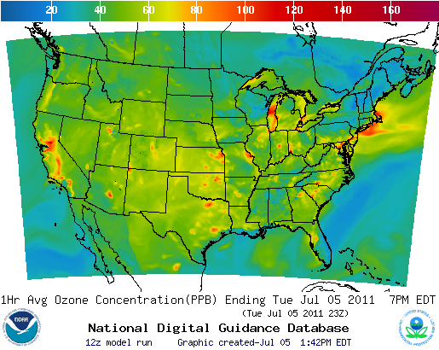
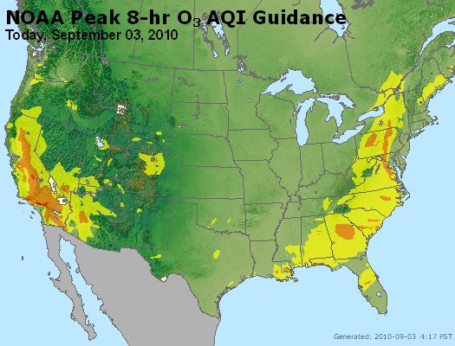
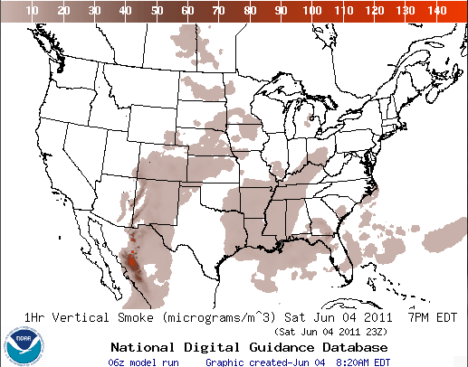
National Air Quality Forecast Capability
End-to-End Operational Capability
Model Components: Linked numerical prediction system
Operationally integrated on NCEP’s supercomputer
  NCEP mesoscale NWP: WRF-NMMB
  NOAA/EPA community model for AQ: CMAQ
  NOAA HYSPLIT model for smoke prediction
Observational Input:
  NWS weather observations; NESDIS fire locations
  EPA emissions inventory
Gridded forecast guidance products
  On NWS servers: airquality.weather.gov and ftp-servers
  On EPA servers
  Updated 2x daily
Verification basis, near-real time:
  Ground-level AIRNow observations
  Satellite smoke observations
Customer outreach/feedback
  State & Local AQ forecasters coordinated with EPA
  Public and Private Sector AQ constituents
AIRNow

Slide 4
Progress in 2011
Ozone, smoke nationwide; dust testing
Ozone Upgrades: Nationwide predictions since 9/10
    Operations: Updated emissions for 2011 (CEM point sources, DOE projection factors); Predictions driven by a new NMMB meteorological model (since 10/18/11)
    Experimental testing: CB-05 mechanism
    Developmental testing: Changing boundary conditions, dry deposition, PBL in CB-05; testing newer CMAQ 4.7.1 driven by NMMB meteorological model
Smoke: Expanded Forecast Guidance Nationwide
    Developmental testing: Improvements to verification
Aerosols: Developmental testing providing comprehensive dataset for diagnostic evaluations. (CONUS)
    Testing CMAQ 4.6 and 4.7.1 with CB-05 chemical mechanism with AERO-4 aerosol modules
      Qualitative; summertime underprediction consistent with missing source inputs
    Dust and smoke inputs: testing dust contributions to PM2.5 from global sources
      Real-time testing of combining smoke inputs with CMAQ-aerosol
    Experimental testing of dust prediction from CONUS sources
    Real-time testing of assimilation of surface PM2.5 measurements
    R&D efforts continuing in chemical data assimilation, real-time emissions sources, advanced chemical mechanisms
Notes:
Emission updates:
1) Updated CEM point source data from 2008 to 2009.
2) Updated DOE projection factors from 2010 to 2011.
3) Changed the number of electricity marketing module (EMMs)
from 13 to 22, consistent with the changes made in DOE models.
4) Removed climatological forest fire emissions in experimental ozone predictions
Updates in CMAQ 4.7:
(a) updates to the heterogeneous N2O5 parameterization,
(b) improvement in the treatment of secondary organic aerosol (SOA),
(c) inclusion of dynamic mass transfer for coarse-mode aerosol,
(d) revisions to the cloud model, and
(e) new options for the calculation of photolysis rates.

Slide 5
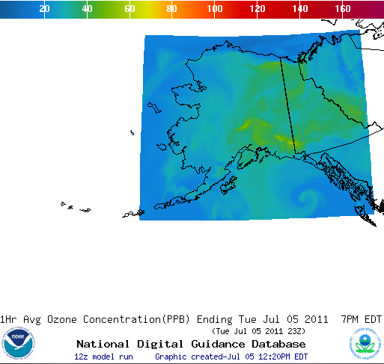
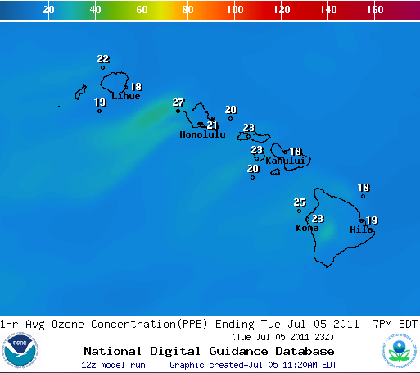
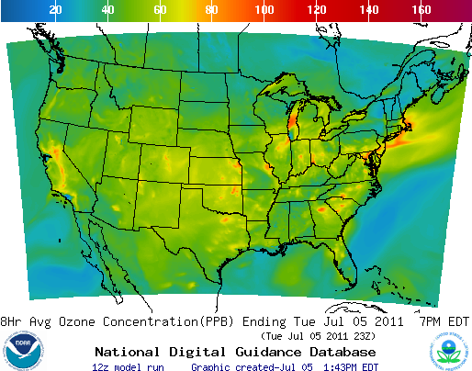

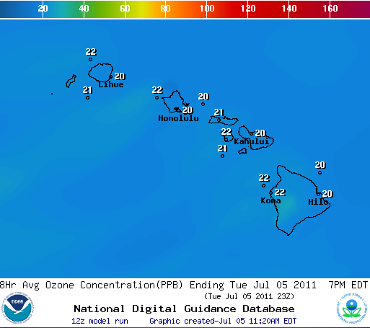
Operational Nationwide Ozone
Operational predictions at http://airquality.weather.gov/
1-Hr Average Ozone
1-Hr Average Ozone
1-Hr Average Ozone
8-Hr Average Ozone
8-Hr Average Ozone
8-Hr Average Ozone

Slide 6
CONUS ozone prediction:
Summary verification 2009 to 2011
2009
CONUS, wrt 76ppb Threshold
Operational
2010
CONUS, wrt 76ppb Threshold
Operational
0.98
2011
CONUS, wrt 76ppb Threshold
0.99
0.96
Operational
0.94
0.95
See verification of experimental
CB05 predictions (Jerry Gorline, Tuesday 2pm), and developmental predictions CMAQ 4.7.1 (Yunsoo Choi, Wednesday 9:30 am)

Slide 7
Chemical mechanism sensitivity analysis
Experimental ozone prediction (with CB05 mechanism) shows larger biases than
operational ozone prediction (CB-IV mechanism)
  Summertime,
  Eastern US.
Sensitivity studies in progress:
  Box model studies, e.g. organic nitrate treatment (Saylor and Stein)
  Emission sensitivity (Poster by Yunsoo Choi)
Seasonal bias of daily mean ozone for CONUS
Operational (CB-IV)
Experimental (CB05)
Mechanism differences
Ozone production
Precursor budget
Seasonal input differences
Emissions
Meteorological parameters
in 2009

Slide 8
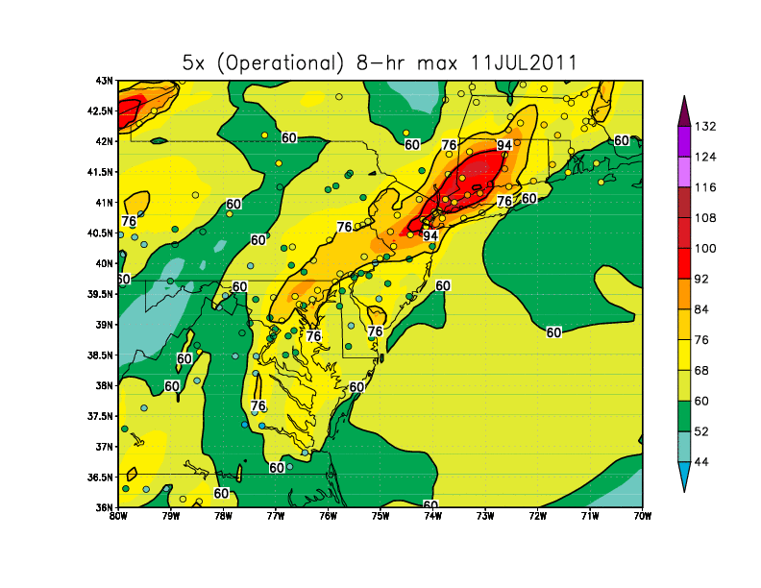
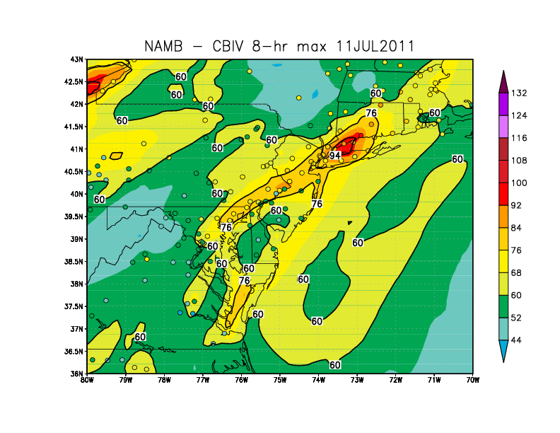
Impact of meteorological model
Operational NAM driven ozone predictions
Testing of NMMB driven ozone predictions
Observed monitor values in the circles
Impacts of NMMB meteorology and land use changes on air quality predictions discussed by Jeff McQueen, and see posters by Marina Tsidulko and Jianping Huang
8

Slide 9
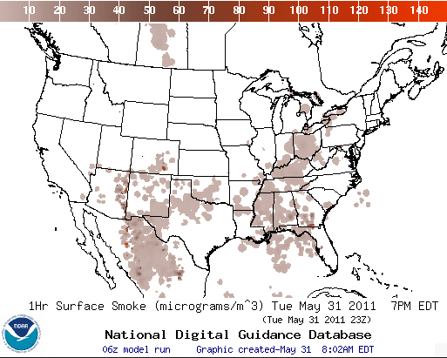
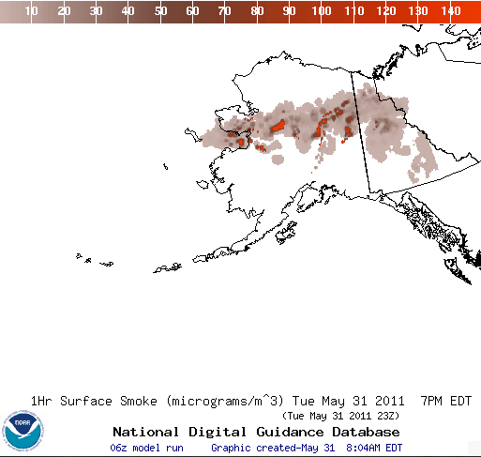
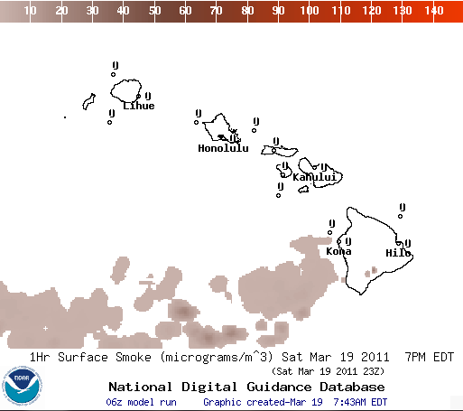
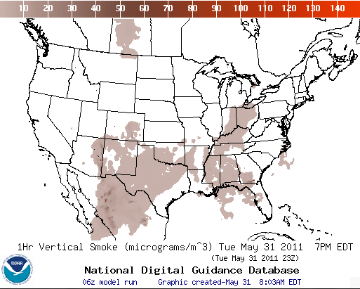
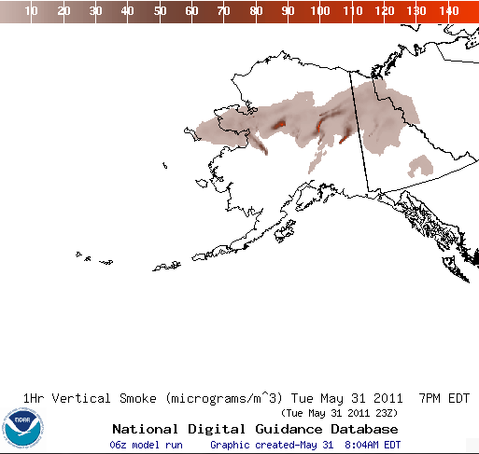
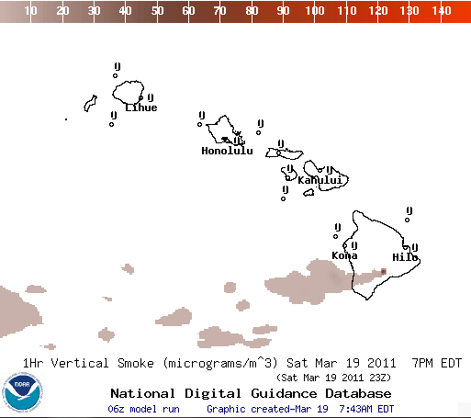
Operational Nationwide Smoke
Operational predictions at http://airquality.weather.gov/
Surface Smoke
Surface Smoke
Surface Smoke
Vertical Smoke
Vertical Smoke
Vertical Smoke

Slide 10
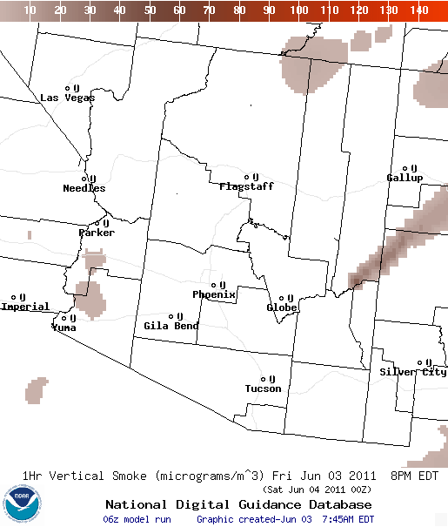
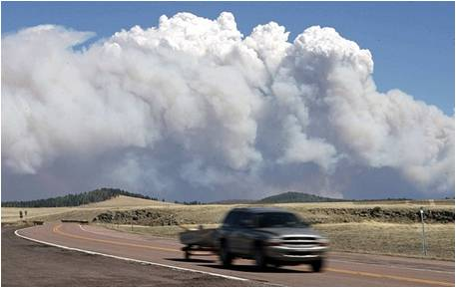
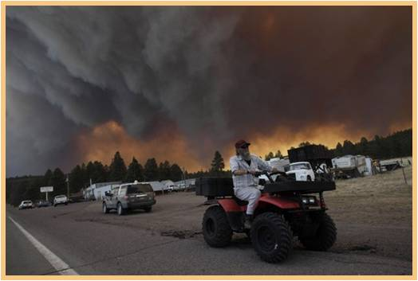
Wallow Wildfire in Arizona
June 6 (Luna, NM, AP)
Wallow fire, June 3 ¹
Fire began May 29, 2011, consumed more then 500,000 acres and 32 homes³
16 injuries³; more then 9000 people evacuated ²
60mph winds contributed to its rapid spread ¹
Code orange air quality forecast issued for Albuquerque for 4 days (June 6,8,9,13) - NWS prediction included high smoke concentrations
Hazardous air quality predicted by NAQFC and observed in Springerville, AZ
NAQFC joined coordination calls with state, local, federal agencies in AZ and NM, and USFS Fire Science Lab in Seattle
Animation of NOAA’s prediction of smoke concentrations in column
Eastern Arizona wildfire still rages, AP, June 5, 2011. http://www.latimes.com/news/la-na-arizona-wildfires-20110606-pictures,0,6897558.photogallery
As Arizona wildfire rages, officials allow some to return home, CNN, June 12, 2011 http://www.cnn.com/2011/US/06/12/arizona.wildfires/
InciWeb, Incident information system, accessed on Oct. 23, 2011 http://www.inciweb.org/incident/article/2262/
10

Slide 11
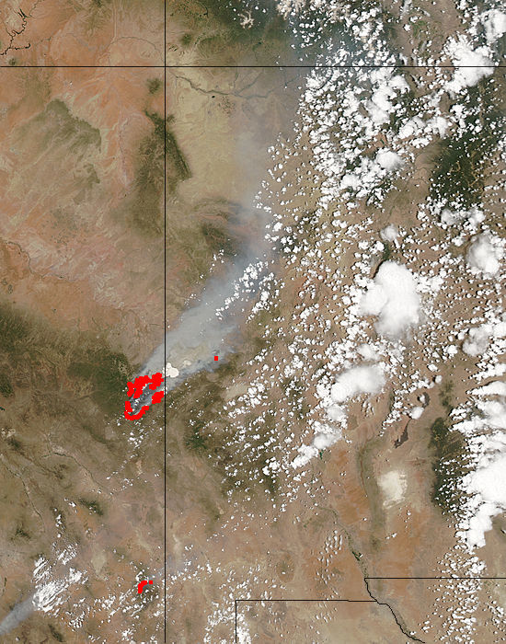
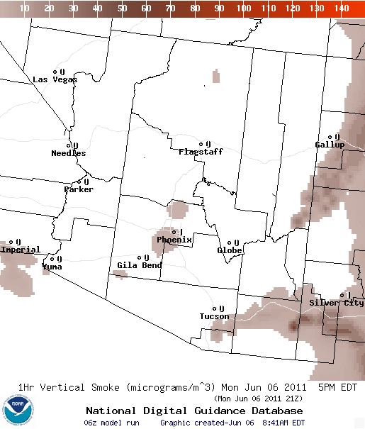
June 6, 2011
MODIS
NWS smoke prediction
Wallow North fire, Arizona : 2011/157 - 06/06 at 20:40 UTC
Aqua 1km pixel size
Vertical column smoke at 21 Z on 06/06
11

Slide 12
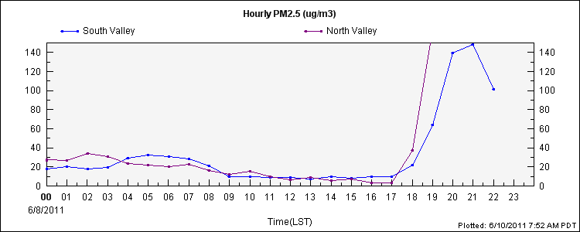
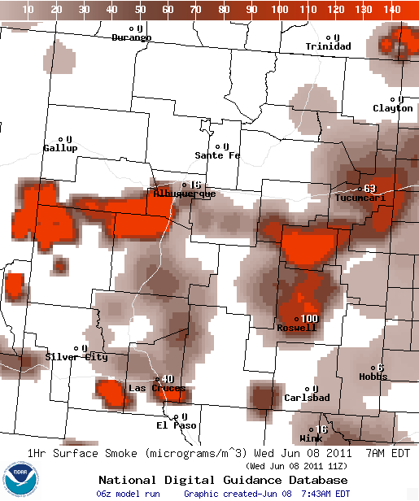
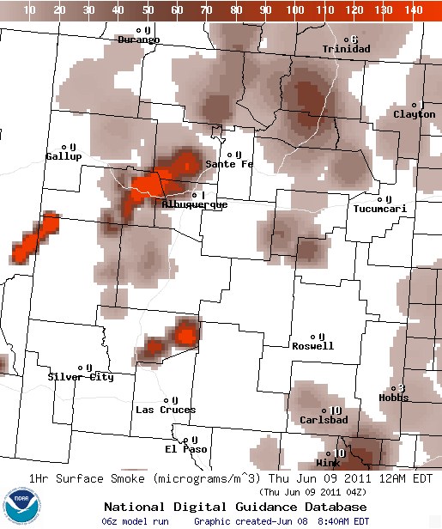
Albuquerque, NM
Surface PM2.5 observations
http://www.airnowtech.org/
NOAA’s predictions of surface smoke concentrations
airquality.weather.gov
11 Z on 06/08/2011
04 Z on 06/09/2011
12

Slide 13
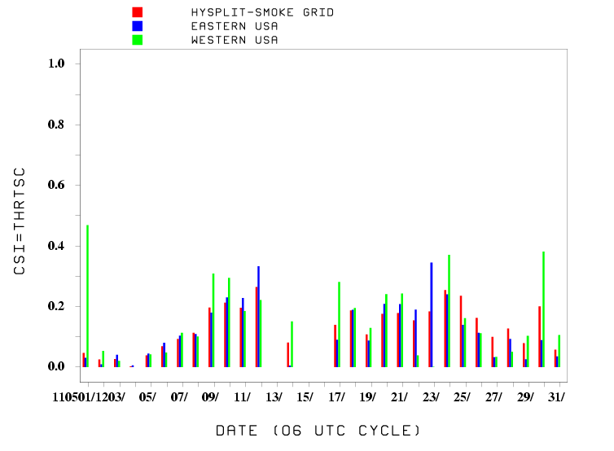
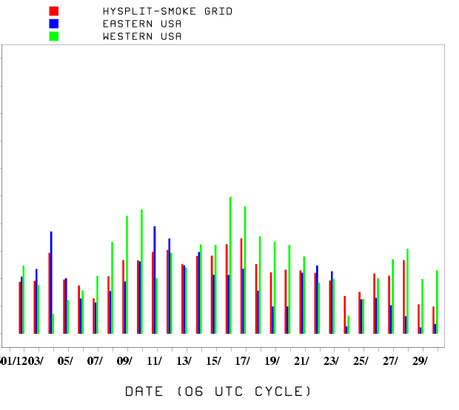
Verification of smoke predictions
Daily time series of FMS for smoke concentrations larger than 1um/m3
A^{OB}
May 2011
May 2011
June 2011
A^{OV}
A^{PR}
Figure of merit in space (FMS), which is a fraction of overlap between predicted and observed smoke plumes, exceeds 0.08 in the western US since May 29 when Wallow wildfire began.
NESDIS GOES Aerosol/Smoke Product is used for verification
13

Slide 14
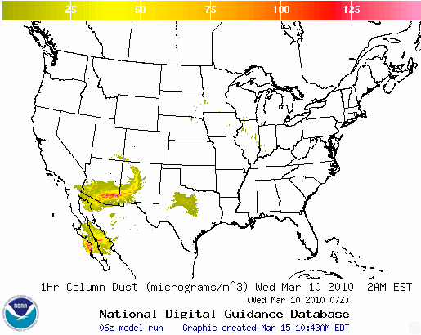
CONUS Dust Predictions: Experimental Testing
Experimental predictions at http://airquality.weather.gov/expr/
  Standalone prediction of airborne dust from dust storms:
  Wind-driven dust emitted where surface winds exceed thresholds over source regions
Source regions with emission potential estimated from monthly MODIS deep blue climatology (2003-2006).
  HYSPLIT model for transport, dispersion and deposition
  Updated source map in experimental testing (Draxler et al., JGR, 2010)
  Emissions modulated by soil moisture in developmental testing.
Developmental testing
14

Slide 15
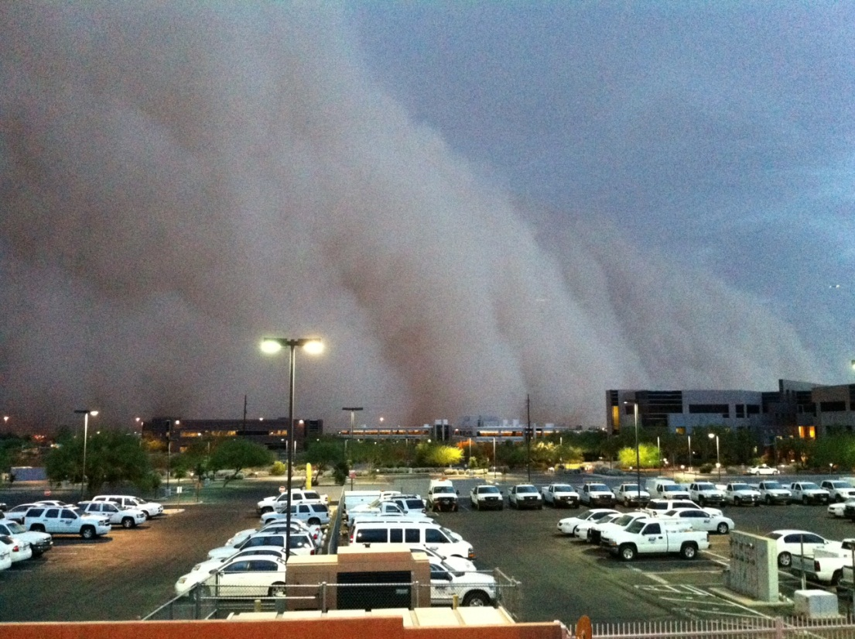
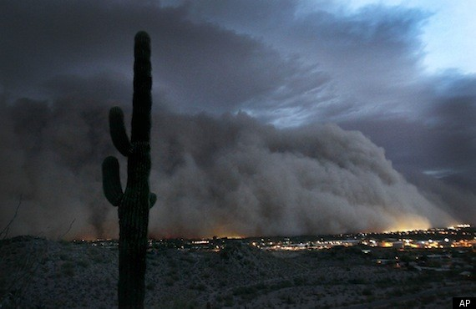
Phoenix, AZ Haboob July 5, 2011
Massive dust storm hit Phoenix, AZ in the evening on July 5, 2011²
Cloud was reported to be 5,000 feet when it hit, radar shows heights from 8,000-10,000 feet tall and 50 miles wide
Originated from Tucson
Stopped air traffic for over an hour
Arizona DEQ reported a PM10 concentration of 6,348 ug/m³ during peak of storm at site in downtown Phoenix¹
Storm moved through Phoenix at 30-40 mph¹
Source: http://www.wrh.noaa.gov/psr/pns/2011/July/DustStorm.php
“More Phoenix storms forecast after huge evening dust storm,” http://www.azcentral.com/community/phoenix/articles/2011/07/06/20110706phoenix-dust-storm-weather-abrk.html
Phoenix Dust Storm: Arizona Hit with Monstrous ‘Haboob’, http://www.huffingtonpost.com/2011/07/06/phoenix-dust-storm-photos-video_n_891157.html
Source: http://www.huffingtonpost.com/2011/07/06/phoenix-dust-storm-photos-video_n_891157.html
15

Slide 16
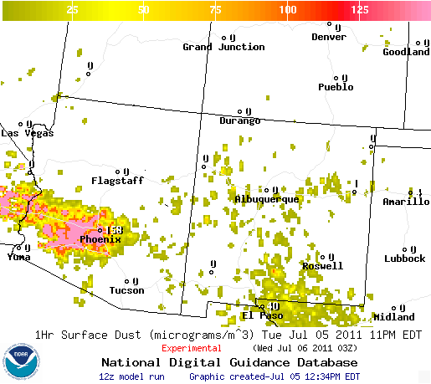
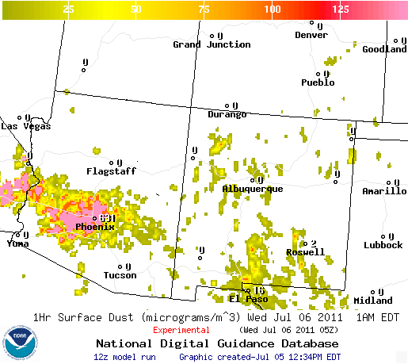
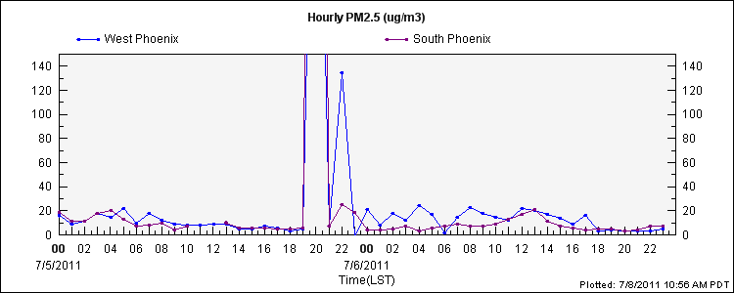
Phoenix Observed PM 2.5 Observations
Based on observations, largest impact on Phoenix was between 8 PM and 10 PM LST
Predicted surface dust concentrations:
- 8PM 158 ug/m³
- 10PM 631 ug/m³
*Note* AZ three hours behind EDT in summer
Timing of July 5 storm: beginning time of predicted storm is correct, but predicted storm extends past observed ending
For dust storm on October 4 near Picacho, AZ developmental predictions (with more sources and emissions modulated by real time soil moisture performed better). This configuration is targeted for experimental testing on November 1.
Peak values: 996 ug/m³ at South Phoenix station at 8PM and 506 ug/m³ at West Phoenix station at 8 PM (AIRNow Tech)
16

Slide 17
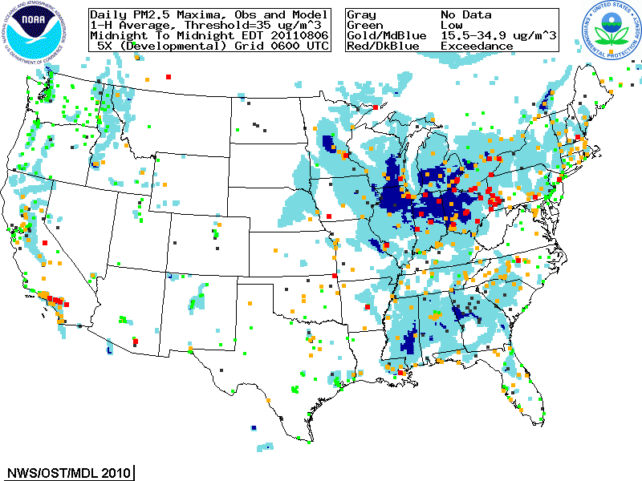
Developmental PM2.5 predictions for Summer 2011
  Focus group access only, real-time as resources permit
  Aerosols over CONUS
    From NEI sources only
    CMAQ:
    CB05 gases, AERO-4 aerosols
    Sea salt emissions and reactions
    No climatological wildfire emissions
  Testing of real-time wildfire smoke emissions in CMAQ

Slide 18
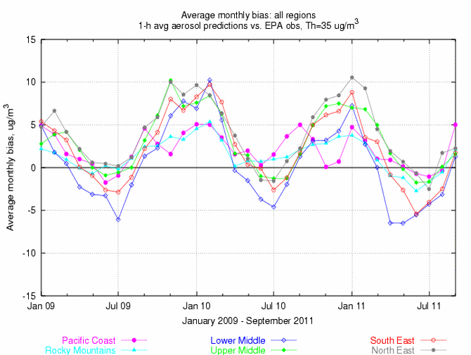
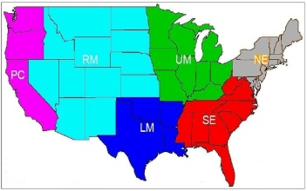
Quantitative PM performance
Forecast challenges
Aerosol simulation using emission inventories:
Seasonal bias: winter - overprediction; summer – underprediction Speciated PM2.5 component biases (poster by Yunhee Kim)
Intermittent sources (contributions of wildfire smoke are in real time testing; also evaluation in poster by Hyun Cheol Kim)
Chemical boundary conditions/trans-boundary inputs (Poster by Youhua Tang; Pius Lee’s talk at 3:20pm today)

Slide 19
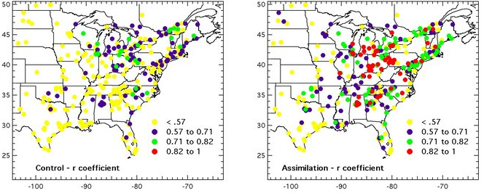
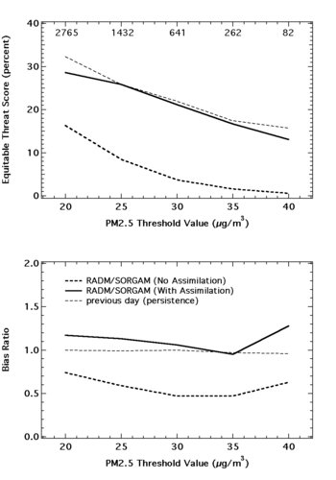
Assimilation of surface PM data
Assimilation increases correlation between forecast and observed PM2.5
Control is forecast without assimilation
Assimilation reduces bias and increases equitable threat score
Bias ratio
Equitable threat score [%]
Pagowski et al
QJRMS, 2010
Exploring bias correction approaches, e.g. Djalalova et al., Atmospheric Env., 2010
19

Slide 20
Summary
US national AQ forecasting capability status:
Ozone prediction nationwide (AK and HI since September 2010; NMMB meteorology since October 18, 2011)
Smoke prediction nationwide (HI since February 2010)
Experimental testing of dust prediction from CONUS sources (since June 2010)
Developmental testing of CMAQ aerosol predictions with NEI sources
Near-term plans for improvements and testing:
Operational dust predictions over CONUS
Development of satellite product for verification of dust predictions
Understanding/reduction of summertime ozone biases in the CB05 system
Development of higher resolution predictions (optimization of prediction code, I/O on NCEP operational computers; faster preparation of emission inputs – poster by Hyun Cheol Kim)

Slide 21
Plans for PM2.5
Development and integration of components for quantitative PM predictions:
Integration of NEI, smoke and dust sources; inventory updates
Data assimilation, bias correction; starting with surface PM monitor data
Inclusion of lateral boundaries from global model predictions
Testing advanced chemical mechanisms; evaluation of PM speciation
Closer coupling of meteorological and chemical models
Target operational implementation of initial quantitative total PM2.5 forecasts for northeastern US in FY16

Slide 22
Acknowledgments:
AQF Implementation Team Members
Special thanks to Paula Davidson, OST chief scientist and former NAQFC Manager
NOAA/NWS/OST Ivanka Stajner NAQFC Manager
NOAA/OAR Jim Meagher NOAA AQ Matrix Manager
NWS/OCWWS Jannie Ferrell Outreach, Feedback
NWS/OPS/TOC Cindy Cromwell, Bob Bunge Data Communications
NWS/OST/MDL Jerry Gorline, Marc Saccucci, Dev. Verification, NDGD Product Development
Tim Boyer, Dave Ruth
NWS/OST Kyle Wedmark, Ken Carey Program Support
NESDIS/NCDC Alan Hall Product Archiving
NWS/NCEP
  Jeff McQueen, Youhua Tang, Marina Tsidulko, AQF model interface development, testing, & integration
  Jianping Huang
  *Sarah Lu , Ho-Chun Huang Global data assimilation and feedback testing
  *Brad Ferrier, *Dan Johnson, *Eric Rogers, WRF/NAM coordination
  *Hui-Ya Chuang
  Geoff Manikin Smoke Product testing and integration
  Dan Starosta, Chris Magee NCO transition and systems testing
  Robert Kelly, Bob Bodner, Andrew Orrison HPC coordination and AQF webdrawer
NOAA/OAR/ARL
  Pius Lee, Rick Saylor, Daniel Tong , CMAQ development, adaptation of AQ simulations for AQF
  Tianfeng Chai, Fantine Ngan, Yunsoo Choi,
  Hyun-Cheol Kim, Yunhee Kim, Mo Dan
  Roland Draxler, Glenn Rolph, Ariel Stein HYSPLIT adaptations
NESDIS/STAR Shobha Kondragunta, Jian Zeng Smoke Verification product development
NESDIS/OSDPD Liqun Ma, Mark Ruminski HMS product integration with smoke forecast tool
EPA/OAQPS partners:
Chet Wayland, Phil Dickerson, Brad Johns AIRNow development, coordination with NAQFC
  * Guest Contributors

Slide 23
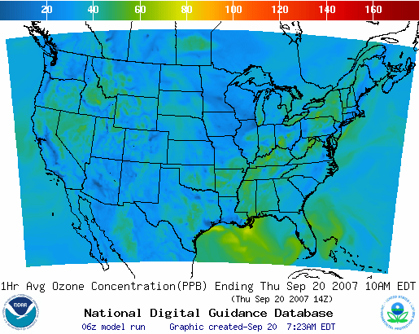
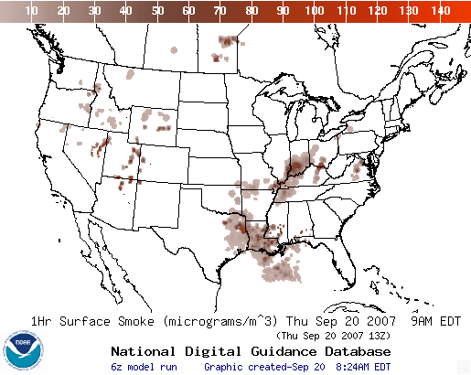
Operational AQ forecast guidance airquality.weather.gov
CONUS Ozone
Expansion Implemented September, 2007
Smoke Products
Implemented March, 2007
Further information: www.nws.noaa.gov/ost/air_quality

Slide 24
Backup

Slide 25
Real-time Verification Approach for Ozone
  Real-time verification of data
    Comparing model with observed values from AIRNow ground level observations
  Daily maximum of 8-hour ozone
    Metric is the fraction correct with respect to threshold commonly used for “code orange” AQ alerts in the US (currently 75 ppb)
  Skill target for fraction correct ≥ 0.9
d
c
Threshold
Fraction Correct =
(a+c)/(a+b+c+d)
Observations
a
b
Threshold
Prediction

Slide 26
Progress from 2005 to 2008:
Ozone Prediction Summary Verification
2005
Initial Operational Capability (IOC)
Operational, NE US Domain
EUS
2006
Operational, Eastern US
Operational
EUS
2007
Experimental, Contiguous US
Approved 9/07 to replace Eastern US config in operations
Experimental
CONUS
2008
CONUS, wrt 85ppb Threshold
Operational
CONUS

Slide 27
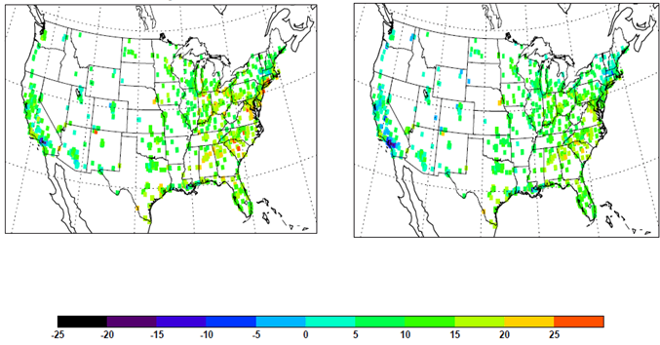
Ozone sensitivity in the CB05 system:
Experimental and developmental configuration
Model-minus-AIRNow observations: mean for daytime in August 2009
Experimental test configuration
Developmental test configuration with modified:
- Lateral boundary conditions,
- Minimum PBL height,
- Aerodynamic resistance, forest canopy height
ppbv
In depth: Byun et al. in the Processes session

Slide 28
Smoke Forecast Tool:
What is it?
Overview
  Passive transport/dispersion computed with HYSPLIT & WRF-NAM (or GFS, OCONUS). 24-hr spin-up, 48-hour prediction made daily with 6Z cycle
Fire Locations
  NESDIS/HMS: Filtered ABBA product (only fires with observed associated smoke)
Emissions
  USFS’ BlueSky algorithm for emitted PM2.5
Smoke Transport/dispersion
  HYSPLIT (Lagrangian); plume rise based on combustion heat and meteorology
Verification
  Based on satellite imagery for footprint of extent of observed smoke in atmospheric column exceeding threshold of detection
28

Slide 29
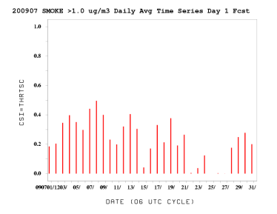
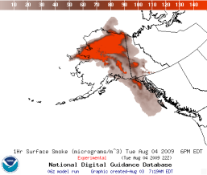
Smoke Forecast Tool
Major Components
NWP Model
NAM/WRF-NMM
NOAA/NWS
Weather
Observations
NESDIS HMS
Fire Locations
HYSPLIT Module:
NOAA/OAR
USFS’s BlueSky
Emissions Inventory:
USFS
Verification:
NESDIS/GASP Smoke
29
Notes:
29

Slide 30

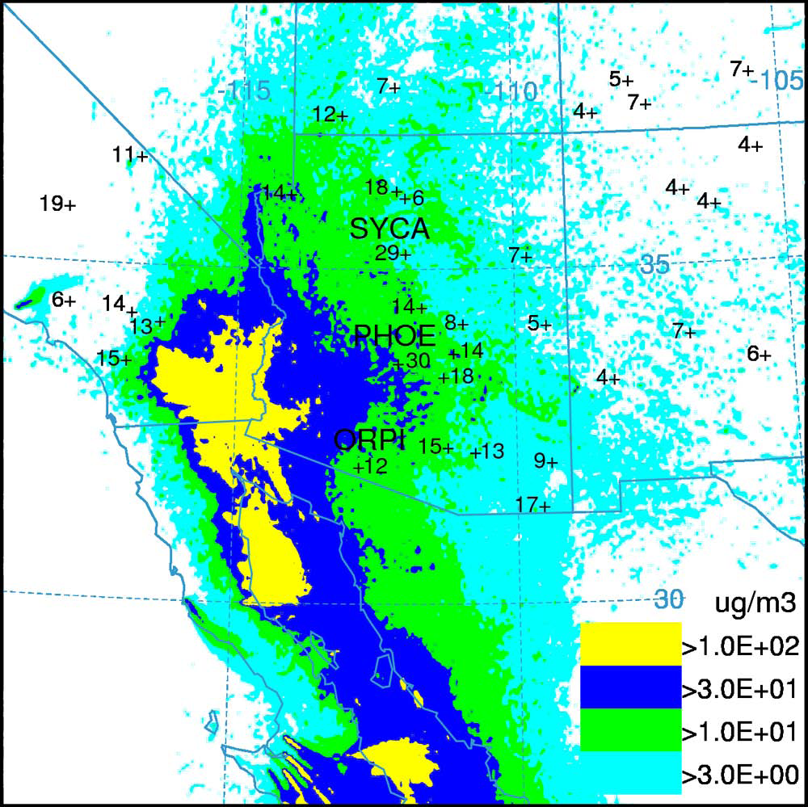
Dust simulation compared with IMPROVE data
June-July 2007 average dust concentration
HYSPLIT simulated air concentrations are compared with IMPROVE data in southern California and western Arizona:
  Model simulations: contours
  IMPROVE dust concentration: numbers next to “+“
  Variability in model simulation
  Highest measured value in Phoenix
  Model and IMPROVE comparable in 3-10 ug/m³ range
  Spotty pattern indicates under-prediction. Considering ways for improving representation of smaller dust emission sources.
(Draxler et al., JGR, 2010)
30

Slide 31
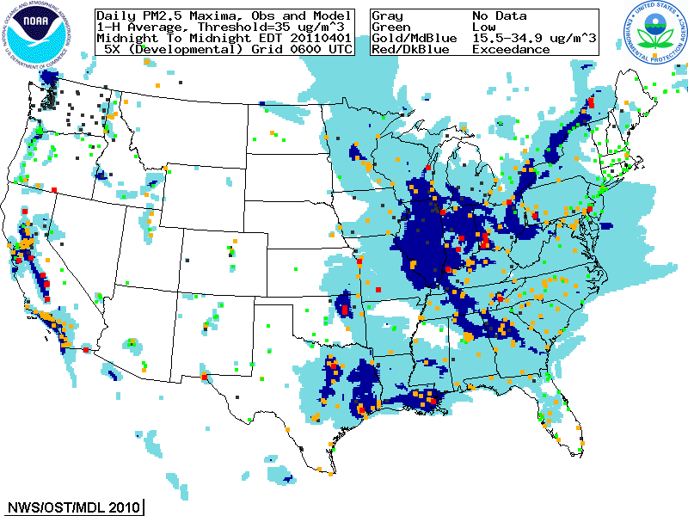
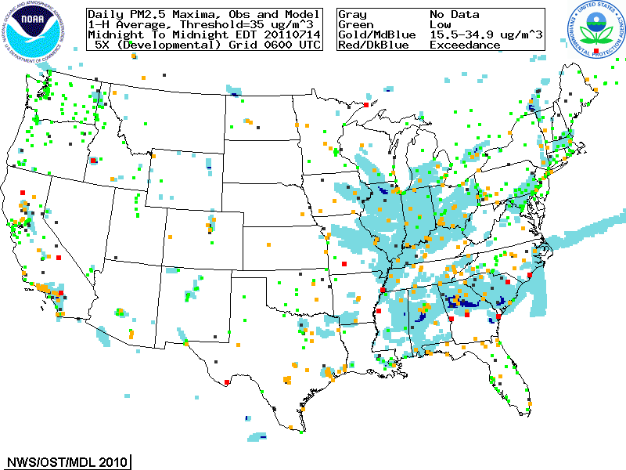
Developmental Aerosol Predictions: Summary Verification, 2011
April 1, 2011
July 14, 2011

Slide 32
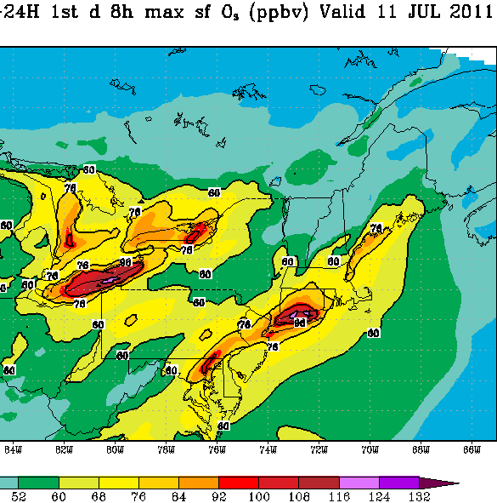
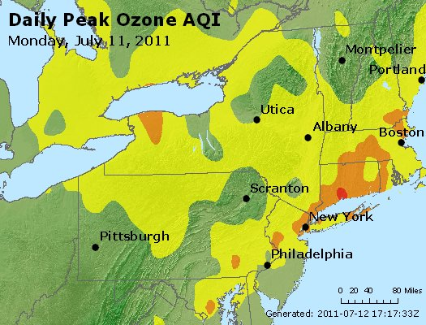
AQ Forecaster Feedback Examples
Michael Geigert, CT Department of Environmental Protection:
Analyzed case on July 11 AIRNow data vs 12Z operational ozone model run
Model still over-predicting in most cases, however not unreasonable
Model does not yet have the resolution to pick up hourly fluctuations of plume location and intensity
Still most problematic at coastal sites, but it still performed very well overall
Modeled
Examples of model overprediction
32

