Slide 1
Status of the Two Continent AQMEII Project
S.T. Rao
Director, Atmospheric Modeling and Analysis Division
NERL, EPA

Slide 2


Background on AQMEII
Co-chairs: S. Galmarini & S.T. Rao
Model evaluation is essential for model development and model improvements
Air quality models are playing an important role in the decision-making process for emission controls and definition of air quality standards. Model evaluation helps identify how models need to be used in the policy context.
AQMEII’s focus:
Developing a common model evaluation framework
Evaluating regional-scale numerical air quality models
Bridging North American & European modeling communities
AQMEII is supported by JRC-IES, US-EPA, Environment Canada, EU’s DG-RTD and DG-ENV
For additional information, see articles below:
Rao, S.T., S. Galmarini, AND K. Puckett. Air Quality Model Evaluation International Initiative (AQMEII): Advancing State of the Science in Regional Photochemical Modeling and Its Applications. BULLETIN OF THE AMERICAN METEOROLOGICAL SOCIETY. American Meteorological Society, Boston, MA, 92(1):23-30, (2011).
Galmarini, S. and S.T. Rao. The AQMEII Two-Continent Regional Air Quality Model Evaluation Study: Fueling Ideas with Unprecedented Data. ATMOSPHERIC ENVIRONMENT. Elsevier Science Ltd, New York, NY, 45(14):2464, (2011).

Slide 3
Defining the model evaluation framework
Diagnostic Evaluation
Can the model properly simulate the physical and chemical processes occurring in the atmosphere?
Can the model capture the interactions between meteorology and chemistry?
Dynamic Evaluation
Can the model capture the changes induced by the meteorological conditions?
Can the model reproduce the changes induced by the emission reductions?
Model-predicted concentration and
deposition
Probabilistic Evaluation
What is our confidence in the model-predicted values?
How do observed concentrations compare within an uncertainty range of model predictions?
Operational Evaluation
How do the model predicted concentrations compare to observed concentration data?
What are the overall temporal or spatial prediction errors or biases?

Slide 4
Participants
AUSTRIA 1
CANADA 1
SWITZERLAND 1
GERMANY 3
SPAIN 1
FINLAND 1
FRANCE 3
GREECE 1
ITALY 1
NORWAY 1
POLAND 2
UK 2
US 4

Slide 5
AQMEII: The two continent model evaluation exercise
Collected model results for EU and North America continent for a period of 1 year (2006)
Assembled model outputs and monitoring data for special case studies
Organized the information in a central database at JRC with high-level of harmonization
Exchanged experience on the use of emission inventories produced in NA and EU
Conducted 4-D Analysis of model behavior and compared modeled values with data from monitoring networks

Slide 6
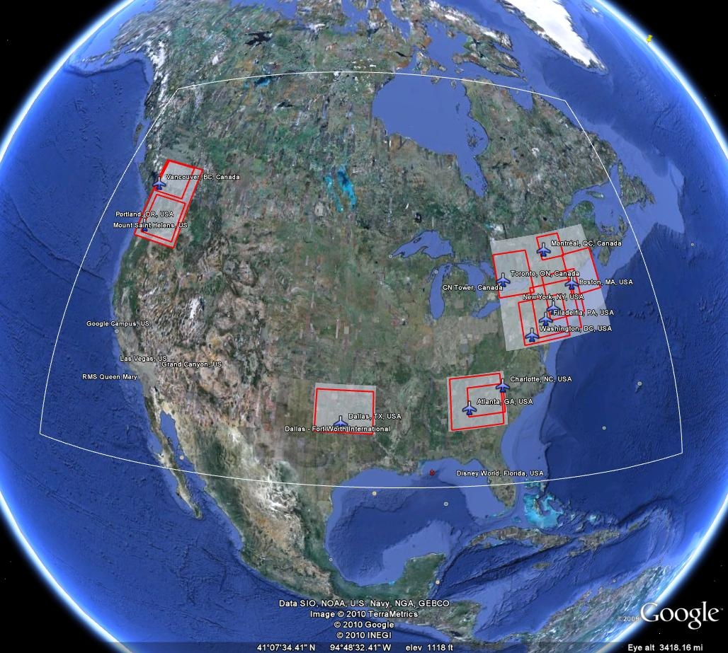
AQMEII and MOZAIC: monitoring data from commercial flights

Slide 7
Where we are now and where we will be by the end of 2011
All groups working on analysing different modeling aspects using community data
Collective analysis performed at JRC
Atmospheric Environment (AE) special issue (SI) opened
May 31, 2011 - all contributions to AE SI were delivered
Dec 1, 2011 - AE SI closed with finally accepted paper
AE special issue on AQMEII targeted for publication in Feb 2012
October 2011 – wrap-up AQMEII Phase 1 & launch AQMEII Phase 2

Slide 8
AQMEII - Phase 2
Take advantage of the experience gained and the community identified to move on to the phase 2 of AQMEII and continue international collaboration on modeling research and its applications
Focus on the evaluation of regional-scale coupled models’ capability to simulate interactions of air quality (AQ) and climate change (CC)
  Can the current versions of coupled models properly simulate the aerosol-radiation feedback processes?
  How important is the scale interaction in AQ and CC studies?
  Are the AQ-CC interactions simulated by the global models comparable to the regional models?
  Can global models learn from regional-scale models and vice versa?

