Slide 1
Overview of New Features in CMAQv5.0
Jonathan Pleim
and the CMAQ Development Team
Atmospheric Modeling and Analysis Division, NERL, EPA

Slide 2
Highlights
CMAQv5.0
  Incorporates many scientific advances to keep abreast of the latest research in gas chemistry, aerosol chemistry and thermodynamics, aqueous chemistry, and photolysis
  Improved advective and turbulent transport
  Major structural upgrades that improve flexibility and maintainability
  Updates to WRF for CMAQ modeling Gilliam Talk Tuesday 830 AM
  MCIP4.0 is also being released
The 2-way Coupled WRF-CMAQ system
  Rohit Mathur next talk
  Wong Talk Tuesday 850 AM, Yu Talk Tuesday 930 AM
Bi-directional surface flux for NH₃ and Hg
  Jesse Bash next after Rohit
  Cooter Talk Tuesday 1020 AM, Jeong Talk Tuesday 1040 AM

Slide 3
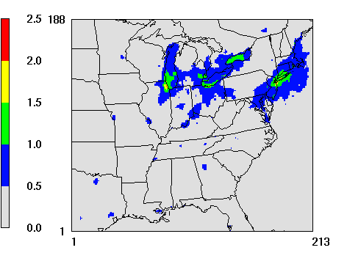
CMAQv5.0 Updates
Gas-phase mechanisms
SAPR07TB
  Fully updated organic and inorganic reactions consistent with current consensus knowledge on atmospheric kinetics
  Additional explicit species that have either high emissions, high toxicity, or high SOA formation potential
    xylene, a-pinene, benzene, 1,3-butadiene, etc.
Updates to both Mechanisms
  SO₂+OH rate constant
  Made N₂O₅ hydrolysis consistent
CB05
  Updated toluene mechanism by Whitten et al. (2010)
    Impacts in urban areas
Changes in mean Max 8-hr O₃
(CB05-TU - CB05-Base)
ppbV
Sarwar et al GMD 2011

Slide 4
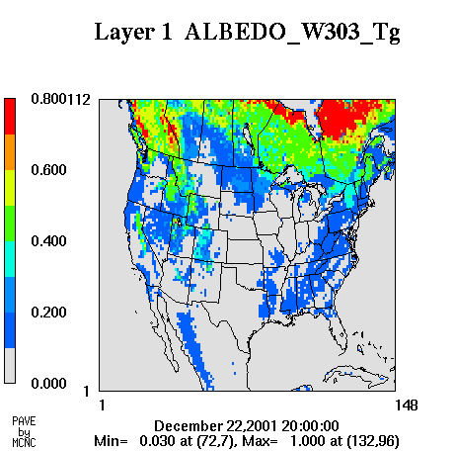
CMAQv5.0 Updates
Improving Representation of Photolysis
Upgrades to the In-line photolysis module:
  Read input data (e.g., quantum yield, cross section) from an ascii file (created by a pre-processor)
    Easier to update data or add new reactions
Surface albedo by wavelength and land-use
  Temporal and spatial (fractional land-use) variations
  Includes albedo for snow and seaice from WRF
Ozone column data from satellite (1978-present) for whole globe
Hutzell and Streicher Talk Tuesday 140 PM

Slide 5
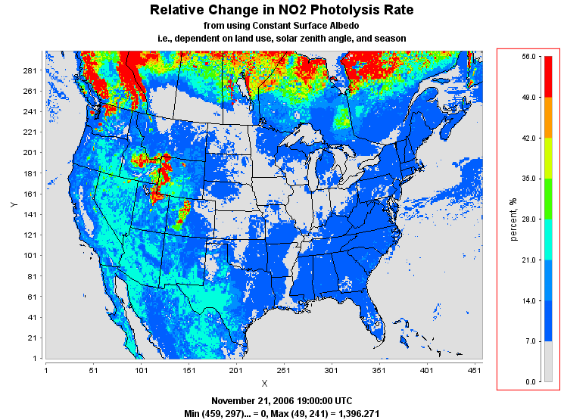
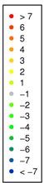
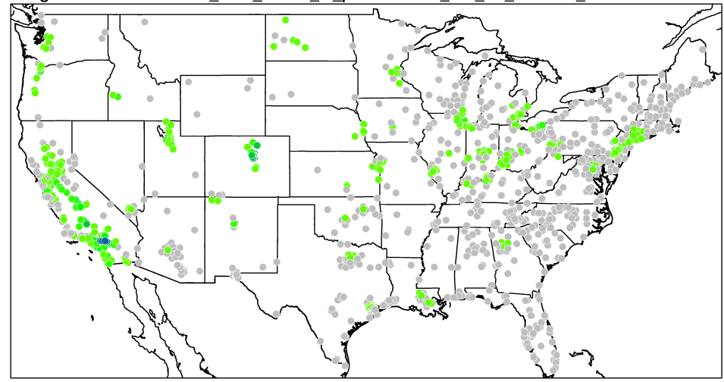
CMAQv5.0 Updates
Improving Representation of Photolysis
Addressing winter-time O₃ in the
Western states
Aerosol Effects on Photolysis and
simulated photochemistry
Difference in max. 8-hr O₃ bias
ppb
Reduction in bias in vicinity and downwind
of source regions

Slide 6
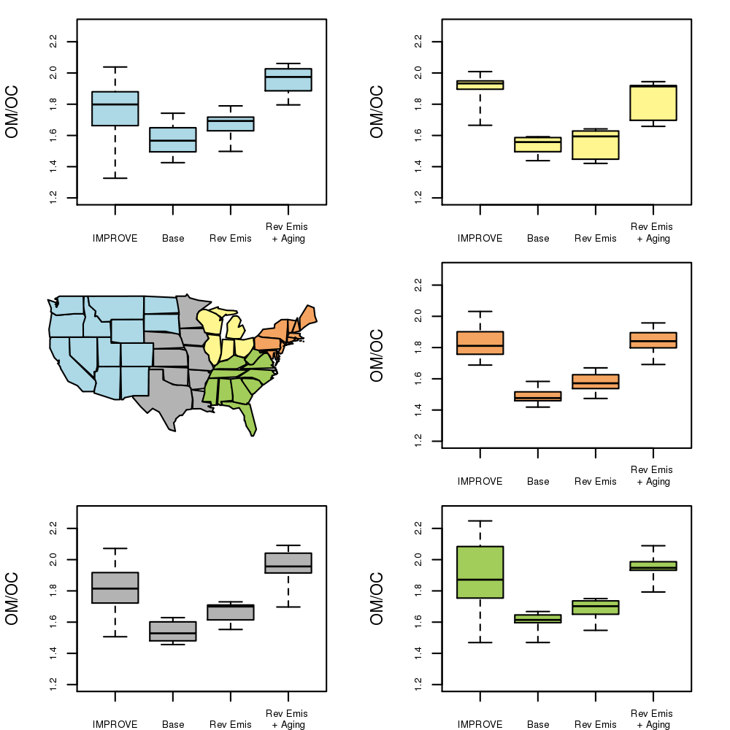
CMAQv5.0 Updates
PM Treatment: Non-carbon organic mass
Source-specific OM/OC ratios in primary emissions
Simulate oxidation of primary OC → NCOM
Much better agreement with measurements at IMPROVE sites, especially in summer
Summer
Simon et al 2011 ACP
Simon and Bhave Poster
July 2006
6

Slide 7
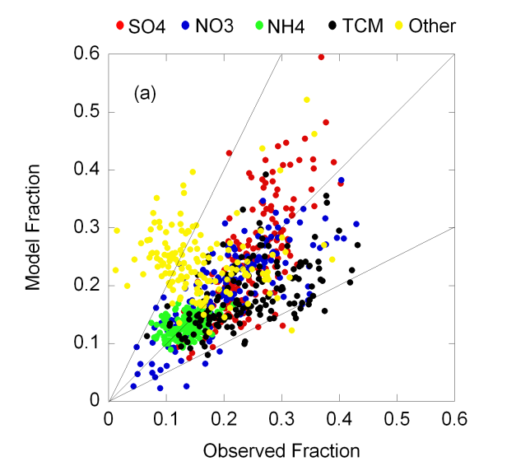
CMAQv5.0 Updates
PM Treatment
“Unspeciated” PM_{2.5}: PM_{other}
  Cool season: high-bias
  Warm season: low-bias
Speciating PM_{other} helps Characterize seasonal bias
PH₂O | PNA
PCL | PNH4
PNCOM | PAL
PCA | PFE
PSI | PTI
PMG | PK
PMN | PMOTHR
PM_{2.5} Emissions
Linkage w/other CMAQ modules:
  Mg,K,Ca (for ISORROPIA v2.0)
  Fe,Mn (for AQCHEM)
Reff et al ES&T 2009

Slide 8
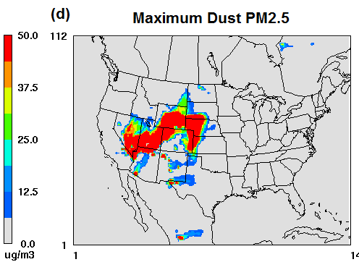
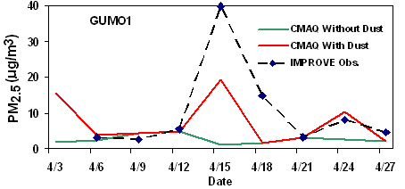
CMAQv5.0 Updates
PM Treatment
Aerosol Thermodynamics
  ISORROPIAv2.1
    Includes chemistry of additional crustal species
    Updated sea-salt emission speciation
    Includes code optimization to reduce computational time
  Bhave et al Talk Tuesday 12 PM
Fugitive Dust Emissions
  Development and incorporation of a wind-blown dust algorithm
Tong et al., JGR, submitted

Slide 9
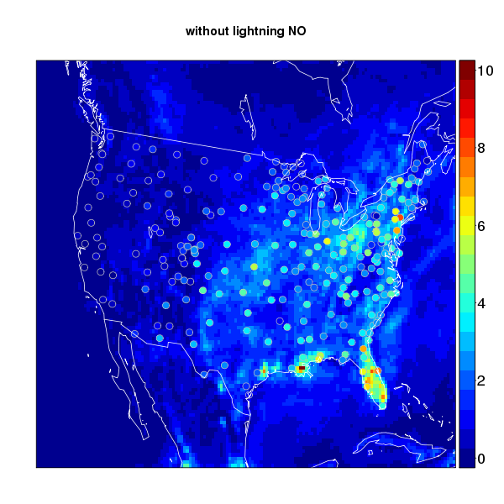
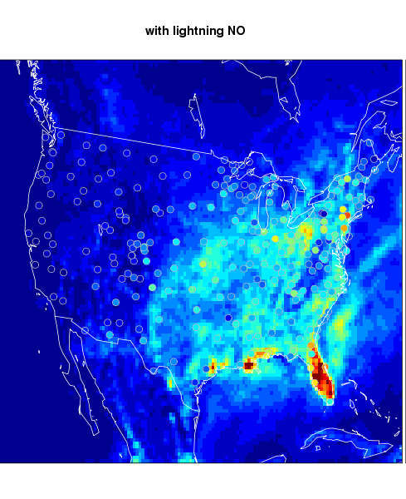
CMAQv5.0 Updates
Dry Deposition
  Mosaic approach
    Output dry deposition flux for the different land-use categories within a grid cell
      Linkage with ecological assessment studies
Impact of LNO_{x} on NO₃⁻ wet deposition
kg/ha; summer 2004
  Lightning NOx
    Four Options for lightning NOx emissions
  No lightning NOx
  NOx read from file created from NLDN data
  NOx parameterized based on convective precip
  Read flash counts from user provided file
Pinder et al Poster

Slide 10
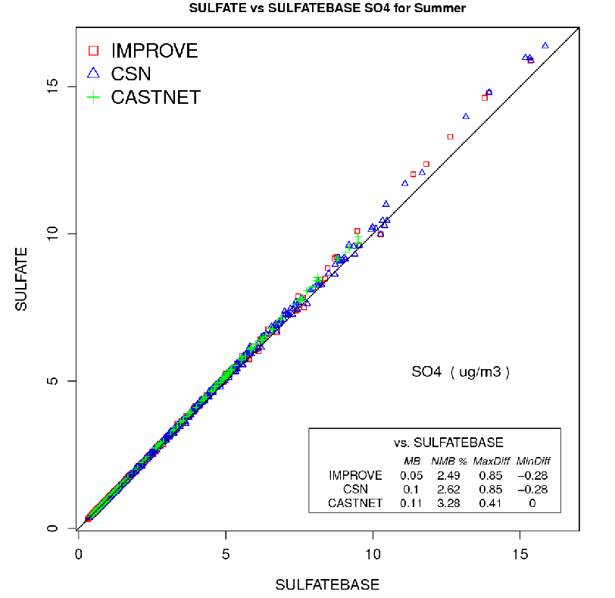
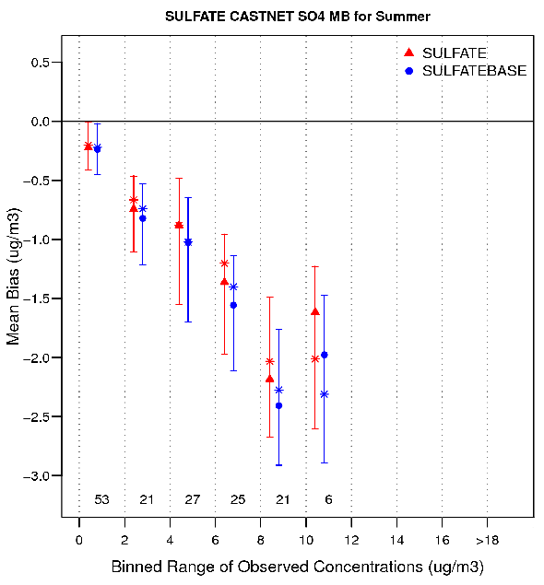
Aqueous Chemistry
Updated SO₂ oxidation rates via H₂O₂, O₃, MHP, PAA based on Jacobson, AE, 1997
Updated SO₂ oxidation rate via metal catalysis based on Martin and Good, AE, 1991
Model now uses predicted Fe and Mn in catalyzed sulfur oxidation instead of prescribed background values
Changes increase sulfate leading to small decrease in low bias
Sarwar et al Poster

Slide 11
Transport upgrades
New scheme for vertical advection
  More closely follows mass continuity calculations in WRF
  Less diffusion in upper layers
  Allows small deviations from mass conservation
New scheme for stable boundary layer in WRF and CMAQ
  Better simulation of nocturnal low level jet
  More mixing after evening transition
  Lower minimum K_{z} to be more consistent with WRF

Slide 12
CMAQv5.0 Updates
Structural Changes
Name-list control file
  Controls processing of each species
  Eliminates the numerous include files
  Enables runtime changes in chemical species operations
  Enables runtime factors for emissions and depostion
Aerosol module redesign
  Eliminating dependencies and duplication across modules
  Easier maintainence
  Facilitates modifications

Slide 13
Evaluation
Unit tests for each new feature of CMAQv5.0 have been evaluated for:
  2 weeks in November/December 2006 and July 2006
  12 km CONUS domain
CMAQv5.0beta was released in April to users/developers by request
Full year (2006) operational and diagnostic evaluation is underway
  12 km CONUS domain
  Emission sensitivities
  Appel Talk Wednesday 830 AM
Fine scale (4 km) evaluation for TexAQS 2006 is underway
  Sarwar Poster, Godowitch poster, Kang Talk Wednesday 430 PM

Slide 14
New features of CMAQv5.0.1 (2012)
Instrumented model capabilities – Sulfur tracking, DDM, primary carbon apportionment
Community contributions Yarwood Tuesday 1020
  Volatility Basis Set - CMU, EPRI, Environ
  Advanced Plume Treatment – EPRI, Environ
SOA modifications Pye Poster
  Update/add long-chain alkane yields
  Add SOA from oxidation of polycyclic aromatic hydrocarbons (PAHs)
Isoprene chemistry update
New more advanced photolysis model
Coming attractions
  PM and Ozone source apportionment
  RACM2
  Updated Carbon Bond Mechanism
  CMAQ adjoint

Slide 15
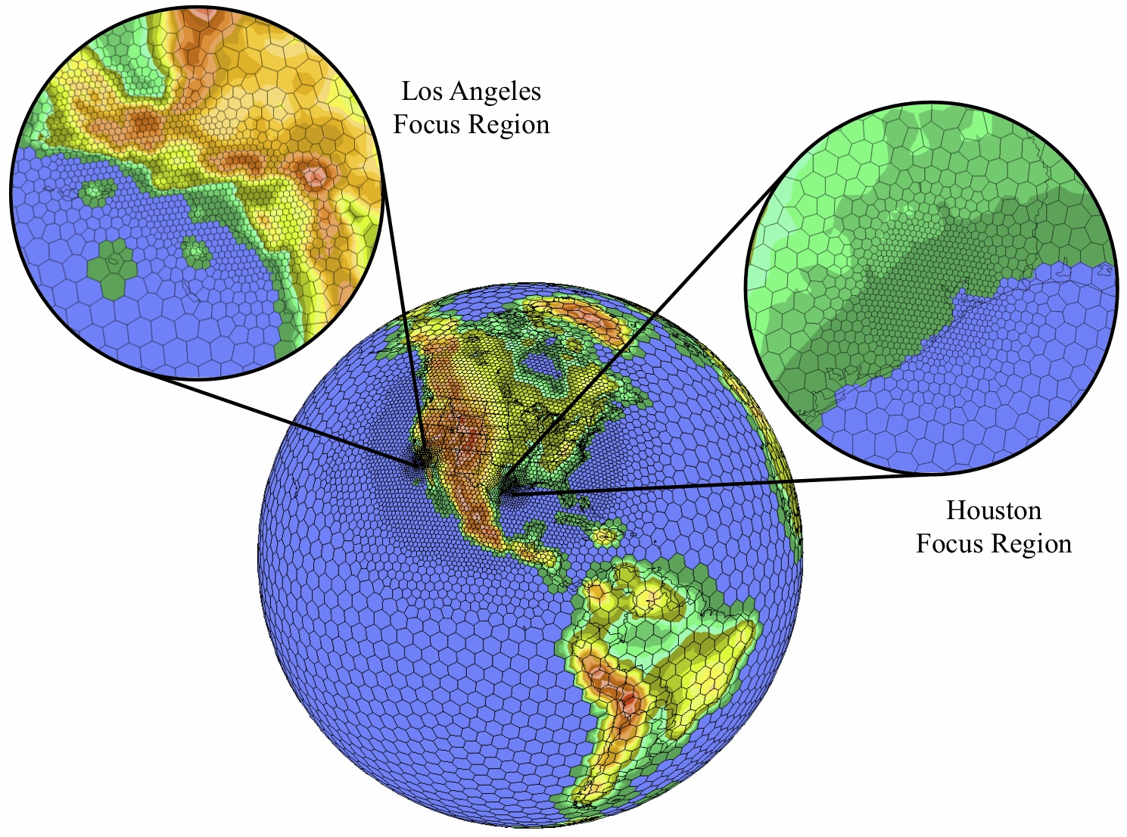
  Global icosahedral met/chem with grid refinement
Courtesy of Martin Otte

