Slide 1
10th Annual CMAS conference
October 24 – 26, 2011
Performance Assessment of Five-year East Texas Air Quality Forecasting System (ETAQ)
Fong Ngan ^{2,*}, Hyun Cheol Kim ^{2,*}, Fang-Yi Cheng³, Soontae Kim ⁴, DaeGyun Lee ⁵, Bernhard Rappenglueck ¹, Pius Lee ²
and
Daewon W. Byun
¹ Institute for Multi-Dimensional Air Quality Studies, University of Houston, USA
² Air Resource Laboratory, NOAA, USA
³ Dept. of Atmospheric Sciences, National Central University, Taiwan
⁴ Division of Environmental Civil & Transportation Engineering, Ajou University, Korea
⁵ National Institute of Environmental Research, Korea
* Earth Resources Technology, Inc

Slide 2
Acknowledgement
UH-IMAQS:
Xiangshang Li, Beata Czader, Peter Percell, Barry Lefer & researchers/students
UH-IMAQS former group members:
InBo Oh , Meongdo Jang , ChangKeun Song, Heejin In , Seungbum Kim,
Nankyoung Moon, Eunyoung Kim
Sharon Zhong, Craig B. Clements
Graciela Lubertino, Alex Cuclis, Kee-Youn Yoo, Trung Nguyen, Yuping Li,
Funding supports:
TCEQ (Texas Commission on Environmental Quality)
HARC (Houston Advanced Research Center)
EPA (US Environmental Protection Agency)

Slide 3
Outline
Review of ETAQ forecasting system
Evaluations of ETAQ forecasting over the SE Texas region
Correlation of ozone and temperature in CONUS scale

Slide 4
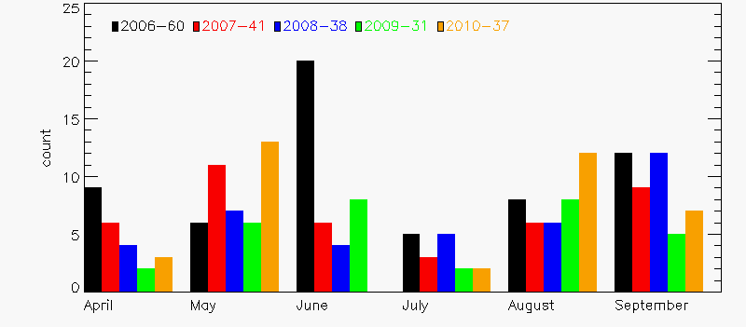
Introduction
East Texas Air Quality (ETAQ) Forecasting System
Utilizing MM5/SMOKE/CMAQ-based modeling system
Forecasting air quality over the SE Texas since June 2006
Being used for planning of various campaigns (ex. TexAQS-II, SHARP)
Providing a multi-year modeling platform to study met. & emiss. uncertainties
8-hr O3 exceedence days in HGB
Total O3 event days during Apr-Sep
Number of Days
Month
Notes:
April-24, May-43, June-38, July-17, Aug-40, Sep-45
Frequent high ozone episode in HGB area may be attributed to huge amount of VOC from petrochemical industries + NOx from vehicles
TexAQS 2000: HRVOC(e.g. ETH, OLE) are responsible for THOE (Transient High Ozone Episode) in HGB area
Analysis presented in here focus on the O3 season which is April – September.
There are two peak: late spring time & late summer period and a break of intensive O3 events either in June or July.

Slide 5
ETAQ Model Configuration
Model | Version | F1 system | F2 system
Domain |  | CONUS 36 km (D36) Eastern Texas 12 km (D12) Houston-Galveston 4km (D04) | CONUS 36km (D36) Texas 12km (E12) Eastern Texas 4km (E04)
Fct. Hour |  | 2 days (49hr + 6hr spin-up)
MM5 | 3.6.1 | NAM initialization USGS24 (36 & 12km), TFS LULC (4km) Grid nudging (36 & 12km), no nudging (4km) Grell convection RTTM radiation UH-modified MRF PBL UH-modified NOAH LSM
MCIP | 2.3h | Min PBLH – 300 m (urban) and 50 m (others)
SMOKE | 2.1h | NEI 99 + TEI 2000 | NEI 99 + TEI projected to 2005
CMAQ | 4.4 | CB4 (cb4_ae3_aq) GEOS-Chem BC PPM advection Multiscale horizontal diffusion Eddy vertical diffusion RADM cloud
NOTE: TEI – Texas Emission Inventory (HRVOC imputed for base year 2000)
TFS – Texas Forest Service
GOES-Chem BC – downscaling from GEOS-CHEM year 2002 monthly mean
UH-modified MRF PBL reduces daytime WS bias by the enhanced friction velocity (Cheng and Byun, 2008)
UH-modified Noah LSM reduces T bias by inserting LULC-base emissivity (Cheng and Byun, 2008)

Slide 6
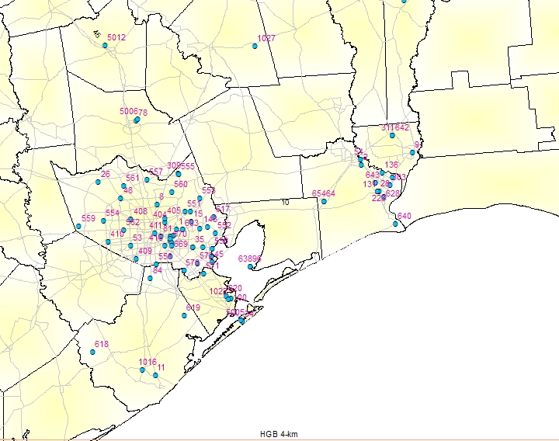
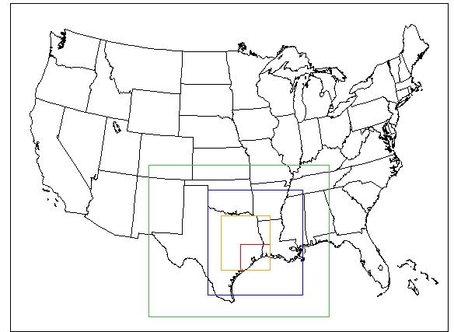
ETAQ domains
SE Texas
F1, F2 CONUS 36km (D36)
CONUS
Houston
Metropolitan
F2 Texas 12km (E12)
Gulf of Mexico
F1 Eastern Texas 12 km
(D12)
F2 E-Texas 04km
(E04)
F1 HGB 04km
(D04)

Slide 7
Evaluations of ETAQ forecasting
SE Texas region

Slide 8
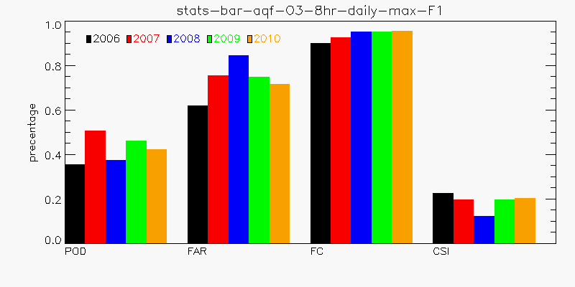
Performance metrics (2006-2010, 8-hr Ozone daily max)
POD (Prob. Of Detection) = b/(b+d)
FAR (False Alarm Ratio) = a/(a+b)
FC (Fraction correct) = (b+c)/(a+b+c+d)
CSI (Critical Success Index) = b/(a+b+c)
8-hr NAAQS for O3: 75 ppb
a False Alarm | b Hit
c Non-event | d Missed event
Forecast
Observations
Notes:
Performance metrics of 8-hr ozone daily max for 2006-2010. We are looking at prob of detection, false alarm ratio, fraction correct and critical success index. They were calculated base on 8-hr O3 standard which is 75 ppb. This is a schematics for scatter plot with obs in x-axis & forecast in y-axis. Low-right quarter is non-event and low-left is missed event. For upper panel, right quarter is false alarm & left is hit cases.

Slide 9
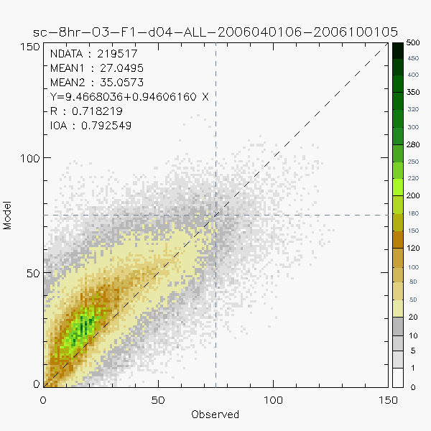
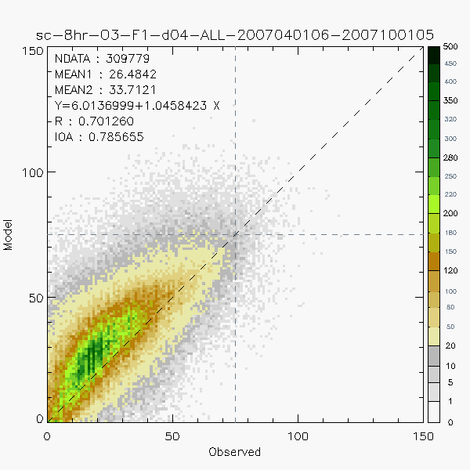
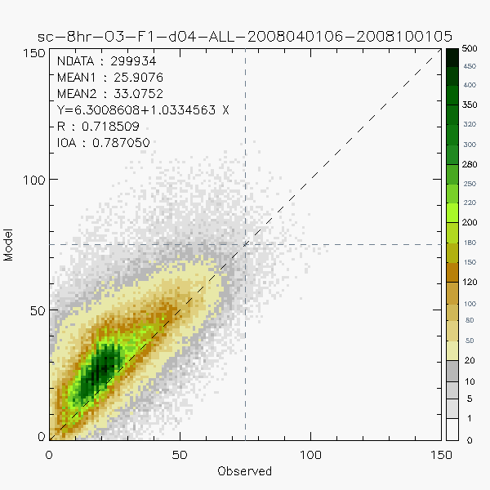
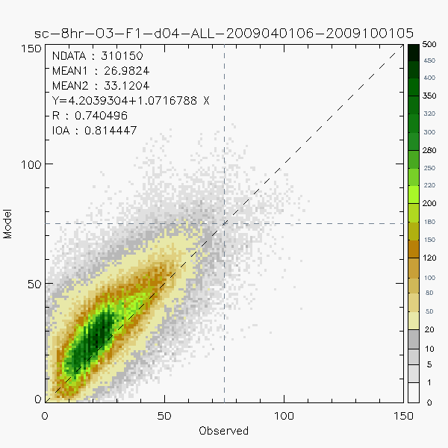
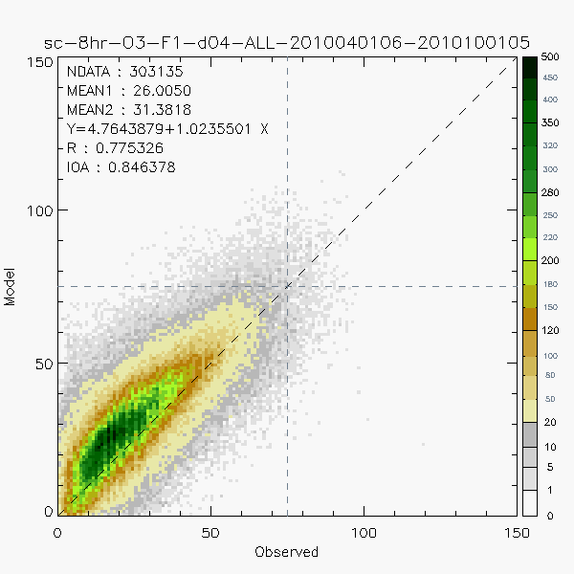
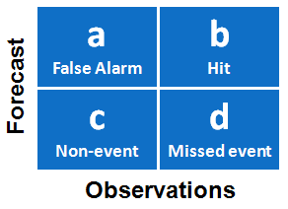
Scattered Plot, 8-hr Ozone
2006
2007
2008
Color coded with sample population
Forecast over-predicted O3 level in low-middle range
Year 2006: more missed events
Year 2008: more false alarm
Year 2010: best statistics
2009
2010
Notes:
These scattered diagrams of 8-hr ozone are color-coded with sample population.
The model over-predicted O3 level in low-middle range in general. More cases of missed events could be seen in 2006 while more false alarm were in 2008. 2010 has the best statistics score among 5 years.

Slide 10
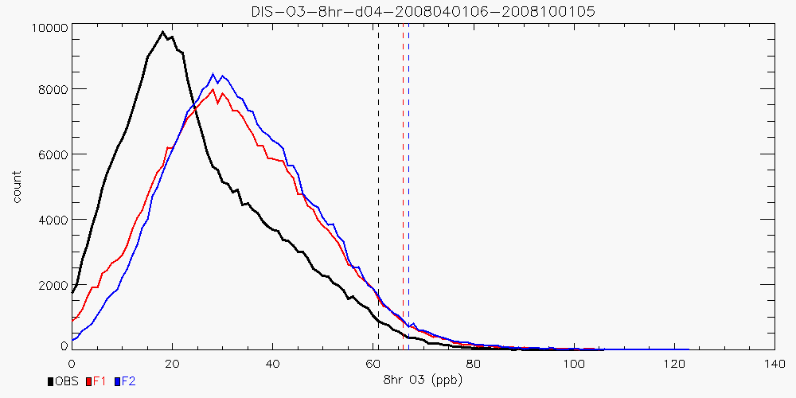
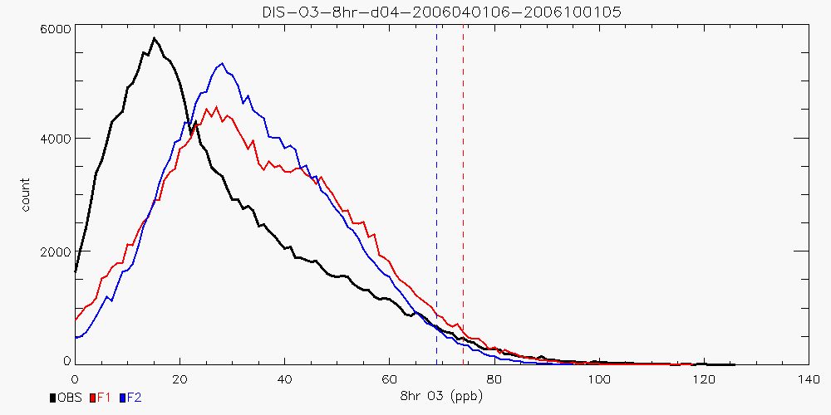
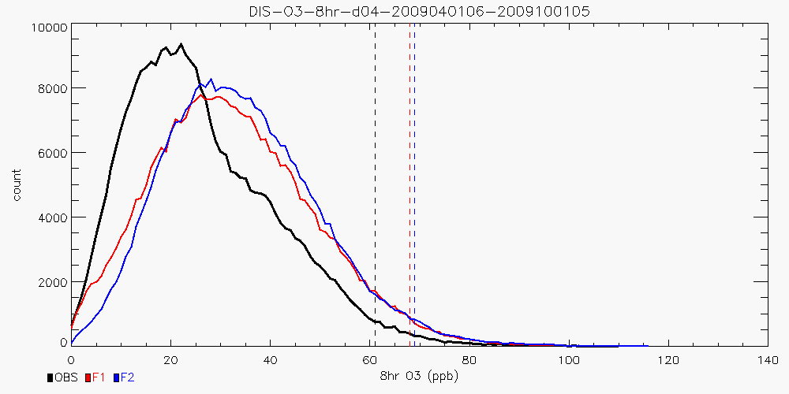
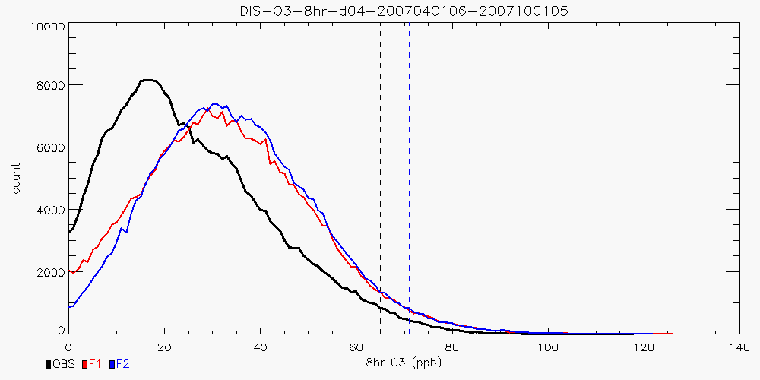
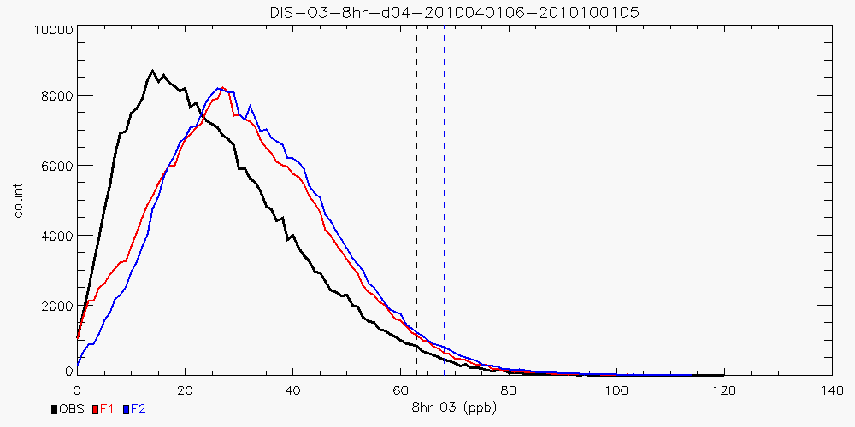
Distribution of 8-hr O3
2008
F1/F2 forecasting show very similar distribution shape
NOx level decrease => less near zero O3
Obs
F1
F2
2006
2009
Dash line
97.5 percentile
2007
2010
Notes:
x-axis is ozone level in ppb while y-axis is sample point count

Slide 11
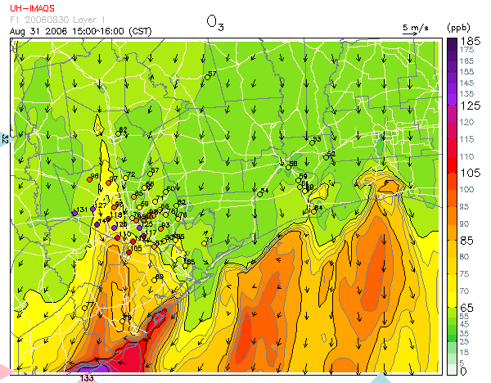
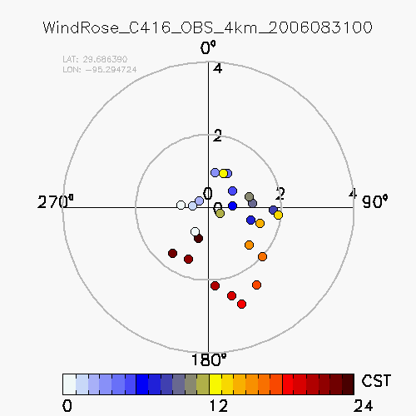
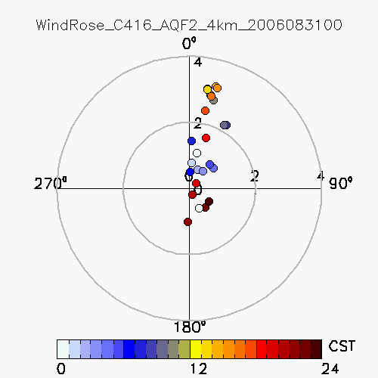
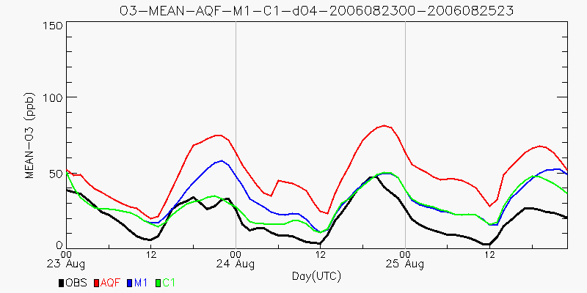
Causes of Bad Forecasting
Meteorological factors
Over-prediction of wind speed and inaccurate flow patterns inherited from synoptic inputs
Example: August 31, 2006
Too strong northerly winds after frontal passage pushed the ozone plume to the Gulf.
Forecast O3
Obs
Forecast
Simulation of precipitations & cloudiness at the incorrect locations & times
Example: August 23-25, 2006
Incorrect prediction of precip. led to over-estimation of ozone level (red line).
Forecast
Ngan et al. 2011
submitted to AE
Obs
Notes:
Retrospective Simulations for TexAQS II
Investigation of causes of bad forecasting may lead to future improvements.

Slide 12
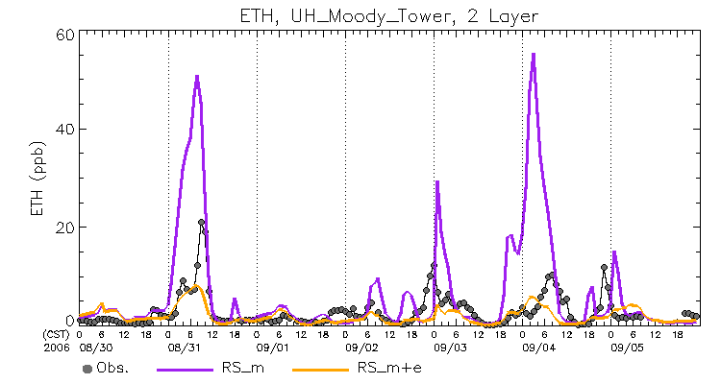
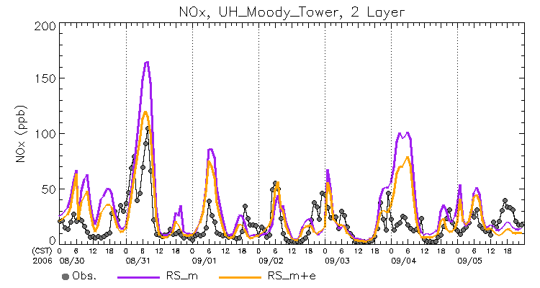
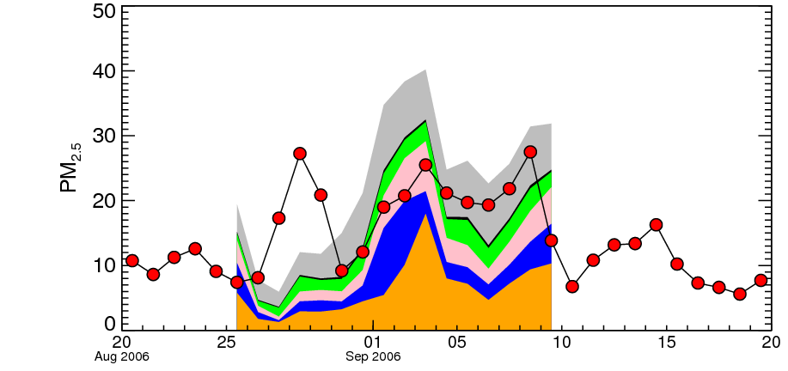
Causes of Bad Forecasting
Emission uncertainties
Too high NOx & VOC level – ETAQ emiss based on 2000 imputed emission (Byun et al. 2007)
ETAQ EI
updated
EI
Updated emission (using 2006 Texas point-source special inventories) sensitivity test
Better simulation of O3 peak on non-event days but under-prediction on events days.
Plots from Lee (2009)
EI provided by Dr. Soontae Kim
Lack of intermittent emission from wildfire & dust events, both domestic & outside domain
Saharan Dust
Haze
+ wildfire
PM other
EC
OM
ANH4
ANO3
ASO4
Obs
Kim et al. (2010)
Forecast
Notes:
BEMR from all sources in HGB area
VOC: reduced by ~200 ton/day
NOx: reduced by ~350 ton/day

Slide 13
Correlation of ozone and temperature
CONUS scale

Slide 14
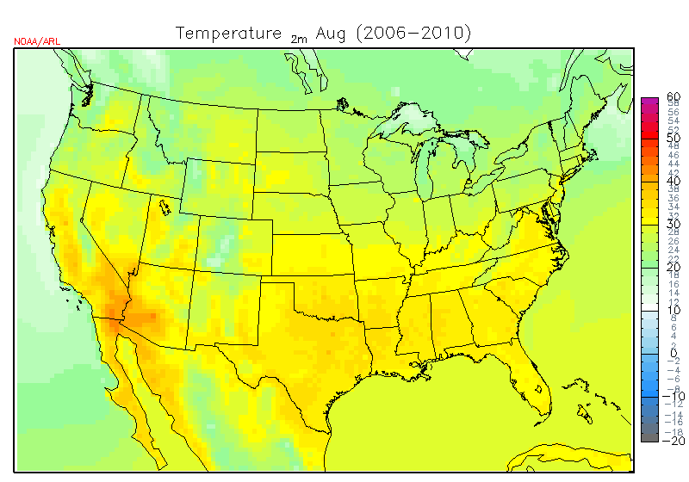
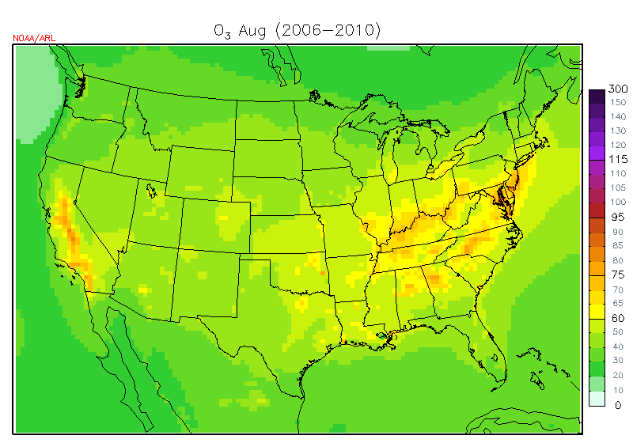
5-year monthly mean (August)
2m Temperature
Daytime ozone
MOD : ETAQ forcasting 2m temperature and daytime ozone (14-17 LT)
OBS : AQS ozone (14-17 LT) and MADIS 2m temperature

Slide 15
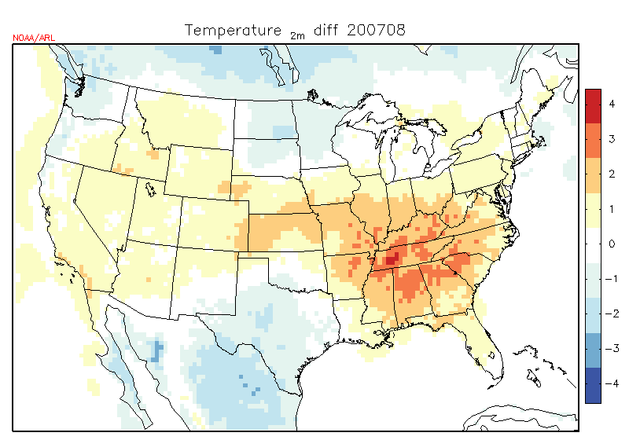
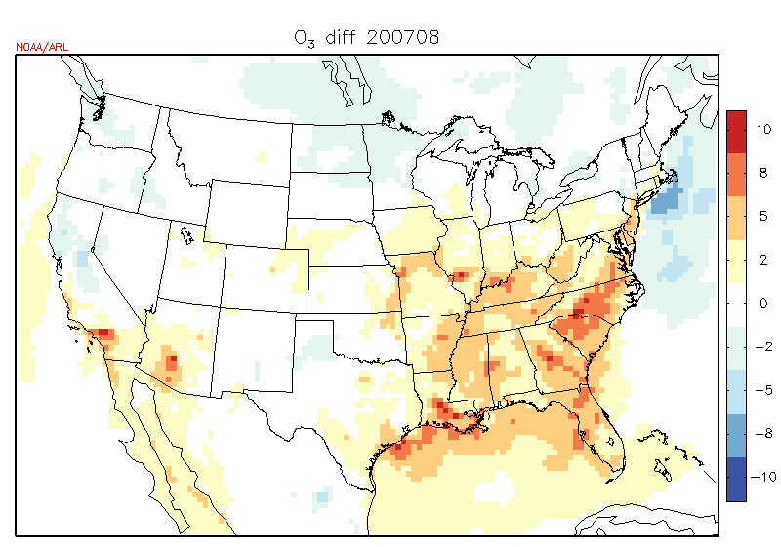
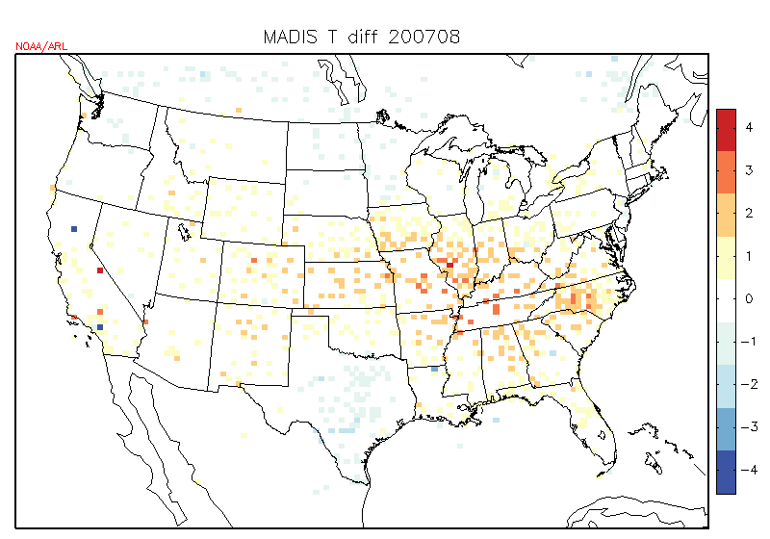
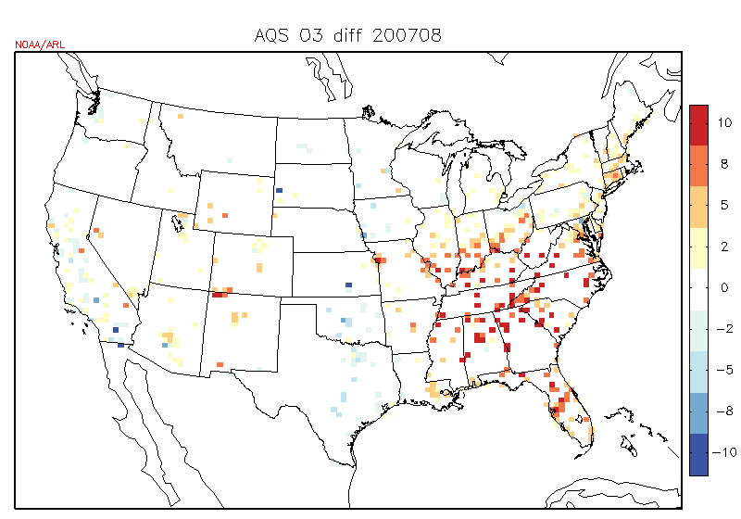
2007 August
Temperature anomaly
Ozone anomaly
MOD
Very hot year. Ozone anomaly is more than 10 ppb.
OBS

Slide 16
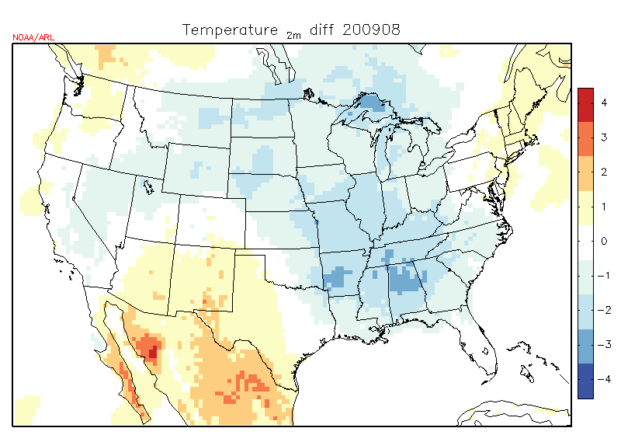
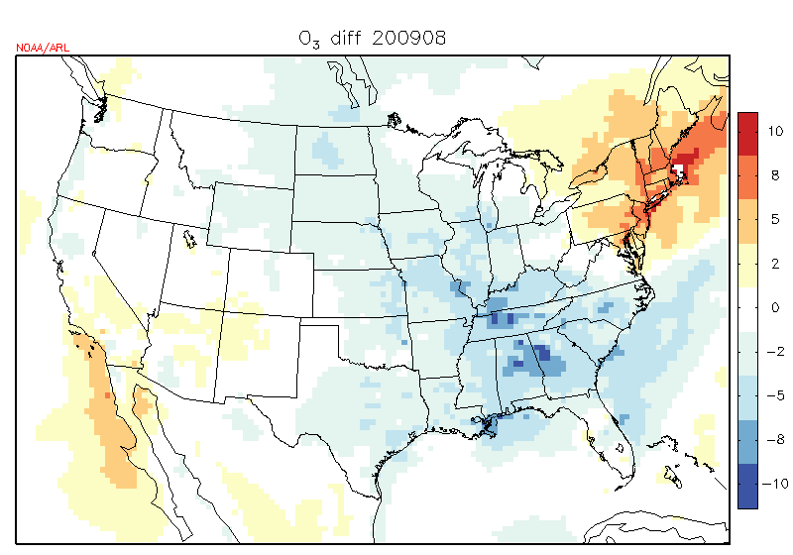
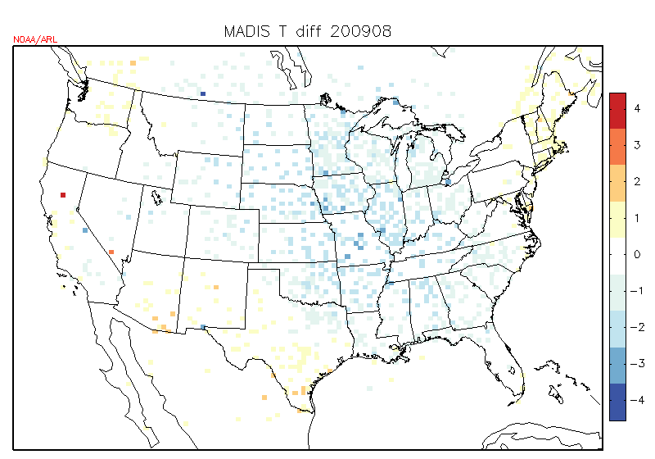
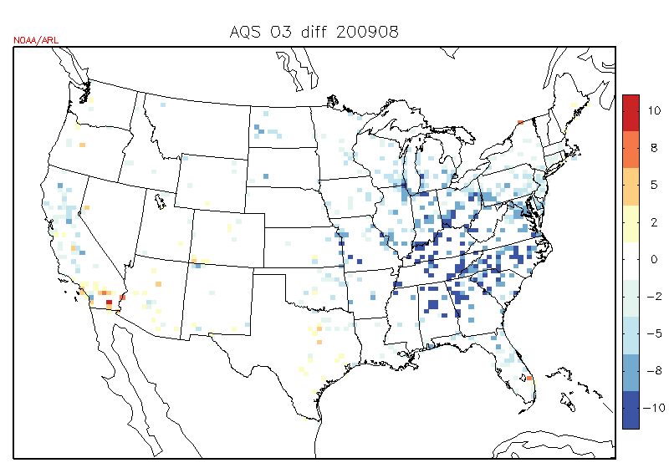
2009 August
Temperature anomaly
Ozone anomaly
MOD
cool year
OBS

Slide 17
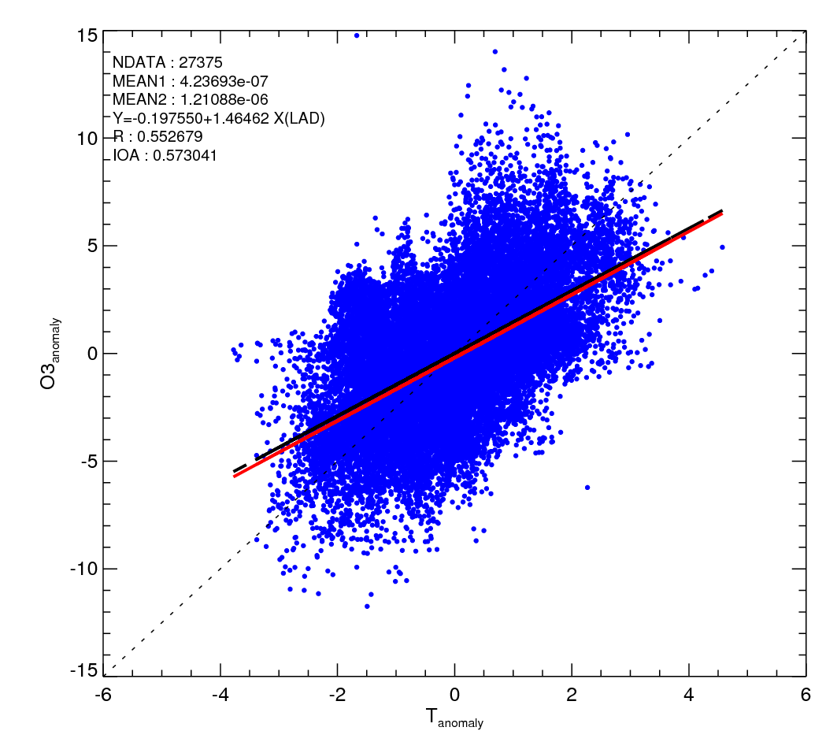
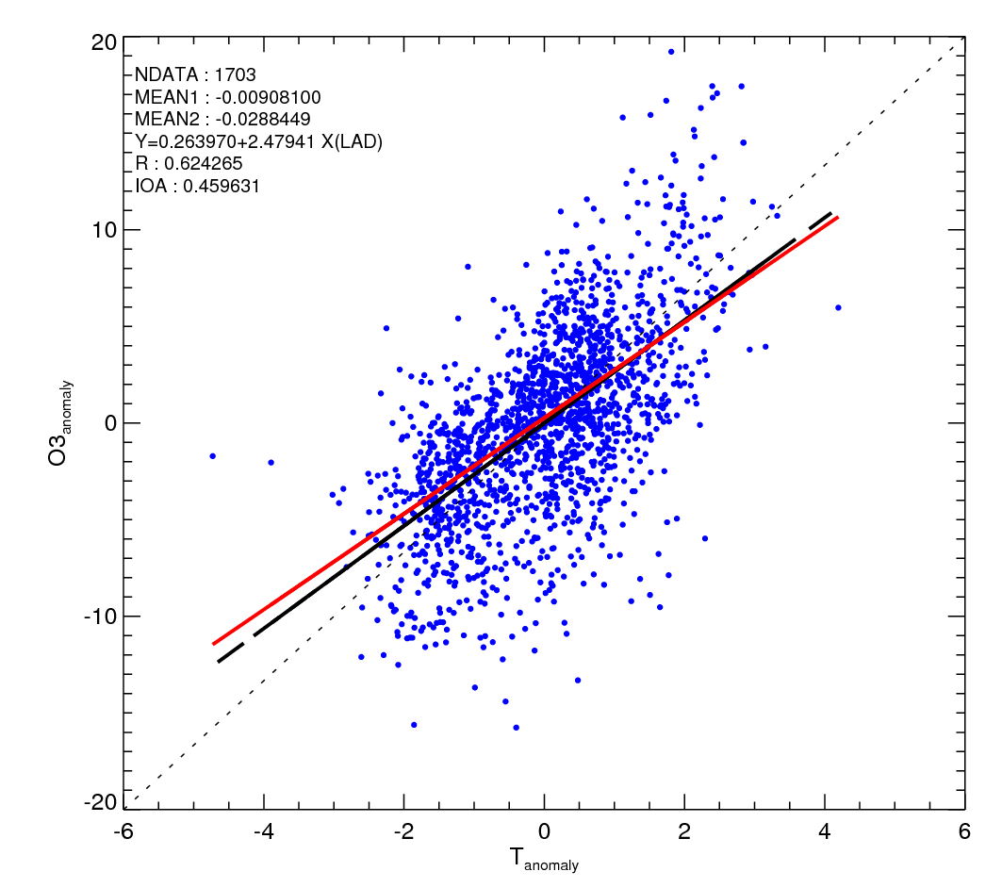
Temperature anomaly .vs. Ozone anomaly
MOD
OBS
Sampling on Eastern US (large T variation in complex terrain region)
Strong correlation between temperature anomaly and ozone anomaly
1 degree temperature change causes 1.5~2.5ppb ozone change

Slide 18
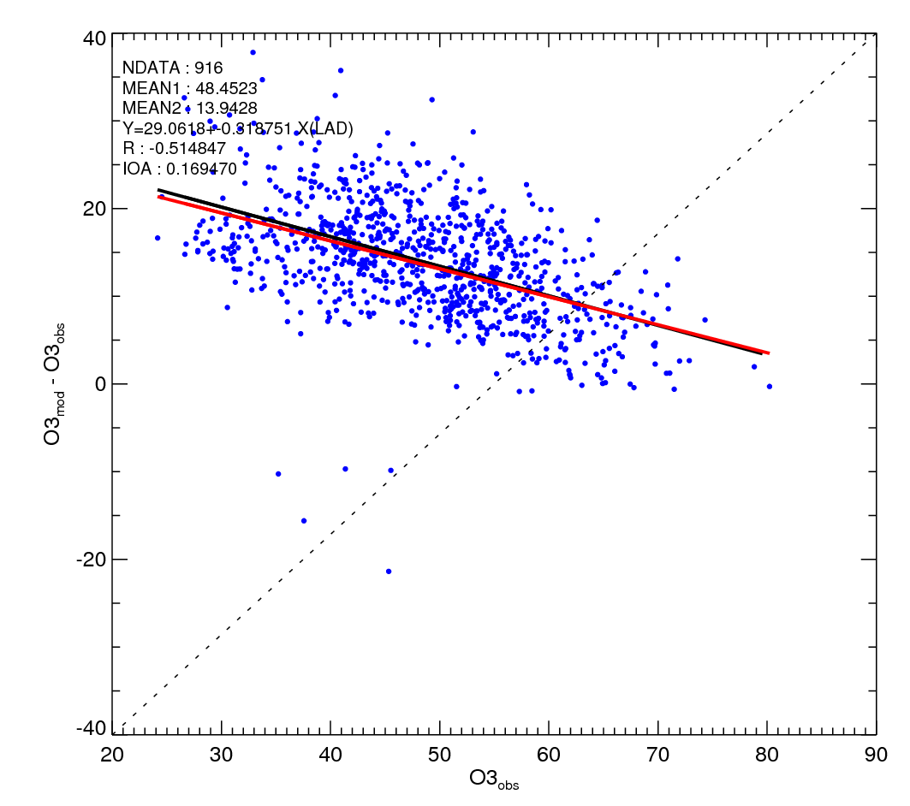
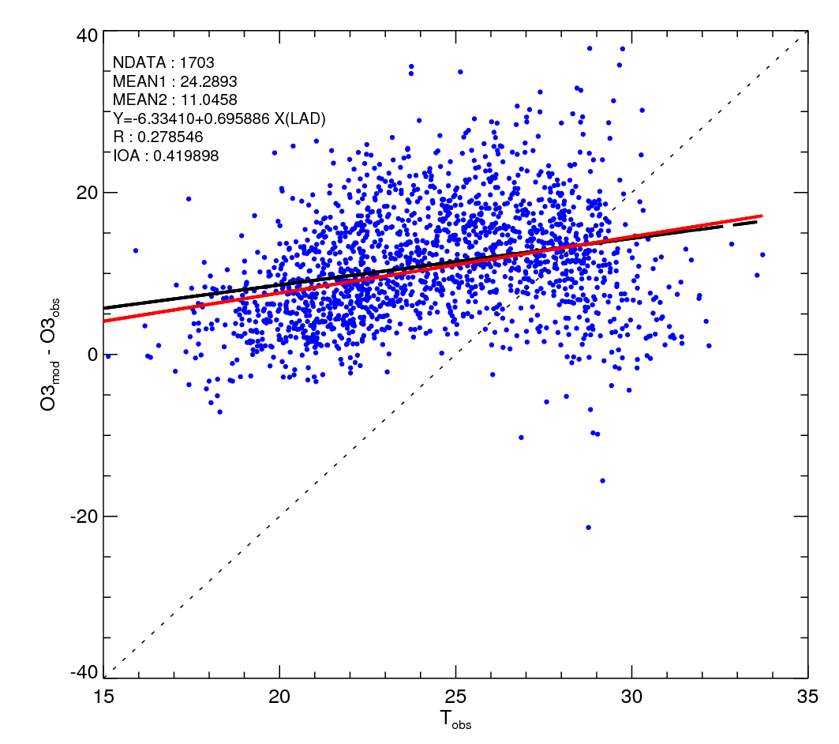
Ozone bias .vs. ozone level
Ozone bias .vs. temperature
Less ozone bias in high ozone level
Positive correlation of ozone bias & temperature in lower temperature
Large uncertainty of ozone bias in high temperature

Slide 19
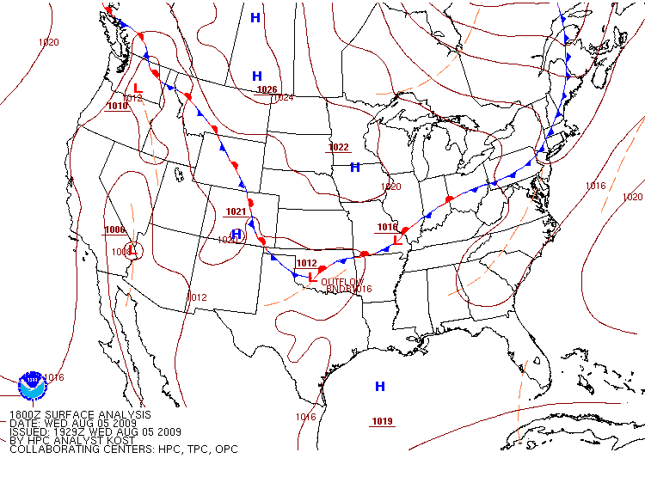
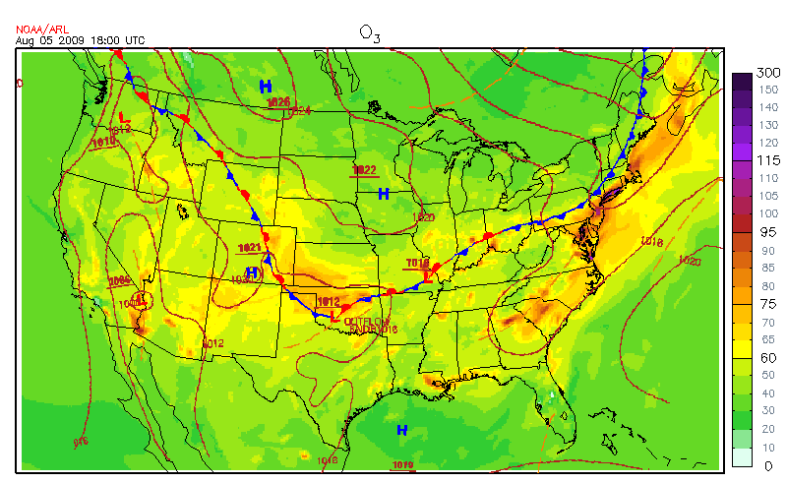
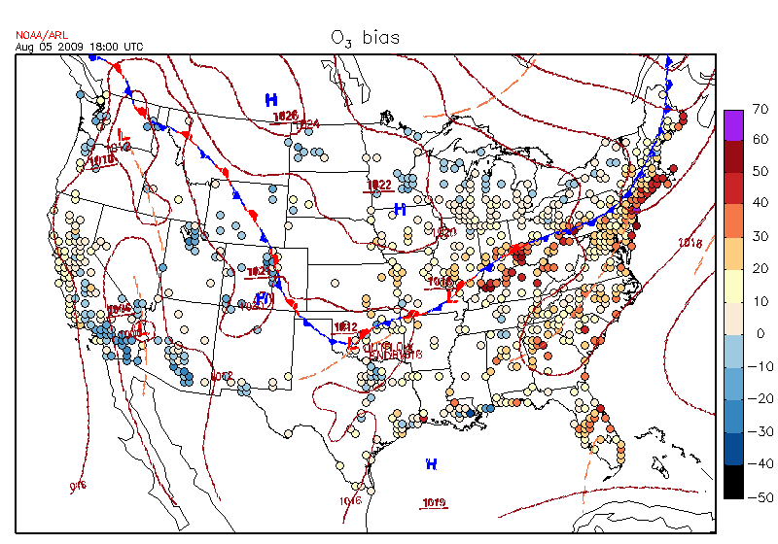
Ozone bias .vs. frontal passage
Overlaid weather chart on surface O3
Relate O3 bias with frontal position

Slide 20
Summary
ETAQ forecasting system has been operating for the southeastern TX with two set of emissions since June 2006.
Year 2006 experienced more O3 events and model had more missed events than other years.
Causes of bad forecasting were identified with efforts of retrospective simulations for TexAQS 2006.
Met. factors – inaccurate wind flows from synoptic inputs, difficulties in precip/cloud predictions.
EI. uncertainties – Too high level of NOx & VOCs emissions, lack of intermittent emissions (wildfire & dust)
CMAQ model works better at high ozone level and performs well for predicting ozone peak. Ozone biases in middle range ozone could be problematic in simulating background ozone.
Positive correlation of ozone bias & temperature can be seen in low-middle-range temperature. The correlation shifts to negative when temperature is larger than 26C.

Slide 21

Taken at UH, 2008

Slide 22

Taken at UH, 2008

Slide 23
Backup slides

Slide 24
ETAQ Operation Paradigm
NAM download
start
2 days forecast
NAM download
start
2 days forecast
UTC
6 hours
21
03
09
15
21
03
09
15
Current day
Day1
Day 2
Forecasting
display
Forecasting
display
NAM (from NCEP web site) download starts at 21 UTC (15 LST)
Results display on Web at 06 UTC (midnight, 9 hours after NAM download)
Model is initialized at 00 UTC and forecasts 54 hours (ends at 06 UTC on Day 3)

Slide 25
ETAQ Emissions Inputs
 | F1 | F2
Area/Non-road source | Base year 2000 | Future year 2007
Mobile source | MOBILE6 2000 | MOBILE 2003 (projected)
Point source | Base year 2000 | Projected to 2005
Mobile source
Projected 2003 level by linear interpolated MOBIBLE emissions from 2000 and 2007
Projection for 2005 presenting too low NOx emission from mobile source
(Byun et al. 2005; 2006)
Point source
EI rates for 2007 were projected from 2000 by applying the growth & control factors from by TCEQ
2005 NOx was from 2007 EI multiplied by a factor based on 2005/2007 MECT
2006 EI was added imputed VOC after projection following SIP
(Byun et al. 2005, Byun et al. 2006; 2007)

Slide 26
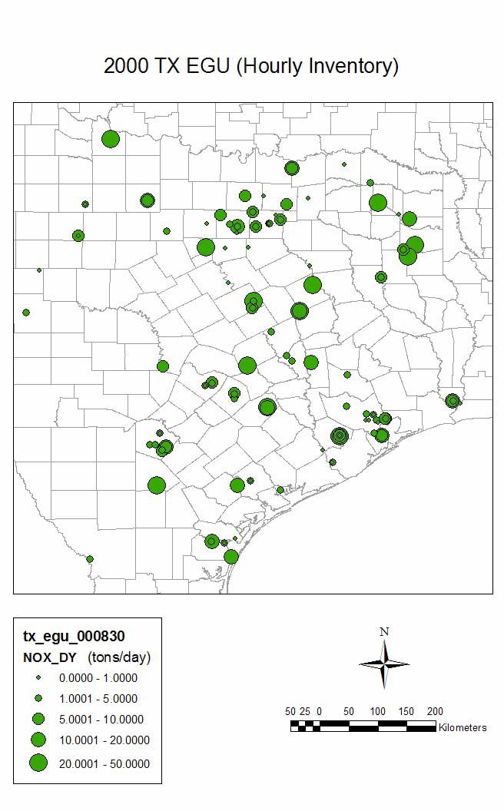
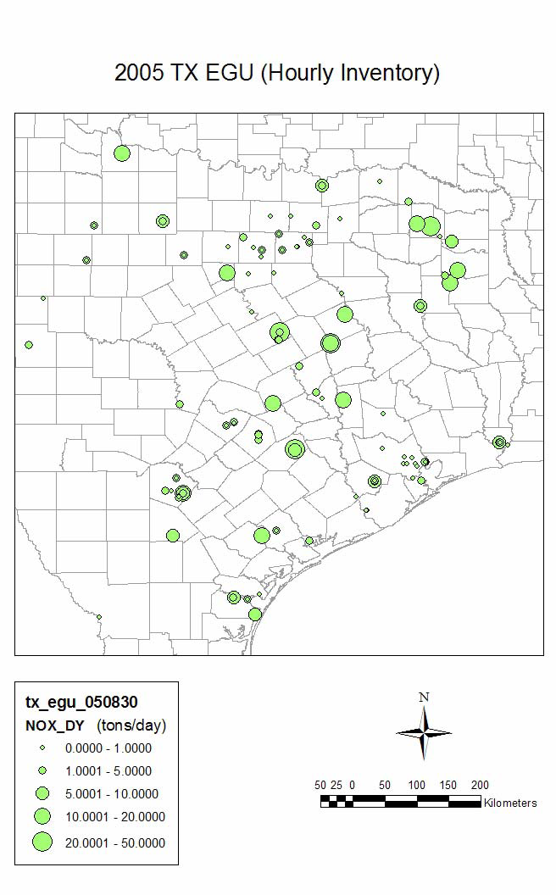

Projected Texas EGU NOx emissions after State Implementation Plan (SIP)
2007 emissions inventory were projected from 2000 EI with growth and control factors from TCEQ.
For HGA, NOx emissions for 2005, a factor of 1.747 was applied on 2007 EI based on the 2005/2007 MECT (Mass Emission Cap and Trade) allowances.

Slide 27
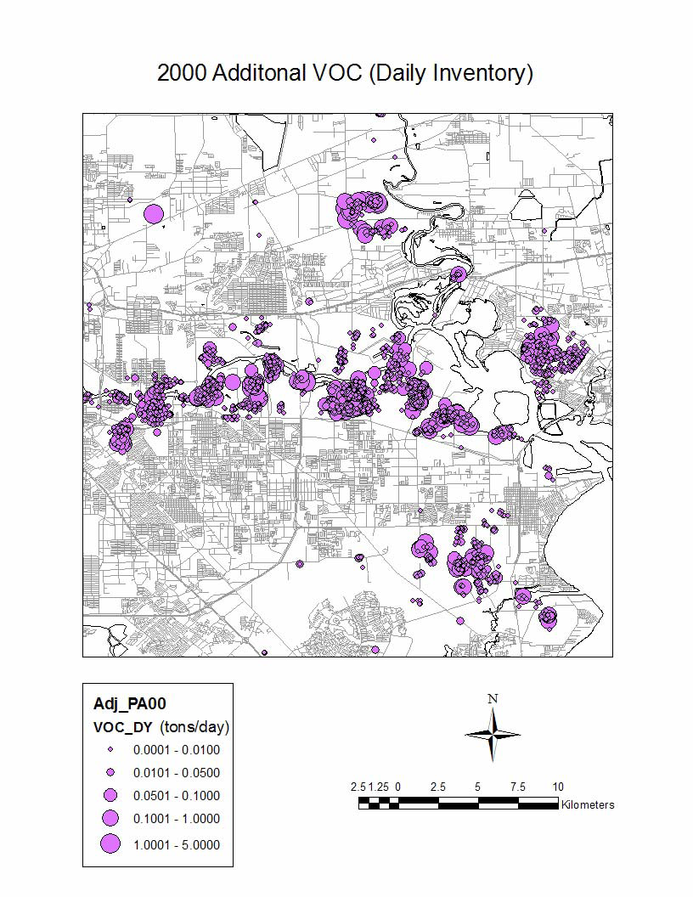
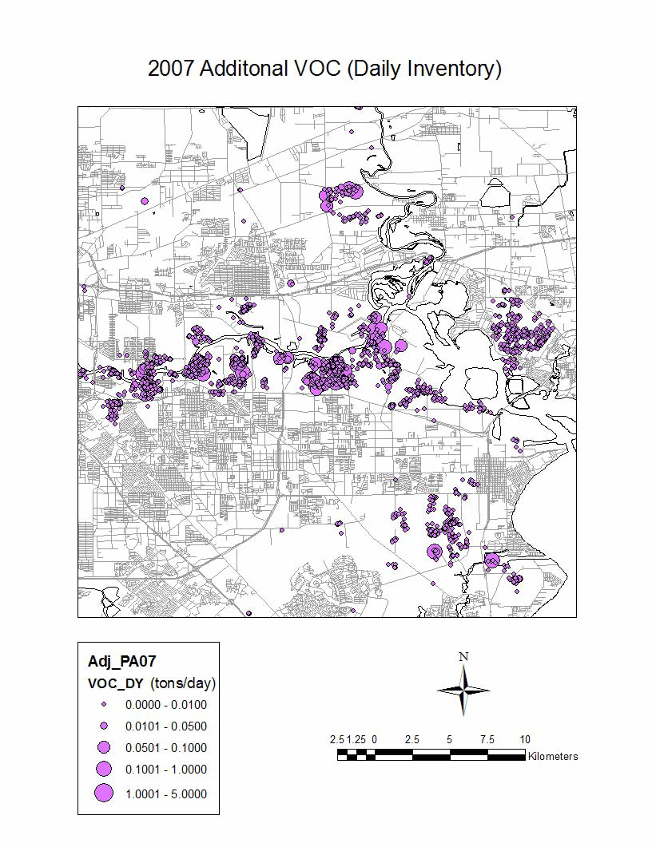
VOC emissions for imputation after SIP
UH AQF system uses additional VOC emissions at the 2007 level.

Slide 28
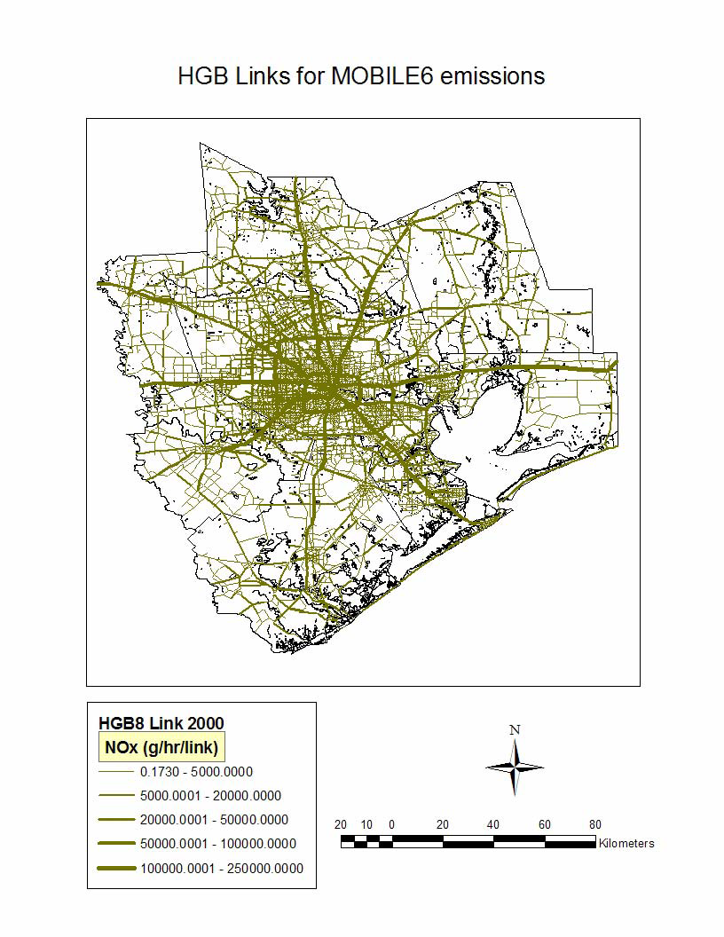

MOBILE6 NOx emissions for 2000 and 2007
The emissions amounts for each county, vehicle type, hour and species were determined for 2005 based on those for 2000 and 2007.
A factor was applied on 2007 MOBILE6 emissions to get 2003 emissions.

