Slide 1


Emission market modeling; case study of NO_{x} SIP call sources
CMAS 2011
S. Morteza Mesbah, Amir Hakami
Department of Civil & Environmental Engineering, Carleton University
Stephan Schott
Department of Public Policy & Administration, Carleton University

Slide 2
Outline
NO_{x} cap-and-trade programs in the US
Trading with exchange rate
Marginal abatement cost
Evaluation of three policies
  Current policy (cap-and-trade)
  Cap-and-trade with exchange rate based on:
    24 hour average ozone
    24 hour ozone exposure

Slide 3
US NO_{x} cap-and-trade
SIP call trading program (2003-2008) is a market-based program to control power plant NO_{x} emissions
It was replaced by Clean Air Interstate Rule (CAIR) program in 2008
The program’s components
  1 permit is 1 ton of NO_{x} in the ozone season
  Permits are allocated based on Plants’ electricity generation
  Plants can bank or trade their permits
  Plants must have enough permits to cover their emissions at trading deadline

Slide 4
Can permit trading be more effective?
Under current cap-and-trade all emissions are equal (one-to-one trading)
NO_{x} emissions in different locations have different effect on ozone concentrations (they are not equal)
One-to-one emission trading does not control ozone efficiently
  Exchange rate =
  is the sensitivity of ozone to NO_{x} from plant
  The exchange rate is not new in the literature (e.g. Montgomery 1970, Krupnick 2001). The adjoint model provides an effective approach for calculation of

Slide 5
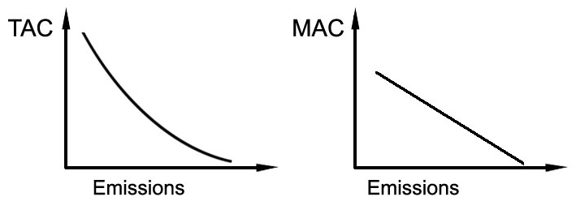
Marginal abatement cost
Total Abatement cost (TAC) is the total cost for emission reduction
Marginal abatement cost (MAC) is the derivative of TAC
  MAC curve can be used to predict plant’s behavior

Slide 6
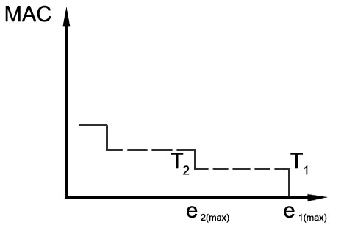
Emissions reduction options
Emission control technologies (long term option)
Output (electricity) reduction (short term option)

Slide 7
Short term MAC estimation
Opportunity cost of output reduction (Opportunity cost is the forgone benefit of an action) is estimated using:
  The estimated relationship between outputs and emissions, and
  The electricity price from the US Energy Information Administration (EIA)
O&M cost of the control technology is estimated using Integrated Planning Model (IPM) of the US EPA

Slide 8

The Rochester Power Plant
Unit | 1 | 2 | 3 | 4
Capacity(MW) | 46 | 63 | 63 | 82
Coal-fired
SNCR control
Location: Rochester, NY, US

Slide 9
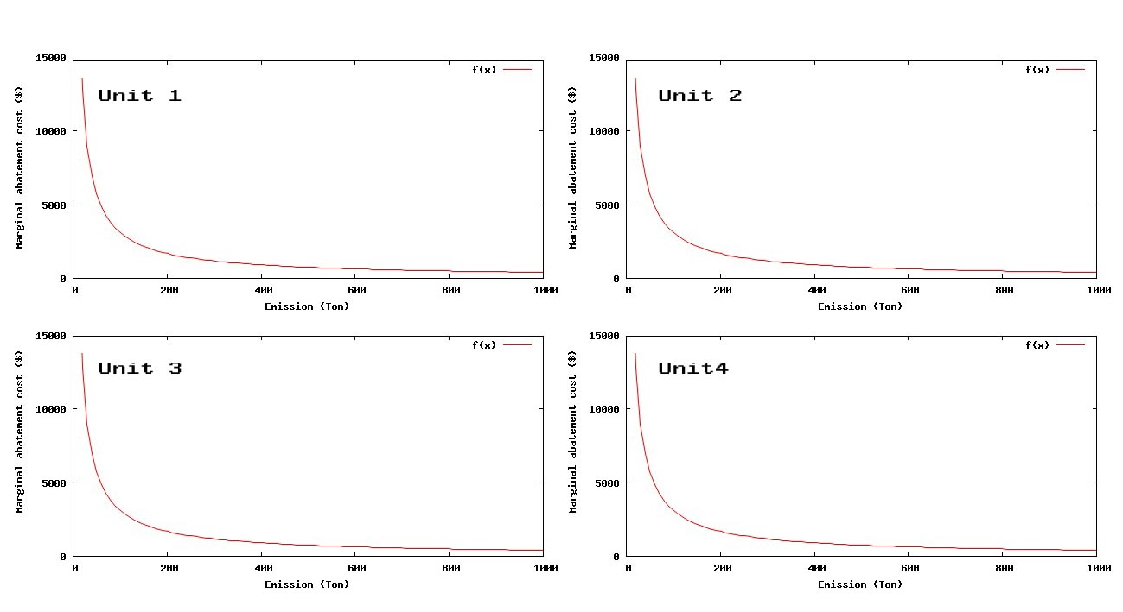
MAC of the Rochester Power Plant
Permit buyer:
MAC > permit price
Permit seller:
MAC < permit price
Permit price in the ozone season 2007: 900 $/ton
 | Unit 1 | Unit 2 | Unit 3 | Unit 4
Ozone season NO_{x} emissions (ton) | 264 | 263 | 219 | 219
MAC($/ton) | 1361 | 1180 | 1970 | 1163

Slide 10
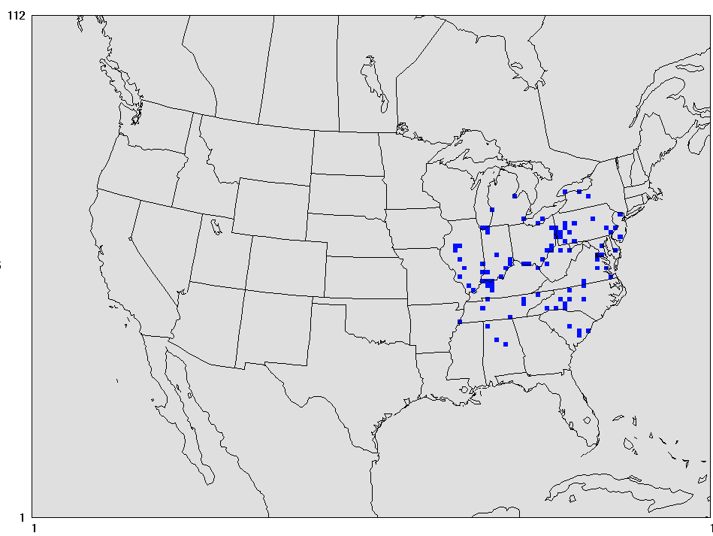
Case study
Point Sources:
  218 SIP call coal fired plants with SCR/SNCR technology
Domain:
  Continental United States
  Date:
  16th to 31st July 2007
Adjoint cost functions:
  Average concentration in grids with ozone concentrations more than 60 ppb
  Ozone exposure : population times ozone concentrations

Slide 11
Policies
CaC: Command and Control (emissions equals to the allocated permits)
CaT: Cap and Trade with no exchange rate (one-to-one trading)
CaT-EX: Cap and trade with exchange rate based on average ozone in critical grids
CaT-EXP: Cap and Trade with exchange rate based on ozone exposure

Slide 12
Decision support system
CaT-EX CaT-EXP CaT CaC
Adjoint of CMAQ
Exchange rates
Optimization Model
Emissions distribution
Forward CMAQ
Ozone concentrations

Slide 13
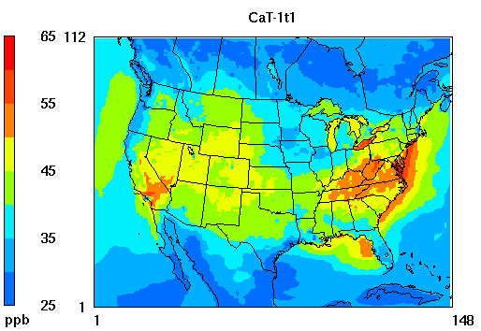
Cap-and-Trade (CaT)
The average of 24 hour average ozone from 16th to 31st of July 2007

Slide 14
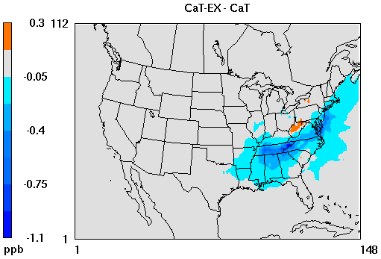
CaT w/t Exchange Rate (CaT-EX)
Change in average ozone by switching from CaT to CaT-EX

Slide 15
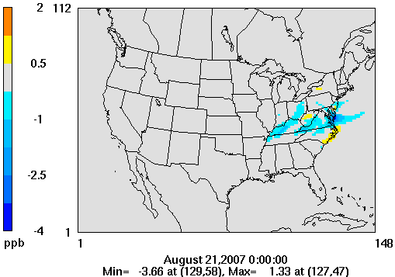
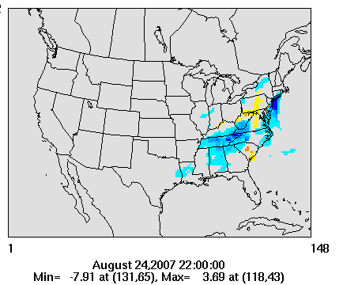

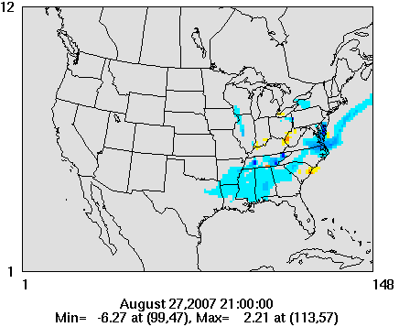
CaT w/t Exchange Rate (CaT-EX)

Slide 16
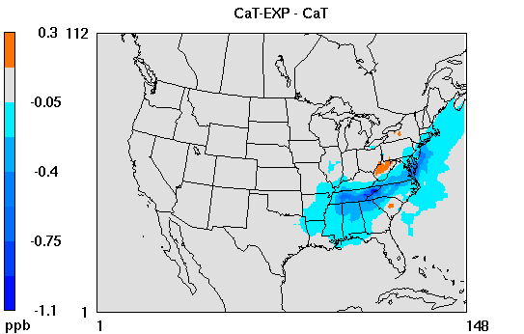
CaT w/ Exposure EX (CaT-EXP)
Change in average ozone by switching from CaT to CaT-EXP

Slide 17

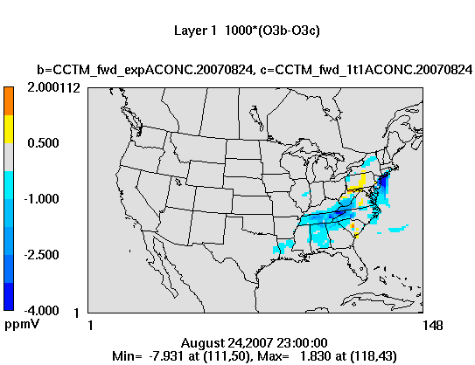


CaT w/ Exchange Rate (CaT-EXP)

Slide 18
Cost

Slide 19
Mortality
∆M=Y₀*β *∆ozone*Population
Y₀ : baseline non-accidental mortality
0.007448 for 2007 (US CDC, 2010)
β : concentration response coefficient
1.04/20 ppb (Bell et. all 2004)
Statistical value of life: 6.9 million $ (US EPA)

Slide 20
Switching from CaT to CaT-EX
 | CaT to CaT-EX | CaT to CaT-EXP
Extra cost (million $) | 2.99 | 2.61
Mortality decreased (death/year) | 84. 05 | 87.71
Benefit (million $) | 579.95 | 605.20

Slide 21
Conclusions
Adjoint sensitivity analysis is a useful tool informing the decision making process
The exposure based trading is the most efficient policy examined
The additional benefit of the CaT-EXP policy is about 230 times more than its extra cost (excluding implementation cost)
Implementation challenges need to be investigated
Other cost functions such as maximum 8 hour ozone or maximum 1 hour ozone can be considered

Slide 22
Questions?
Thank-you

