Slide 1
Meteorological Model Impact on the National Air Quality Forecast Modeling Capability Performance
October 24, 2011
NOAA/OAR/ARL and NWS/NCEP/EMC
Air Quality Team

Slide 2
NCEP AQ Project Team
Marina Tsidulko - PBL & Chemistry Verification
- High Res. Met modeling
Youhua Tang - Regional on-line NEMS AQ development
- Lateral Boundary Condition studies
Jianping Huang - Improved Met-chem coupling
- National AQF System Design & Implementation
- Hysplit Smoke & CMAQ AOD verification
Sarah Lu - Global radiative feedback testing
- NEMS GFS online aerosols development
Ho-Chun Huang - Chemical data assimilation
- Global aerosol system sources
Jeff McQueen - AQF System Evaluation
- DOD Dispersion & PBL analysis support
Geoff Manikin - Hysplit Smoke, dust, RSMC testing & implementation
Caterina Tassone - Real-time 2.5 km Boundary Layer Analysis
Binbin Zhou – Dispersion/ensemble modeling for H.S.
Pius Lee, et al., ARL - NOAA/OAR/ARL team leader
Ivanka Stajner, NWS/OST - NWS Air Quality Forecasting Project Manager
Notes:
An underutilzed team of world class scientists who are developing, maintaining and evaluating the current regional operational system while working with OAR, NESDIS, NASA and university scientists to develop data assimilation, global and inline-interactive systems

Slide 3
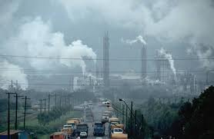
Current Emphasis
NAQFC Model Challenges
  Evaluating Community Air Quality Forecast System (CMAQ)
  Coupling the driving Met processes
      air-sfc interactions → Dry Deposition, biogenic emissions
      boundary layer mixing
      Radiation → Chemistry photolysis
      Clouds → aqueous chemistry
  Towards Operational Data Assimilation
    AIRNOW PM2.5 underway
    MODIS, OMI AOD planned
  High resolution Air Quality Prediction (~ 4km)
  Evaluation of met errors important for AQ
    Surface fluxes, Low level winds, temperature, moisture
    Boundary layer turbulence, evolution
    Orographic flow features & timing
    Cloud, convection, precip evolution, timing
    weak & strong frontal features

Slide 4
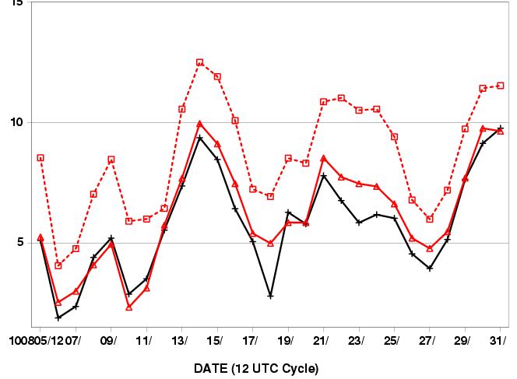
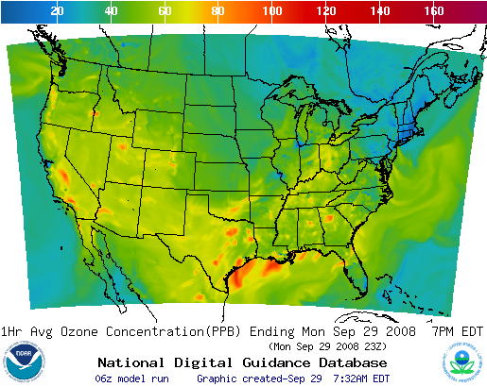
NAM-CMAQ NAQFC Current Configuration
Ozone and PM2.5 Predictions
Emissions:
EPA CEM anthropogenic inventories
2005 base year projected to current year w/ EGU
BEIS V3 Biogenic Emissions
Met Model:
North American Model (NAM)
Non-hydrostatic Multi-scale Model (NMM→NMMB)
12 km 60 Levels
AQ Model:
EPA Community Model For Air Quality
  CMAQ V4.6: 12 km/L22 CONUS Domain
  Operational: CB04 gas-phase
  Exper/Dev: CB05 gas-phase/ Aero-4 aerosols
Access
Output available on National Digital Guidance Database
  48 hour forecasts from 06/12 UTC Cycles
PM graphics, GRIB files from EMC
8 hour max ozone day 2 bias over CONUS
Black: NAM-CMAQ CB IV
Red: NMMB-CMAQ CB IV
Dashed: NMMB-CMAQ CB05 combo1
142

Slide 5
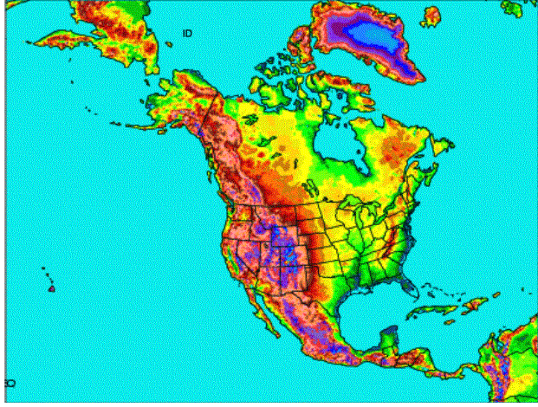
October 18, 2011 NAM Upgrade
New NAM
NEMS based NMMB
B-grid replaces E-grid
Parent remains 12 km to 84 hr
Multiple Nests Run to 60 hr
  4 km CONUS nest
  6 km Alaska nest
  3 km HI & PR nests
Single locatable ~1.33-1.5 km FireWeather/IMET/DHS run to 36hr
Current NAM
WRF-NMM (E-grid)
GSI analysis
4/Day = 6 hr update
Forecasts to 84 hours
12 km horizontal
12 hr pre-forecast assimilation period with 3hr updates (catch-up)

Slide 6
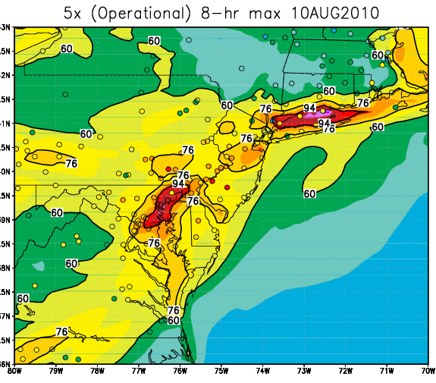
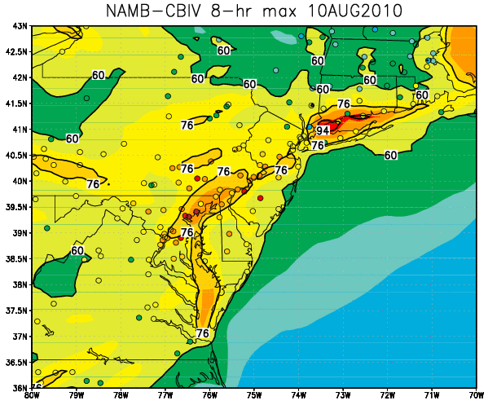
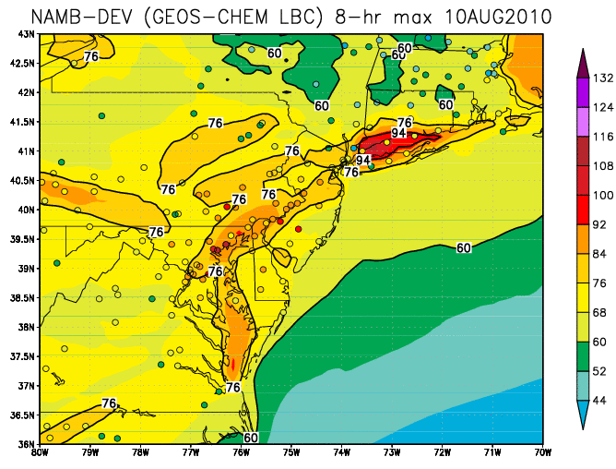
NMMB Impact on CMAQ
Day 2 Ozone 8h daily maximum
August 10, 2010 Case
NAM – CB-IV
NMMB – CB-IV
NMMB –CB05/C1
NMMB CB-IV runs:
  Improved along Long Island Sound
  Underpredicted Max O3 over Baltimore-Washington areas
NMMB CB05 combo1 run: (improved Vd, PBL limits, chem lbcs)
  Overestimates in low ozone regions (e.g.: Upstate NY, Mass)

Slide 7
Developmental/Experimental Runs
NAM vs NEMS/NMMB CMAQ forecasts
  V4.6 CB-05 developmental bundled code (Combo1):
    M-O similarity theory deposition velocity
    Improved canopy resistance
    Minimum PBL height
    GEOS-5 Chem dynamic LBCs
August 8, 2010 → Sept. 7, 2010 12 UTC Cycle
Day two 8 hr avg daily maximum & (diurnal 1 hr avg) O3 forecasts
  Fraction correct by threshold & >75 ppb
  Bias by threshold and diurnal time-series
  Daily and diurnal time-series
Regions:
  CONUS, Eastern U.S., Western U.S., sub-domains

Slide 8
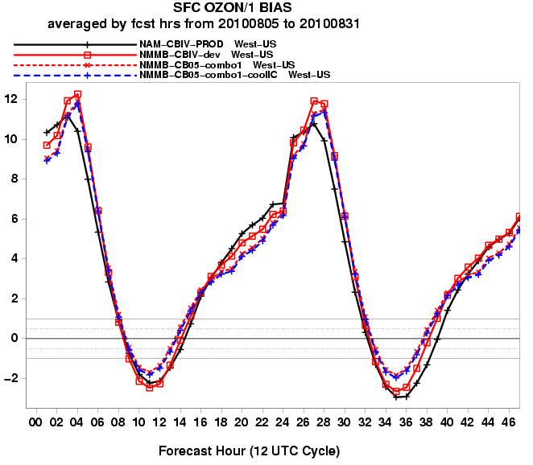
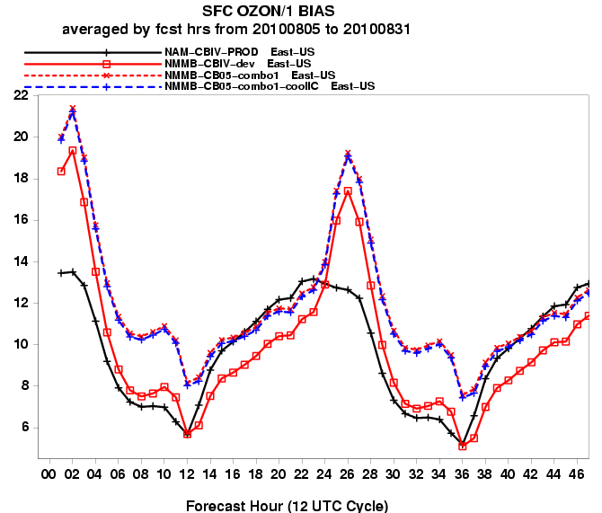
Diurnal Cycle 1 hr O3 BIAS (ppb)
August 2010 West vs East
Western US
Eastern US
Early morning error spike for only NMMB runs in East
Early morning error spike for all runs in West
  Deeper PBLH in NMMB mixes down residual pollutant air mass

Slide 9
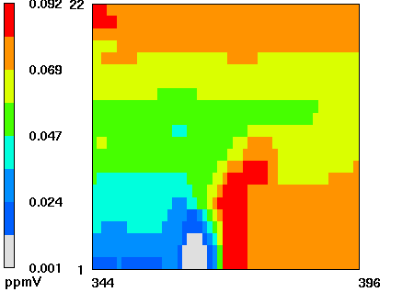
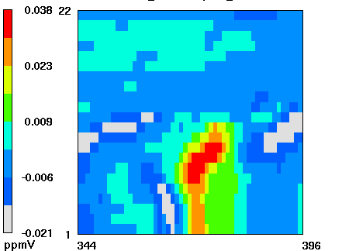
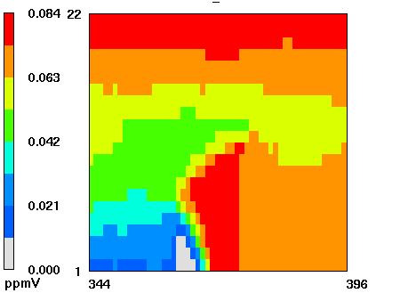
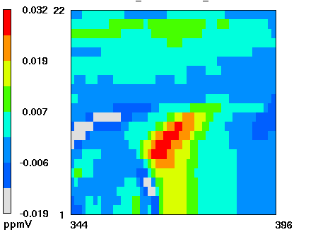
Contributions to early morning
O3 spike: Fumigation (Jianping Huang, EMC)
(NMMB CB05 combo1)
8 am local
8 am local
Difference plot :
(NMMB CB05 combo1)
Minus
(wrf-nmm CB05 combo1)
Legend:
Latitudinal
Cross-section on
Philadelphia, PA.
Vertical black
line indicates
location of
Philadelphia, PA.
(NMMB CB05 combo1)
10 am local
10 am local
Stronger fumigation
for nmmb in morning
O₃ concentration (ppb) Y-Z cross-section at Philadelphia
traversed W-E 600km on Aug 21, 2010

Slide 10
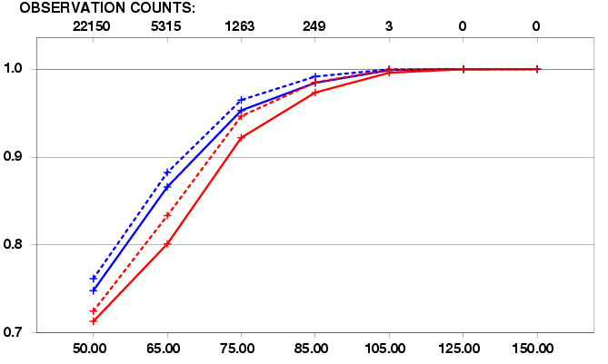
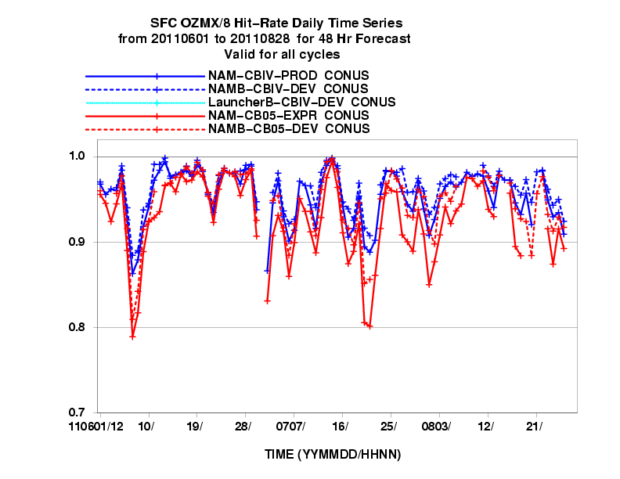
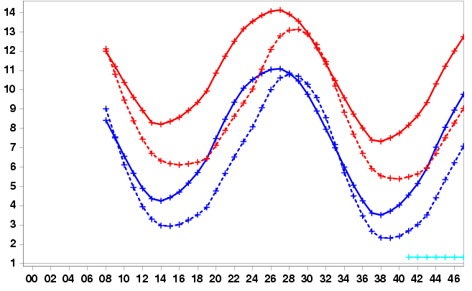
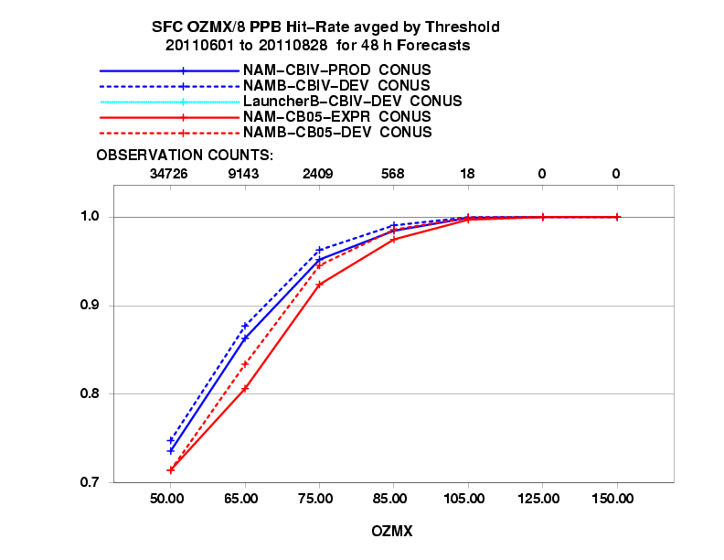
Air Quality Forecast 2011 Verification
Daily 8 hr Max ozone Eastern U.S. Errors for Day 2
NAM vs NMMB CMAQ 12 km
Fraction Correct by Threshold
Fraction Correct > 75 PPB by day
NAM-B CB-IV best; overestimate
NAM-B CB05-combo1 improved
Largest errors from 7/18 – 7/23/11
8 hr avg diurnal error

Slide 11
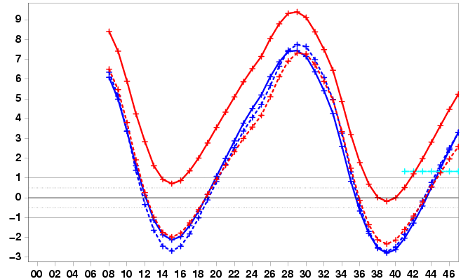
Air Quality Forecast 2011 Verification
Daily 8 hr Max ozone Western U.S. Errors for Day 2
NAM (solid) vs NMMB(dashed) CMAQ 12 km
Fraction Correct by Threshold
Fraction Correct > 75 PPB by day
NAM-B CB-IV best; underestimate
NAM-B CB05-combo1 improved
Largest errors 6/6, 7/19 – 7/20/11
8 hr avg Diurnal Error

Slide 12
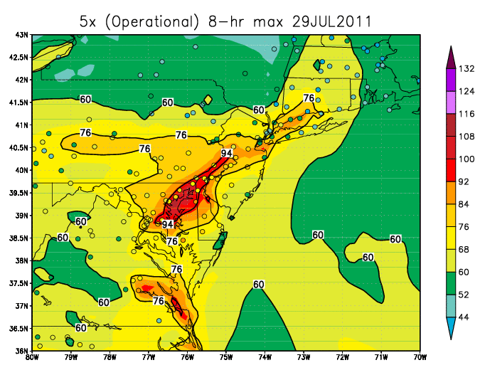
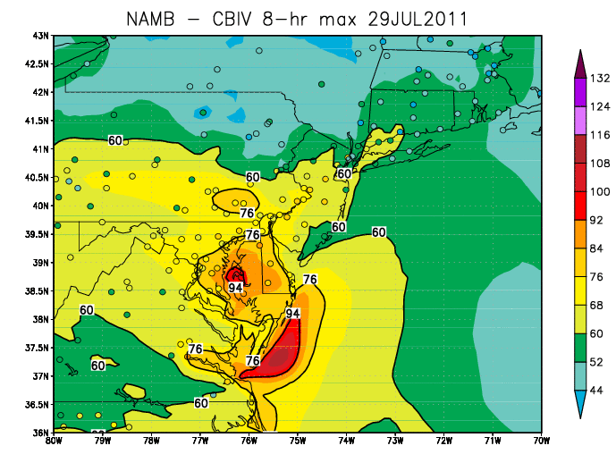
Air Quality Forecast 2011 Verification
July 29, 2011 case
NAM-CMAQ CB-IV chemistry
NAMB-CMAQ CB-IV chemistry
NAM-B CMAQ: Significant improvement over Mid-Atlantic

Slide 13
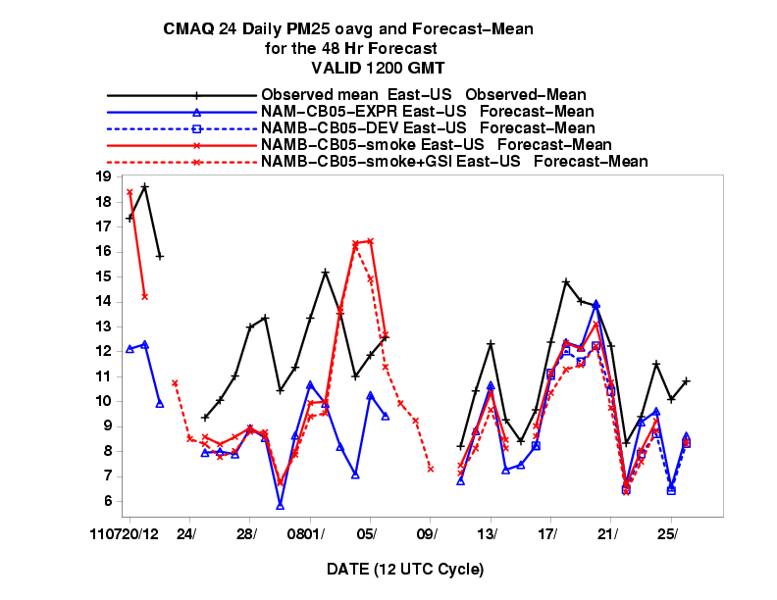
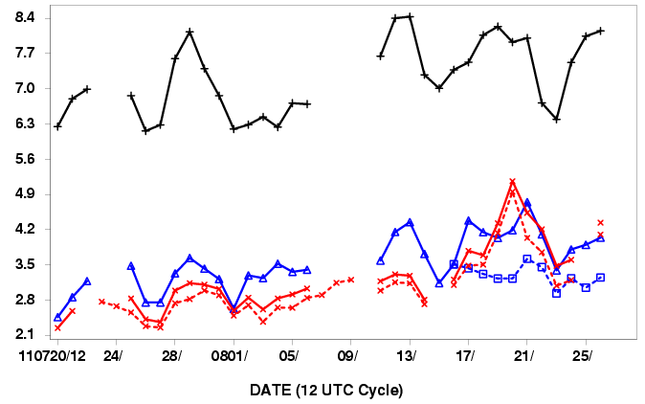
Air Quality Forecast 2011 Verification
24 hour PM2.5 Daily Errors (Day 2)
WEST
EAST
Fire runs overpredict PM2.5 in East from Aug. 4-6, 2011

Slide 14
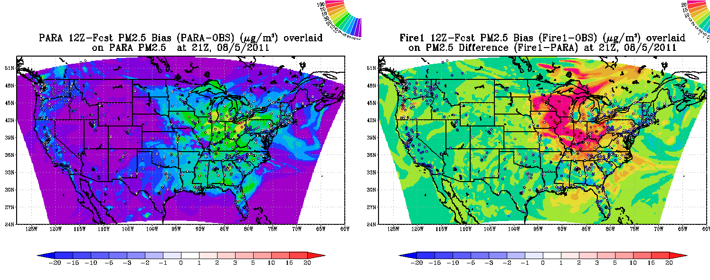
August 5, 2011 Case
34 hour (21 Z) CMAQ CB05 PM forecasts
Youhua Tang
NAM-CMAQ Experimental run
(w/o fire sources)
1 hr avg PM2.5
Difference between CMAQ
w/ and w/o fire sources
1 hr avg PM2.5
Canadian smoke plumes impact large portion of Midwest sfc PM
Sources too strong, downward mixing ???

Slide 15
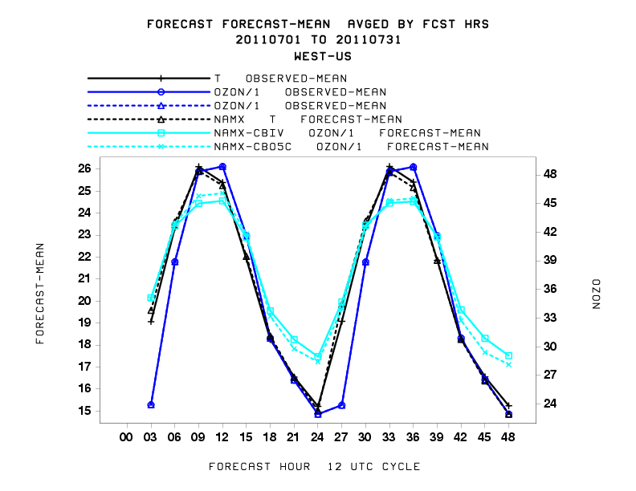
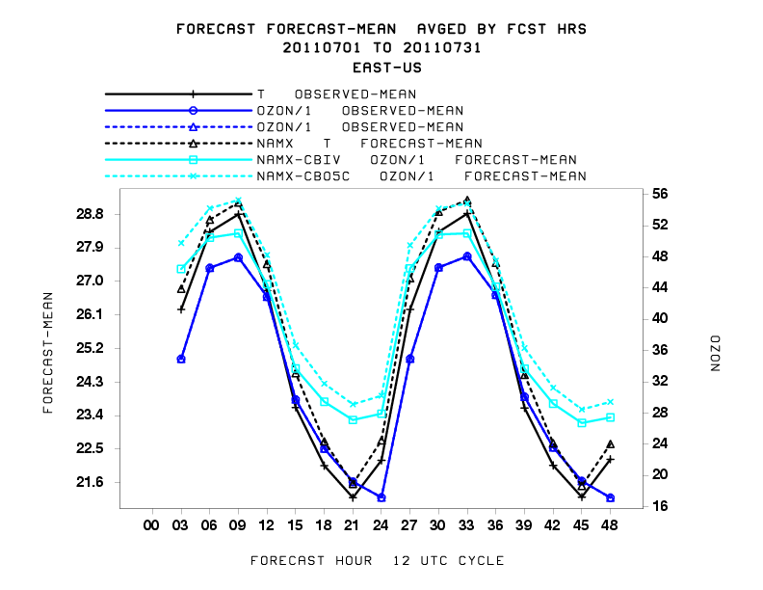
NMMB West vs East
2 m Temperature vs 1 h ozone
Diurnal Forecast means
WEST
EAST
West: NMMB improved near daily max (cooler)
East: Small differences (slight warm bias)

Slide 16
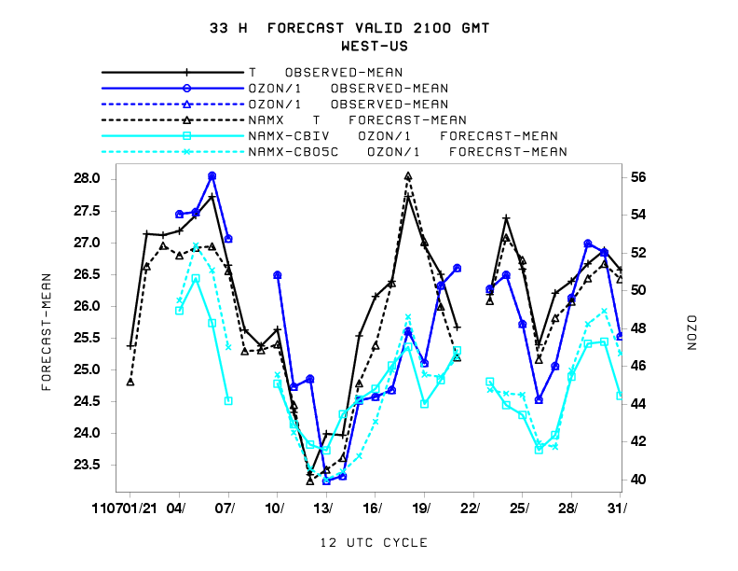
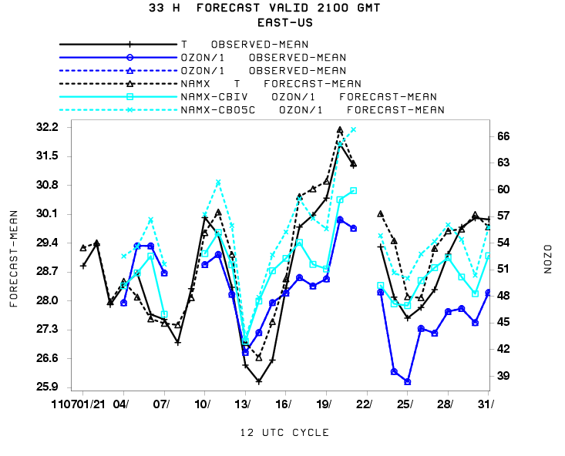
NMMB West vs East
2 m Temperature vs 1 h ozone
33 hour forecasts valid 21:00 UTC
WEST
EAST
West : Temperatures good, Ozone underpredicted
East : Slightly warmer, Ozone overpredicted

Slide 17
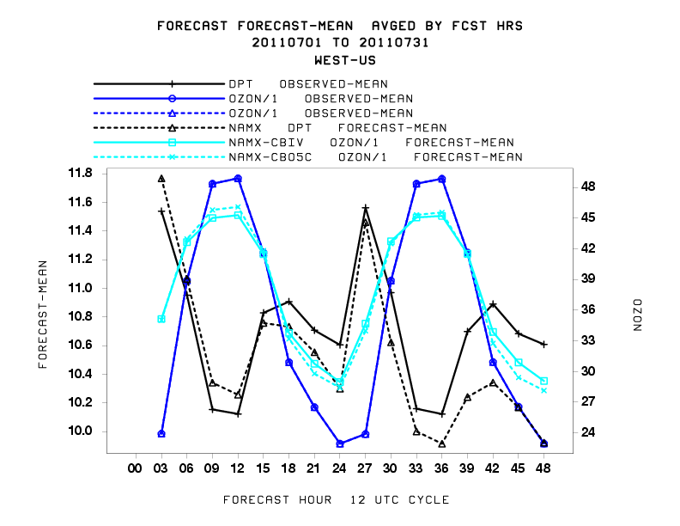
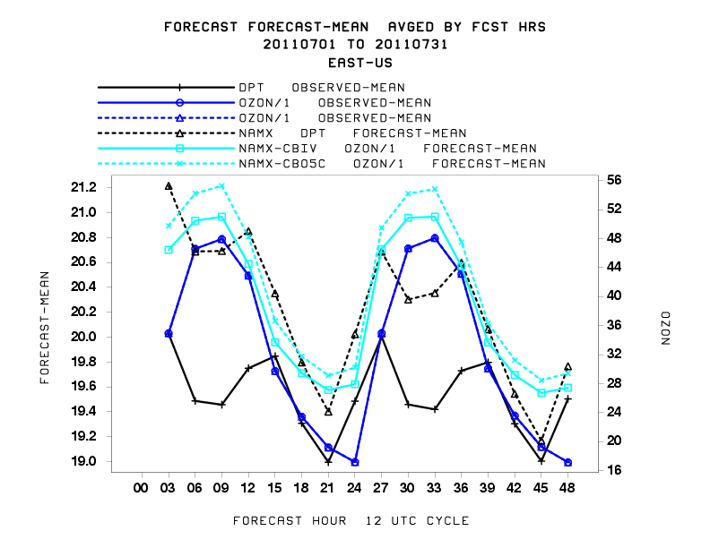
NMMB West vs East
2 m Dew Point T vs 1 h ozone
Diurnal forecast means
WEST
EAST
West: Dry at night
    Ozone max correlated with daytime Td minimum
EAST: Moist bias
    Ozone errors correlated with daytime Td moist error

Slide 18
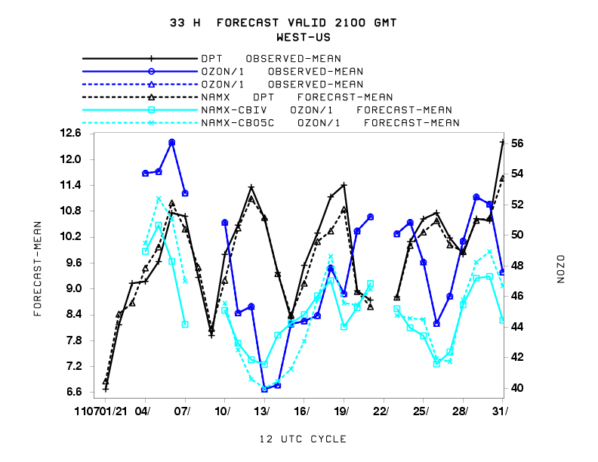
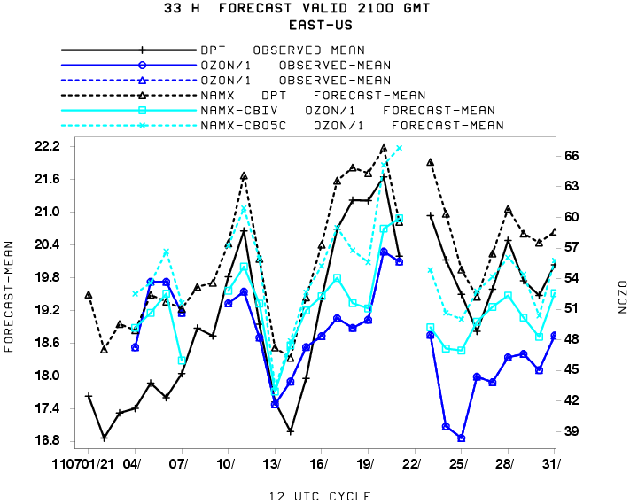
NMMB West vs East
2 m Dew Point T vs 1 h ozone
33 hour forecasts valid 21:00 UTC
WEST
EAST
West : Dewpoint forecasts are good
East : moist bias, Ozone correlated with Td

Slide 19
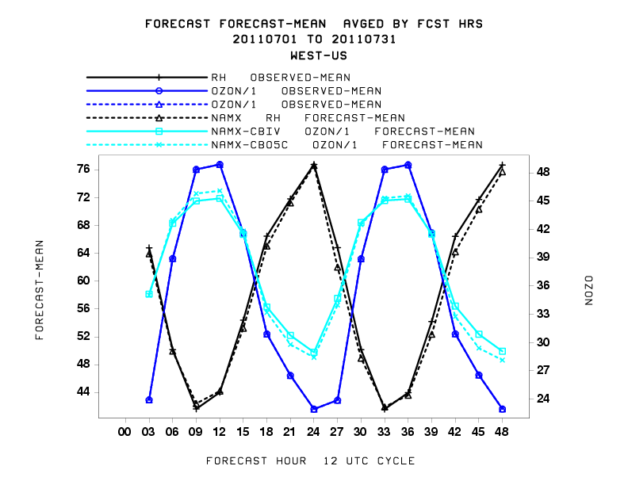
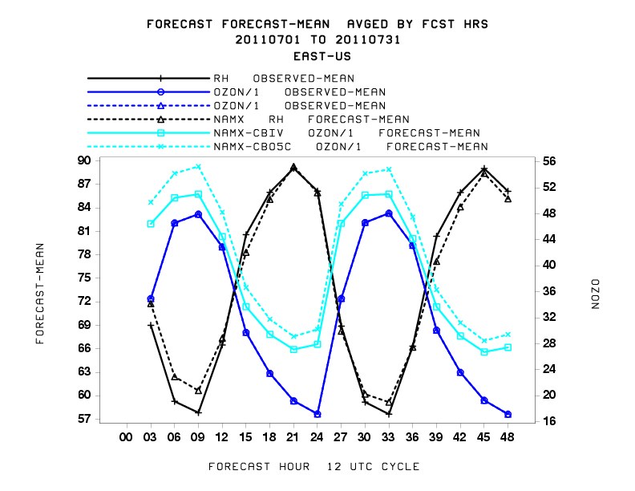
NMMB West vs East
2 m RH vs 1 h ozone
Diurnal forecast means
WEST
EAST
West : RH → Excellent agreement w/ obs
East : Moist bias late in day, ozone error largest

Slide 20
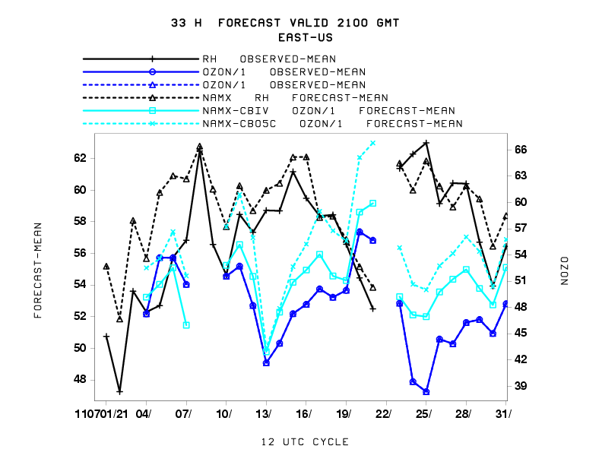
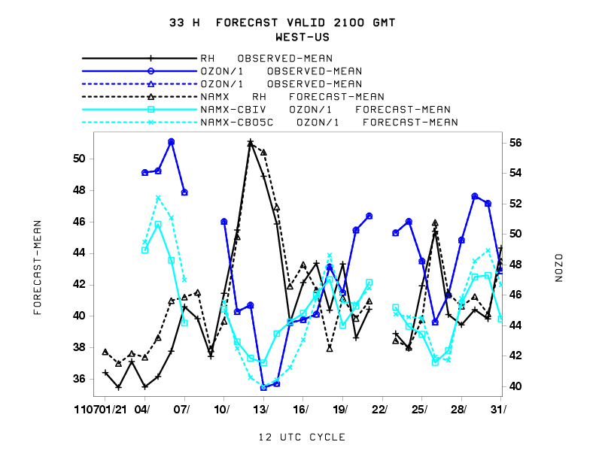
NMMB West vs East
2m RH vs 1 h ozone
33 hour forecasts valid 21:00 UTC
WEST
EAST
NMMB RH forecasts good
High RH correlated with lower ozone in Mid July
  Clouds ?

Slide 21
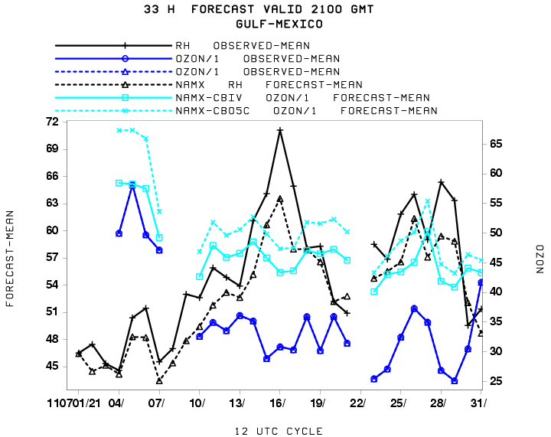
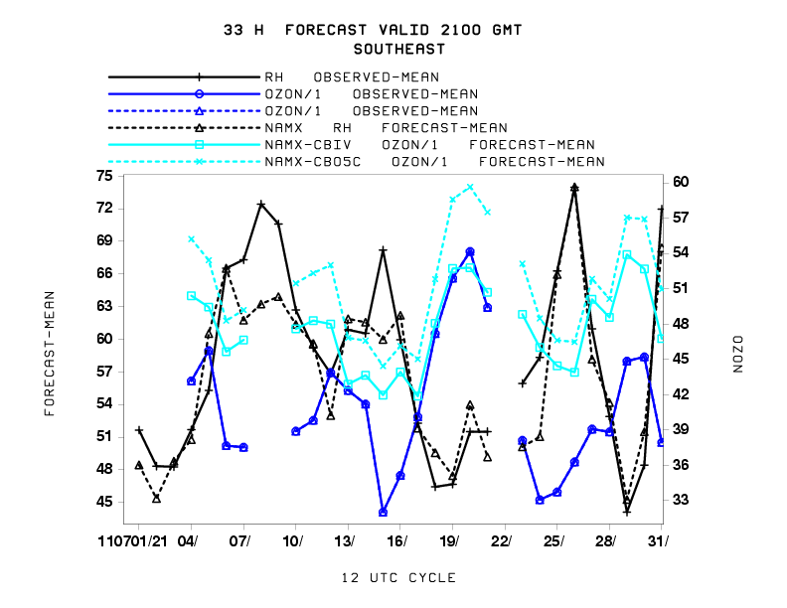
NMMB Gulf and SE States
2m RH vs 1 h ozone
33 hour forecasts
Gulf of
Mexico
South East
SE NMMB RH forecasts good
High RH correlated with lower observed ozone and largest model overprediction
  esp July 15, 26, 31

Slide 22
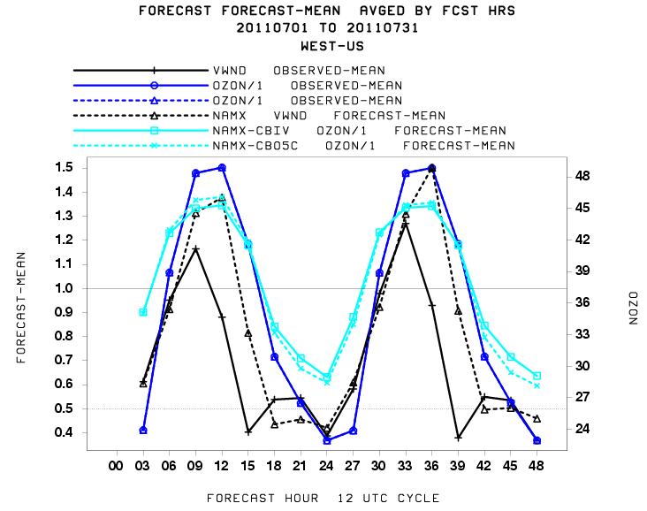
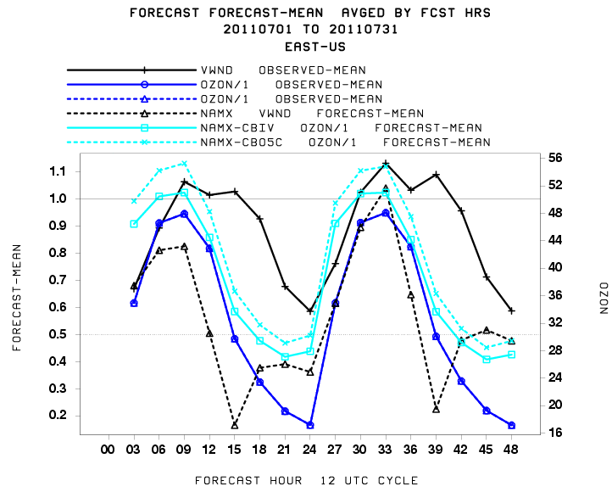
NMMB West vs East
10 m Wind Speed vs 1 h ozone
Diurnal mean forecasts
WEST
EAST
West : Wind Speed overpredicted, Ozone under predicted East : Wind Speed underpredicted esp at night

Slide 23
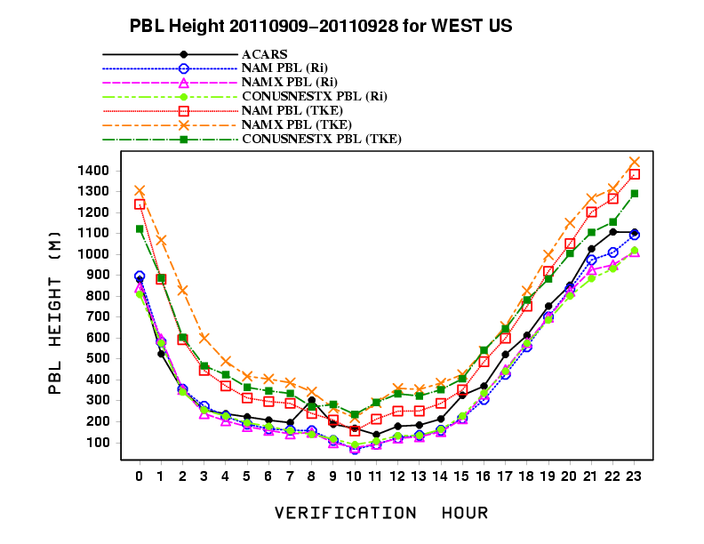
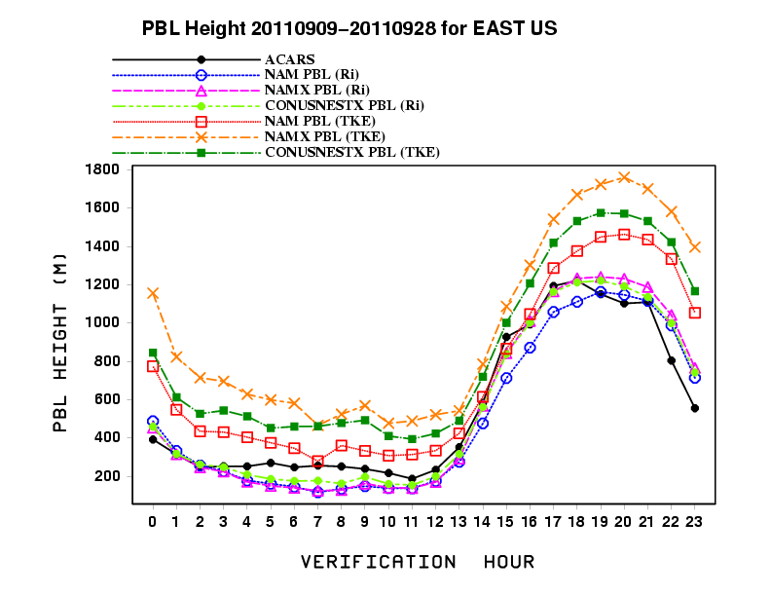
NAM, NAMX, Nest PBL verification
averaged over West, East domains
Marina Tsidulko
Diurnal cycle of ACARS PBL depth estimates
NAM vs NAMX vs CONUSNESTX
Averaged for Sept 9 – 28, 2011

Slide 24
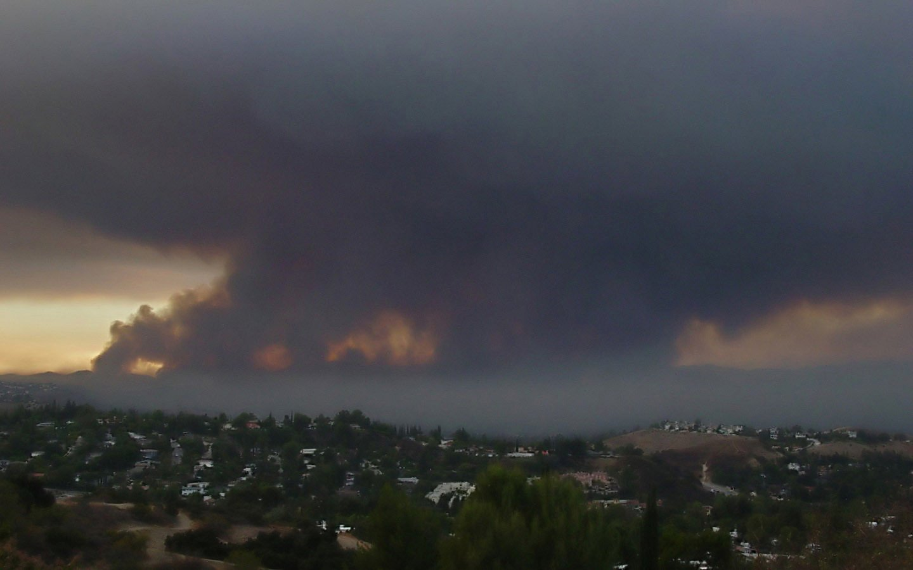
Summary
  Met Model Characteristics Continue to have a Large Impact on AQ
  NEMS NMMB Behaviors
  Improved temperature, Td forecasts
  More boundary layer mixing in AM
  Improved moisture forecasts in West
  East : Moist bias, wind underprediction
Met Impacts on AQ: Ozone Predictions overly sensitive to moisture
Model more sensitive than observations
  In East, O3 overprediction also coincides with under-predicted winds
  Vertical AQ profiles difficult to captured
Inclusion of intermittent sources difficult
  Plume rise calibrations underway with ARL
  Inclusion of dust
  Inclusion of external sources from boundaries
Improved metrices required – AQME II
  FC strongly forced by non-events
  Vertical profiles of PBL and AQ

