Slide 1
Overview of the Two-way Coupled
WRF-CMAQ Modeling System
Rohit Mathur, Jonathan Pleim, David Wong, Tanya Otte, Rob Gilliam, Shawn Roselle, Jeff Young
Atmospheric Modeling and Analysis Division, NERL, U.S. EPA
Frank Binkowski, Aijun Xiu
Institute for the Environment, UNC

Slide 2
2-Way Coupled Meteorology/Air Quality Modeling:
Rationale
Concurrent meteorology and chemistry-transport calculation
  High frequency communication between dynamical and chemical calculations
    Requisite for finer scale urban modeling/exposure applications
      Higher temporal integration (Δt << 1 hour) is necessary at finer horizontal grid resolutions (Δx < 10 km).
      Such high rates of data exchange are not practical using I/O disk files
Represent and assess the potentially important radiative effects of pollutant loading on simulated dynamical features and air quality
  Many compounds contribute to poor air quality as well as climate change (e.g., O₃ and aerosols)
  Need tools to simultaneously address both issues and their interactions
Consistent treatment of dynamical processes in meteorological and AQ models; reduces redundant calculations

Slide 3
Air Quality-Climate Interactions
Optical and Radiative Characteristics of Aerosols
Direct effects
    Light scattering aerosols (e.g., sulfate)
      Backscatter incoming solar
      Reduce radiation impinging on the Earth’s surface
      cool the surface (negative surface forcing)
      Increase radiation reflected to space
      cool the top of the atmosphere (negative TOA forcing)
    Light absorbing aerosols (e.g., black carbon/soot)
      Absorb incoming solar
      Reduce radiation impinging on the Earth’s surface
      cool the surface (negative surface forcing)
      Absorb outgoing solar reflected from surface and clouds
      Reduce radiation reflected to space
      Warm the top of the atmosphere (positive TOA forcing)
Indirect effects
  Changes in cloud formation and duration resulting from scattering and absorption
  Aerosols act as CCN; impact cloud optical thickness; impact cloud lifetime
Shaocai Yu’s presentation tomorrow

Slide 4
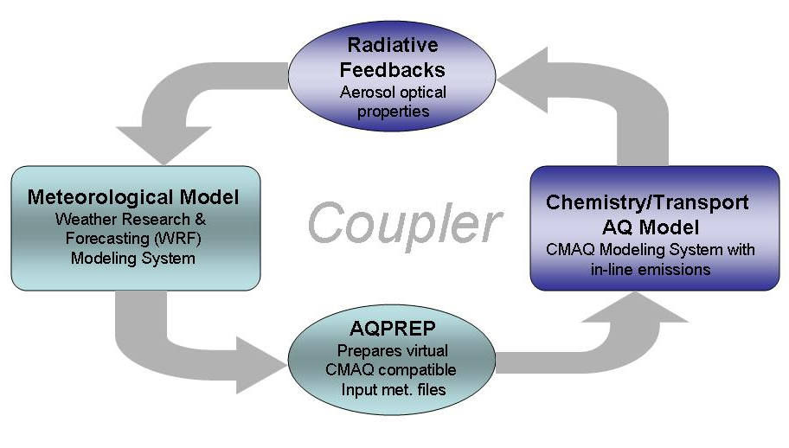
Two-Way Coupled WRF-CMAQ Modeling System:
Design and Model Features
Aerosol Optics & Feedbacks
Volume weighted refractive indices
for each wavelength based on
- Composition and size distribution
- SO₄²⁻, NO₃⁻, NH₄⁺, Na⁺, Cl⁻, EC, POA,
anthropogenic and biogenic SOA,
other primary, water
Both RRTMG and CAM Shortwave
radiation schemes in WRF
Effects of aerosol scattering and
absorption on photolysis
Effects of O₃ on long-wave radiation
Flexible design of model coupling allows
data exchange through memory resident buffer-files
flexibility in frequency of coupling
identical on-line and off-line computational paradigms with minimal code changes
both WRF and CMAQ models to evolve independently;
Maintains integrity of WRF and CMAQ
More on model structure: David Wong’s presentation tomorrow

Slide 5

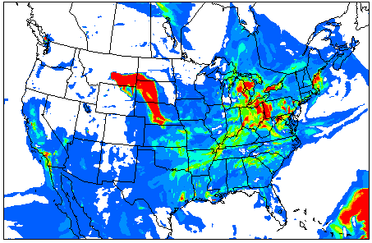

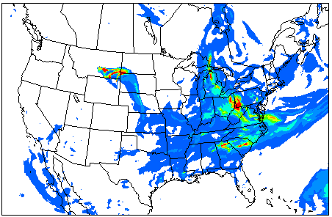

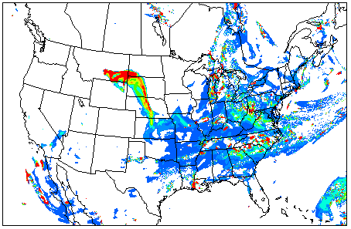

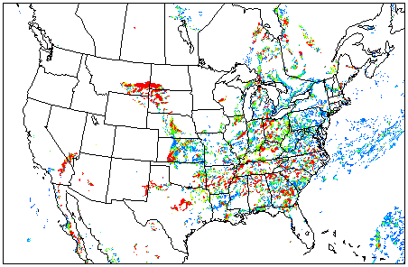

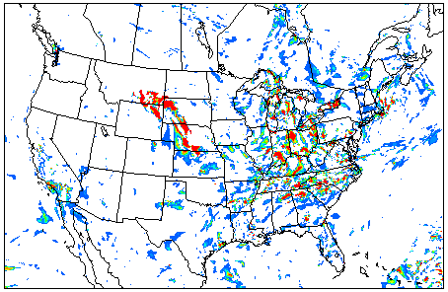
Surface PM_{2.5}
Aerosol Optical Depth
Surface SW Reduction
Increase in BL pollution (PM2.5)
PBL Reduction
July 14, 2006 21Z

Slide 6
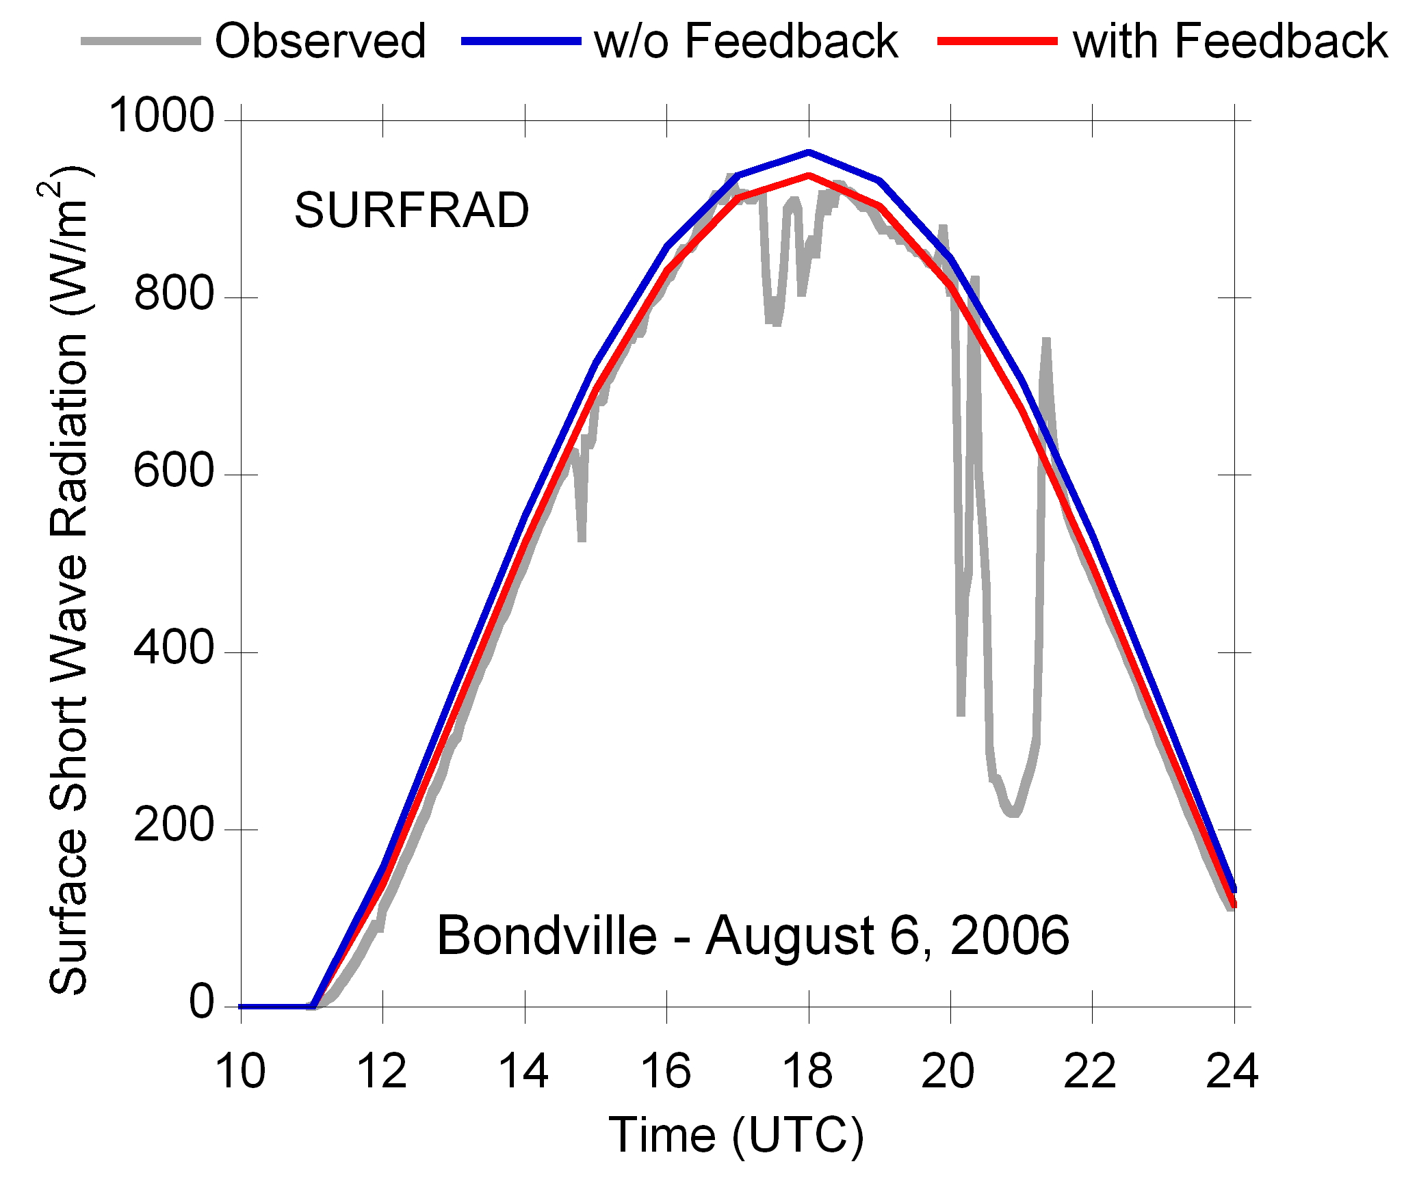
Direct Effects on Shortwave Radiation Reaching the Surface
With and Without Feedbacks
Is the signal detectable relative to measurements?
Slight cooling and better agreement with measurements noted in simulation with aerosol feed-backs

Slide 7
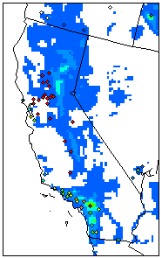
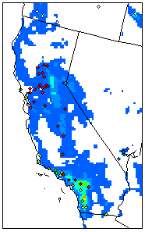
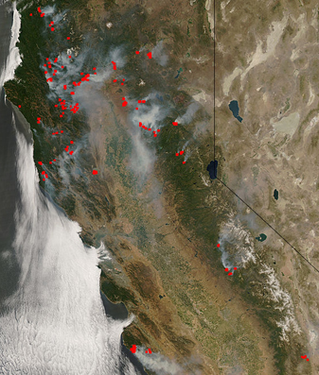

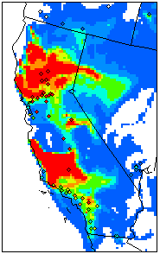
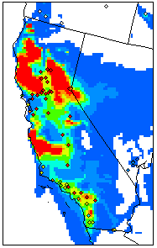
California Wildfires
A High aerosol Loading Case
6/25/08
6/27/08
Widespread wildfires resulted in significant PM pollution during mid/late June 2008 in California and surrounding states
Without Fires Emissions
With Fires Emissions
Fuel loading: National Fire DangerRating (NFDR) system
Emission Factors: Fire Emission Production Simulator (FEPS)
Function of fuel class
Daily-avg. PM_{2.5}

Slide 8
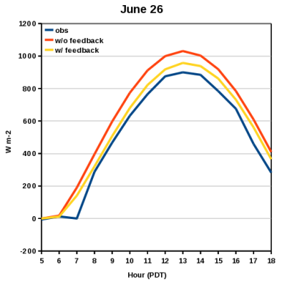

Shortwave Radiation Reaching the Surface
With and Without Feedbacks
Comparison with measurements at ISIS site at Hanford, CA
June 26 June 27
More pronounced reduction in shortwave radiation due to aerosol loading
Including aerosol direct forcing improves simulation of SW radiation

Slide 9
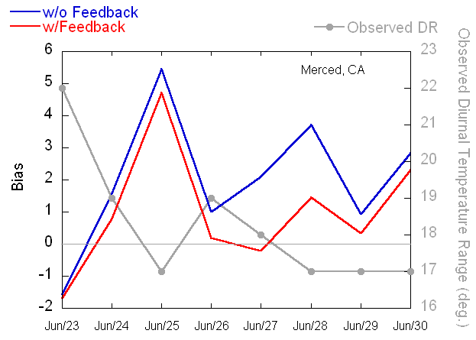
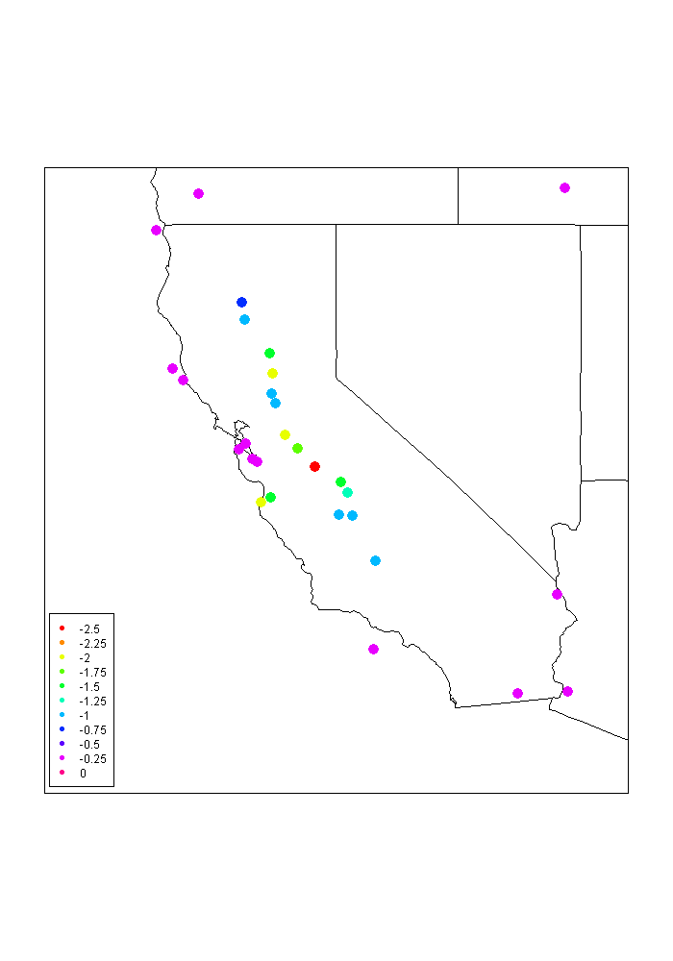
Diurnal Temperature Range (DTR)
Proxy for variability in surface solar radiation
Difference in DTR
w/Feedback – w/o Feedback
June 28, 2008
Comparison with observed range at site
impacted by wildfire plume
Reduction in bias in simulated DTR
More widespread observations of DTR could be used to assess aerosol effects

Slide 10

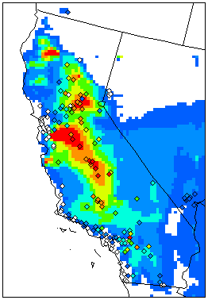
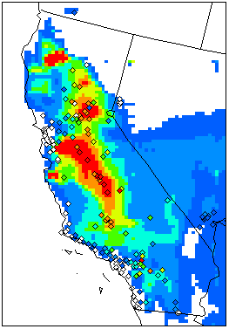

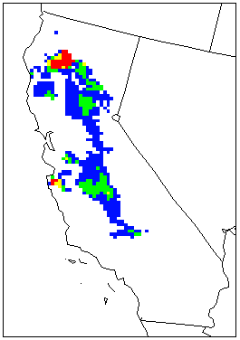
Maximum 8-hr. O₃: June 27 2008
Without Feedbacks
Enhancement due to feedback
at locations where [O₃] > 75ppb
With Feedback
Reduction in PBL heights results in increased O₃
Feedback effects could have important air quality impacts

Slide 11

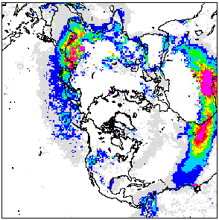
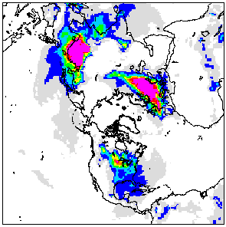

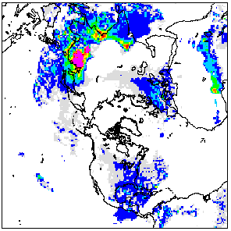

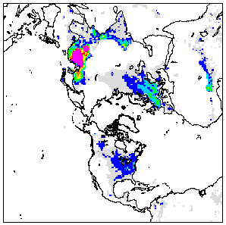

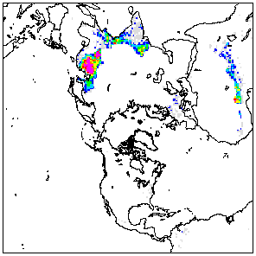
Looking Ahead:
Spatial Heterogeneity in Aerosol Effects over the Northern Hemisphere
MODIS AOD
Model AOD
March Average
2006
Reduction in surface solar radiation
Reduction in 2M Temperature
Reduction in PBL Height
“Dimming”
“Cooling”
“Suppressed ventilation”

Slide 12
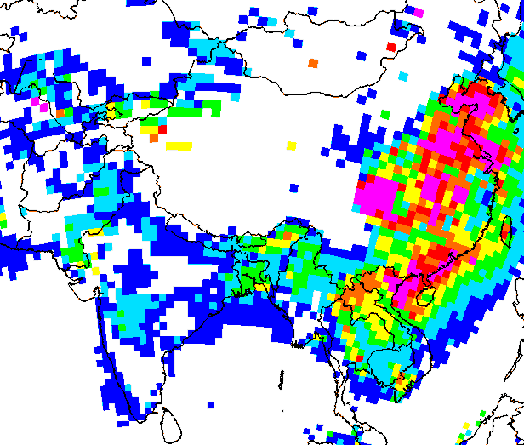
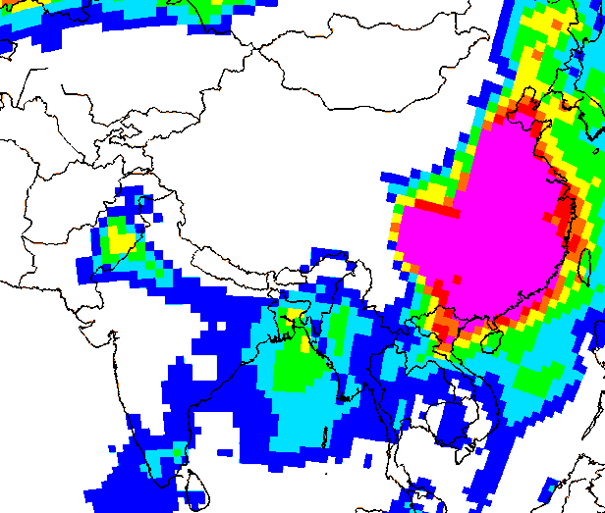

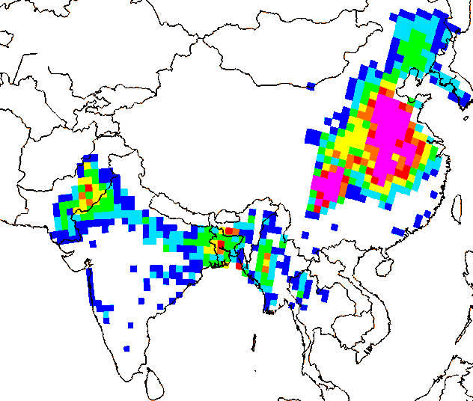
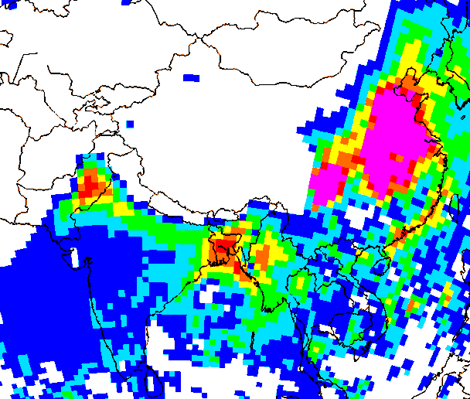
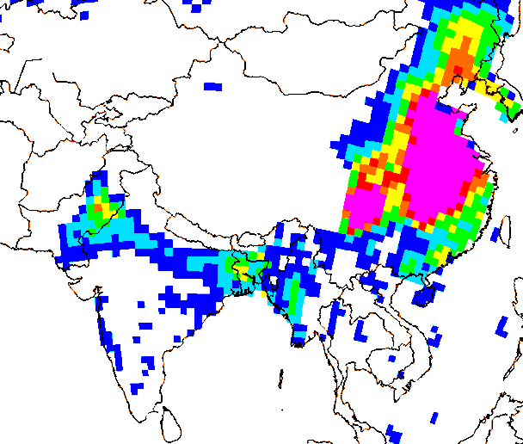
Aerosol Radiative Effects: Asia
MODIS
Model AOD
Reduction in surface solar radiation
Reduction in 2M Temperature
Reduction in PBL Height
“Dimming”
“Cooling”
“Suppressed ventilation”
March 2006 average

Slide 13
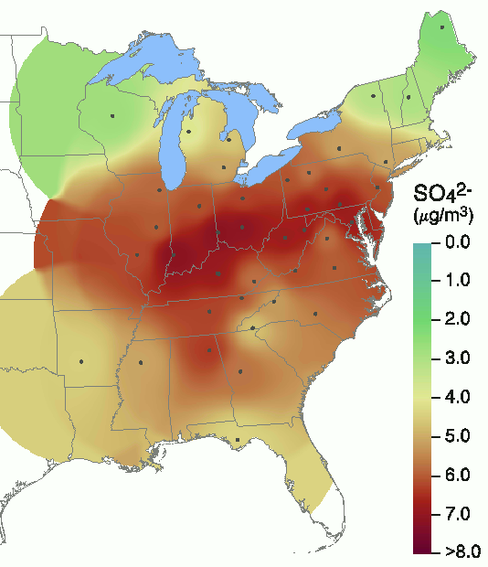
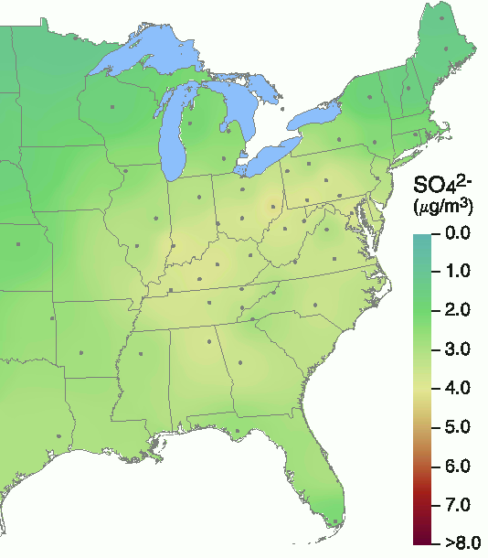

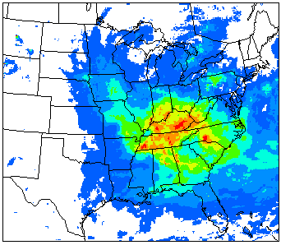

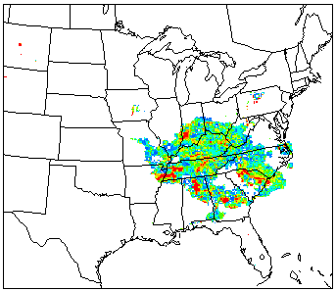
Looking Ahead:
Can models capture past trends in aerosol loading and associated radiative effects?
1989-1991
2007-2009
Title IV of the CAA achieved significant reductions in SO₂ and NO_{x} emissions from EGUs since the 1980s
Tropospheric SO₄²⁻ burden has reduced significantly
Can the associated increase in surface solar radiation be detected in the measurements and models (“brightening effect”)
USEPA/CAMD
Preliminary Results:
Decrease in AOD
Increase in Surface SW
Multi-year WRF-CMAQ simulations to assess the responsiveness of the model to Title IV emission changes are now being set-up
ΔAOD > 0.4

Slide 14
Summary
Air quality and climate issues are inherently linked
  Spatial and temporal variability of short-lived radiatively active species need to be accurately characterized
A computationally efficient and flexible coupled meteorology-atmospheric chemistry modeling system based on the WRF and CMAQ models has been developed
Direct feedback of aerosols on SW radiation has been tested
  Effects can be large in regions with significant aerosol loading
  Preliminary comparisons with limited measurements show improvements in simulation skill for SW radiation and 2m T
  Air pollutant concentrations can be significantly increased due to reductions in PBL height
Challenge: Assessing the magnitude and directionality of feedback effects on simulated air quality

Slide 15
