Slide 1
Modeling emission trends for scenarios of the future using MARKAL
Dan Loughlin, Chris Nolte, Bill Benjey
Farhan Akhtar and Rob Pinder
U.S. EPA Office of Research and Development
Daven Henze
University of Colorado
Presented at the 10th Annual CMAS Conference, UNC-CH, Oct. 24-26, 2011

Slide 2
Purpose of presentation
Describe the use of the MARKet ALlocation (MARKAL) energy system model to develop long-term emission projections for alternative scenarios of the future

Slide 3
Notes
Abbreviations are defined in the extra slides at the end of the presentation
Results are provided for illustrative purposes only
DISCLAIMER:
  The views expressed in this presentation are those of the authors and do not necessarily reflect the views or policies of the U.S. Environmental Protection Agency or the University of Colorado

Slide 4
Presentation outline
Part 1. Overview of MARKAL
  Assumptions
  Scope and detail
  Outputs
  Use
Part 2. Generating CMAQ-ready future emissions
  Translation of MARKAL emissions into growth-and-control factors
  Use of growth-and-control factors in developing future air quality modeling inventories
Part 3. On the horizon: GLIMPSE
  Example results

Slide 5
Part 1. Overview of MARKAL

Slide 6
Overview of MARKAL
Modeling U.S. energy system scenarios with MARKAL
Scenario assumptions
Population growth
Economy
Climate change
Technology development
Behavior
Policies
Outputs
Technology pathway
Fuel use
Criteria air pollutant
emissions
Greenhouse gas (GHG)
emissions
Short-lived climate
forcer (SLCF) emissions
and radiative impact
MARKAL
energy system model and
U.S. EPA MARKAL database

Slide 7
Overview of MARKAL: Assumptions
Modeling U.S. energy system scenarios with MARKAL
Baseline assumptions
Data sources include:
U.S. EIA:
Annual Energy Outlook 2010
Commercial Building Energy Consumption Survey
Residential Energy Consumption Survey
Transportation Energy Data Book
U.S. EPA:
eGRID database
AP-42 emission factors
Greenhouse Gas Inventory
Speciate database
Regulatory impact assessments
MOVES model
Other:
Argonne’s GREET model
Scientific literature
Scenario assumptions
Population growth
Economy
Climate change
Technology development
Behavior
Policies
Outputs
Technology pathway
Fuel use
Criterial air pollutant
emissions
Greenhouse gas (GHG)
emissions
Short-lived climate
forcer (SLCF) emissions
and radiative impact
MARKAL
energy system model

Slide 8




Overview of MARKAL: Scope and detail
Modeling U.S. energy system scenarios with MARKAL
Energy system in MARKAL
Scenario assumptions
Population growth
Economy
Climate change
Technology development
Behavior
Policies
Outputs
Technology pathway
Fuel use
Criterial air pollutant
emissions
Greenhouse gas (GHG)
emissions
Short-lived climate
forcer (SLCF) emissions
and radiative impact
Primary
energy
Processing and conversion of energy carriers
End-use sectors
MARKAL
energy system model

Slide 9
Overview of MARKAL: Scope and detail
Modeling U.S. energy system scenarios with MARKAL
Energy system in MARKAL
Scenario assumptions
Population growth
Economy
Climate change
Technology development
Behavior
Policies
The full energy system diagram represented in MARKAL is much larger than this. For example, the U.S. EPA 9-Region MARKAL database includes:
  98 energy service demands (x9, one for each region)
  346 residential and commercial technologies (x9)
  149 transportation technologies (x9)
  527 industrial technologies across 12 industries (x9)
  48 electricity production technologies (x9)
  38 other conversion technologies (x9)
  462 resource extraction steps
  More than 11,000 components
MARKAL is also an inter-temporal model, representing the energy system in time steps over the 2005-to-2055 time horizon. This allows the evolution of the system to be modeled over a multi-decadal period.
Outputs
Technology pathway
Fuel use
Criterial air pollutant
emissions
Greenhouse gas (GHG)
emissions
Short-lived climate
forcer (SLCF) emissions
and radiative impact

Slide 10
Overview of MARKAL: Scope and detail
Modeling U.S. energy system scenarios with MARKAL
Why energy?
Scenario assumptions
Population growth
Economy
Climate change
Technology development
Behavior
Policies
Air quality
Contributions to U.S. anthropogenic emissions:
NOx – 95%
SO₂ – 89%
CO – 95%
Hg – 87%
Climate change
Contributes 94% of U.S. anthropogenic CO₂ emissions
Water supply and quality
89% of U.S. electricity production uses water for steam or cooling
Represents 39% of U.S. water withdrawals
(agriculture ~ 41%; domestic ~ 12%)
Outputs
Technology pathway
Fuel use
Criterial air pollutant
emissions
Greenhouse gas (GHG)
emissions
Short-lived climate
forcer (SLCF) emissions
and radiative impact

Slide 11
Overview of MARKAL: Output
Illustrative results
Modeling U.S. energy system scenarios with MARKAL
Solar
Wind
Outputs
Technology pathway
Fuel use
Criteria air pollutant
emissions
Greenhouse gas (GHG)
emissions
Short-lived climate
forcer (SLCF) emissions
and radiative impact
Scenario assumptions
Population growth
Economy
Climate change
Technology development
Behavior
Policies
Hydro
MARKAL
energy system model and
U.S. EPA MARKAL database
Nuclear
Natural gas
Coal

Slide 12
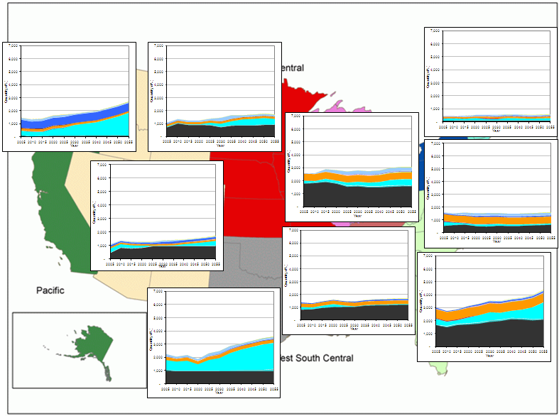
Overview of MARKAL: Output
Illustrative results
Modeling U.S. energy system scenarios with MARKAL
Regional output
Electricity production by technology
R1 New England
Outputs
Technology pathway
Fuel use
Criteria air pollutant
emissions
Greenhouse gas (GHG)
emissions
Short-lived climate
forcer (SLCF) emissions
and radiative impact
Scenario assumptions
Population growth
Economy
Climate change
Technology development
Behavior
Policies
R9 Pacific
R4 West North Central
R3 East North Central
MARKAL
energy system model and
U.S. EPA MARKAL database
R2 Middle Atlantic
R8 Mountain
R6 East South Central
R5 South Atlantic
R7 West South Central

Slide 13
Overview of MARKAL: Output
Illustrative results
Modeling U.S. energy system scenarios with MARKAL
Scenario assumptions
Population growth
Economy
Climate change
Technology development
Behavior
Policies
Outputs
Technology pathway
Fuel use
Criteria air pollutant
emissions
Greenhouse gas (GHG)
emissions
Short-lived climate
forcer (SLCF) emissions
and radiative impact
E85 plugin hybrid
Electric
Diesel
E85
MARKAL
energy system model and
U.S. EPA MARKAL database
Advanced
gasoline
Conventional
gasoline

Slide 14
Overview of MARKAL: Output
Illustrative results
Modeling U.S. energy system scenarios with MARKAL
Scenario assumptions
Population growth
Economy
Climate change
Technology development
Behavior
Policies
Outputs
Technology pathway
Fuel use
Criteria air pollutant
emissions
Greenhouse gas (GHG)
emissions
Short-lived climate
forcer (SLCF) emissions
and radiative impact
Lighting
MARKAL
energy system model and
U.S. EPA MARKAL database
Refrigeration
Cooling

Slide 15
Overview of MARKAL: Output
Illustrative results
Modeling U.S. energy system scenarios with MARKAL
Electricity
Outputs
Technology pathway
Fuel use
Criteria air pollutant
emissions
Greenhouse gas (GHG)
emissions
Short-lived climate
forcer (SLCF) emissions
and radiative impact
Scenario assumptions
Population growth
Economy
Climate change
Technology development
Behavior
Policies
Electricity
Natural gas
Natural gas
MARKAL
energy system model and
U.S. EPA MARKAL database
Biomass
Ethanol
Jet Fuel
Electricity
LPG
Gasoline
Natural gas
Diesel

Slide 16
Overview of MARKAL: Output
Illustrative results
Modeling U.S. energy system scenarios with MARKAL
Scenario assumptions
Population growth
Economy
Climate change
Technology development
Behavior
Policies
Outputs
Technology pathway
Fuel use
Criteria air pollutant
emissions
Greenhouse gas (GHG)
emissions
Short-lived climate
forcer (SLCF) emissions
and radiative impact
MARKAL
energy system model and
U.S. EPA MARKAL database

Slide 17
Overview of MARKAL: Output
Illustrative results
Modeling U.S. energy system scenarios with MARKAL
Scenario assumptions
Population growth
Economy
Climate change
Technology development
Behavior
Policies
Outputs
Technology pathway
Fuel use
Criteria air pollutant
emissions
Greenhouse gas (GHG)
emissions
Short-lived climate
forcer (SLCF) emissions
and radiative impact
CO₂
SO₂
N₂O
CH₄
BC
OC
MARKAL
energy system model and
U.S. EPA MARKAL database

Slide 18
Overview of MARKAL: Application
Use of MARKAL:
What is the technology/fuel pathway that meets energy demands and constraints (e.g., emission limits) at least cost?
What are the resulting fuel use and emission impacts?
How do the least cost pathway, fuel use, and emissions change when scenario assumptions change?
- Alternative assumptions about economic growth
- Adoption of a new policy
Example:
Examining the response to a hypothetical CO₂ policy resulting in 35% reduction from 2005 levels by 2050

Slide 19
Overview of MARKAL: Application
Illustrative results
A base scenario
Wind
-35%
Hydro
Electric sector
Nuclear
Industrial
Natural gas
Transportation
Coal
NO_{x}
SO₂
PM₁₀
N₂O
CH₄
BC
Renewables
Oil
Natural gas
Coal

Slide 20
Overview of MARKAL: Application
Illustrative results
A hypothetical CO₂ policy scenario
Solar
Wind
Hydro
Electric sector
Nuclear
Industrial
Natural gas
CCS
Transportation
Coal
NO_{x}
SO₂
PM₁₀
N₂O
CH₄
BC
Renewables
Oil
Natural gas
Coal

Slide 21
Part 2. Generating CMAQ-ready future emissions
Methodology described and demonstrated in:
Loughlin, D.H., Benjey, W. G., and C.G. Nolte (2011). “ESP v1.0: methodology for exploring emission impacts of future scenarios in the United States.” Geoscientific Model Development, 4, 287-297, doi:10.5194/gmd-4-287-2011.

Slide 22
Generating CMAQ-ready future emissions
Region 5 (South Atlantic) NO_{x} emissions by MARKAL source category
Heavy duty - gasoline
Off highway
- diesel
Rail
Heavy duty - diesel
EGU-Coal
Illustrative results

Slide 23
Generating CMAQ-ready future emissions
Step 1.
Annual emissions are summed for each combination of:
  pollutant species
  MARKAL emission category
  Census Division

Slide 24
Generating CMAQ-ready future emissions
Step 2.
A cross-walk is used to link MARKAL emissions categories to aggregated Source Classification Codes (SCCs)
The MARKAL emissions are allocated fully to each of the matching aggregated SCCs

Slide 25
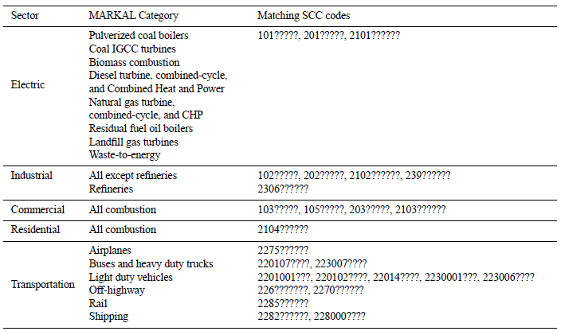
Generating CMAQ-ready future emissions
Crosswalk linking MARKAL emission categories with SCC codes
Notes:
“?” is a wildcard that signifies a match with any digit
The crosswalk can be made more specific for shorter-term projections by using less aggregation

Slide 26
Generating CMAQ-ready future emissions
Step 3. For each aggregated SCC, multiplicative emission growth factors are calculated by dividing future-year emissions by base-year emissions

Slide 27
Generating CMAQ-ready future emissions
Step 4. Copies of the resulting growth factors are made for each matching combination of:
  pollutant
  SCC
  state within the region
The resulting emissions growth factors are placed in a projection packet in a SMOKE growth-and-control file

Slide 28
Generating CMAQ-ready future emissions
Step 5. SMOKE is used to apply the growth factors to the base-year inventory to develop a CMAQ-ready future-year inventory
Alternatively, these factors can be used within EPA’s CoST model to develop a projected emissions inventory

Slide 29

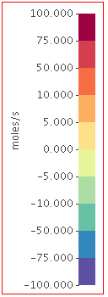
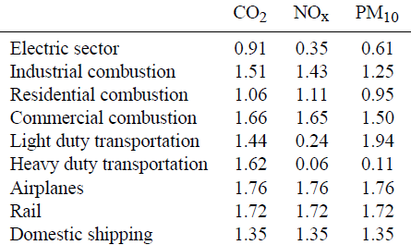

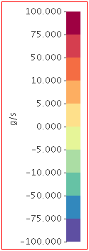
Generating CMAQ-ready future emissions
Illustrative results
Results for a baseline scenario, South Atlantic Census Division
Changes in daily NOx emissions
Regional growth factors – 2005 to 2055
Changes in daily PM₁₀ emissions

Slide 30
Generating CMAQ-ready future emissions
Important considerations:
How do you apply growth factors to a technology that does not exist in the base year?
How do you site new emission sources?
We address these issues by interpreting MARKAL-projected changes as long-term trends, not source-specific changes
Aggregating by SCC allows us to capture trends by emission category, with the assumptions that (i) all sources in a category will follow the trend of that category, and (ii) new sources in the category will be co-sited with existing sources

Slide 31
Part 3. On the horizon: GLIMPSE

Slide 32
What is GLIMPSE?
GEOS-Chem Adjoint
LIDORT radiative transfer model
Integrated with
MARKAL for the
Purpose of
Scenario
Exploration
Goals:
  Screening tool for simultaneous analysis of climate change (radiative forcing) and air quality/health effects of GHGs and short-lived pollutant species
  Rapidly consider tradeoffs between the environmental and climate impacts with mitigation options and costs
Framework links economic and atmospheric models:
  Energy use and production market model of emissions growth and mitigation using MARKAL
  GEOS-Chem/LIDORT Adjoint model for determining the radiative forcing impacts and air quality effects of spatial emissions of SLCFs
Collaborators:
Rob Pinder (EPA/ORD/NERL)
Farhan Akhtar (EPA/ORD/NERL)
Daven Henze (Univ. of Colorado)
Dan Loughlin (EPA/ORD/NRMRL)

Slide 33
Modifications to MARKAL
Added 20- and 100-year global warming potentials
  for CO₂, NO_{x}, SO₂, VOC, CO, BC, OC, CH₄ and N₂O
Added regional direct radiative forcing factors
  for SO₂, BC and OC
To do:
  - Add air quality impact factors from CMAQ adjoint
  - Add health impact factors

Slide 34
Example application of GLIMPSE
Illustrative results
Baseline scenario
CO
Regulated pollutants decrease relative to 2010. Others tend to increase.

Slide 35
Example application of GLIMPSE
Preliminary results
CO₂ policy scenario
CO
Different species react differently to the application of the CO₂ policy

Slide 36

Example application of GLIMPSE
Global warming potential of non-CO₂ emissions
Change in annual GWP₂₀
(CO₂ policy – baseline)
Change in annual GWP₁₀₀
(CO₂ policy – baseline)
Net
warming
CO
CO
Preliminary results
Preliminary results
Changes in these emissions have a net warming effect…

Slide 37
Example application of GLIMPSE
Global warming potential of all tracked emissions
Change in annual GWP₂₀
(CO₂ policy – baseline)
Change in annual GWP₁₀₀
(CO₂ policy – baseline)
CO
CO
Net
cooling
Preliminary results
Preliminary results
… but this effect is dwarfed by the impact of CO₂ reductions

Slide 38
Next steps
Use GLIMPSE to identify emission control strategies that simultaneously address criteria pollutants, GHGs and SLCFs goals
Identify synergies in technological pathways that efficiently address all three, accounting for regional differences in resources and impacts

Slide 39
Questions?
For more information…
  Dan Loughlin:
    Loughlin.Dan@epa.gov
    919-541-3928
Also…
  CMAS poster on GLIMPSE by Farhan Akhtar et al.
  Loughlin, D.H., Benjey, W. G., and C.G. Nolte (2011). “ESP v1.0: methodology for exploring emission impacts of future scenarios in the United States.” Geoscientific Model Development, 4, 287-297, doi:10.5194/gmd-4-287-2011

Slide 40
Extra Slides

Slide 41
U.S. EPA MARKAL database development team
Name | Roles | Contact Information
Cynthia Gage | Transportation, refrigeration, energy demands | Gage.Cynthia@epa.gov
Tyler Felgenhauer | Integrated assessment modeling, adaptation | Felgenhauer.Tyler@epa.gov
Tim Johnson | Regional assessments, geographic and systems, uncertainty analysis, biofuels | Johnson.Tim@epa.gov
Dan Loughlin | Co-team lead, emissions, light duty vehicles, sensitivity analysis, scenarios | Loughlin.Dan@epa.gov
Carol Shay Lenox | Co-team lead, energy efficiency, database management, model calibration | Lenox.Carol@epa.gov
Rebecca Dodder | Biofuels, renewables, energy & water linkages | Dodder.Rebecca@epa.gov
Ozge Kaplan | Industrial sector, waste-to-energy, biofuels | Kaplan.Ozge@epa.gov
Tai Wu | Software development, GIS | Wu.Tai@epa.gov
William Yelverton | Electric sector, renewables, energy & water linkages | Yelverton.William@epa.gov

Slide 42
Recent EPA MARKAL database developments
Expanded pollutant provide energy system coverage for:
  CO₂, NO_{x}, SO₂, PM₁₀, PM_{2.5}, CO, CH₄, N₂O, VOCs, BC and OC
Reviewing and updating emission factors to be more consistent with recent EPA regulations and modeling
Add factors to track water withdrawals and consumption from electricity production activities
Adding additional biofuels production technologies and improving biomass resource characterization
Revamping characterization of heavy duty transportation technologies (incl. trucks, buses, airplanes, trains, shipping)
Binning existing coal plants by plant age and size, and characterizing emission control options for each bin
Improving characterization of climate change impacts on heating and cooling demands

Slide 43
Recent and ongoing MARKAL applications
Developing air pollutant emission scenarios for the ORD Global Change Air Quality Assessment
Evaluating alternative biofuels production technologies, and examining tradeoffs associated with using biomass for liquid fuels or in electricity production
Examining the performance requirements and potential impacts of breakthrough technologies
Assessing specific technologies:
  Hydrogen fuel cell vehicles
  Plug-in hybrids
  Advanced nuclear power
  Coal gasification with CCS
  Outdoor wood hydronic heaters
Investigating the role of energy efficiency in meeting greenhouse gas mitigation targets
Examining how technology growth limits impact mitigation pathways and natural gas demands

Slide 44
Abbreviations
Models and databases:
AP-42 – U.S. EPA compilation of air pollutant emission factors
CMAQ – Community Multiscale Air Quality modeling system
CoST – Control Strategy Tool model
eGRID – Emissions and Generation Resource Integrated Database
GEOS-Chem – 3-D chemical transport model (CTM), driven by input from the Goddard Earth Observing System (GEOS)
GLIMPSE – GEOS-Chem adjoint LIDORT Integrated with MARKAL for the Purpose of Scenario Exploration
GREET – Greenhouse gases, Regulated Emissions, and Energy use in Transportation model
LIDORT – Linearized Discrete Ordinate Radiative Transfer model
MARKAL – MARKet ALlocation energy system model
MOVES – Motor Vehicle Emission Simulator model
SMOKE – Sparse Matrix Operator Kernal Emissions modeling system

Slide 45
Abbreviations, cont’d
Pollutants and related metrics:
BC – black carbon
CH₄ - methane
CO – carbon monoxide
CO₂ – carbon dioxide
GHGs – greenhouse gases
GWP₂₀ – 20-yr global warming potential
GWP₁₀₀ – 100-yr global warming potential
NO_{x} – nitrogen oxides
N₂O – nitrous oxide
OC – organic carbon
PM₁₀ – particulate matter of 10 micrometers or less
PM_{2.5} – particulate matter of 2.5 micrometers or less
SLCFs – short-lived climate forcers
SO₂ – sulfur dioxide
VOC – volatile organic compounds

Slide 46
Abbreviations, cont’d
Technologies and fuels:
CCS – carbon capture and sequestration
CHP – combined heat and power technologies
CNG – compressed natural gas
EGU – electricity generating unit
E85 – blend of approximately 85% ethanol, 15% gasoline
HDV – heavy duty vehicles
IGCC – integrated gasification and combined cycle using coal
LDV – light duty vehicles
LPG – liquid petroleum gas
NGA – natural gas
NGCC – natural gas combined cycle
PV – photovoltaic
Other:
U.S. EIA – U.S. Energy Information Administration
SCC – Source classification code

