Slide 1
Reactive Plume Modeling to Investigate NO_{x} Reactions and Transport in Nighttime Plumes and Impact on Next-day Ozone
    Prakash Karamchandani, Greg Yarwood, Chris Emery and Shu-Yun Chen
    ENVIRON International Corporation, Novato, CA
    Steven S. Brown and David D. Parrish
    NOAA ESRL Chemical Sciences Division, Boulder, CO
    10th Annual CMAS Conference, October 24-26, 2011
    Chapel Hill, North Carolina

Slide 2
Acknowledgement
This research was supported by the State of Texas through the Air Quality Research Program (AQRP) administered by The University of Texas at Austin by means of a grant from the Texas Commission on Environmental Quality (TCEQ)
TCEQ has not yet reviewed the final project report and has not fully reviewed the findings presented here

Slide 3
Scope of AQRP Study
Analysis of nighttime chemistry and mixing in power plant plumes
  NOAA P-3 aircraft measurements (summary in this talk)
  Brown et al. (2011), The Effects of NO_{x} Control and Plume Mixing on Nighttime Chemical Processing of Plumes from Coal-Fired Power Plants, JGR, submitted
Reactive plume modeling with SCICHEM
CAMx Plume-in-Grid (PiG) modeling
CAMx grid modeling
  200 m “high resolution” grid
  Conventional 12 km grid
Next-day ozone impacts
  CAMx PiG
  CAMx 12 km grid

Slide 4
Power Plant Plume Measurements
Second Texas Air Quality Study (TEXAQS II)
NOAA P-3 aircraft
Night flights sampled Oklaunion (near Wichita Falls) on October 10, 2006 and W.A. Parish (near Houston) on October 11-12, 2006
Oklaunion = 21.7 tons/day NO_{x} Low NO_{x} burners without SCR control. Single boiler/exhaust stack.

Slide 5
Oklaunion Intercepts, October 10, 2006
Northerly winds
Eighteen plume intercepts
No systematic dependence of plume width with transport distance/time
Observations suggest that horizontal plume width established shortly after emission or during plume rise, with little increase in plume width, or mixing with background air, as plume transports downwind
Frequent excess NO/titration of O₃ to zero at plume center
N₂O₅ present in “wing” structures at plume edge only, where NO = 0
Nighttime NO_{X} oxidation to HNO₃ takes place only in these wing structures and is suppressed across the majority of the plume

Slide 6
Reactive Plume Modeling with SCICHEM
Second-order Closure Integrated Puff model with Chemistry
Three dimensional Lagrangian puff model, with efficient adaptive time-step algorithm
Puff-splitting and merging algorithms
Model can use either routine observations of meteorology and concentrations or modeled 3-D fields.
Detailed gas-phase photochemistry based on CB-IV
  Updated to CB05 for AQRP study
  Heterogeneous N₂O₅ hydrolysis based on uptake coefficients derived from P-3 measurements by NOAA
CMAQ modules for aerosol and aqueous-phase chemistry

Slide 7
Initial SCICHEM Simulation of October 10, 2006 Oklaunion Night-time Plume
Default model configuration:
  Puff growth parameters
  Plume rise
  Coarse puff resolution-controlled by puff splitting and merging
Routine surface and upper air met observations
CEMS SO₂ and NO_{X} emissions from CAMD
Captured some features observed in the aircraft plume transects close to Oklaunion, such as:
  Titration of background ozone and zero N₂O₅ in the plume core
  Plume widths of 1 to 1.5 km
For transects further downwind, the modeled plume was significantly wider than observed and plume edge effects (formation of N₂O₅ wings) were not reproduced

Slide 8
Refinements to SCICHEM Simulation Based on Plume Data Analysis
Specify initial plume dimensions and plume height
Limit horizontal and vertical puff growth
Use met observations from P-3 measurements to drive the model
Change puff splitting/merging criteria to increase splits and limit merges, resulting in much higher puff resolution:
  Need multiple puffs across plume to represent features such as “N₂O₅ wings”
  Nearly 10,000 puffs instead of 100-300
  Increases computational time for simulation and post-processing
  Area for model improvement, e.g., introduce splitting criteria based on plume chemistry

Slide 9
Plume SO₂ Comparisons
Downwind Distance: 18 km
7:17:36 pm to 7:18:02 pm LST
Downwind Distance: 25 km
7:21:21 pm to 7:22:08 pm LST
Downwind Distance: 14 km
9:24:47 pm to 9:25:01 pm LST
Downwind Distance: 30 km
9:33:26 pm to 9:34:13 pm LST

Slide 10
Plume NO_{Y} Comparisons
Downwind Distance: 18 km
7:17:36 pm to 7:18:02 pm LST
Downwind Distance: 25 km
7:21:21 pm to 7:22:08 pm LST
Downwind Distance: 14 km
9:24:47 pm to 9:25:01 pm LST
Downwind Distance: 30 km
9:33:26 pm to 9:34:13 pm LST

Slide 11
Plume O₃ Comparisons
Downwind Distance: 18 km
7:17:36 pm to 7:18:02 pm LST
Downwind Distance: 25 km
7:21:21 pm to 7:22:08 pm LST
Downwind Distance: 14 km
9:24:47 pm to 9:25:01 pm LST
Downwind Distance: 30 km
9:33:26 pm to 9:34:13 pm LST

Slide 12
Plume N₂O₅ Comparisons
Downwind Distance: 18 km
7:17:36 pm to 7:18:02 pm LST
Downwind Distance: 25 km
7:21:21 pm to 7:22:08 pm LST
Downwind Distance: 14 km
9:24:47 pm to 9:25:01 pm LST
Downwind Distance: 30 km
9:33:26 pm to 9:34:13 pm LST

Slide 13
CAMx Grid and Plume-in-Grid
Can CAMx represent the plume structure?
  200 m high resolution (hi-res) grid
    Only feasible to run for a few hours
    Reveals sheared plume structure that helps to explain the observations and plume model results
  CAMx PiG
    Investigate contribution of shear to puff growth
    Compare using single reactor vs. 5 reactor puffs
    Multiple reactor puffs are needed to get “N₂O₅ wings”
Quantify the next-day ozone impacts of emissions from Oklaunion released at night
  Plume-in-grid vs.12 km grid
  Cases with full emissions and 75% NOx reduction

Slide 14
PiG and Hi-Res Plume Spread
Relative to P-3 obs:
  Standard PiG gets too wide
  Hi-Res plume is better
    Zero explicit diffusion has minor effect
    Spread controlled by grid resolution & numerical diffusion
Modified PiG
  No horizontal growth from shear
  Agrees better with Hi-Res plume
Oklaunion
12 km grid cell
Hi-Res NO₂ plume
No Shear PiG
Standard PiG
X
dσ_{x}/dt = f(turbulence, shear)

Slide 15
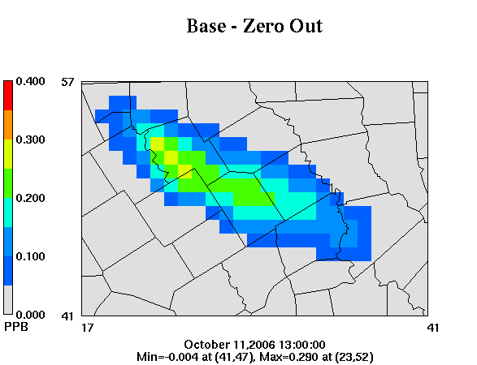
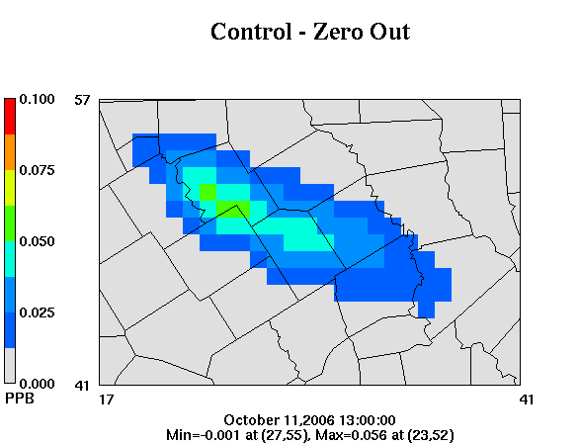
Plume Nighttime NO_{x} Processing with PiG
Next Day Ozone Impact
Max 1-hour ozone from Oklaunion plume on Oct 11
  Plume near Waco
  80% reduction in downwind ozone impact
  Emissions were reduced only 75%
  More conversion of NO_{x} to NO_{z} in plume with reduced emissions
0.4 ppb
Waco
0.1 ppb
Waco

Slide 16
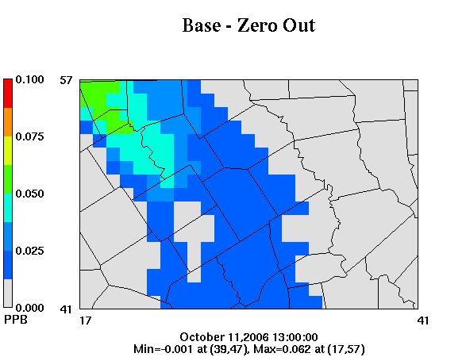
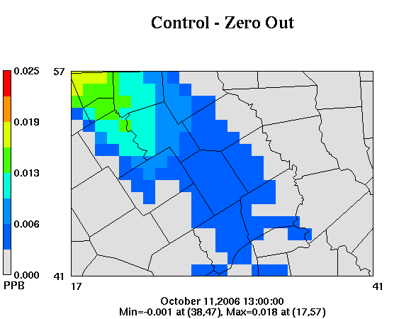
Plume Nighttime NO_{x} Processing w/o PiG
Next Day Ozone Impact
Oklaunion emits directly into 12 km grid
  Typical grid model configuration
Fivefold smaller ozone impact than with PiG
  12 km grid over-states conversion of NO_{x} to NO_{z} at night
70% reduction in downwind peak ozone impact
  Emissions reduced 75%
  12 km grid predicts non-linear effect in the opposite direction to plume models
0.1 ppb
Waco
0.025 ppb
Waco

Slide 17
Conclusions
Plume models and high resolution (200 m) grids tended to over-dilute emissions from Oklaunion at night
  Possible to refine puff growth and improve plume model performance
  Observed N₂O₅ “wings” captured by increasing puff resolution
  Grid result was limited by numerical diffusion
PiG chemistry can predict correct nocturnal NO_{x} chemistry for Oklaunion source
  Puff growth must first be modeled correctly
  Consequence of more efficient NO_{x} processing at night when NO_{x} emissions are reduced
12-km grids misrepresent nocturnal NO_{x} chemistry for Oklaunion source
  Consequence of excessive plume dilution
Considerations for future CAMx PiG models:
  Limit horizontal & vertical growth in nighttime/stable environments
  Review/revise minimum limits on puff growth parameters

