Slide 1


Development and Applications of Response Surface Model (RSM) and
Air Benefit and Cost Assessment System (ABaCAS)
EPA/OAQPS Team: Carey Jang, Sharon Phillips, Charles Fulcher, Neal Fann, Bryan Hubbell, Tyler Fox, Dale Evarts
International Team: Joshua Fu (U. of TN), Yun Zhu (SCUT, China),
Shuxiao Wang, Jia Xing (Tsinghua U., China)

Slide 2
Outline
What is Response Surface Model (RSM)?
  Overview: a statistical “reduced-form” of AQ model
  Objective: real-time AQ response of emissions control
RSM Applications in USA & Asia
  RSM/CMAQ modeling in USA, China & Taiwan
Air Benefit and Cost Assessment System (ABaCAS) (under development)
  Overview: an integrated framework to provide efficient AQ control benefit & cost assessment
  Key Components: BenMAP, RSM/CMAQ, Cost Tool

Slide 3
Air Quality Modeling Techniques: Contribution & Control/Response Assessments
Address “contribution” of source/pollutant to AQ concern
  Zero-Out (Brute Force) Modeling
  Source Apportionment Modeling
    OSAT/PSAT, OPTM/PPTM, TSSA, CMAQ Source Apportionment, etc.
  Source/Receptor Sensitivity Modeling
    Decoupled Direct Method (DDM), Adjoint, etc.
Address “efficacy” of source/pollutant emissions reduction to AQ concern
  Response Surface Modeling (RSM)
    Provide “real-time” AQ response of emissions control
    Applied to REMSAD (PM2.5), CAMx(O3), CMAQ (multi-pollutant) for supporting regulatory modeling efforts (e.g., PM NAAQS)

Slide 4
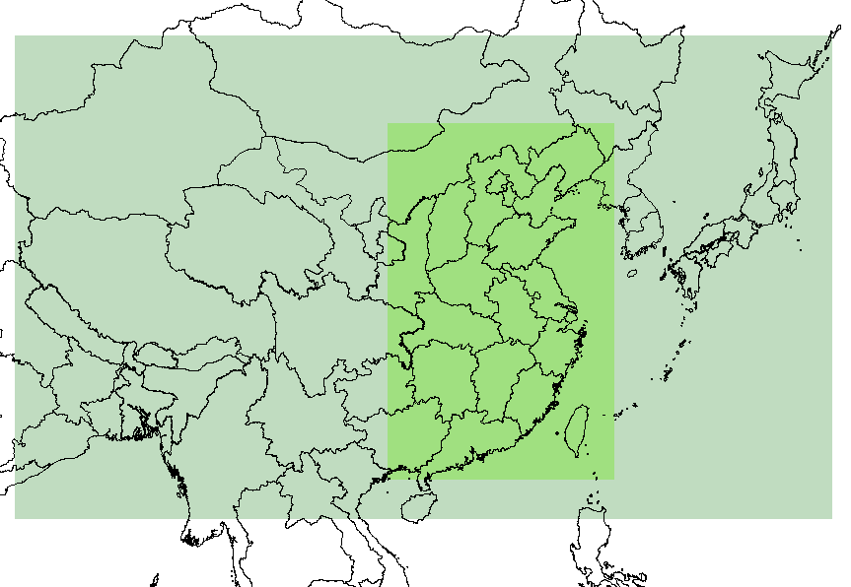
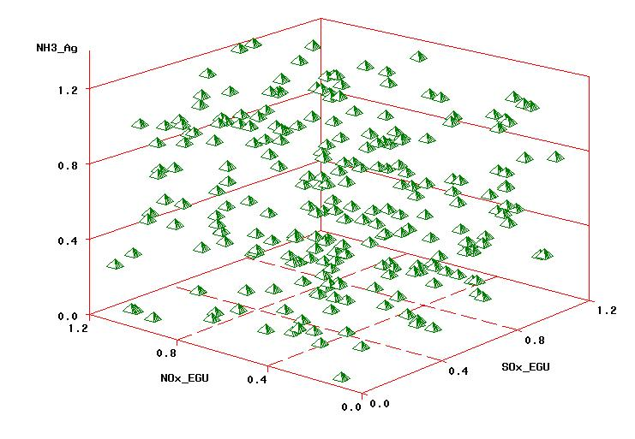
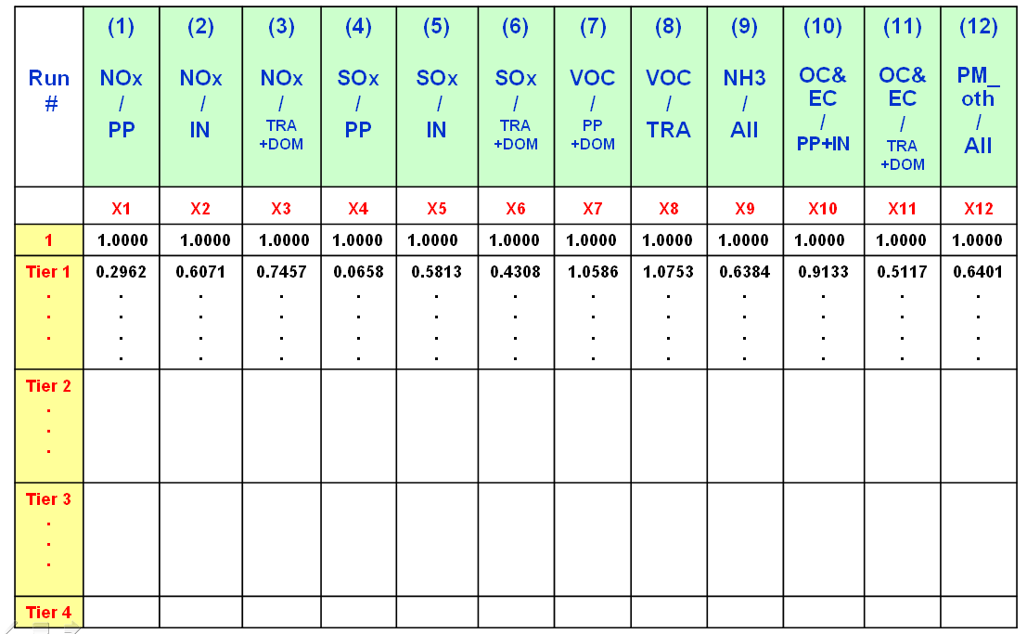
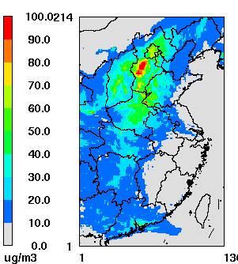
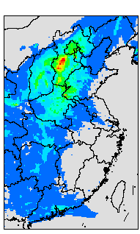
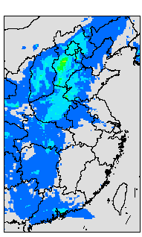
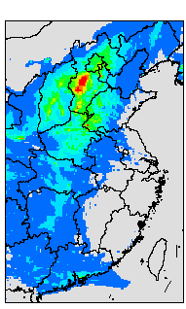
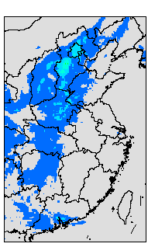
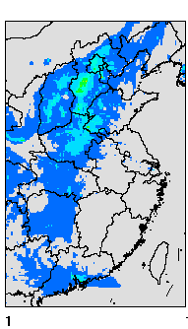
RSM: Methodology
Domain 1
Model system:
MM5v3/CMAQ4.7
Chemical Mechanism:
CB05
Horizontal Resolution:
12 km×12 km;
Vertical Resolution:
23 Layers <MM5>;
14 Layers<CMAQ>;
Grid Number (Domain2):
136×214;
Time Period:
Jan, Apr, Jul, Oct. in 2008
Space Filling:
(Control ratio 0%~120%)
Domain 2
Air Quality Comparison under different control strategies
Control Factors Matrix
PM_{2.5} concentration, Daily Average Jul 28th, 2008
Notes:
4

Slide 5
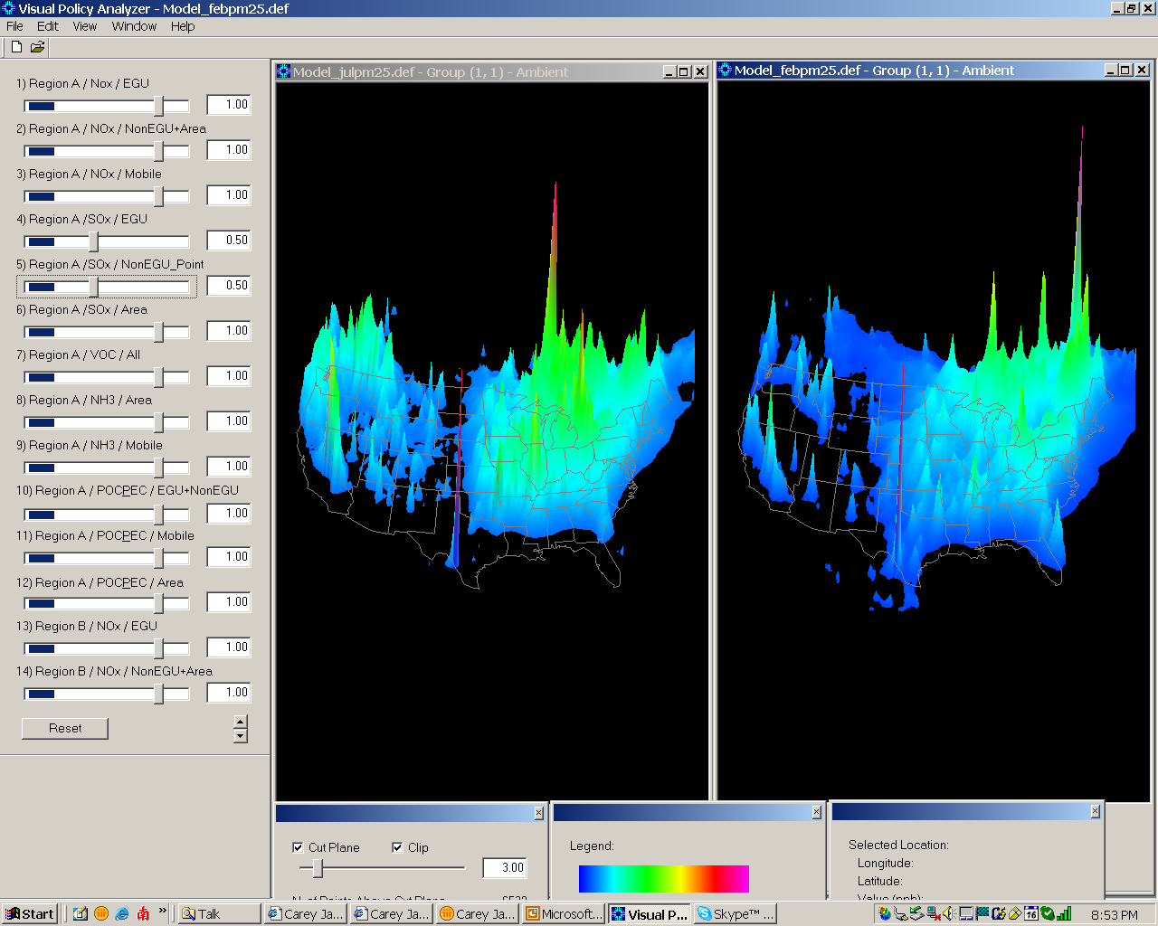
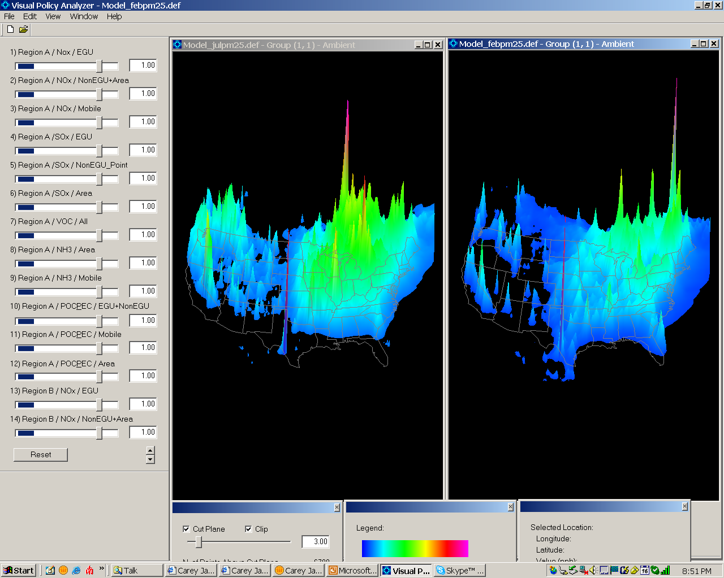
Summer
Winter
PM2.5 Response Surface Modeling

Slide 6
RSM: Objective
Control strategy assessment tool
  Provide the real-time AQ response of emissions control
Model sensitivity
  Evaluate sensitivity of model predictions to changes in emissions (precursors, source categories, etc).
Optimization of cost/benefit
  Help develop cost-effective control strategies leading to optimal AQ/health benefit
Notes:
6

Slide 7
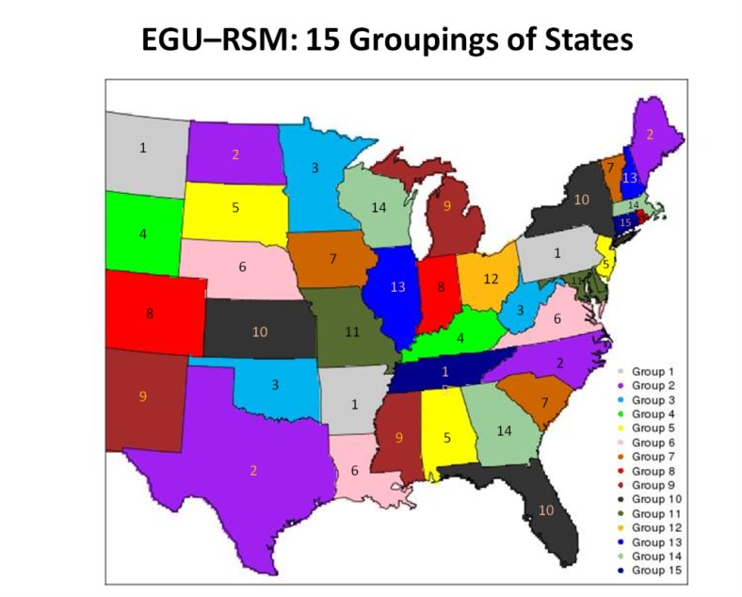
RSM Applications in USA & China
USA
  PM NAAQS analysis
  Inter-pollutant trading
  GHG rules
  EGU (Utility) RSM assessment
Asia
  China PM/O3 RSM modeling
  Taiwan PM/O3 RSM modeling
Beijing
Shanghai
Guangzhou
Taiwan

Slide 8

EGU RSM: Policy Factors (work underway)
Provide real-time RSM assessment of AQ impacts associated with emissions reductions of NOx, SO2, and PM2.5 from statewide EGUs (utility sources) policies
Policy Factors:
  2 EGU pollutants (NOx, SO2): 2x15 cluster groups = 30 policy factors
  1 EGU pollutant (direct PM2.5): 1x15 cluster groups = 15 policy factors
  3 non-EGU types (NOx, SO2, direct PM2.5) = 3 policy factors
  3 mobile source factors (NOx, VOC, direct PM2.5) = 3 policy factors
  2 NH3 factor (NH3 mobile, NH3 other area) = 2 policy factors
➔Total of 37 policy factors
(plus 16 linear factors)

Slide 9

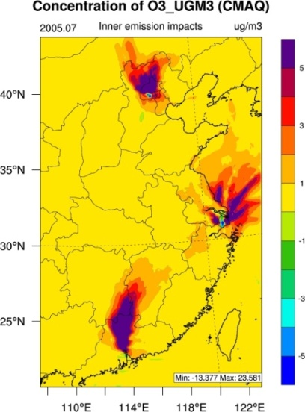
Application of RSM-O₃ in China
Control Ratio for Ozone
Base case:
July, 2005
RSM methodology:
HSS6-4vs2-200
Pollutants:
O₃
Target Sites:
Three key regions
Ozone Response
(Δ O3 / Δ emissions)
Static vs. Dynamic
Horizontal resolution
  12-km resolution
Vertical resolution
  1~14 layers
Simulation Period
  July 2005
(Xing et al., Atm. Chem. Phys., 2010)
Notes:
9

Slide 10
Application of RSM-PM in China
Impacts of SO₂/NOx/NH₃ on PM
PM2.5 Control Non-linearity
NH₃ contribution to PM2.5 is comparable w/ SO₂ & NOx.
Relative contribution of NH₃ becomes larger w/ increased emissions control
NOx vs. SO2
NOx vs. NH3
PM
Sulfate
PM_{2.5}
PM
Nitrate
(Beijing, July 2005)
(Wang et al., E&ST: Accepted, September 2011)

Slide 11
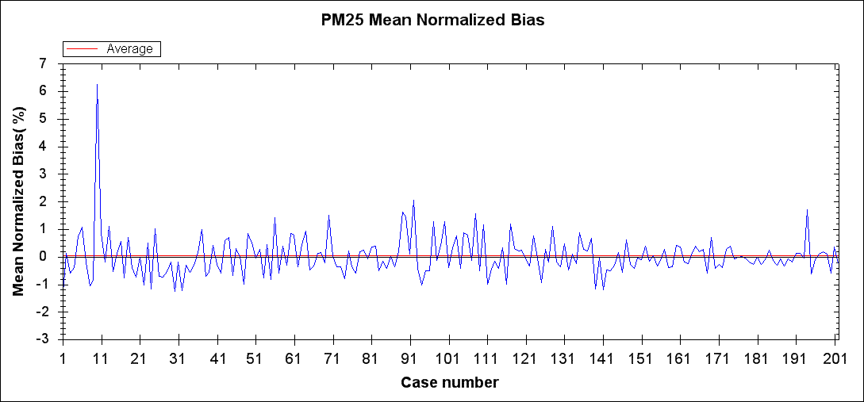
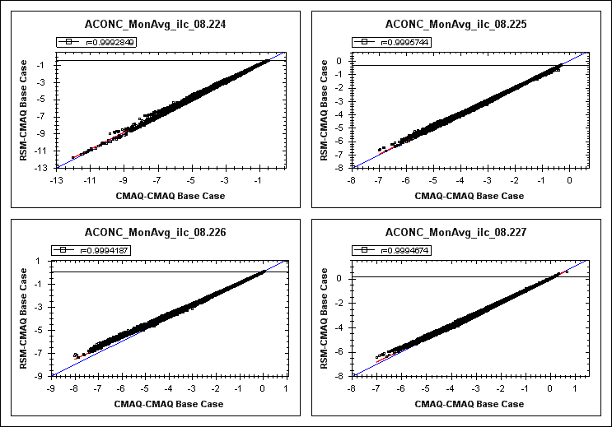
RSM Validation
“Leave-one-out” Cross Validation
  for each RSM iteration, one of the model runs was left out, the RSM is then computed and used to predict the omitted CMAQ run (e.g., under the EGU RSM effort, 202 “RSM vs. CMAQ” cross-validation are conducted)
Out-of-sample Validation
  Additional CMAQ runs are conducted (not part of the experimental design and were not used in developing RSM). RSM predictions for these out-of-sample model runs are then compared with the CMAQ predictions.
Cross Validation
Out-of-Sample Validation

Slide 12
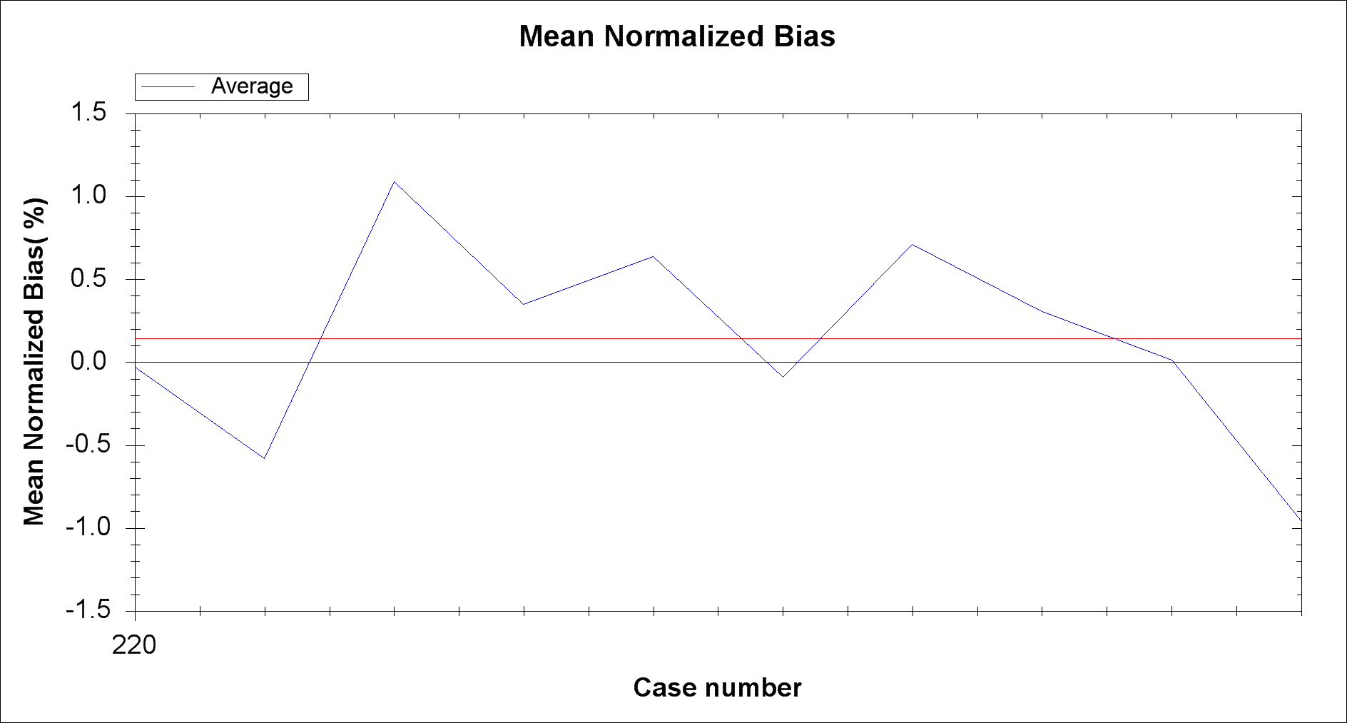
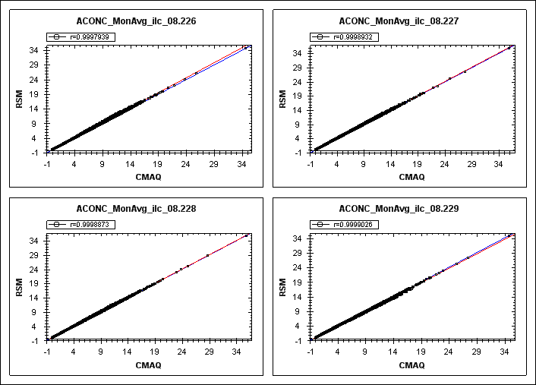
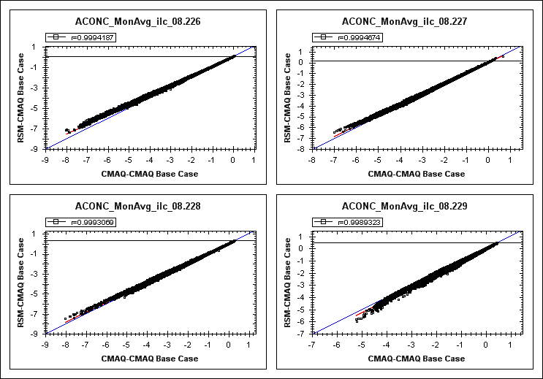
RSM vs. CMAQ (“Out-of-sample” Validation)
Predicted PM2.5 Conc.
Out-of-Sample Validation
(10 runs)
RSM
Predicted PM2.5 Response
(ΔPM2.5)
CMAQ
EGU RSM (August Case):
Out-of-Sample Validation
(Run #226 - #229)
RSM
CMAQ
Notes:
12

Slide 13
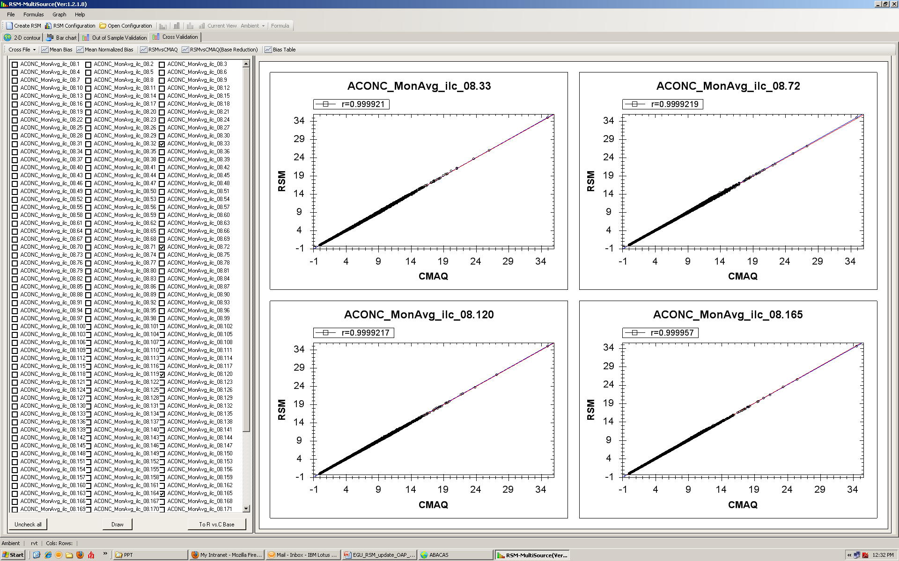
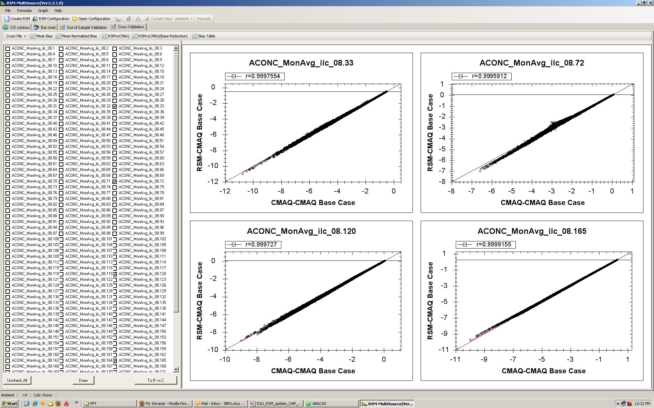
RSM vs. CMAQ (Cross Validation)
Predicted PM2.5 Conc.
Cross Validation
(202 runs)
RSM
Predicted PM2.5 Response
(ΔPM2.5)
CMAQ
EGU RSM (August Case):
Cross Validation
(Randomly Selected Runs)
RSM
CMAQ
Notes:
13

Slide 14
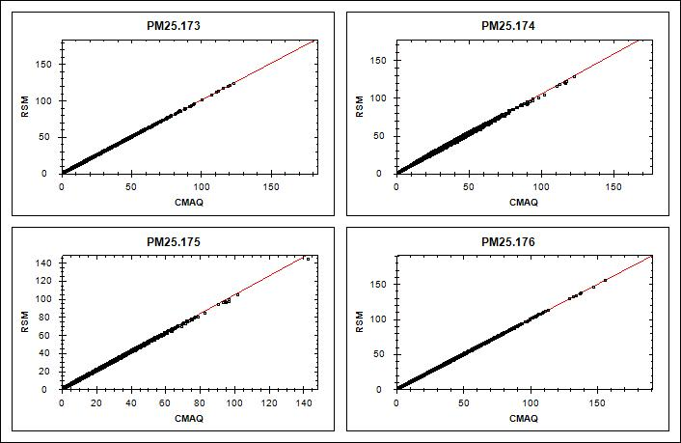
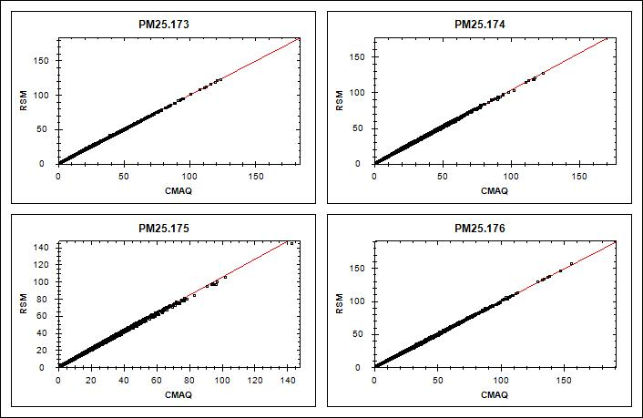
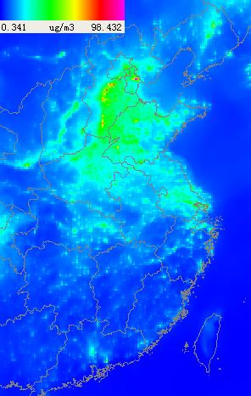

RSM vs. CMAQ (PM “Out-of-sample” Validation)
RSM-VAT VPA
(Case:173-176)
China RSM
All regional factors:
50% reduction
All local factors:
50% reduction
CMAQ
RSM

Slide 15
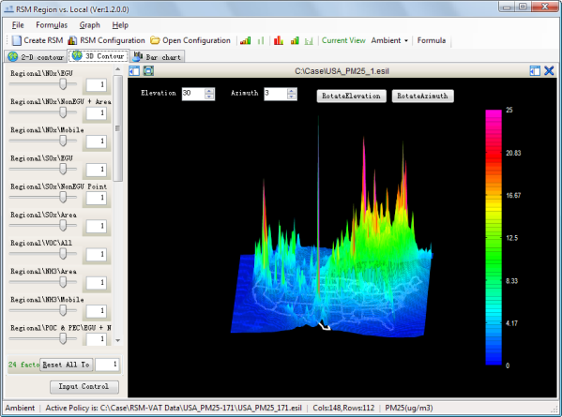
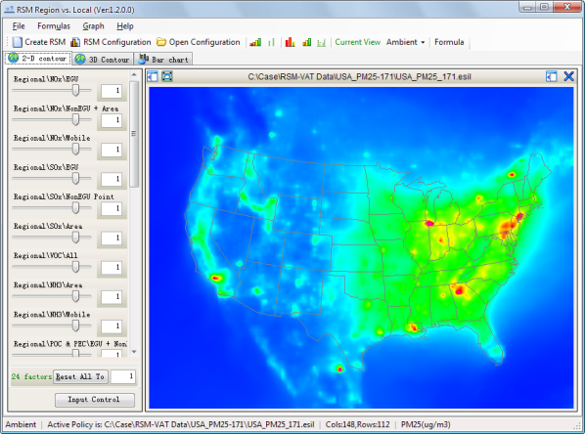
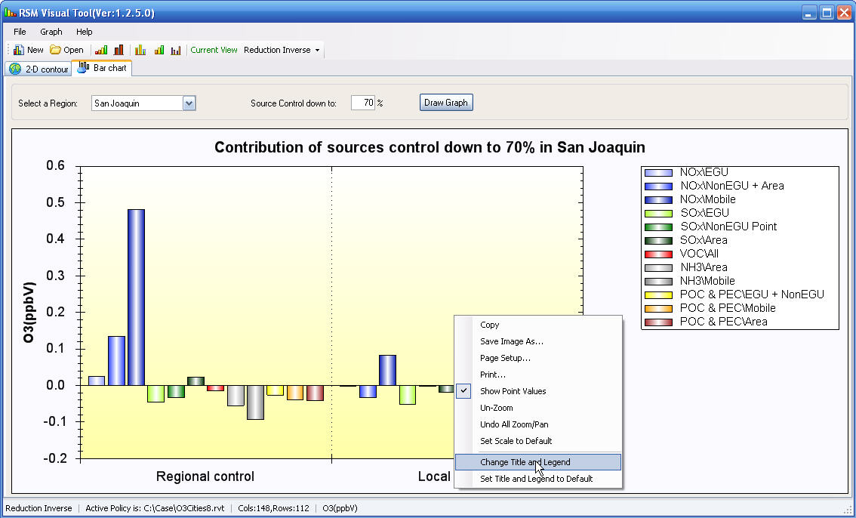
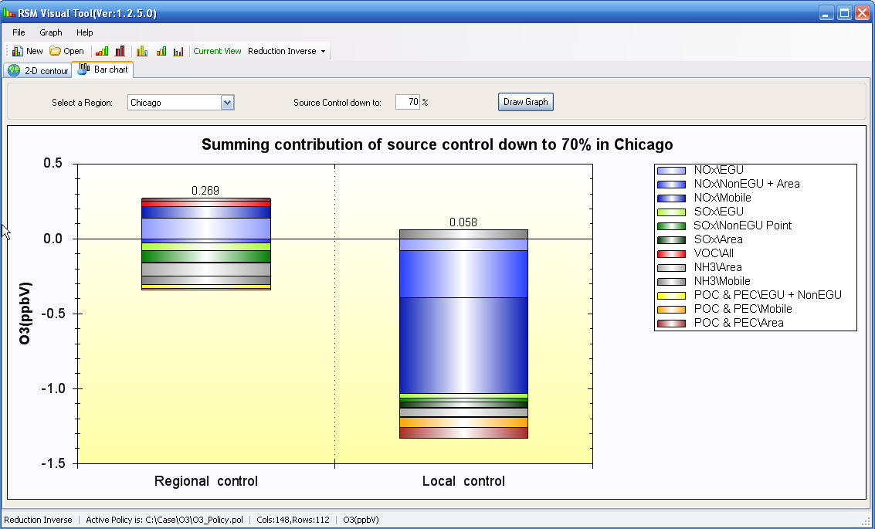
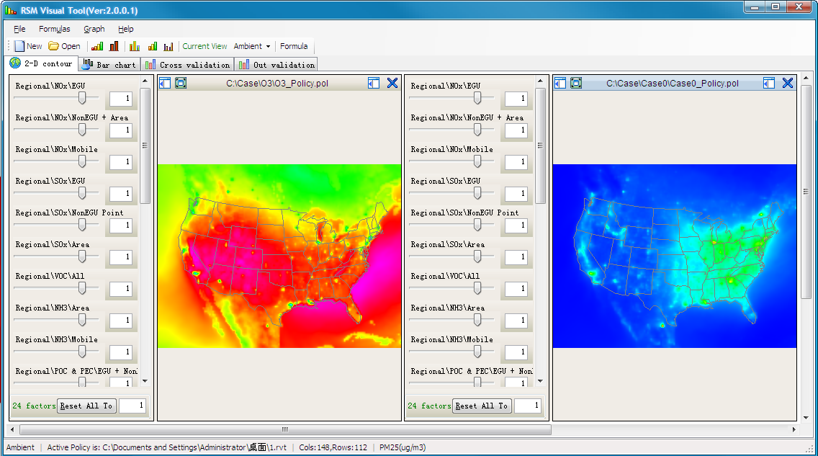
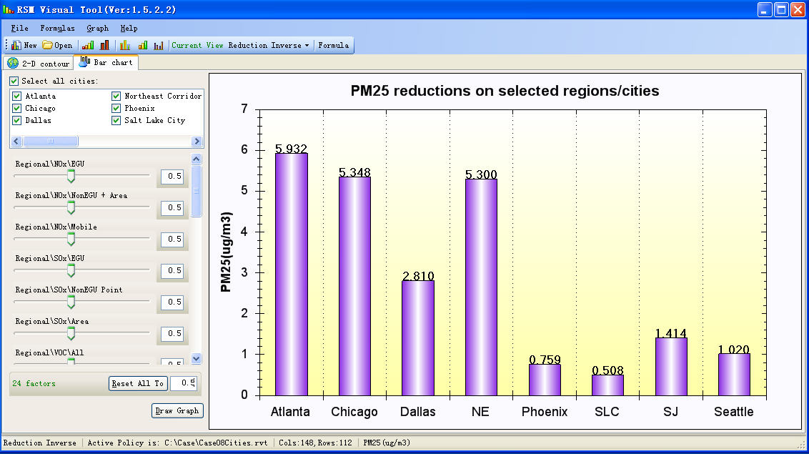
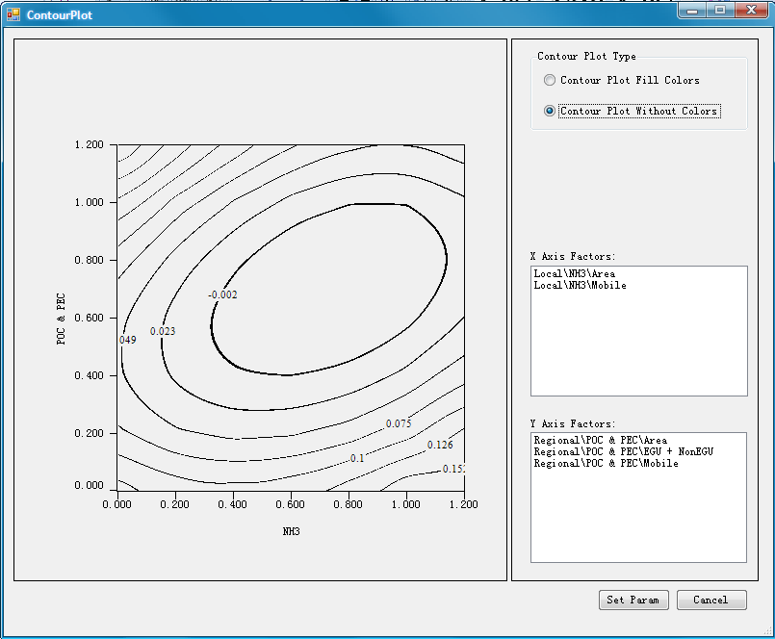
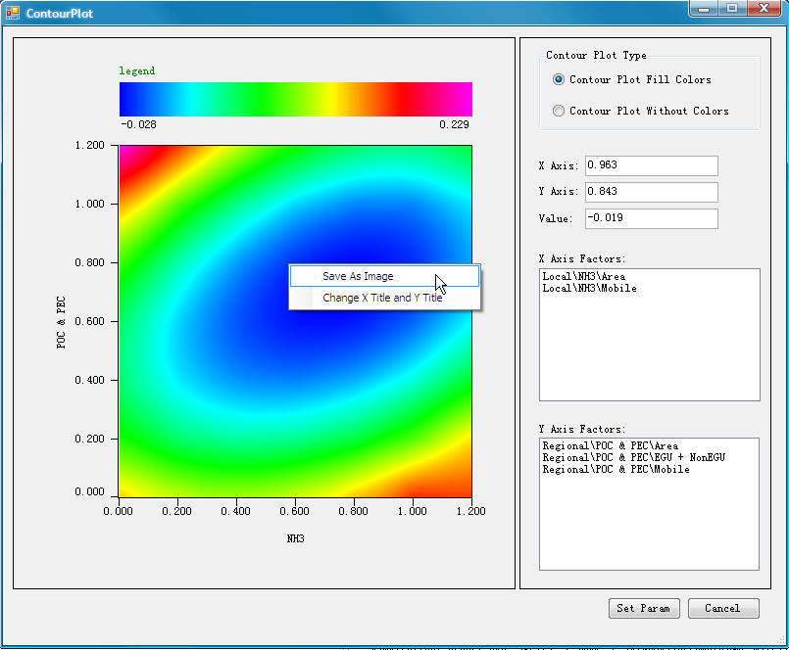
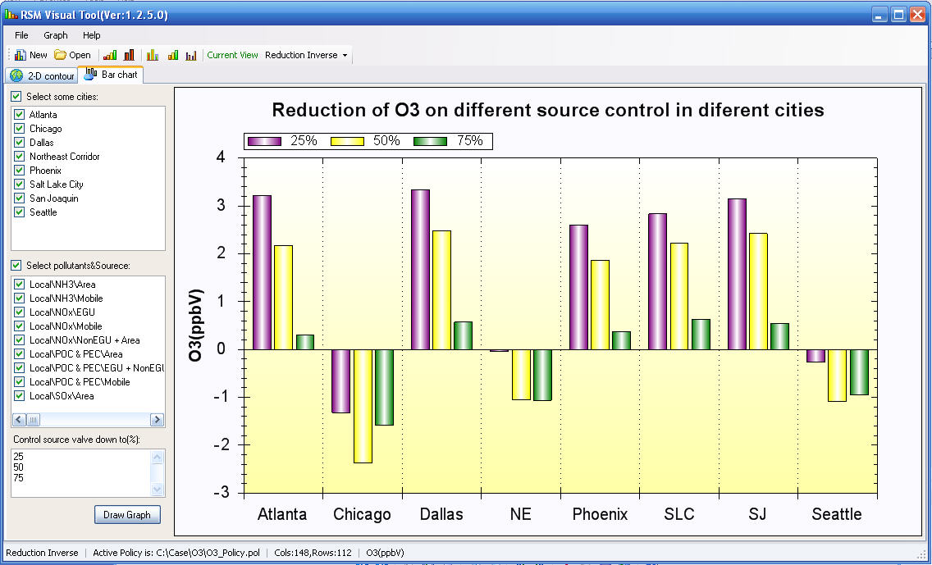
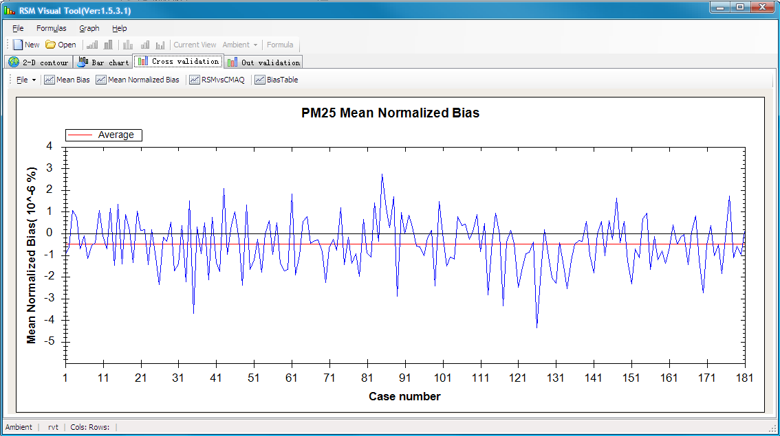
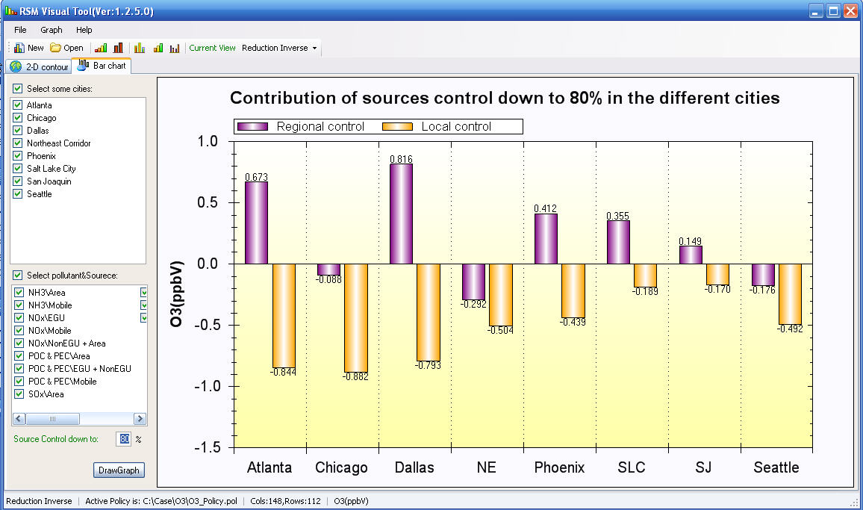
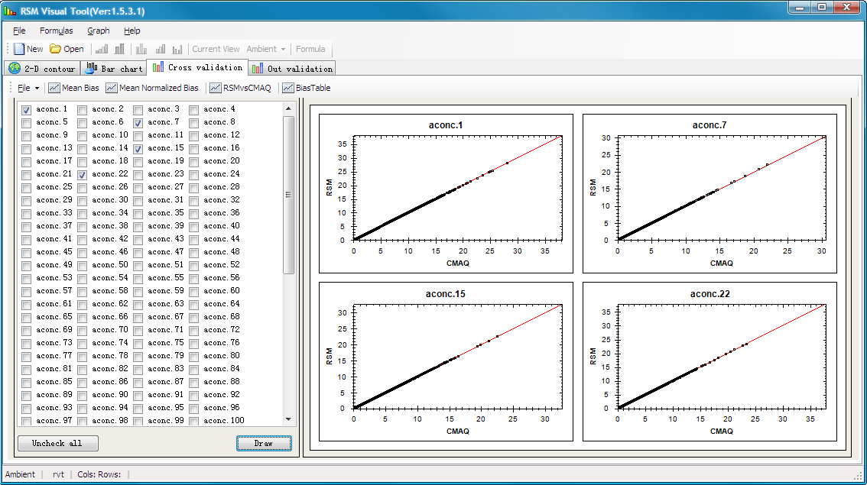
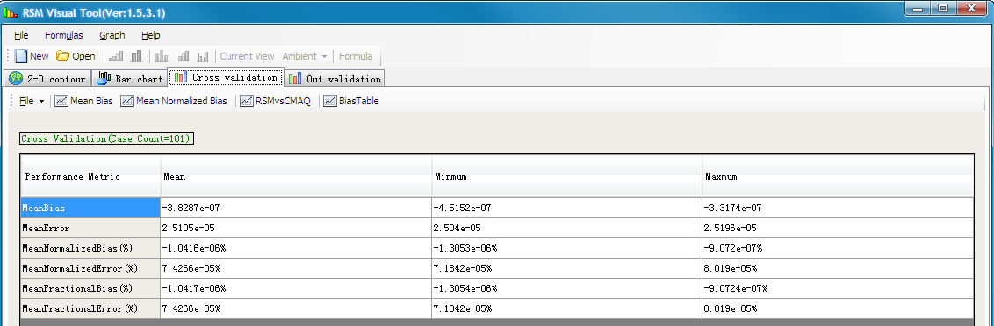



“RSM-VAT”: Visualization & Analysis Tool
RSM-VAT Package
Available upon
Request
(PI: Prof. ZHU Yun, South China Univ. of Technology)

Slide 16

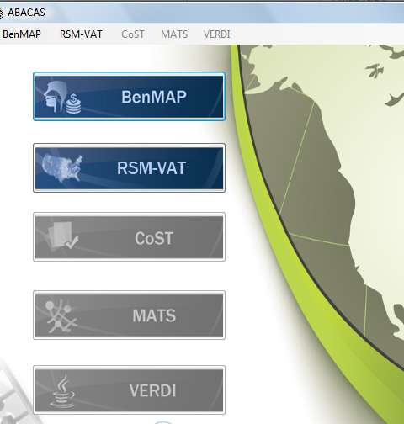
ABaCAS Prototype (under development )
ABaCAS system will provide an integrated framework to link key AQ benefit and cost assessment tools together
Notes:
Comment: This is an important slide, but needs to be improved. Consider to use animations to highlight the key features & differences

Slide 17
Effective AQ Management Requires Scientifically Sound Cost/Benefit Assessment Tools
Emission
Control
Identify and compare cost s of alternative control strategies
Cost tool
Emission Control
AQ
Benefit
Assess air quality benefit of emission control
CMAQ/RSM
Health & Environ.
Benefit
Air Quality Benefit
Health
Benefit
Assess health and Environ.
benefit of emission control
BenMAP

Slide 18
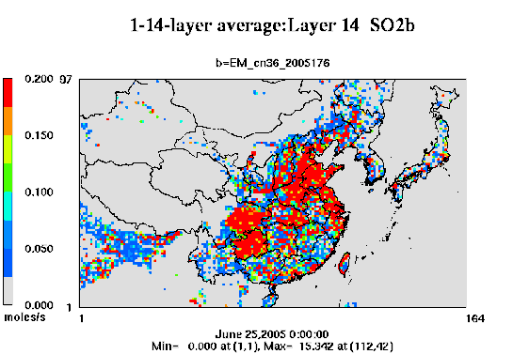
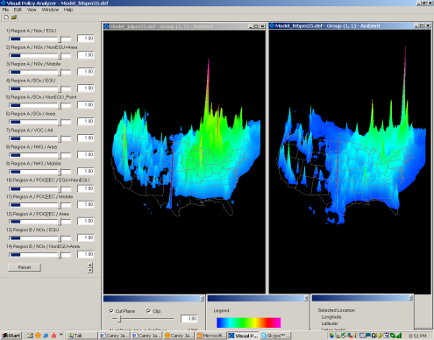
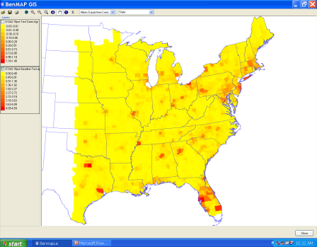
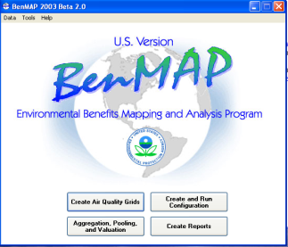
  Air Benefit and Cost Assessment (ABaCAS)
Decision-maker/Analyst
Decision Support System
Integrated
Assessment
Policies
Impacts
Modeling Framework
CMAQ
Air Quality Model
BenMAP
Health Benefits Model
Cost
Cost AnalysisTool
Response Surface Model
(Real-Time Control/Response)
Emissions
Air Quality
Air Pollution Control Cost Tool
Community Multi-scale Air Quality Model
Benefit Mapping Tool
Cost/Benefit Analysis
Emissions Control
Air Quality Benefit
Health
Benefit

Slide 19
What Can ABaCAS Do?
ABaCAS will provide an integrated framework to link cost and benefit assessment effectively
  Provide efficient (or real-time) calculations of AQ or health benefit/ton (emissions), benefit/cost analysis & optimization, etc., under various control strategies/scenarios
ABaCAS will provide a user-friendly and open-source environment
  User-friendly for common users with easy-to-use visualization & analysis functions
  Open-source software for advanced users/developers
  (Leveraged from current RSM-VAT & BenMAP Next-Generation development efforts)

Slide 20
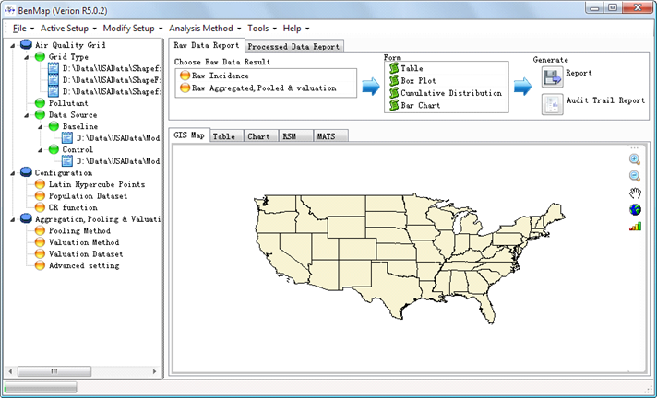
Development of Next-Generation BenMAP
The GUI interface & menu will be designed to streamline operations & QA/evaluation reports and link to RSM/CMAQ & Cost tools.
Notes:
Comment: This is an important slide, but needs to be improved. Consider to use animations to highlight the key features & differences

Slide 21
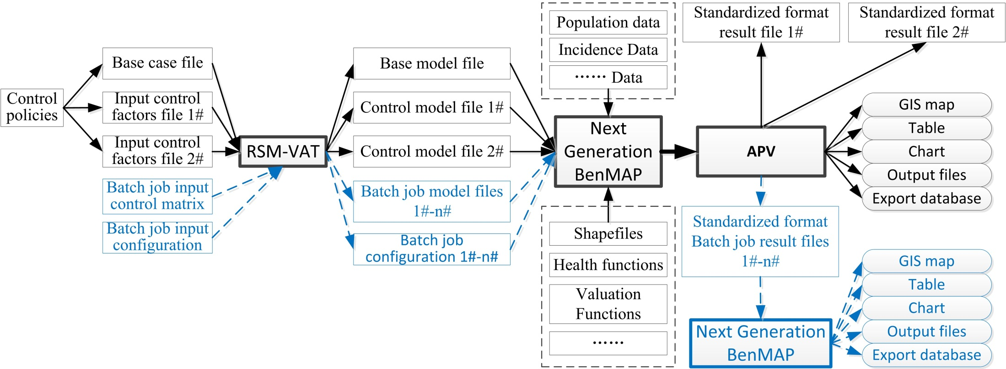
Linking RSM/CMAQ to BenMAP:
Provide real-time or batch mode AQ data to BenMAP

Slide 22
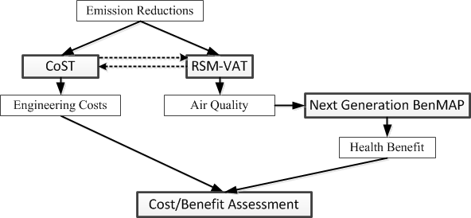
Conceptual Framework for Cost/Benefit Assessment

Slide 23
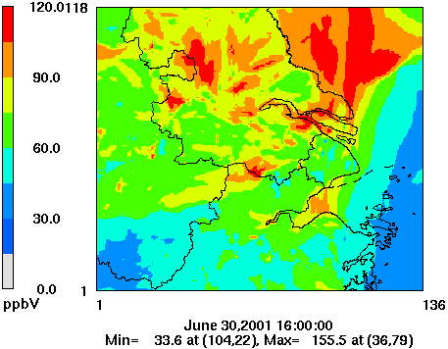
ABaCAS/RSM Pilot Project: Yangtze River Delta (China)
Define Policy Objectives
Develop Experimental Design & Define Policy Factors
YRD RSM/CMAQ Domain
EPA/
Tsinghua
Determine Output Metrics
C
Prepare CMAQ/RSM
and post-processing
programs
D
A
EPA/
U.TN
B
Select
RSM/CMAQ
Base Year
Conduct RSM/CMAQ
Base Run & Test
Tsinghua/
U.TN
Tsinghua/
EPA
Conduct Annual
RSM/CMAQ Simulations
Tsinghua/
Zhejiang/
U.TN
Key Task
To be Discussed
Develop Emission
Inventory for YRD
RSM/CMAQ runs
Build Predictive RSM
SCUT/
Tsinghua
Proposed
Task Leads
Tsinghua
Analyze & Summarize
YRD RSM results
All
RSM Validation &
RSM-VAT Analysis
Perform Benefit/Cost
Analysis
(Link to ABACAS)
Tsinghua/
SCUT
SCUT/
Tsinghua

Slide 24
ABaCAS (Fall 2012)
Air Benefit and Cost Assessment System
Notes:
Comment: This is an important slide, but needs to be improved. Consider to use animations to highlight the key features & differences

Slide 25

We do not inherit the earth;
We just borrow from our children.
THANK YOU!
谢谢!
Carey Jang
U.S. EPA
Office of Air and Radiation
Jang.carey@epa.gov

Slide 26

Recent Peer-Reviewed Publications (2007 - 2011):
Wang, S. X., J. Xing, C. J. Jang, Y. Zhu, J. Fu, J. Hao (2011), “Impact Assessment Ammonia Emissions On Inorganic Aerosols In East China Using Response Surface Modeling Technique”, Environ. Sci. & Tech., Accepted, Sept. 2011.
Xing, J., S. Wang, C. Jang, Y. Zhu, and J. Hao (2010), “Nonlinear response of ozone to precursor emission changes in China: a modeling study using response surface methodology, ACPD, 10, 29809-29851.
Wang L., C. Jang, Y. Zhang, K. Wang, Q. Zhang, D.Streets, J. Fu, Y. Lei, J. Schreifels, K. He, J. Hao, Y. Lam, J. Lin, N. Meskhidze, S. Voorhees, D. Evarts, S. Phillips (2010), “Assessment of air quality benefits from national air pollution control policies in China. Part I, Atmos. Environ. 44 (2010), 3442-3448.
Wang L., C. Jang, Y. Zhang, K. Wang, Q. Zhang, D.Streets, J. Fu, Y. Lei, J. Schreifels, K. He, J. Hao, Y. Lam, J. Lin, N. Meskhidze, S. Voorhees, D. Evarts, S. Phillips (2010), “Assessment of air quality benefits from national air pollution control policies in China. Part II, Atmos. Environ. 44 (2010), 3449-3457.
Li L., C. Chen, J. Fu, C. Huang, D. Streets, H. Huang¹, G. Zhang, Y. Wang, C. Jang, H. Wang¹, Y. Chen, and J. Fu (2011), “Air quality and emissions in the Yangtze River Delta, China”, ACPD, 11, 1621-1639.
Xing, J., Y. Zhang, S. Wang, X. Liu, S. Cheng, Q. Zhang, Y. Chen, D. Streets, C. Jang, J. Hao, W. Wang (2011), “Modeling study on the air quality impacts from emission reductions and atypical meteorological conditions during the 2008 Beijing Olympics”, Atmos. Environ., 45, 1786-1798.
Zhang, Y., X.-Y. Wen, and C. J. Jang (2010), “Simulating Climate-Chemistry-Aerosol-Cloud-Radiation Feedbacks in Continental U.S. using Online-Coupled WRF/Chem, Atmos. Environ., 44(29), 3568-3582.
Liu, X., Y. Zhang, S. Cheng, J. Xing, Q. Zhang, D. G. Streets, C. Jang, W.-X. Wang, and J.-M. Hao (2010), “Understanding of Regional Air Pollution over China using CMAQ:- Part I & II”, Atmos. Environ., 44 (20), 2415-2426.
Fu, J. S., D. Streets, C. Jang, J. Hao, K He., L. Wang, Q. Zhang (2009), “Modeling Regional/Urban Ozone and Particulate Matter in Beijing, China”, J. of Air and Waste Management, Vol. 10, January, 2009.
Chuang, M.T., J. S. Fu, C. Jang, C.Chan, P.C. Ni, C.T. Lee (2008), Simulation of Long-range Transport Aerosols from the Asian Continent to Taiwan by a Southward Asian High-pressure System. Sci. of the Total Environ. 406: 168-179.
Wang, L., J. Hao, K. He, S. Wang, J. Li, Q. Zhang, D. Streets, J. S. Fu, C. J. Jang, H. Takekawa and S. Chatani (2008), “Modeling Study on PM10 Pollution in Beijing: Regional Contributions and Control Implications”, J. of Air & Waste Management 58: 1057-1069.
Shetty S., C. Lin, C. Jang, D. Streets (2008) , "Model Estimate of Mercury Emission from Natural Sources in East Asia," Atmos. Environ. 42, 8674-8685.
Li, L., C. Chen, C. Huang, H. Huang, X. Li, J. Fu, C. Jang, D. Streets (2008), “Regional Air Pollution Characteristics: Simulation of Ozone and PM10 over Yangtze River Delta Region”, Environ. Sci. Vol. 29, No. 1. 238-247.
Streets, D., J. S. Fu, C. Jang, J. Hao, K. He, X. Tang, Y. Zhang, Z. Li, Q. Zhang, L. Wang, B. Wang, and C. Yu (2007), “Air quality during the 2008 Beijing Olympic games”, Atmos. Environ.,, 41, 480-492.
26
U.S. Environmental Protection Agency – Office of Air and Radiation
26
U.S. Environmental Protection Agency – Office of Air and Radiation

Slide 27
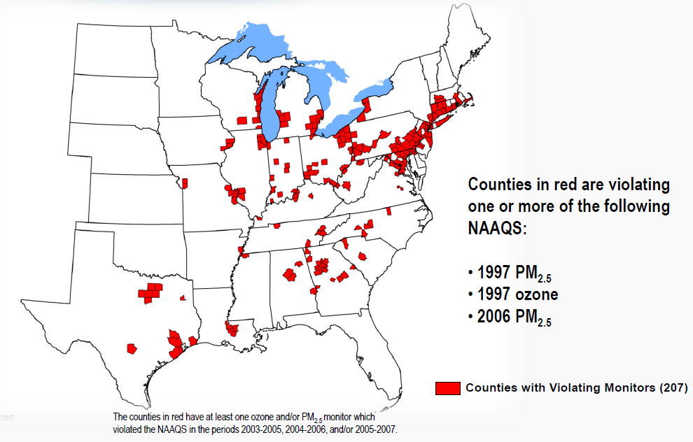
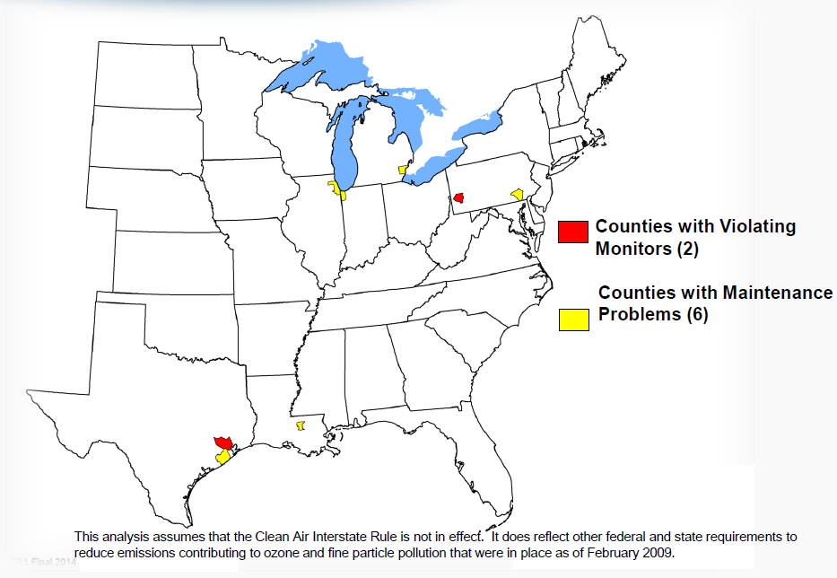
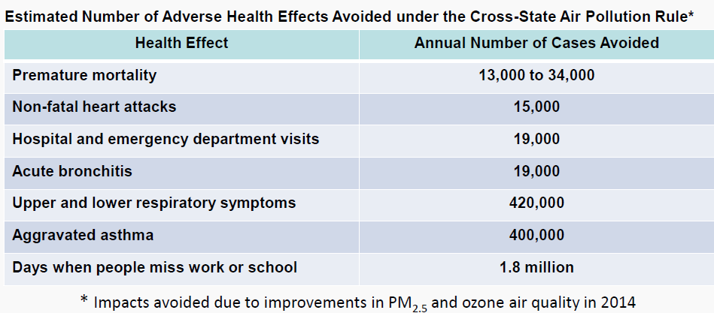

EPA’s “Cross-State Air Pollution Rule”: Cost/Benefit Analysis
The “CSAPR” Rule (2011) will reduce power plant emissions by 2014 (over 2005 levels): SO2 by 73% and NOx by 54% (Control cost ~$2.4 billion)
Air Quality
Benefit
(estimated by AQ modeling tool: CMAQ)
Health
Benefit
($120~$280 billion estimated by health impact tool: BenMAP)
Notes:
In December of this year, EPA will celebrate a major milestone, its 40th anniversary as an Agency and also the 40th anniversary of the US Clean Air Act, our primary law for air quality management.
EPA compared environmental conditions with and without the U.S. Clean Air Act and associated federal, State and local rules between 1970 and 1990:
The economic value of the public health and environmental benefits that Americans have enjoyed from the Clean Air Act of 1970 were estimated to exceed their costs by a margin of 42 to 1.
A second comparison study of the period 1990-2010, when more expensive programs were necessary to get additional air quality improvements:
EPA estimated that by 2010 the benefits of these Clean Air Act amendment programs would exceed their costs by a margin of 4 to 1.
These studies show that the CAA, its amendments and associated programs are preventing:
hundreds of thousands of premature deaths related to air pollution
millions of cases of respiratory illness
wide range of other human health, human welfare, and ecological effects.

Slide 28
RSM PM Analysis:
PM Trend vs. Emissions Control (China)
Emissions
Sulfate PM
Nitrate PM
1990
to
2005
(Historical
emissions)
2005
to
2030
(High
Emissions
Projection)
Notes:
28

