Slide 1


Towards design of effective control strategies for secondary O₃ standards
CMAS Conference
10/26/2011
Daven K. Henze, Kateryna Lapina, University of Colorado Boulder
NASA AQAST team members:
Jana Milford (CU Boulder), Arlene Fiore, Meiyun Lin (Princeton/GFDL/Columbia) Greg Carmichael, Min Huang (U. Iowa), Loretta Mickley (Harvard), Jeffrey Herrick, Steve Dutton, Travis Smith, Vicki Sandiford (US EPA), John Vimont, Ellen Porter (NPS)
c
G
adj

Slide 2
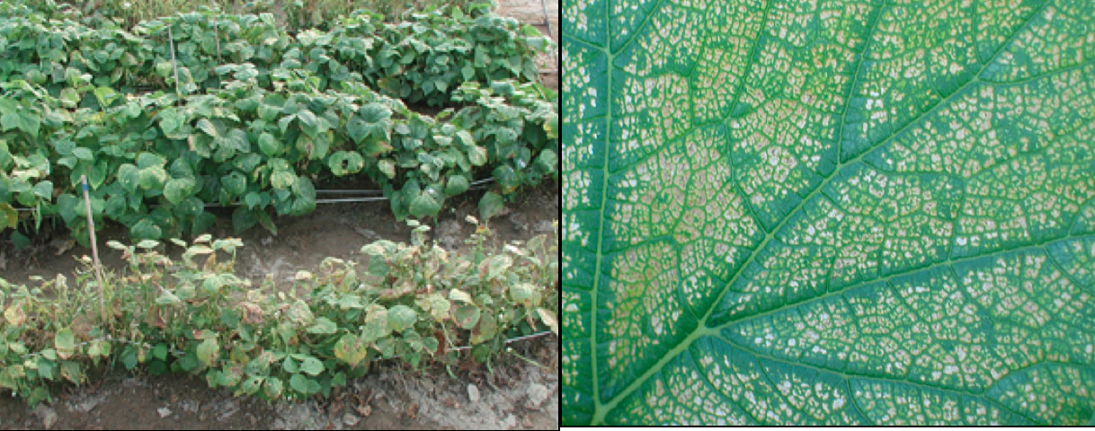
Secondary ozone standards
http://www.ars.usda.gov
Primary standards set limits to protect public health.
Secondary standards set limits to protect public welfare, including damage to crops and vegetation.

Slide 3
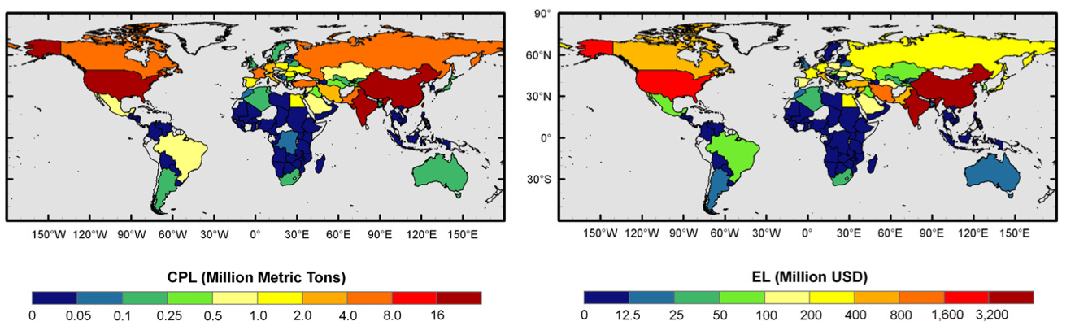
Estimated 2030 crop loss due to ozone exposure
Total crop production loss (left) and economic loss (right), by 2030 following A2 scenario (Avnery et al., 2011)
U.S. , 21-29Mt ($3.1 billion), next China & India
note: can depend on metric – these based on AOT40
Notes:
Soybean, maize and wheat.
Combined crop prod. maps with simulated O3 exposure metrics and conc:response functions to estimate crop yield reductions and economic loss.

Slide 4
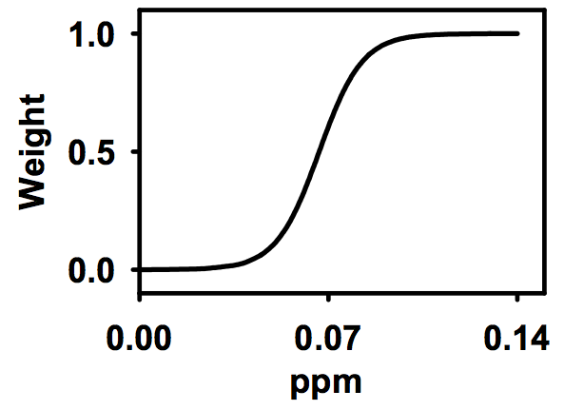
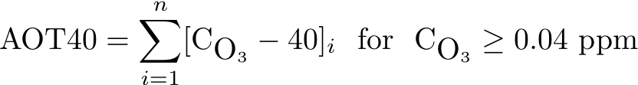
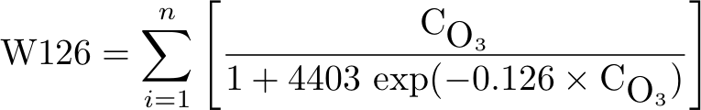
Ozone exposure metrics
“critical” value after 3 months = 3,000 ppb h
(Karenlampi and Skarby, 1996 )
CASAC recommended 7 – 15 ppm h
n = daylight hours in three consecutive months of growing season (averaged over 3 years for US proposed standard)
Notes:
\mbox{AOT40} = \sum_{i=1}^n [\mbox{C}_{\mbox{O}_3} - 40]_i \mbox{~~for~~}\mbox{C}_{\mbox{O}_3} \ge 0.04 \mbox{~ppm}
\mbox{W126} = \sum_{i=1}^n \left [ \frac{\mbox{C}_{\mbox{O}_3}}{1 + 4403 \mbox{~exp} {(-0.126 \times \mbox{C}_{\mbox{O}_3 } )} \right ]

Slide 5
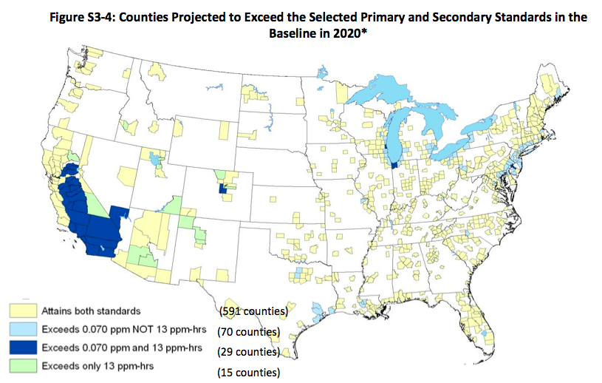
Projected exceedence of a secondary standard (13 ppm h) in the US in 2020
US EPA, 2011 O₃ RIA
Many more counties (>100) would exceed only a secondary standard set at 7 ppm h if primary standard is still 0.075 ppm

Slide 6
Complexities to address for US secondary standard
• Monitors missing in many rural counties and National Parks, particularly in the West
• Existing practices for estimating costs of achieving attainment (impact ratios) are not necessarily applicable to secondary standard
• Unclear origin of ozone leading to crop and vegetation exposure
US EPA, 2011 O₃ RIA
Notes:
Soybean, maize and wheat.
Combined crop prod. maps with simulated O3 exposure metrics and conc:response functions to estimate crop yield reductions and economic loss.

Slide 7
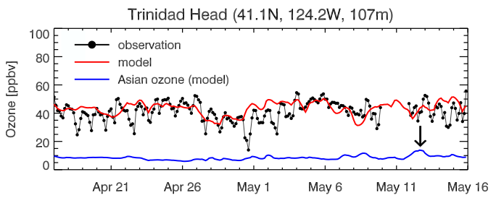
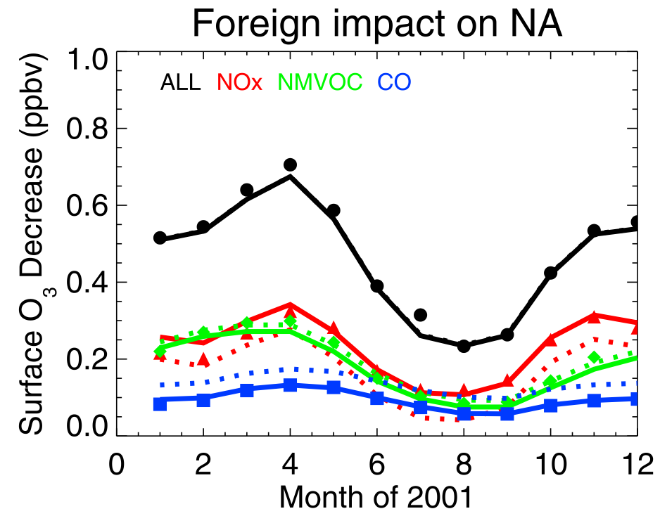
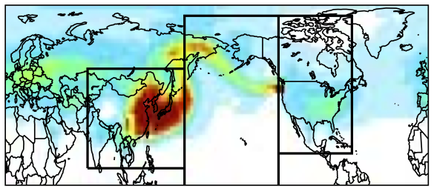

Long range impacts of O₃
∆O₃ from 20% ∆emissions in
foreign source regions
O₃ observed at Mt. Bachelor
10⁻¹¹ ppb/m²
Fiore et al., 2009, HTAP
Zhang et al., 2009
Notes:
intercontinental transport contributes most to surface O3 concentrations at northern midlatitudes during boreal spring and fall (solid circles in Figure 5), reflecting a combination of more frequent storm tracks that enhance ventilation of the continental boundary layer, more efficient transport in stronger midlatitude westerly flow in the free troposphere, and a longer O3 lifetime allowing for a longer transport distance than in summer when O3 production and loss (both chemical and depositional) are largest
See under Fig 4 or 5 explan – symbols – all-models means, lines – only subset of models
Dotted lines – when accounting for long-term change of CH4

Slide 8
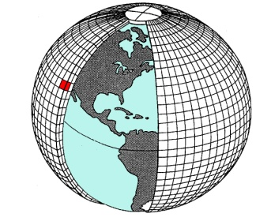
Chemical transport modeling
Forward model (Bet et al., 2001; www.geos-chem.org):
2° x 2.5°, 47 vertical levels
Emissions
FF/BF: EDGAR + regional inventories
BB: GFED2 (2007)
OC/BC: Bond et al 2007
Dust (Fairlie 2006)
Sea Salt
[species(x,y,z,t)]
exposure metric
Meteorology
GMAO
GEOS-5
Adjoint (Henze et al., 2007):
∂metric/∂species
Influence from emissions
adjoint forcing
∂metric/∂emissions

Slide 9
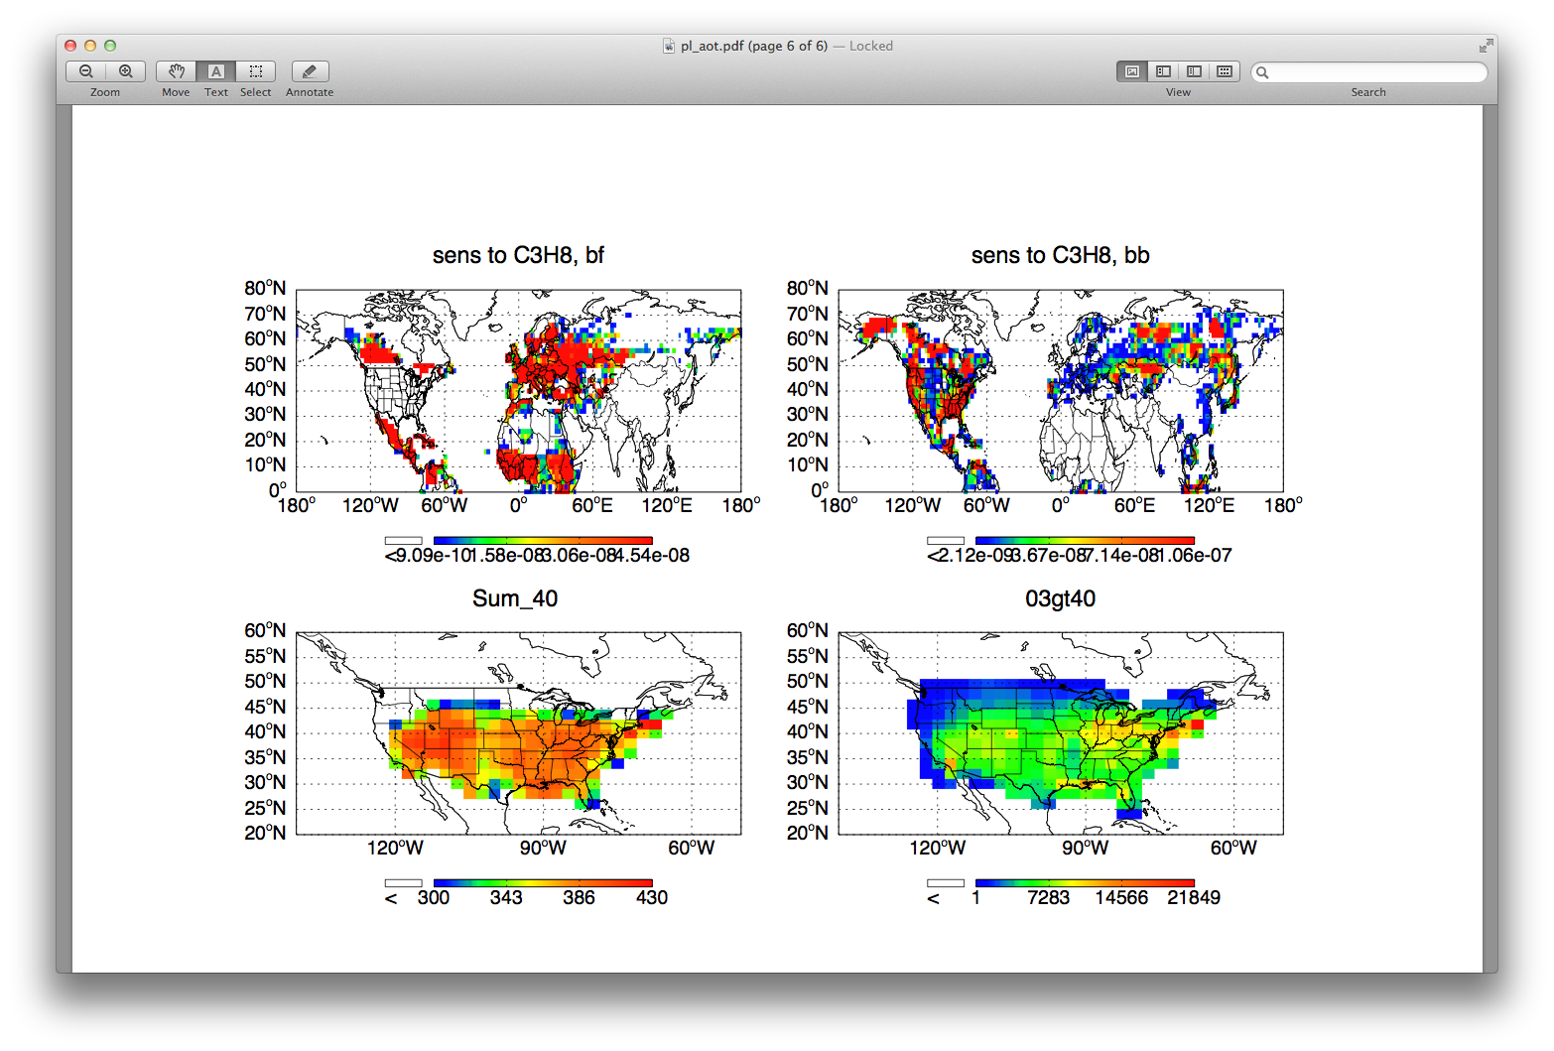
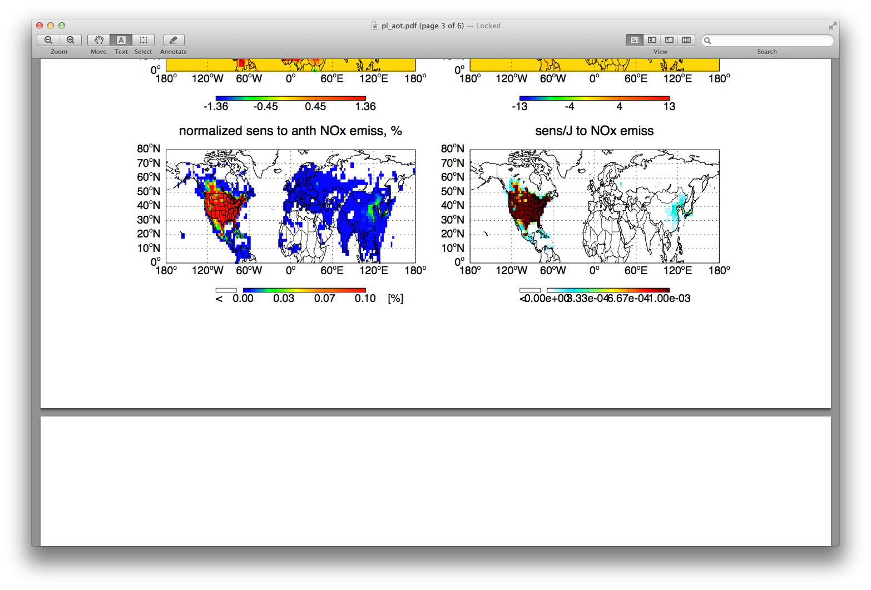

Impact by location
AOT40 in US, 1 month (August)
Sensitivity to anthropogenic NO_{x}
ppb h

Slide 10
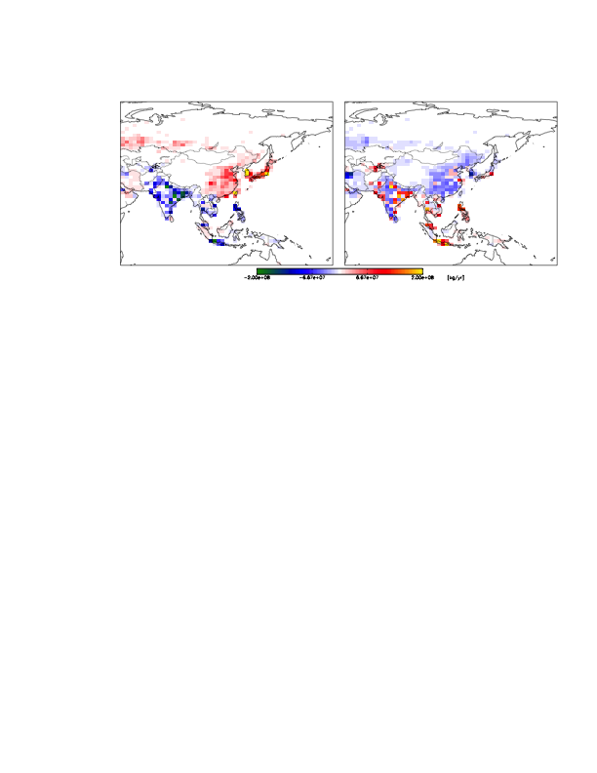
Importance of high-resolution source attribution
Spatial heterogeneity in NO_{x} emissions changes following
- a single Representative Concentration Pathway for AR5
- the difference between two Pathways for AR5
RCP 26: 2050 - 2000
RCP 85 2050 – RCP 26 2050
India ≠ China ≠ Japan ≠ Asia....
Notes:
it was [21,20], then [22,21]
20 = 2000
21 = 2050 RCP 26
22 = 2050 RCP 85

Slide 11
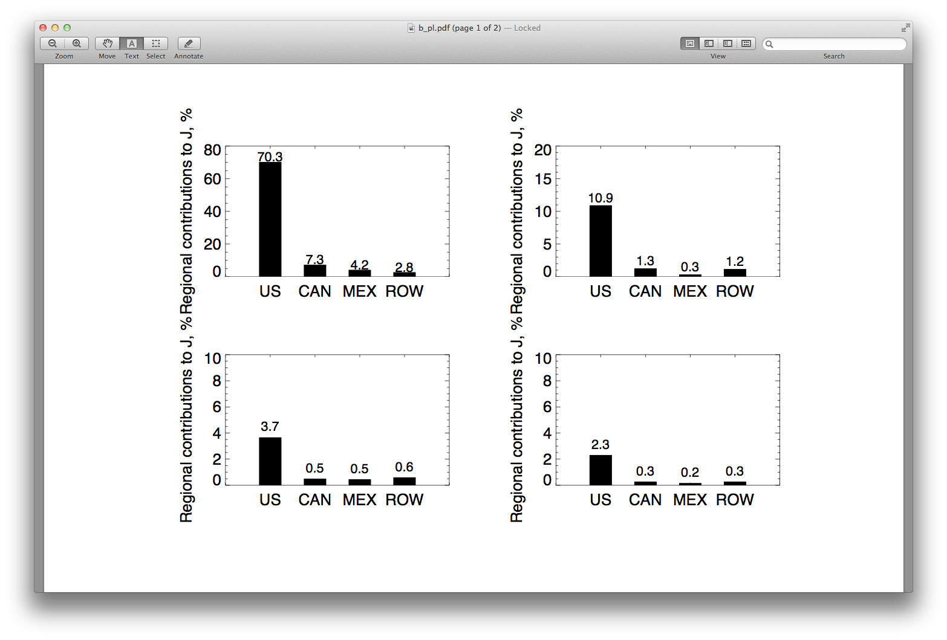
Impact by location
AOT40 in US, 1 month (August)
Sensitivity to anthropogenic NO_{x}
ppb h
by region (%)

Slide 12
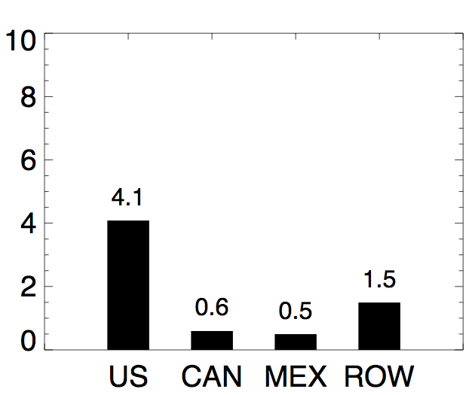
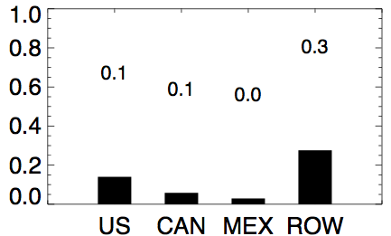
Impact by species
isoprene
CO
C4 alkanes
propene
propane

Slide 13
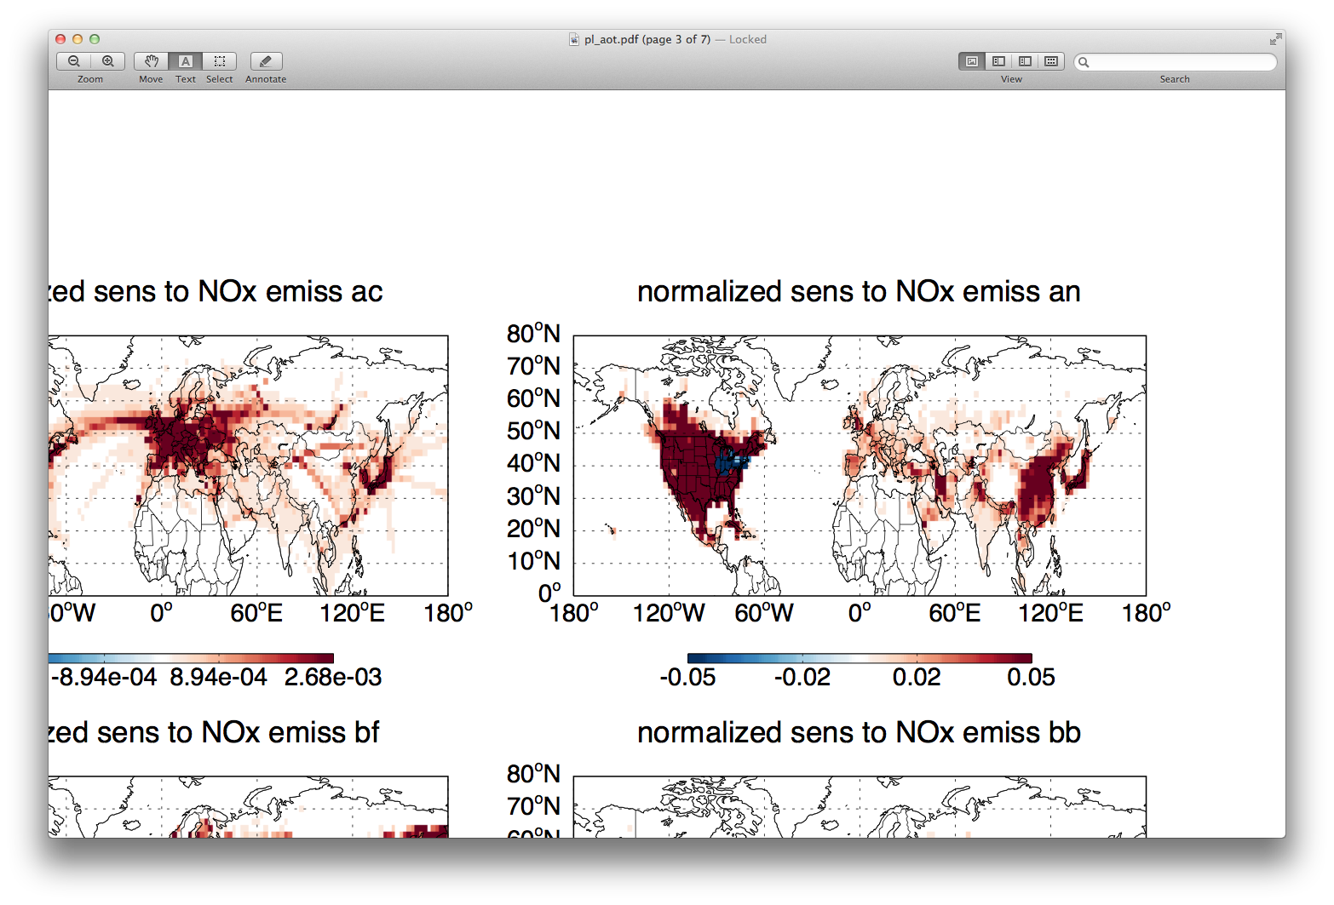
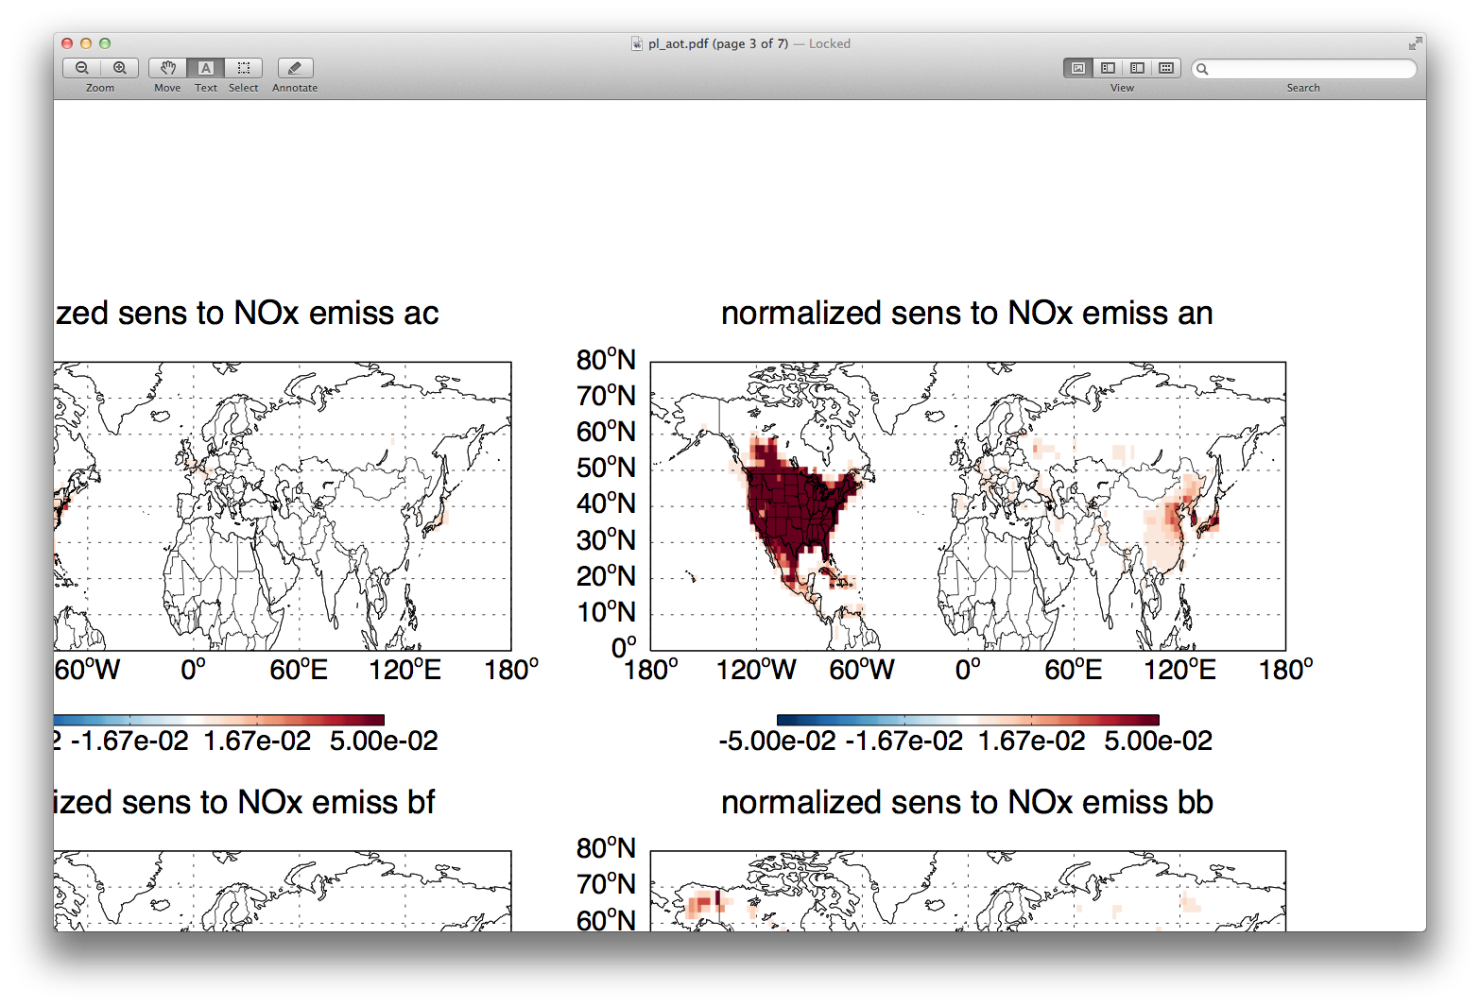
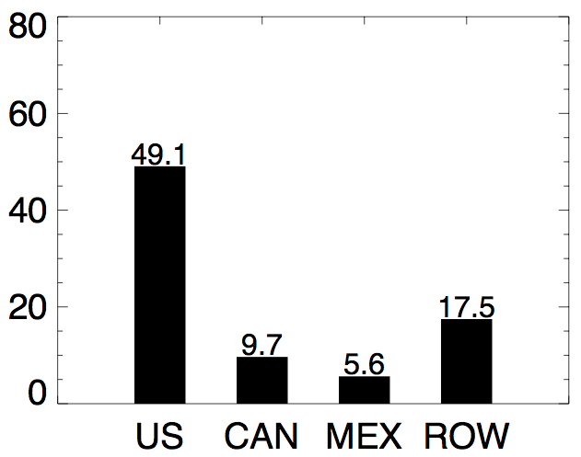
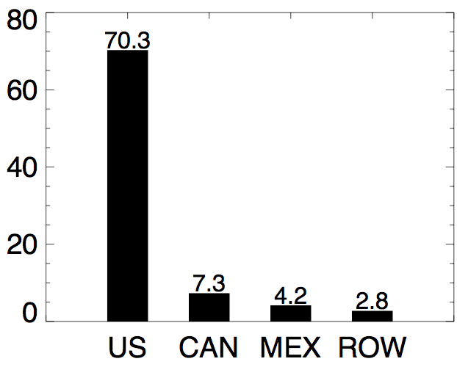
Impact by season
Sensitivity of US AOT40 to anthropogenic NO_{x} emissions
April 2006
August 2005
[%]
[%]
[%]

Slide 14
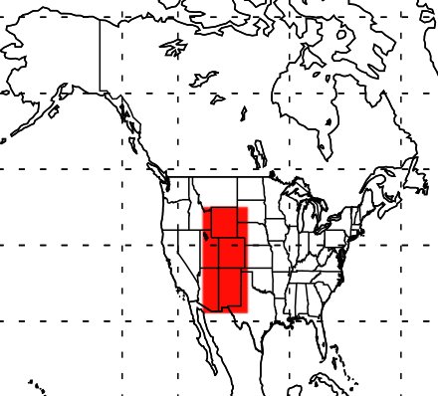
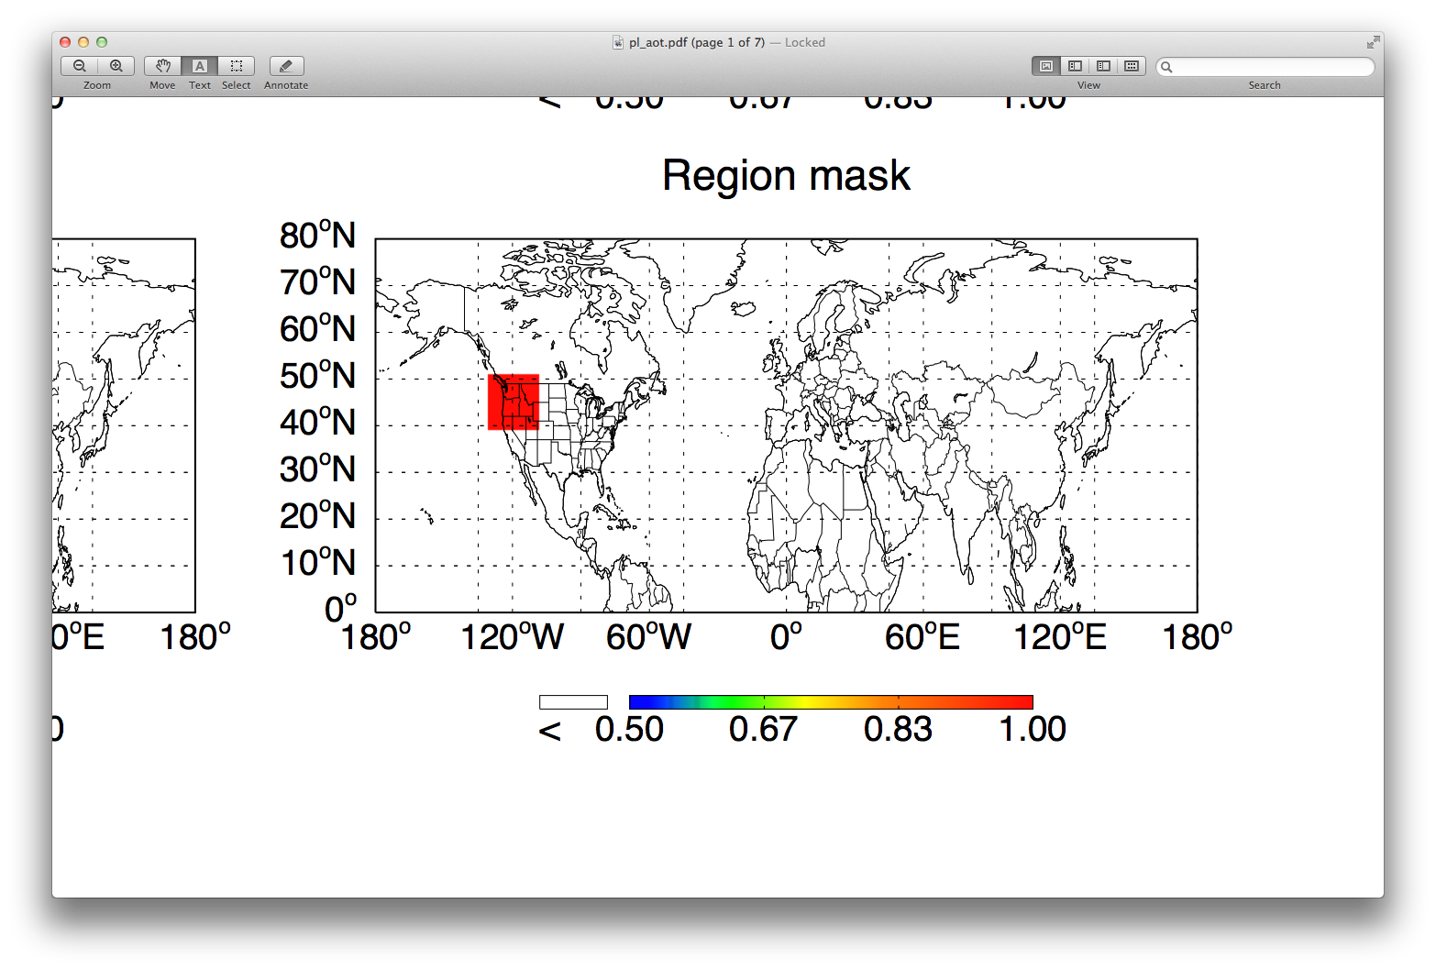
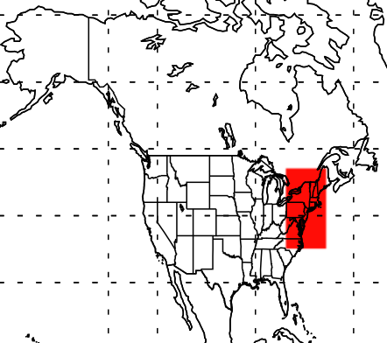
Consider different regions

Slide 15
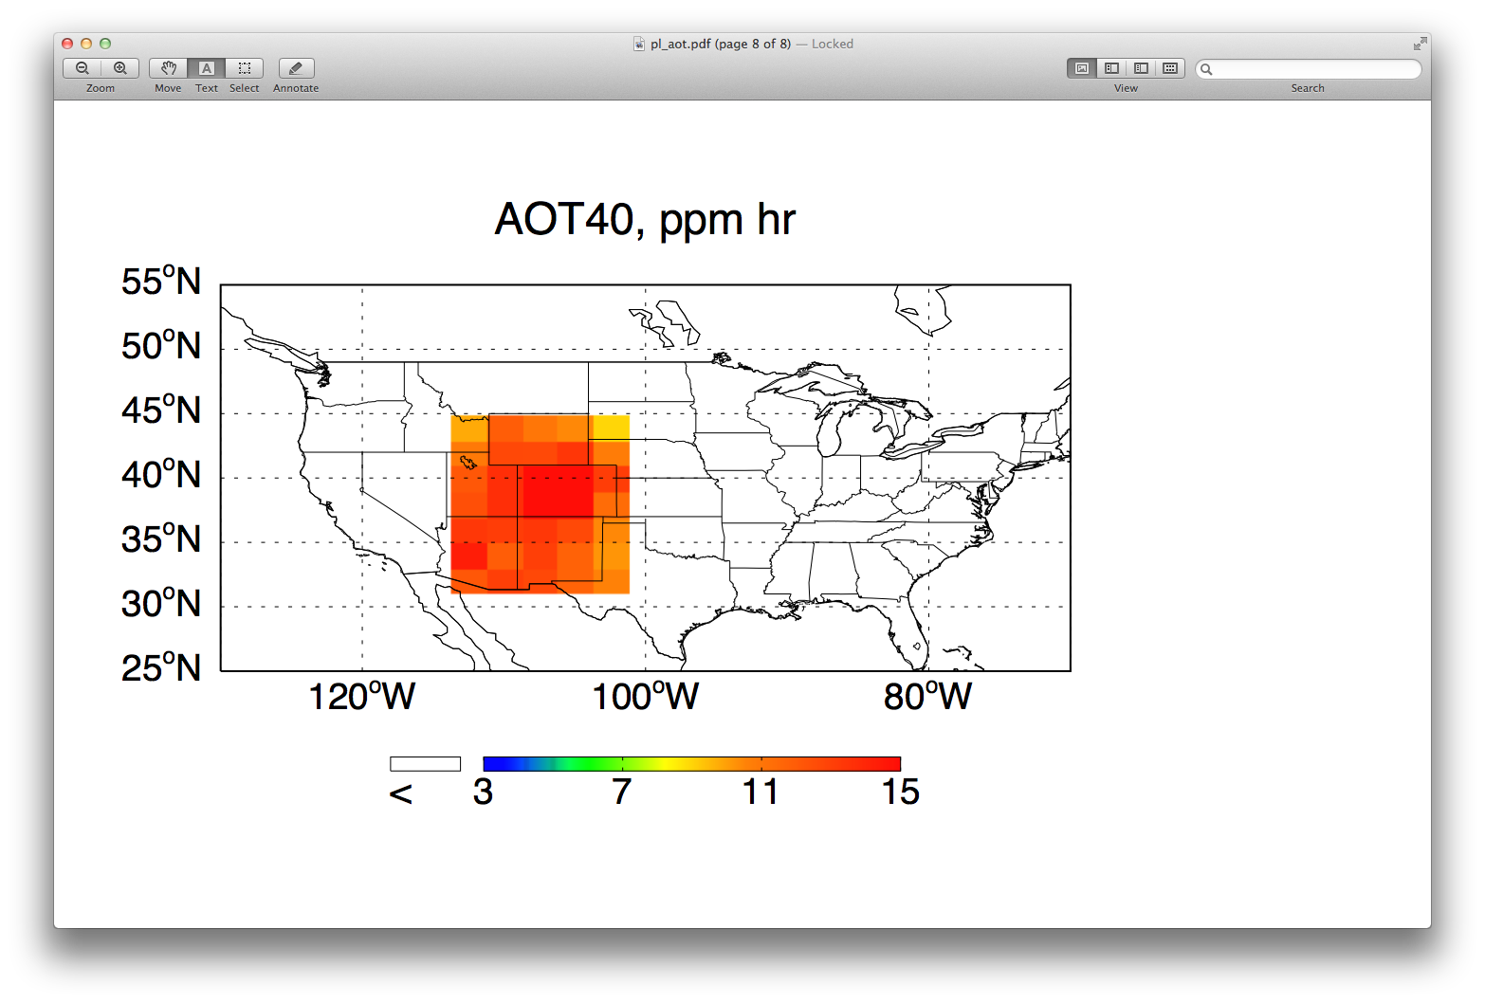
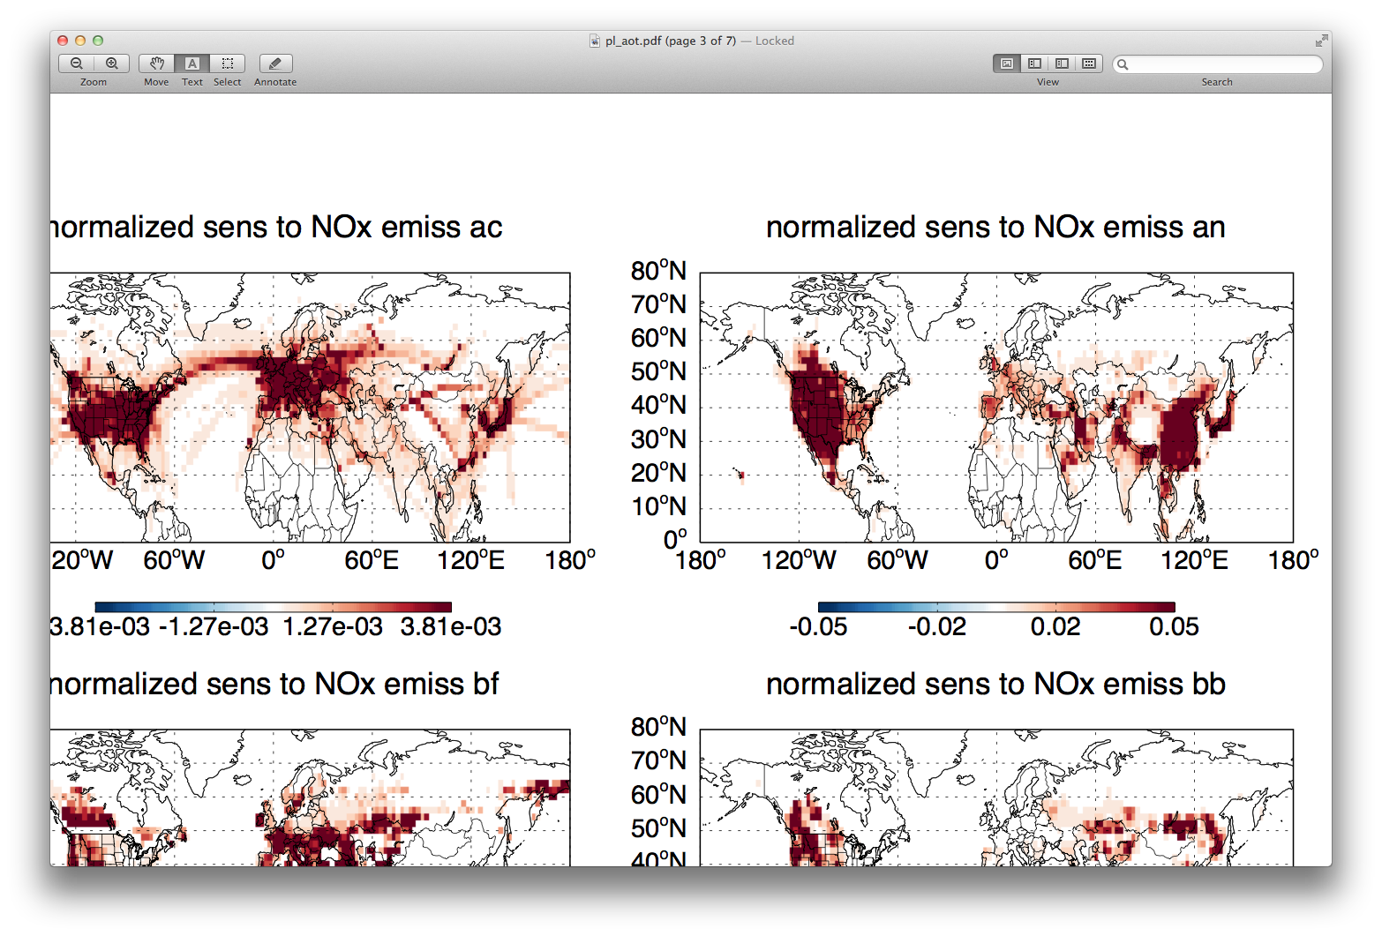
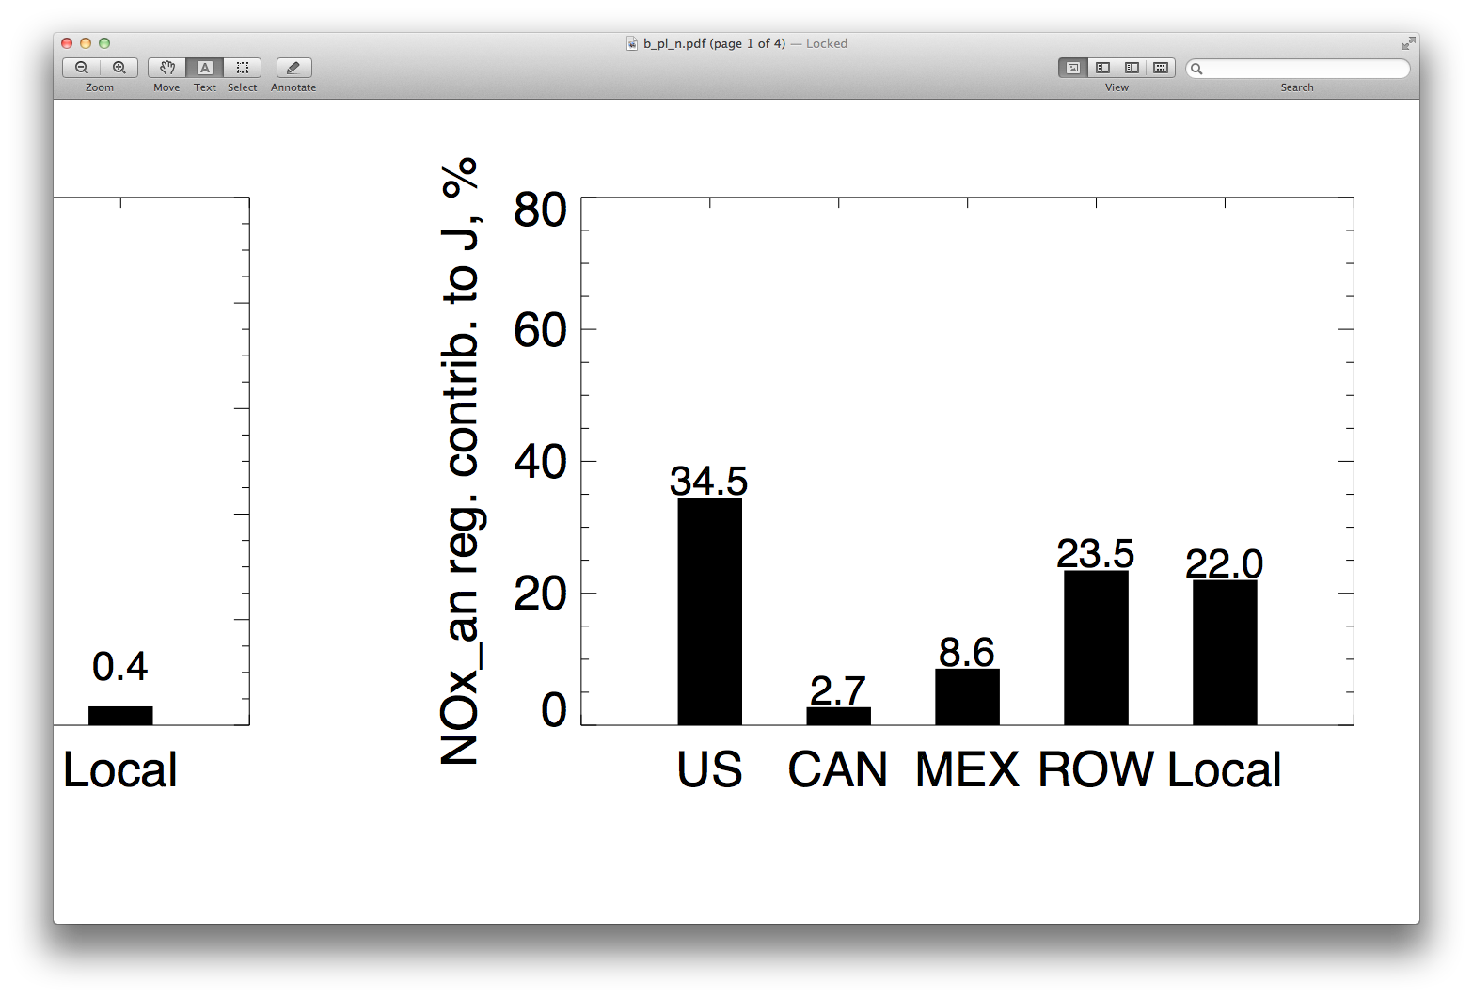
Sources impacting AOT40 in West
AOT40
in the West
ppm hr
Anthropogenic NO_{x} contributions
Contribution by region
[%]

Slide 16
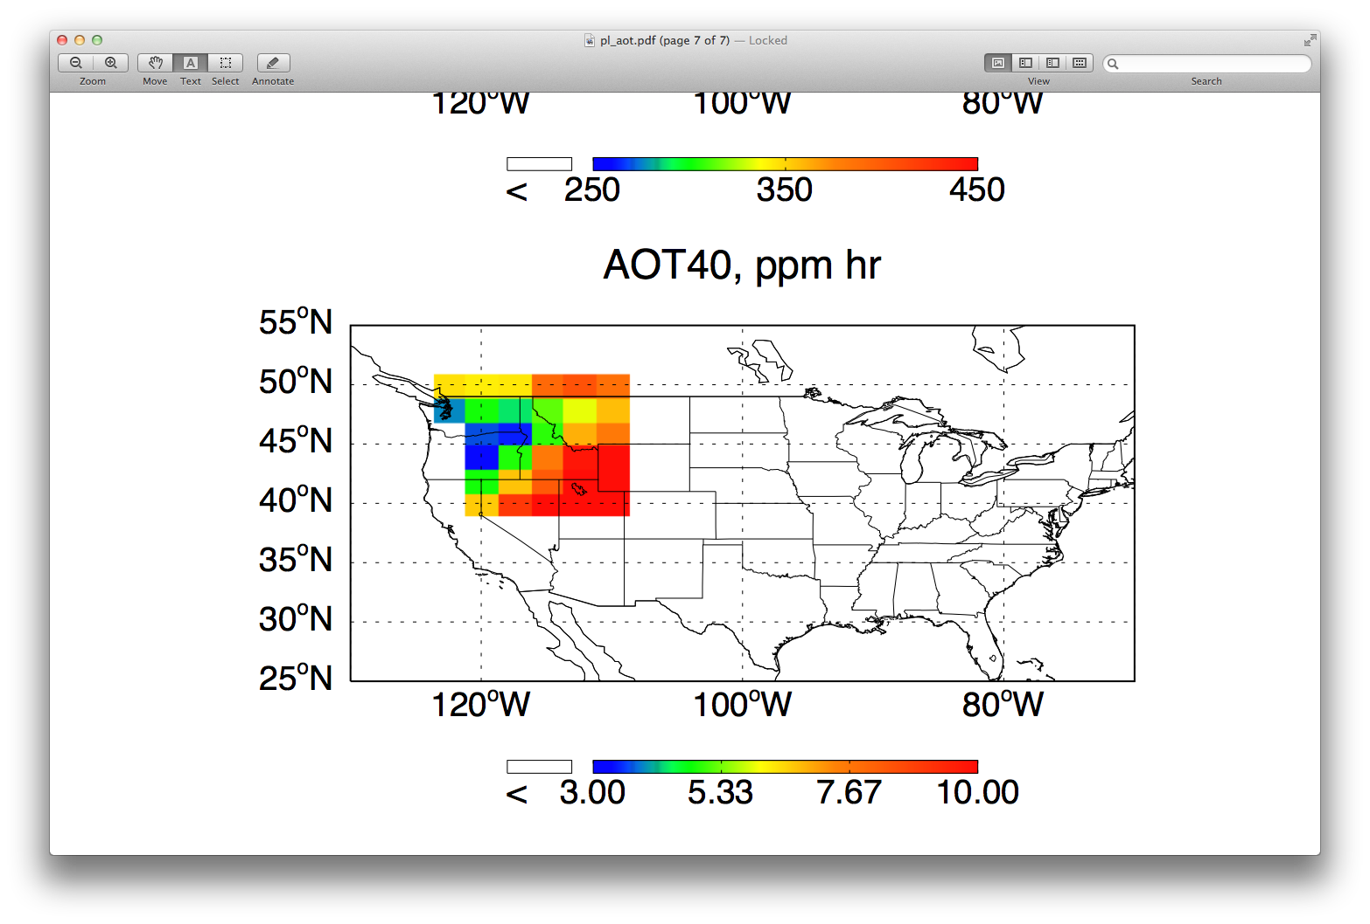
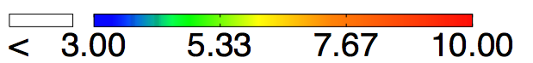
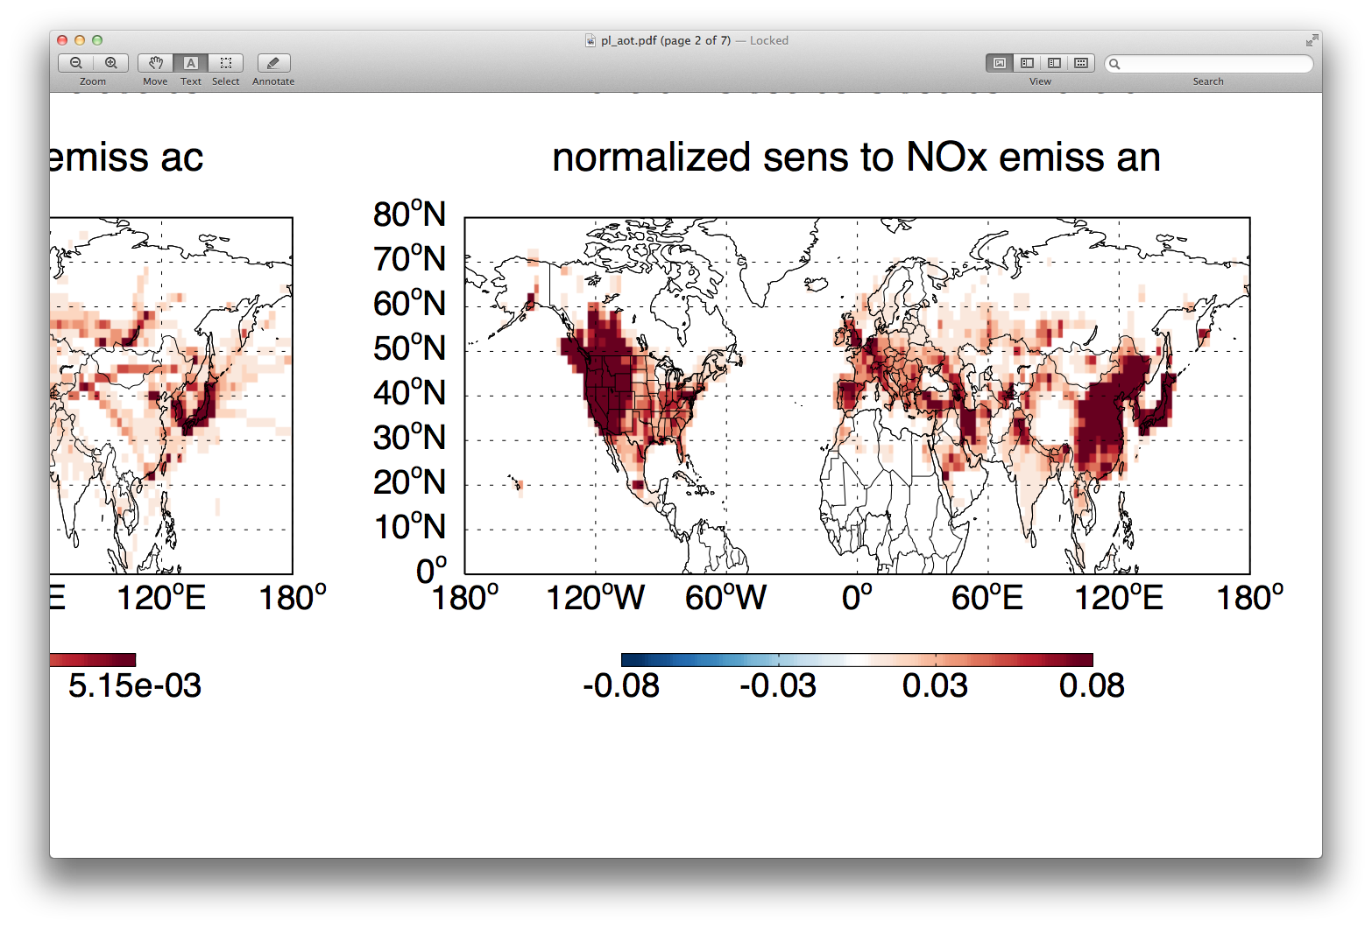
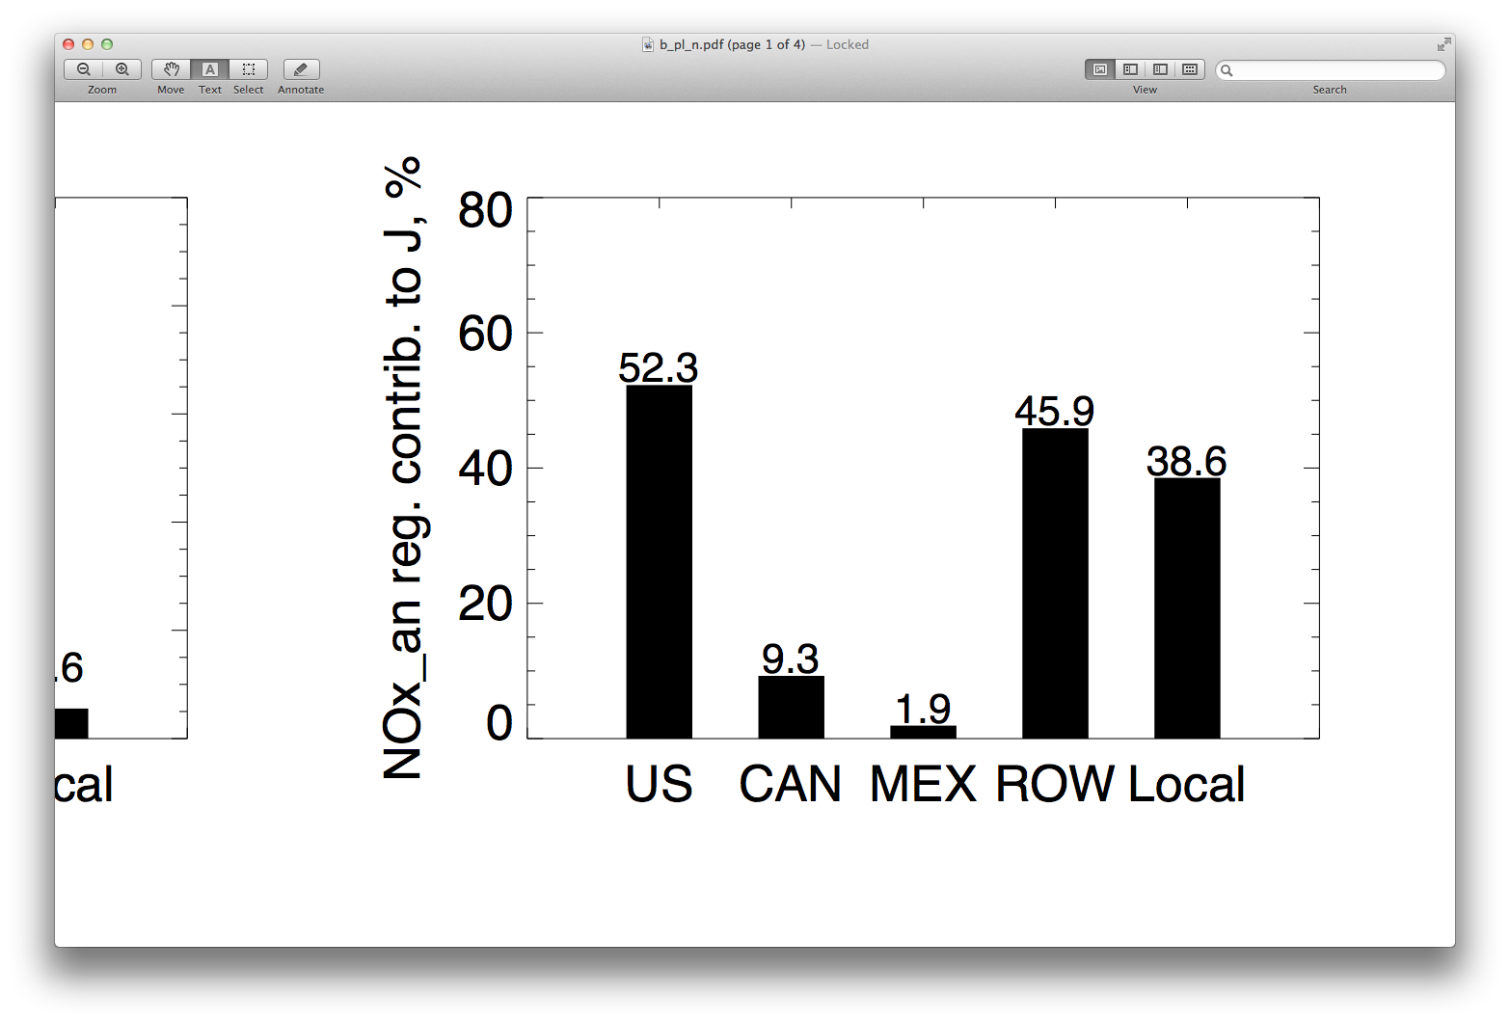
Sources impacting AOT40 in PNW
AOT40
in the West
ppm hr
Anthropogenic NO_{x} contributions
Contribution by region
[%]

Slide 17
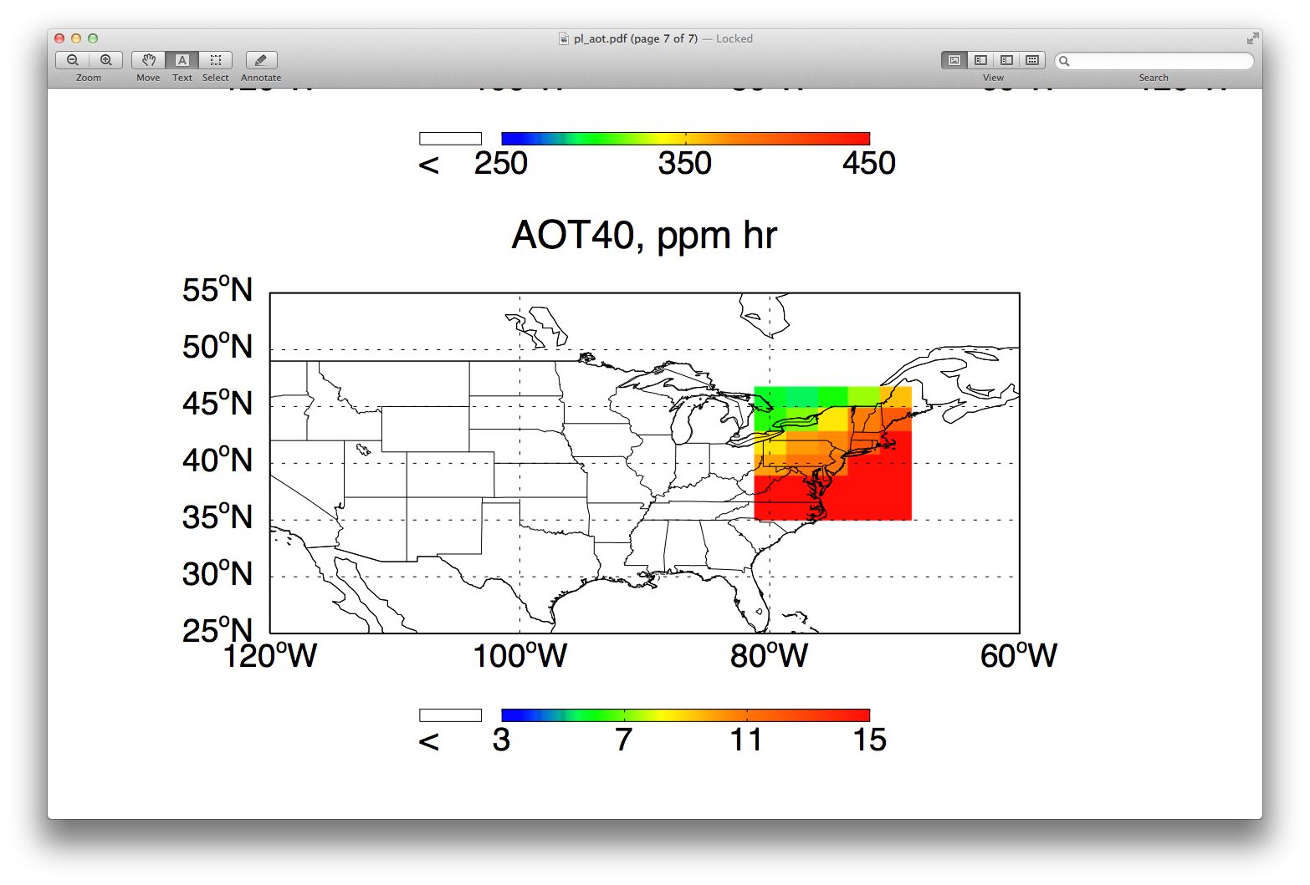
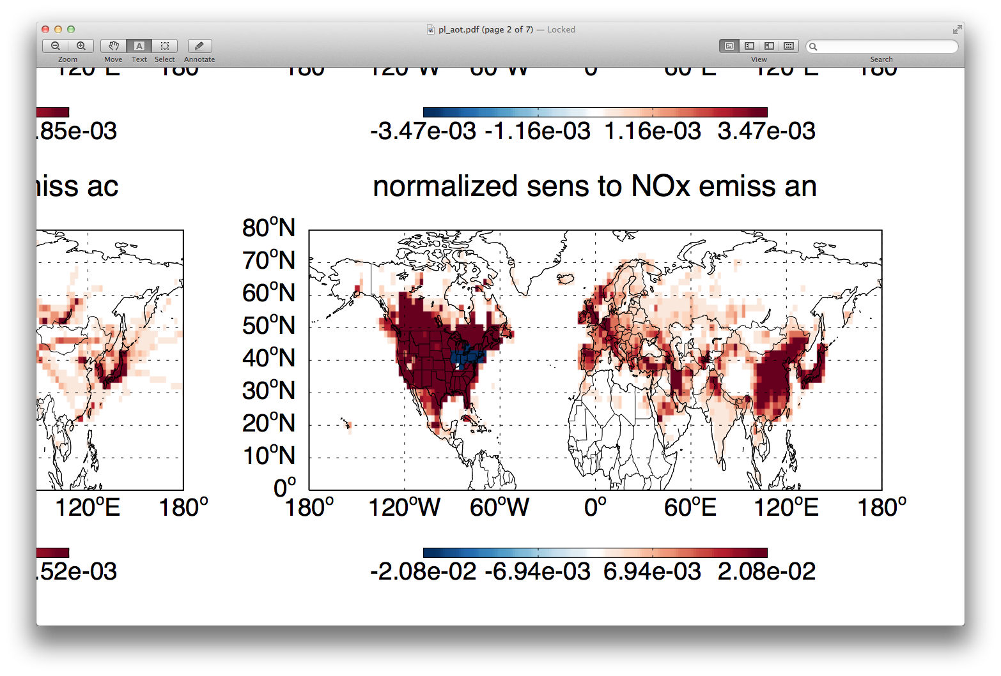
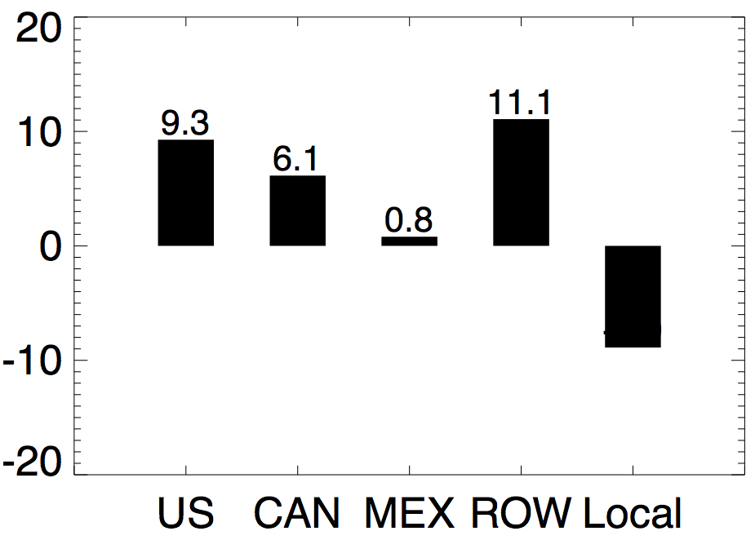
Sources impacting AOT40 in NE
AOT40
in the West
ppm hr
Anthropogenic NO_{x} contributions
Contribution by region
[%]

Slide 18
Final remarks
• Ozone exposure to crops, vegetation: not necessarily solved by meeting primary standards
• 10-50% of US exposure from non-US sources
• 10-30% of US exposure within large, multi-state attainment regions from US emissions outside these regions
Future work:
• Consider other metrics (W126) and longer seasons,
multi year average
• Reduce model values by ~40% to account for surface
gradients
• Higher resolution GEOS-Chem, CMAQ, STEM, other
global models

Slide 19

the end
positions available!
In my group:
- scientific programmer
- postdoctoral research associate
In the Mechanical Engineering department:
- tenure-track faculty position (fluids)
daven.henze@colorado.edu

Slide 20
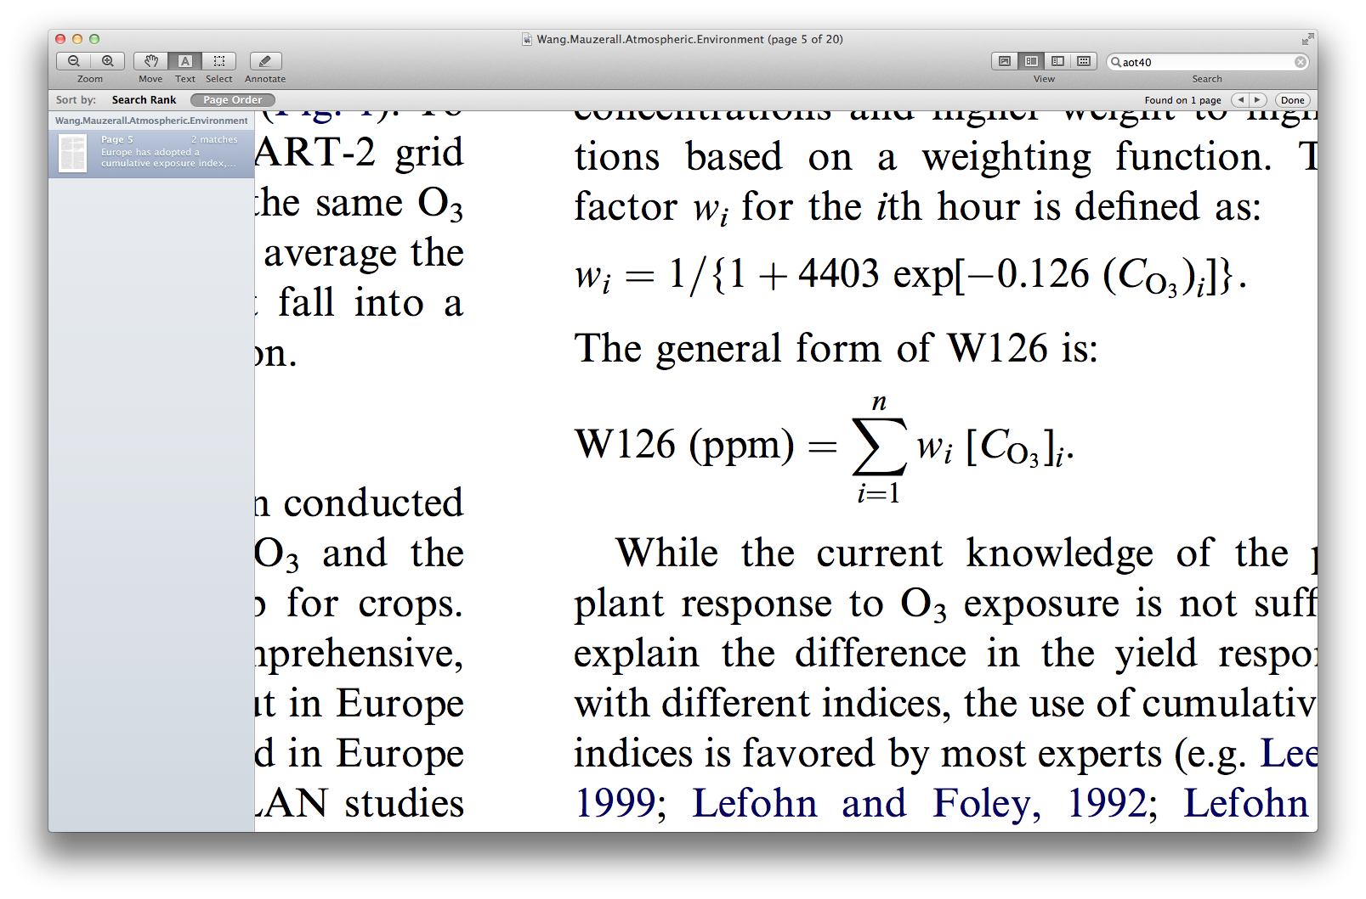
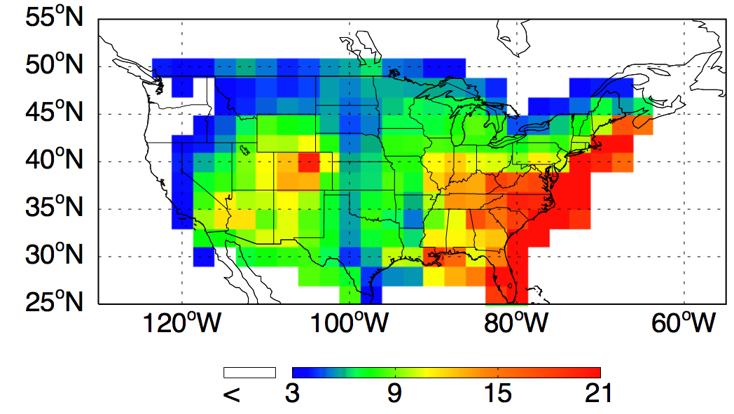
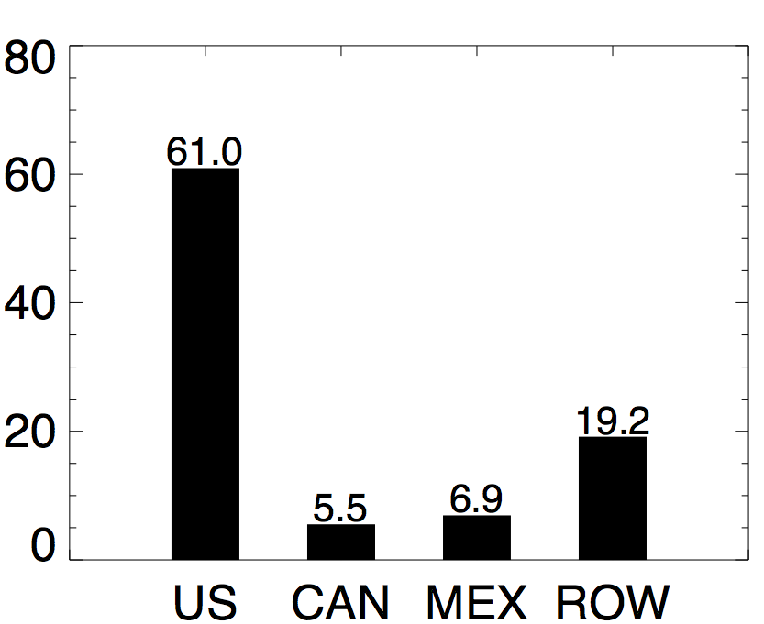
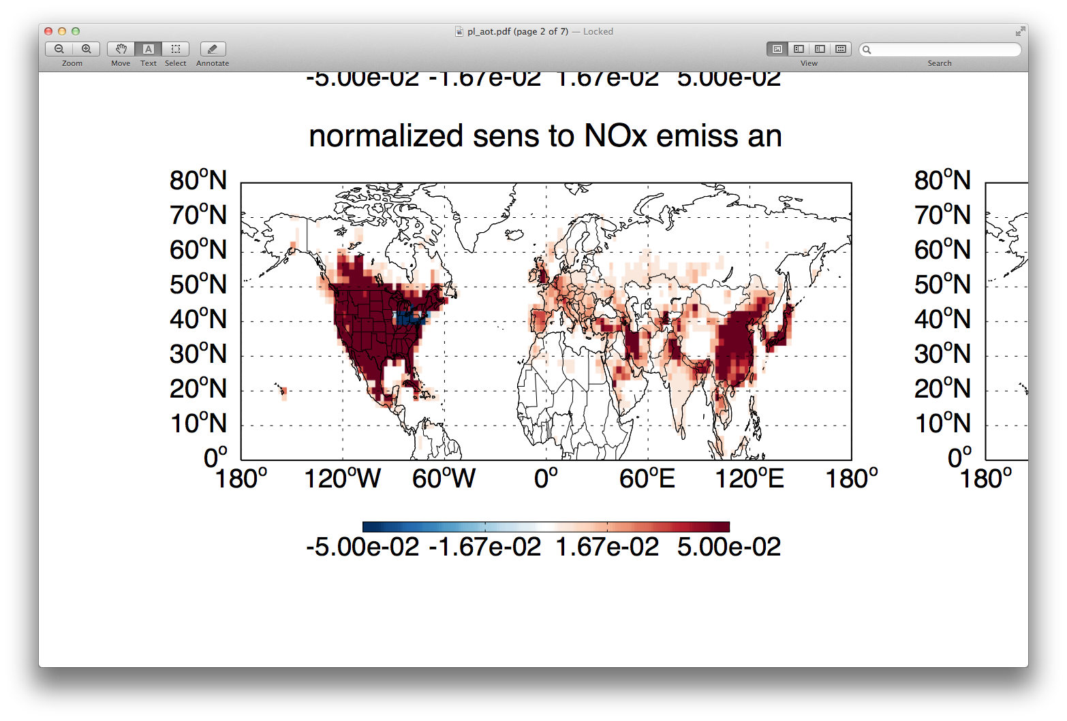
O3 secondary standard test application (Kateryna Lapina, CU Boulder)
W126 cost function evaluated in GEOS-Chem for April, 2006
ppm h
Impact on W126 from NOx emissions
NOx impacts summed by region
[%]
[%]

Slide 21
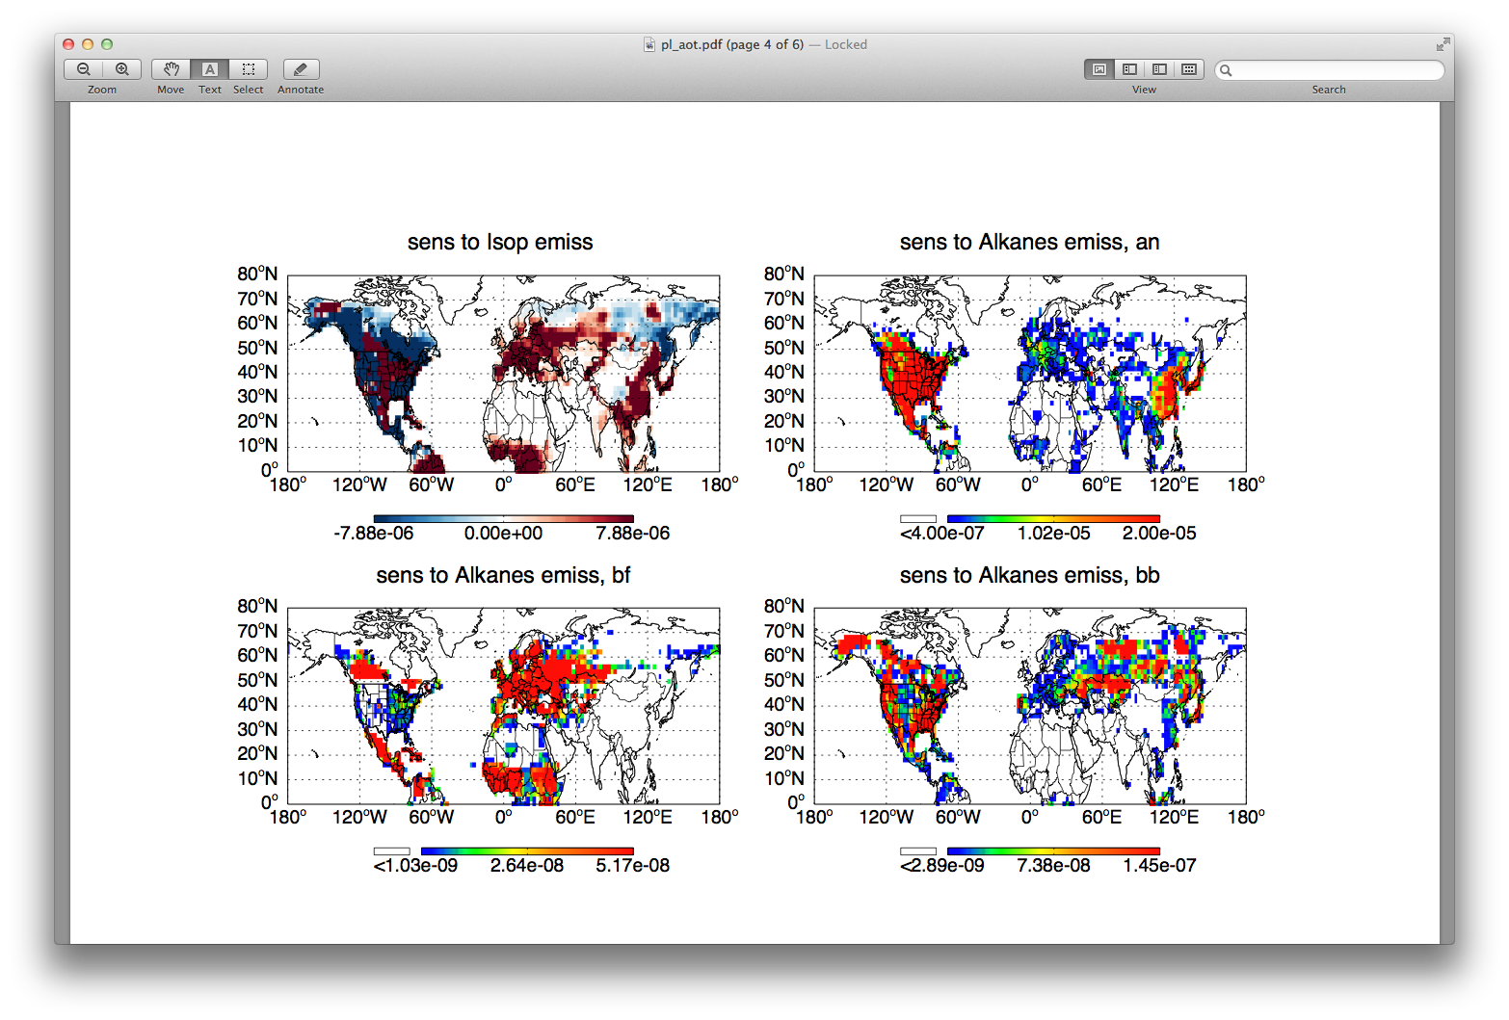
Impact by sector: sources of alkanes
biofuel
biomass burning
anthropogenic
Notes:
Aug?

Slide 22
the end

Slide 23
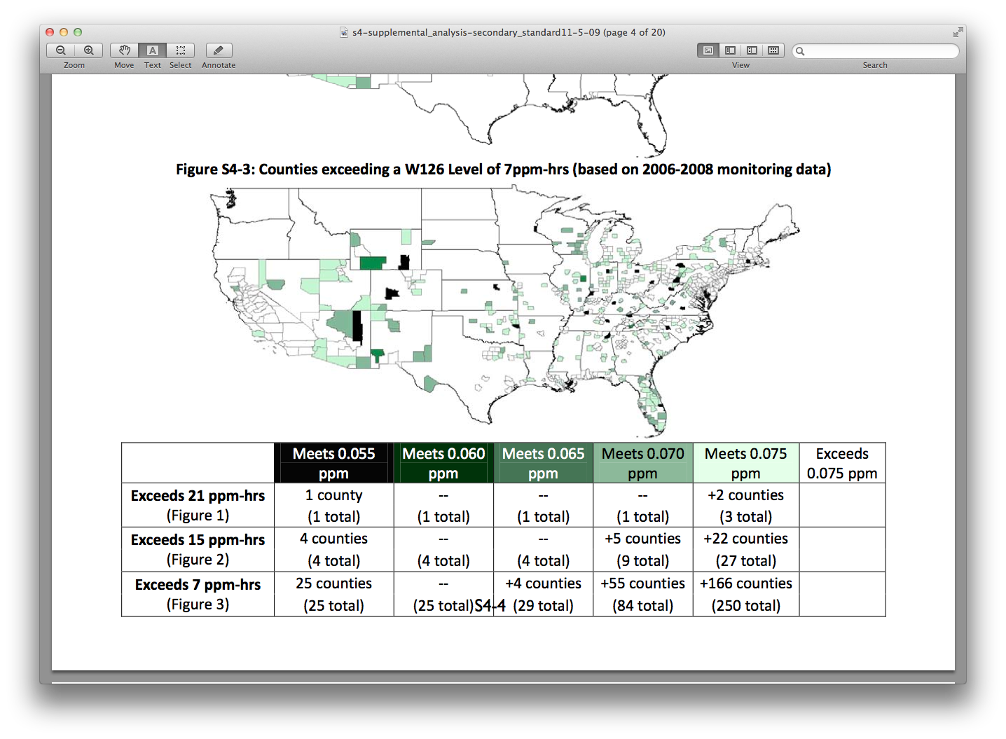
Consider different regions

Slide 24
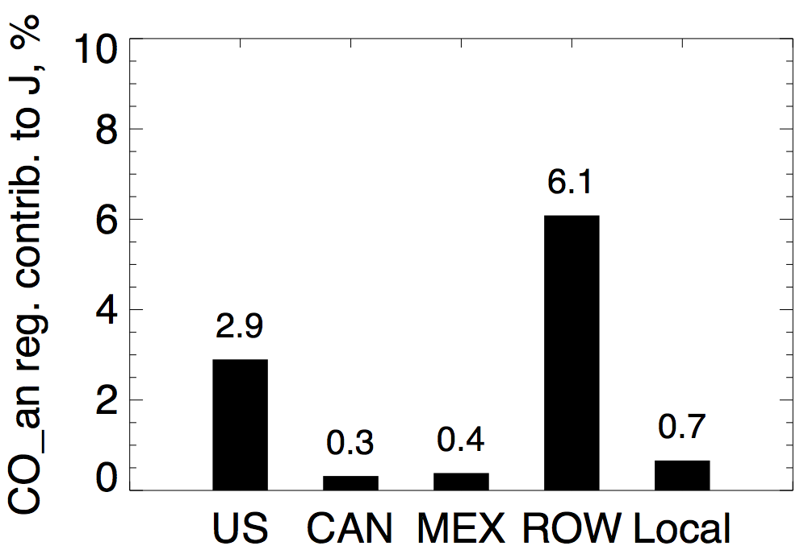
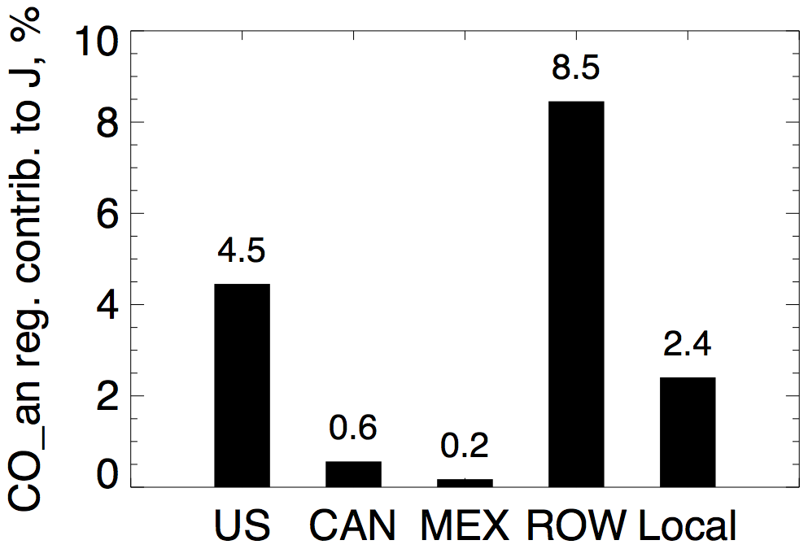
Sensitivity of J to CO anth emissions, %
West US NW US Region

Slide 25
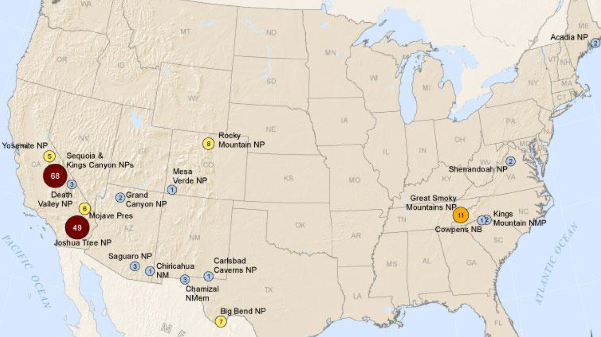
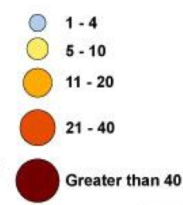
O₃ exceedances in US National Parks
# ozone exceedance (of primary standard) days April-August, 2011
http://www.npca.org/
+320 parks without monitoring
Notes:
From April through August 2011 there were 222 exceedances of EPA’s health-based ozone air pollution standard in national parks with ozone monitors. In addition, based on preliminary NPS data posted on AirNow, there have been more than a dozen additional exceedances of the ozone standard in national parks in the first ten days of September 2011. That compares with 223 national park ozone exceedances in all of 2010 and 196 in all of 2009. There are still two months remaining in the ozone season, which ends in October, assuring that in 2011 national parks will have many more unhealthy ozone exceedances than in any of the past three years.
Kateryna – these #’s are for exceeding the primary standard, or for a secondary standard?

