Slide 1
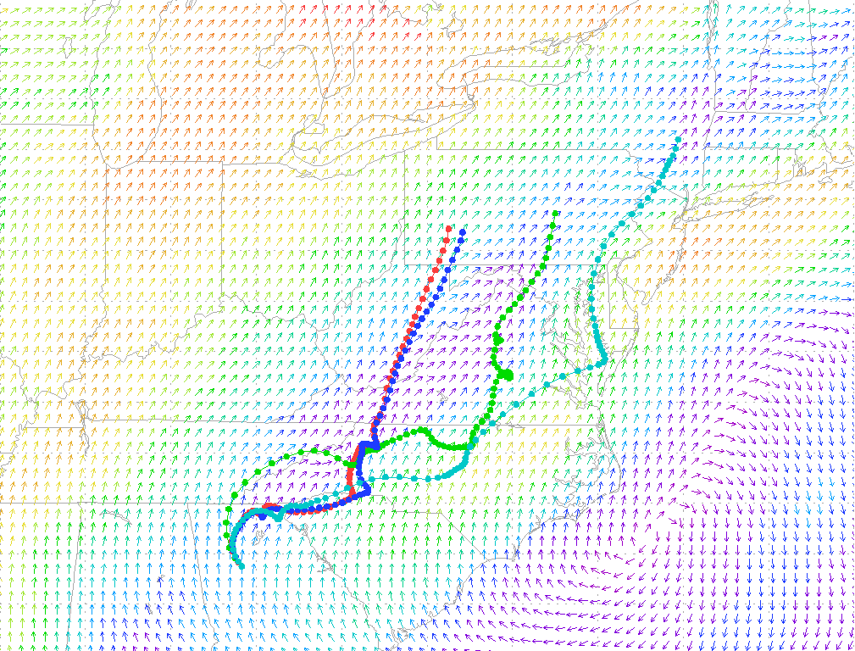
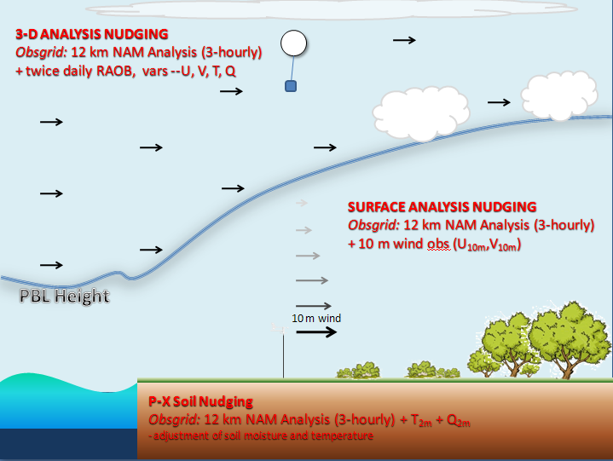
Improving transport in AQ models using alternative FDDA techniques
Rob Gilliam, Jim Godowitch and ST Rao
Office of Research and Development
National Exposure Research Lab, Atmospheric Modeling and Analysis Division, Atmospheric Model Development Branch
October 25, 2011

Slide 2
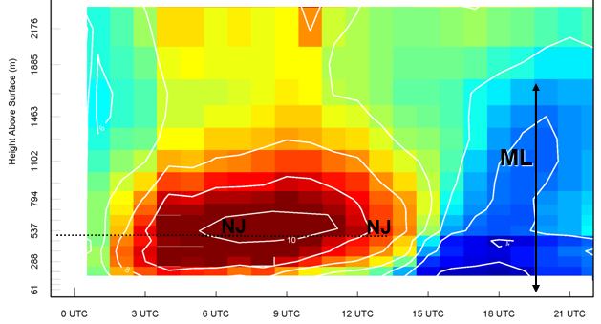
Why focus on transport?
Even a perfectly designed air quality model will produce poor solutions if meteorological transport fields have excessive uncertainty.
Nocturnal jets and residual layer winds are important features in regional pollution transport that have often been inadequately simulated in the past, thus, a main focus of this study.
An example of the impact: the ozone formed over urban areas during the day can be transported quite differently overnight depending on the meteorological transport.

Slide 3
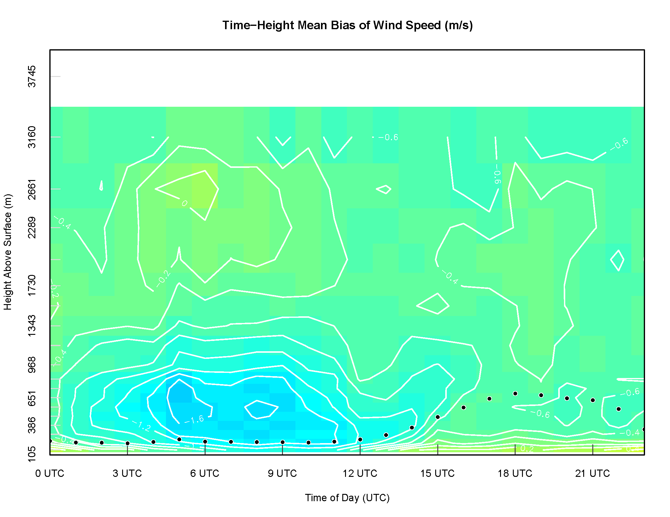
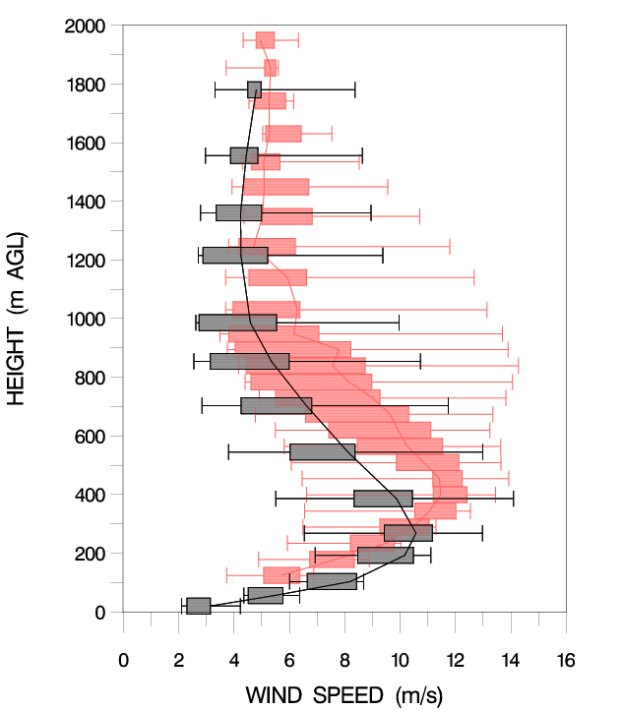
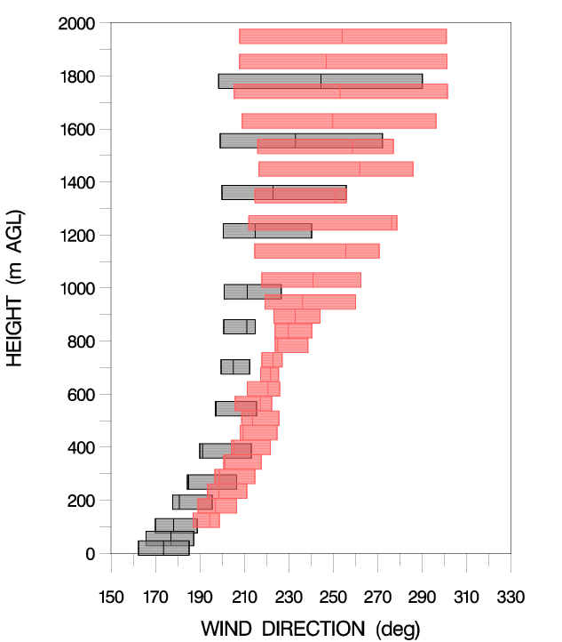
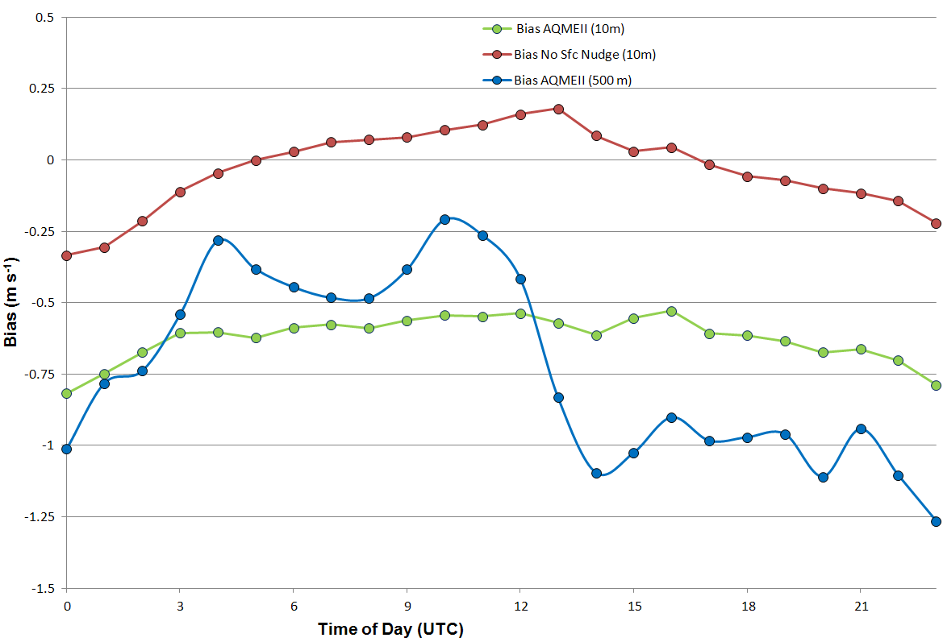
Current Transport Issues in WRF
Godowitch et al. (2011)
Recent evaluations of modeled winds in the lower troposphere (<1000 m), have clearly shown biases in wind, which is likely injecting considerable uncertainty in CMAQ’s transport.
Godowitch et al. (2011)

Slide 4
Can we improve these modeling problem by altering our current nudging techniques?
Can new or unused observations improve WRF if used in our FDDA?

Slide 5




3-D ANALYSIS NUDGING
Obsgrid: 12 km NAM Analysis (3-hourly) + twice daily RAOB, vars --U, V, T, Q
SURFACE ANALYSIS NUDGING
Obsgrid: 12 km NAM Analysis (3-hourly) + 10 m wind obs (U_{10m},V_{10m})
PBL Height
10 m wind
P-X Soil Nudging
Obsgrid: 12 km NAM Analysis (3-hourly) + T_{2m} + Q_{2m}
- adjustment of soil moisture and temperature

Slide 6
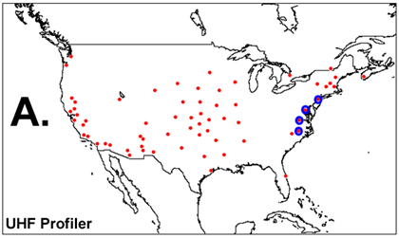
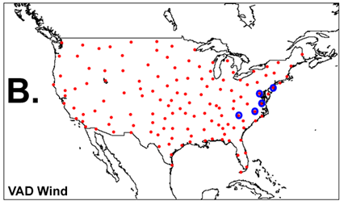
Unused wind profiler observation are available that could improve FDDA
UHF Profiler
Pros: high vertical (10’s of m) and temporal resolution (sub-hourly), good coverage in the more critical air sheds
Cons: inconsistent spacing
Velocity Azimuth Display (VAD)
Pros: Consistent and full US spatial coverage, sub-hourly and easily accessible
Cons: Coarse vertical resolution, can be influenced by birds and precip

Slide 7
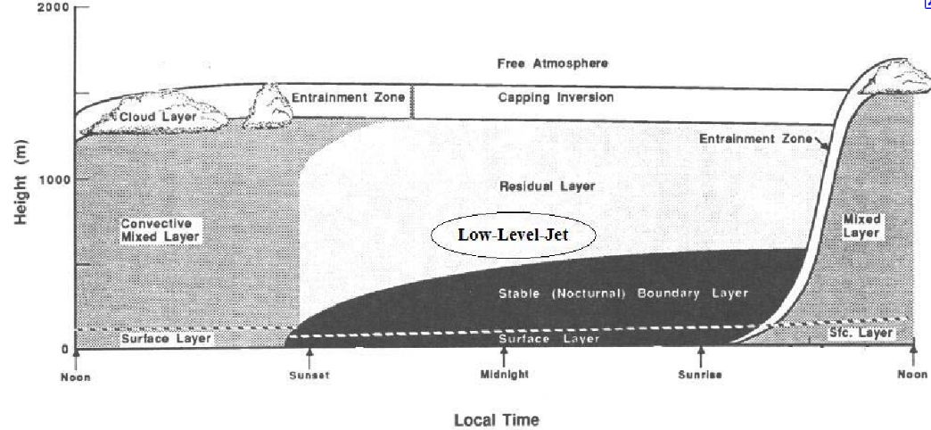
Sensitivity Comparisons
WRF Version 3.3,12 km CONUS, 34 levels, standard US EPA model physics
4 day case, Aug 11-14, 2002
Six sensitivity model simulations
East US high ozone case examined by Godowitch et al. (2011)
**From Stull (1988)
Main metric is CHANGE in layer-average error

Slide 8
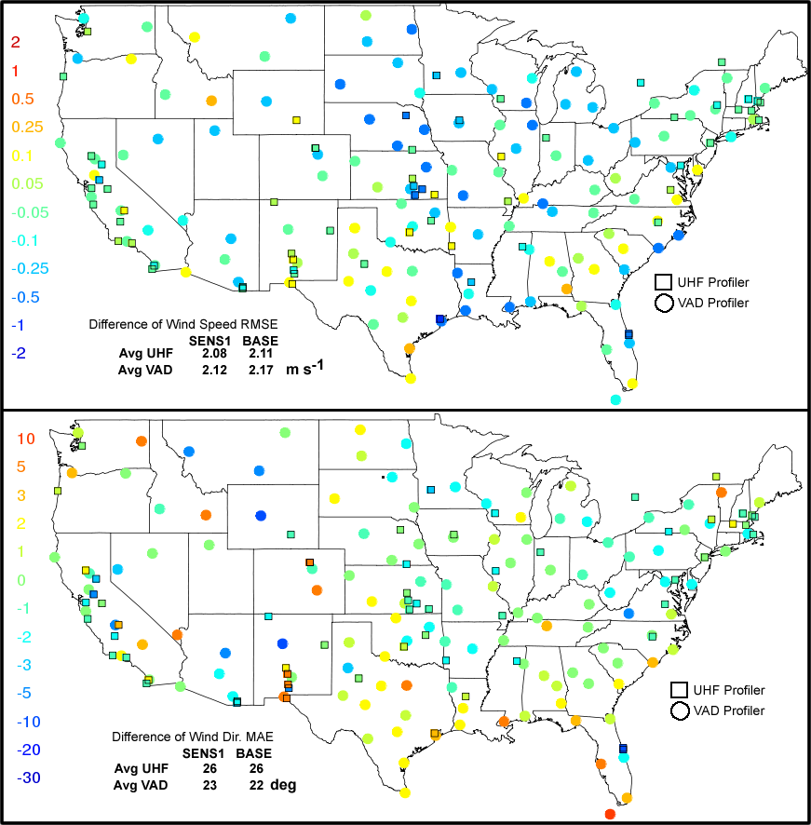
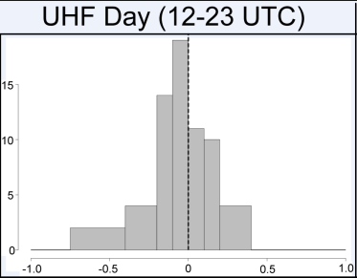
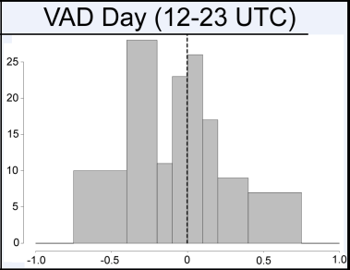
SENS1 vs. BASE
Impact of Surface Analysis Nudging
Frequency distribution of wind speed error difference at sites in spatial plots to the left

Slide 9
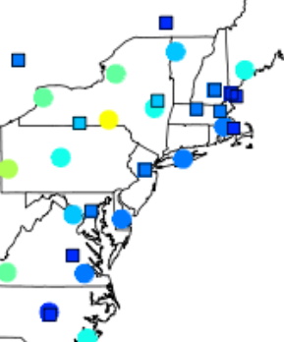
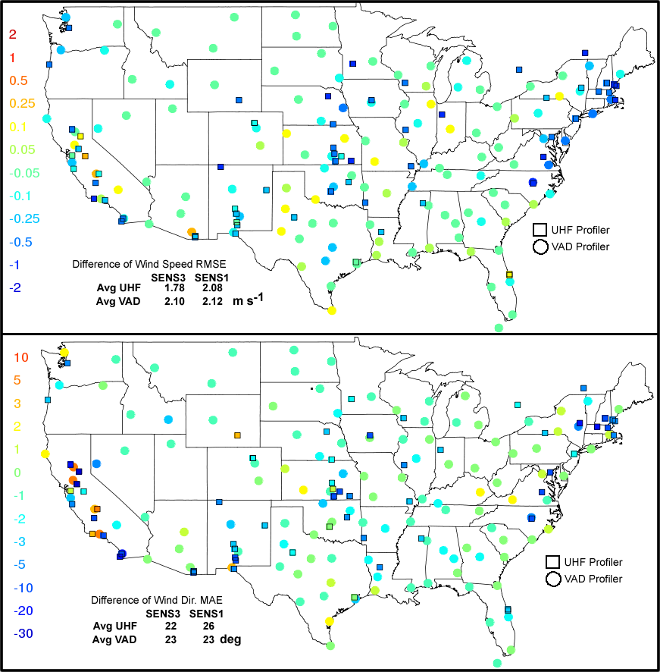
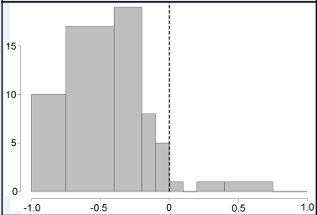

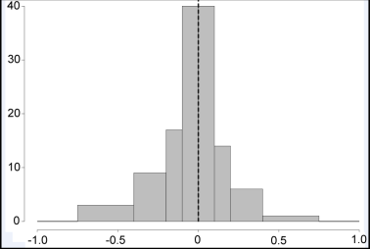
SENS3 vs. SENS1
Impact of UHF Nudging

Slide 10
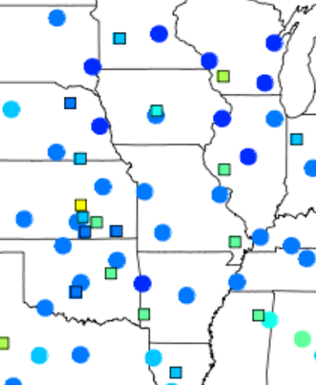
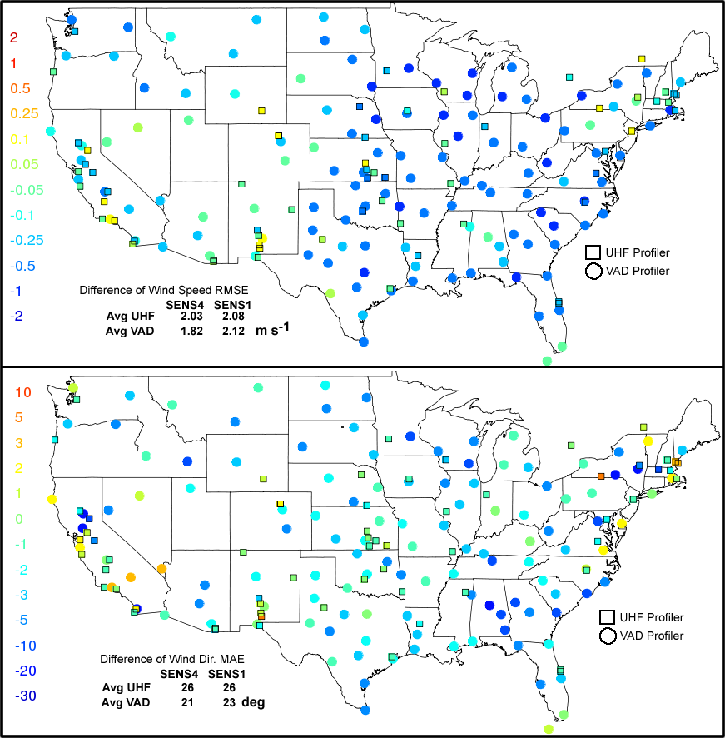
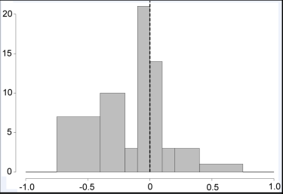
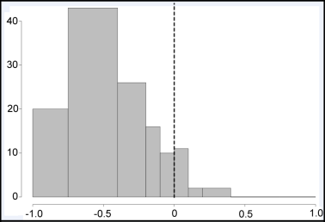
SENS4 vs. SENS1
Impact of VAD Nudging

Slide 11
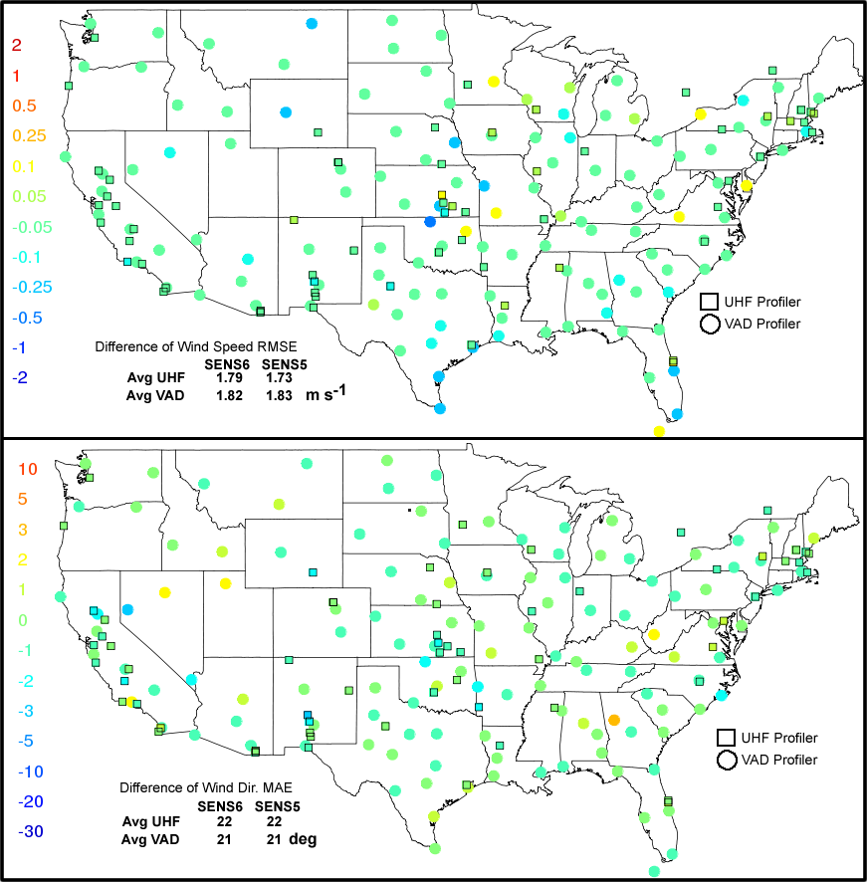
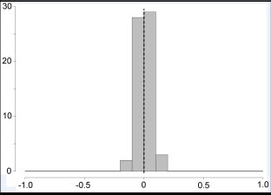
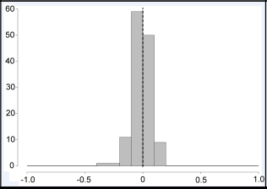
SENS6 vs. SENS5
Impact of RAOB, UHF & VAD Nudging

Slide 12
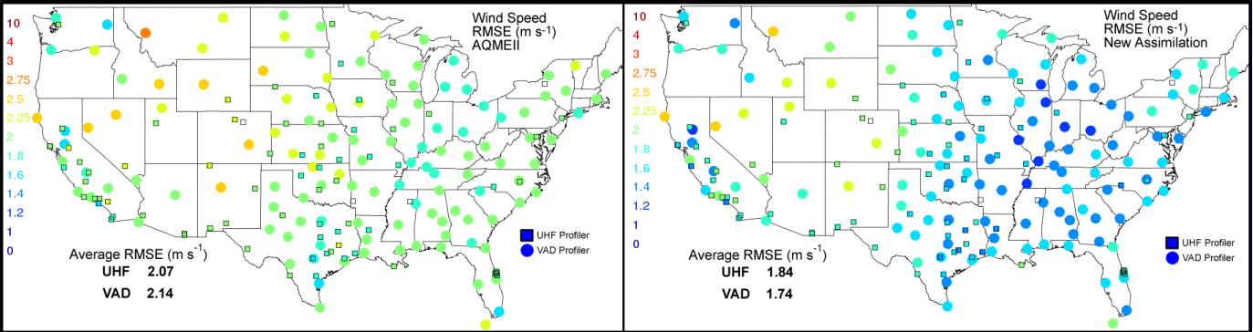
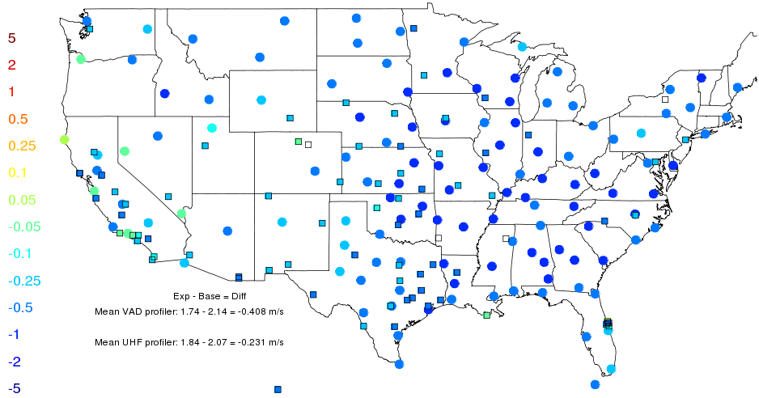
Jun-Aug 2006
Wind Speed RMSE (300-1000 m)
Error difference (NewAssim-AQMEII) (300-1000 m)

Slide 13
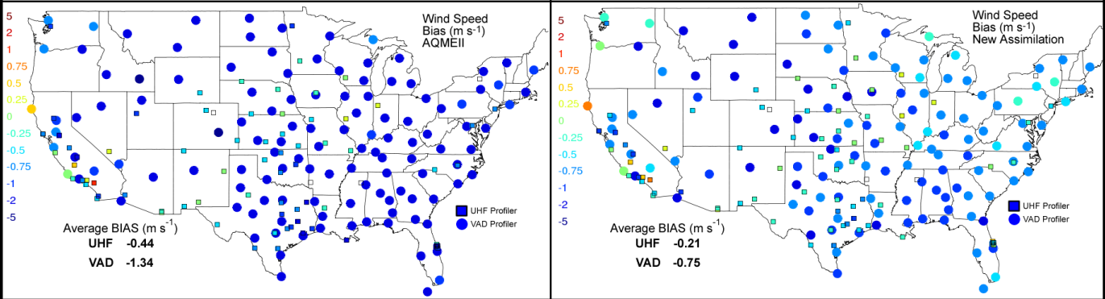
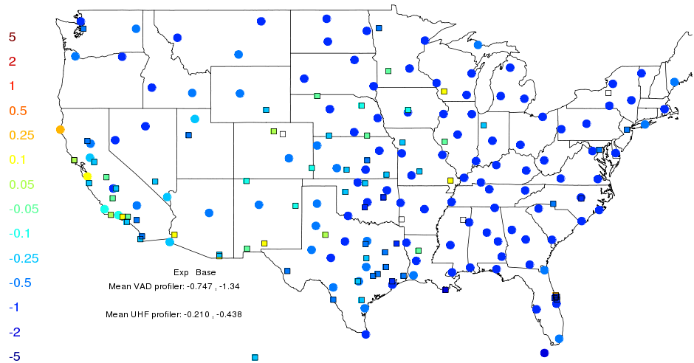
Jun-Aug 2006
Wind Speed Bias (300-1000 m)
Change in Bias (300-1000 m)

Slide 14
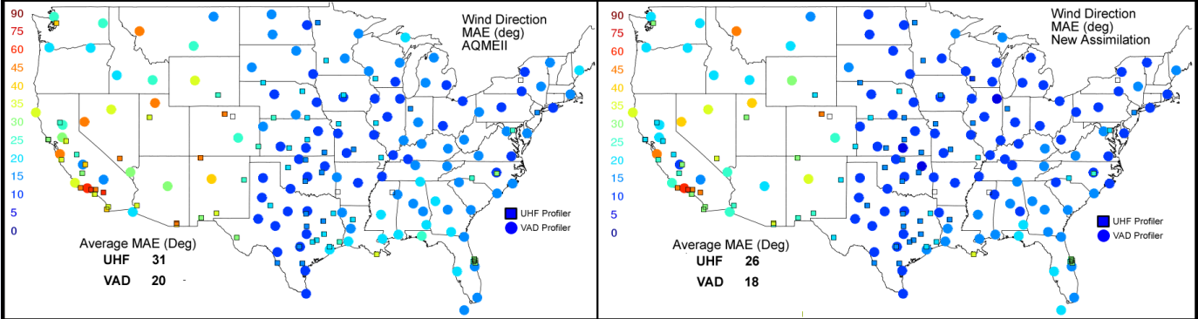
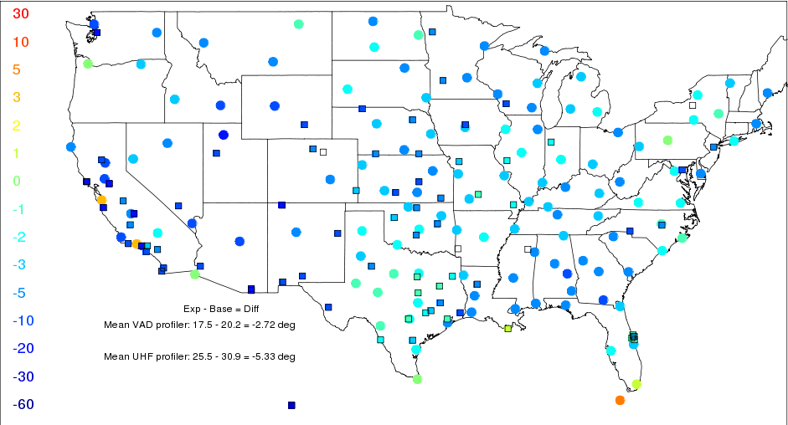
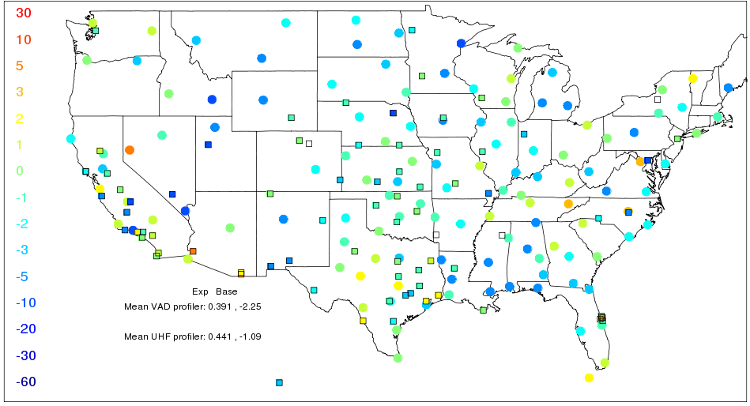
Jun-Aug 2006
Wind Dir. MAE (300-1000 m)
NewAssim-AQMEII MAE (300-1000 m)
Change in WD bias (300-1000 m)

Slide 15
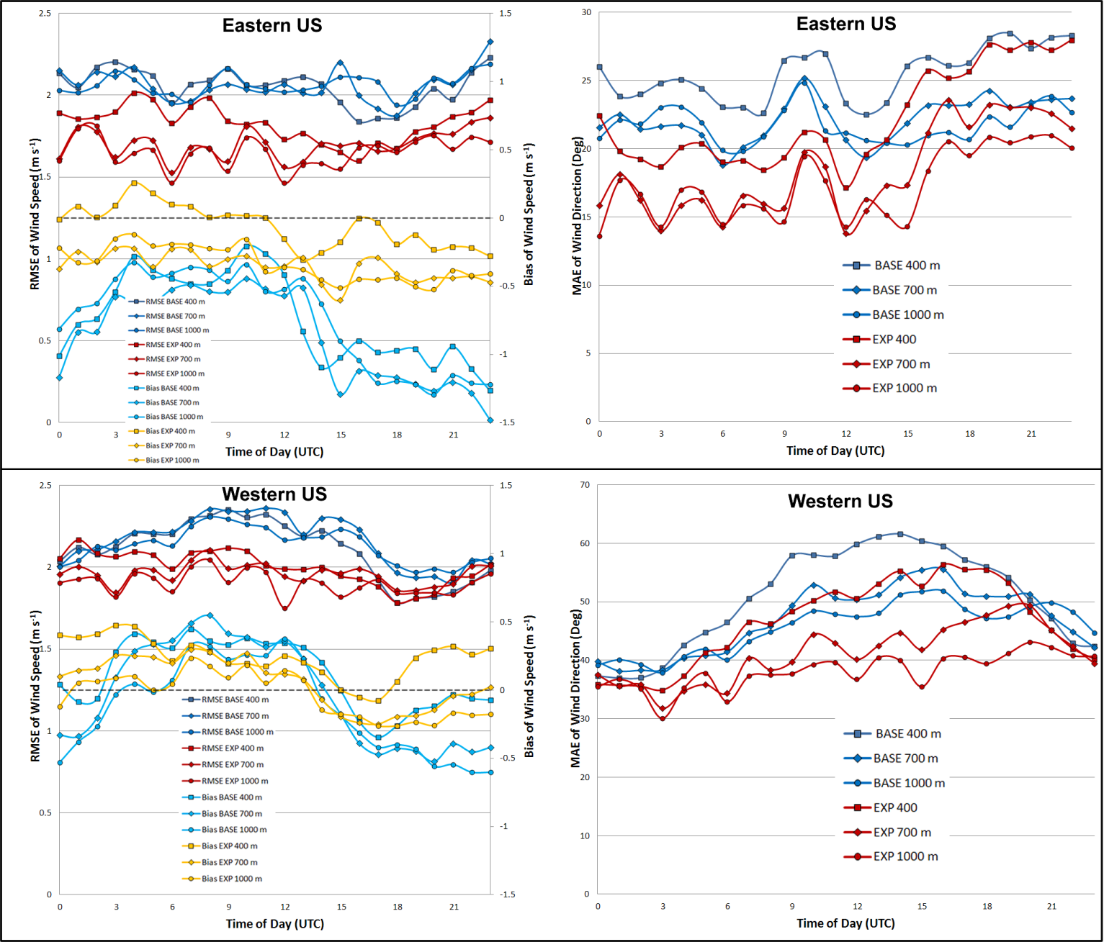
Jun-Aug 2006
Diurnal Statistics
RMSE Wind Speed
BASE NewAssim
Bias Wind Speed
BASE NewAssim
RMSE Wind Speed
Bias Wind Speed

Slide 16
Conclusions
Assimilation of UHF and VAD winds above the PBL were independently shown to improve model representation of the nocturnal jet and residual layer.
Convective boundary layer winds were improved by eliminating all PBL nudging and refining the geostropic forcing at the top of the PBL using UHF and VAD observations; a top down approach.
No PBL nudging will allow PBL models to interact with the land-surface model freely without the artificial nudging.

Slide 17
Future Work
Investigate other sources of wind and temperature profiles
- Aircraft wind, temperature and moisture profiles
- Satellite wind
- Satellite sounding and radiance data
- mesoscale analyses
Show that improvements translate to better air quality model results
Independent verification of our approach from other groups is necessary. Feel free to contact me for detail on data preprocessing.

Slide 18
Supplementary Slides

Slide 19
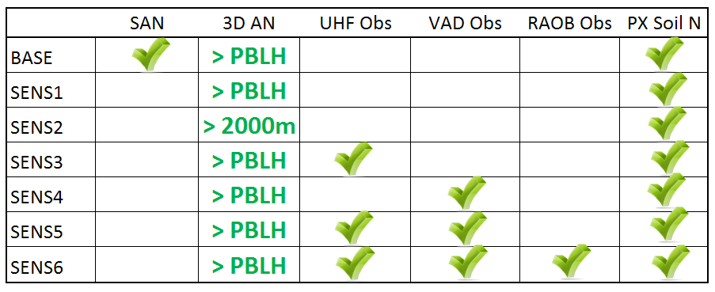
Nudging Sensitivities
4 day case, Aug 11-14, 2002
East US high ozone case examined by Godowitch et al. (2011)
SAN
Surface analysis nudging
3D AN
3D Analysis Nudging

Slide 20
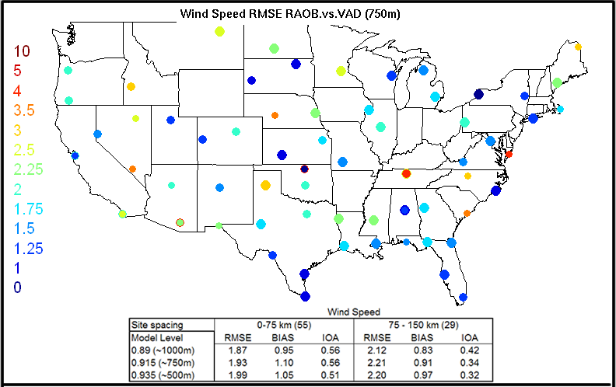
Observational Uncertainty
Observations from RAOB and VAD sites that were in close proximity (39 are collocated) paired in time at the ~500, 750 and 1000 m levels
RMSE, Bias and Index of agreement (IOA) were computed to provide a level of inherent observation uncertainty

Slide 21
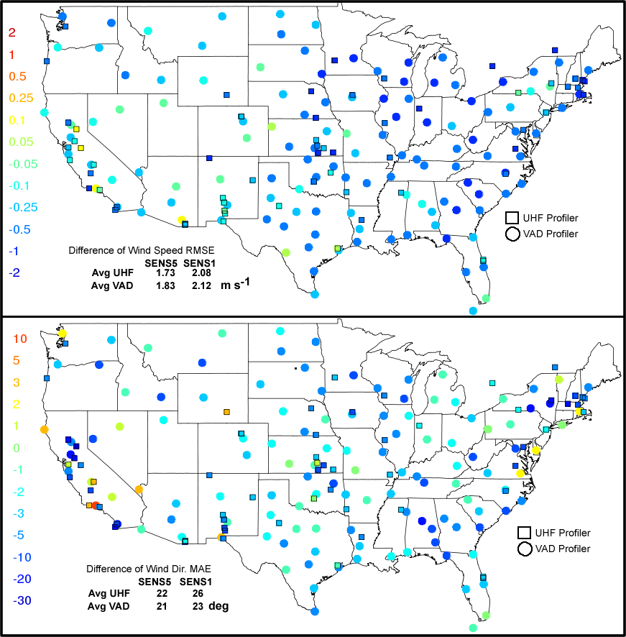
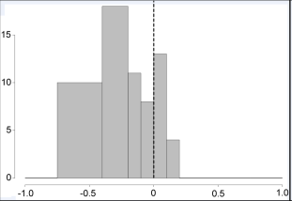
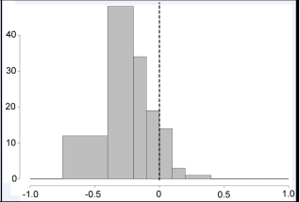
SENS5 vs. SENS1
Impact of UHF & VAD Nudging

