Slide 1
EPA’s 2007 and 2008 v5 Emissions Modeling Platforms
Alison Eyth, Rich Mason, Alexis Zubrow
U.S. EPA
Emissions Inventory and Analysis Group
Office of Air Quality
Planning and Standards eyth.alison@epa.gov
October 25, 2011

Slide 2
Emissions Modeling Platform
Definition: The data and processing methods used to produce emissions inputs to air quality models
EPA has worked to improve both data and methods for the v5 emissions modeling platform
2008 NEI is the basis of the v5 platform
  Version 1.5 is currently available on CHIEF
  (email me if you find issues with it)
  Version 2 is coming in early 2012 and will include improved: HAPs, lat-lon locations, more control device information, and other updates from states
Both 2007 and 2008 platforms are needed
  Stationary nonEGUs + nonpoint shared across both

Slide 3
Base Year Emissions: Major Sectors & Projected Milestones
 | Starting point | Mature platform
EGUs | NEI2008v1.5 + improved CEMS matching | NEI2008v2 with possible RPO data incorporated
Non-EGU point and nonpoint | NEI2008v1.5 + location corrections, EPA evolutionary updates | NEI2008v2 with possible RPO data incorporated
Oil and gas | NEI2008v1.5 | NEI2008v2 plus WRAP Phase III 2006 estimates for some states
Onroad | State/month-based MOVES with national defaults | SMOKE MOVES using representative counties
Nonroad | NEI2008v1.5 | NEI2008v2 with possible RPO data
Fires | NEI2008v1.6 | New “typical” / average fires and updated agricultural fires
Notes:
major elements only. See Excel workbook “2007_2008_platform_summary_##aug11.xlsx for more details

Slide 4
2008 NEI v1.5 Aircraft, Locomotives and CMV
Airports
  All known airports (~20K) included as point sources -many are small general aviation sources
  Includes ground support equipment and APUs
Rail
  Worked with the Eastern Regional Technical Advisory Counsel (ERTAC) and rail trade organizations to improve emissions estimates
  2008 EPA/ERTAC estimates are allocated to shape files representing track miles and associated with counties
  Rail yards added in 2008 as point sources
Commercial Marine Vehicles
  Now allocated to line shapes for underway emissions, polygons for port emissions, and off shore polygons for areas beyond the state waters
Notes:
airports: effort was to acct 4 Pb emissions

Slide 5
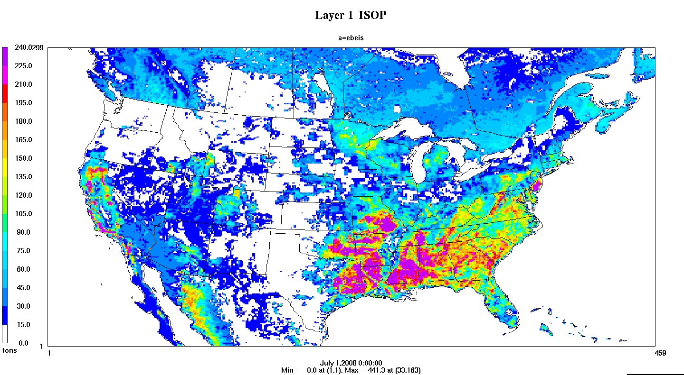
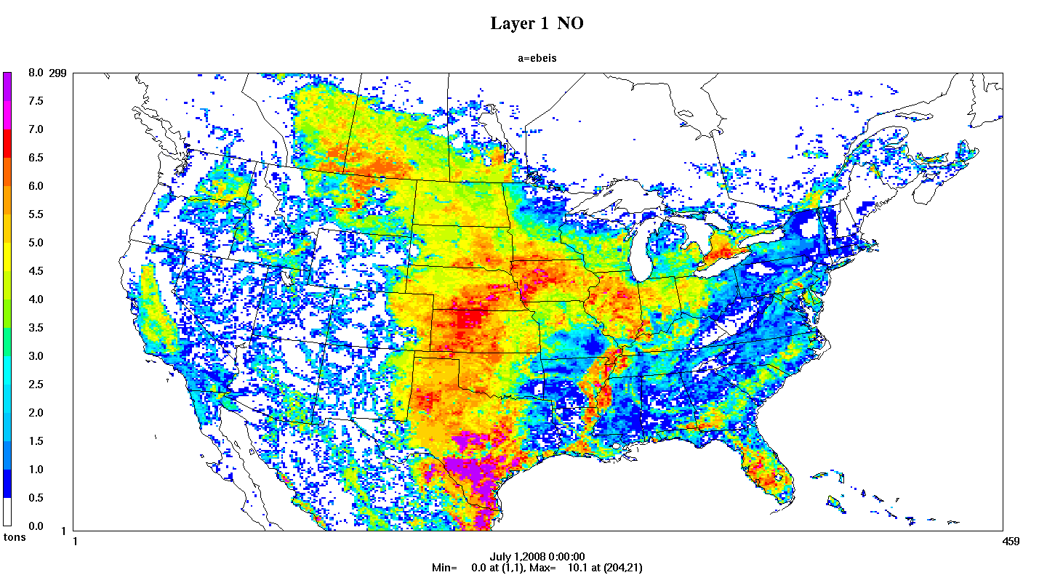
Non-NEI Components
Biogenics: BEIS 3.14
Isoprene and NO shown for July 2008
International Inventories
Canada: 2006
Mexico: new projected
2008 from 1999

Slide 6
Onroad emissions
Recent regulatory projects prior to April, 2011 used MOVES runs with national defaults + state level meteorology by month
  Allocated to counties based on NMIM emissions
SMOKE-MOVES developed in 2010-2011
  Uses MOVES in a more detailed way than before
  Estimates emissions for both on-network and off-network processes
  Uses gridded hourly temperatures to compute emissions
  Representative counties mean you don’t have to run MOVES for every single county
  Used for its first regulatory project in summer 2011
  Will be used for the 2007/2008 platform

Slide 7
SMOKE-MOVES Integration Tools
Driver Script
Meteorological
Preprocessor
(Met4Moves)
MOVES
Post-processing
Script for
Emission Factors
SMOKE
AQ model-ready files

Slide 8
Oil and Gas Updates
4 states make up 97% of the reported 2008 VOC emissions for oil & gas – TX, OK, WY, CO (most is in the nonpoint inventory)
TX & OK have highest NO_{X} -approx 85% of national
Incorporating information from WRAP Phase III
  2006 base year; 2009 projections coming soon
  Basin-specific temporal and spatial allocation, speciation
Barnett Shale (NE TX) Phase II year 2009 via TCEQ ongoing:
  http://www.tceq.texas.gov/airquality/point‐source‐ei/psei.html#barnett
Marcellus Shale inventories in NE not available
 | NO_{X} | PM_{2.5} | SO₂ | VOC
2005 Platform | 487,745 | 6,410 | 62,042 | 1,035,796
2008 NEI v1.5 | 408,298 | 7,043 | 61,714 | 1,758,024
% Change | -16% | 10% | -1% | 70%

Slide 9
Temporal allocation of Animal NH3 and Residential Wood Combustion
Developed meteorology-based temporal allocation methods for residential wood combustion and ammonia from animal husbandry
New SMOKE preprocessor (GenTPRO) creates temporal allocation factors by month, day, and/or hour
GenTPRO also generates a temporal cross-reference file

Slide 10
GenTPRO
RWC: uses regression equation relating ambient PM_{2.5} and temperatures to create day-of-year temporal profiles
NH3 (CAFO): uses Russell and Cass equation to compute hourly temporal profiles from temperature and wind speed
MET: uses user-selected meteorology variable to create hour of year temporal profiles
RWC: weekly profile

Slide 11
Fires
Point fires
  2005 through 2008 developed with SMARTFIRE 1.0
    wildfires, prescribed burns, rangeland, unclassified
  Agricultural (cropland) fires in NEI v2.0
  Developing 2009 and 2010 with SMARTFIRE 2.0
Developed a fire averaging tool (FAT)
  Processes point daily fires to produce emissions at daily/county resolution
  Purpose is for regulatory runs for base and future year
  Leverages point daily fires, user can pick range of years
  Uses rolling average – user picks the averaging period
  (e.g. 2 weeks)

Slide 12
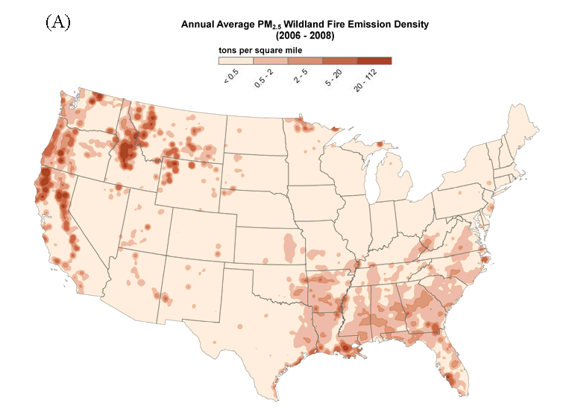
2006-2008 Average Fires

Slide 13
Area Fugitive Dust
Includes paved and unpaved road dust, agricultural tilling, construction, etc.
New adjustments developed by George Pouliot as follows
Transport fraction
  Reduces PM based on landuse via BELD3
Meteorological adjustment
  Snow and rain suppresses PM emissions
  When there is snow on the ground or top 1cm layer of Soil is at least 50 % saturated, sets dust emissions to zero
  Leave Emissions Unchanged Otherwise

Slide 14
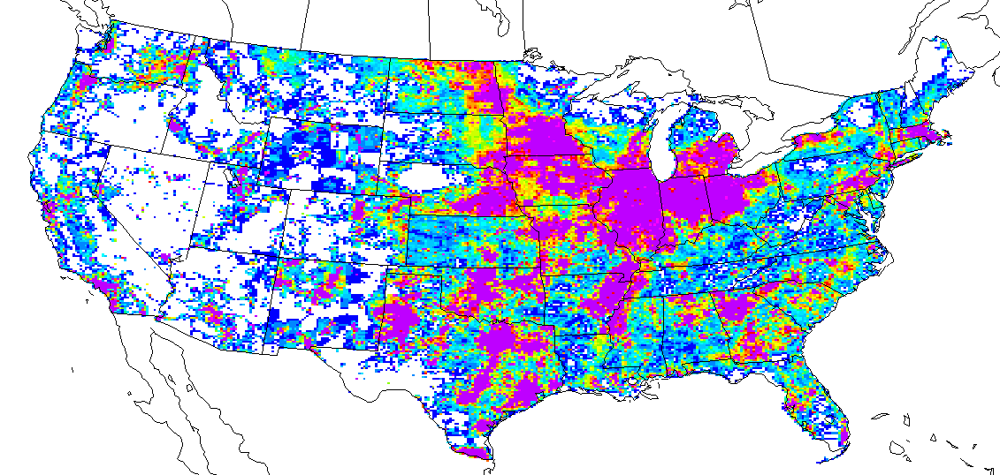
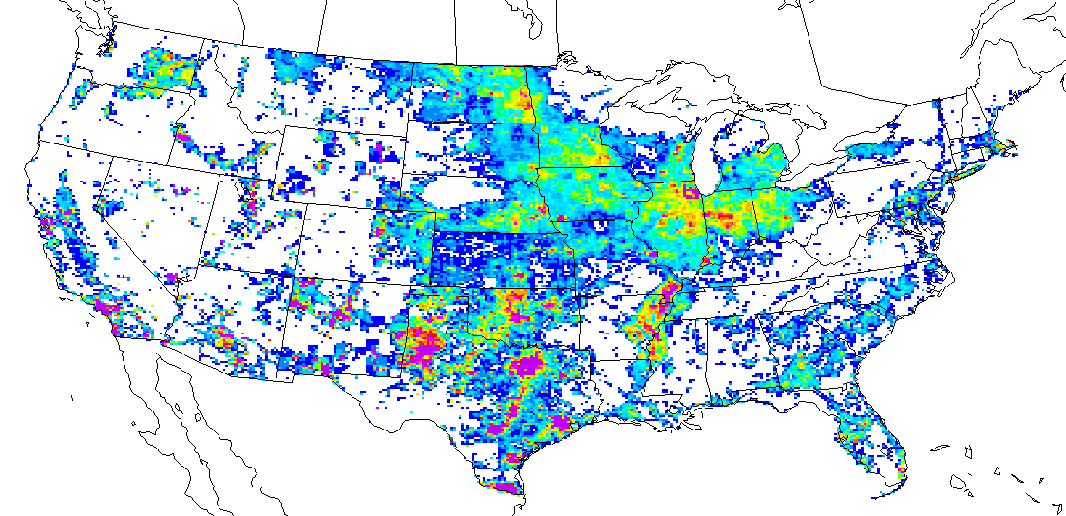
Impact of Fugitive Dust Adjustments in May, 2008

Slide 15
Spatial Surrogate Improvements
Spatial surrogates are used to allocate nonpoint and mobile sources to grid cells
Census data-based surrogates are being updated with 2010 census data
Surrogates based on FEMA HAZUS data (e.g., Industrial Land, Commercial + Industrial) being updated with Circa 2010 data
NTAD 2011 data to be used for transportation surrogates
Other updates are being considered
  Agriculture, TIGER-Line data (e.g. roads), etc.

Slide 16
CMAQ 5.0 support
A new version of the Speciation Tool uses the new SPECIATE 4.3 and can create profiles for CMAQ 5.0
  Produces both the older AE5 PM species and the more detailed AE6 PM species
  (e.g. Al, Mg, etc.)
  Public release may be developed
Future work in support of CMAQ 5.0
  Soil NH₃ flux
  Lightning NO_{X}

Slide 17
Next Steps and Platform Uses
Continue to build 2007/2008 base year inventories
Perform sector-specific “shake-out” analyses
Review RPO emissions
Begin construction of future base case
  Oil & Gas projections is a key area of interest
2007 platform to be used for regulatory applications in 2012
2008 platform to be used for 2008 NATA
Release SMOKE v3.1, including:
  GenTPRO plus new temporal profile processing
  Flat File 2010 (FF10) support (output from EIS)
  FF10 for monthly, hourly, and daily emissions

Slide 18
Acknowledgments of Platform Contributors
NEI Team: 2008 NEI
UNC-IE: SMOKE-MOVES, GenTPRO, surrogates, assessment of RPO data
CSC: Ancillary files and platform testing
Environ: SMOKE-MOVES, Fire Averaging Tool, Speciation Tool, updated oil and gas emissions
WRAP: funding agency for updated oil and gas emissions
ERG: Mexico projections

