Slide 1
Weekly cycles of observed and modeled NO_{x} and O₃ concentrations as a function of land use type and ozone production sensitivity
CMAS meeting
Chapel Hill, North Carolina
Yunsoo Choi^{1,2}, Hyuncheol Kim^{1,2}, Daniel Tong^{1,2}, Pius Lee¹, Rick Saylor³, Ariel Stein^{1,2}, Fantine Ngan⁴, Yunhee Kim^{1,2}, Jeff McQueen⁵,
Ivanka Stajner⁶
¹NOAA/ARL, ²ERT, ³NOAA/ARL/ATDD, ⁴UCAR, ⁵NOAA/NWS/NCEP, ⁶NOAA/NWS/OST
October 26, 2011

Slide 2
Introduction
Most of weekly cycles of surface O₃ are investigated in an urban areas (e.g., Southern California, Los Angeles, Atlanta, NYC, Chicago, Dallas, Houston, Phoenix, and Baltimore from Lebron, 1967; Cleveland et al., 1974; Elkus and Wilson, 1977; Vukovich, 2000; Marr and Harley, 2002; Fujita et al., 2003; Qin et al., 2004; Blanchard and Tanenbaum, 2006; Shutters and Balling Jr., 2006; Blanchard et al., 2008; Yarwood et al., 2008)
Theses studies highlighted weekend effect over urban areas where higher ground-level O₃ concentrations occur during weekends rather than weekdays.

Slide 3
Introduction
Beirle et al. (2003) and Kaynak et al. (2009) examined weekly cycle of NO₂ column density using the retrieval products from the GOME and SCIAMACHY and showed temporal variations of weekly NO_{x} column density.
They highlighted high weekly NO_{x} and low weekend NO_{x} emissions in urban areas (Beirle et al., 2003) and seven urban sites (Kaynak et al., 2009), although no such difference is found in their rural sites (Kaynak et al., 2009).

Slide 4
Introduction
In addition to characterizing weekly cycles of NO_{x} emissions, determining chemical environment, which is possibly derived from the ratio of VOCs to NO_{x} emissions, is crucial to understand about photochemical production (Sillman et al. 1990).
Martin et al. (2004) and Duncan et al. (2010) showed a feasibility to use the ratio of satellite HCHO to NO₂ column density from GOME and OMI as a proxy for chemical environment (e.g., NO_{x} saturated or NO_{x} sensitive regime).

Slide 5
Motivation
U.S. can be divided into geographical regions (e.g., urban, forecast, and others) or chemical regimes (e.g., NO_{x}-saturated, mixed, NO_{x}-sensitive regime).
See how satellite-derived geographical region or chemical regime stations capture weekly cycles of ground-level NO_{x} and O₃.
Chemical regime stations can be derived from both satellite and model.
See the difference of weekly cycles of NO_{x} and O₃ at EPA AQS stations over between satellite-derived and model-derived chemical regimes.

Slide 6
AVHRR USGS geographical regions
Geographical land use designations (e.g., urban, forest, and other region) are derived from the Advanced Very High Resolution Radiometer (AVHRR) global land cover characteristic data using http://edc2.usgs.gov/glcc/globdoc2_0.php)

Slide 7
GOME-2 and CMAQ chemical regimes
O₃ sensitivity regimes (NO_{x}-saturated, mixed, and NO_{x}-sensitive) are from low to high values of photochemical indicators based on ratio of HCHO to NO₂ columns from GOME-2 and CMAQ. The black, green, and red colors represent NO_{x}-saturated, mixed, and NO_{x}-sensitive regime.

Slide 8
Model description
Version and time period: CMAQ 4.7.1 and August 2009
Horizontal and vertical resolution: 12km with 22 vertical layers to 100 hPa
Meteorology data: from WRF-NMM
Emissions: based on US EPA’s NEI 2005
CB05 (gas-phase chemistry)-AQ(aqueous-phase chemistry)-AERO5(aerosol chemistry and dynamics) module
Boundary chemical condition: GEOS-CHEM simulation

Slide 9
Measurements
1. Satellite measurement
Satellite NO₂ and HCHO column density: from GOME-2 sensor on EUMETSAT MetOp-A satellite [Munro et al., 2006]
GOME-2 NO₂ and HCHO column products are from http:/www.temis.nl/airpollution
2. In-situ ground measurement
Hourly O₃ data: 1100 US EPA’s AQS stations
Hourly NO_{x} data: 265 US EPA’s AQS stations

Slide 10
Weekly O₃ cycles over chemical regimes
O₃ weekly cycles are determined by chemical environment.
NO_{x} sensitive regime:
VOC >> NO_{x}
Weekday O₃ high and weekend O₃ low
Weekday NO_{x} high and weekend NO_{x} low
NO_{x} saturated regime:
VOC << NO_{x}
Weekday O₃ low and weekend O₃ high

Slide 11
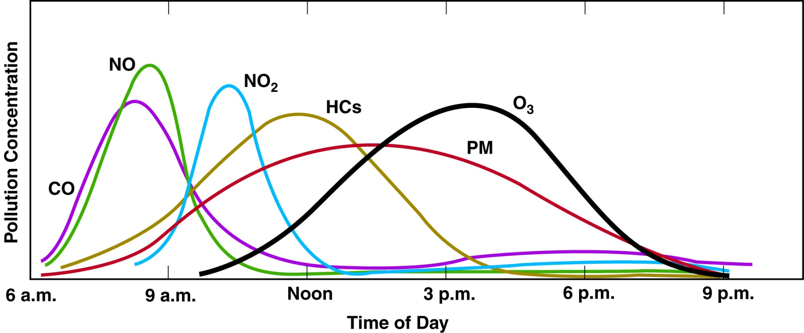
GOME-2 as chemical environment indicator
GOME-2 captures light reflected from the Earth’s surface and its local over-passing hour is 9-10 AM. Ratios of GOME-2 HCHO to NO₂ columns represent chemical environment.

Slide 12
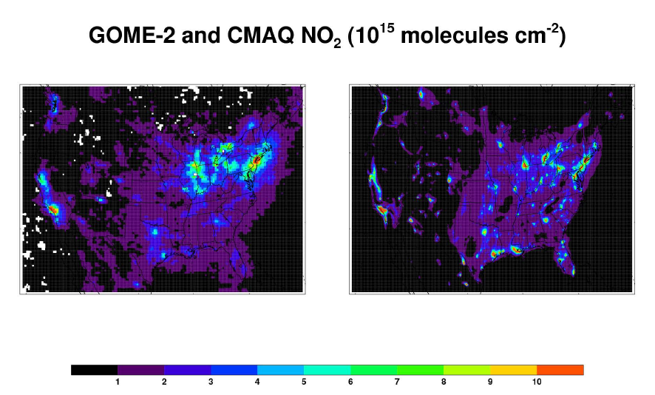
Satellite and Model NO₂ column
CMAQ generally over-predicts NO₂ columns over urban regions of the US, particularly over the southern US, but it under-predicts NO₂ columns over some other urban and rural regions.

Slide 13
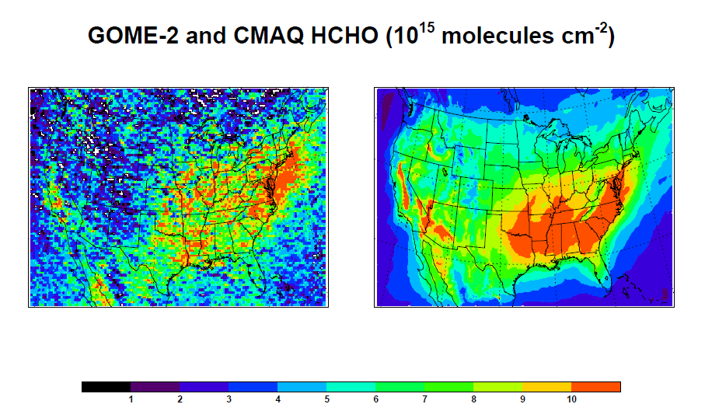
Satellite and Model HCHO column
CMAQ over-predicts HCHO column over the southeastern US, but it under-predicts HCHO column over the northeastern coastal regions.

Slide 14
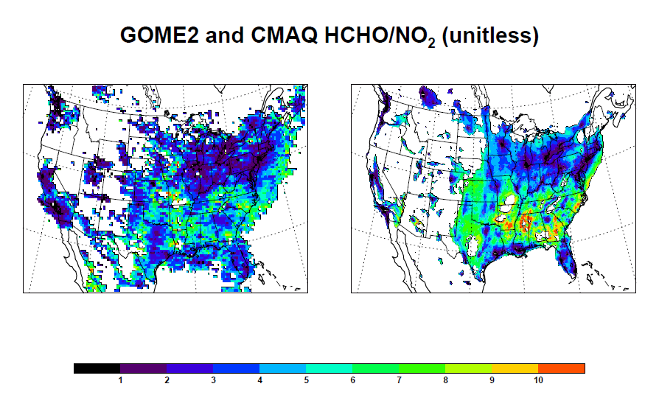
Indicator: VOC/NO_{x} ≈ GOME-2 HCHO/NO₂
GOME-2 and CMAQ ratios of HCHO/NO₂ are a proxy for Volatile Organic Compounds (VOCs)/Nitrogen Oxides (NO_{x}) concentrations, which is called as GOME-2 chemical indicator or CMAQ chemical indicator.

Slide 15
O₃ change (1-5PM) to GOME-2 HCHO/NO₂
Baseline CMAQ – CMAQ with 30% NO_{x} reduction
Baseline CMAQ - CMAQ with 30% VOC reduction
O₃ changes are proportional to NO_{x} emission changes where GOME-2 ratio is high (e.g., HCHO/NO₂ > 2 or 3), but O₃ changes are proportional to VOC emission changes where GOME-2 ratio is low (e.g., HCHO/NO₂ <1).

Slide 16
GOME-2 and CMAQ chemical regimes
Category 1: HCHO/NO₂ < 1, Black-colored, NO_{x}-saturated regime
Category 2: 1 < HCHO/NO₂ < 2, Green-colored, mixed
Category 3: HCHO/NO₂ > 2, Red-colored, NO_{x}-sensitive regime

Slide 17
Weekly NO_{x} emissions from CMAQ
High weekday emission and low weekend emission at EPA’s AQS stations over geophysical regions (left) and chemical regimes (right)

Slide 18
Weekly NO_{x} (AVHRR region & GOME-2 regime)
High weekday and low weekend NO_{x} concentrations at EPA’s AQS stations over AVHRR geophysical regions (left) and GOME-2 chemical regimes (right)

Slide 19
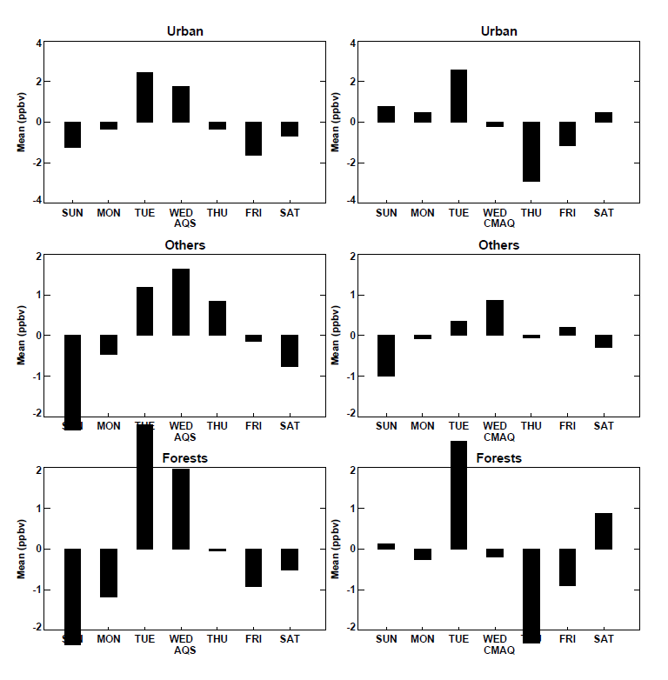
Weekly O₃ (AVHRR region & GOME-2 regime)
Weekend effect (high weekend O₃ anomaly) is seen at EPA’s AQS stations over GOME-2 NO_{x}-saturated regime (in AQS and CMAQ, right), but is not shown at stations over an urban region (in AQS and CMAQ, left).

Slide 20
Weekly O₃ (GOME-2 regime & CMAQ regime)
Weekend effect is seen at EPA’s AQS stations over GOME-2 NO_{x}-saturated regime (both in AQS and CMAQ, left), but is not shown at stations over CMAQ NO_{x}-saturated regime (in AQS, right).

Slide 21
Conclusion
Both AQS-observed weekly cycles of NO_{x} at EPA’s AQS stations over AVHRR geographical regions and GOME-2 chemical regimes consistently show high weekdays and low weekends.
Weekly cycles of surface O₃ (including weekend effect) are better shown at EPA’s AQS sites over GOME-2 chemical regimes than AVHRR geographical regions or CMAQ chemical regimes
This study suggests that chemical classification into GOME-2 chemical regime stations gives a more detailed picture for weekly O₃ cycles than CMAQ chemical or AVHRR geographical classification.

Slide 22
Thank you for your attention.
Question?

