Slide 1
Modeling spatially-dependent, non-stationary bias in GEOS-CHEM
Halil Cakir¹, Benjamin Wells¹, Pat Dolwick¹, Joseph Pinto², Lin Zhang²
¹US EPA, OAQPS, RTP, NC 27711; ²US EPA, NCEA, RTP, NC 27711; ³Harvard University, Div. of Appl. Sci. and Eng., Cambridge, MA 02138;

Slide 2
Model Evaluation
Historically model performance has been evaluated using domain wide metrics, such as the mean fractional bias, or by comparison of time series at individual monitoring sites.
Useful information can be obtained by examining spatial patterns across model domains
- spatial extent of areas of agreement or disagreement
- nature of inputs, physical/ chemical processes that could affect results
Question now is what indices would be most useful.

Slide 3
Synthetic data Set and the Index Evaluation
Indexes for Model Evaluation

Slide 4
Indexes for Model Evaluation
Coefficient of Divergence (COD) (Wongphatarakul, Friedlander, and Pinto, 1998).
Q-Index (Wang and Bovik, 2002)
Index of Agreement (IOA) (Wilmott et al. 1981, 1985, and 2011)
M (Watterson, 1996)
Index of Model Integrity

Slide 5
Indexes for Model Evaluation
Coefficient of Divergence (COD) (Wongphatarakul, Friedlander, and Pinto, 1998).
where the predicted values (P) of the model are compared with the observed values (0) measured by the monitoring network for i samples.

Slide 6
Indexes for Model Evaluation
Q-Index (Wang and Bovik, 2002)
Can be rewritten as a product of three components:
where σ_{xy} is the covariance between monitor and modeled signals (or readings). µ_{0(x)} and µ_{0(y)} are the means, and σ²_{x} and σ²_{y} the variances of the monitor and modeled signals respectively. The dynamic range of Q is [-1, 1].

Slide 7
Indexes for Model Evaluation
Index of Agreement (IOA) (Wilmott et al. 1981, 1985, and 2011)

Slide 8
Indexes for Model Evaluation
M (Watterson, 1996)

Slide 9
Indexes for Model Evaluation
Index of Model Integrity (IMI)

Slide 10
Synthetic Data Set
A synthetic data set was created to evaluate various indexes’ performance.
2006 hourly ozone readings were used to create the synthetic dataset.
First, 1 and 5 ppb were added to monitor readings to create three mock models with constant bias on temporal profile.
Second, seasonal bias (1 and 5 ppb) was added in a way to make yearly average bias zero.
Third, completely random values were added (ranging between -2 and 2; and -10 and 10) to create 2 additional synthetic models.
Finally we added multiplicative (5% and 25%) bias into monitor reading for the final synthetic set.

Slide 11
Synthetic Data Set
Actual 2006 hourly ozone readings from the CASTNET monitor ABT147

Slide 12
Synthetic Data Set
+1 and +5 ppb added to actual 2006 hourly ozone readings from the CASTNET monitor
ABT147 to create first set of synthetic model estimates. Above graph shows only the first
100 hours of readings from the monitor and the synthetic model with +5 ppb bias .

Slide 13
Synthetic Data Set
Synthetic data set with +- 5 ppb seasonal bias but 0 ppb yearly bias. Above graph shows
100 hours cross-section where negative seasonal bias changes into positive seasonal bias
halfway. Out of 4 seasons, two were with +5 ppb and the other two were with -5 ppb bias,
making yearly bias equals to zero.

Slide 14
Synthetic Data Set
Synthetic data set with 25% multiplicative bias.

Slide 15
Synthetic Data Set
Synthetic data set created by adding random values ranging between -10 and +10 ppb to
monitor readings. (Note that yearly bias (approximately) equals to zero for this data set as well).

Slide 17
GEOS-Chem evaluation
Spatial patterns

Slide 18
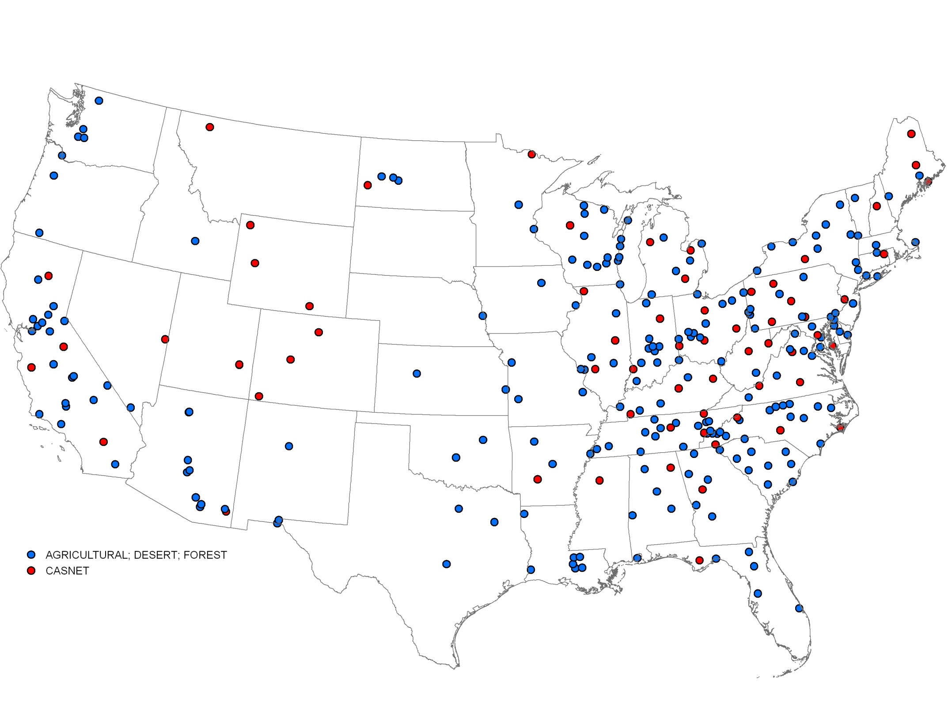

Slide 19
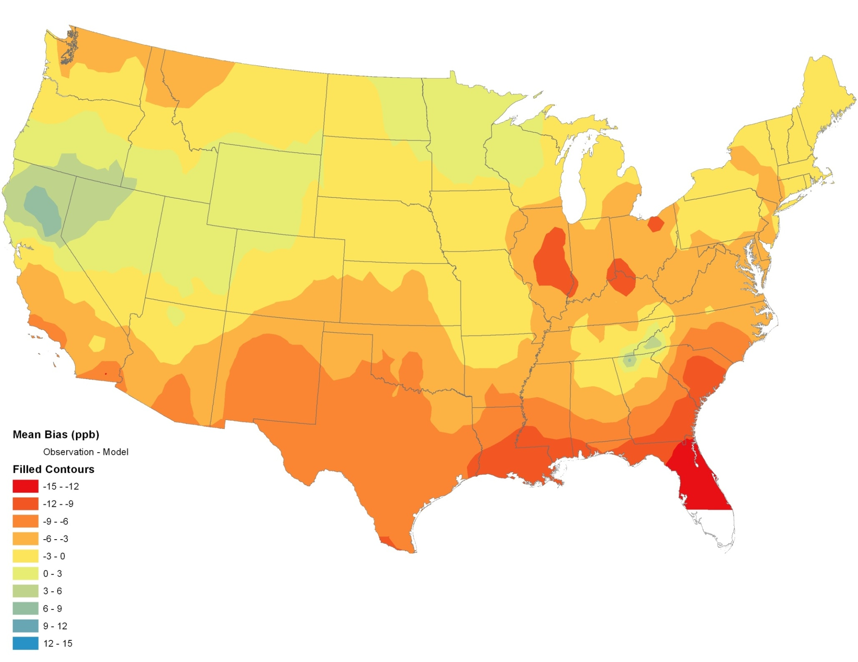
Hourly Stats
2006
Overall Mean Bias: -3.3 ppb
Overall Obs. Mean: 33.8 ppb
Overall GEOS-CHEM Mean:37.1 ppb

Slide 20
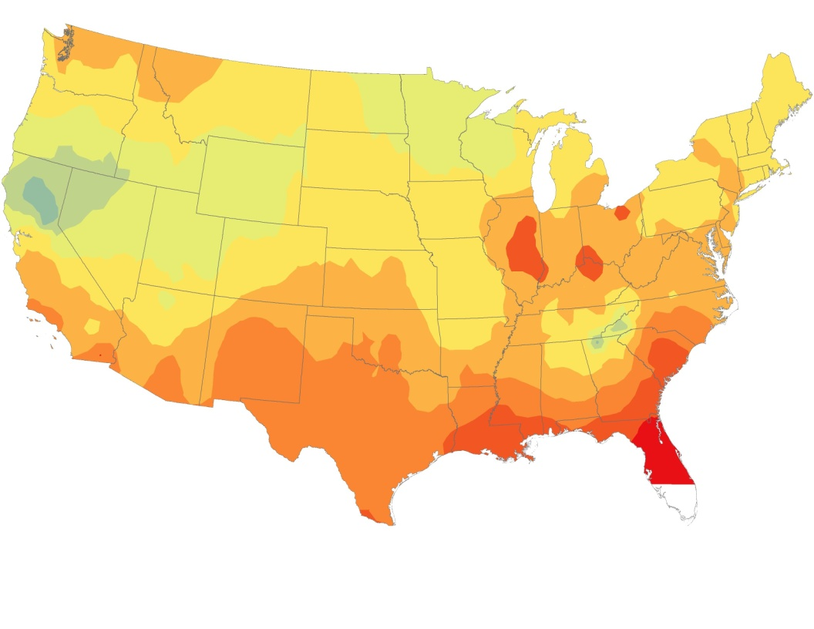
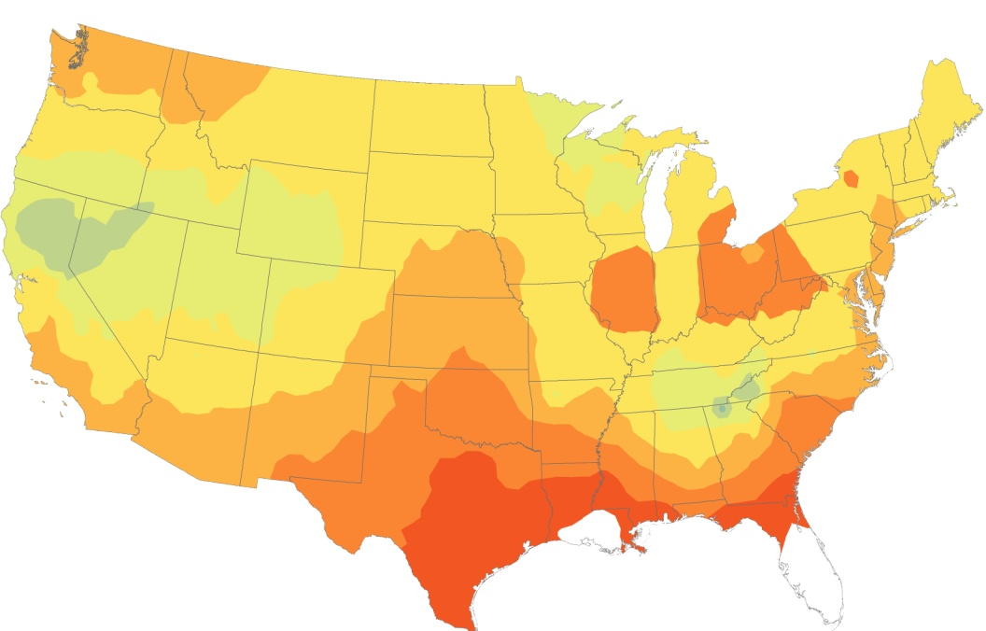
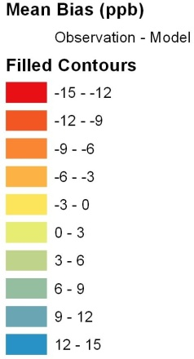
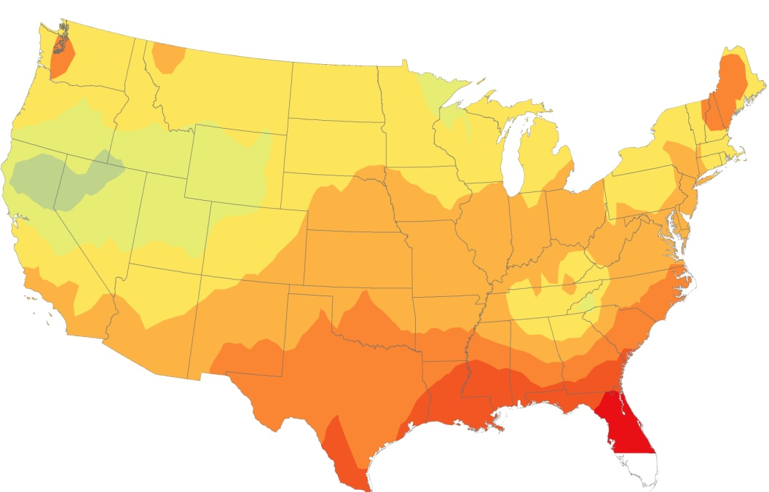
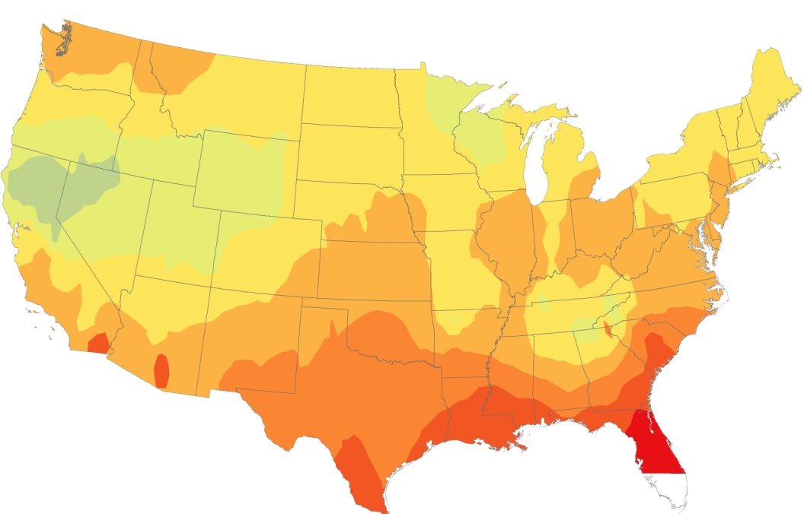
Hourly Stats
2006
2007
All Years: 2006 to 2008
2008

Slide 21
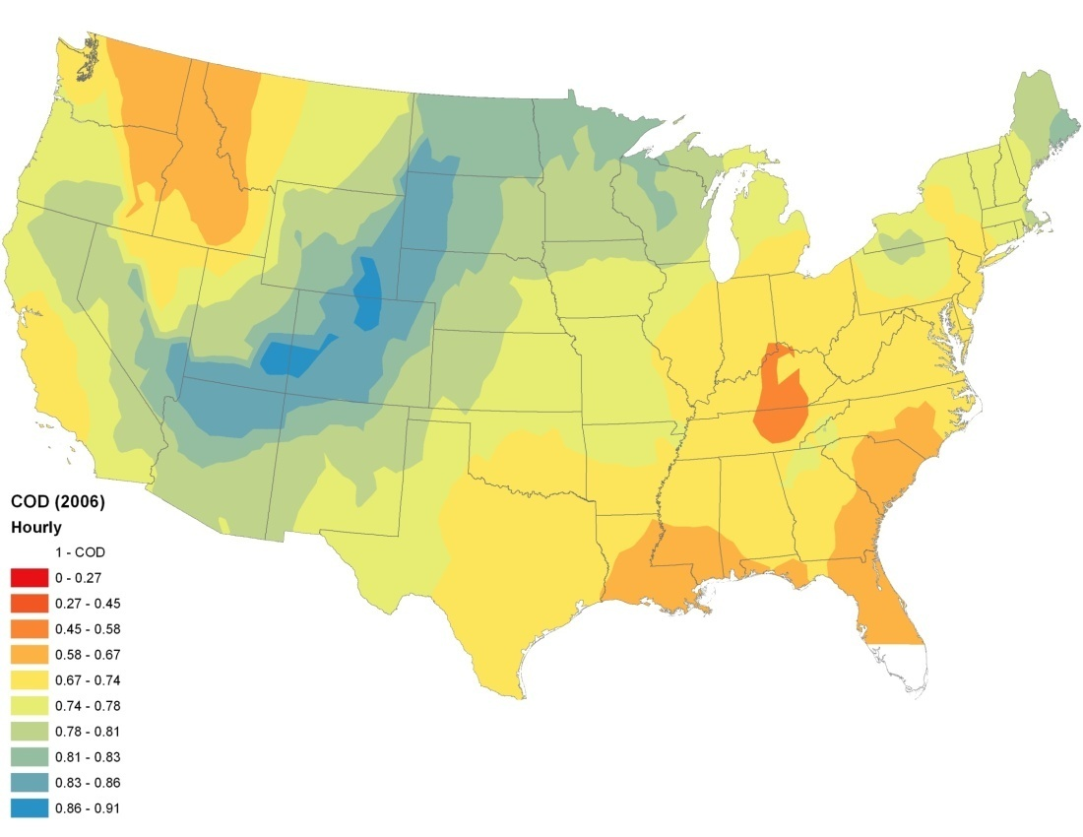
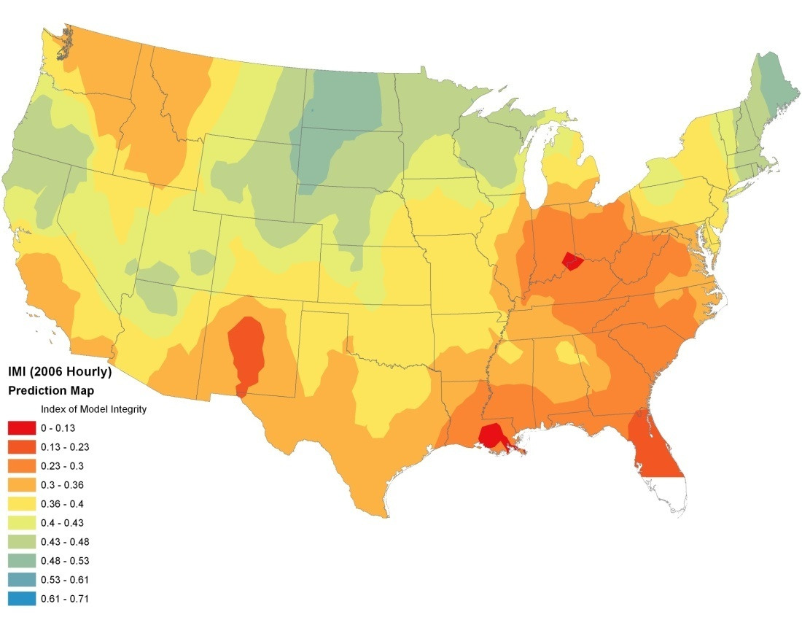
Hourly Stats

Slide 22
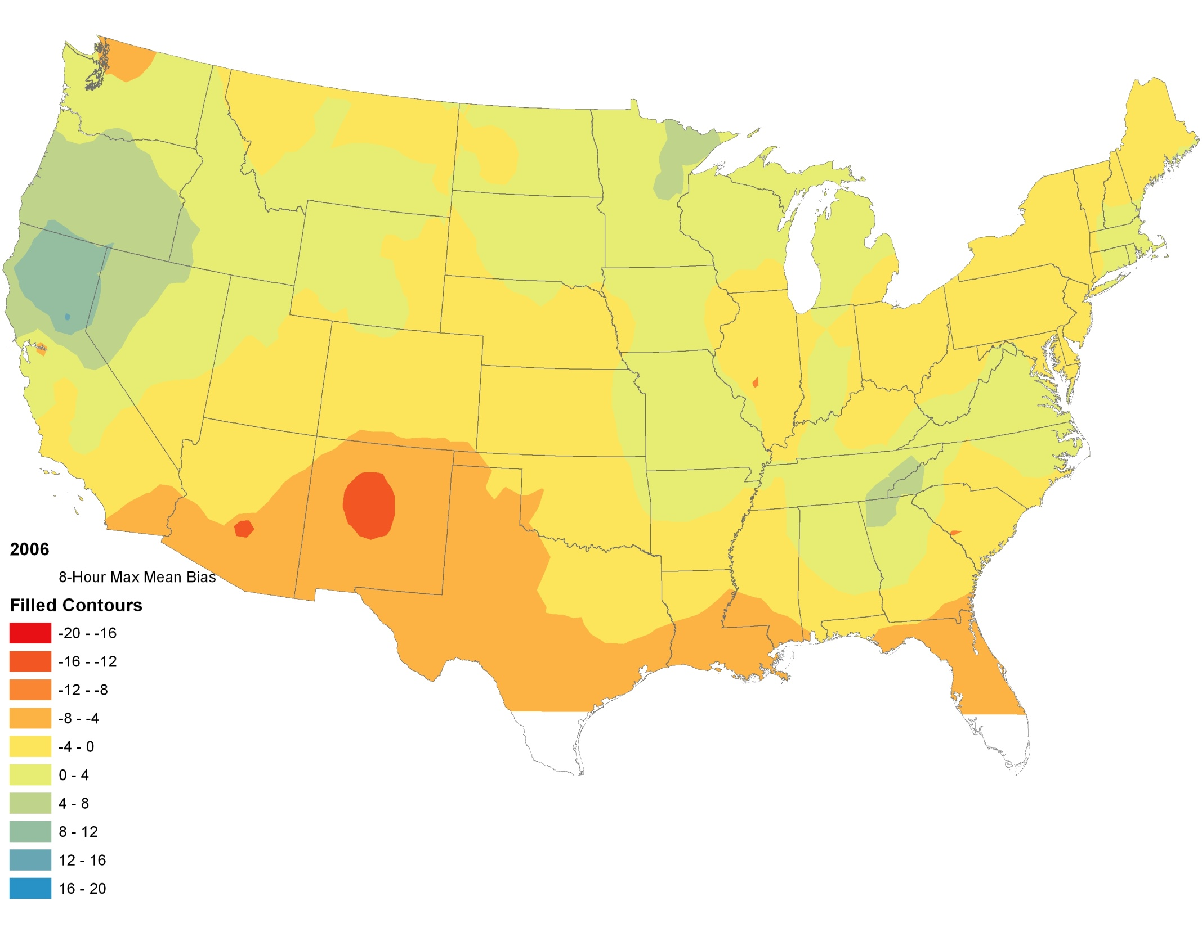
Daily 8-Hour Max. Stats

Slide 23
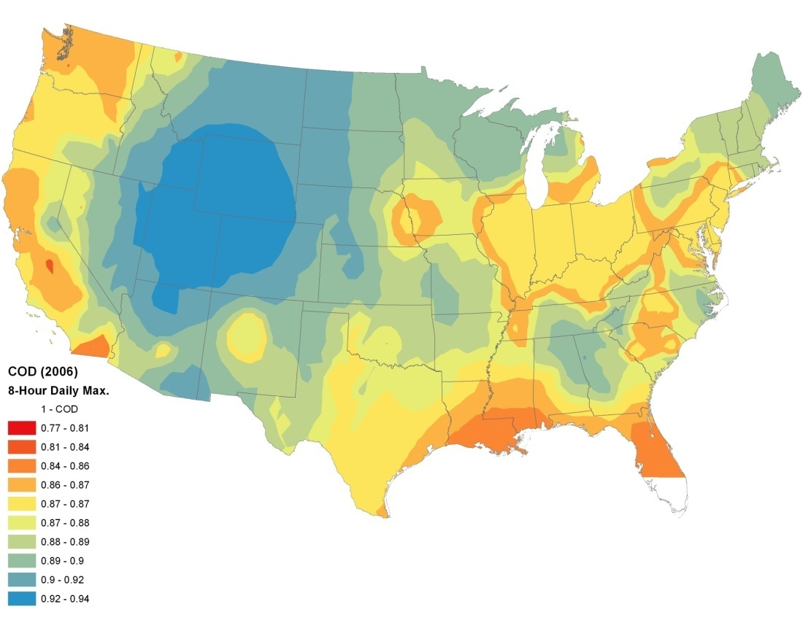
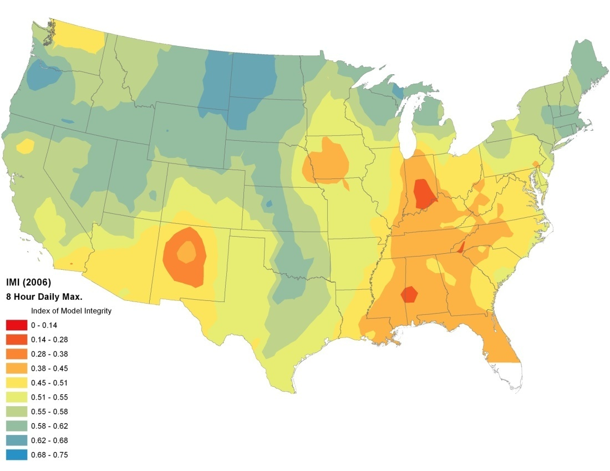
Daily 8-Hour Max. Stats

Slide 24
Summary
Large scale patterns metrics for model evaluation are found
  largest areas of disagreement are in the Southeast, the Mid- Atlantic and in the Northwest.
  analysis shows inter-annual variability in model performance.
IMI and COD appear too be most useful for providing information about model agreement and disagreement. Pearson R, Q index, and IOA not especially sensitive to changes in model performance.
Next steps will involve examining causes for large scale patterns.

Slide 25
Questions

Slide 27
Index performances
 | Observation (Site ABT147) | Additive Bias +1 ppb | Additive Bias +5 ppb | Seasonal Bias -/+1 ppb | Seasonal Bias -/+5 ppb | Multiplicative Bias 5% | Multiplicative Bias 25% | Random Noise +/-2 | Random Noise +/-10
MEAN | 31.223 | 32.223 | 36.223 | 31.224 | 31.244 | 32.801 | 39.154 | 31.199 | 31.203
STD DEV | 13.439 | 13.439 | 13.439 | 13.405 | 13.964 | 14.117 | 16.810 | 13.475 | 14.539
BIAS |  | 1.000 | 5.000 | 0.001 | 0.021 | 1.578 | 7.931 | -0.023 | -0.019
COVARIANCE |  | 180.575 | 180.575 | 179.620 | 175.328 | 189.651 | 225.842 | 180.323 | 179.284
CORRELATION |  | 1.000 | 1.000 | 0.997 | 0.934 | 1.000 | 1.000 | 0.996 | 0.918
Q INDEX |  | 0.999 | 0.989 | 0.997 | 0.934 | 0.997 | 0.951 | 0.996 | 0.915
1 – “Coefficient of Divergence (COD)” |  | 0.940 | 0.878 | 0.927 | 0.848 | 0.975 | 0.887 | 0.935 | 0.836
Index of Agreement (IOA) OLD |  | 0.999 | 0.965 | 0.999 | 0.966 | 0.996 | 0.919 | 0.998 | 0.956
Index of Agreement (IOA) NEW |  | 0.951 | 0.757 | 0.952 | 0.758 | 0.923 | 0.615 | 0.952 | 0.758
M INDEX |  | 0.953 | 0.770 | 0.953 | 0.767 | 0.920 | 0.657 | 0.942 | 0.735
1 – “Relative RMSE” |  | 0.968 | 0.840 | 0.968 | 0.840 | 0.944 | 0.724 | 0.961 | 0.815
Index of Model Integrity (IMI) |  | 0.968 | 0.840 | 0.965 | 0.785 | 0.944 | 0.724 | 0.957 | 0.748

Slide 28
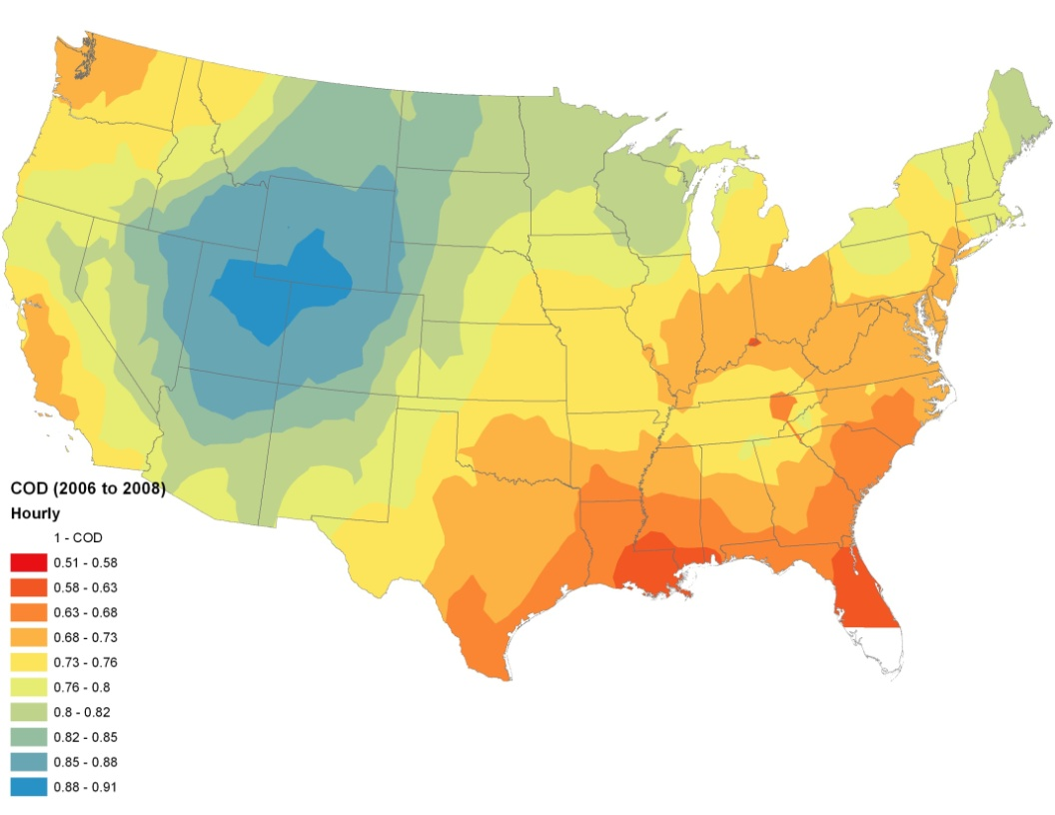
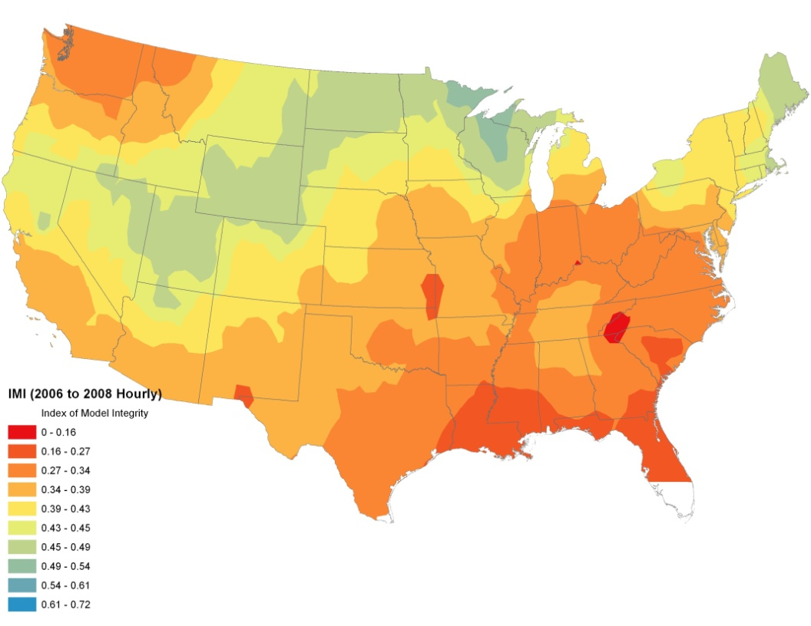
Hourly Stats

Slide 29
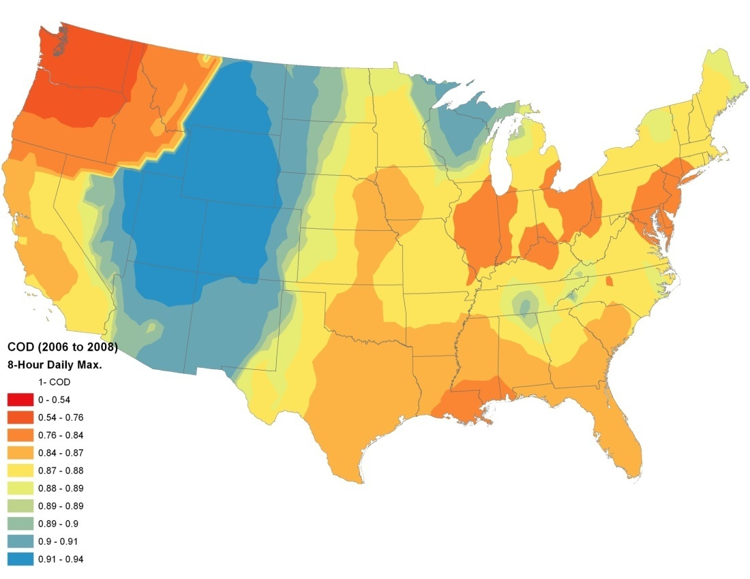
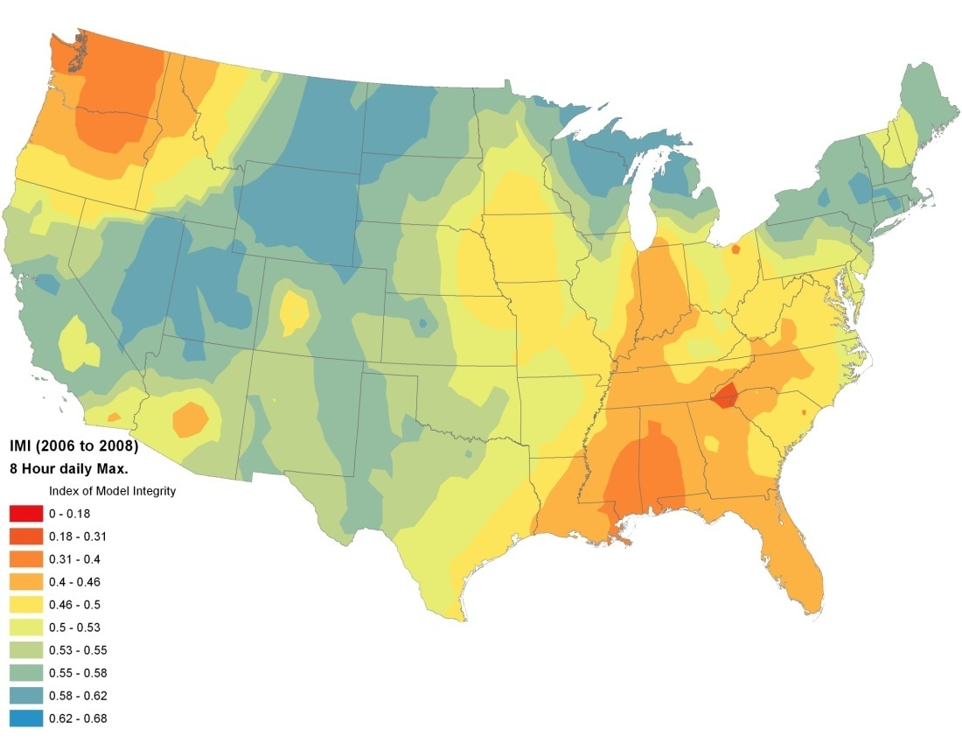
Daily 8-Hour Max. Stats

Slide 30
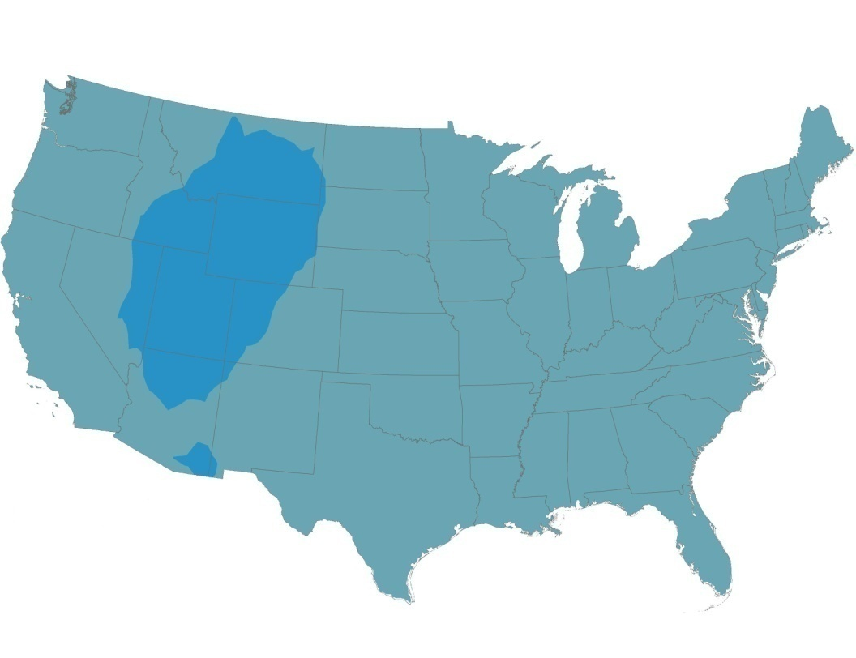
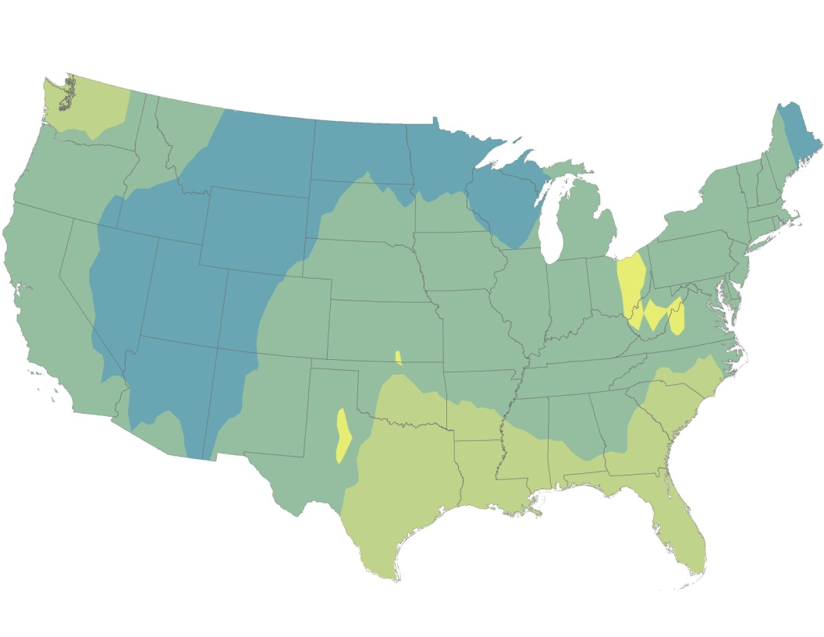
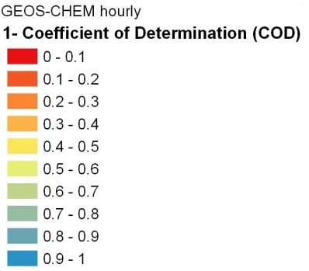
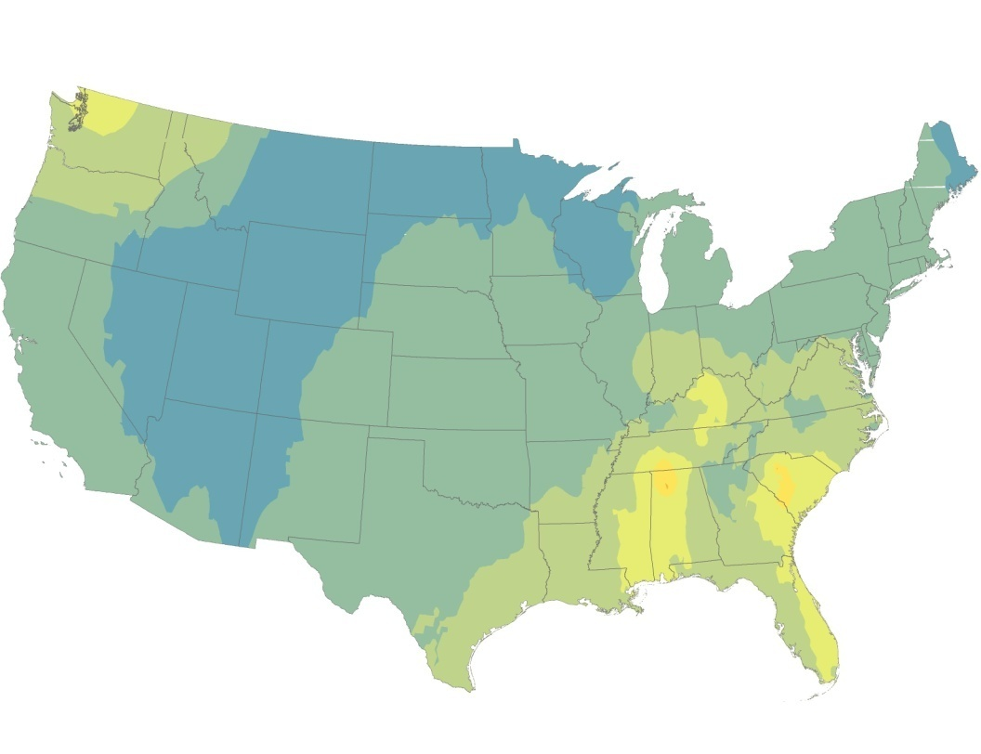

2006
2007
2008
All years: 2006 to 2008

Slide 31
