Slide 1
CMAQ-urban: fine scale air pollution modelling in London
Nutthida Kitwiroon and Sean Beevers
King’s College London
Notes:
Routine sources of health data are attractive for air pollution studies for various reasons: large scale, relatively cheap.
Most common source is mortality data
Less common are hospital utilization data
Less common still are primary care data
Fortunate in UK to have the potential to use all three.
Primary care data from primary care research databases have been used by us in the past for daily time-series and episode studies in London. (can provide one or two slides if needed).
More recently we have become interested in using primary care data for investigating the health effects of exposure to traffic and the possible health benefits of interventions, in particular the LEZ for London.
This talk is in three parts:
Describe the nature of these databases
Describe experience with a pilot study using DIN
Outline plans for future work

Slide 2
Talk summary
Motivation for developing the local scale modelling
Modelling methods
Evaluation
Future work
Notes:
Routine sources of health data are attractive for air pollution studies for various reasons: large scale, relatively cheap.
Most common source is mortality data
Less common are hospital utilization data
Less common still are primary care data
Fortunate in UK to have the potential to use all three.
Primary care data from primary care research databases have been used by us in the past for daily time-series and episode studies in London. (can provide one or two slides if needed).
More recently we have become interested in using primary care data for investigating the health effects of exposure to traffic and the possible health benefits of interventions, in particular the LEZ for London.
This talk is in three parts:
Describe the nature of these databases
Describe experience with a pilot study using DIN
Outline plans for future work

Slide 3
Motivation
To provide evidence of the impact on air quality, of intergovernmental, national and local authority policies
In the UK, policy’s aimed at meeting NO₂, PM₁₀ and PM_{2.5} EU limit values (http://www.defra.gov.uk/publications/2011/04/13/pb13378-air-pollution/)
Epidemiological requirements for spatio-temporal analysis
To include space-time-activity data in exposure assessments both for policy development and to reflect the dose from pollutants that have a range of toxicity (PM).
Notes:
Routine sources of health data are attractive for air pollution studies for various reasons: large scale, relatively cheap.
Most common source is mortality data
Less common are hospital utilization data
Less common still are primary care data
Fortunate in UK to have the potential to use all three.
Primary care data from primary care research databases have been used by us in the past for daily time-series and episode studies in London. (can provide one or two slides if needed).
More recently we have become interested in using primary care data for investigating the health effects of exposure to traffic and the possible health benefits of interventions, in particular the LEZ for London.
This talk is in three parts:
Describe the nature of these databases
Describe experience with a pilot study using DIN
Outline plans for future work

Slide 4
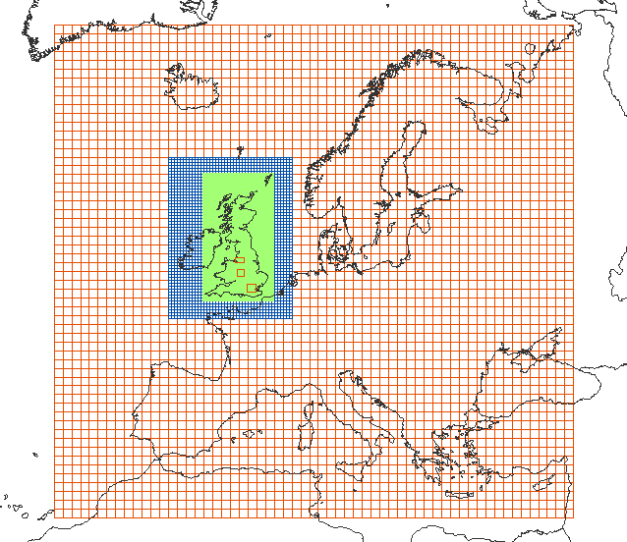
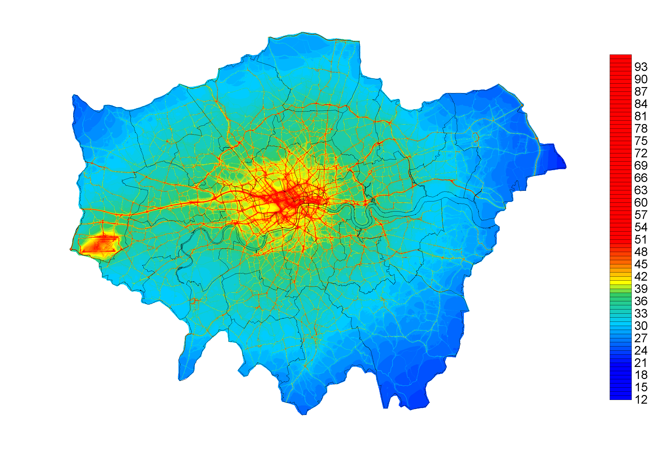



CMAQ-urban setup
European Monitoring and Evaluation Programme (EMEP)
The European Pollution Release and Transfer Register (EPRTR)
UK scale, the National Atmospheric Emissions Inventory (NAEI)
The London Atmospheric Emissions Inventory (LAEI).
Kelly FJ, Anderson HR, Armstrong B, Atkinson RW, Barratt B, Beevers SD, Mudway IS, Green D, Derwent RG, Tonne C, Wilkinson P. 2011. The impact of the Congestion Charging Scheme on air quality in London. Health Effects Institute. http://pubs.healtheffects.org/view.php?id=358. Accessed 16/07/11
MRC-HPA Centre for Environment and Health
Imperial College
London

Slide 5
CMAQ-urban setup
Model: WRF3.1 and CMAQ 4.7.1
Emissions: EMEP, including EPRTR, NAEI and LAEI
Domain setting: 4 nesting levels, downscaling from 81km covering the entire Europe to 3km over the Urban UK. 23 model layers with 7 layers under 800m and approximately 15km above the ground at the top layer.
IC/BC: GFS model (1x1 deg) for WRF and STOCHEM for CMAQ
Physics settings:
  Radiation Scheme: RRTM scheme
  Microphysics: Kain-Fritsch (new Eta) scheme
  Planetary Boundary Layer: YSU scheme
  Surface Scheme: Monin-Obukhov scheme
  Land Surface Scheme: Noah scheme
Chemical setting: CB-05 with aqueous and aerosol chemistry
Model: ADMS roads v2.3
Emissions: LAEI major roads
Domain setting: Greater London area, 20x20m predictions.
IC/BC: From CMAQ 3x3km predictions
Meteorology: Results from WRF
Chemical setting: NO-NO₂-O₃ chemistry (Carslaw, 2005)
Street canyons (by direction) height-width ratio. Model based upon OSPM (Berkowicz, 1998, 2000, 2008)
MRC-HPA Centre for Environment and Health
Imperial College
London

Slide 6
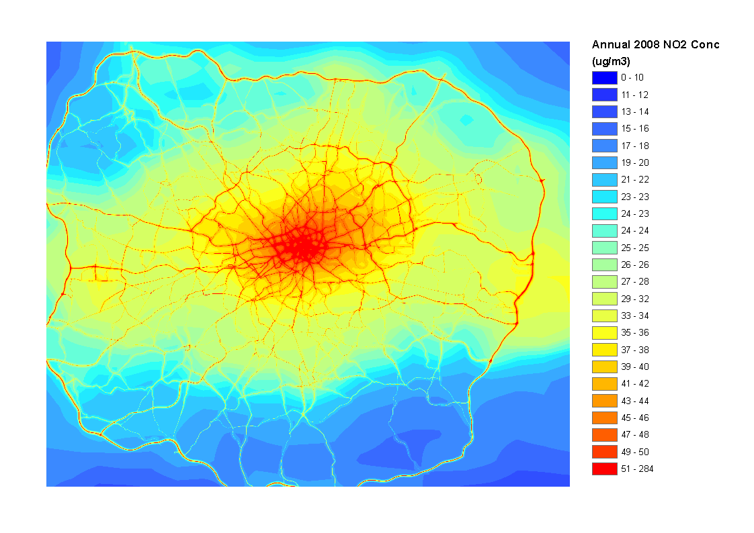
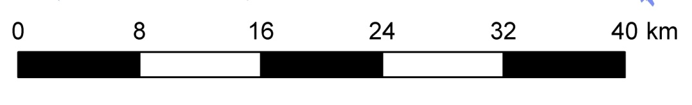
Annual average NO₂ at 20m x 20m in 2008
MRC-HPA Centre for Environment and Health
Carslaw DC. 2011. DEFRA Urban model evaluation analysis – phase 1. http://uk-air.defra.gov.uk/library/reports?report_id=654
Imperial College
London

Slide 7
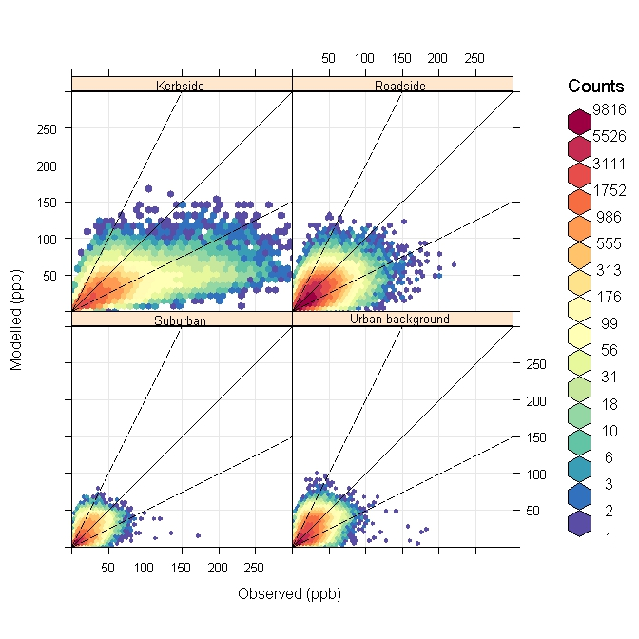
Hourly scatter plots in 2006
Number of sites
Kerbside – 7
Roadside – 40
Urban background – 22
Suburban - 16
Plots by OpenAir: http://www.openair-project.org/
MRC-HPA Centre for Environment and Health
Imperial College
London

Slide 8
Model evaluation statistics (2006)
Poll | Site | FAC2 | MB (ppb) | NMB | RMSE (%) | r
NO₂ | All | 0.73 | -4.73 | -0.17 | 17.73 | 0.58
O₃ | All | 0.61 | 2.84 | 0.15 | 12.13 | 0.64
NO₂ | KS | 0.64 | -19.0 | -0.39 | 38.12 | 0.58
NO₂ | RS | 0.75 | -4.98 | -0.17 | 16.29 | 0.56
NO₂ | SU | 0.71 | -0.79 | -0.05 | 10.76 | 0.58
NO₂ | UB | 0.74 | -2.09 | -0.10 | 12.25 | 0.55
O₃ | KS | 0.37 | 5.63 | 0.68 | 11.12 | 0.50
O₃ | RS | 0.60 | 2.97 | 0.17 | 11.94 | 0.59
O₃ | SU | 0.66 | 2.70 | 0.13 | 12.41 | 0.65
O₃ | UB | 0.61 | 2.64 | 0.14 | 12.09 | 0.64
MRC-HPA Centre for Environment and Health
Imperial College
London

Slide 9
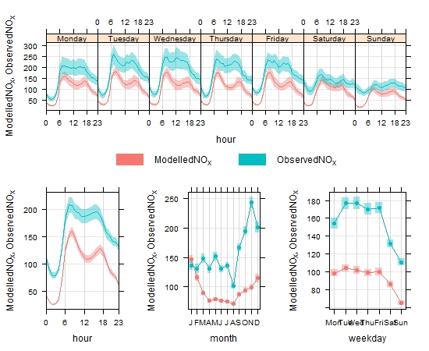
NO_{X} at Marylebone Road kerbside (ppb)
Plots by OpenAir: http://www.openair-project.org/
MRC-HPA Centre for Environment and Health
Imperial College
London

Slide 10
NO_{X} measurement and emissions trends
Estimated trend in NO_{X} concentrations at 10 long running inner London roadside sites.
Carslaw, D.C., Beevers, S.D. Westmoreland, E. Williams, M.L. Tate, J.E., Murrells, T. Stedman, J. Li, Y., Grice, S., Kent, A. and I. Tsagatakis (2011b). Trends in NO_{X} and NO₂ emissions and ambient measurements in the UK. Version: July 2011. http://uk-air.defra.gov.uk/library/reports?report_id=673. Accessed 31/05/2011.
Carslaw DC, Beevers SD, Tate JE, Westmoreland E, Williams ML. 2011a. Recent evidence concerning higher NO_{X} emissions from passenger cars and light duty vehicles. Atmospheric Environment (in press).
MRC-HPA Centre for Environment and Health
Imperial College
London

Slide 11
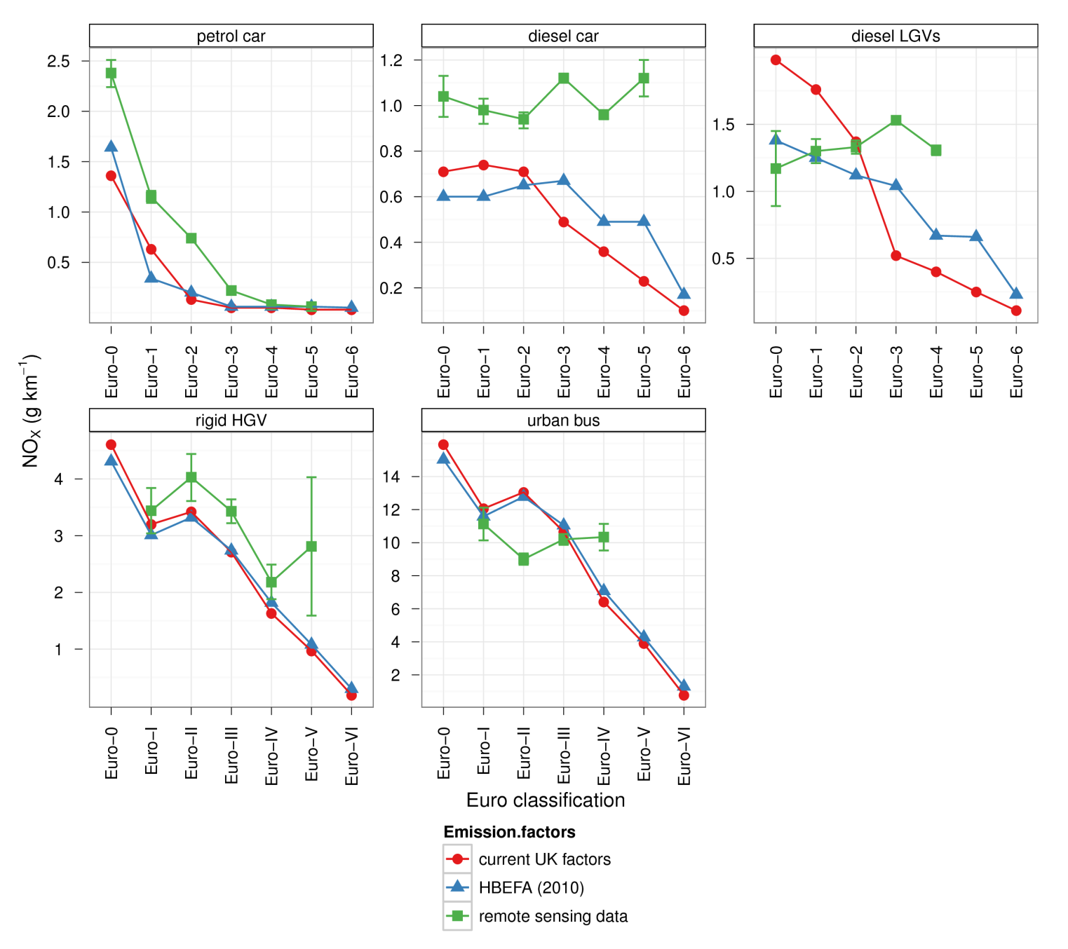
Assumed trend in vehicle NO_{X} emissions by euro class
MRC-HPA Centre for Environment and Health
Imperial College
London

Slide 12
The trend in normalised median NO_{X} emissions by location in London
MRC-HPA Centre for Environment and Health
Imperial College
London

Slide 13
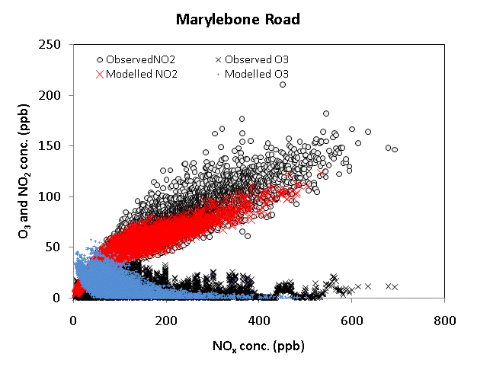
Street scale chemistry model
Constrained chemistry model. R² ~ 0.96
NO_{X} bin (ppb)
To model the concentrations of NO-NO₂-O₃ a simple hourly chemistry model was used - Carslaw (2005). The reaction rates and photo dissociation rates were taken from JPROC, part of the CMAQ model run. Torr was calculated the concentration weighted time of flight at each prediction point.
Carslaw, D. C., 2005. Evidence of an increasing NO₂/NO_{X} emissions ratio from road traffic emissions. Atmospheric Environment 39 (26), 4793–4802.
MRC-HPA Centre for Environment and Health
Imperial College
London

Slide 14
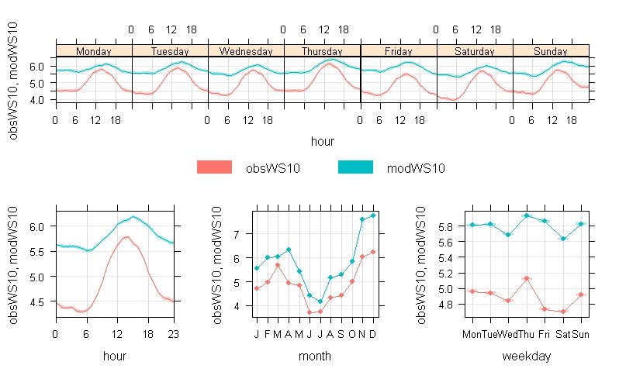
Overnight wind speed
Measurements taken from 147 ground based met. sites throughout the UK
MRC-HPA Centre for Environment and Health
Imperial College
London

Slide 15
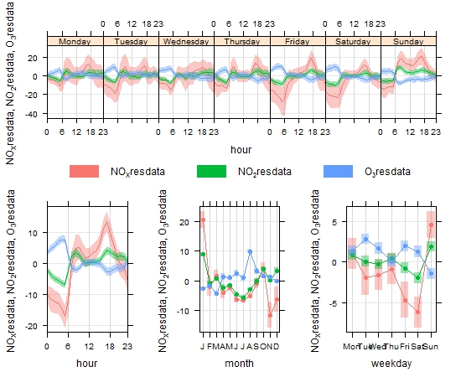
NO_{X}-NO₂-O₃ at Kensington and Chelsea urban background (ppb)
MRC-HPA Centre for Environment and Health
Imperial College
London

Slide 16
Error and uncertainty
Increased negative bias closer to traffic sources. NO_{X} emissions inventory underestimate over time.
Average concentrations by hour of the day and day of the week show there to be a negative model bias at night time, associated with over predicted nighttime wind speed in WRF in combination with emissions errors during Friday/Saturday morning.
Evidence of a seasonal over and underestimates of emissions as well as over estimates of wind speed during winter months.
Hour of day and day of week over and underestimates of road traffic emissions are also evident. We should scale using detailed hourly emissions?
Other potential errors: The ADMS model and the street canyon model (based upon OSPM) has not been investigated here. The influence of defining street canyon characteristics and other important sources of error. Note 2008 results.
Some evidence of the effect of multi-lane roads and the existence of tidal traffic flows which are potentially influential at kerbside and roadside sites.

Slide 17
Conclusions and future work
The results look promising, although some work remains. The final model will include PM - testing CMAQ v5 beta at present.
Model uses
Predict NO_{X}/NO₂/O₃ and PM₁₀/PM_{2.5} from European to local road scales (all in one model)
Use with space-time-activity data in London to improve estimates of personal exposure and to use these in epidemiological studies.
Adding exposure in specific micro-environments to the model in London e.g. Indoor/in vehicle/tube as part of the MRC/NERC “Traffic” project.
MRC-HPA Centre for Environment and Health
Imperial College
London

Slide 18
Thanks for your attention…
Thanks to colleagues at ERG:
David Carslaw and Martin Williams
Thanks to DEFRA for funding for NO_{X} emissions trends work and Transport for London for funding the LAEI
MRC-HPA Centre for Environment and Health
Imperial College
London

Slide 19
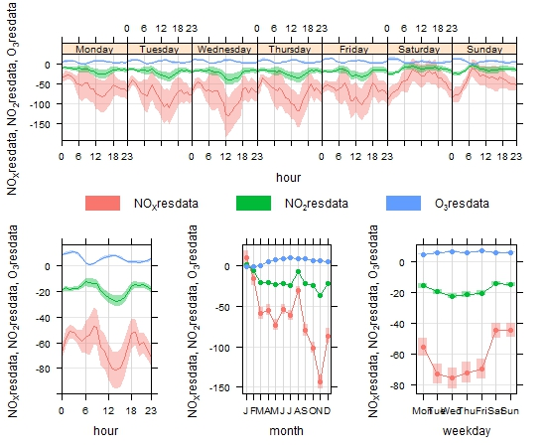
NO_{X}-NO₂-O₃ at MY1 kerbside (ppb)
MRC-HPA Centre for Environment and Health
Imperial College
London

Slide 20
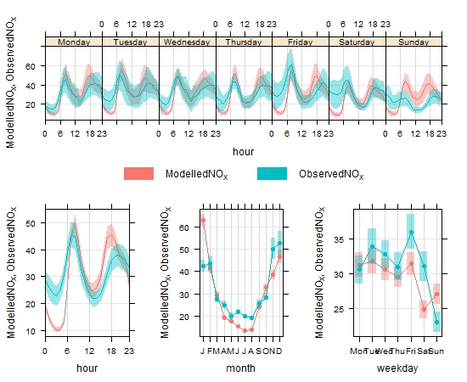
NO_{X} at KC1 urban background (ppb)
MRC-HPA Centre for Environment and Health
Imperial College
London

