Slide 1
Model inter-comparison of
CMAQ and CHIMERE in the framework of CALIOPE air quality project
J.M. Baldasano, M.T. Pay, S. Mailler,
P. Jiménez, S. Gassó
e-mail: jose.baldasano@bsc.es
Barcelona Supercomputing Center-Centro Nacional de Supercomputación (BSC-CNS)
Technical University of Catalonia (UPC)

Slide 2
CALIOPE Air Quality Forecasting System
EU12
IP4
Emission data
EMEP data
GFS/FNL
(global-0.5ºx0.5º)
BC+IC-met
WRF-ARW
(4 km x 4 km)
HERMES
(4 km x 4 km)
HERMES-EMEP
(12 km x 12km)
WRF-ARW
(12 km x 12 km)
nesting
T, solar radiation
Rel. Hum.
meteorology
emissions
BC+IC-chem
CMAQ
(4 km x 4 km)
CMAQ
(12 km x 12 km)
nesting
EU50
LMDz-INCA2
(global-3.75ºx2.5º)
BSC- DREAM8b Europe – North America – Middle East (50 km²)
OUTPUTS
Gas and particulate matter
OUTPUTS
Gas and particulate matter

Slide 3


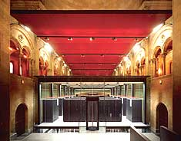
CALIOPE Air Quality Forecasting System (www.bsc.es/caliope)
Spain: 4 km (399x399 grid cells ), Europe: 12 km (480x400 grid cells )
Modules
- Meteorology: WRF-ARW v3.2.1, ibc: GFS (NCEP)
38 sigma levels; top of the atmosphere 50 hPa
- Emissions:
EMEP (Europe) and HERMES (Spain)
- Chemistry: CMAQ-CTM v4.5, CBIV, Cloud chem. (aqu.), Aerosol module (AERO4), bc: LMDz-INCA model, 15sigma levels
- Mineral dust from Africa:
BSC-DREAM8b
-Evaluation: NRT-ground level observations, satellite, ozone soundes
Notes:
3
26/10/2011

Slide 4
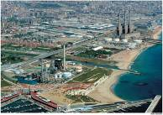
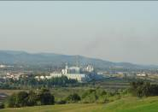
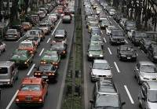
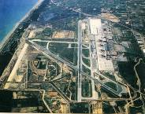
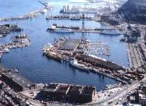

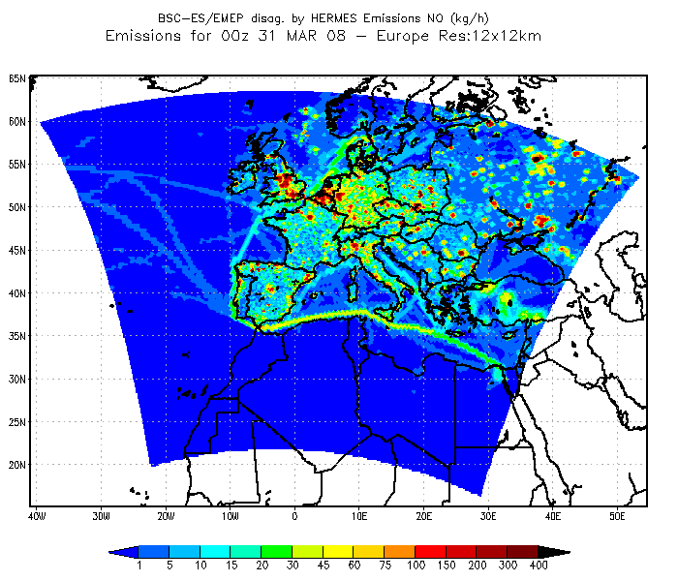
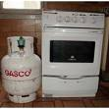


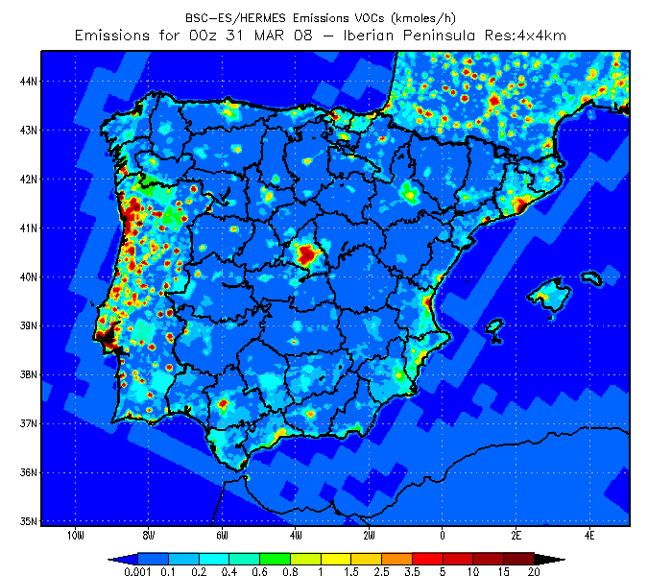
HERMES 2004: High-Elective Resolution
Modelling Emission System (1km²-1 h)
Notes:
4
26/10/2011

Slide 5
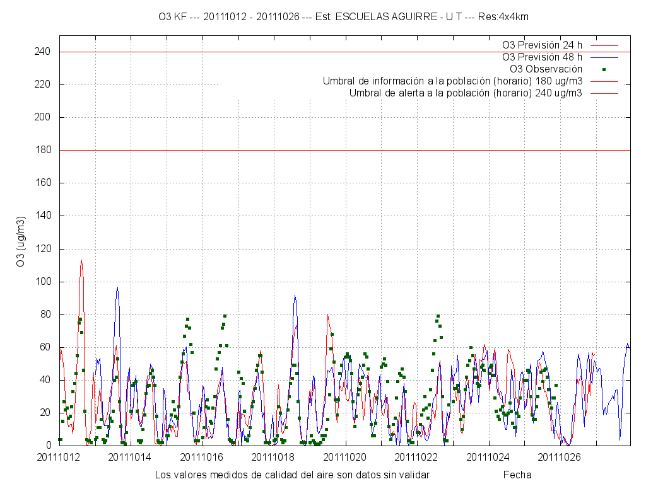
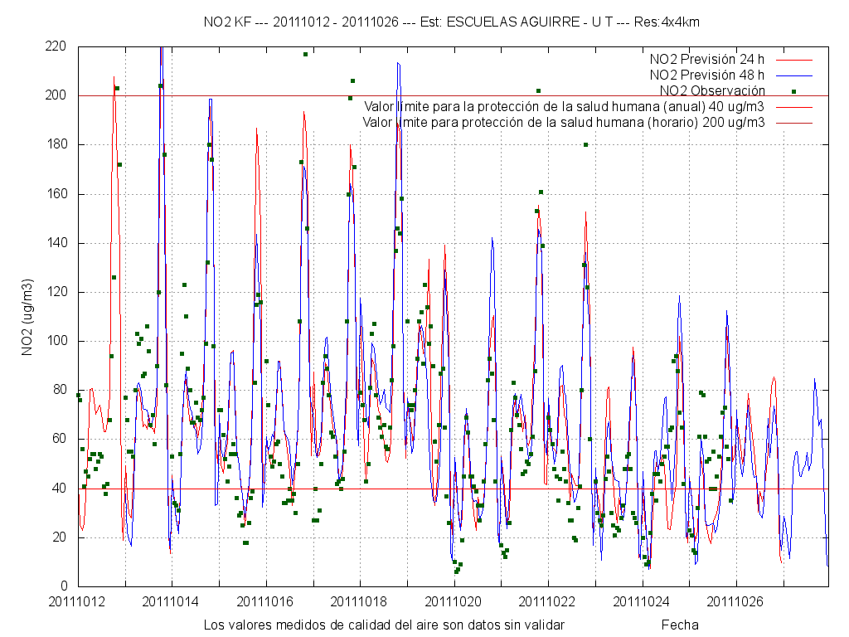
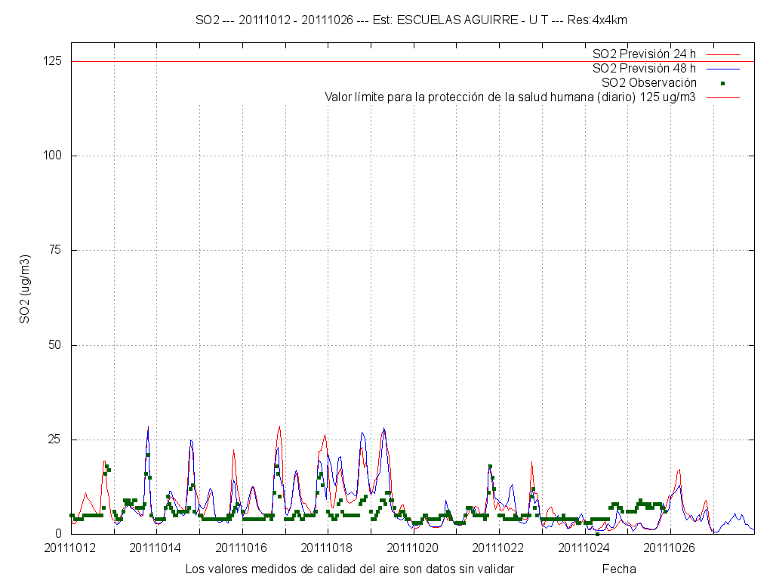
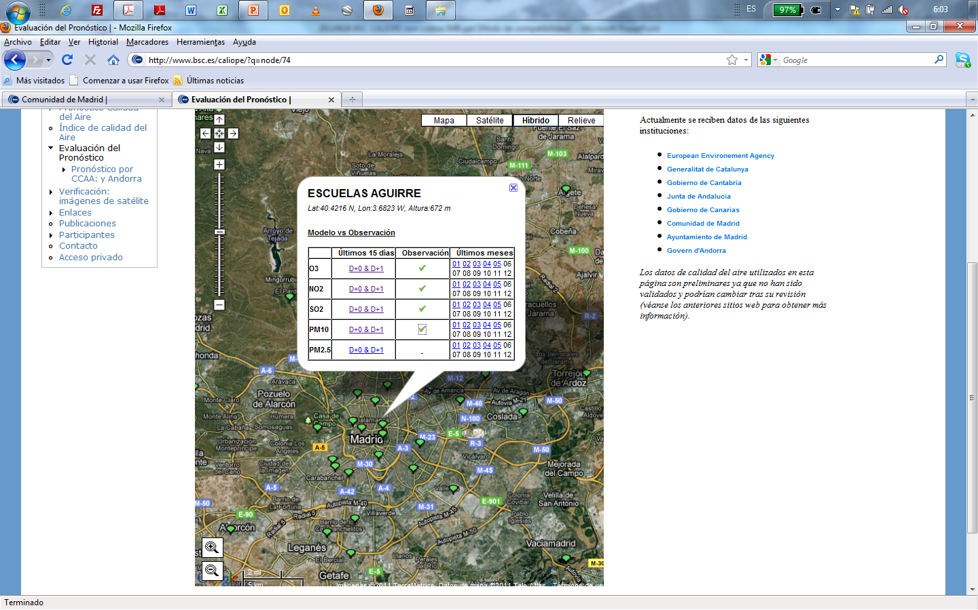
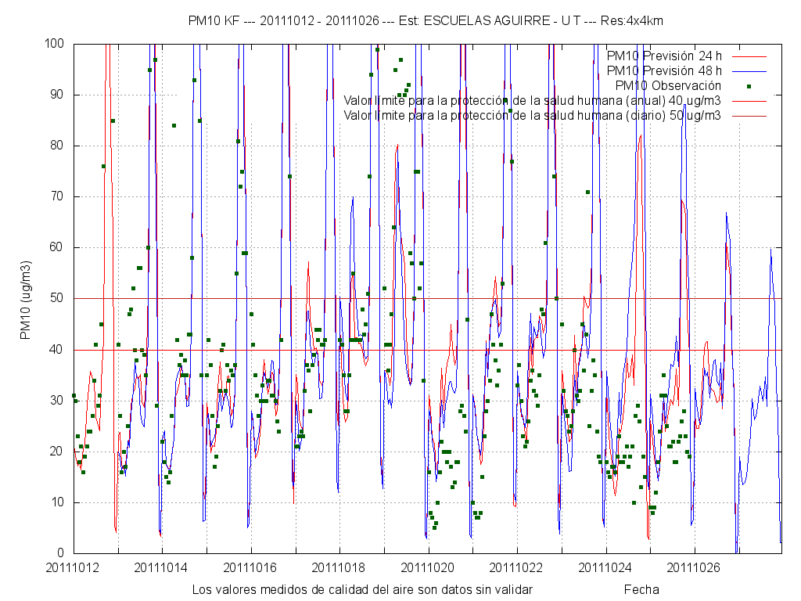

Slide 6
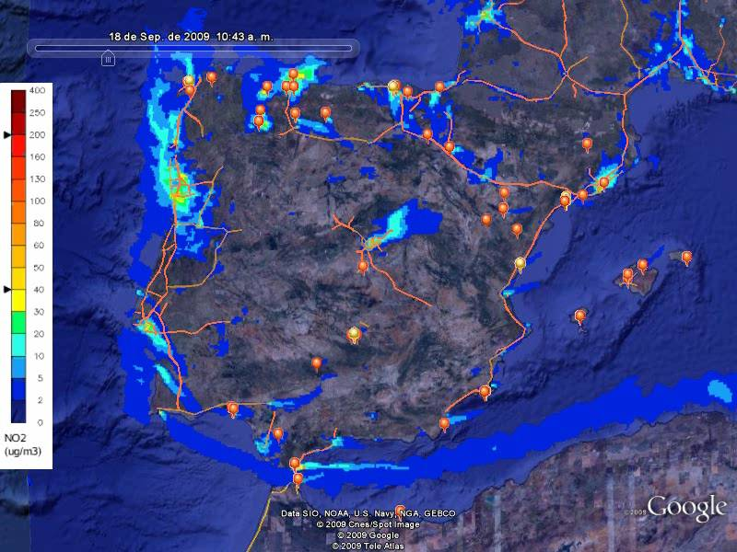
Analysis: integration between emissions and air quality

Slide 7
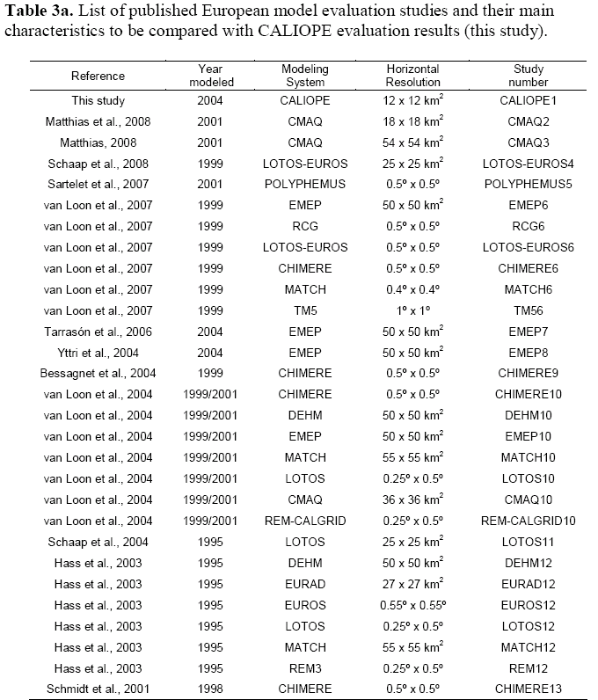
Pay et al. (Atmospheric Environment, 2010)
Baldasano et al. (STOTEN, 2011)
References
Bessagnet, B., Hodzic, A., Vautard, R., Beekmann, M., Cheinet, S., Honoré, C., Liousse, C. and Rouil, L., 2004. Aerosol modeling with CHIMERE—preliminary evaluation at the continental scale. Atmos. Environ., 38(18), 2803-2817.
Hass, H., van Loon, M., Kessler, C., Stern, R., Matthijsen, J., Sauter, F., Zlatev, Z., Langner, J., Foltescu, V., Schaap, M., 2003. Aerosol Modeling: Results and Intercomparison form European Regional scale Modeling Systems. GLOREAM, EUROTRAC 2 Report. EUREKA Environmental Project
Matthias, V., Aulinger, A., and M. Quante, 2008. Adapting CMAQ to investigate air pollution in North Sea coastal regions. Environ. Modell. Softw. 23, 356-368.
Matthias, V., 2008. The aerosol distribution in Europe derived with the Community Multiscale Air Quality (CMAQ) model: comparison to near surface in situ and sunphotometer measurements. Atmos. Chem. Phys. 8, 5077-5097.
Sartelet, K.N., Debry, E., Fahey, K., Roustan, Y., Tombette, M., Sportisse, B., 2007. Simulation of aerosols and gas-phase species over Europe with the POLIPHEMUS system: Part I-Model-to-data comparison for 2001. Atmos. Environ., 41, 6116-6131
Schaap, M., Timmermans, R.M.A., Roemer, M., Boersen, G.A.C., Builtjes, P., Sauter, F., Velders, G., Beck, J., 2008. The LOTOS- EUROS model: description, validation and latest developments. Intern. J. Environ. and Pollut., 32, 270-290.
Schaap, M., Van Der Gon, H., Dentener, F.J., Visschedijk, A.J.H., van Loon, M., ten Brink, H.M., Putaud, J.P, Guillaume, B., Liousse, C., Builtjes, P.J.H., 2004. Anthropogenic black carbon and fine aerosol distribution over Europe. J. Geophys. Res. 109 (D18207). doi:10.1029/2003JD004330
Schmidt, H., Derognat, C., Vautard, R., Beekmann, M., 2001. A comparison of simulated and observed ozone mixing ratios for the summer of 1998 in Western Europe. Atmos. Environ., 6, 6227-6297
Tarrasón, L., Fagerli, H., Klein, H., Simpson, D., Benedictow, A.C., Vestreng, V., Rigler, E., Emberson, L., Posch, M., Spranger, T., 2006. Transboundary Acidifcation, Eutrophication and Ground Level Ozone in Europe from 1990 to 2004. EMEP Status Report 1/06: to support the review of the Gothenburg Protocol. The Norwegian Meteorological Institute, Oslo, Norway. (Available at http://www.emep.int/publ/reports/2006/status_report_1_2006_ch.pdf)
van Loon, M. Roemer, M.G.M., Builtjes, P.J.H., Bessagnet, B., Rouïll, L., Christensen, J., Brandt, J., Fagerli, H., Tarrasón, L., Rodgers, I., 2004. Model inter-comparison. In the framework of the review of the Unified EMEP model. TNO-Report R2004/282. Apeldoorn, The Netherlands.
van Loon, M., Vautard, R., Schaap, M., Bergstrom, R., Bessagnet, B., Brandt, J., Builtjes, P.J.H., Christensen, J.H., Cuvelier, C., Graff, A., Jonson, J.E., Krol, M., Langner, J., Roberts, P., Rouïl, L., Stern, R., Tarrasón, L., Thunis, P., Vignati, E., White, L., Wind, P., 2004. Evaluation of long-term ozone simulations from seven regional air quality models and their ensemble. Atmos. Environ., 41, 2083-2097.
Yttri, K.-E., Aas, W., Forster, C., Torseth, K., Tsyro, S., Tarrasón, L., Simpson, D., Vestreng, V., Lazaridis, M., Kopanakis, I., Aleksandropoulou, V., Gehrig, R., Adams, M., Woodfield, M., Putaud, J.P., Schultz, M., 2006. Transboundary particulate matter in Europe. EMEP Status Report 4/06. The Norwegian Meteorological Institute, Oslo, Norway. (Available at http://www.nilu.no/projects/ccc/reports/emep4-2006.pdf)

Slide 8
Pay et al. (Atmospheric Environment, 2010)

Slide 9
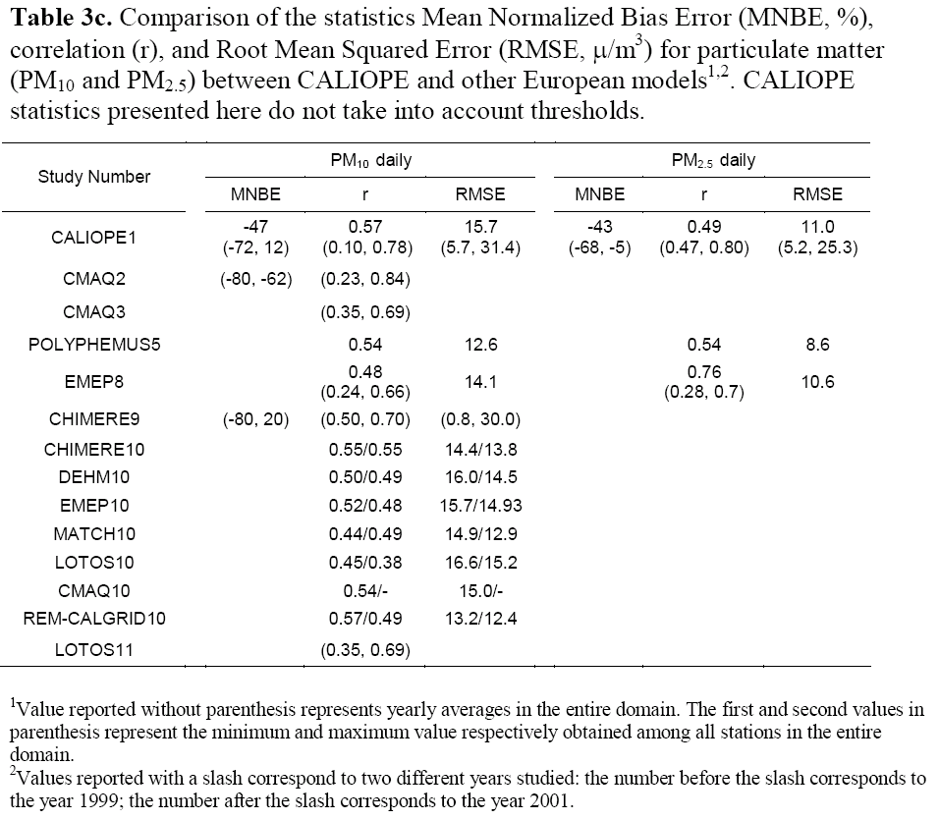
Pay et al. (Atmospheric Environment, 2010)

Slide 10
PRELIMINARY ANALYSIS: Model inter-comparison of
CMAQ and CHIMERE
Domain and resolution:
Europe: 12 km (480x400 grid cells )
Iberian Peninsula: 4 km (399x399 grid cells )
Year: 2004, same IC, BC, NWP model: WRF v3.0.1.1
Chemical mechanism: CMAQ → CBIV; CHIMERE: MELCHIOR2
Simulation CMAQ-HERMES (CALIOPE AQ System):
CTM: CMAQ Model v4.5
Emissions: HERMES in Spain, EMEP disaggregation outside Spain
Simulation CHIMERE-HERMES:
CTM: Chimere2008c
Emissions: HERMES in Spain, EMEP disaggregation outside Spain
Simulation CHIMERE-EMEP:
CTM: Chimere2008c
Emissions: EMEP disaggregation throughout the entire domain.

Slide 11
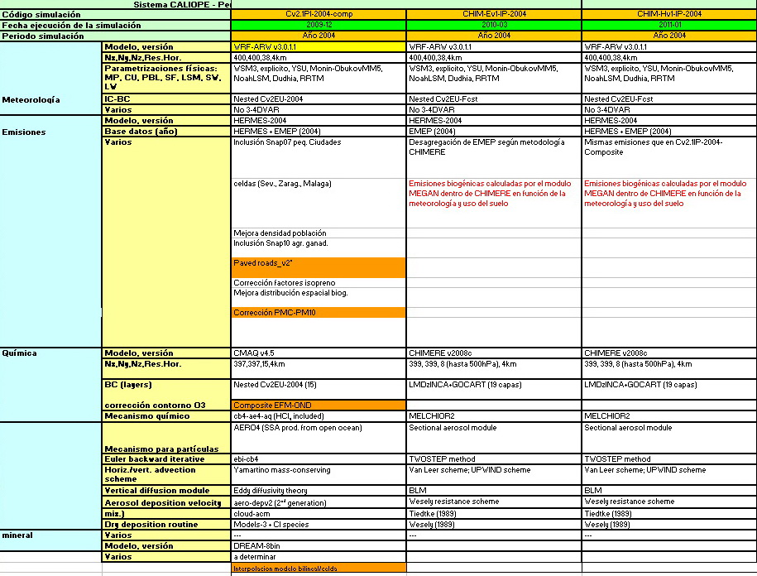

Slide 12
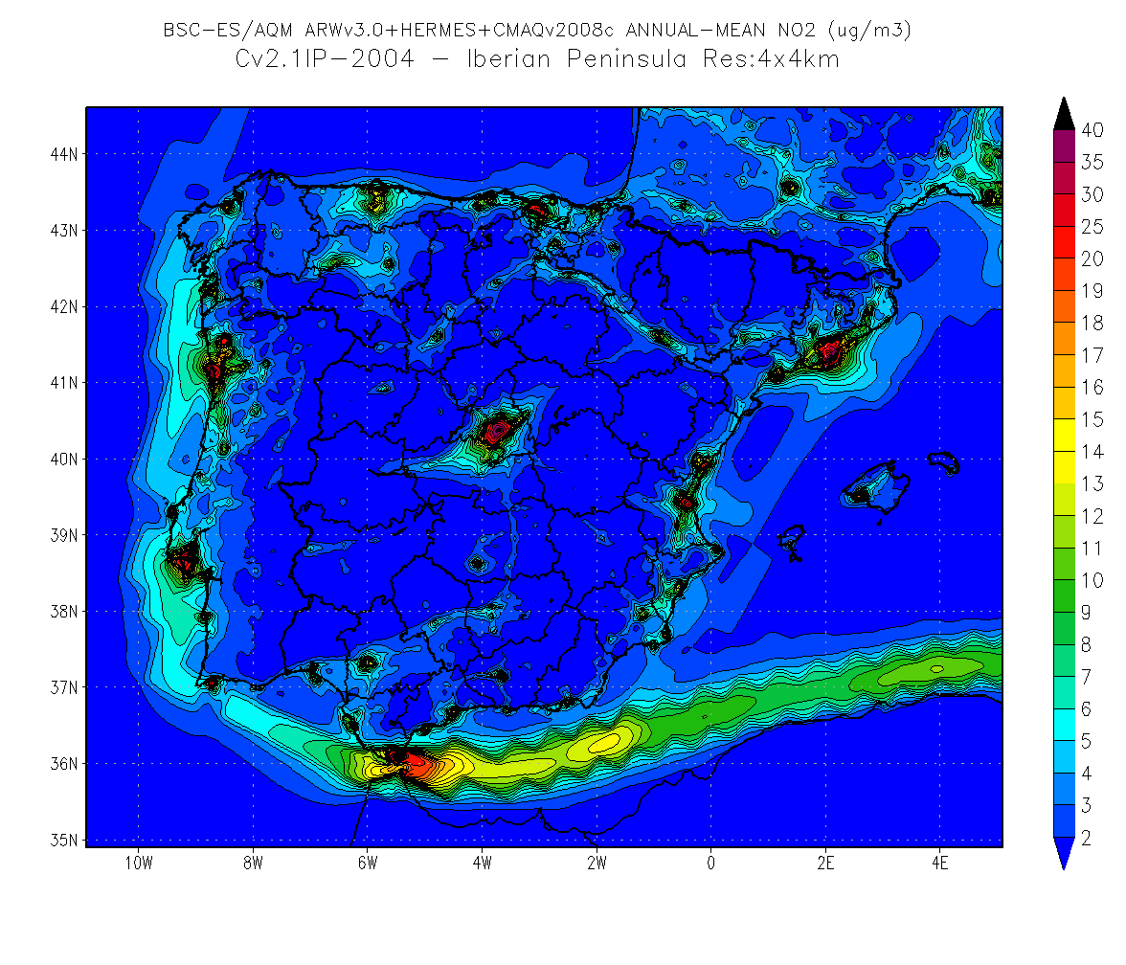
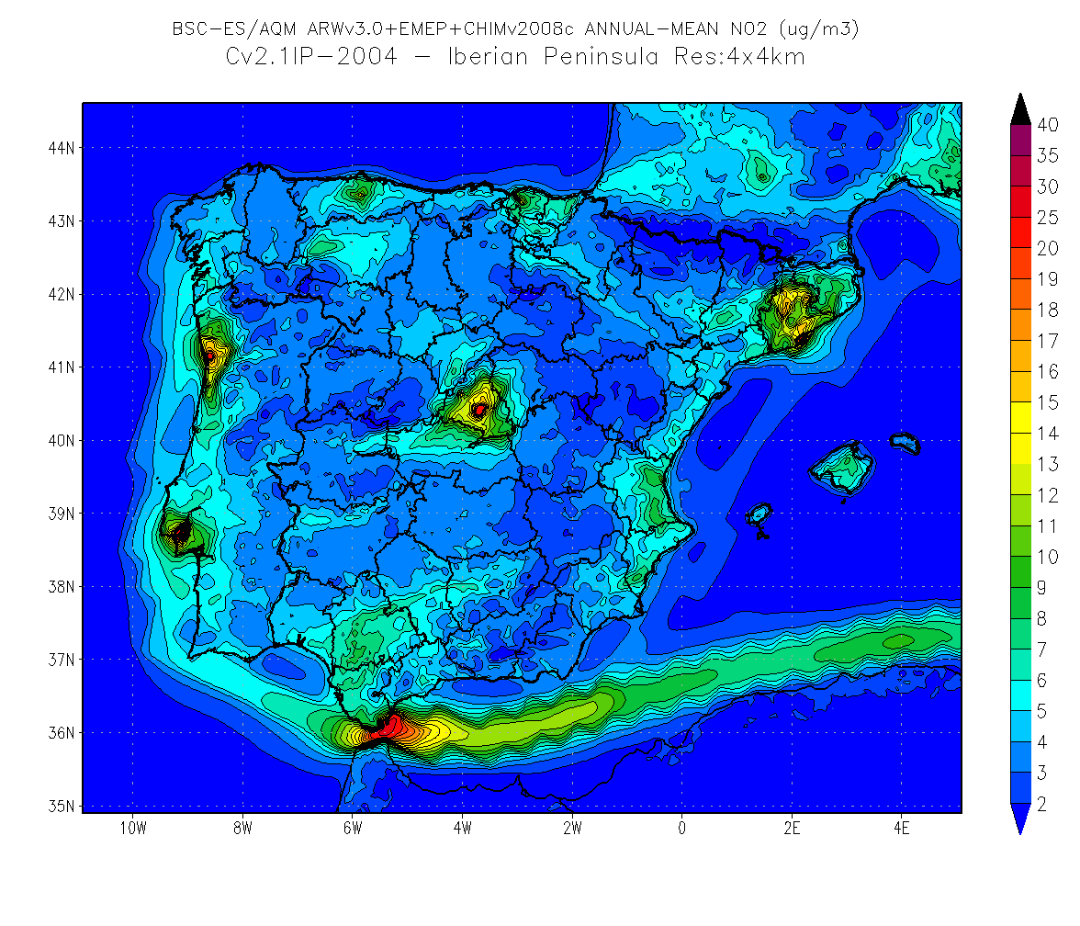
NO₂: Simulation year 2004, annual mean
CHIMERE+HERMES
CHIMERE+EMEP
The difference between CMAQ and CHIMERE to the average levels is not very strong
The impact of the emission inventory is crucial to the structure of the simulated concentrations
CMAQ+HERMES

Slide 13
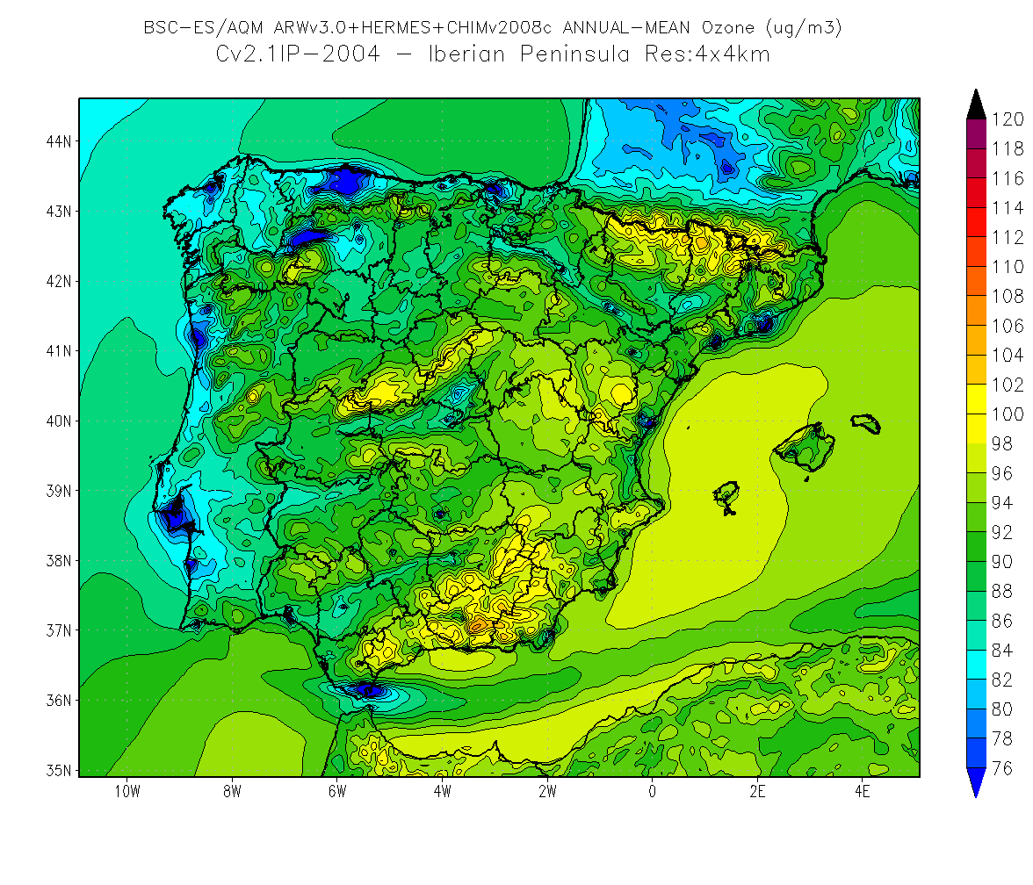
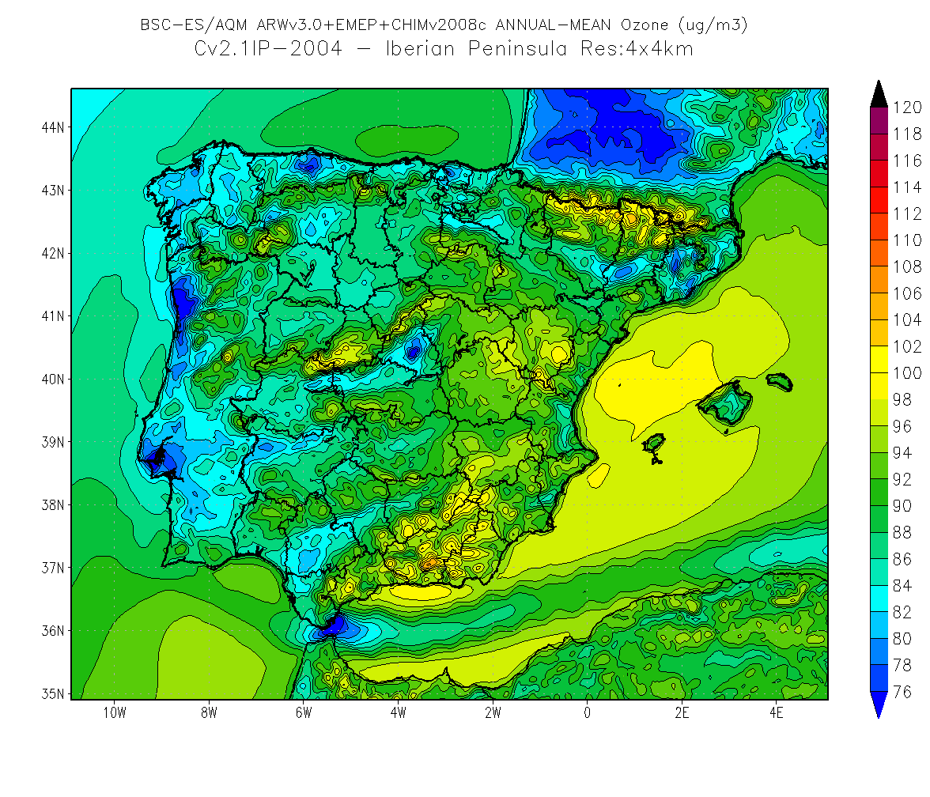
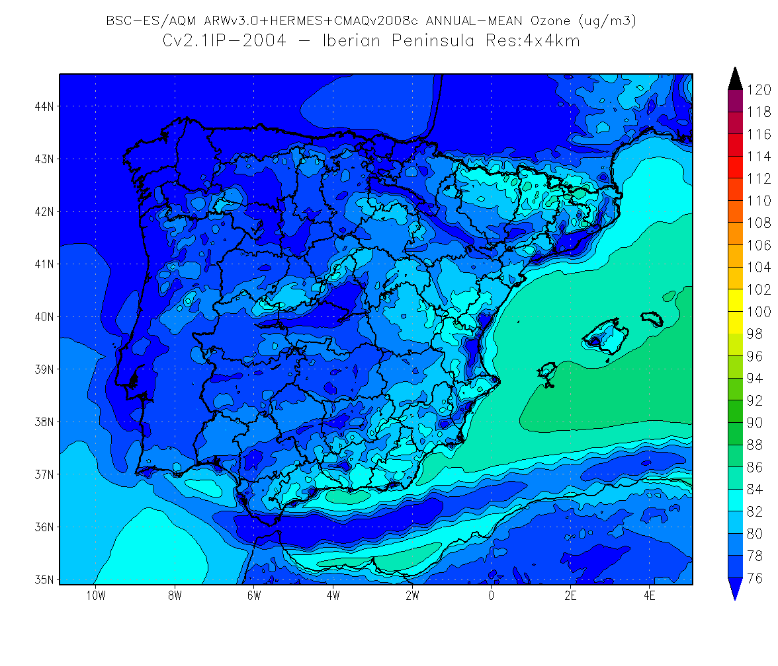
O₃: Simulation year 2004, annual mean
CHIMERE+EMEP
CHIMERE+HERMES
Clear difference between both CTM.
Special differences near of pollution sources (cities, industries) and big cities
Difference between the simulation with CMAQ and CHIMERE may also be due to biogenic emissions
CHIMERE con emisiones HERMES
CMAQ+HERMES

Slide 14
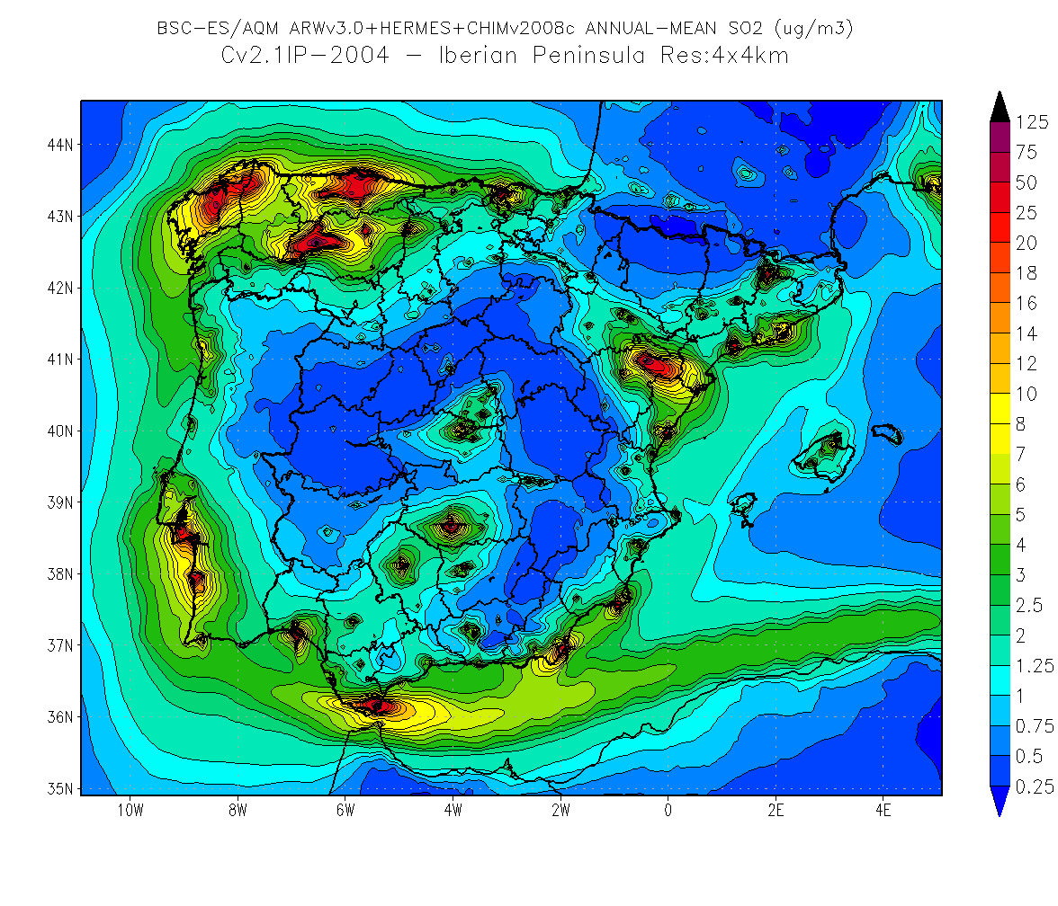
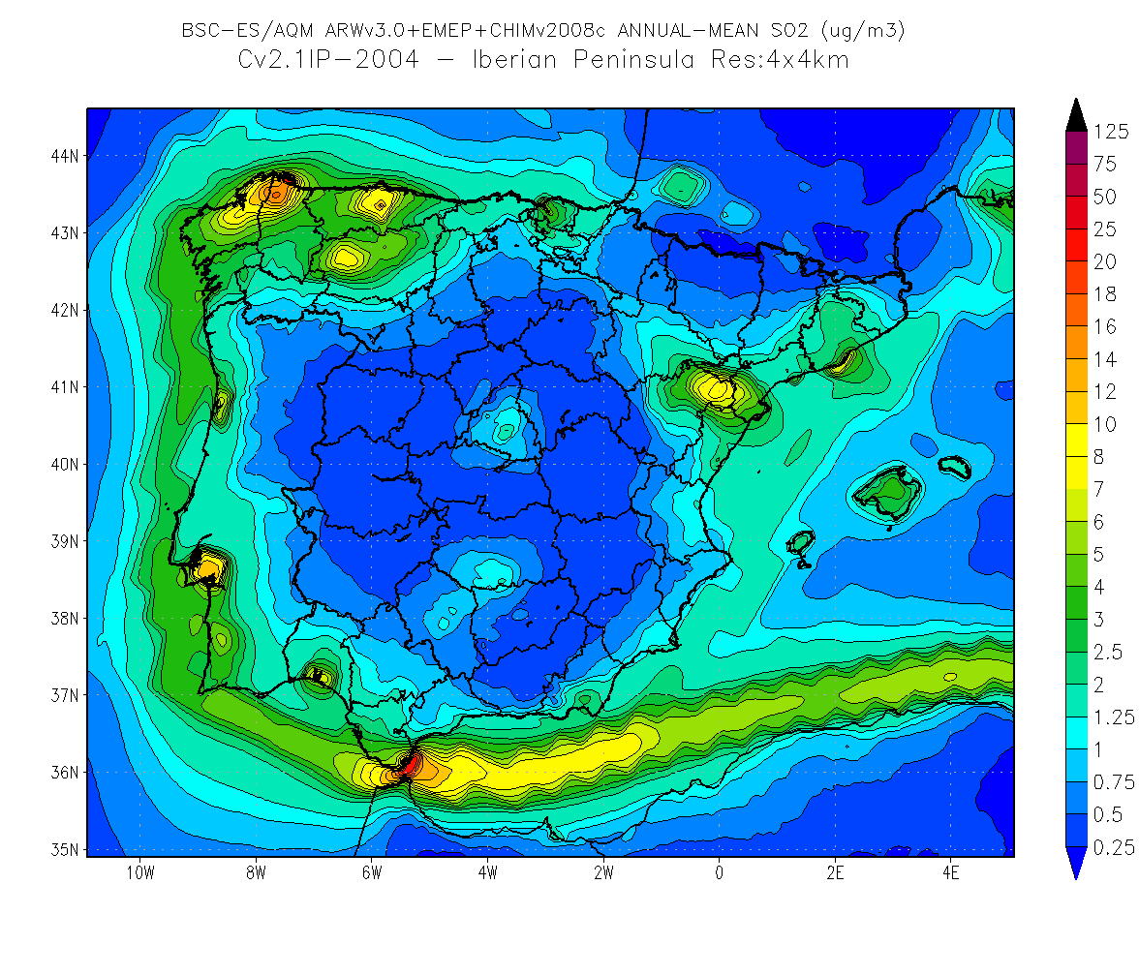
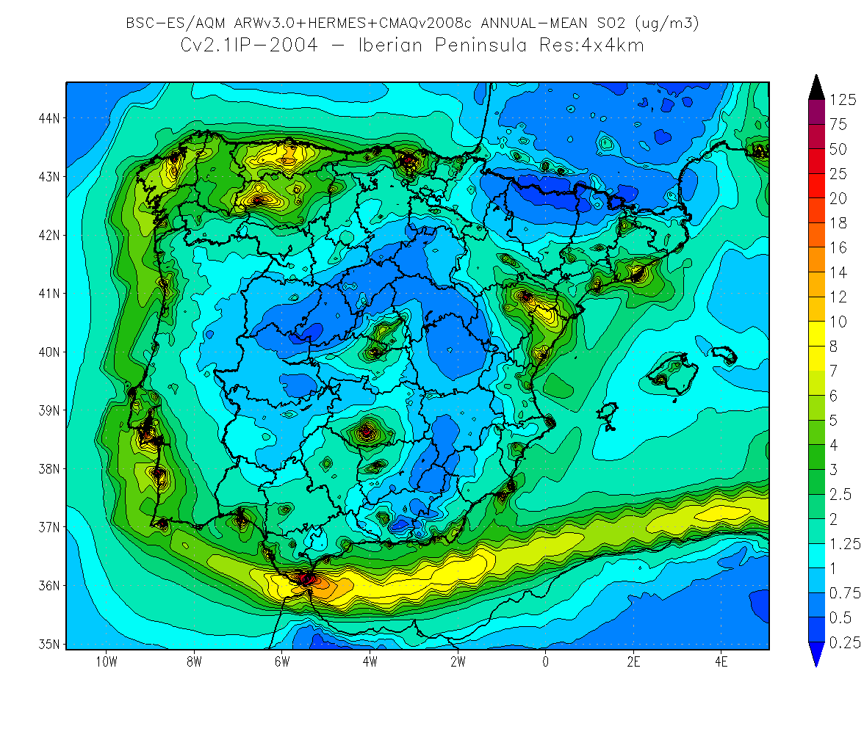
SO₂: Simulation year 2004, annual mean
CHIMERE+HERMES
CHIMERE+EMEP
With the HERMES emissions, CHIMERE trends to produces higher peak concentrations near the sources of SO₂
CMAQ produce higher background concentrations
CMAQ+HERMES

Slide 15
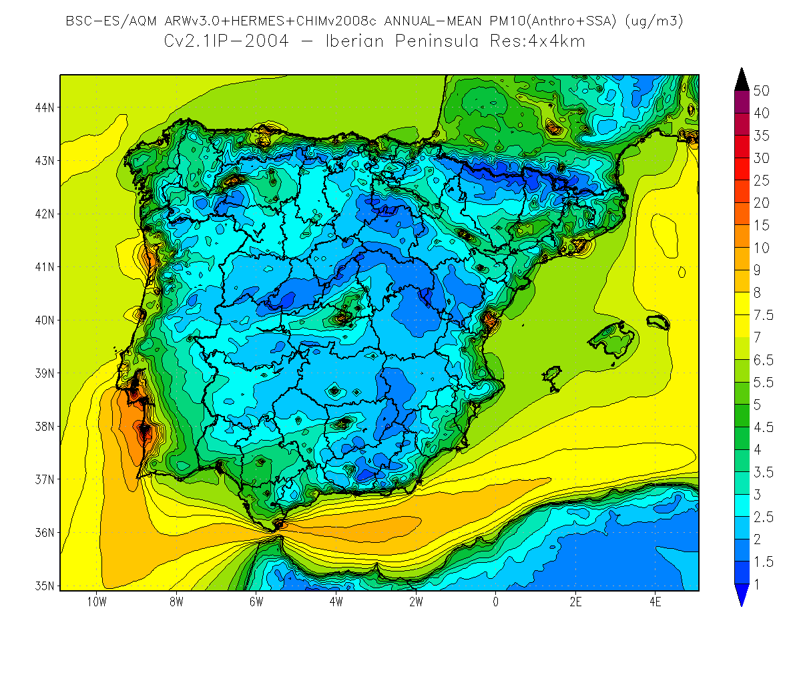
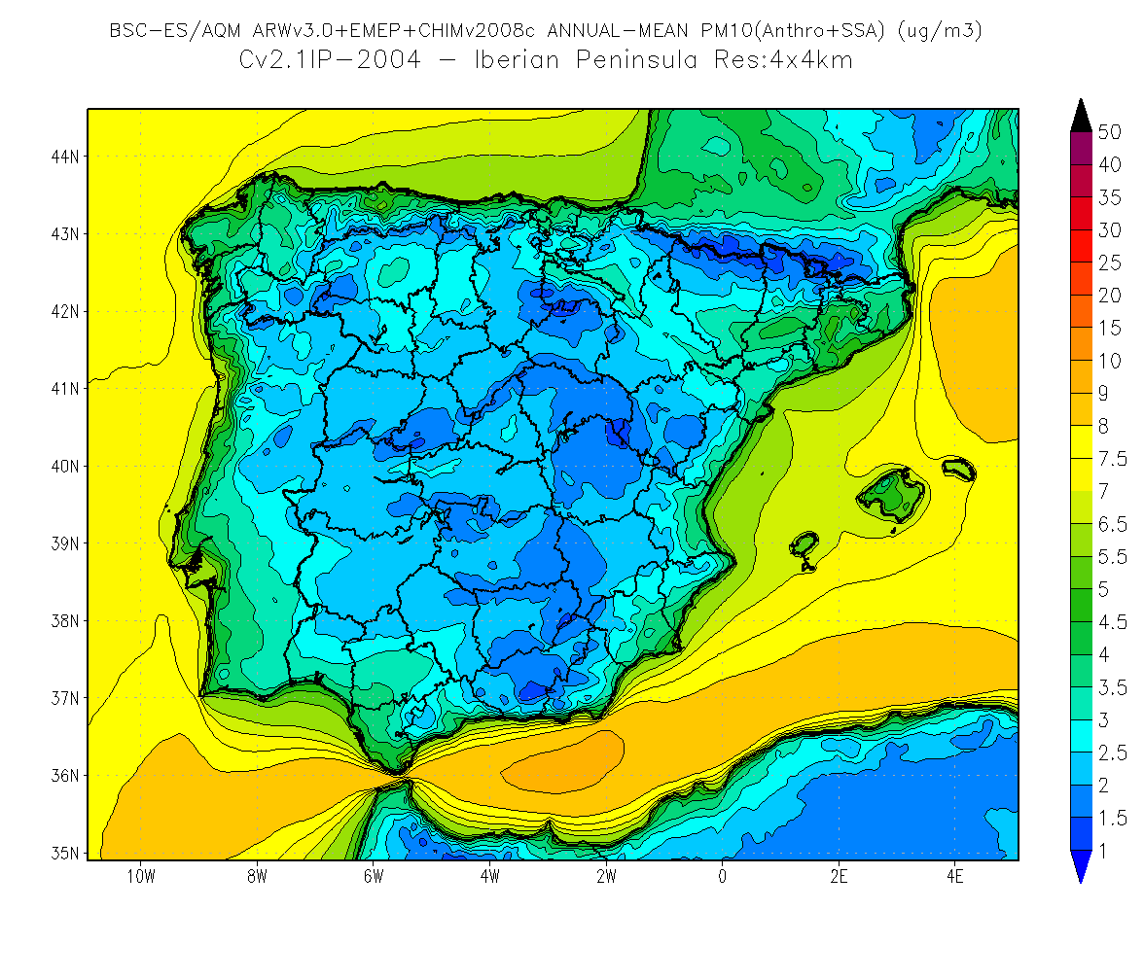
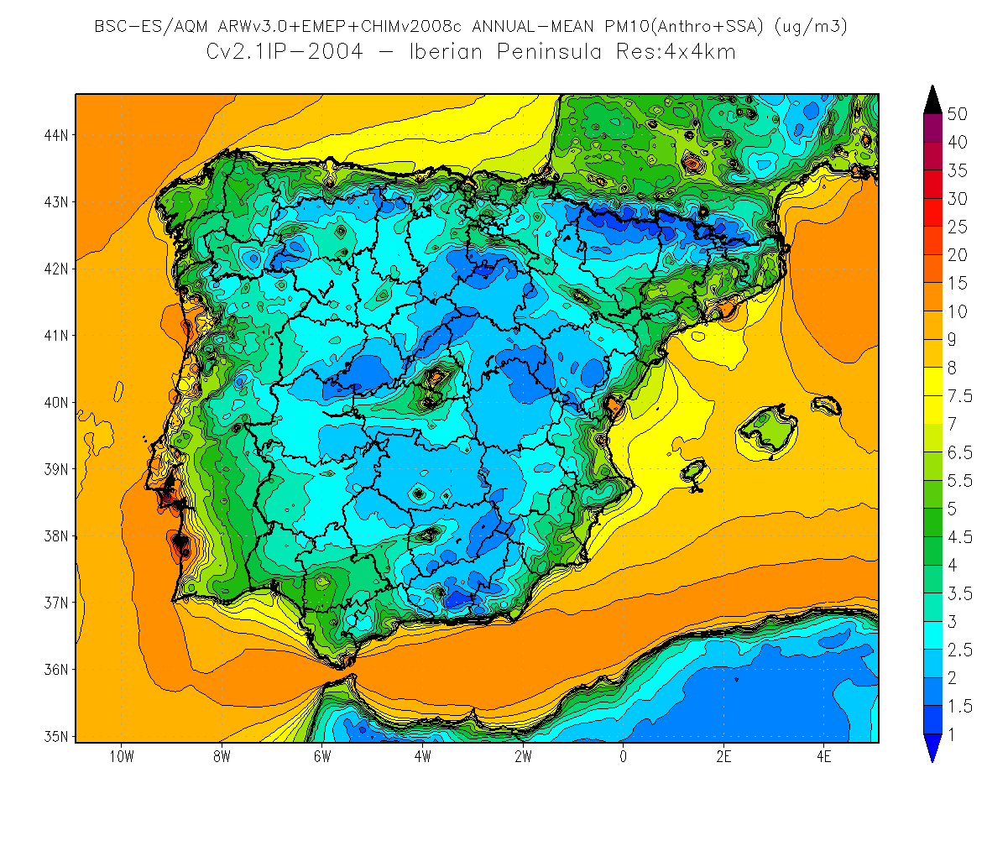
PM₁₀: Simulation year 2004, annual mean
CHIMERE+HERMES
CHIMERE+EMEP
The difference between CMAQ and CHIMERE to the average levels is not very strong
The impact of the emission inventory is crucial to the structure of the simulated concentrations
CMAQ+HERMES

Slide 16
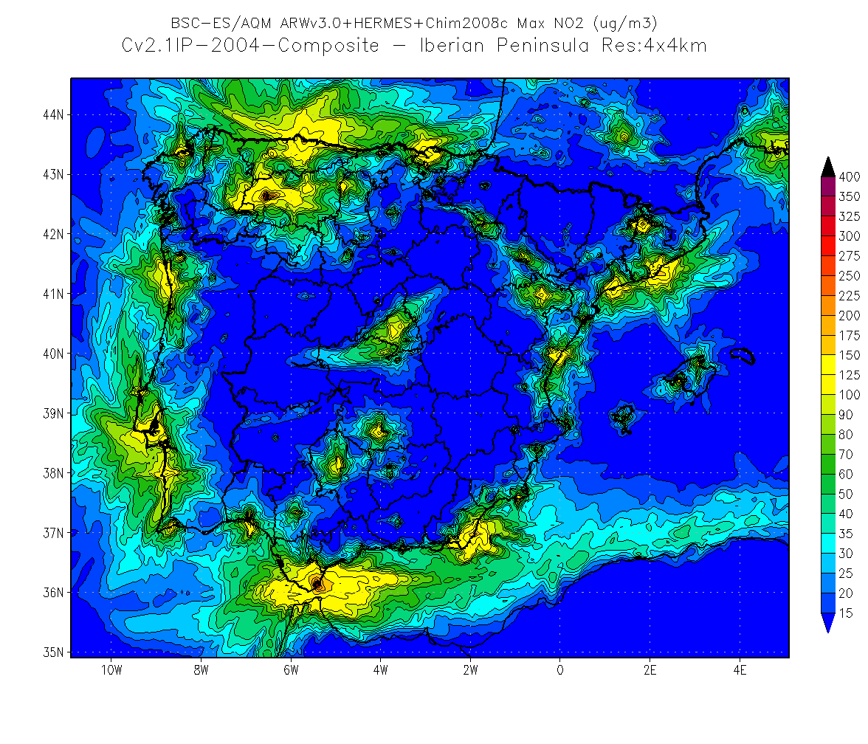
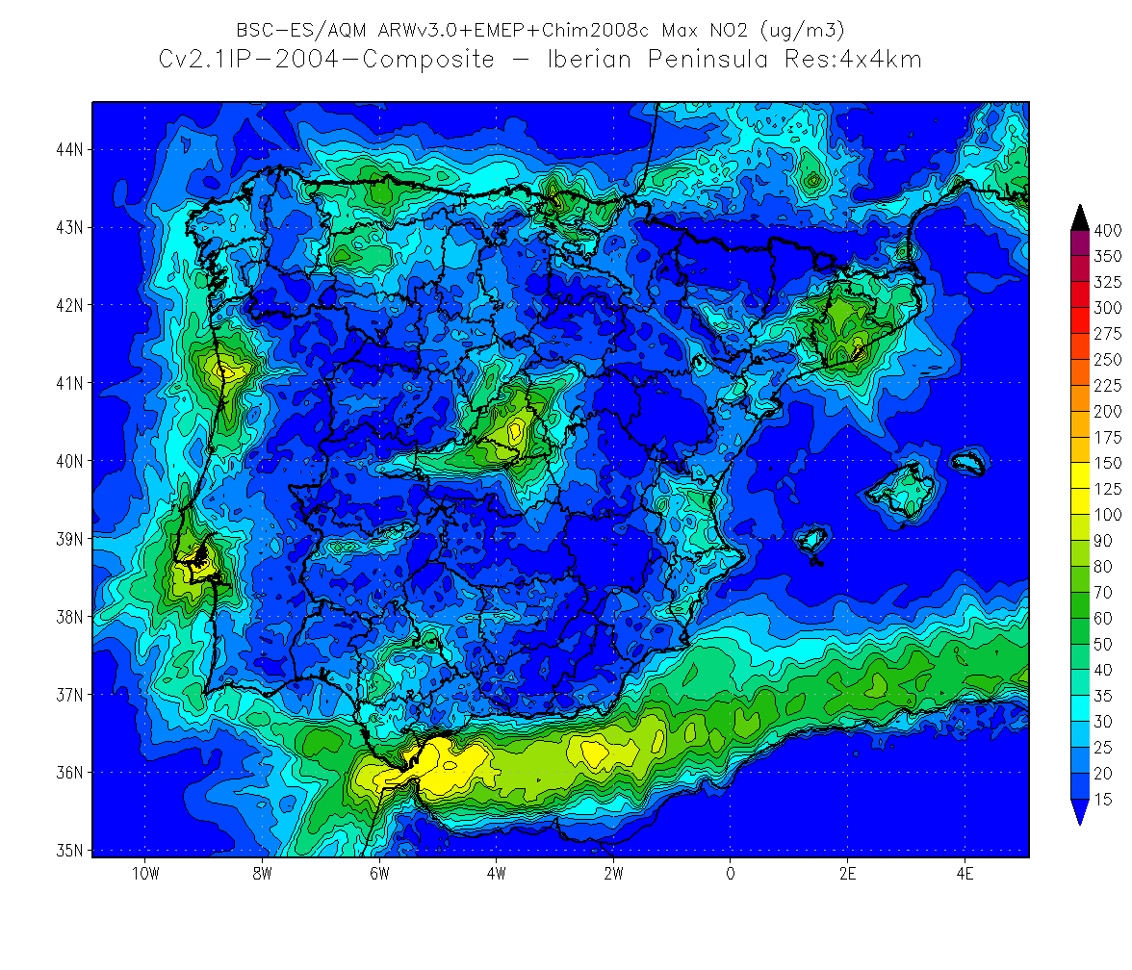
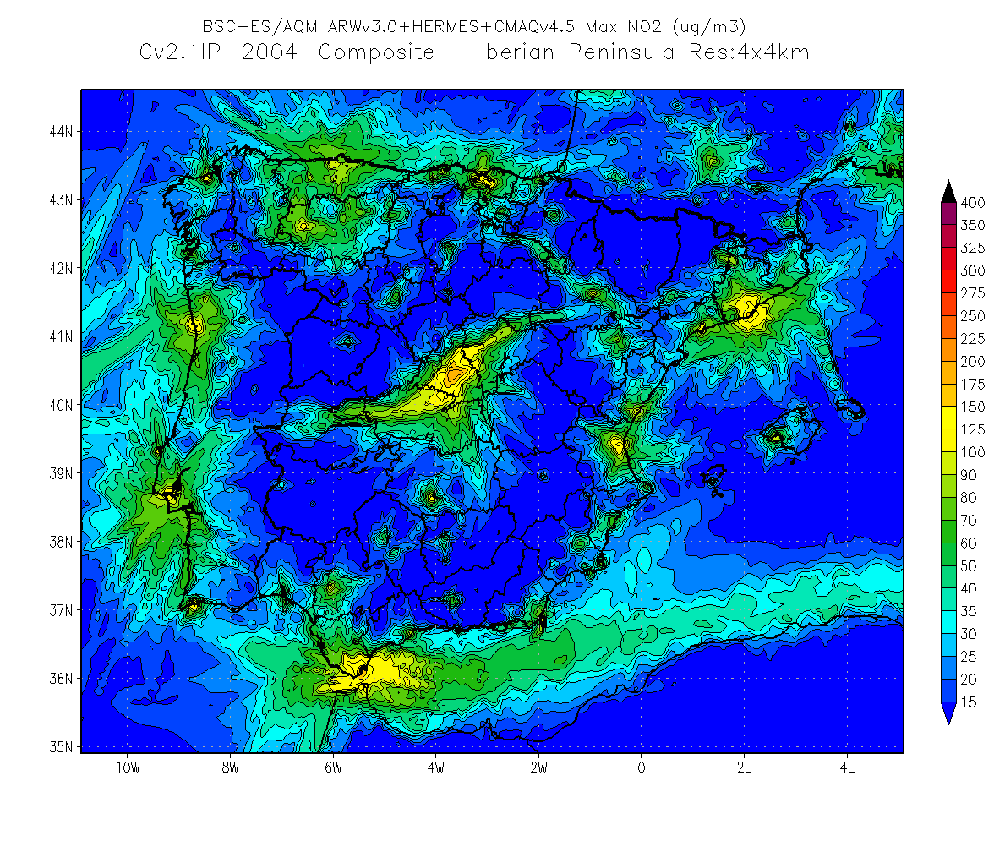
NO₂: Simulation year 2004, max annual mean
CHIMERE+HERMES
CHIMERE+EMEP
The impact of CTM is also important (see Northwest)
The emissions impact is critical, with maximum levels of NO₂ much higher with CHIMERE+HERMES
The maximum concentrations of NO₂ are stronger in CHIMERE+HERMES for the entire domain with the exception of the Madrid area
CMAQ+HERMES

Slide 17
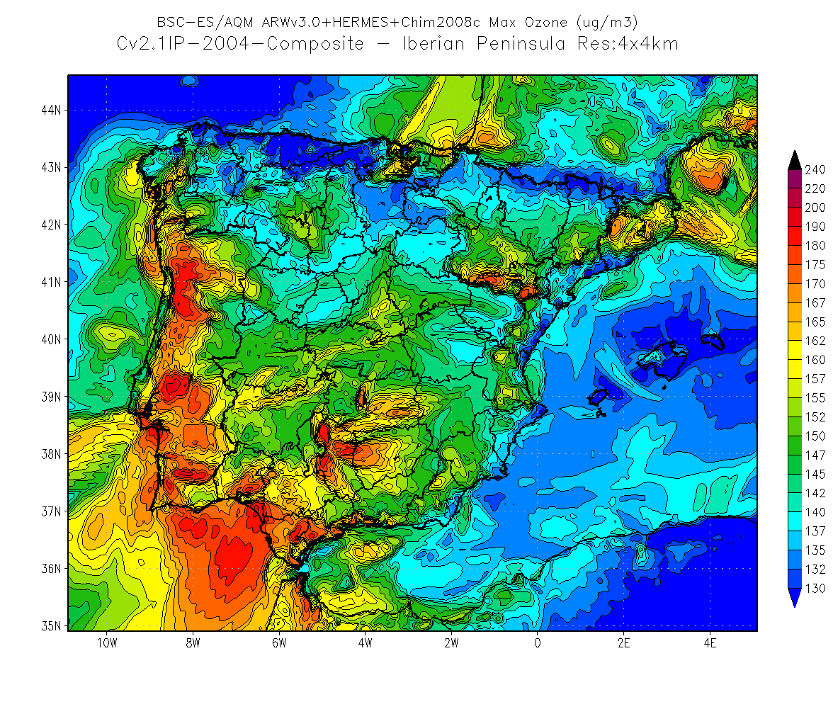
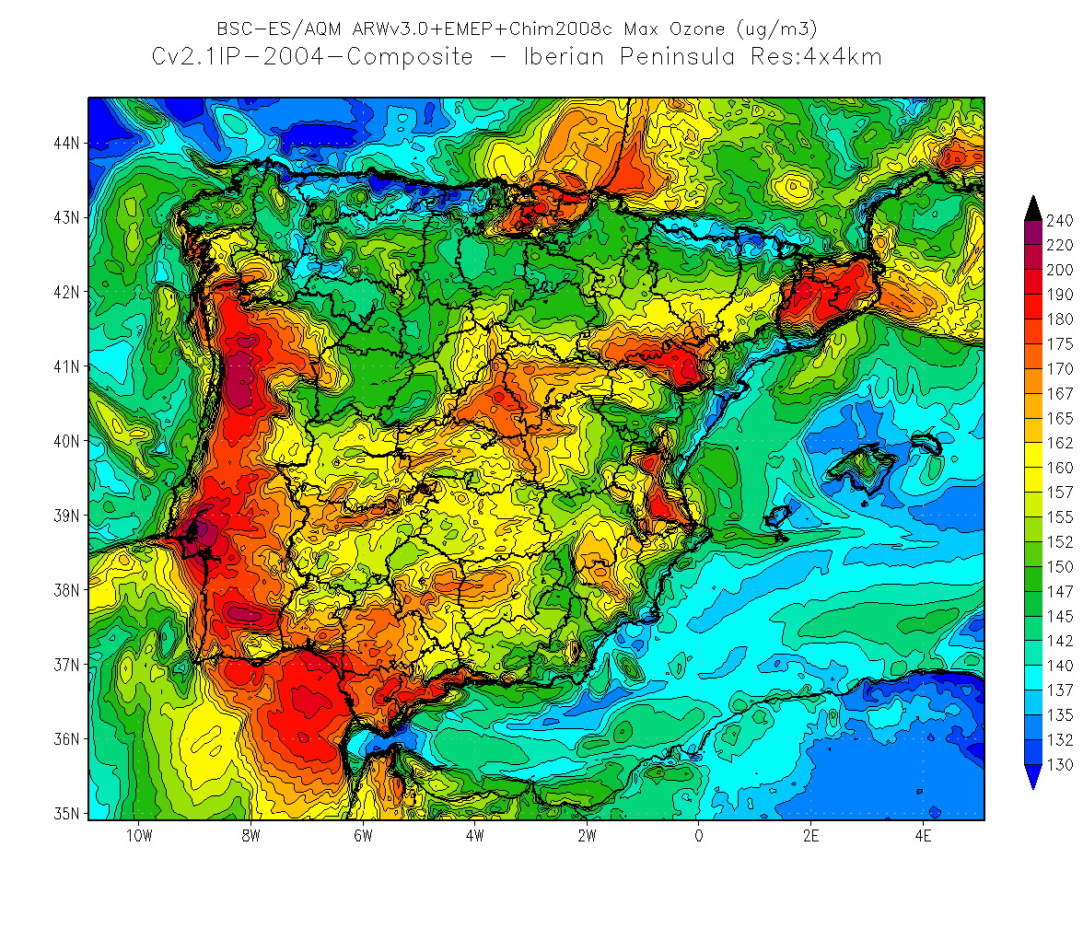
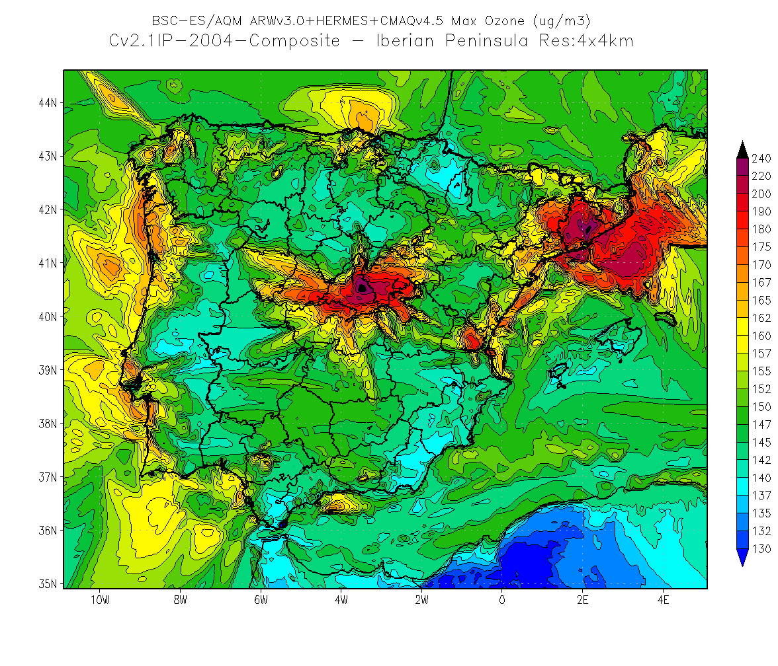
O₃: Simulation year 2004, max annual mean
CHIMERE+HERMES
CHIMERE+EMEP
CMAQ and CHIMERE have a very different behavior, with higher maximum O₃ in southern Spain in CHIMERE, higher in the central and northwest with CMAQ
Conc. of O₃ CHIMERE lower than CMAQ for the more industrial areas with more NO₂ emissions (northwest coast of Catalonia and Valencia)
Underestimating the maximum O₃ in Madrid and BCN area with CHIMERE+HERMES
CHIMERE con emisiones HERMES
CMAQ+HERMES

Slide 18
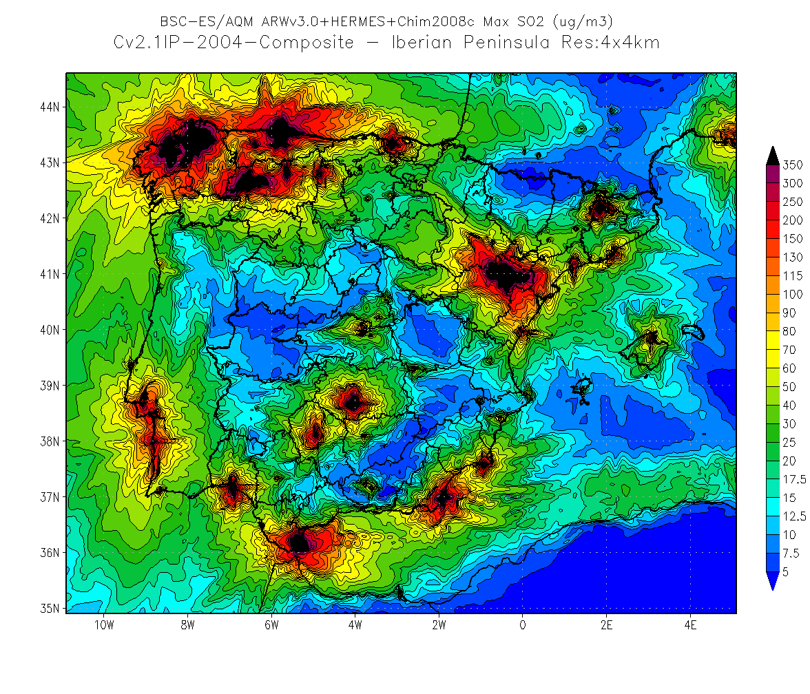
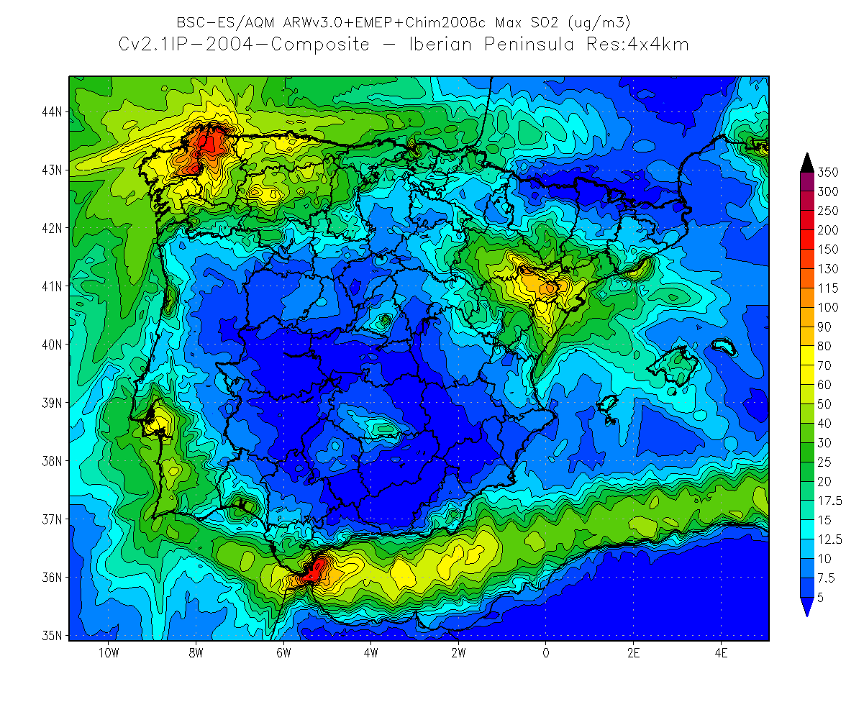
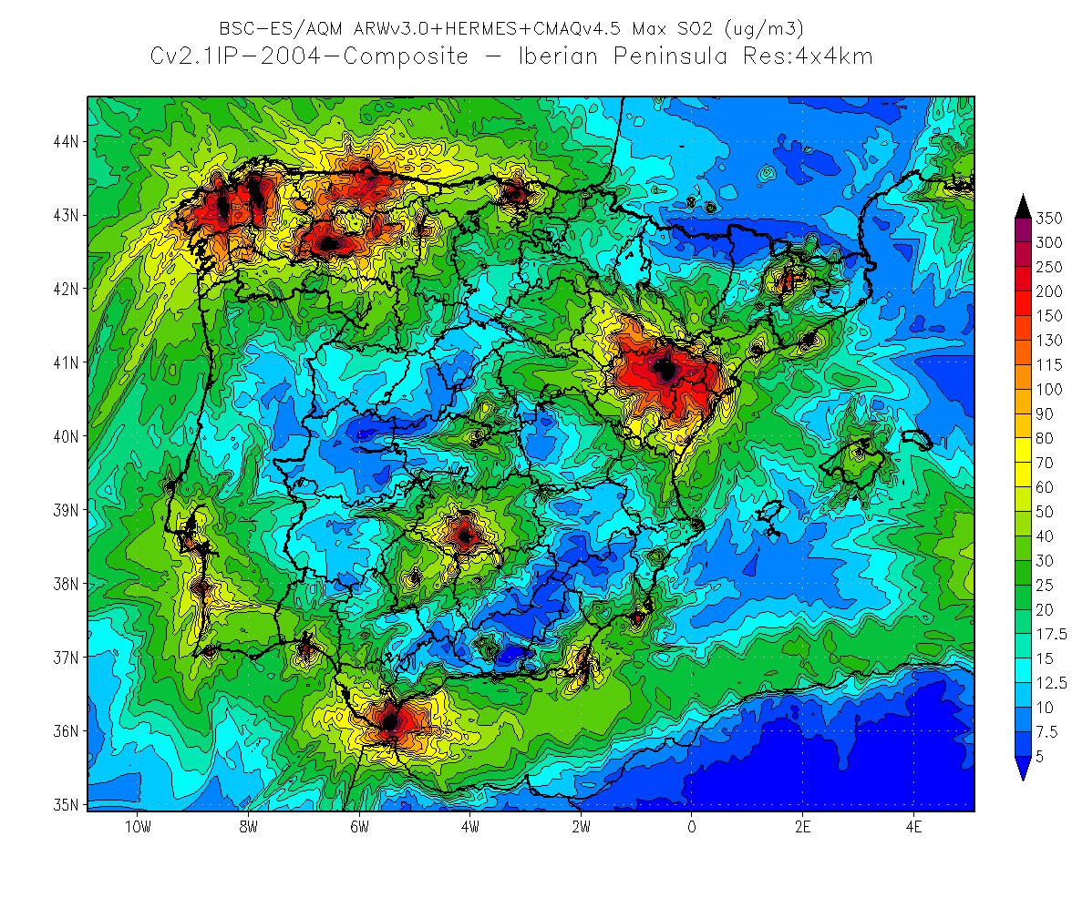
SO₂: Simulation year 2004, max annual mean
CHIMERE+HERMES
CHIMERE+EMEP
The maximum levels of SO2 are very low in the simulation CHIMERE-EMEP, lower than in any simulation HERMES simulated throughout the area
The values ​​of the maximum concentration of SO2 are more realistic with CMAQ. Does it cause?
CMAQ+HERMES

Slide 19
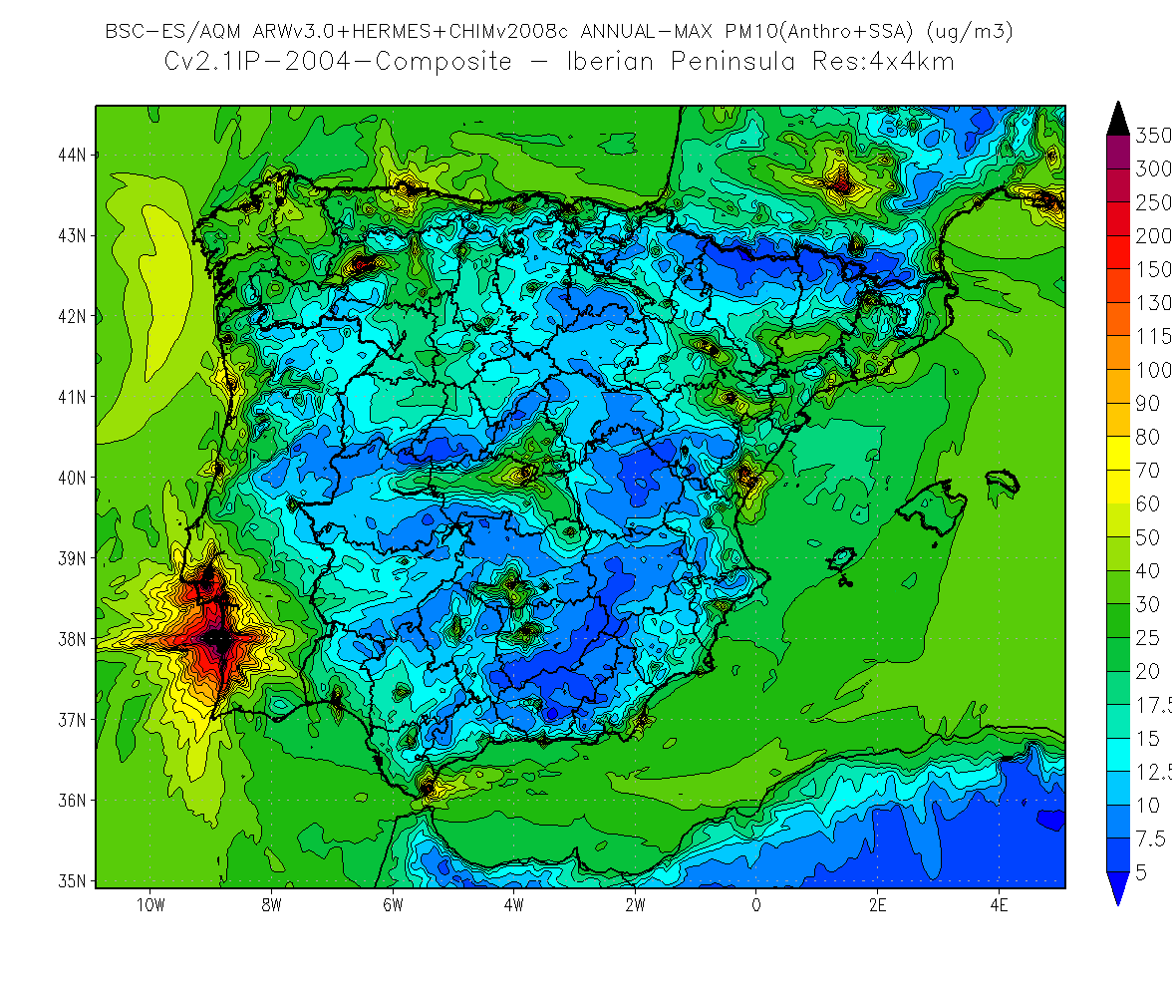
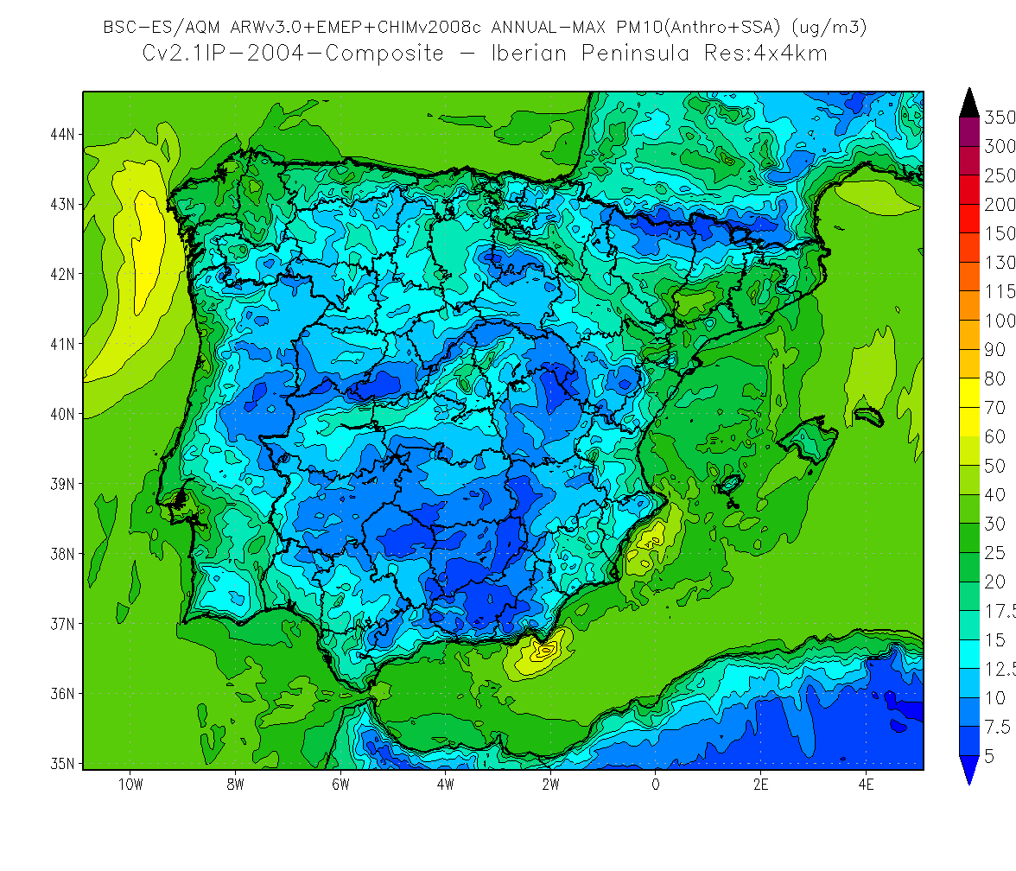
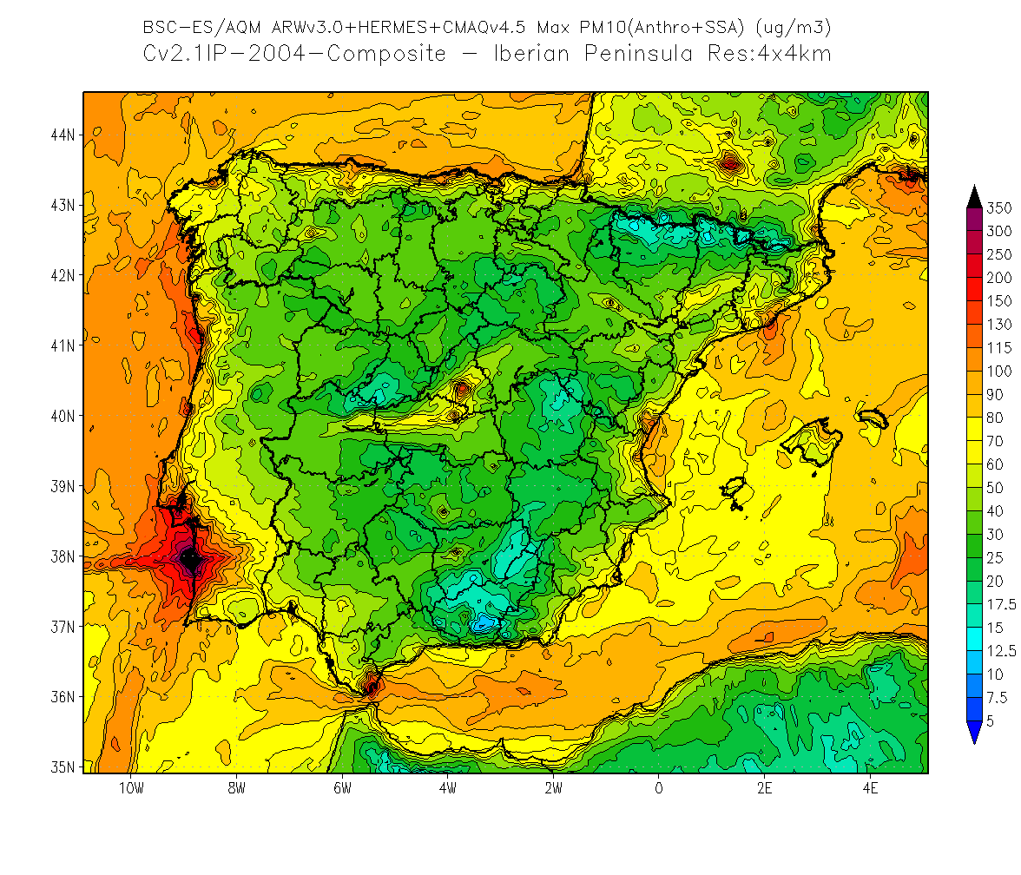
PM₁₀: Simulation year 2004, max annual mean
CHIMERE+HERMES
CHIMERE+EMEP
Clear difference between both CTM.
Better results with CMAQ
Special differences near of pollution sources: big cities, industries
The role of emissions inventory is crucial
CMAQ+HERMES

Slide 20
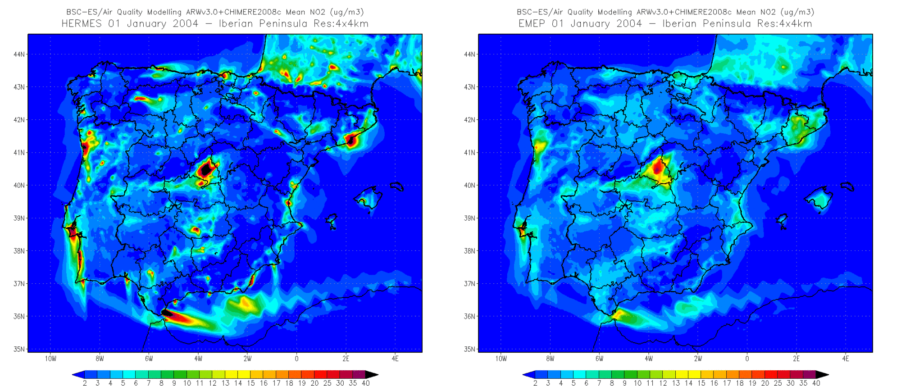
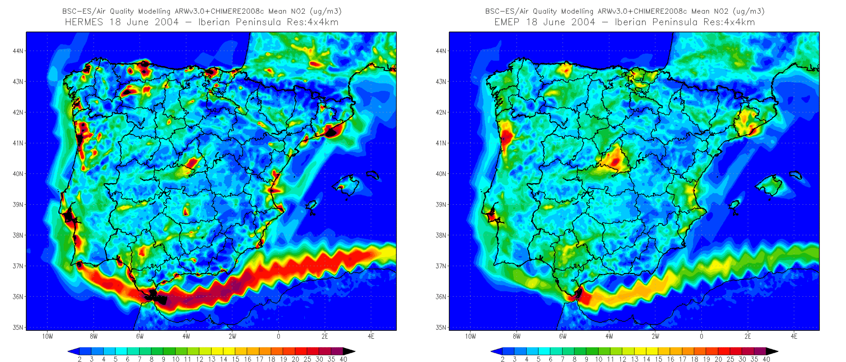
NO₂
Winter day
CHIMERE+HERMES
CHIMERE+EMEP
Summer day

Slide 21
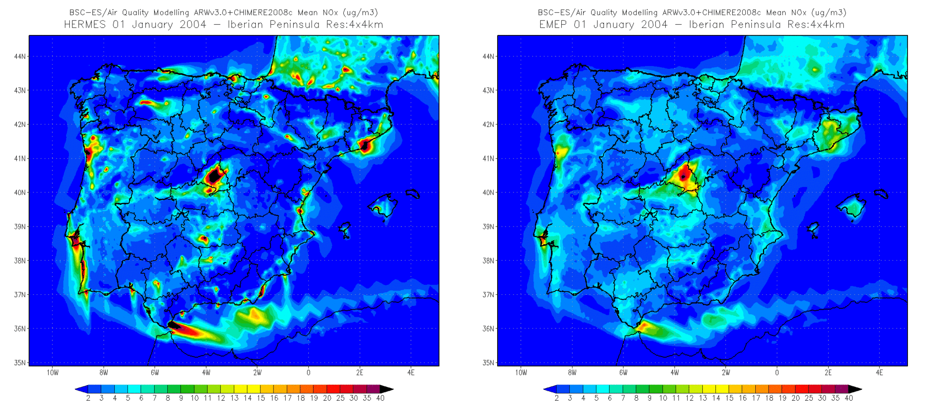
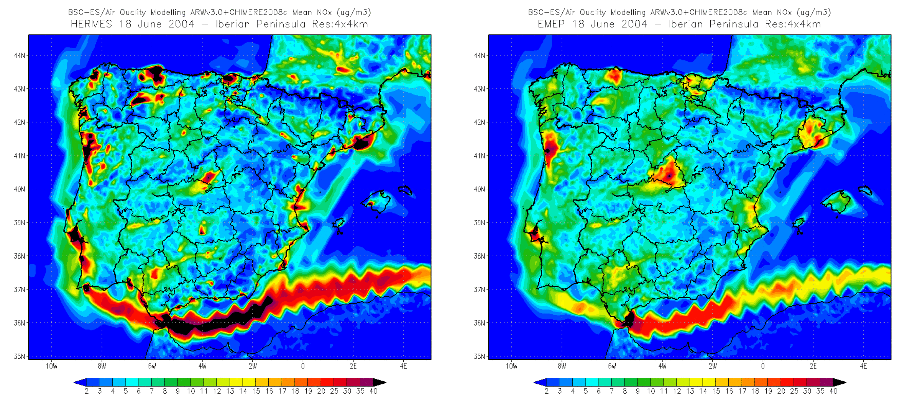
NO_{x}
Winter day
CHIMERE+HERMES
CHIMERE+EMEP
Summer day

Slide 22
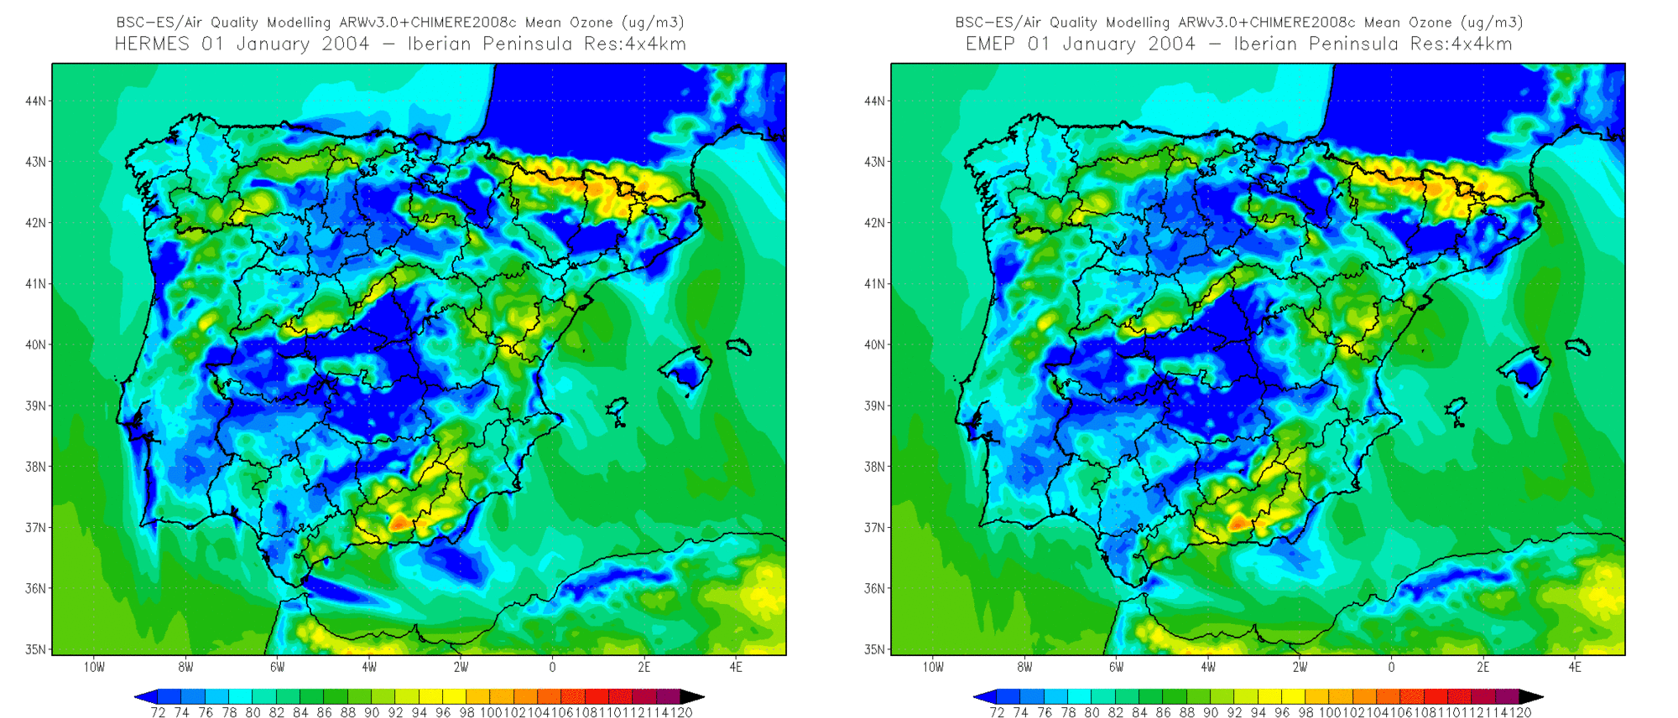
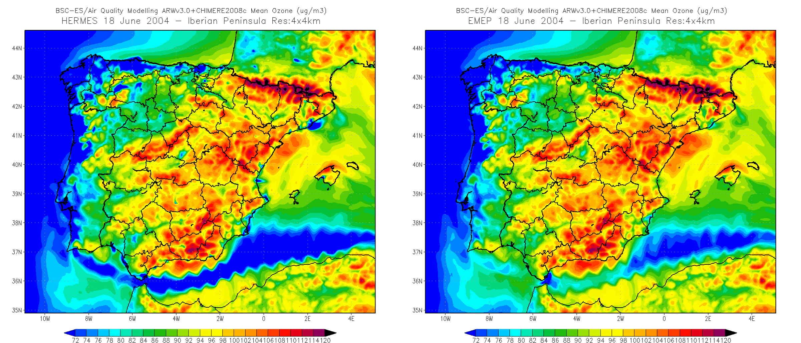
O₃
Winter day
CHIMERE+HERMES
CHIMERE+EMEP
Summer day

Slide 23
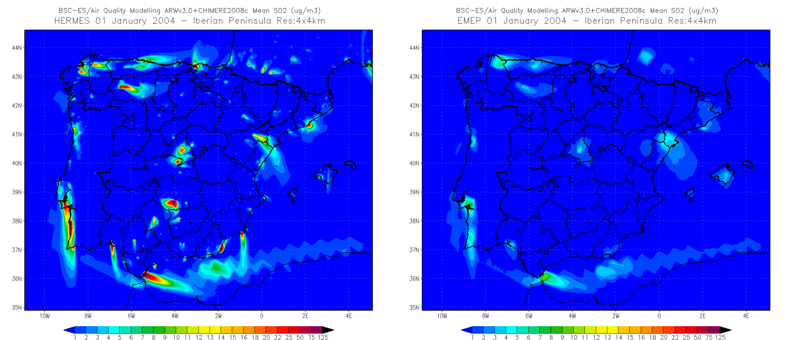
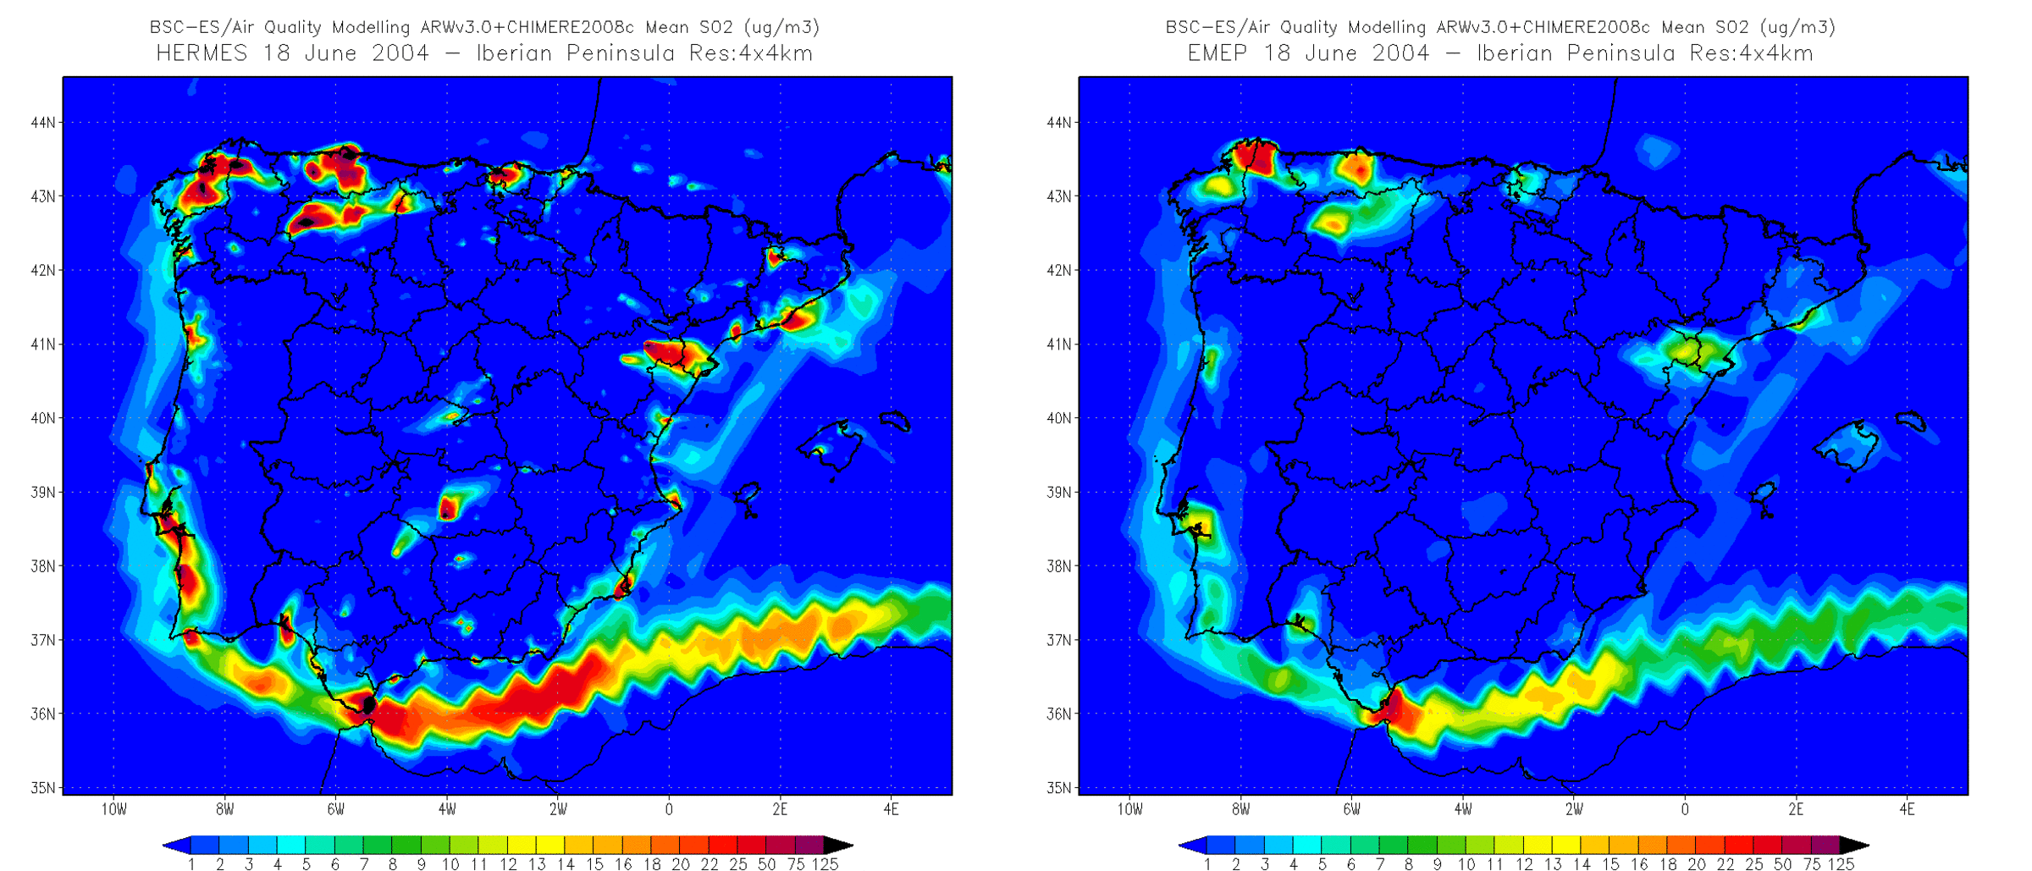
SO₂
Winter day
CHIMERE+HERMES
CHIMERE+EMEP
Summer day

Slide 24
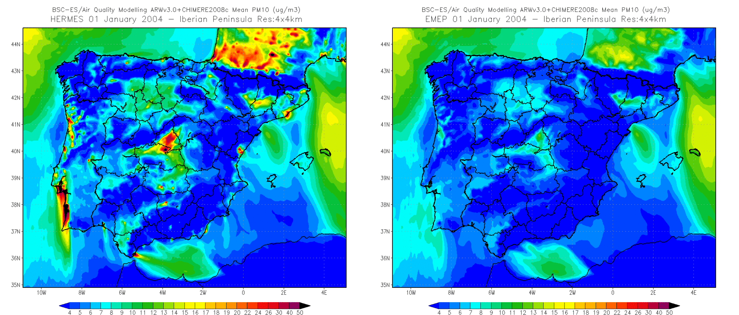

PM₁₀
Winter day
CHIMERE+HERMES
CHIMERE+EMEP
Summer day

Slide 25

Effective plume rise
In the simulation with the EMEP disaggregation inventory, the rate of SO₂ especially, NO₂ also, is much lower in the first layers of the model (about 50%).
This can be attributed to the large proportion of the EMEP emissions may fall outside the boundary layer, and thus not reach the ground (50% of emissions are above 500m), with HERMES more emissions enter into the boundary layer (50% of emissions below 250m)
Cumulative emissions (%, horizontal axis) as a function of height (m, vertical axis)

Slide 26
Comparison table (preliminary results)
 | Annual mean | Max annual mean
NO₂ | similar | CMAQ, peaks?
O₃ | CHIMERE | CMAQ
SO₂ | CMAQ, peaks? | CMAQ, peaks?
PM10 | CMAQ | CMAQ

Slide 27


Slide 28
Conclusions
The CALIOPE AQF system is contributing to a deeper understanding of atmospheric processes and the dynamics of air pollutants over Europe, and specially over Spain
The role of the emissions inventory is crucial.
It should be more explicit about disaggregation methods when using top-down inventory
The use of a bottom-up emission inventory with high resolution has clear advantages, marking their need
There are significant differences in results between both CTM: CMAQ and CHIMERE
The height of injection from the stacks is an important factor that should be carefully considered: especially for SO₂, but also for NO₂.
The operational forecasts are available at http://www.bsc.es/caliope.

Slide 29


THANK YOU FOR YOUR ATTENTION
CONTACTS:
jose.baldasano@bsc.es
Acknowledgments
This work was funded by the CALIOPE project 441/2006/3-12.1, 357/2007/2-12.1 and 157/PC08/3-12.0 of the Spanish Ministry of Environment.

