Slide 1
Developing Forward and Adjoint Aqueous Chemistry Module for CMAQ with Kinetic PreProcessor
Jaemeen Baek, Pablo Saide, Gregory R. Carmichael Annmarie G. Carlton*, Jessica Carlson
and Charles O. Stanier
University of Iowa
*Rutgers University
Oct. 25th, 2011. 10th Annual CMAS Conference

Slide 2
Overview
Background
Building KPP input equations
Forward box model tests
Forward CMAQ comparison
Developing an adjoint box and 3-D model

Slide 3
Background
When there are clouds or fogs, gas and aerosol phase species can dissolve into water droplets and participate aqueous chemistry, changing the concentrations of those species significantly
Aqueous chemistry is an important mechanism that oxidizes S(IV) to S(VI)

Slide 4

Atmosphere-Water Interactions
OH
O3
HO2
CO2
H2CO3*
HCO3-
H+
OH
O3
H2O2
NO NO₂
HNO₃
HNO₂
NH3
Wet deposition
Scavenging
NH4+
OH-
NO⁻₃
NO⁻₂
H+
Cl-
HCl
SO2
HSO₃⁻
SO2₃⁻
HCO₃⁻ Na⁺
Cl⁻ Mg²⁺
SO₂
H₂S
RSR
H₂SO₄
Dust
NH₄⁺ NO₃⁻
SO4²⁻ Na, Cl
Organic acids
(formic, acetic, oxalic, benzoic acids)
Aerosol
Aldehyde
(NH4)2SO₄
NH₄NO₃
Organics
(Adopted from the figure 5.2 in Stumm and Morgan, Aquatic chemistry)

Slide 5
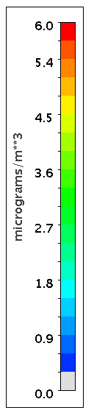
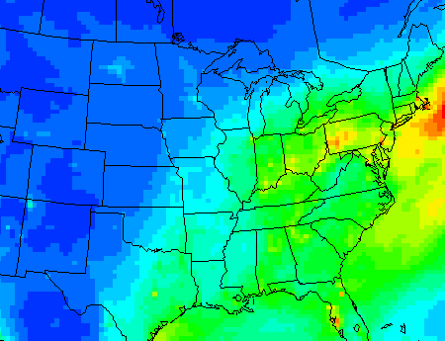
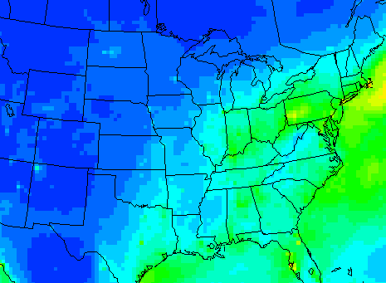
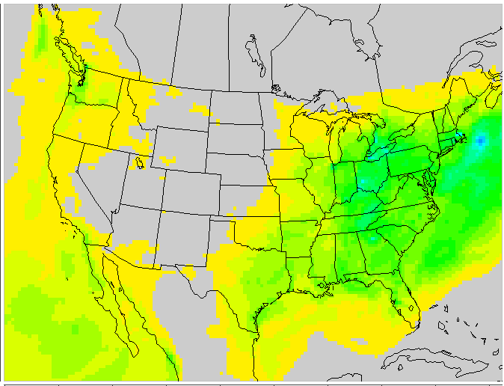
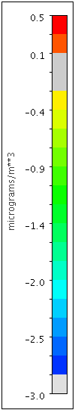
CMAQ Sulfate
No aq. chem. Sulfate
CMAQ – No. aq. chem
Jan. 11th – Jan. 31st, 2002

Slide 6
Rationale
It is expected that additional aqueous chemical reactions will be added to CMAQ, at least experimentally
In current CMAQ, the mechanism is embedded deeply within the code
  This causes two problems:
    Challenging to add new chemistry
    Very challenging to develop a new adjoint model if chemistry is changed
Using KPP solves both of these problems
  Mechanism is separated from the solver
  Adjoint model is generated automatically by KPP together with the forward model

Slide 7
Objectives
Developing the forward and adjoint model of aqueous chemistry is necessary as a part of CMAQ adjoint for aerosol model
Evaluate the Rosenbrock solver results with the CMAQ Forward Euler solver results
Develop the adjoint aqueous chemistry module and its evaluation

Slide 8
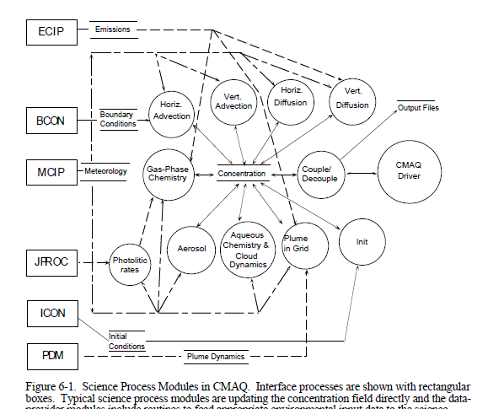
Aqueous Chemistry in CMAQ
Hetero.
CMAQ Science document, 1999

Slide 9
Aqueous Chemistry in CMAQ
Aqueous chemistry module is composed with…
  Equilibrium reactions
    Gas-liquid phase partitioning (Henry’s Law)
    Dissociation
  Kinetic chemical reactions
    S(IV) to S(VI)
  Removal mechanism
    Wet deposition and scavenging
    Analytical solutions to first order removal
  SOA formation from methyl glyoxal and glyoxal
  Forward Euler Solver and bisectional method are used

Slide 10
Advantage of using KPP for developing a Rosenbrock Solver
The strength of KPP is that “sparsity in Jacobian/Hessian is carefully exploited in order to obtain computational efficiency” (http://people.cs.vt.edu/~asandu/Software/Kpp)
Easier to extend to include more detailed chemistry
KPP generates forward, tangent linear and adjoint codes
Equilibrium reactions do not fit in KPP
  => Converted to kinetic reaction forms

Slide 11
Partitioning between Gas and Liquid Phase – Henry’s Law
KPP

Slide 12


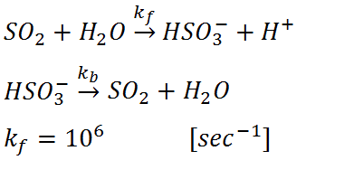

Dissociation
KPP
d_{f}: k_{f} for dissociation
d_{b}: k_{b} for dissociation

Slide 13


Wet deposition of aqueous species
KPP
Scavenging of Aitken mode aerosol
KPP

Slide 14
Dissolving aerosol or gaseous species to water droplet
KPP

Slide 15
Evaluation of Rosenbrock Solver
1) Sensitivities of final results to values of k_{f} and d_{f}
2) Wet deposition
3) pH tests with CO₂ (gas) only
  Initial pH is set as 7.0 in the Rosenbrock solver
4) Comparison of species concentrations
5) Mass balance of S(IV), S(VI), S(total), N, NH₃ and CO₂
6) Computational time

Slide 16
1) Sensitivities to k_{f} and d_{f}
k_{f} for partitioning and d_{f} for dissociation are set to a large number to force rapid equilibrium
  too large k_{f} and d_{f} may cause solver failure
  too large k_{f} and d_{f} may increase computation time
  too small k_{f} and d_{f} may delay reactions to reach an equilibrium
k_{f} and d_{f} are changed
from 10 ( forward reaction takes 0.1 second )
to 1,000,000 (sec⁻¹)

Slide 17
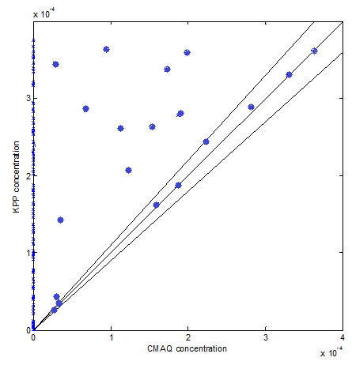
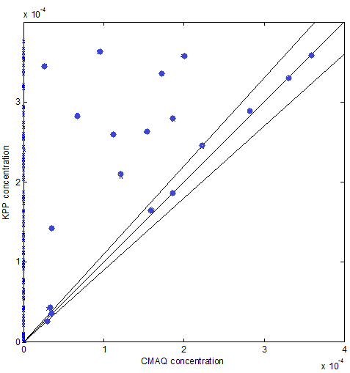
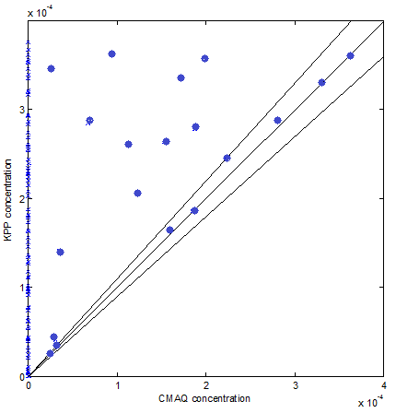
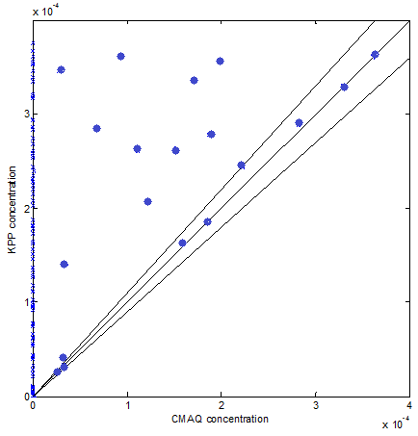
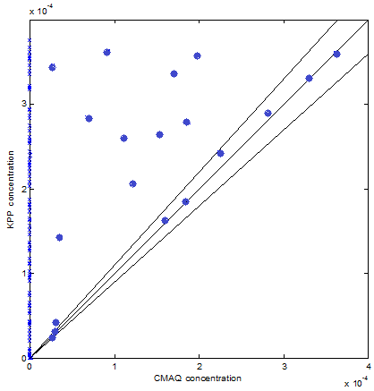
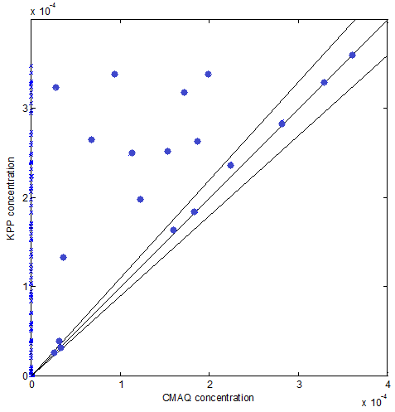
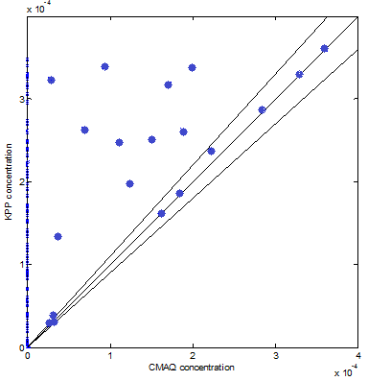

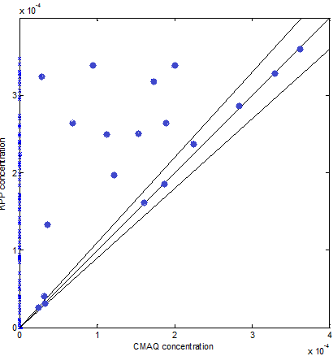
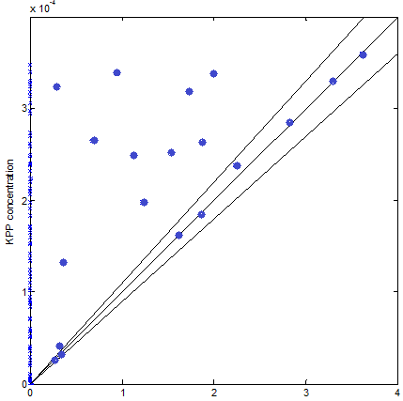
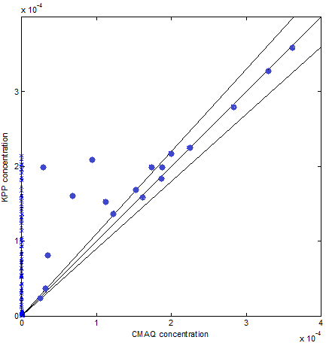
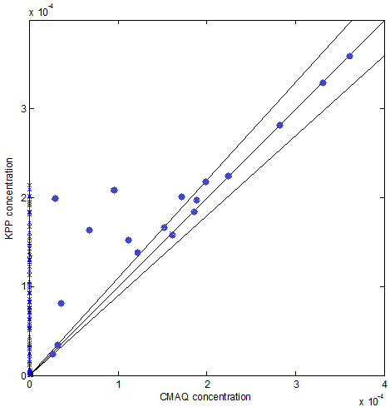
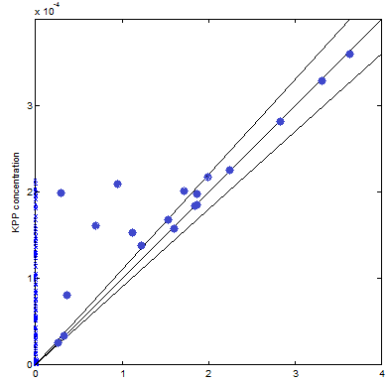
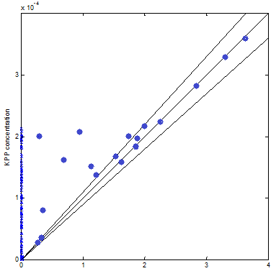
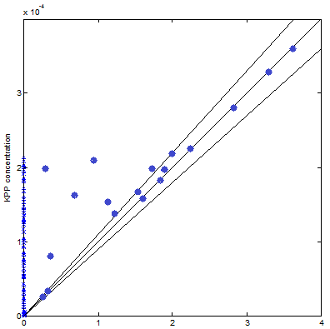
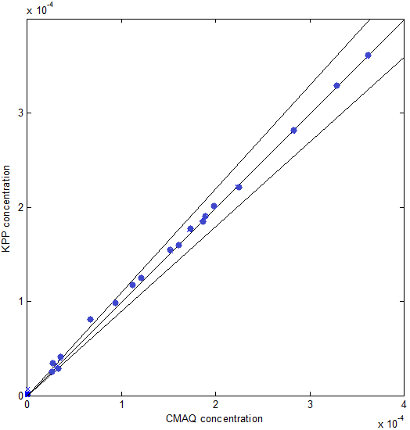
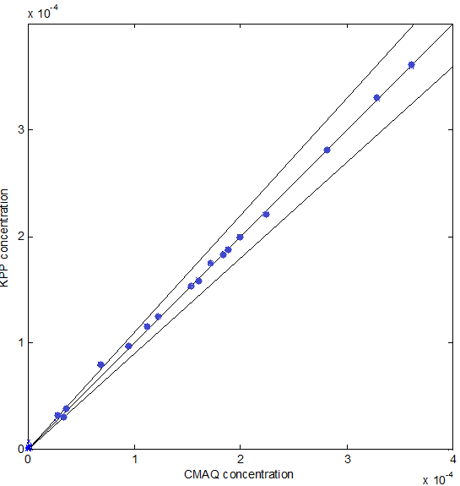
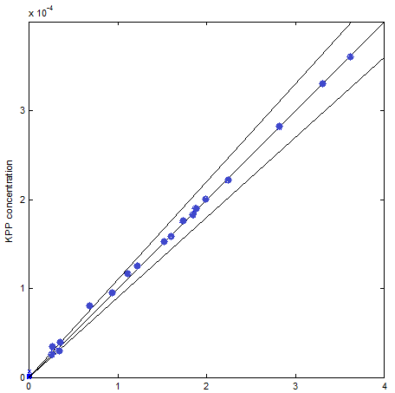
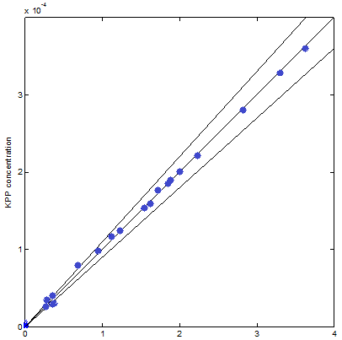
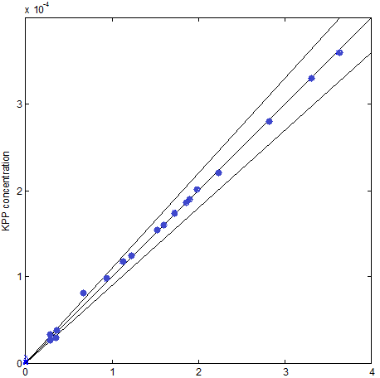
Kf (Partitioning) X-axis: CMAQ results Y-axis: KPP results
10 100 1,000 100,000 1,000,000
Kf
(Disso-
ciation)
10
100
1,000
10,000
k_{f} value has little influence
d_{f} >= 10⁵

Slide 18
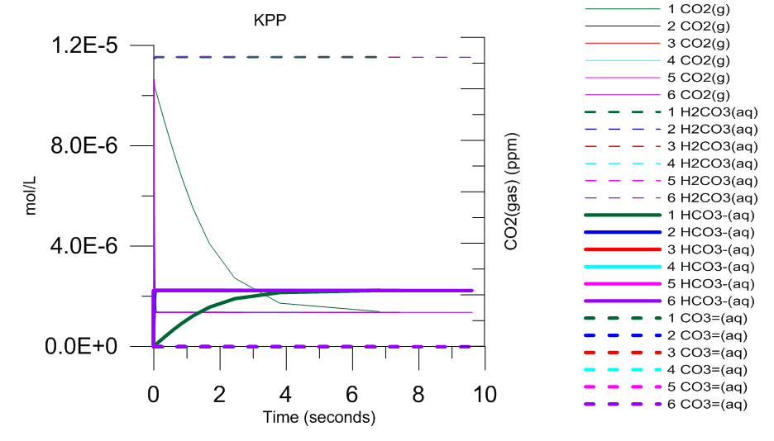
CO₂ species concentrations over time
CO2 (g) ( 320ppm at t=0)
k_{f} changes from 10 ( case 1) and to 10⁶ (case 6)
For k_{f} > 10², results are almost identical
Notes:
CO2 concentrations with different K values are almost identical
except when K = 10 sec-1 (green lines)

Slide 19
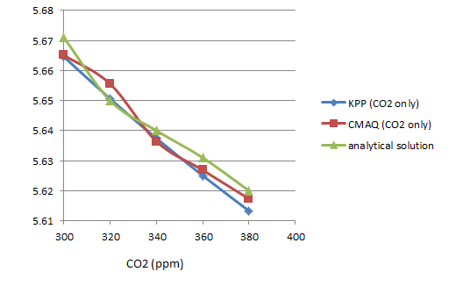
2) pH tests with CO₂ (gas)
The relative differences between KPP and the analytical solutions are less than 1%
pH was estimated
at 25 C
pH(t=0) = 7.0
Equations:
CO₂(g)  CO₂(aq)
CO₂  HCO₃⁻
HCO₃  CO₃²⁻
H₂O  H⁺ + OH⁻

Slide 20
3) Wet deposition
Precipitation rate is set unrealistically small to check how concentrations change

Slide 21
4) Comparison of species concentrations
Initial conditions
  300 sets of Initial conditions of 15 gases and 12 aerosols are randomly created within an atmospherically relevant range
  Cloud life time = 30 minutes without precipitation, and 5 or 15 minutes with precipitation

Slide 22
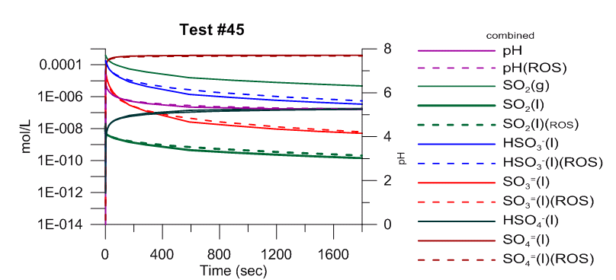
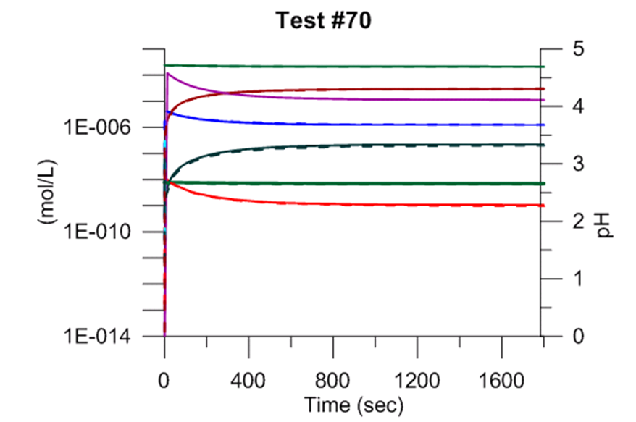
4-a) Concentrations Comparison – with O₃ and H₂O₂

Slide 23
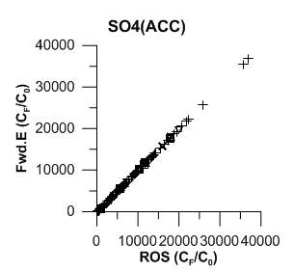
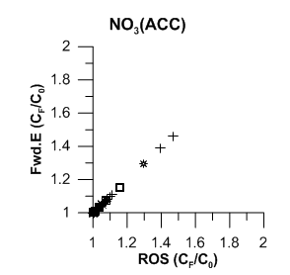
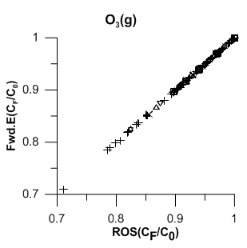
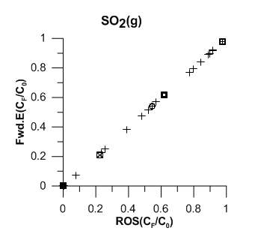
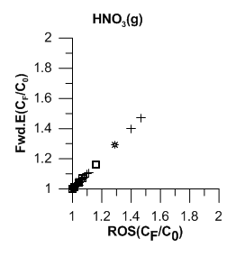
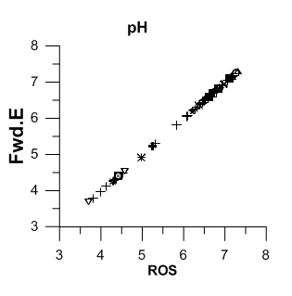
4-a) Concentrations Comparison – with O₃ and H₂O₂
S(IV) -> S(VI)
N₂O₅(g)->
NO₃(acc), HNO₃(g)

Slide 24
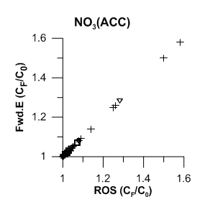
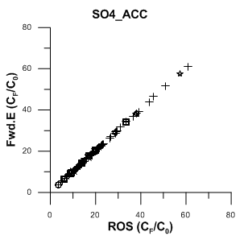
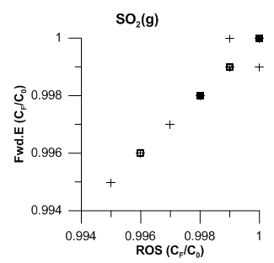
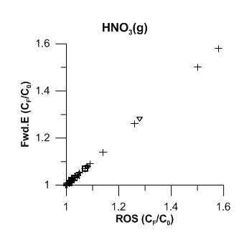
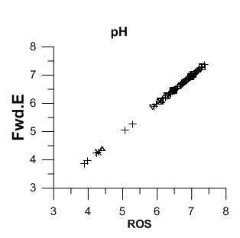
4-b) Concentrations Comparison – without O₃ and H₂O₂
H₂SO₄(gas)
=> SO₄(ACC)
N₂O₅(g)->
NO₃(acc), HNO₃(g)

Slide 25
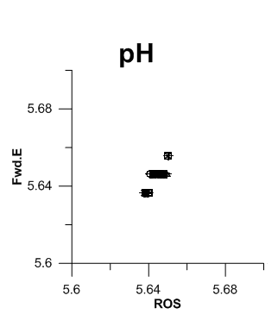
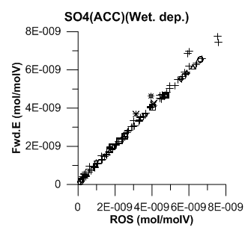
4-c) Concentrations comparison with precipitation
Precipitation rates = 1e-3 mm/hr, Liquid water content = 1g/m³ and cloud time = 15min.
Gas and aerosol concentrations => close to 0.0
pH => buffered dominantly by CO₂(gas)
pH changes with CO2

Slide 26
5) Mass Balance
Mass balance of S(IV), S(VI), total sulfur, nitrate, ammonia, and carbonate.
Species | ROS (mol/molV) |  | Fwd. E. (mol/molV)
 | t=0 | t=1800 (sec) | t=0 | t=1800 (sec)
S(IV) | 0.200e-06 | 0.144e-06 | 0.200e-06 | 0.144e-06
S(VI) | 0.278e-08 | 0.577e-07 | 0.278e-08 | 0.580e-07
S total | 0.202e-06 | 0.202e-06 | 0.202e-06 | 0.202e-06
N | 0.378e-08 | 0.378e-08 | 0.378e-08 | 0.378e-08
NH3 | 0.105e-07 | 0.105e-07 | 0.105e-07 | 0.105e-07
CO2 | 0.340e-03 | 0.340e-03 | 0.340e-03 | 0.340e-03

Slide 27
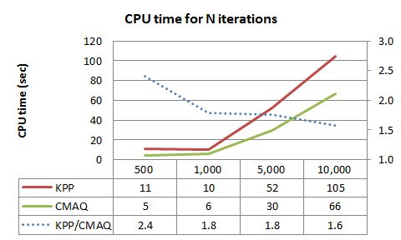
6) Computational time
KPP/CMAQ

Slide 28
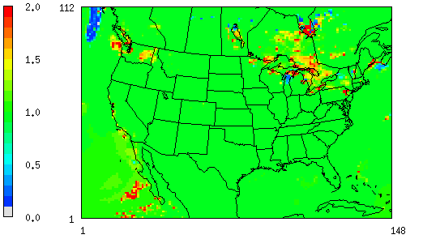
CMAQ Aq. Chem. with a Rosenbrock Solver – Sulfate
Under testing
Rosenbrock solver / Forward Euler solver

Slide 29
Adjoint Box Model
Run forward and adjoint integrator for the adjoint sensitivities tests with the finite differences.
Under testing and debugging

Slide 30
CMAQ adjoint Model – Cloud Processes
Cloud Dynamics
Aqueous Chemistry
Forward Mode
(water content, T, Precipitation, C(gas), C(aer))
Forward Mode
(water content, T, Precipitation, C(gas), C(aer), C(liq))
Backward Mode
(water content, T, Precipitation, C(gas), C(aer), λ )
Backward Mode
(water content, T, Precipitation, C(gas), C(aer), C(liq), λ )
(S. Zhao and A.Hakami, Carleton Univ.)

Slide 31
Future Work
Forward model
  Testing Rosenbrock solver in CMAQ simulation
  Comparisons of CMAQ simulations with Rosenbrock solver and forward Euler solver with computational time checking
Adjoint model
  Debugging/evaluation of the adjoint box model
  Debugging/evaluation of the CMAQ adjoint module for cloud processes

Slide 32
Acknowledgement
ShunLiu Zhao and Amir Hakami at Carleton University
Daven Henze at Colorado University
Sergey Napelenok and Rob Pinder at EPA
Although the research described in the article has been funded wholly or in part by the United States Environmental Protection Agency’s STAR program through grant R833865, it has not been subject to the Agency’s required peer and policy review and therefore does not necessarily reflect the views of the Agency and no official endorsement should be inferred.

