Slide 1

High-Order DDM Sensitivity Analysis of Particular Matter in CMAQ
Wenxian Zhang, Shannon Capps, Yongtao Hu,
Athanasios Nenes, and Armistead Russell
Georgia Institute of Technology
Oct 11, 2010

Slide 2
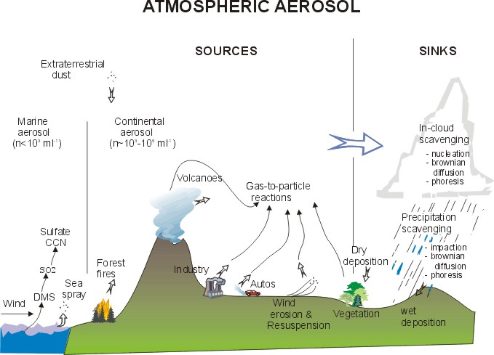
PM has the
potential to
affect
Visibility
Human health
Climate
…
Notes:
PM is a major pollutant in atmosphere. These particles are shown to have adverse impacts on environment and human health, especially the ones with a diameter less than 2.5 micro meters. This part of particular matter mainly comes from precursor gases, such as Nox, Sox from industry and mobile vehicles. In order to reduce the levels of PM, we need to know how the PM concentration responds to source emissions.

Slide 3
Sensitivity Analysis
A tool to quantify the response of pollutant concentrations to the changes in source emissions or other parameters
Sensitivity can be calculated by different methods, depending on the focus of application.
- Brute Force Method (BFM)
- Decoupled Direct Method (DDM)
- Adjoint
Input:
E, T, RH,
U, R…
Output:
Ci
Air Quality
Model
What’s the response?
Sensitivity
Notes:
Sensitivity is the right tool to do the job. It quantifies the respond of pollutants to emission changes. Linear response can be captured by first order sensitivity while non-linear response can be captured by higher-order sensitivities. Sensitivities can be calculated by several methods. If you want to look back from concentrations to sources, you may want to choose adjoint method; if you want to look forward from sources to concentrations, you may want to choose DDM. This study focuses on the forward approach and extended this approach to calculate higher order sensitivities.

Slide 4
Decoupled Direct Method
BFM
DDM-PM
E
Air Quality
Model
C(E)
Base Run
Air Quality Model
C₀
C
C _{gas}
C _{aerosol}
C _{transport}
E + ΔE
Air Quality
Model
C(E + ΔE)
Second Run
S₀
S
S _{gas}
S _{aerosol}
S _{transport}
E - ΔE
Air Quality
Model
C(E - ΔE)
Third Run
First Order
First Order
Second Order
Second Order
Notes:
DDM operates with an underlying AQM. Sensitivities are calculated by taking derivatives of the governing equation. DDM simultaneously computes pollutant concentrations and sensitivities. Compared to BFM, which needs several model runs to calculate the numerical approximation of sensitivities, DDM is apparently time-saving and more accurate.

Slide 5
Brief History of DDM Sensitivity in Air Quality Models
1980’s: Dunker developed for air quality modeling
- Gas phase, first order
1997+: Implementation in CIT, URM, CMAQ, CAMx
2002+: First order aerosol phase (eg., Boylan et al., 2002 in URM; Napelenok et al., 2006 in CMAQ; Koo et al., 2007 in CAMx)
2003: High order gas phase (eg., Hakami et al. 2003 in CMAQ)
- Use for source apportionment and uncertainty analysis
Notes:
Here’s a brief history of DDM in air quality models. It came out in 1980’s to conduct first-order sensitivities for gases. In later 1990’s it has been widely implemented in AQMs. After 2000, first order DDM sensitivity for particular matter became available. In 2003, high-order sensitivity analysis has been implemented in CMAQ for application in source apportionment and uncertainty analysis. This study, will extend the high-order DDM to particular matters.

Slide 6
Implementing HO DDM-PM in CMAQ:
First Order
Second Order
(Solve using the same algorithm for concentrations)
Notes:
These are the basic steps to implement high-order DDM of PM in CMAQ. The first equation is the governing equation describing advection, diffusion, and chemical transformation of particulate matters. Taking derivatives of the governing equation twice gives second-order sensitivity equations. Solving the equations gives second-order DDM sensitivities.

Slide 7
ISORROPIA
Sulfate-ammonium-nitrate-
chloride-sodium system
RH, temperature
Total concentrations
H₂SO₄, NH₃, HNO₃,
HCl, H₂O_{v}
H⁺, NH₄⁺, Na⁺, Cl⁻, SO₄⁼, HSO₄⁻, NO₃⁻, OH⁻, H²O,
NH_{3(aq)} , HNO_{3(aq)} , HCl_{(aq)}
Salts
Equilibrium equations
Notes:
Things become a little complicated when it comes to the interaction between particular matter and gases. They undergo equilibrium reactions and their concentrations are simulated by ISORROPIA in CMAQ. Given the total concentration of sulfate, ammonium, nitrate, chloride, and sodium, ISORROPIA partitions gas and particle based on equilibrium equations. And these equations are the starting point to develop DDM sensitivity analysis.

Slide 8
Calculating Second-Order (and higher)
DDM Sensitivities
Equilibrium Equation
First-Order
Sensitivity Equation
Second-Order
Sensitivity Equation
Second-Order Sensitivities;
Higher order found from similar
Processes (eqs. very similar to 1st order)
Available from 1st order
Notes:
Here is an example to show how to get high-order DDM sensitivities from equilibrium equations. Taking the equilibrium between nitrate and nitric acid gas for example, taking derivative on both side of the equation gives equations to solve for first-order sensitivity. Taking further derivative gives the equation of second-order derivative. It has similar structure to the first-order equation on left-hand-side, and needs sensitivity from first-order equations on the right-hand-side. Repeating this process will lead to higher order sensitivities. When implementing DDM in ISORROPIA, we applied an approach that follows the solution routine in ISORROPIA and also considered the effects of the activity and water content on sensitivities.

Slide 9
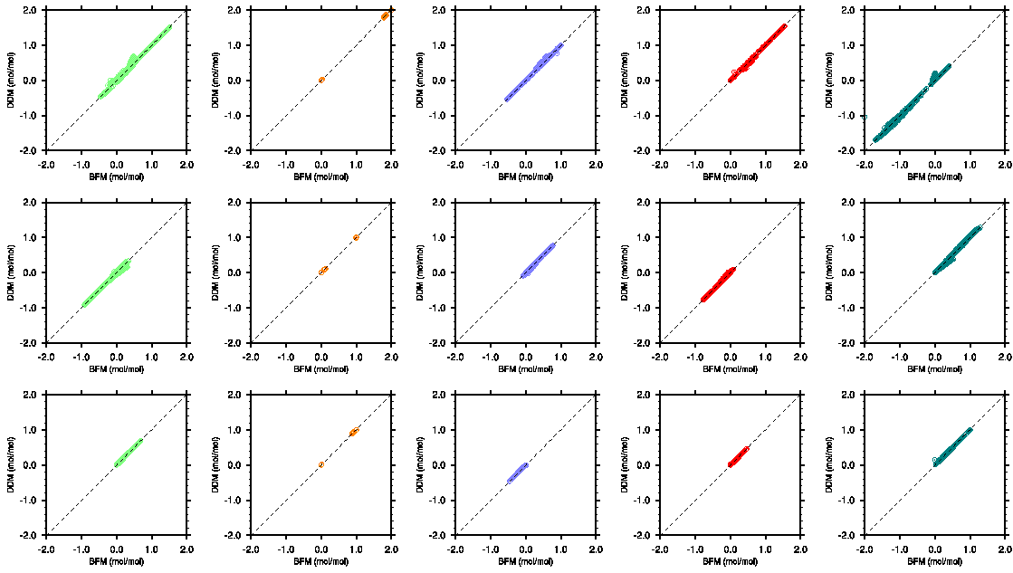
Evaluation of DDM Performance: First Order
RH = 95% T = 298K
Total Sulfate: 0.1~10μmol/m³
Total Ammonium: 0.1~10μmol/m³
Total Nitrate: 0.1~10μmol/m³
Total Sodium: 0.5μmol/m³
Total Chloride: 1.0μmol/m³
H⁺ NH₄⁺ SO₄⁼ HSO₄⁻ NO₃⁻
TS
TA
TN
DDM Sensitivities (mol/mol)
Brute Force Sensitivities (mol/mol)
Notes:
We use brute force method to evaluate DDM results. Let’s first look at how they compare within the stand-alone ISORROPIA. Here’s the cases we tested: RH 95%, T-298K, …, The points in the figures are showing first-order sensitivities with bfm on x axis, ddm on y axis. For example, this figure is showing the first-order sensitivity of hydrogen ion w.r.t. TS. TA, and TN. We got good agreement between ddm and bfm. Also the values of sensitivities are making physical sense. Positive sensitivity of hydrogen ion to total sulfate reflects the increase of acidity of the aerosol when adding sulfate; negative value of the sensitivity to ammonia reflects the reduction in acidity. Also, look at the sensitivity of nitrate, the positive value of the sensitivity to total sulfate reflects the fact that adding sulfate will push nitrate back to the gas phase; positive value of the sensitivity to total ammonium and nitrate means that adding both ammonium and nitrate will increase nitate concentration in aerosol.

Slide 10
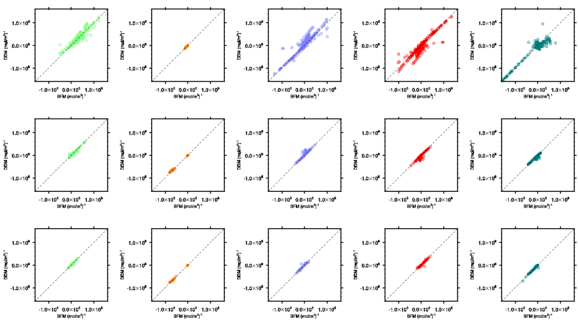
Evaluation of DDM Performance: Second Order
RH = 95% T = 298K
Total Sulfate: 0.1~10μmol/m³
Total Ammonium: 0.1~10μmol/m³
Total Nitrate: 0.1~10μmol/m³
Total Sodium: 0.5μmol/m³
Total Chloride: 1.0μmol/m³
H⁺ NH₄⁺ SO₄⁼ HSO₄⁻ NO₃⁻
DDM Sensitivities (mol/m³)⁻¹
TS
TA
TN
Brute Force Sensitivities (mol/m³)⁻¹
Notes:
Then let’s look at the second-order sensitivity. Same input to ISORROPIA, same arrangement of figures, again, same good agreement. The message second-order sensitivity sent to us is that the system is non-linear. Positive value indicate a convex response while negative values indicate a concave response. Take the first figure for example, we know first order sensitivity of H to TS is positive. Now we got positive second-order sensitivity, which means the response of hydrogen ion to total sulfate will go a concave way. Also, compare to the previous figures, we see more noisy behavior, which will be explained in next slide.

Slide 11
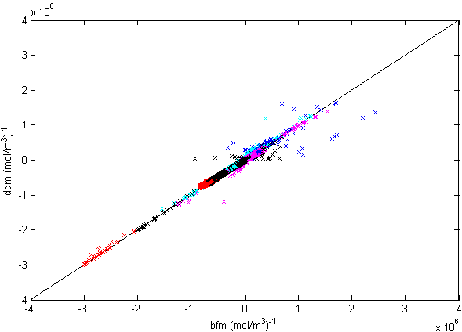
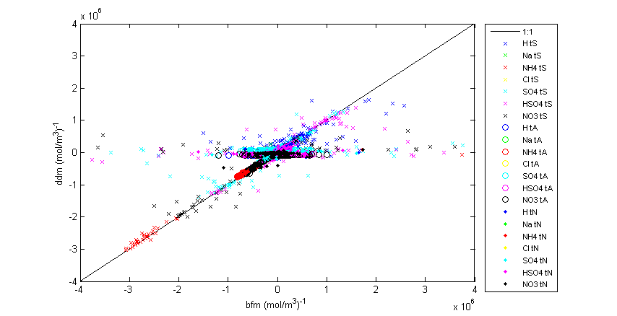
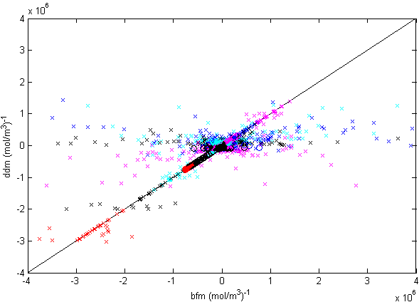
Accuracy: DDM versus BFM
Noisy BFM second-order
sensitivities
- Perturbation (Δ)
- Convergence criteria (ε)
Notes:
One thing we need to be caution is that bfm is not always reliable in terms of high order sensitivity. In some cases, its value is changing with perturbation delta and the convergence criteria used in ISORROPIA. This is an example to show the noisy behavior of bfm sensitivity. The three figures are comparison of ddm and bfm sensitivities for the same input in ISORROPIA. Smaller perturbation or looser criteria will lead bfm to be noisy. We investigate the noisy points further and found that bfm sensitivity does not satisfy the charge balance, so bfm is not accurate at these conditions, but ddm seems to give a resonaable value.

Slide 12
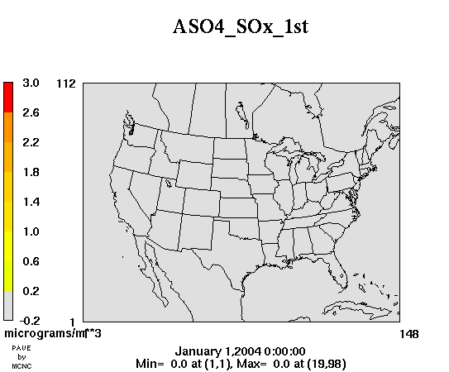
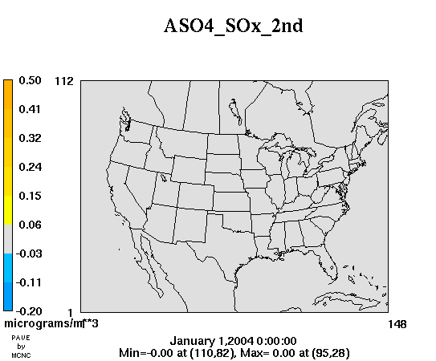
Performance of HO DDM-PM in CMAQ
Aerosol Sulfate (AS)
First Order Sensitivity of AS to SOx
Second Order Sensitivity of AS to SOx
Episode: Jan1 – Jan 7, 2004
Grid resolution: 36km, 13 vertical layers
Meteorology: MM5
Emissions: SMOKE
Notes:
Then let’s look at how high-order DDM works in CMAQ. We set up a test run of CMAQ4.5 for the first week of 2004. Those two movies are showing first and second order sensitivy of AS to total sox. As we expected, the sensitive region is in East US. Secoond order sensitivy is small compared to the first one but they do have a noticebale magenitude.

Slide 13
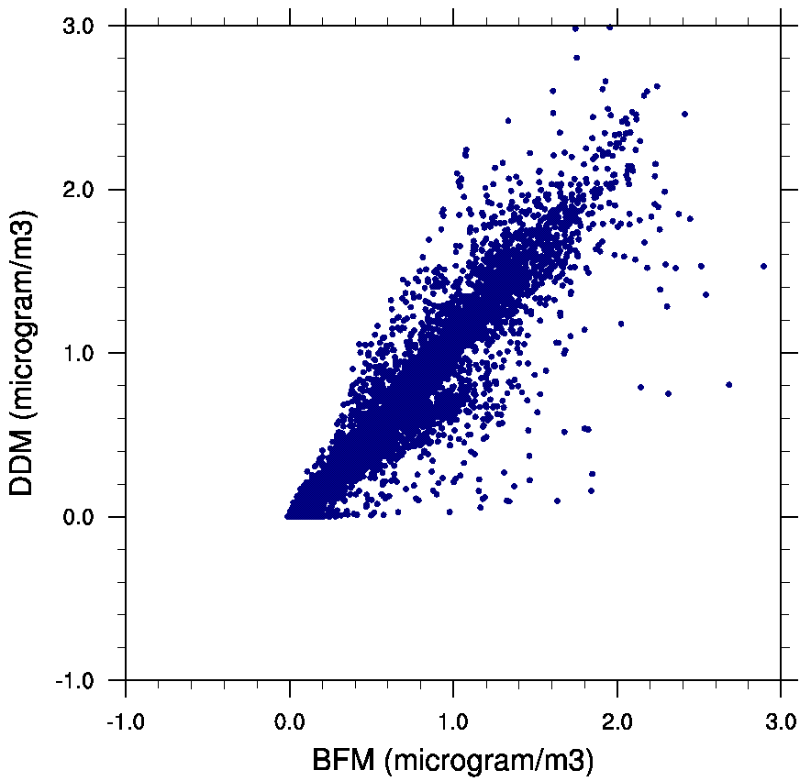
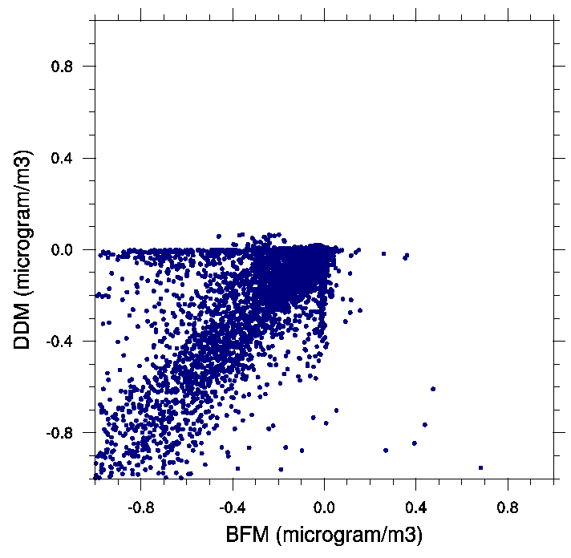
Evaluation of HO DDM-PM in CMAQ
Aerosol Sulfate (AS)
First Order Sensitivity of AS to SOx
Second Order Sensitivity of AS to SOx
Date: Jan 2, 2004
Emission change for BFM: 50%
Notes:
Again, we use BFM to evaluate HODDMPM of aeroso

Slide 14
Summary
High-order DDM-PM has been developed and implemented in CMAQ.
HO DDM-PM appears to perform better than BFM.
- Need better way to test as BFM is subject to noise
Results from CMAQ captures the features of physical and chemical processes.
Future Applications
- Source Apportionment
- Emission inventory assessment
- Air quality model uncertainty analysis

Slide 15
Acknowledgements
Advisor: Dr. Armistead Russell
Funding Source: Conoco-Phillips
Support from CAMx modeling group

