Slide 1
Modeling biomass burnings by coupling a sub-grid scale plume model with Adaptive Grid CMAQ
Aika Yano
Fernando Garcia-Menendez
Yongtao Hu
M. Talat Odman
Gary Achtemeier (USDA Forest Service)
D. Scott McRae (NC State)
9th Annual CMAS Conference
11 October, 2010

Slide 2
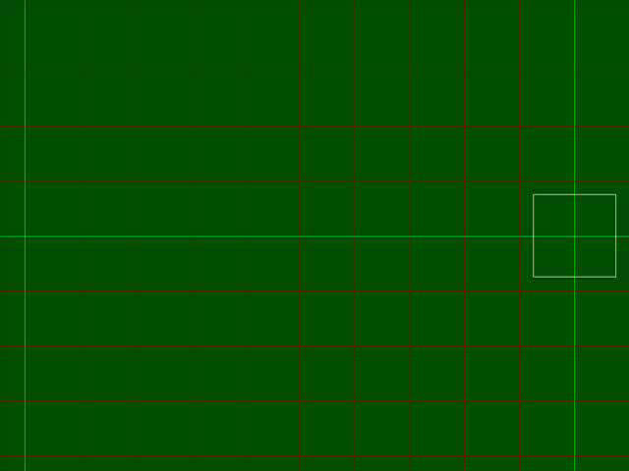
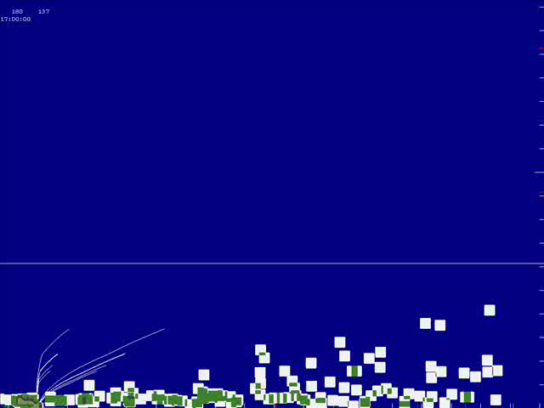
sub-grid scale plume model: Daysmoke
Notes:
Daysmoke, a smoke plume rise model developed for prescribed burn in the South Dr.Achtemeier in the forest service
Calculates locations of 1kg PM2.5 parcels for every 20 seconds per fire
good at predicting turbulence, eddy diffusivity rather than having PM disperse evenly in a grid cell at the source

Slide 3
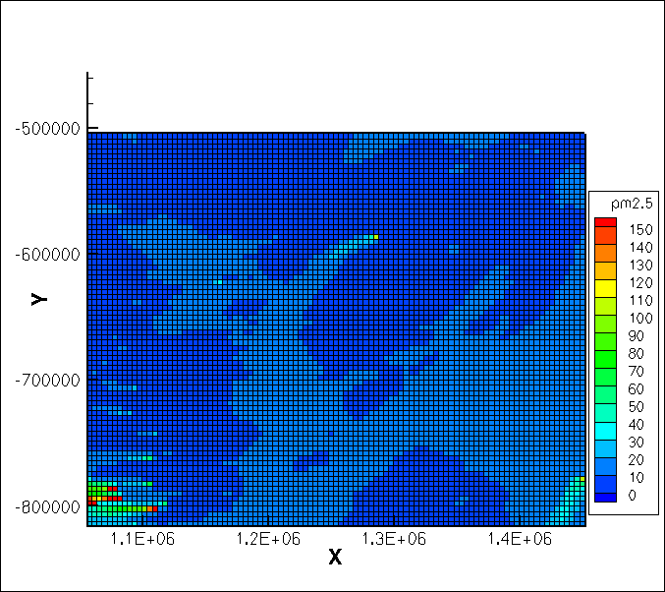
Adaptive Grid - CMAQ
Notes:
AG-CMAQ by Dr.Odman Dr.Hu
: Adaptor is driven by a weight function which can be a linear function of meteorology and chemistry.
adjust the driving force of grid adaptations by either:
Supplying a separate emissions input file for sources to be resolved = ideal for biomass burnings
Or changing the adaptation weight function to focus on different pollutants, terrain, or other features.

Slide 4
AG-CMAQ vs Daysmoke
+ Eularian
+ Unit in concentration
- Uniform conc in grid cell
+ Constant data pts to calculate
+ Lagrangian
+ Unit in mass
+ No emission dilution
- Varying data pts to be calculated per time step
AGD-CMAQ
Objective: combine the two models to obtain the most detailed conc. in a grid model
Notes:
Four major differences in the model that I had to overcome to create AG daysmoke – CMAQ
Ended up rearranging Daysmoke to fit into AG CMAQ

Slide 5

How to combine Daysmoke in AG-CMAQ?
Emissions
Daysmoke
Chemical
Coupling
Parcel/Puff/Plume concentrations
Ambient concentrations
Particles
Handover
Parcels mixed in grid cells
Meteorology
Grid
Support?
d = downwind distance
Distributions
CMAQ
MM5 (WRF)
Grid
Grid
Grid
Adaptor
Meteorology
Concentrations
Particles/CCN
Meteorology
Notes:
5
Flow chart of our project we are working on, I will be covering the part circled in pink
Coupling of daysmoke to AG CMAQ with a method I named Handover which allows space-dependent emissions. (can vary when and where to insert the emissions)

Slide 6

New CMAQ setup
Inside driver
Inside sciproc
VDIFF
CMAQ DAYSMOKE
XADV
Rest of CMAQ codes
Notes:
Where did I add daysmoke in CMAQ?
Inside subroutine sciproc, it first calles VDIFF then went to COUPLE before, but I added a subroutine called CMAQ-DAYSMOKE after VDIFF before going into COUPLE

Slide 7
CMAQ_DAYSMOKE: Between VDIFF and COUPLE
DAYSMOKE
Calculate locations of 1kg PM2.5 parcels per Daysmoke time step
HANDOVER
Convert Daysmoke emissions to concentrations
Determine when and where Daysmoke results can be carried over to AG-CMAQ
OutConcPlus
Convert parcels beyond the boundary into concentrations in Adaptive grid (for each species)
update grid conc.
Notes:
Boundary = “wall”
Update in CGRID only at appropriate times ,loctstep

Slide 8
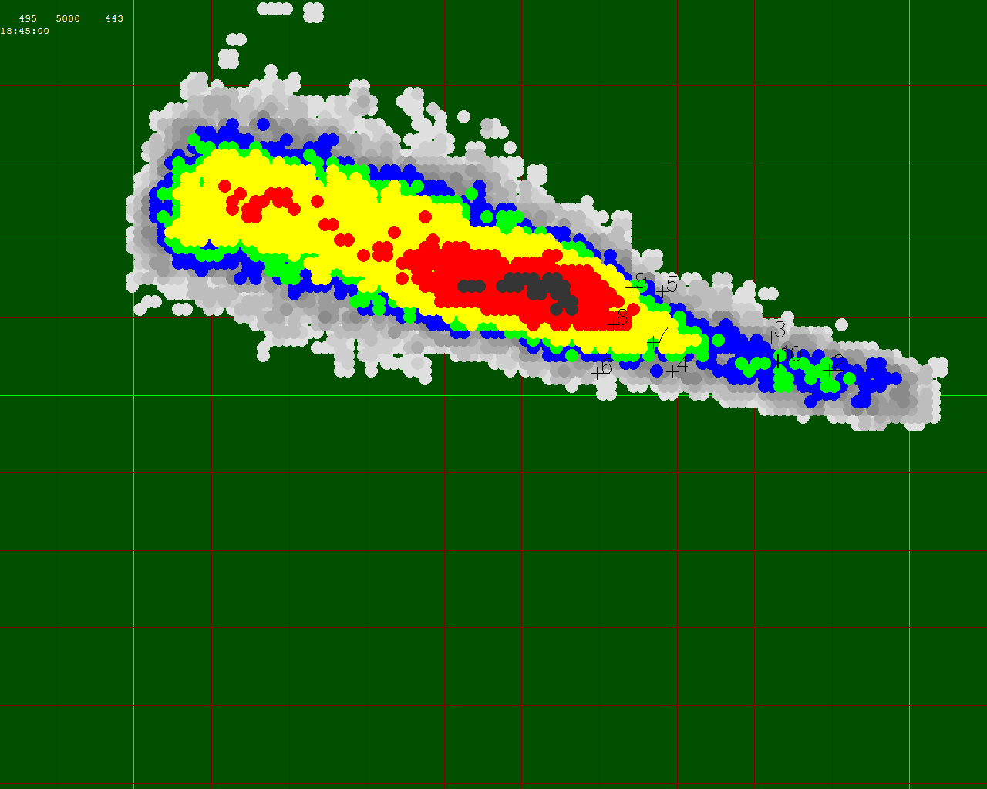
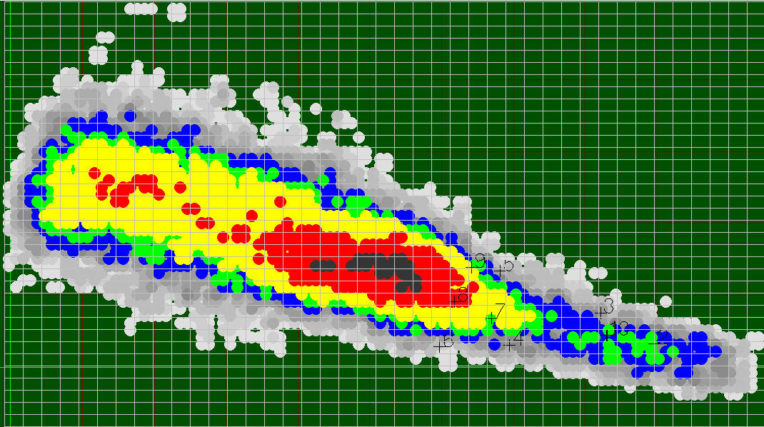
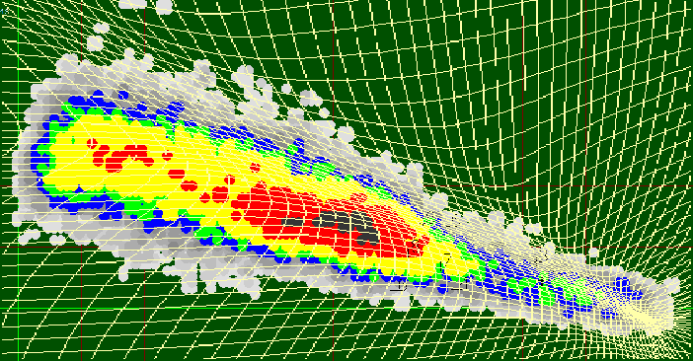
Handover
Notes:
How to determine the wall? Here u see a snap shot of Daysmoke, smoke plume starting at the bottom right and developing to the left
Calculate concentrations with fine grids, about 10m x 10m
Calculate concentrations in adapted CMAQ grid
Compare concentrations by taking the sum of the differences in the concentration for every app.10m downwind from the burn site
Look for the optimal location to draw the wall ( in purple), wall must be set after the plume is fully developed and must be at the farthest local minimum of the concentration difference curve.

Slide 9
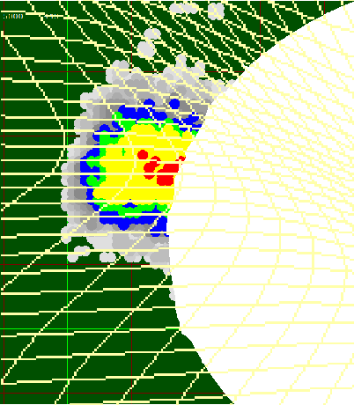
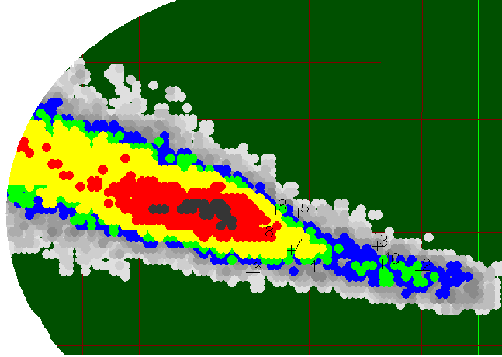
Handover
Remain in Daysmoke
Emission added to grid concentration
Notes:
Now that the wall is determined,
all the parcels that didn’t reach the wall remain as 1kg parcels to be calculate its trajectory inside Daysmoke
Parcels beyond the wall is converted into concentrations and get passed on to CGRID

Slide 10
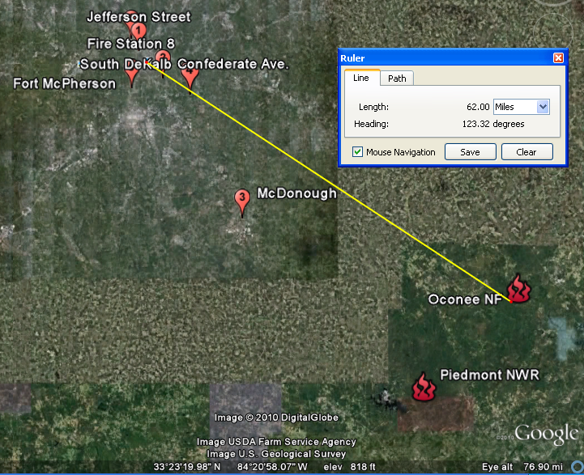
Atlanta Smoke Case
Feb. 28 2007
Oconee NF (1542 acres) 5 yr old
10:00 am - 3:00 pm total 5hr
Piedmont NWR (1460 acres) 1 yr old
11:00 am - 2:00 pm
total 3hr
Notes:
Case study done for the two national parks’ prescribed burns occurred back in Feb 28 2007 in GA.

Slide 11
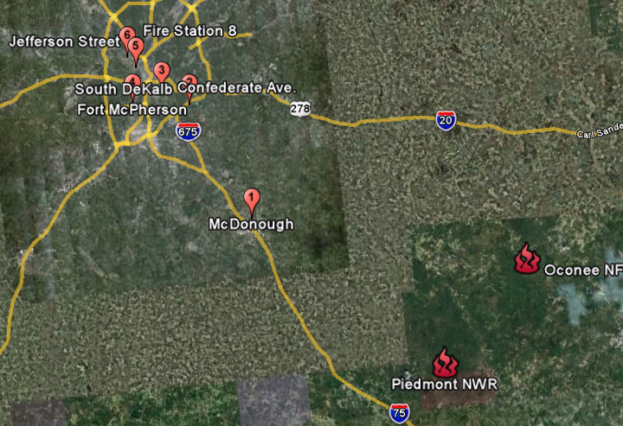

Atlanta Smoke Case
Feb. 28 2007
Notes:
Northerly winds to south easterly winds
What happened was the wind shifted its direction so Atlanta became downwind from the two prescribed burn locations

Slide 12
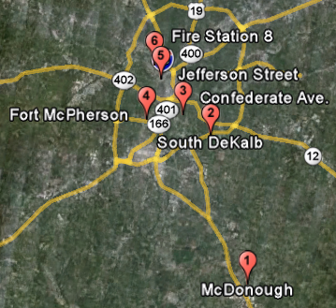
Measurement Sites
Notes:
The affect of the PB smoke was recorded in 6 PM monirotring sites in atlanta and are shown. Labled from 1 being closest to the fire and 6 being the fartest.

Slide 13

CMAQ vs AGD-CMAQ
Notes:
Detailed grids around 2 burn sites allow the smoke to remain separated as a two longer than it did for uniform grid CMAQ

Slide 14
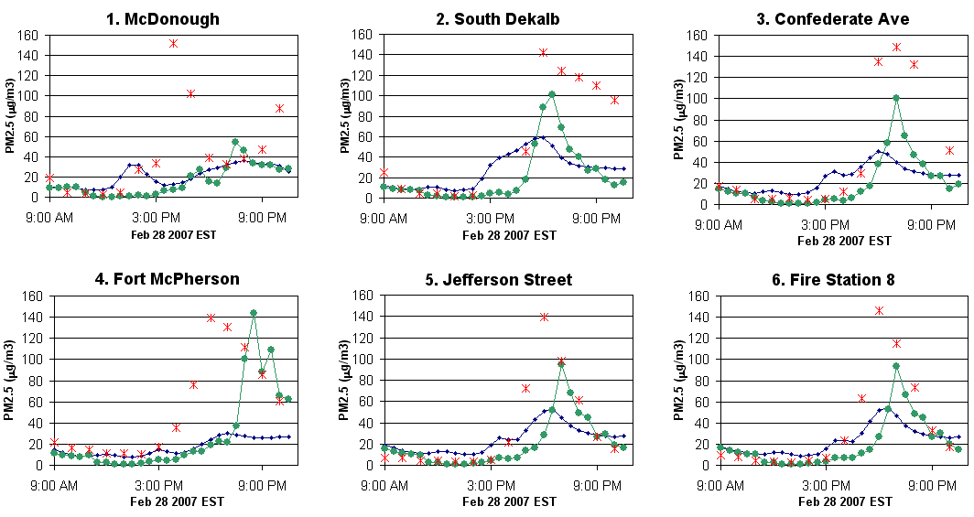

Model Comparison
Notes:
Uniform grid cmaq in blue
Ag daysmoke in green
Observed concentrations in red
Green seems to catch the concentration peaks better

Slide 15
Mean Normalized Error
Notes:
Uniform grid cmaq run error in blue
AG CMAQ in yellow (model presented from last year)
AGD CMAQ in green
5/6 times AGD CMAQ did better prediction than CMAQ runs did

Slide 16
Summary
Inputting PB smoke emissions into grid concentrations can be varied in time and place using Handover method in AG-CMAQ coupled with Daysmoke (AGD-CMAQ) .
On average, AGD-CMAQ has less error from the measured concentration than CMAQ and AG-CMAQ
AGD-CMAQ seems to pick up the measured concentration peaks better
Notes:
16

Slide 17
Future work: changes in grid adaptation
Emissions
Daysmoke
Chemical
Coupling
Parcel/Puff/Plume concentrations
Ambient concentrations
Parcels
Handover
Parcels mixed in grid cells
Meteorology
Grid
Support?
d = downwind distance
Distributions
CMAQ
MM5 (WRF)
Grid
Grid
Grid
Adaptor
Meteorology
Concentrations
Particles/CCN
Meteorology
Notes:
17
different distributions for different scpecies.
Adaptor should be extended to 3-D.
Can a weight function be designed for optimum grid support at minimum distance downwind? Shorter the distance the faster the hadover (i.e., the smaller the computations in reactive Daysmoke)

Slide 18
Using Fourier Transform for grid adaptation
Notes:
Sum of conc. Error analysis currently done after adaptation but use error analysis to adapt the grid.
Discribe concentration profile with Fourier series
Keep only terms with higher amplitude, determine how big/small the grid sizes should be
Take the inverse of truncated series to obtain the grid concentration

Slide 19
Thank you
Questions/Comments

Slide 20
Mean Normalized Error
Notes:
Uniform grid cmaq run error in blue
AGD in red in the middle
AG CMAQ in yellow (model presented from last year)
4. Only time agd cmaq did worse than any other models. Because…
20

Slide 21
Fort McPherson
Notes:
Green is the only one who came even close to capturing the peak, just a few hours delay

