Slide 1
A Comparison of CMAQ Predicted Contributions to PM_{2.5} from Aircraft Emissions to CMAQ Results Post Processed Using the Speciated Modeled Attainment Test
Matthew Woody, Saravanan Arunachalam, J. Jason West, and Uma Shankar
UNC Chapel Hill
October 11-13, 2010
9th Annual CMAS User’s Conference, Chapel Hill, NC

Slide 2
Motivation
Aviation activities cause emissions of particulate matter and gaseous precursors of particulate matter
Air quality models such as the Community Multiscale Air Quality (CMAQ) model provide the ability to estimate contributions of aircraft emissions to PM_{2.5}
Air quality modeling results are independent of ambient air quality monitoring data
The Speciated Modeled Attainment Test (SMAT) model post-processor tool estimates contributions to PM_{2.5} by combining air quality model output with ambient air quality monitoring
Overall Goals
Evaluate the use of SMAT as a model post-processor and assess its significance for aviation applications
Apply modeled response of aviation emissions to ambient air quality monitoring data
Quantify the influence of post processing CMAQ results using SMAT on PM_{2.5} contributions attributed to aircraft emissions as compared to non-post processed CMAQ results

Slide 3
Modeling Approach
Meteorological output from Pennsylvania State University/NCAR mesoscale (v3-7) model (MM5)
Constant for all simulations (2005)
Emissions processed through Sparse Matrix Operator Kernel Emissions (SMOKE) v2.5 along with research version of Emissions and Dispersion Modeling System (EDMS) v5.0
Research version of EDMS 5.0 provides aircraft landing and takeoff emissions up to 10,000 ft.
Chemical boundary and initial conditions from GEOS-Chem global-scale simulations (2005 and 2025)
4 annual CMAQ (v4.6) modeling scenarios at 36 km grid resolution
ISORROPIA (v1.7) thermodynamic equilibrium model for inorganic PM
Scenario Name | Base Emissions | Aircraft Emissions
base05 | 2005 | ---
airc05 | 2005 | 2004
base25 | 2025 | ---
airc25 | 2025 | 2025
2004 aircraft in 2005
2025 aircraft in 2025

Slide 4
Emissions Processing
Non-Aviation Emissions
Base 2005 from 2005 National Emission Inventory (NEI)
UNC interpolated NEI from 2020 and 2030 to 2025
Include projected growth and controls “on the books” for various sectors at national and state level
Proposed Transport Rule, Clean Air Visibility Rule (CAVR), Mobile Source Air Toxics (MSAT), Nonroad Diesel Rule, etc.
Provides first approximation, but may not represent actual growth and controls

Slide 5
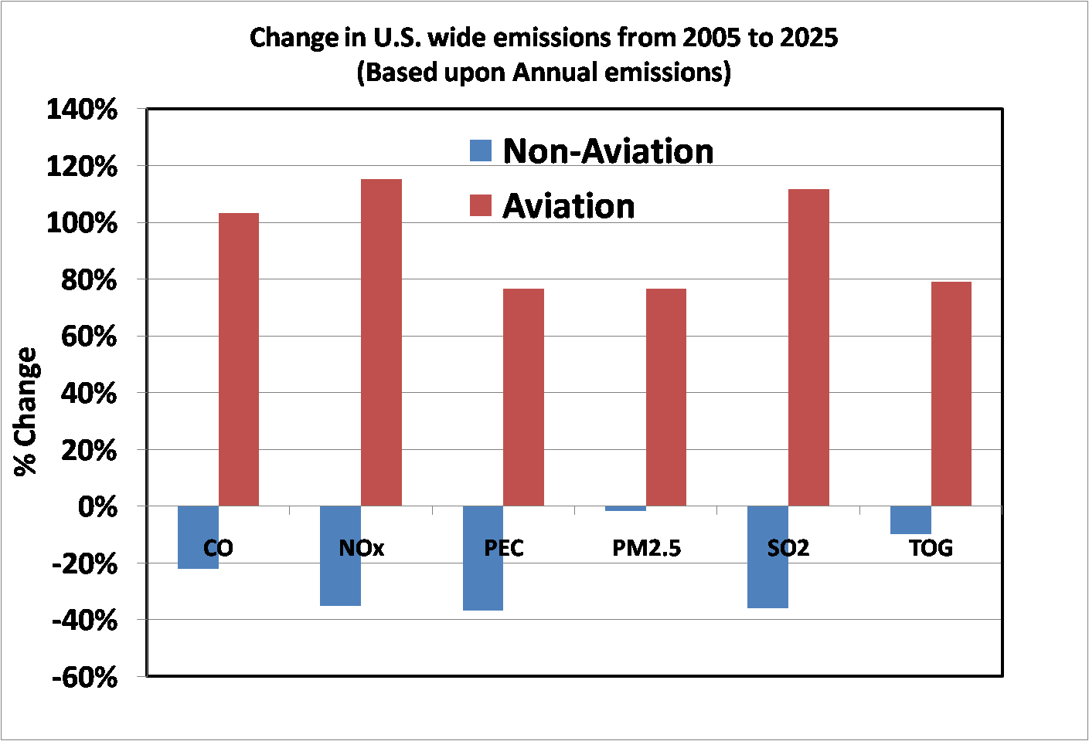
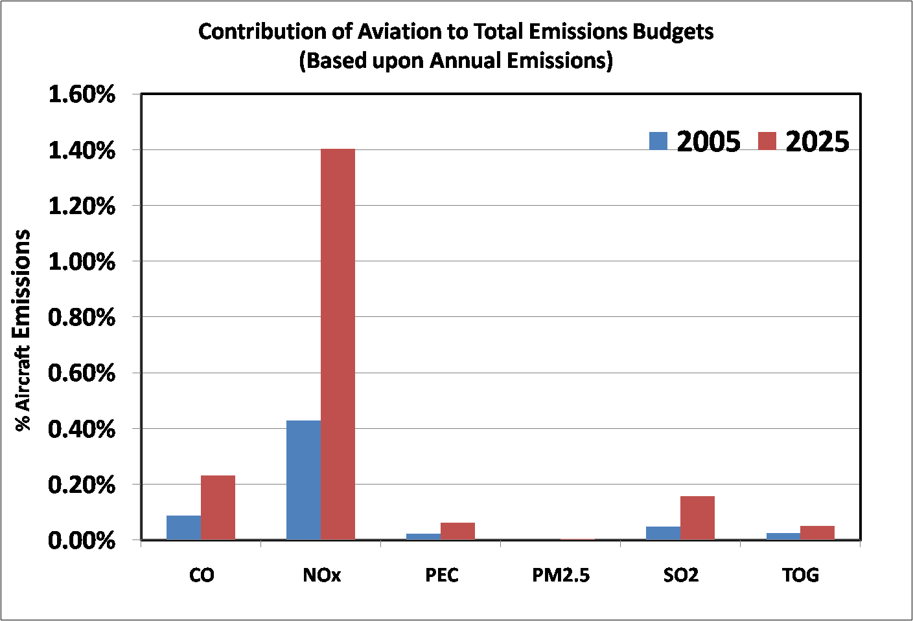
Emissions Processing
Aircraft Emissions (CSSI, 2009)
Estimates of CO, TOG, NO, NO₂, SO_{x} and PEC
‘Baseline seed day’ estimates based on actual National Airspace System activity data
Hourly emissions from 99 airports for one day scaled to others (February 19, 2004)
Future year forecasts based on annual Terminal Area Forecasts estimates (×2.27 for 2025) and assumes no mitigation policies or changes in technology
Actual 2025 aircraft emissions will be lower due to advanced technologies, alternative fuels and changes in operational procedures.

Slide 6
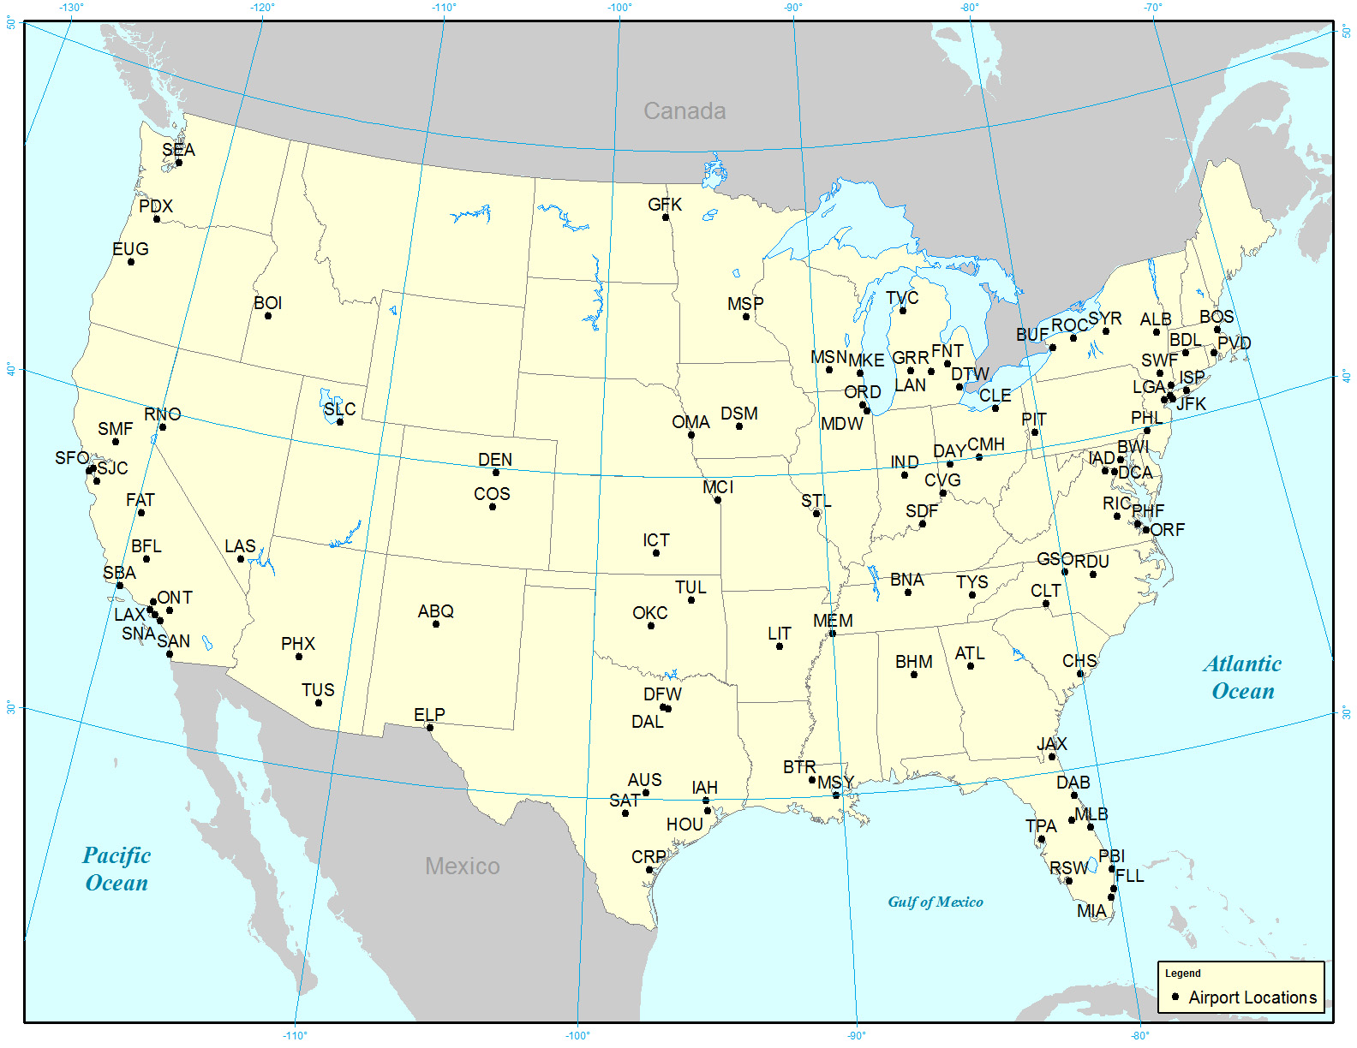
Modeling Domain and Airports Modeled

Slide 7
SMAT
Air quality modeling results are independent of ambient air quality monitoring data
The SMAT model post-processor tool estimates contributions to PM_{2.5} by combining air quality model output with ambient air quality monitoring data
Considered best practice by EPA and used in a number of policy relevant studies for regulatory purposes: State Implementation Plans (SIP), Clear Skies, Proposed Transport Rule, Low Sulfur Diesel Rule, and revisions to NAAQS
Applies modeling results in a relativistic sense to ambient air quality data, reducing uncertainty associated with the model
SMAT used exclusively in the U.S.
SMAT is a model post-processor that applies CMAQ model output to ambient monitoring data

Slide 8
SMAT
SMAT applies modeling output in relativistic sense
Calculates Relative Response Factor (RRF) for individual PM_{2.5} species
Applies RRF values to ambient monitoring data
Total PM_{2.5} mass based on Federal Reference Method (FRM) monitors (5 year average)
Speciated PM_{2.5} mass based on Speciated Trends Network (STN) and Interagency Monitoring of Protected Visual Environments (IMPROVE) network monitors (3 year average)
Uses sulfate, adjusted nitrate, derived water, inferred carbonaceous material balance (SANDWICH) technique (Frank, 2006)
Particulate Bound Water (PBW) adjustment required to compare SMAT and CMAQ results

Slide 9
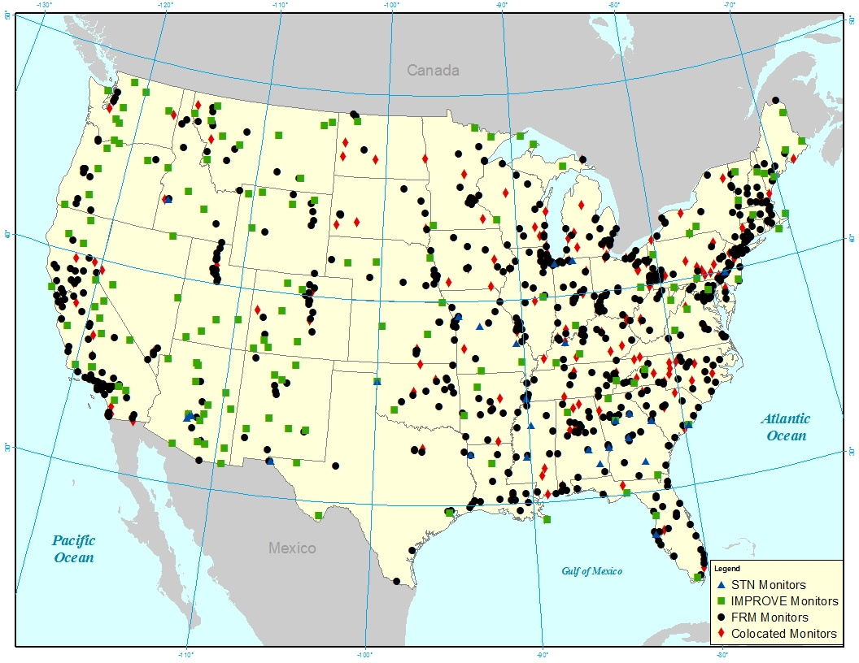
Ambient Monitors Used in SMAT

Slide 10
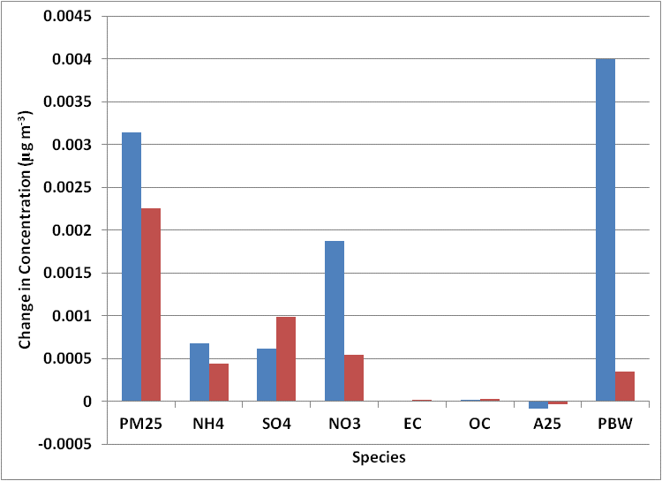
Particle Bound Water (PBW) Adjustment
Differences in CMAQ and SMAT PBW
CMAQ
PM_{2.5} equals sum of speciated components (inclusion of PBW defined by user) and can either be reported as wet or dry PM_{2.5}
ISORROPIA thermodynamic model
PBW calculated at all ambient conditions
SMAT
PM_{2.5} reported as wet PM_{2.5} (includes PBW)
AIM inorganic model
PBW calculated at 35% relative humidity and 22 degrees Celsius
Average Contribution within
Continental U.S.

Slide 11
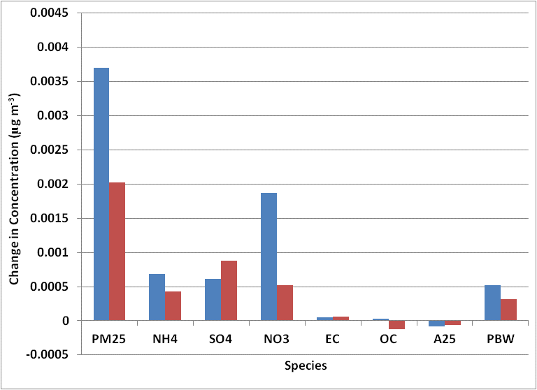
PBW Adjustment
CMAQ PBW adjusted using ISOREV
PBW calculated at 35% relative humidity and 22 degrees Celsius rather than ambient conditions
ISORROPIA run in reverse mode using CMAQ predicted concentrations of ammonium, sulfate, and nitrate
Used to calculate CMAQ wet PM_{2.5}
Average Contribution within
Continental U.S.

Slide 12
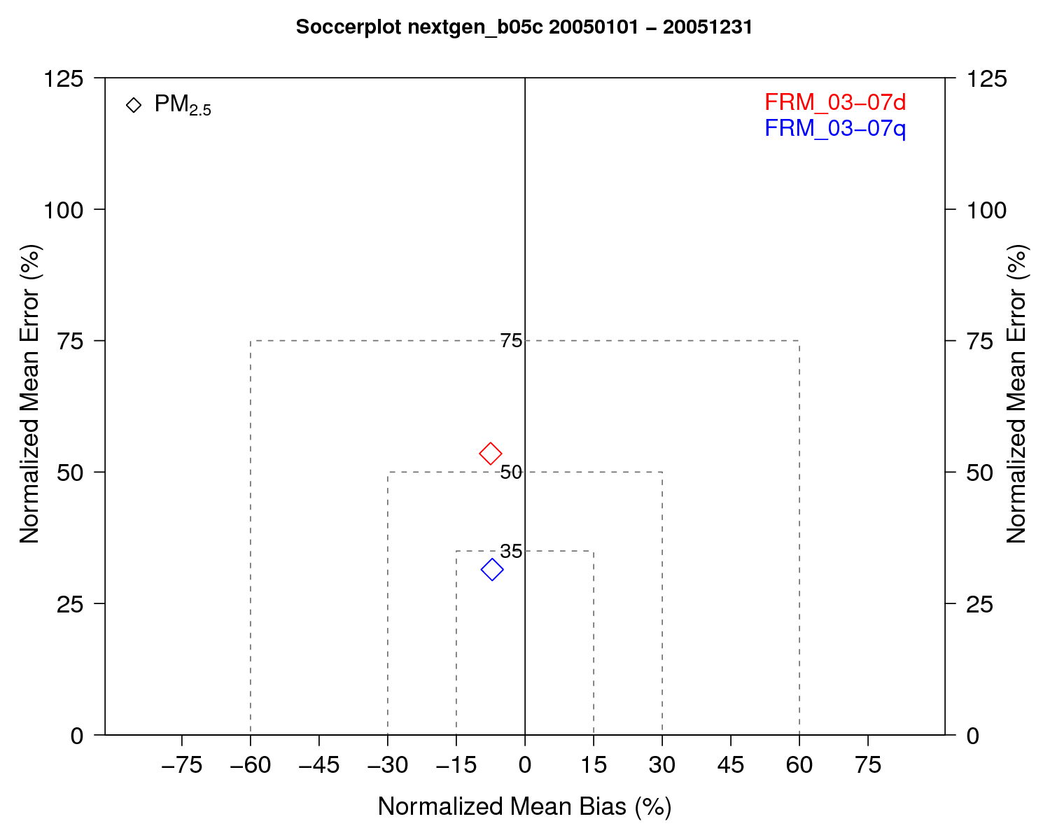
Model Evaluation
CMAQ dry PM_{2.5} in good agreement with 5 year (2003-2007) daily average and quarterly averages measured at FRM monitors
Overall good model performance for 2005
IMPROVE, STN, CASTNet, and FRM (2005)
FRM (2003-2007)
Notes:
Dry CMAQ PM

Slide 13
Annual Aircraft PM_{2.5} Contributions
2005
2025
CMAQ
SMAT
Aviation emissions contribute to higher PM_{2.5} concentrations in 2025 than 2025.
SMAT reduces impacts of aircraft emissions to PM_{2.5} but results are not unexpectedly different.

Slide 14
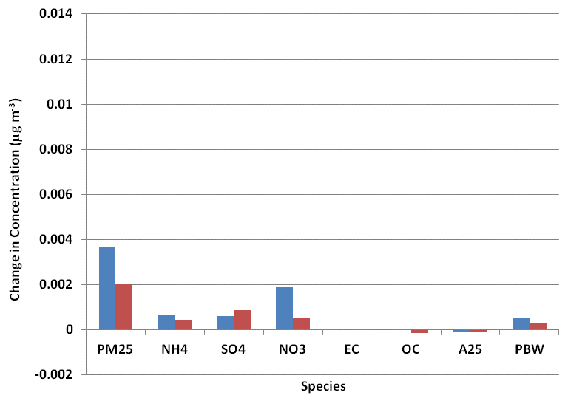
Results – Continental U.S.
2005
2025
CMAQ adjusted PBW
Inorganic PM_{2.5} dominates the difference in CMAQ and SMAT predicted contributions to PM_{2.5} from aircraft emissions.
SMAT relies on ambient measurements of neutralization for inorganic species while CMAQ relies on thermodynamic modeling.

Slide 15
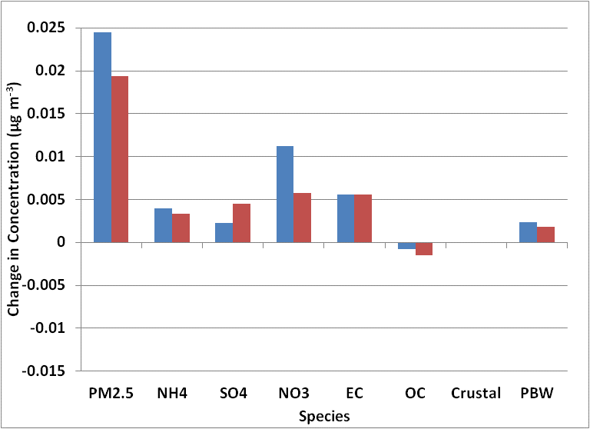
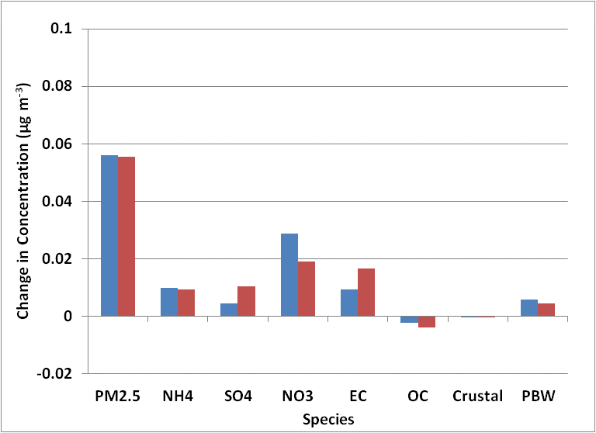
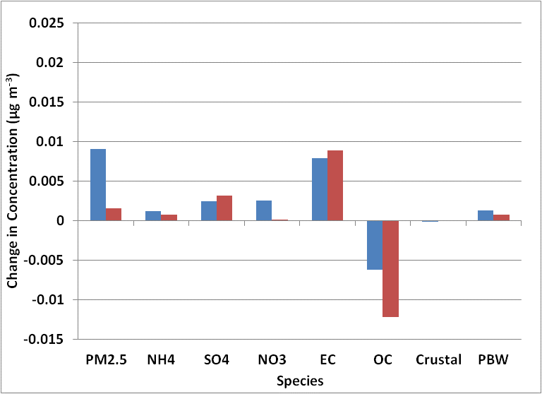
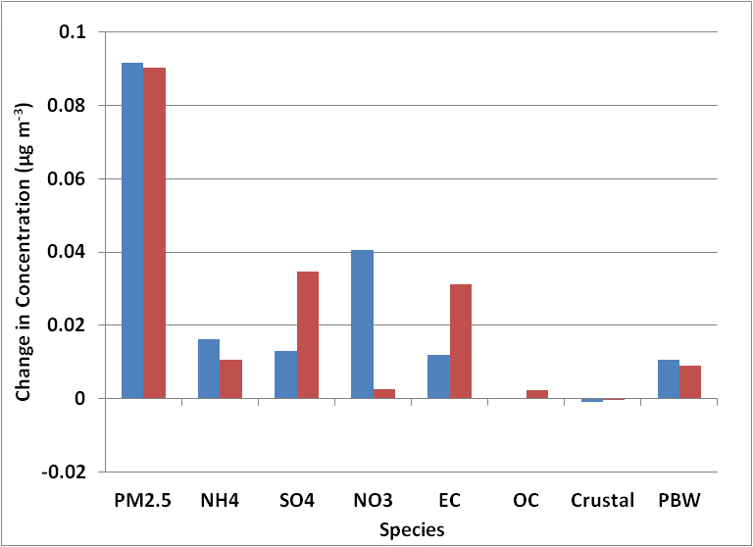
Results – Focus on LAX and ATL
2005
2025
LAX
ATL
SMAT estimates higher contributions from ASO4 and lower contributions from ANO3. Contributions from ANO3 are essentially removed at ATL in future year.

Slide 16
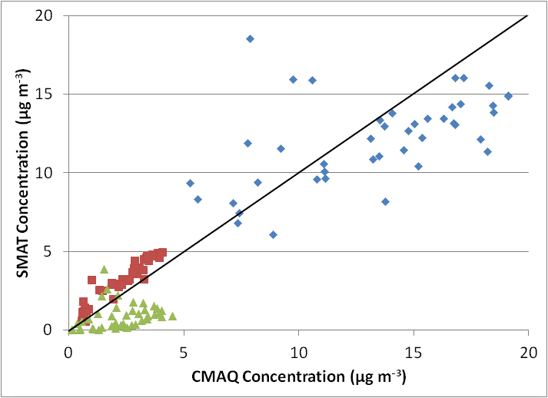
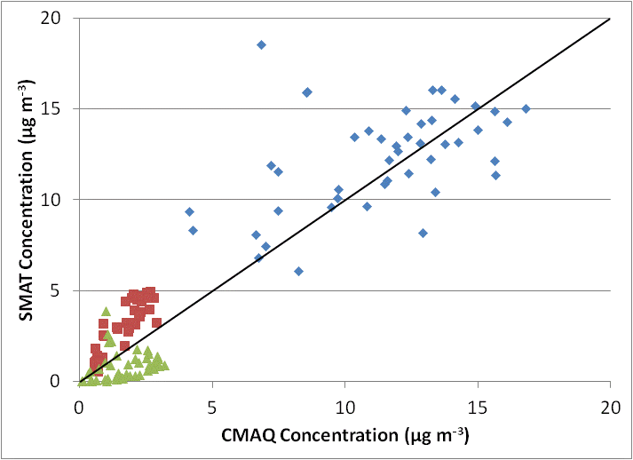
Base Concentration Comparison (Model Performance)
2005
2025
Base PM_{2.5} concentrations are comparable between observed (SMAT) values and CMAQ while observed (SMAT) values indicate higher sulfate and lower nitrate base concentrations.
RRF applied to a higher SMAT base value (compared to CMAQ) leads to SMAT estimating a larger contribution from aircraft emissions from that species.

Slide 17
SMAT ANH4 and PBW Precision
ANH4
PBW
Default:
4 Digits
Increased
Precision (ip): 7 digits
Precision issues within SMAT lead to “numerical noise” associated with ANH4 and PBW when the change in emissions is relatively small between the base and sensitivity cases (e.g. addition of aircraft emissions).

Slide 18
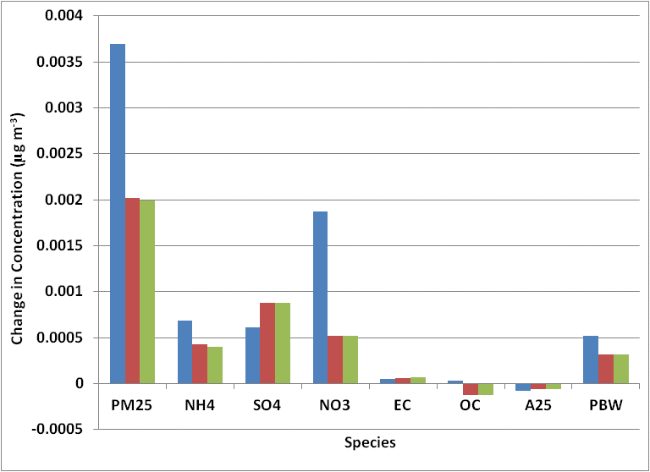
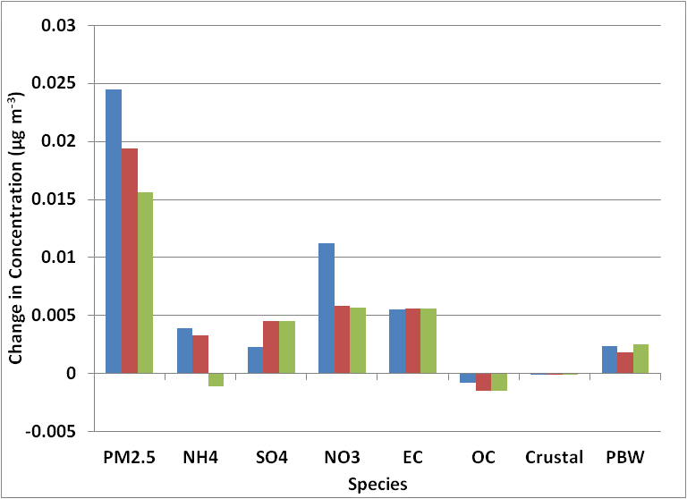
SMAT ANH4 and PBW Precision
2005 – US Average
2005 - LAX
ANH4 and PBW “numerical noise” has little effect on average contributions in the U.S. but can have significant effects in a single grid cell.

Slide 19
Conclusions
Difficult to perform direct comparison of CMAQ and SMAT without adjustment to PBW
Both CMAQ and SMAT results estimate higher contributions to PM_{2.5} from aircraft emissions in 2025 than 2005
Overall, SMAT reduces contributions from aviation emissions but results are not unexpectedly different
CMAQ and FRM PM_{2.5} mass are in good agreement
SMAT results indicate higher contributions from ASO4 and lower contributions from ANO3 with a net result of lower contributions from aircraft emissions to PM_{2.5}.
Precision adjustment important when assessing small changes in emissions
SMAT limited by ambient monitoring data
Spatial and temporal resolution (good within U.S. but limited elsewhere)
Measurements of volatile species

Slide 20
Acknowledgements
CSSI, Inc. for providing EDMS outputs for 99 airports
This work was funded by FAA and Transport Canada under FAA Award Nos.:
07-C-NE-UNC, Amendment Nos. 001, 002, 003 and 004
The Investigation of Aviation Emissions Air Quality Impacts project is managed by Christopher Sequeira.
Any opinions, findings, and conclusions or recommendations expressed in this material are those of the author(s) and do not necessarily reflect the views of the FAA, NASA or Transport Canada.

Slide 21
Annual Aircraft ANO3 and ASO4 Contributions
ANO3
ASO4
CMAQ
SMAT
CMAQ typically predicts higher contributions of ANO3 and lower contributions of ASO4

Slide 22
Results – SMAT to CMAQ Ratio
PM_{2.5} ANO3
2005
2025
SMAT estimates for contributions to PM_{2.5} are typically lower in Eastern and Central U.S. which corresponds to areas where SMAT estimates smaller contributions to ANO3 from aircraft emissions.

