Slide 1
Dynamic Model
Performance Evaluation
Using Weekday-Weekend and Retrospective Analyses
Jim Smith and Mark Estes
Texas Commission on
Environmental Quality
Austin, Texas
Presented at the 9th Annual CMAS Conference
Chapel Hill, NC, October 11-13, 2010
Air Quality Division

Slide 2
Model Performance Evaluation
Static MPE compares base-case modeled concentrations with measurements.
Can be very extensive:
  Multiple pollutants: ozone, precursors, intermediate or product species
  Multiple analysis techniques: statistics, 1, 2, and 3-dimensional graphics, animations, probing tools, sensitivity analyses
  Special purpose data: field studies, aircraft, marine, sondes, supersites, satellites
But cannot directly address the most important question: Does the model respond appropriately to changes in inputs?
Notes:
Ozone precursors include NO, NO₂, and VOC species.
Intermediate and product species include HONO, H₂O₂, HNO₃ and PANs.
Statistics include bias, error, peak-to-peak comparisons, MSE, etc.
1-dimensional graphics include time series and vertical concentration plots.
2-dimensional graphics include scatter plots, tile plots, and peak ozone contours.
3-dimensional graphics include 3-d pollution contours and animations of surface contours.
Model response to changes in inputs, particularly emissions, is especially important when using a relative-response approach to predicting future design values.

Slide 3
Model Performance Evaluation
Dynamic MPE is designed to address the model’s response to changes in inputs.
  Sensitivity analysis and direct-decoupled method (DDM) are common forms of dynamic MPE.
  Retrospective analysis compares modeled predictions with observed air quality in a projection year.
  Weekday-weekend analysis takes advantage of day-of week changes in emission patterns (mostly on-road mobile) to see if the model can mimic observed changes in ozone concentrations.
Notes:
Sensitivity analyses and DDM/HDDM (higher-order DDM) can show how robust the model’s predictions are. In other words, are the model’s predictions valid under conditions which differ from those upon which the model is based? For example, would a modeled ozone change from NO_{X}-sensitive to VOC-sensitive if biogenic emissions were in fact twice those used in the model?
Retrospective analysis can consist simply of comparing past modeling with current air quality, but we really don’t care much about how well previous modeling predicted current air quality. The real question is how well does current modeling predict response to changes. Current modeling typically includes up-to-date databases, improved modeling software, and benefits from knowledge of actual growth and controls instead of predictions. So the best application of retrospective analysis is to use the current model to “predict” a prior year. This requires constructing an inventory for that year, but this task can be made much easier by selecting a year that was previously modeled.
In some areas, ozone concentrations have been observed to increase on weekends because of reduced NO_{X} emissions (the so-called NO_{X} disbenefit which results from fresh NO emissions reacting with ozone). Weekday-weekend emission differences (both timing and magnitude) form a sort of “natural laboratory” for testing the model’s response to emission changes. Weekday-weekend analysis applied to only observations is a form of observation-based modeling which is sometimes used to assess whether an airshed is NO_{X}- or VOC-limited.

Slide 4
Modeling for the HGB Ozone Nonattainment Area
Attainment demonstration of 1997 8-hour ozone standard submitted March, 2010 for the Houston/Galveston/Brazoria (HGB) ozone nonattainment area.
  Modeled 96 days from several periods in 2005 and 2006
  Coincided with the Second Texas Air Quality Study (TexAQS II)
  Used CAMx with 36-12-4-2 km nested grids, 38 vertical layers
Notes:
HGB – Houston/Galveston/Brazoria
CAMx – Comprehensive Air Quality Model with extensions

Slide 5
The HGB Modeling Domain
Notes:
Map showing the nested modeling domains for the HGB attainment demonstration
36 km grid - Eastern US from Amarillo east into the Atlantic Ocean, south of Brownsville to Fargo
12 km grid - Eastern half of Texas, most of Arkansas, Louisiana, Oklahoma, and Mississippi
4 km grid – Southeast Texas including Houston, Galveston, and Beaumont-Port Arthur
2 km grid – Centered on Harris County including Galveston Bay and parts of several surrounding counties

Slide 6
Attainment Modeling
Very extensive (static) MPE utilizing both routine and TexAQS II observations.
2006 baseline, projected to 2018 future year
  Baseline design values (DV_{b}) were 2006-7-8 average DVs at monitoring sites.
2018 predicted DVs were calculated as:
DV_{p} = RRF * DV_{b}
where RRF (relative response factor) is
max modeled 2018 8-hour ozone concentration “near” a monitor
max modeled 2006 8-hour ozone concentration “near” a monitor
Notes:
MPE for the 2010 submittal included many species not usually measured including nitric and nitrous acids, PAN, formaldehyde, and several hydrocarbon species. Data sources included the Research Vessel Ron Brown, several aircraft, ozone sondes, “smart” balloons, and special purpose sites in rural and urban areas and above ground-level, along with the extensive network of ozone and NO_{X} monitors and 12 automatic gas chromatographs operated by state and local governments and industry groups.
The baseline DV is sometimes referred to as a five-year weighted average since each of the three individual DVs is itself a three-year average of fourth-high concentrations.
“Near” a monitor means the maximum modeled ozone concentration within an array of grid cells including the monitor. For the HGB area, we used 7X7 arrays of 2 km grid cells.

Slide 7
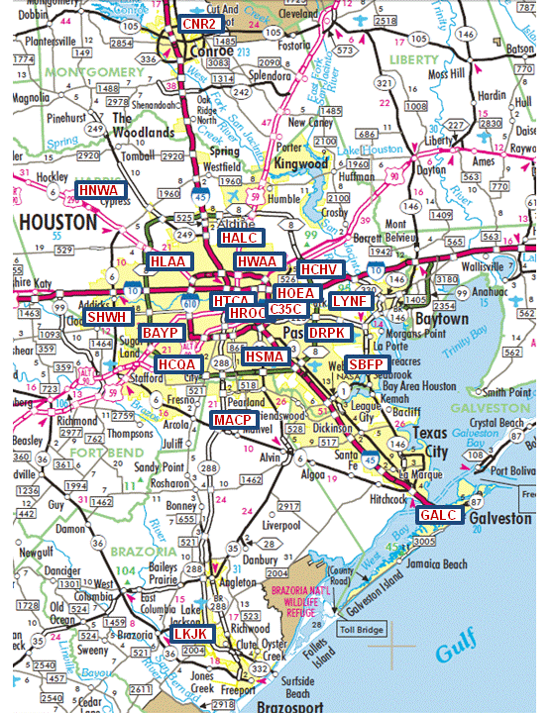
Ozone Monitoring Sites
(Sites Referred To In This Presentation )
Site Code | Site Name
BAYP | Bayland Park
C35C | Clinton Drive
CNR2 | Conroe (relocated)
DRPK | Deer Park
GALC | Galveston
HALC | Aldine
HCHV | Channelview
HCQA | Croquet
HLAA | Lang
HNWA | NW Harris County
HOEA | Houston East
HROC | Houston Regional Office
HSMA | Monroe
HTCA | Texas Avenue
HWAA | North Wayside
LKJK | Lake Jackson
LYNF | Lynchburg Ferry
MACP | Manvel Croix Park
SBFP | Seabrook Friendship Park
SHWH | Westhollow
Notes:
Map showing the twenty monitoring sites discussed in this presentation (there are a lot of sites not shown here).

Slide 8
Retrospective Modeling
“Predicting” a Prior Year’s Ozone DVs
To evaluate model response to emission changes, we modeled 2000 as if it were a future year. We
  Used a baseline 2000 inventory developed for a previous attainment demonstration.
  Calculated 2006-to-2000 RRFs, just like the 2006-to-2018 RRFs.
  Calculated 2000 DV_{p}s by multiplying the 2006-to-2000 RRFs by the 2006 DV_{b}.
  Compared the 2000 DV_{P}s with the actual 2000 baseline DVs:
  2000 DV_{b} = Average of 2000, 2001, 2002 DVs.
Notes:
Biogenic emissions developed for the 2006 episode days were used in both the 2000 and 2006 modeling (just like future-case modeling).
The 2000 baseline was developed for a somewhat smaller modeling domain than that used for the more recent attainment demonstration. In the perimeter areas where no 2000 emissions were available, we just used the 2006 emissions. This should pose no problems since the areas affected were all at least 1000 km from Houston.
We used the 2000 baseline DV instead of the regular 2000 DV because the RRFs are applied to a 2006 baseline which consists of the average of three DVs.

Slide 9
Retrospective Modeling
Results
Monitor Code | 2006 DV_{b} | 2000 DV_{b} | 2006-to-2000 RRF |  | 2000 DV_{p}
 |  |  | Actual | Model
BAYP | 96.7 | 107.0 | 1.11 | 1.11 | 107.0
C35C | 79.0 | 97.0 | 1.23 | 1.18 | 93.5
DRPK | 92.0 | 107.7 | 1.17 | 1.18 | 108.1
GALC | 81.7 | 98.3 | 1.20 | 1.11 | 90.7
HALC | 85.0 | 108.7 | 1.28 | 1.15 | 97.9
HCQA | 87.0 | 105.3 | 1.21 | 1.13 | 98.6
HLAA | 77.7 | 90.0 | 1.16 | 1.11 | 86.4
HNWA | 89.0 | 104.7 | 1.18 | 1.13 | 100.4
HOEA | 80.3 | 102.0 | 1.27 | 1.17 | 94.0
HROC | 79.7 | 95.0 | 1.19 | 1.15 | 91.6
HSMA | 90.3 | 96.3 | 1.07 | 1.16 | 104.8
HNWA | 76.3 | 97.3 | 1.28 | 1.14 | 86.9
SHWH | 92.3 | 100.3 | 1.09 | 1.11 | 102.9
Average | 85.2 | 100.7 | 1.19 | 1.14 | 97.1
Notes:
Table showing the names of 13 regulatory monitors used in this analysis, along with the 2000 and 2006 baseline ozone concentrations, actual and modeled RRFs (actual is the ratio of the 2006 DV_{b} to the 2000 DV_{b}, and finally the 2000 DV_{p}.

Slide 10
Retrospective Modeling
Results
Monitor Code | 2006 DV_{b} | 2000 DV_{b} | 2006-to-2000 RRF |  | 2000 DV_{p}
 |  |  | Actual | Model
BAYP | 96.7 | 107.0 | 1.11 | 1.11 | 107.0
C35C | 79.0 | 97.0 | 1.23 | 1.18 | 93.5
DRPK | 92.0 | 107.7 | 1.17 | 1.18 | 108.1
GALC | 81.7 | 98.3 | 1.20 | 1.11 | 90.7
HALC | 85.0 | 108.7 | 1.28 | 1.15 | 97.9
HCQA | 87.0 | 105.3 | 1.21 | 1.13 | 98.6
HLAA | 77.7 | 90.0 | 1.16 | 1.11 | 86.4
HNWA | 89.0 | 104.7 | 1.18 | 1.13 | 100.4
HOEA | 80.3 | 102.0 | 1.27 | 1.17 | 94.0
HROC | 79.7 | 95.0 | 1.19 | 1.15 | 91.6
HSMA | 90.3 | 96.3 | 1.07 | 1.16 | 104.8
HNWA | 76.3 | 97.3 | 1.28 | 1.14 | 86.9
SHWH | 92.3 | 100.3 | 1.09 | 1.11 | 102.9
Average | 85.2 | 100.7 | 1.19 | 1.14 | 97.1
Two highest monitors predicted within 0.5 ppb
Notes:
The model pretty much nailed the two highest monitors in 2000, Bayland Park (BAYP) and Deer Park (DRPK).

Slide 11
Retrospective Modeling
Results
Monitor Code | 2006 DV_{b} | 2000 DV_{b} | 2006-to-2000 RRF |  | 2000 DV_{p}
 |  |  | Actual | Model
BAYP | 96.7 | 107.0 | 1.11 | 1.11 | 107.0
C35C | 79.0 | 97.0 | 1.23 | 1.18 | 93.5
DRPK | 92.0 | 107.7 | 1.17 | 1.18 | 108.1
GALC | 81.7 | 98.3 | 1.20 | 1.11 | 90.7
HALC | 85.0 | 108.7 | 1.28 | 1.15 | 97.9
HCQA | 87.0 | 105.3 | 1.21 | 1.13 | 98.6
HLAA | 77.7 | 90.0 | 1.16 | 1.11 | 86.4
HNWA | 89.0 | 104.7 | 1.18 | 1.13 | 100.4
HOEA | 80.3 | 102.0 | 1.27 | 1.17 | 94.0
HROC | 79.7 | 95.0 | 1.19 | 1.15 | 91.6
HSMA | 90.3 | 96.3 | 1.07 | 1.16 | 104.8
HNWA | 76.3 | 97.3 | 1.28 | 1.14 | 86.9
SHWH | 92.3 | 100.3 | 1.09 | 1.11 | 102.9
Average | 85.2 | 100.7 | 1.19 | 1.14 | 97.1
Two monitors were over-predicted
Notes:
Monroe monitor (HSMA) was over-predicted by 8.5 ppb, and Westhollow (SHWH) was over-predicted by 2.6 ppb. Over-predicting the 2000 baseline means the model’s response was stronger than was exhibited by the real airshed.

Slide 12
Retrospective Modeling
Results
Monitor Code | 2006 DV_{b} | 2000 DV_{b} | 2006-to-2000 RRF |  | 2000 DV_{p}
 |  |  | Actual | Model
BAYP | 96.7 | 107.0 | 1.11 | 1.11 | 107.0
C35C | 79.0 | 97.0 | 1.23 | 1.18 | 93.5
DRPK | 92.0 | 107.7 | 1.17 | 1.18 | 108.1
GALC | 81.7 | 98.3 | 1.20 | 1.11 | 90.7
HALC | 85.0 | 108.7 | 1.28 | 1.15 | 97.9
HCQA | 87.0 | 105.3 | 1.21 | 1.13 | 98.6
HLAA | 77.7 | 90.0 | 1.16 | 1.11 | 86.4
HNWA | 89.0 | 104.7 | 1.18 | 1.13 | 100.4
HOEA | 80.3 | 102.0 | 1.27 | 1.17 | 94.0
HROC | 79.7 | 95.0 | 1.19 | 1.15 | 91.6
HSMA | 90.3 | 96.3 | 1.07 | 1.16 | 104.8
HNWA | 76.3 | 97.3 | 1.28 | 1.14 | 86.9
SHWH | 92.3 | 100.3 | 1.09 | 1.11 | 102.9
Average | 85.2 | 100.7 | 1.19 | 1.14 | 97.1
Most monitors, and the average, were under-predicted
Notes:
The remaining 9 monitors were under-predicted by between 3.6 and 10.8 ppb. Under-predicting the 2000 baseline means the model’s response was less strong than was exhibited by the real airshed.

Slide 13
Retrospective Modeling
Conclusions
The model replicated the 2000 baseline DVs fairly well, especially at the two highest monitors.
The model overall was a little less responsive to the 2000-2006 emission changes than the actual airshed:
  To evaluate model response in prospective terms, invert the 2006-to-2000 RRFs.
  The average predicted 2000-to-2006 response was 0.887, average actual response was 0.843.
Notes:
It is more intuitive to evaluate the model in prospective terms than in retrospective terms (i.e. moving forward instead of backward in time). Inverting the RRFs converts them from retrospective to prospective. On average, the model predicts an 11% improvement from 2000 to 2006, while in reality the improvement was nearly 16%.

Slide 14
Weekday-Weekend Analysis
Different weekday-weekend traffic patterns form a “natural laboratory” to assess how the airshed (and models) respond to emission changes.
  Weekend increases in ozone concentration may indicate that ozone formation is VOC-sensitive. This phenomenon is often referred to as the “weekend effect.”
  Weekend decreases may be an indication of NO_{X}-sensitive ozone formation.
Notes:
Weekday-weekend analysis applied to observational data is a type of observation-based modeling, and is used to assess whether an airshed in VOC-sensitive, NO_{X}-sensitive, or in-between. NO_{X}-sensitive airsheds will typically respond better to NO_{X} emission reductions and vice-versa.

Slide 15
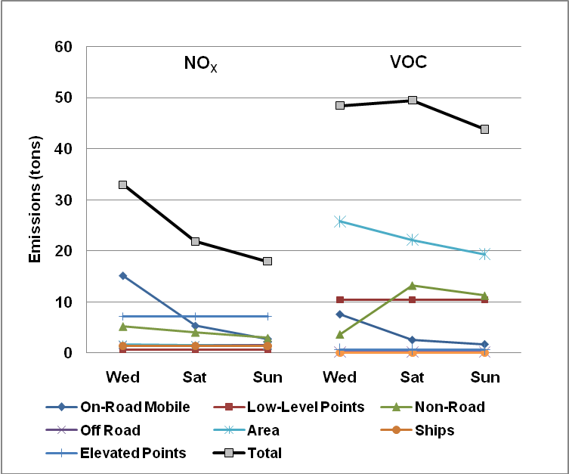
Weekday-Weekend Analysis
HGB 2006 Modeled 6 AM
NO_{X} and VOC Emissions
(excluding biogenics)
Notes:
Plot showing 6 AM emissions modeled in the 2010 attainment demonstration for Wednesdays (used to represent a “typical” weekday), Saturdays, and Sundays. 6 AM is especially important because most of the emission changes between weekdays and weekends are attributed to mobile sources. While traffic volumes vary from weekdays to weekend days, the differences in traffic patterns are probably more important than total emissions since morning emissions are typically responsible for the lion’s share of ozone production.
The plot shows that 6 AM on-road mobile NO_{X} emissions drop from about 15 tons on Wednesday to about 6 tons on Saturday, then to about 3 tons on Sunday. Non-road emissions drop from about 5 tons to about 3 tons to about 2 tons, while other NO_{X} sources show little variation. Total NO_{X} emissions are about 33, 22, and 18 tons, respectively.
On-road VOC shows the same pattern as NO_{X}, but is smaller both in tons and as a fraction of the total inventory. Area source VOC also declines from Wednesday to Saturday to Sunday, but non-road VOC increases due to recreational activities such as boating. Overall, VOC is relatively constant with about 48, 49, and 44 tons, respectively.
The large contribution of area sources is partly due to oil and gas production activities in the area.
These plots illustrate why we consider the primary driver for the “weekend effect” to be NO_{X} emissions instead of VOC.

Slide 16
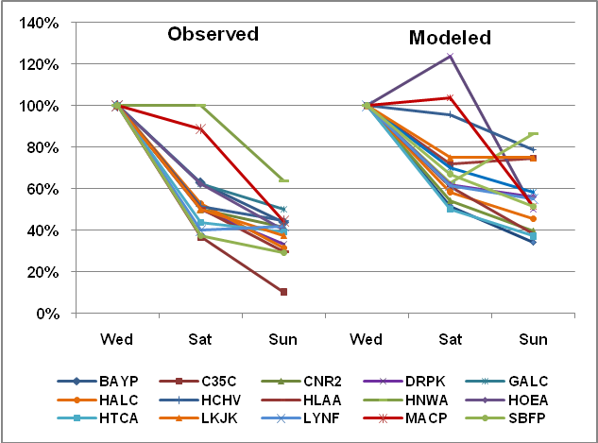
Weekday-Weekend Analysis
Median Observed and Modeled
6 AM NO_{X} Concentrations
Median 6 AM observed and modeled NO_{X} concentrations expressed as a percentage of Wednesday, all modeled Wednesdays, Saturdays, and Sundays.
Notes:
This plot shows median observed and modeled 6 AM NO_{X} concentrations for fifteen NO_{X} monitors in the HGB area. The median is taken over the Wednesdays, Saturdays, and Sundays that occurred during the 96 episode days modeled (there are 16 Wednesdays and 11 each Saturdays and Sundays). Because of the large variation in NO_{X} concentrations from monitor to monitor, all median concentrations are displayed as a percent of the Wednesday values (hence Wednesday medians are always plotted as 1).
The graph shows that measured NO_{X} concentrations decline between 0% and about 62% from Wednesdays to Saturdays, and between around 38% and 90% from Wednesdays to Sundays. These declines are much greater than seen in the modeled emissions at least partly because the NO_{X} monitors are mostly source-oriented and many are specifically sited to measure concentrations associated with motor vehicles.
In contrast with the measurements, modeled Saturday concentrations of NO_{X} range from an increase of about 22% to a decrease of about 50% from Wednesdays, and Sunday values decrease from between about 13% to around 65% from Wednesdays. At least some of the disagreement between modeled and observed NO_{X} concentrations is likely caused by the model averaging across grid cells, while the observations are point measurements.

Slide 17
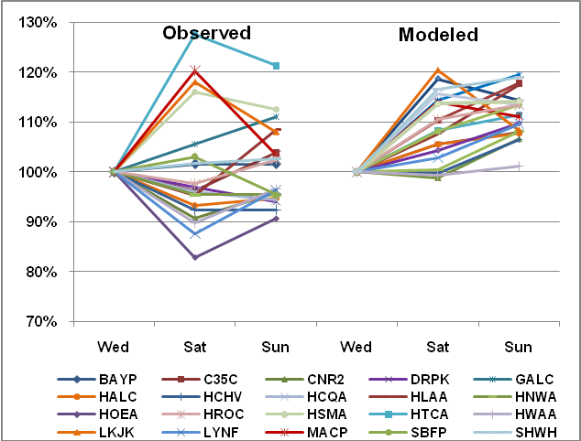
Weekday-Weekend Analysis
Median Observed and Modeled
8-Hour Peak Ozone Concentrations
Median observed and modeled daily peak 8-hour ozone concentrations expressed as a percentage of Wednesday, all modeled Wednesdays, Saturdays, and Sundays.
Notes:
This plot shows median observed and modeled peak 8-hour ozone concentrations for twenty regulatory monitors in the HGB area. The median is taken over the Wednesdays, Saturdays, and Sundays that occurred during the 96 episode days modeled (there are 16 Wednesdays and 11 each Saturdays and Sundays). To be consistent with the NO_{X} concentrations shown on the previous slide, all median concentrations are displayed as a percent of the Wednesday values (hence Wednesday medians are always plotted as 1).
Observed Saturday peak 8-hour ozone concentrations range from around 27% higher to 17% lower than Wednesdays, and Sunday concentrations range between about 21% higher to 10% lower than Wednesdays, with little indication of any coherent pattern.
Modeled Saturday peak 8-hour ozone concentrations range from around 20% higher to 2% lower than Wednesdays, and Sunday concentrations range between about 20% to 2% greater than Wednesdays. There is an apparent pattern showing increasing concentrations from Wednesday to Saturday to Sunday.

Slide 18
Weekday-Weekend Analysis
Observed 8-hour peak ozone concentrations vary widely across day types, but show no coherent pattern.
Modeled ozone concentrations show a weekend increase, and thus appear to indicate greater VOC-sensitivity than the real airshed.
Small sample sizes – 16 Wednesdays, 11 each Saturdays and Sundays among original episode days – increase potential sampling error.

Slide 19
Weekday-Weekend Analysis
All Wednesday-Saturday-Sunday Model Runs
Since meteorology is independent of day of week, we can increase the number of modeled Saturdays by treating all 96 episode days as Saturdays. Similarly for Wednesdays and Sundays.
  Call these sensitivity model runs “all-WSS.”
Compare with every Wednesday, Saturday, and Sunday in May 15 – October 15, 2005-9, which gives 110 of each day type (66 each for Galveston).
Notes:
These are model sensitivity runs where the entire set of 96 modeled days were first all given Wednesday emissions, then Saturday, then Sunday.
There is some cause for concern that the day-to-day carryover of pollution from the previous days is not correct, especially for Saturdays and Sundays. A more realistic (but more expensive) test would be to run seven simulations, starting each on a different day of the week. To test for biases introduced via the WSS test, we regressed the modeled ozone for the all-WSS Wednesdays which coincided with actual Wednesdays against ozone concentrations from the Wednesdays in the baseline runs, and similarly with the Saturdays and Sundays. For all three day types, the regression R² was in each case near 99%, with slopes between 0.99 and 1.01, so it was determined that the current approach was adequate for HGB. But HGB may not carry over as much pollution as some areas due to the afternoon sea breeze which advects pollutants inland, so other areas may wish to consider another approach to increasing the number of days.

Slide 20
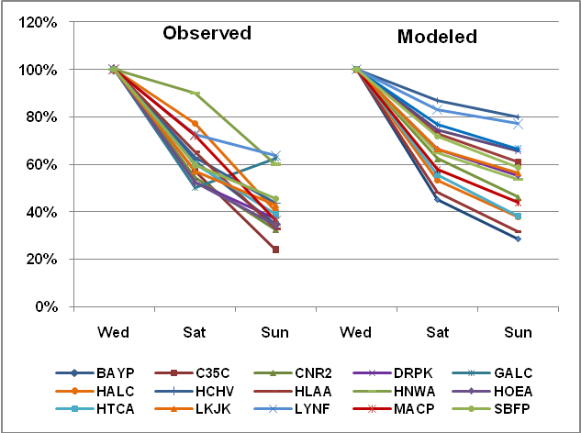
Weekday-Weekend Analysis
Median Observed and Modeled 6 AM
NO_{X} Concentrations, All-WSS Runs
Median NO_{X} concentrations expressed as a percentage of Wednesday; Observed concentrations from May 15 - October 15, 2005-9, Modeled concentrations from All-WSS runs.
Notes:
The observed median NO_{X} concentrations based on five ozone seasons’ Wednesdays, Saturdays, and Sundays behave a lot like those seen in the earlier analysis which considered only the episode Wednesdays, Saturdays, and Sundays. Modeled median NO_{X} concentrations from the all-WSS runs, on the other hand, now all decline monotonically from Wednesday though Saturday through Sunday and all look very similar except for the slopes. Median modeled Saturday concentrations range from a decrease of between about 12% to about 55% from Wednesday, and Sunday decreases range between 20% and about 73% compared with Wednesdays.
The much more orderly behavior of the modeled concentrations is due to using identical meteorology for each day type instead of whatever happened to occur on the modeled Wednesdays, Saturdays, and Sundays. By in effect removing the noise associated with day-specific meteorology, the all-WSS runs provide a better picture of the signal of interest, i.e. the concentration changes due to the day-to-day emission changes.

Slide 21
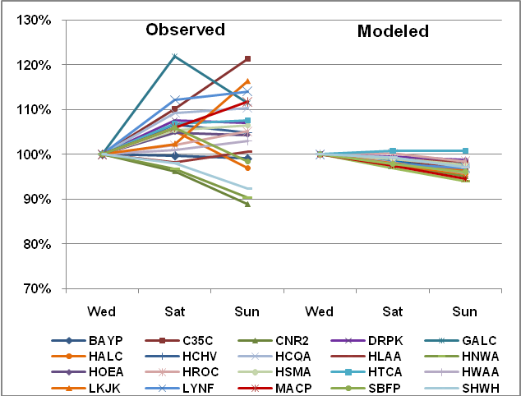
Weekday-Weekend Analysis
Median Observed and Modeled 8-Hr Peak
Ozone Concentrations, All-WSS Runs
Median ozone concentrations expressed as a percentage of Wednesday; Observed concentrations from May 15 - October 15, 2005-9, Modeled concentrations from All-WSS runs.
Notes:
The observed median ozone concentrations based on five ozone seasons’ Wednesdays, Saturdays, and Sundays are again qualitatively similar to those seem for the episode-only Wednesdays, Saturdays, and Sundays, but do not vary somewhat less widely: Saturday median concentrations range between an increase of 22% and a decrease of 4% from Wednesday, and Sunday concentrations range from an increase of 21% to a decrease of 12% from Wednesday.
The median modeled ozone concentrations, however, have a markedly different appearance than those from the run using the episode-only Wednesdays, Saturdays, and Sundays. Instead of increasing from Wednesday to Saturday to Sunday, now all but two sites show monotonic decreases. Furthermore, the range is greatly reduced, with Saturday median concentrations ranging from approximately a 1% increase to a 3% decrease, and Sunday concentrations ranging from a 1% increase to around a 6% decrease.
At first glance, it appears that there must be some problem with the all-WSS simulations, since the signal is of the opposite sign from that seen when using only the episode Wednesdays, Saturdays, and Sundays, but in fact the difference is almost entirely due to random meteorological effects. To verify this, we examined the ozone concentrations simulated in the all-WSS runs for the Wednesdays, Saturdays, and Sundays that coincided with the actual corresponding day of the week. When we compared these concentrations with those simulated in the baseline, we observed very similar patterns. So the actual episode days just happened to behave in a manner that seemingly contradicts the more robust all-WSS analysis, and the only factor which can account for this effect is the meteorology which occurred on the particular modeled Wednesdays, Saturdays, and Sundays. The conclusion is that the pattern seen for the episode Wednesdays, Saturdays, and Sundays was caused by random meteorological effects which overwhelmed the signal of interest, namely weekday-weekend ozone patterns.

Slide 22
Weekday-Weekend Analysis
All Wednesday-Saturday-Sunday Model Runs
The observed ozone concentrations look much like those of the episode-days only runs, but...
Modeled concentrations now show a slight decrease on weekends and much less variability compared to the earlier analysis.
  The all-WSS runs increase the sample sizes 7 to 10-fold, and also remove meteorological variation as a source of error.
  “True” pattern of model response to weekday-weekend emission patterns was masked by meteorological variation among days.

Slide 23
Weekday-Weekend Analysis
All Wednesday-Saturday-Sunday Model Runs
The all-WSS model runs suggest that the model is somewhat NO_{X}-sensitive, but observed ozone concentrations do not appear to concur.
But observations include a number of non-ozone-conducive days (rain, wind, clouds, etc.). Modeled days were selected to represent ozone-conducive periods.
Instead of just using the median of the observed concentrations, let’s also look at the 75th and 90th percentiles.
Notes:
The 75th and 90th percentiles represent days that were more conducive to ozone formation at the respective monitors.
To verify that it is appropriate to compare the medians of the episode days with the 75th and 90th percentiles of the concentrations from five ozone seasons, we looked at the median observed concentration across all 96 episode days at each monitor. In every case but one the episode median was between the 75th and 90th percentiles of the five-year concentration data. For Galveston (GALC) the median was slightly lower than the 75th percentile (56 ppb vs. 56.6 ppb).

Slide 24
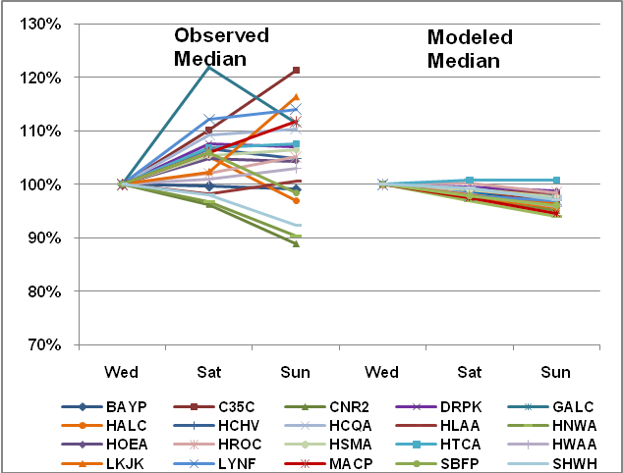
Weekday-Weekend Analysis
Median Observed and Modeled 8-Hr Peak
Ozone Concentrations, All-WSS Runs
Median ozone concentrations expressed as a percentage of Wednesday; Observed concentrations from May15 - October 15, 2005-9, Modeled concentrations from All-WSS runs.
Notes:
Repeat of slide 21.

Slide 25
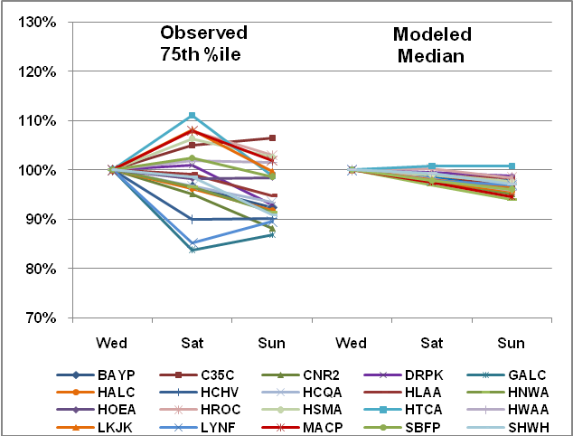
Weekday-Weekend Analysis
75th Percentile Observed and Median Modeled 8-Hr Peak Ozone Concentrations, All-WSS Runs
Median ozone concentrations expressed as a percentage of Wednesday; Observed concentrations from May15 - October 15, 2005-9, Modeled concentrations from All-WSS runs.
Notes:
Same as previous slide, except median observed ozone concentrations have been replaced with 75th percentile concentrations. The pattern has shifted downwards somewhat, with Saturday concentrations now between an approximate 11% increase and 17% decrease, relative to Wednesday, and with Sunday concentrations ranging from a 7% increase to a 13% decrease compared with Wednesday.

Slide 26
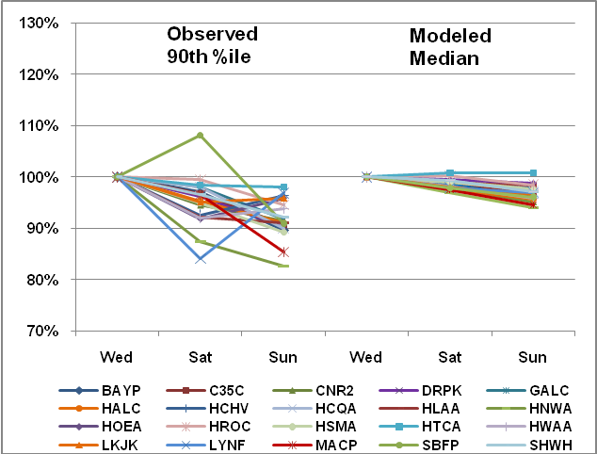
Weekday-Weekend Analysis
90th Percentile Observed and Median Modeled 8-Hr Peak Ozone Concentrations, All-WSS Runs
Median ozone concentrations expressed as a percentage of Wednesday; Observed concentrations from May15 - October 15, 2005-9, Modeled concentrations from All-WSS runs.
Notes:
Same as previous slide, except 75th percentile observed ozone concentrations have been replaced with 90th percentile concentrations. Now the pattern shift is more dramatic, with all but one site decreasing from Wednesday to Saturday and all sites showing decreases from Wednesday to Sunday. Saturday concentrations now range from an 8% increase to a 17% decrease relative to Wednesday, and Sunday concentrations ranging from a 2% to an 18% decrease compared with Wednesday. Overall, the 90th percentile concentrations show a greater response to the weekday-weekend emission patterns than do the modeled concentrations.

Slide 27
Weekday-Weekend Analysis
Conclusions
Variability due to meteorology appears to be large compared to day-of-week effects:
  Large number of samples are needed to detect signal in noisy data.
  Using all-WSS runs can increase sample sizes and also average-out meteorological variability.
The airshed appears to respond to changes to some types of emissions (mobile source NO_{X}) better than the model, at least for higher ozone concentrations.

Slide 28
Summary
Dynamic MPE can be employed to assess how well the model simulates the airshed’s response to emission changes.
Retrospective and weekday-weekend analyses were used in Texas’ 2010 attainment demonstration.
A novel technique for increasing the number of samples for weekday-weekend analysis was demonstrated.

Slide 29
Summary
Both retrospective and weekday-weekend analyses demonstrate that the model responds appropriately to emission changes, but may not be quite as responsive as the airshed.
Notes:
Good news: The HGB area’s 2010 8-hour ozone design value as of October 6 was 84 ppb at Manvel Croix Park, and all but four regulatory sites in the area had 2010 DVs of 78 ppb or lower. Barring an unusually high late-season ozone event, this will be the second consecutive year that the HGB area has been in compliance of the 1997 8-hour ozone standard of 85 ppb.

