Slide 1
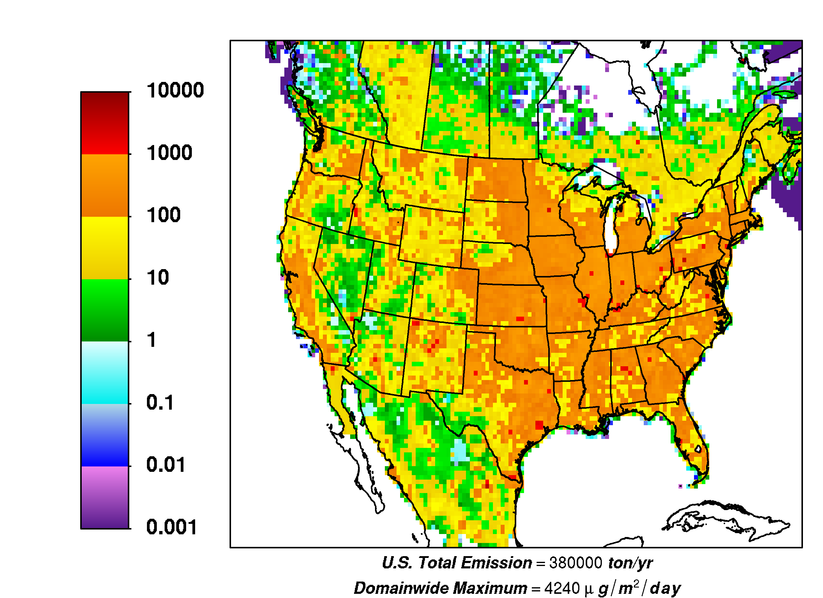
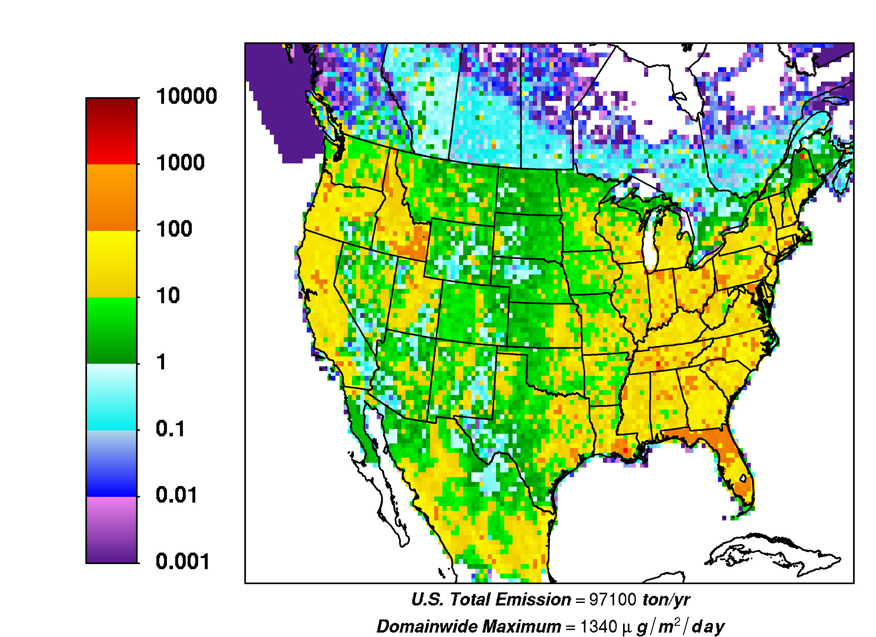
Modeling the trace-elemental composition of PM_{2.5} in CMAQ
Heather Simon, Prakash Bhave, George Pouliot,
Daniel Tong, Wyat Appel
Acknowledgements: Adam Reff, Golam Sarwar

Slide 2
Outline
The importance of PM_{2.5} Speciation
Emissions changes
CMAQ changes

Slide 3
PM_{2.5} Speciation
Ambient PM_{2.5}
Primary Anthropogenic
Secondary

Slide 4
PM_{2.5} Speciation
Ambient PM_{2.5}
CMAQ PM_{2.5}
Primary Anthropogenic
Secondary

Slide 5
CMAQ estimates of PM_{Other} are very poor
Winter 2001
Northeast U.S.
Appel et al. (2008) evaluated CMAQ v4.5 across network of urban monitoring sites (CSN) in eastern U.S.
  Examined the speciated contributions to PM_{2.5}
  Stratified evaluation into 4 seasons and 4 geographic regions
In 10 of 16 subsets, CMAQ’s PM_{Other} exhibited largest compositional bias.
  Positive bias in Winter & Fall
  Negative bias in Summer
Large PM_{Other} biases noted in several other CMAQ evaluation studies: Mathur et al (2008), Hogrefe et al (2007), Foley et al (2010), Appel et al (2010)
Summer 2001
NC, SC, GA, FL
Plots provided by W. Appel

Slide 6
Diagnosing the cause of PM_{Other} biases
If we speciate PM_{other} in CMAQ, we can utilize vast ambient datasets of PM_{2.5} trace elements to diagnose CMAQ’s largest biases for PM_{2.5}
Note: Pie charts are conceptual and not based on actual measured or modeled concentrations

Slide 7
Model changes needed to speciate PM_{Other}
Emissions: Divide PM_{Other} into desired components
  Requires changes to SMOKE’s gspro file
CMAQ: Change code to track new species
Post-processing: Change the SPECDEF file for combine, sitecompare scripts, and AMET scripts

Slide 8
Emissions: Speciating PM_{Other}
65% of primary PM_{2.5} in the NEI falls in “Other”
Reff et al. (ES&T 2009)
  analyzed PM_{2.5} source characterization profiles in the SPECIATE database
  constructed emission inventory of trace elements, metal oxides, and NCOM
  reduced the unspeciated PM_{2.5} mass from 65% of NEI to 18%
Emissions (tons/yr)
Plot provided by A. Reff

Slide 9
Emissions: Apply new PM_{2.5} speciation in SMOKE
PM_{other} emissions were divided in 14 species
Why were these 14 chosen?
  Na, Cl, NH₄, and H₂O (already explicit species in CMAQ)
  NCOM is needed to accurately model total organic mass (OM)
  Al,Ca,Fe,Si,Ti (a linear combination of these represents crustal material )
  Mg,K,Ca (for ISORROPIA v2.0)
  Fe,Mn (for AQCHEM)
PH₂O | PNA
PCL | PNH4
PNCOM | PAL
PCA | PFE
PSI | PTI
PMG | PK
PMN | PMOTHR
PM_{2.5} Emissions

Slide 10
Emissions: Gridded maps of new species (tons per year)
2001 annual emissions of Si
2001 annual emissions of Cl
Plots provided by A. Reff

Slide 11
CMAQ: New code
Name changes for accuracy
  AORGPAI/J → APOCI/J
  A25J → AOTHRJ
Add 10 new species to CGRID array: APNCOMI, APNCOMJ, AALJ, ACAJ, AFEJ, ASIJ, ATIJ, AMGJ, AKJ, AMNJ
  Change all AE include files
  Add pointers and include new species in calculation of 3rd moment/PM mass in: AERO_INFO.f, aero_driver.F, aero_depv.F, aero_subs.f
Allow for emission of 10 new species and 4 species that previously originated only from sea spray and secondary processes in PMEM_DEFN.F and AERO_EMIS.F
Calculate wet deposition for new species in aqchem.F and AQ_PARAMS.EXT
Aerosol code restructuring (Steve Howard and Jeff Young) will significantly simplify the process of adding new species in the future: See poster by Steve Howard.

Slide 12
CMAQ: Expected impact on model output
Increased emissions of existing CMAQ species
  Na, Cl, H₂O, NH₄
Changes to physical properties of PM_{other}
  MW
  Density
  Size distribution

Slide 13
How big are changes in CMAQ concentrations?

Slide 14
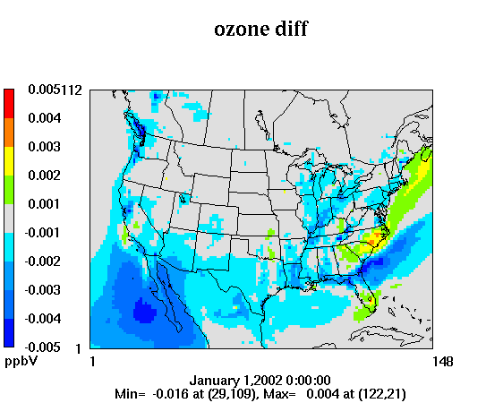
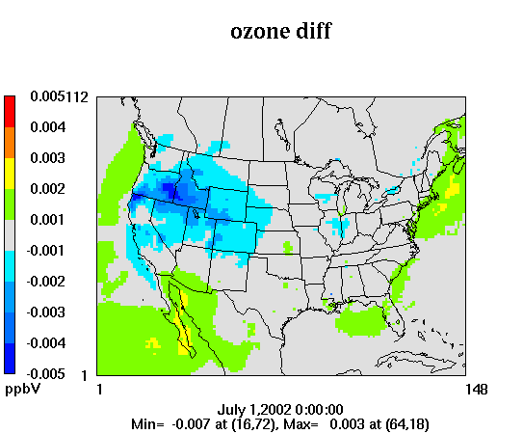
CMAQ: Gas-phase changes (new – old)
January Monthly Avg
July Monthly Avg
January monthly average ozone ranged from 15-45 ppb
  Domain-wide average change of 0.002 %
July monthly average ozone ranged from 35-65 ppb
  Domain-wide average change of 0.0004%

Slide 15
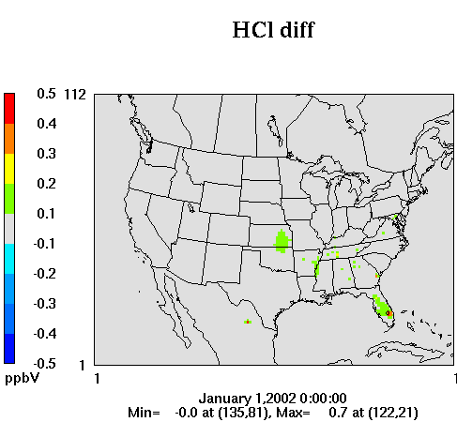
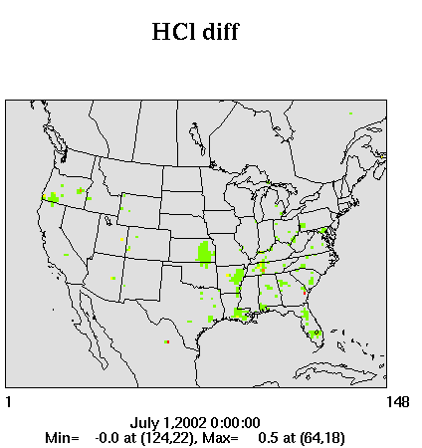
CMAQ: Gas-phase changes (new – old)
January Monthly Avg
July Monthly Avg
In January and July, monthly average HCl concentrations are between 0.1 and 0.5 ppb across much of the Eastern US
  Domain-wide average January change of 12%
  Domain-wide average July change of 19%

Slide 16
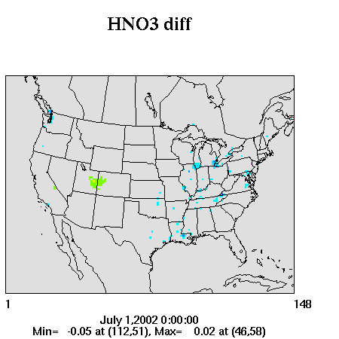
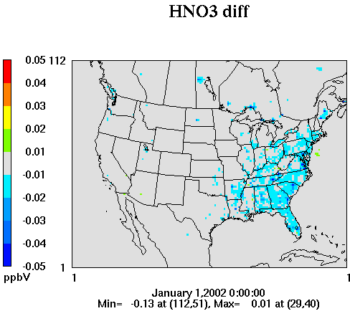
CMAQ: Gas-phase changes (new – old)
January Monthly Avg
July Monthly Avg
July Monthly Avg
In January, monthly average HNO₃ concentrations are generally between 0.5 and 1.3 ppb in the Eastern US
  Domain-wide average January change of 0.3%
In July, monthly average HNO₃ concentrations are generally between 1 and 3 ppb in the Eastern US
  Domain-wide average July change of 0.3%

Slide 17
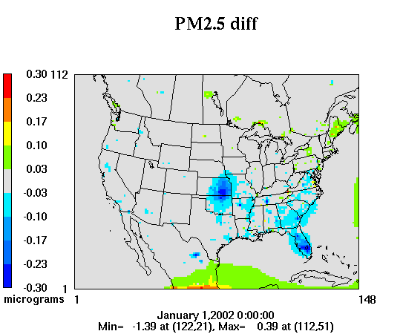
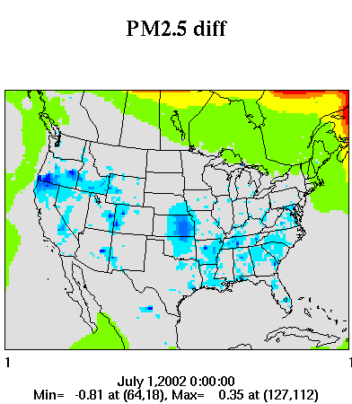
CMAQ: PM_{2.5} changes (new – old)
January Monthly Avg
July Monthly Avg
Monthly average PM_{2.5} concentrations were between 5 and 20 ug/m³ in the Eastern US
  Domain-wide average January change of 0.4%
  Domain-wide average July change of 1.5%

Slide 18
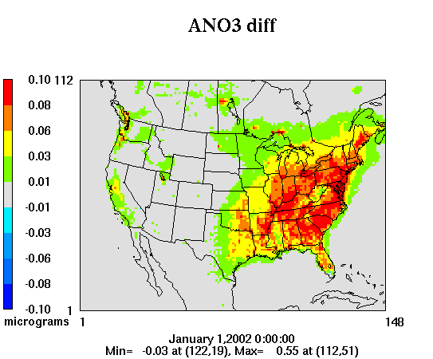
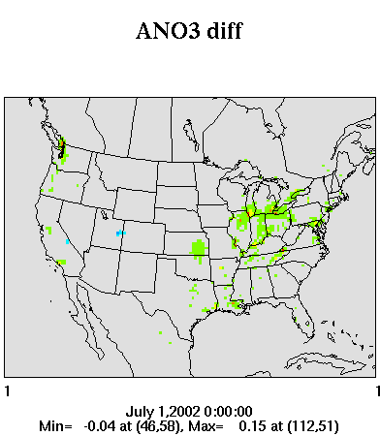
CMAQ: PM_{2.5} changes (new – old)
January Monthly Avg
July Monthly Avg
Monthly average nitrate concentrations were between 2 and 5 ug/m³ in the Eastern US for Jan
  Domain-wide average January change of 3%
Monthly average nitrate concentrations were between 0.5 and 2 ug/m³ in the Eastern US for July
  Domain-wide average January change of 0.8%

Slide 19
CMAQ: Diagnosing the cause of each difference
-Modified CMAQ Code
-New ρ, Dp, MW
-New emission speciation including Na, Cl, NH₄, H₂O
-Modified CMAQ Code
-Old ρ, Dp, MW
-New emission speciation except Na, Cl, NH₄, H₂O = 0
-Modified CMAQ Code
-New ρ, Dp, MW
-New emission speciation except Na, Cl, NH₄, H₂O = 0
-Original CMAQ Code
-Original Emissions
These scenarios should look almost identical
effect of new physical parameters
effect of emitting thermodynamically active species
overall changes caused by new modeling scheme

Slide 20
CMAQ: Diagnosing the cause of each difference
-Modified CMAQ Code
-New ρ, Dp, MW
-New emission speciation including Na, Cl, NH₄, H₂O
-Modified CMAQ Code
-Old ρ, Dp, MW
-New emission speciation except Na, Cl, NH₄, H₂O = 0
-Modified CMAQ Code
-New ρ, Dp, MW
-New emission speciation except Na, Cl, NH₄, H₂O = 0
Original
These scenarios should look almost identical
effect of new physical parameters
effect of emitting thermodynamically active species
overall changes caused by new modeling scheme

Slide 21
CMAQ: Diagnosing the cause of each difference
-Modified CMAQ Code
-New ρ, Dp, MW
-New emission speciation including Na, Cl, NH₄, H₂O
-Modified CMAQ Code
-New ρ, Dp, MW
-New emission speciation except Na, Cl, NH₄, H₂O = 0
Original
Subdivided
These scenarios should look almost identical
effect of new physical parameters
effect of emitting thermodynamically active species
overall changes caused by new modeling scheme

Slide 22
CMAQ: Diagnosing the cause of each difference
-Modified CMAQ Code
-New ρ, Dp, MW
-New emission speciation including Na, Cl, NH₄, H₂O
Original
Subdivided
Physical Properties
These scenarios should look almost identical
effect of new physical parameters
effect of emitting thermodynamically active species
overall changes caused by new modeling scheme

Slide 23
CMAQ: Diagnosing the cause of each difference
Original
Subdivided
Physical Properties
Final
These scenarios should look almost identical
effect of new physical parameters
effect of emitting thermodynamically active species
overall changes caused by new modeling scheme

Slide 24
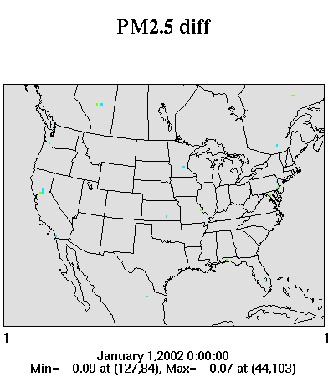
CMAQ: Diagnosing the cause of each difference - January
Final - original
Subdivided - Original

Slide 25
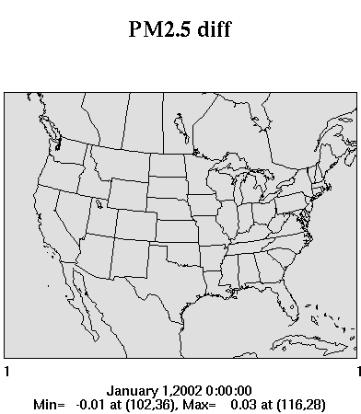
CMAQ: Diagnosing the cause of each difference - January
Final - original
Physical Properties - Subdivided

Slide 26

CMAQ: Diagnosing the cause of each difference - January
Final - original
Final – Physical Properties
Wintertime PM_{2.5} changes are caused by our new emissions of NH₄, Cl, and H₂O

Slide 27
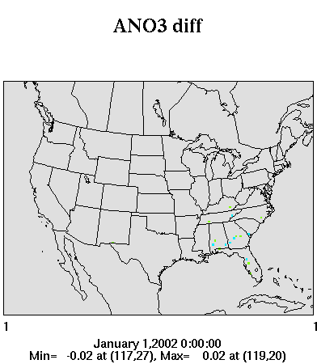
CMAQ: Diagnosing the cause of each difference
Final - original
Subdivided - Original

Slide 28

CMAQ: Diagnosing the cause of each difference
Final - original
Physical Properties - Subdivided

Slide 29

CMAQ: Diagnosing the cause of each difference
Final - original
Final – Physical Properties
Wintertime ANO3 changes are caused by our new emissions of Na and NH₄

Slide 30
Applications of PM_{Other} Speciation
Currently underway:
Diagnosing PM_{2.5} Bias
  Dust emissions sensitivities/improvements
  Modeling NCOM and total organic mass
ISORROPIA II (requires K, Ca, and Mg)
Future updates/applications:
Aqueous chemistry (currently assumed concs for Fe and Mn, but now can use CMAQ predicted concentrations for fine Fe and Mn)
ClNO₂ chemistry
Residual nonattainment modeling
Evaluation against CMAPS and other field study data

Slide 31
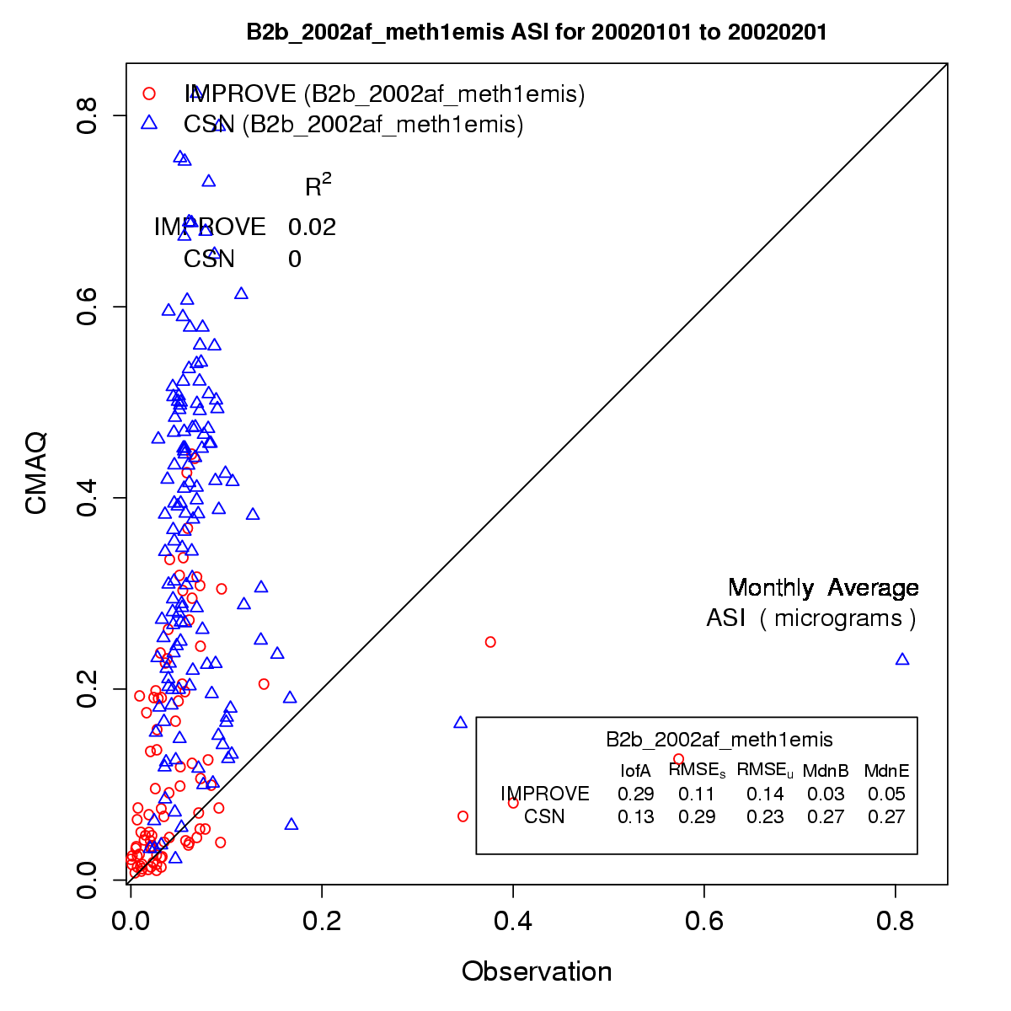
Assessing the Anthropogenic Fugitive Dust Emission Inventory and Temporal Allocation using an Updated Speciation of Particulate Matter
January 2002
George Pouliot
Tuesday October 12, 10:40
Emissions Inventories, Models, and Processes Session
Redbud Room

Slide 33
CMAQ: Expected impact on model output (1)
Emissions of semivolatile species
-PM_{Other} used to be assigned to A25J (non-volatile)
  -A portion of PM_{Other} will now be assigned to semi-volatile species (ANH4, AH2O, ACL)

Slide 34
CMAQ: Expected impact on model output (2)
HCl
Cl
Na
SO4
NH4
NH3
NO3
ISORROPIA
Emissions of species that are thermodynamically active: ANH4, ACL, ANA
HNO3

Slide 35
CMAQ: Expected impact on model output (3)
MW for new species
  MW of A25J = 200 g/mol
  MW for metals < 56 g/mol
  MW for NCOM = 220 g/mol
Transport module uses ppm
Altitude
Unit conversion depends on air density and aerosol MW
Aerosol module uses mass concentration
Concentration (ug/m³ or ppm)

Slide 36
CMAQ: Expected impact on model output (4)
I vs J mode
  -PM_{Other} used to be emitted only in the J mode
  -NCOM is emitted in both I (0.1%) and J (99.9%) modes.
Mass concentration
Accumulation (J) mode
Aitken (I) mode
Particle Diameter (um)

Slide 37
CMAQ: Expected impact on model output (5)
d_{p}
d_{p}
Density = mass/volume
  Density of A25J is 2.2 g/cm3
  Density of NCOM is 2.0 g/cm3
  Density of H2O is 1 g/cm3
Dry deposition = f(d_{p})

