Slide 1
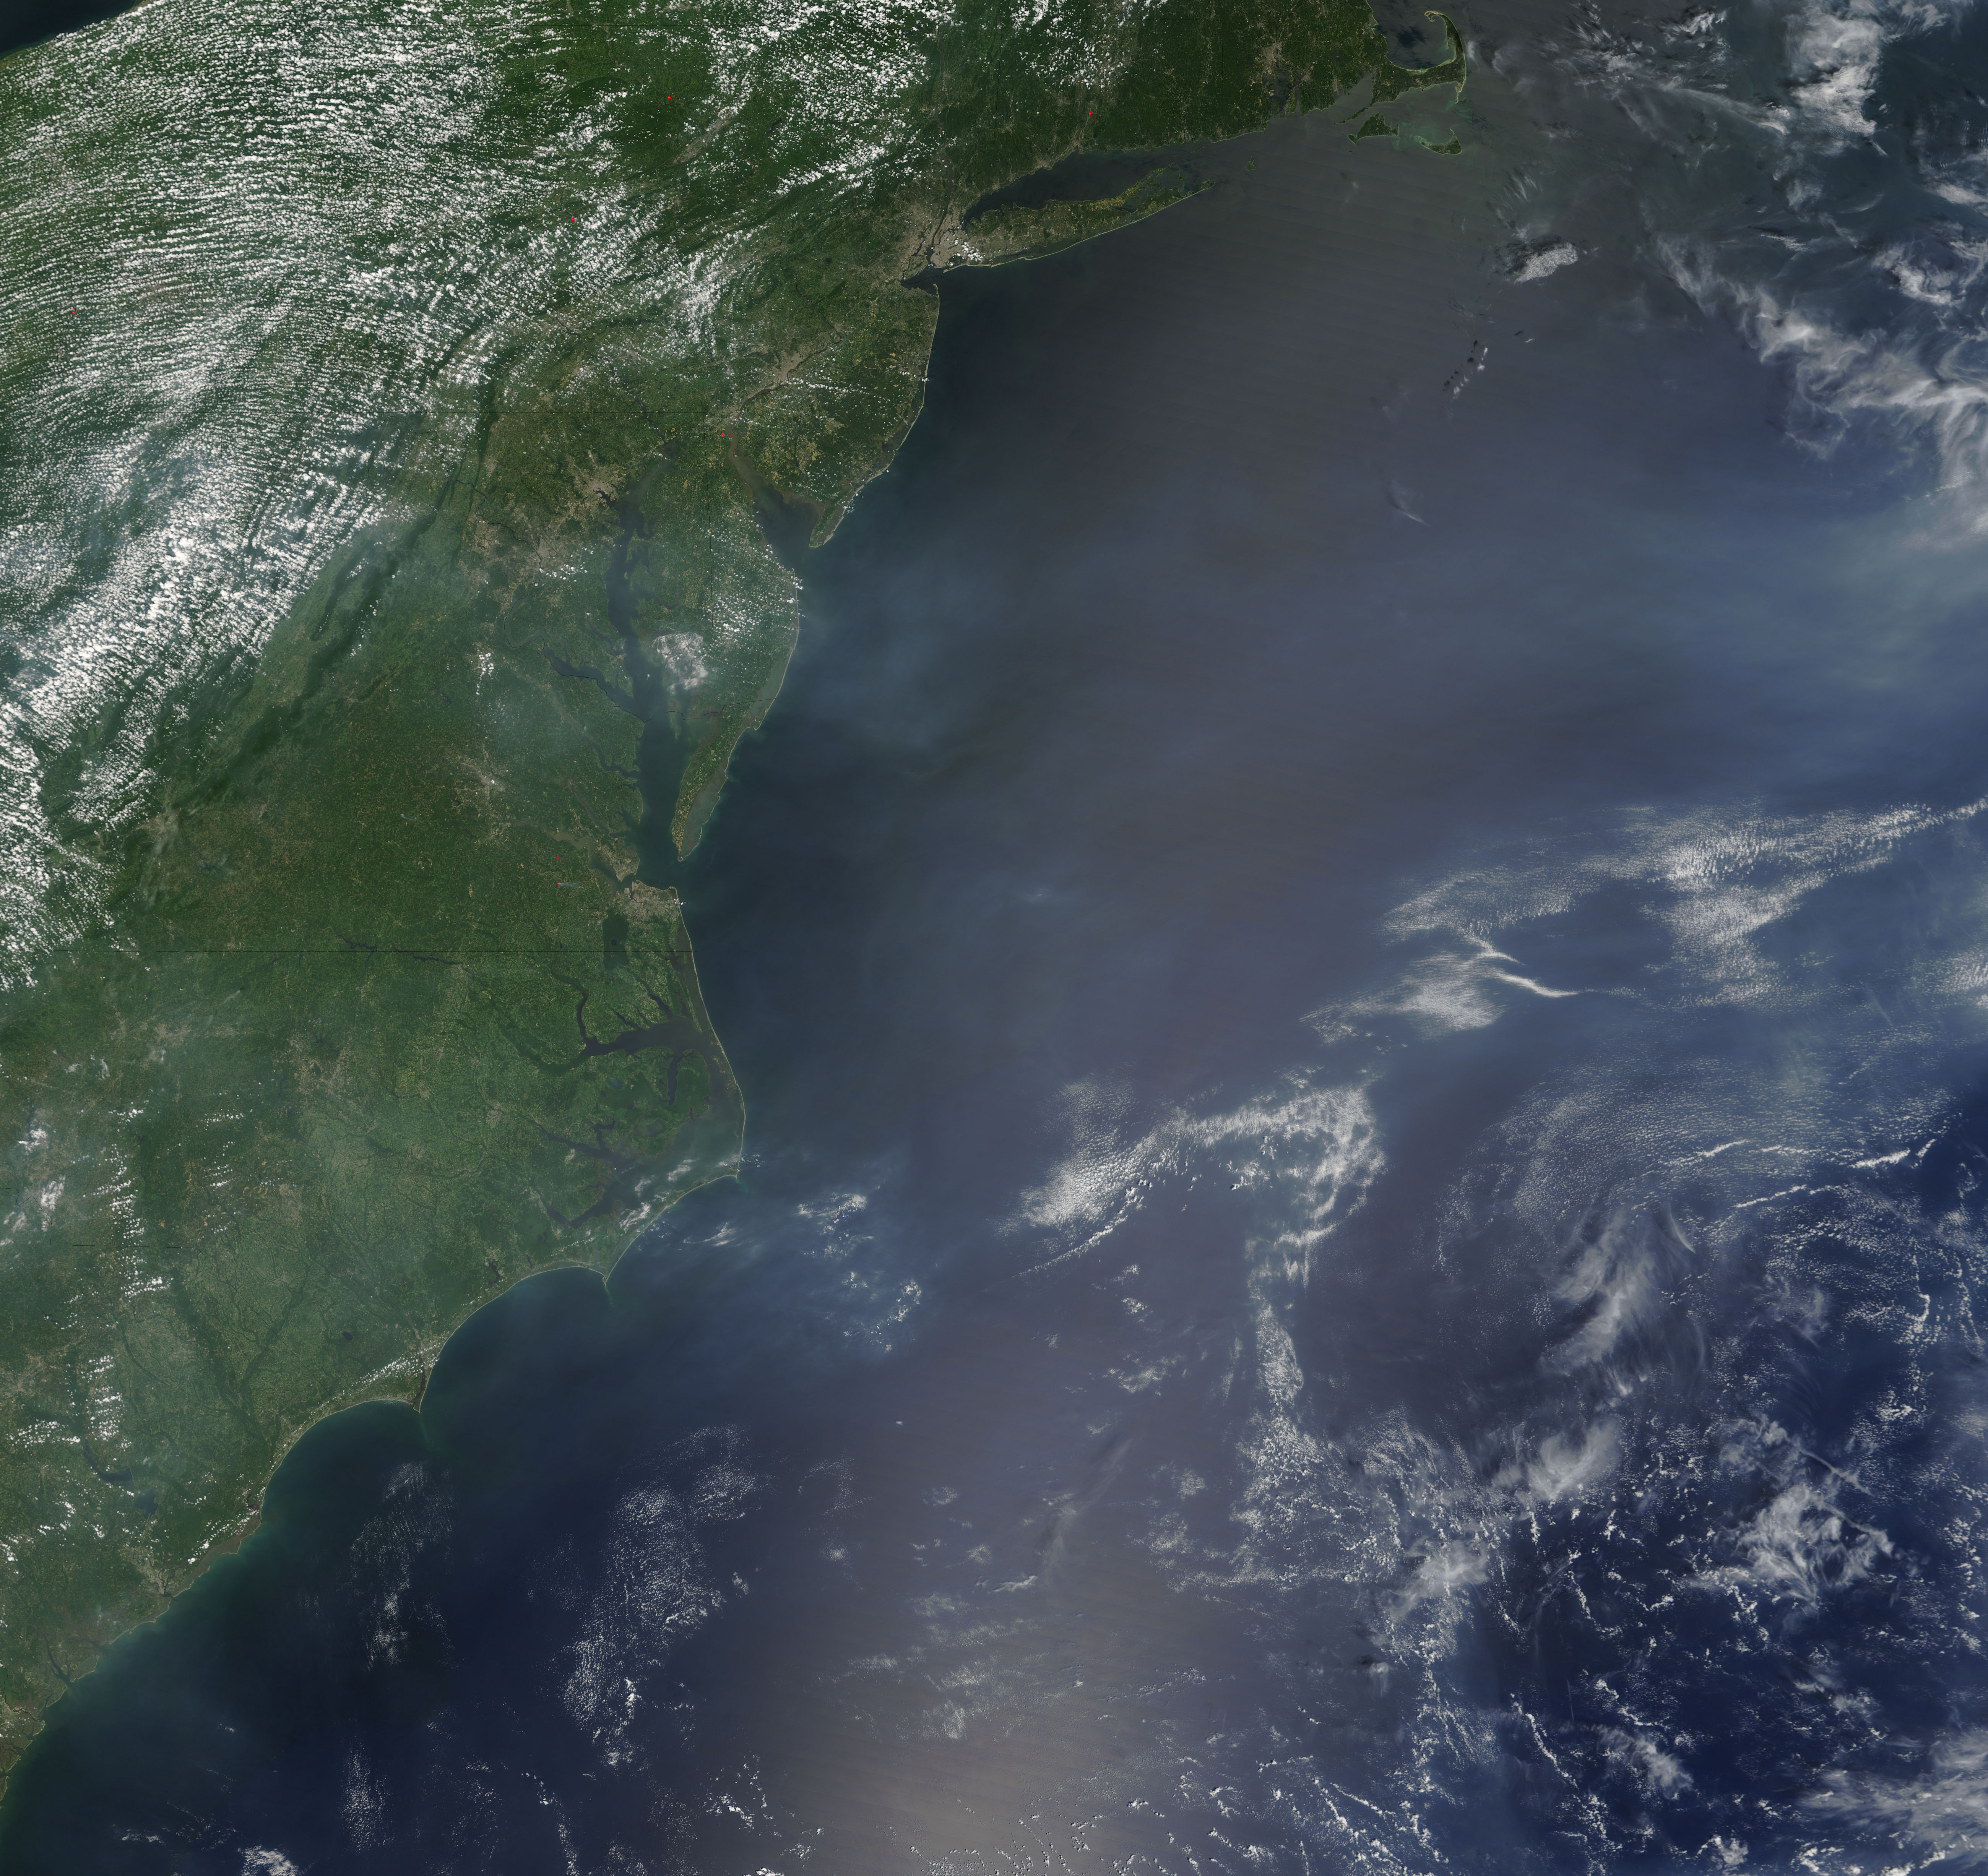
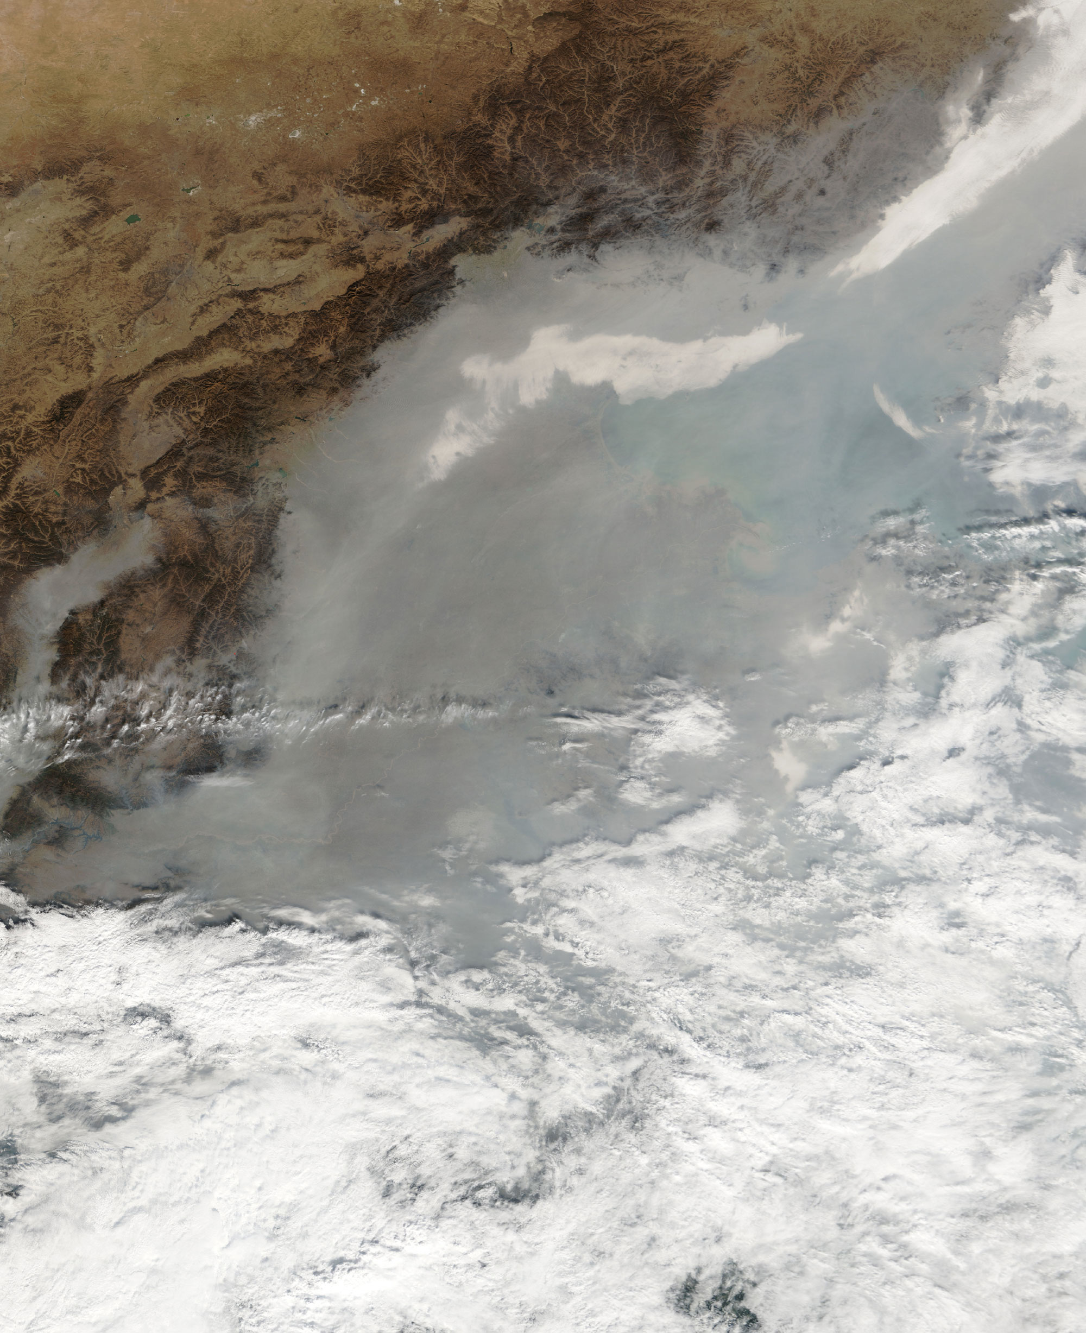
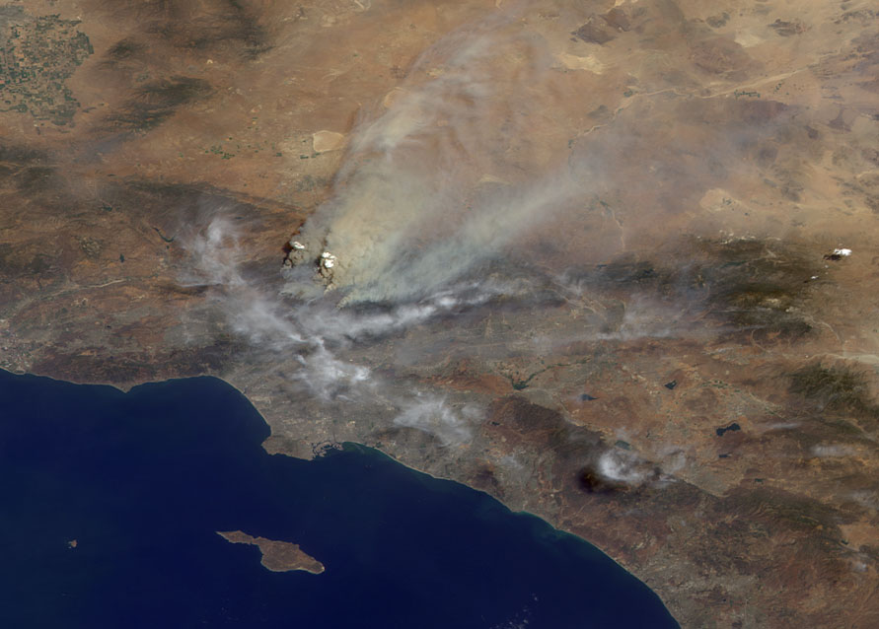

Potential Anthropogenic Controls
on Biogenic Organic Aerosol
Havala Olson Taylor Pye¹,
Arthur W. H. Chan², and John H. Seinfeld
Department of Chemical Engineering
California Institute of Technology
¹ Now at: US EPA, Atmospheric Modeling and Analysis Division, RTP, NC
² Now at: Department of Environmental Science, Policy and Management,
University of California, Berkeley
Images: NASA

Slide 2
Introduction
other VOCs
Gas-phase VOCs
+ O₃, OH, NO₃
Semi-volatile organic compounds
Particle phase
Notes:
Present GEOS-Chem framework
Results focused on NOX-dependent biogenic SOA yields and SOA from nitrate oxidation pathway
2

Slide 3
Introduction
other VOCs
Model treatment:
Gas-phase VOCs
+ O₃, OH, NO₃
Semi-volatile organic compounds
A_{i} aerosol-phase concentration
G_{i} gas-phase concentration
α_{i} mass-based stoichiometric coefficient
M_{O} total aerosol mass for partitioning
K_{i} equilibrium partitioning coefficient
P_{i}º vapor presure of pure species i at T
C_{i}* saturation vapor pressure
Particle phase
Notes:
Present GEOS-Chem framework
Results focused on NOX-dependent biogenic SOA yields and SOA from nitrate oxidation pathway
3

Slide 4
Objective
Update the GEOS-Chem SOA framework
  Update biogenic emissions for organic aerosol module
  Add NO_{x}-dependent terpene photooxidation and ozonolysis yields
Examine the interaction between primarily anthropogenic species (NO_{x}, NO₃) and biogenic emissions in terms of SOA
Notes:
Also cleaned up tracer lumping

Slide 5
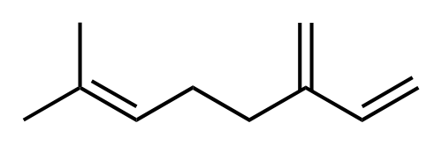

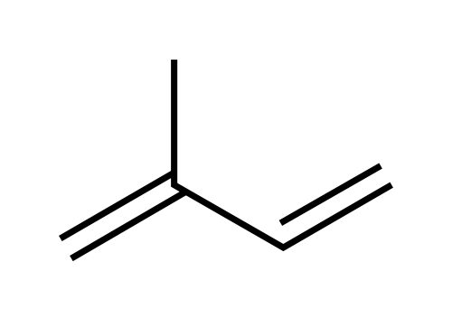
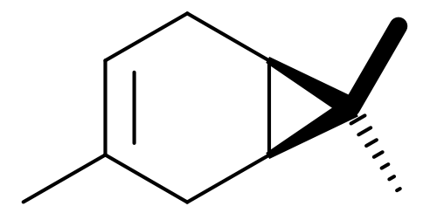
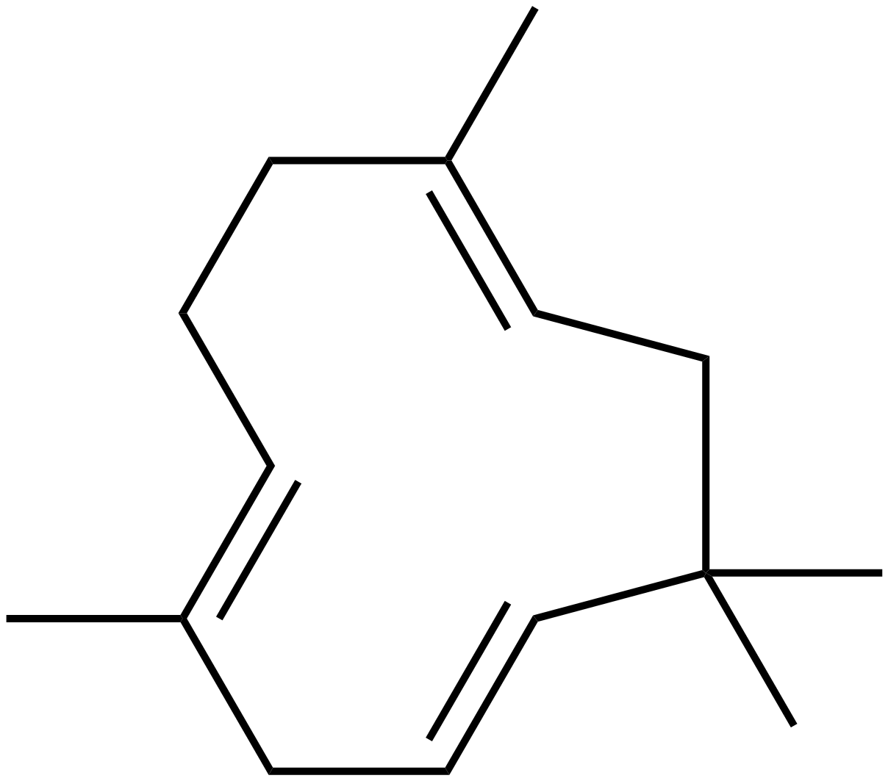
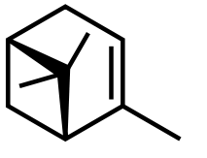
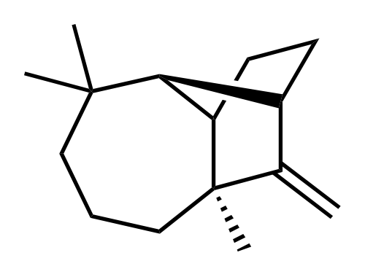
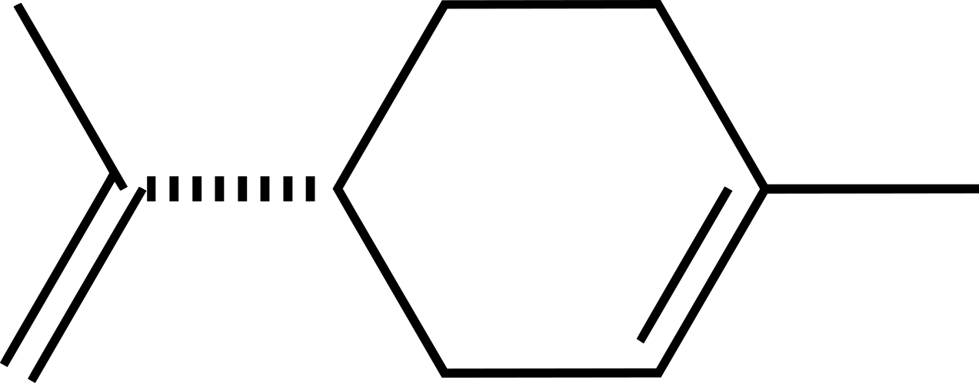
Biogenic Emissions
Isoprene
Monoterpenes
Sesquiterpenes
C₅H₈
C₁₀H₁₆
C₁₅H₂₄
Model of Emission of Gases and Aerosol from Nature (MEGAN)
(Guenther et al., 2006 ACP):
ε Baseline emission rate
γ_{age} Activity factor for age
γ_{LAI} Activity factor for leaf area index
γ_{T} Activity factor for temperature
γ_{p} Activity factor for light
LDF Light-dependence fraction

Slide 6
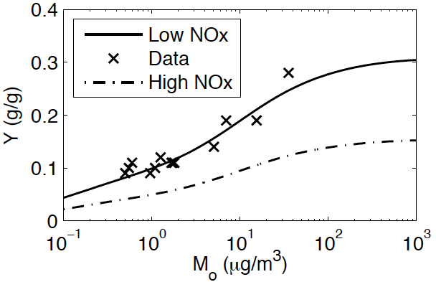
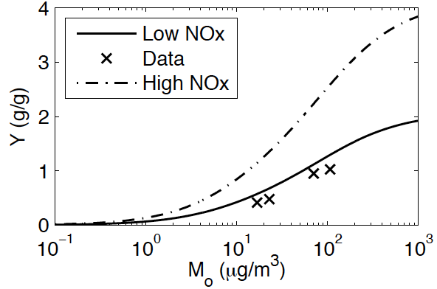
NO_{x} Dependence of Terpene Aerosol
Monoterpenes have much higher yields under low-NO_{x} conditions (except limonene)
Sesquiterpenes have much lower yields under low-NO_{x} conditions
(data is not at 298 K)
Data: Shilling et al., 2008 ACP
Data: Griffin et al., 1999 JGR
Notes:
Sesq have higher yield due to either:
Higher probability of isomerization of the alkoxy racial
Higher yield of less volatile organic nitrate

Slide 7
Gas-phase chemistry leading to SOA
(Ng et al., 2007 ACP)
Notes:
Daytime chemistry
Hydrocarbon reacts with OH followed by O2 very rapidly to form peroxy radical

Slide 8
NO_{x} Branching Ratio
HC₀ + Ox₀ → RO₂
RO₂ + HO₂ → α_{a}P₁ + α_{b}P₂ + …
RO₂ + NO₀ → α_{c}P₁ + α_{d}P₂ + …
Fraction of peroxy radical reacting with NO:
Plots for August 2000
(Pye et al., 2010 ACPD)

Slide 9
Terpene SOA
HC | Description | Aerosol Formation Pathways | Experimental Data
MTPA | Bicyclic monoterpenes | + OH,O₃; + HO₂ + OH,O₃; + NO + NO₃ | High and Low NO_{x}: a-pinene ozonolysis (Shilling 2008, Ng 2007) NO₃: b-pinene + NO₃ (Griffin 1999)
LIMO | Limonene | + OH,O₃; + HO₂ + OH,O₃; + NO + NO₃ | High and Low NO_{x}: limonene ozonolysis (Zhang 2006) NO₃: b-pinene + NO₃ (Griffin 1999)
MTPO | Other monoterpenes | + OH,O₃; + HO₂ + OH,O₃; + NO + NO₃ | High and Low NO_{x}: a-pinene ozonolysis (Shilling 2008, Ng 2007) NO₃: b-pinene + NO₃ (Griffin 1999)
SESQ | Sesquiterpenes | + OH,O₃; + HO₂ + OH,O₃; + NO + NO₃ | High and Low NO_{x}: a-humulene, b- caryophyllene (Griffin 1999, Ng 2007) NO₃: b-pinene + NO₃ (Griffin 1999)
Multiple pathways…use VBS to reduce tracers

Slide 10
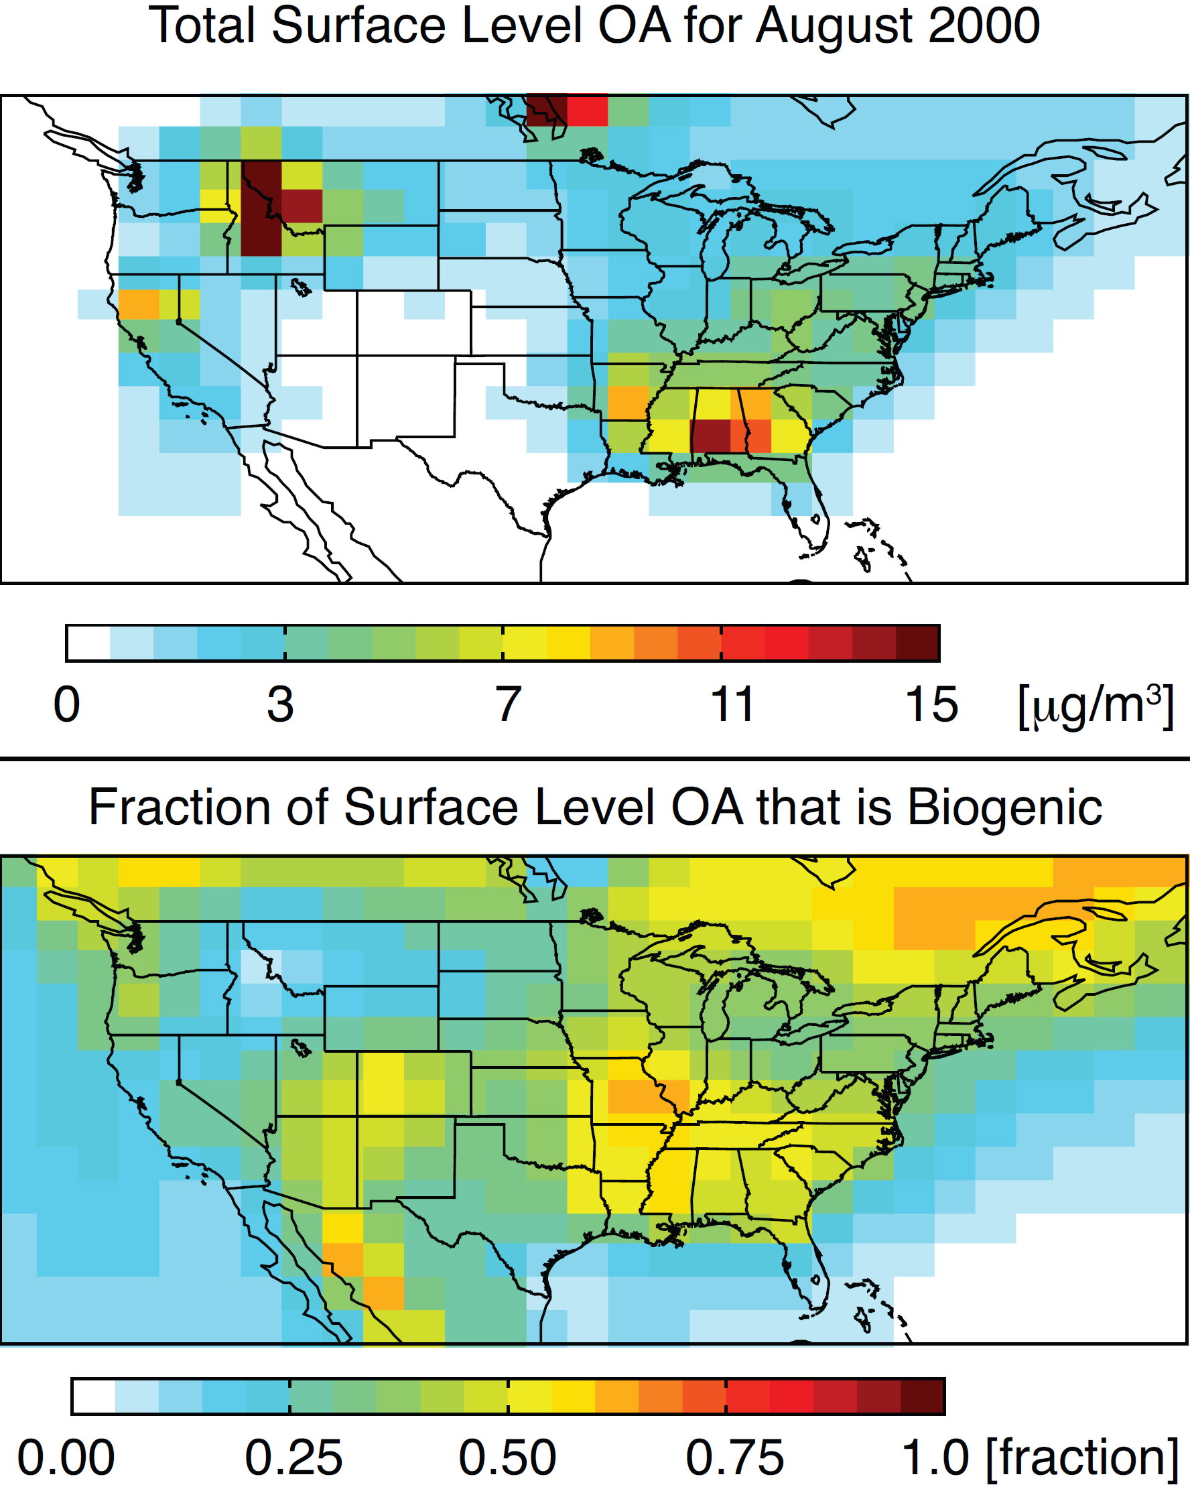
Biogenic SOA Important in Summer
(Pye et al., 2010 ACPD)
Notes:
High concentrations reflect
Biomass burning
High biogenic emissions
Fractional contribution of biogenic aerosol is higher in a revised simulation with semivolatile POA
High concentrations reflect
Biomass burning
High biogenic emissions
Fractional contribution of biogenic aerosol is higher in a revised simulation with semivolatile POA

Slide 11
Minor Effect of NO_{x}-Dependent Aerosol
Change in total OA as a result of forcing the parent HC through high-NO_{x} or low-NO_{x} yields
Increased aerosol from monoterpenes and light aromatics
Significant isoprene, nitrate radical oxidation, and sesquiterpene aerosol
Less aerosol from monoterpenes and light aromatics
Plots for August 2000. Reference total OA levels are the same as the previous slide (model calculated β).
(Pye et al., 2010 ACPD)

Slide 12
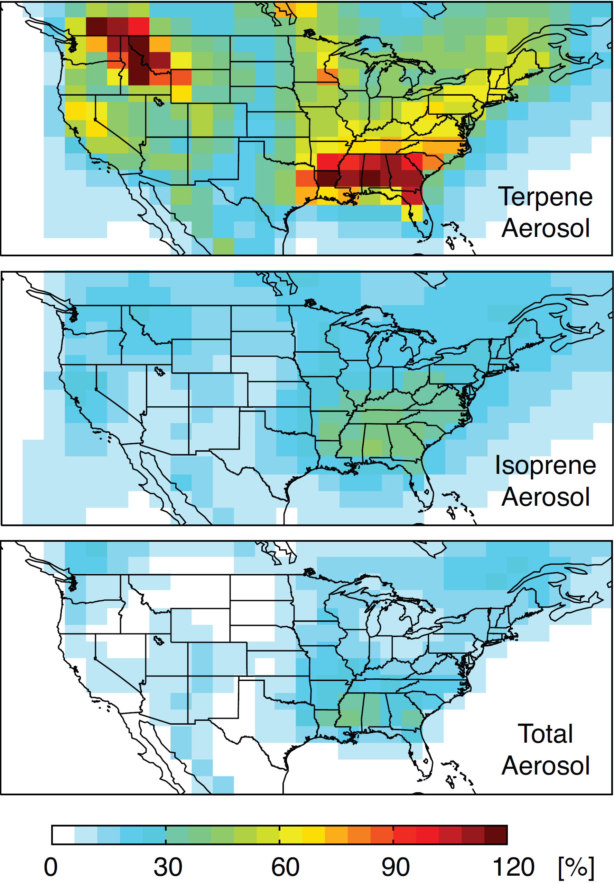
Significant Aerosol from NO₃ Oxidation
Aerosol from the NO₃ oxidation pathway contributes roughly half of the terpene aerosol (enhancement of 100%) in the Southeast
Isoprene + NO₃ aerosol is also significant
Total aerosol is enhanced about 30% due to aerosol from NO₃ oxidation
Plots for August 2000, Traditional POA
(Pye et al., 2010 ACPD)
Notes:
Aerosol from the NO₃ oxidation pathway contributes roughly half of the terpene aerosol (enhancement of 100%) in the Southeast
Isoprene + NO₃ aerosol is also significant
Total aerosol is enhanced about 30% due to aerosol from NO₃ oxidation
Future estimates can be improved by better representations of nitrate radical titration and OH levels in isoprene source regions
Plots for August 2000, Traditional POA

Slide 13
Global Net Production of Organic Aerosol
(GEOS-Chem 2°x2.5°)
Precursor | Traditional POA | Semivolatile POA
 | [Tg/yr] | [Tg/yr]
Terpenes | 15.1 | 13.7
Isoprene | 8.6 | 7.9
Aromatics+IVOCs | 3.2 | 8.5
SVOCs* | 61.0 | 0.7
Oxidized SVOCs | 0 | 38.5
Total OA | 88 | 69
* Non-volatile POA emission rate in Tg/yr for traditional POA simulation
(Pye et al., 2010 ACPD)

Slide 14
Conclusions
The effect of NO_{x}-dependent yields on biogenic aerosol is small (but could be larger in terms of oxidants)
Aerosol from NO₃ oxidation is potentially a large contributor to aerosol in the southeast US
Future Work
Represent aging of aerosols on long timescales
Improve gas-phase oxidant levels (isoprene chemistry)
Consider additional processes (aerosol acidity, effect of NO₂)

Slide 15
Acknowledgements
The numerical simulations for this research were performed on Caltech’s Division of Geological & Planetary Sciences Dell cluster.
HOTP was supported by the NSF Graduate Research Fellowship Program
This research has was supported by the Office of Science (BER), U.S. Department of Energy, Grant No. DE-FG02-05ER63983 and STAR Research Agreement No. RD-833749 awarded by the U.S. Environmental Protection Agency (EPA). It has not been formally reviewed by the EPA.
Emissions updates were in collaboration with Mike Barkley, now at EOS Group, Department of Physics and Astronomy, University of Leicester, UK

Slide 17
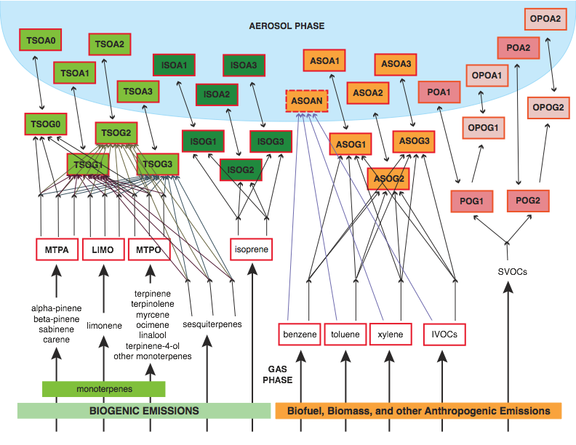
(Pye et al., 2010 ACPD)

Slide 18
Absorptive Partitioning
A gas-phase parent HC reacts to form several semi-volatile compounds:
The relative amount in each phase is governed by absorptive partitioning (Pankow, 1994 Atm. Env.):
A_{i} aerosol-phase concentration
G_{i} gas-phase concentration
α_{i} mass-based stoichiometric coefficient
M_{O} total aerosol mass for partitioning
K_{i} equilibrium partitioning coefficient
P_{i}º vapor presure of pure species i at T
C_{i}* saturation vapor pressure
Notes:
18

Slide 19
Contributions to Global OA
Fraction of Parent Hydrocarbon Reacting in the Gas Phase Through
Each Pathway
Contribution of Each Pathway to Aerosol from a Given Parent Hydrocarbon
Estimated for M_{O} = 1.5 μg/m³
(Pye et al., 2010 ACPD)

