Slide 1
Temporal Source Apportionment of
Policy-Relevant Air Quality Metrics
Nicole MacDonald
Amir Hakami

Slide 2
Presentation Outline
Sensitivity Analysis & Source Apportionment
Questions to Answer
Application Detail
Results
Summary & Future Work

Slide 3
Adjoint Sensitivity Analysis
Sensitivity Analysis
  Forward (tangent linear) method → source-oriented
      Backward (adjoint) method → receptor-oriented
Can efficiently calculate sensitivities of a few outputs (metrics) with respect to many inputs (emissions) at all locations and times
Individual sources with the most influence on a metric can be identified
  → Useful in evaluating policy decisions!
Adjoint sensitivity analysis is inherently a deterministic source apportionment method
  Can apportion concentration-based metrics among sources

Slide 4
Why Adjoint Analysis?
Metric
f(C)
Source 3
Source 2
Source 4
Source 1

Slide 5
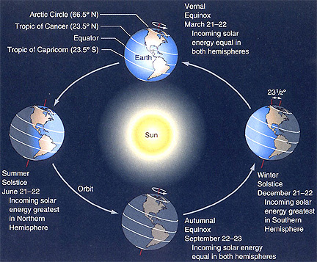
Questions to Answer
Is there any consistent temporal pattern in sensitivities at each location?
Do emissions at different times of the day contribute differently to the end metric?
Is there a great deal of variability in temporal patterns at various locations (i.e., spatial variability of temporal patterns)?
Does the choice of end metric (adjoint cost function) affect these patterns?
Is the shifting of emissions in time a viable policy option?

Slide 6

The Adjoint of CMAQ
The adjoint of gas-phase CMAQ
North American continental domain (36km resolution, 13 layers)
Summer of 2007
Sensitivities of O₃ with respect to NO_{x} emissions
End metric (cost function) = average O₃ over continental North America

Slide 7
What We Will See in the Results
Sensitivity ratio (SR): ratio of hourly sensitivity for each hour/grid to the average sensitivity for that day for that grid
SRs are then averaged temporally or spatially
Locations and days with very small daily average are excluded
Locations with at least 30 days above minimum kept in the analysis

Slide 8
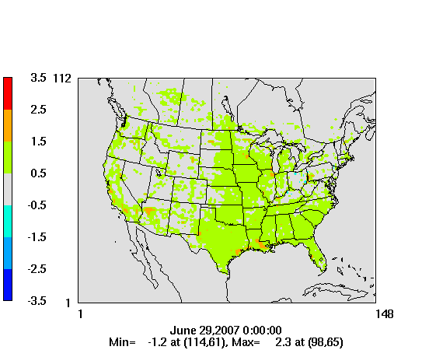
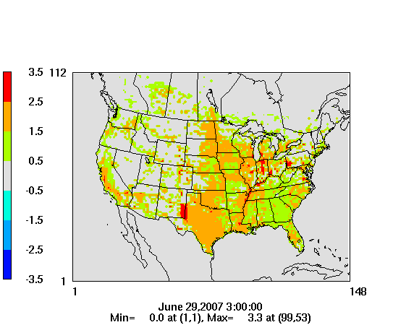
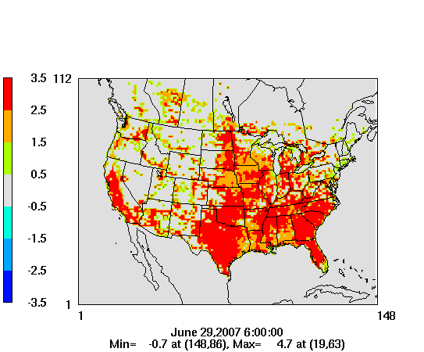
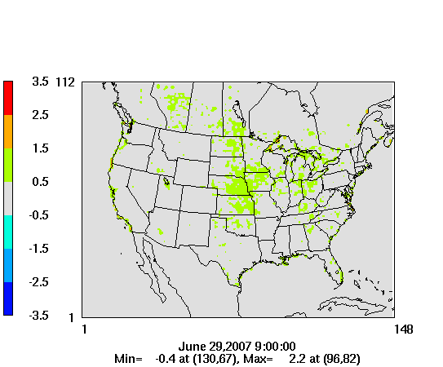
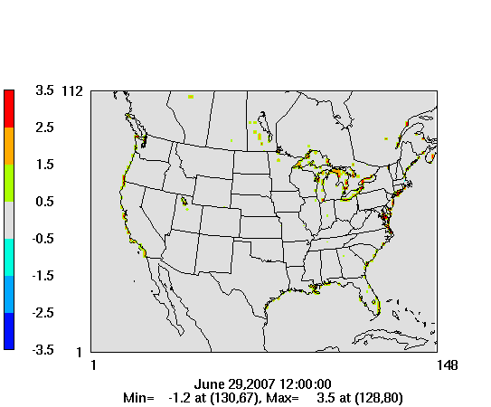
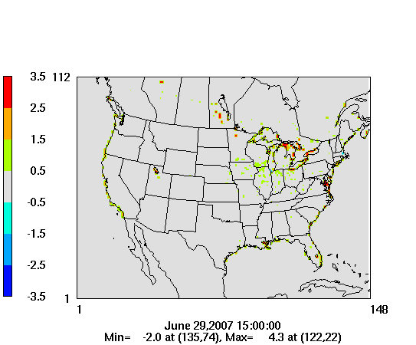
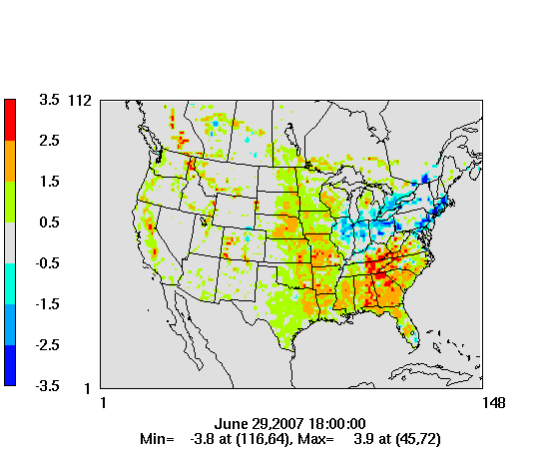
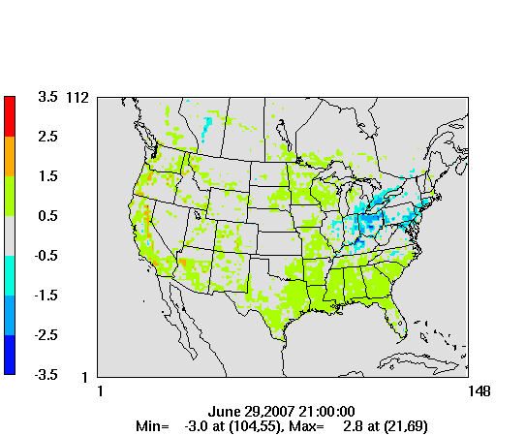
Time Evolution of SRs
Hour 0
Hour 3
Hour 6
Hour 9
Sensitivity Ratios
Hour 12
Hour 15
Hour 18
Hour 21

Slide 9
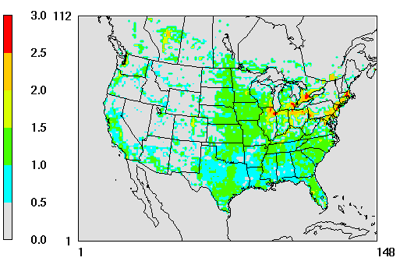
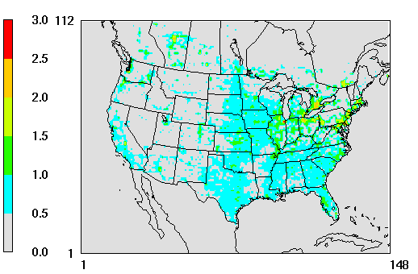
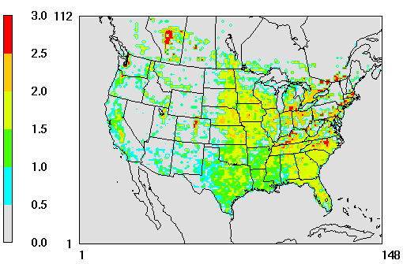
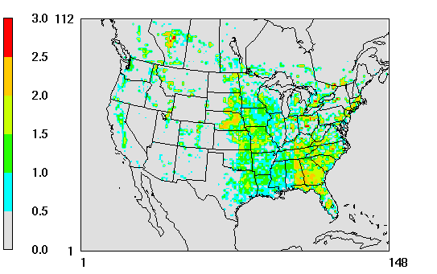
Temporal Variability of SRs
Relative Sensitivity
Standard Error
(P84 – P16)/2
Hour 6
Hour 18

Slide 10
Spatial Variability in Time Series
Sensitivity Ratios

Slide 11
More Spatial Variability…
Sensitivity Ratios

Slide 12
NO_{x}-Limited Locations
Average O₃
Sensitivity Ratio

Slide 13
NO_{x}-Inhibited (Nightly Titration) Locations
Average O₃
Sensitivity Ratio

Slide 14
Other End Metrics: Short-Term Mortality
Sensitivity Ratio
Mortality rate based on Bell et al., 2004

Slide 15
Future Work & Questions to Answer
How are sensitivity patterns affected if intermittent end metrics (e.g., 8-hr maximum O₃) are used?
Is emission-shifting a policy option to take advantage of diurnal patterns of sensitivities?
Should diurnal patterns be considered in emissions trading?
What are the reasons for the early morning peak and consistently negligible mid-day sensitivities?

Slide 16
Summary & Conclusions
Very distinct temporal patterns exist in the sensitivities of all grid cells
These temporal patterns are very consistent across a large range of locations
Areas with strong NO_{x}-inhibited regimes and/or areas close to the continental outflux regions (NE US) can have negative evening sensitivities
Significant differences exist between early morning, evening, and mid-day gradients
These behaviors can be somewhat different for various metrics

Slide 17
Questions?

