Slide 1
Application and Analysis of Kolmogorov-Zurbenko Filter in the Dynamic Evaluation of a Regional Air Quality Model
Daiwen Kang
Computer Science Corporation, Research Triangle Park, NC, USA
S. T. Rao, Rohit Mathur, Sergey Napelenok, and Thomas Pierce
AMAD/NERL, U.S. Environmental Protection Agency, Research Triangle Park, NC, USA

Slide 2
Motivation
Dynamic Evaluation: Examines a retrospective case(s) to evaluate whether the model has properly predicted air quality response to known emission and/or meteorological changes.
KZ Filter: Decompose a time series into different scales of motion (spectra) which characterizes contribution of different atmospheric processes.
Impact of changes in emissions (generally seasonal to long term, especially for anthropogenic emissions) and meteorology (generally short term) can potentially be separated into different spectrums by KZ filter.

Slide 3
Kolmogorov-Zurbenko (KZ) Filter
A time-series of hourly species (S) data can be presented by:
S(t): original time-series, ID(t): intra-day component, DU(t): diurnal component, SY(t): synoptic component, and BL(t): baseline component .
The KZ(m, p) filter (a filter with window length m and p iterations) can be defined by:
Components:
Reference: Hogrefe et al. (2000), Bull. Amer. Meteor. Soc. 81, 2083-2105.

Slide 4
Description of KZ processing
Apply KZ filter to the 2006 annual, 2002 and 2005 summer CMAQ simulations and the AQS observation hourly data
Screen the data for completeness. To include a site, at least 70% of observations must be available.
For all the qualified sites (444 for 2006 annual, and ~780 for summers) calculate the stats between modeled and observed components.

Slide 5
Any observed time series S(obs,t) and model simulated time series S(mod,t) can be decomposed into four components using KZ filter:
Two questions need to be asked:
Can both time series be decomposed in the same manner by KZ filter, i.e., does the same component represent the same thing in both time series?
How does each component relate to other components, or how are the errors and biases between S(obs,t) and S(mod,t) reflected among the components?

Slide 6
According to error propagation theory, if
then the errors :
The magnitude of the variable is determined by the degree of independence of A and B. IF , then A and B are completely independent from each other. We can then define the relative dependence as:
RD is nothing but the ratio of the covariance part to the sum of the individual component errors. The smaller the RD values are, the more independent of the components are.

Slide 7
Mean RD (%) Values of Component Signals for Hourly O₃ Time Series
Signal Components | 2002 Summer | 2005 Summer | 2006 Summer | 2006 Year
O3 = ID+DU+SY+BL | 33.9 | 32.2 | 31.7 | 33.4
IDDU = ID + DU | 27.1 | 27.8 | 28.4 | 28.1
DUSY = DU + SY | 28.9 | 28.6 | 24.8 | 27.9
SYBL = SY + BL | 5.0 | 4.9 | 5.8 | 5.5
IDSY = ID + SY | 5.4 | 5.1 | 5.3 | 5.1
DUBL = DU + BL | 1.2 | 0.3 | 1.1 | 1.0
IDBL = ID + BL | 0.4 | 0.5 | 0.3 | 0.2
O3 = ST + BL (ST=ID+DU+SY) | 3.4 | 3.0 | 3.1 | 2.9

Slide 8
32%
O3
ID
DU
SY
BL
28%
28%
5%
5%
1%
<0.5%
3%

Slide 9
In the following slides, the O₃ time series is only decomposed into the short-term (ST) and baseline (BL) components, i.e:
Since we have proved that the KZ filter can effectively separate the ST and BL components in both observed and modeled time series (RD ~ 3%) , and the following holds:
the following slides will demonstrate the results at all the AQS sites (qualified for KZ analysis) with the 2006 yearly simulation.

Slide 10
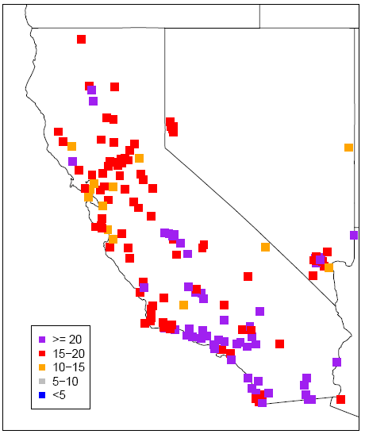
RMSE for Hourly O₃ and Baseline Component
O₃ RMSE
BL RMSE
O₃ RMSE
The RMSEs for baseline component are much smaller than O₃ RMSEs (the BL contributes ~30% of the total O₃ errors)
BL RMSE

Slide 11
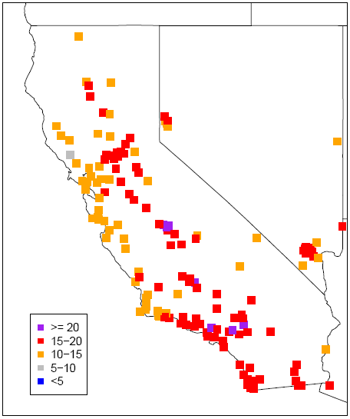
RMSE for Hourly O₃ and Short-term (ST) Component
O₃ RMSE
ST RMSE
O₃ RMSE
Short-term components play a major role in the total errors of hourly O₃ simulations, which contributes ~70% to the total errors.
ST RMSE

Slide 12
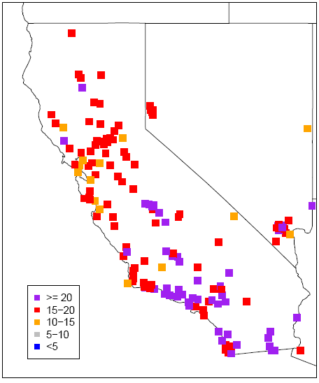
RMSE for Hourly O₃ and Combined ST+BL Components
O₃ RMSE
ST+BL RMSE
O₃ RMSE
The combined RMSE values of short-term components and baseline component are almost identical to the RMSE values of hourly O₃.
ST+BL RMSE

Slide 13
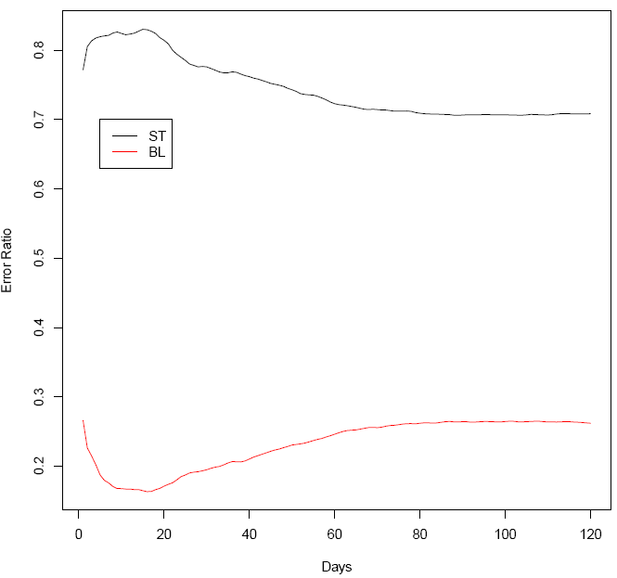
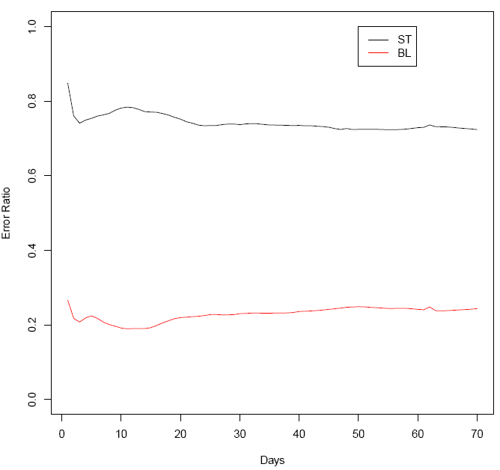
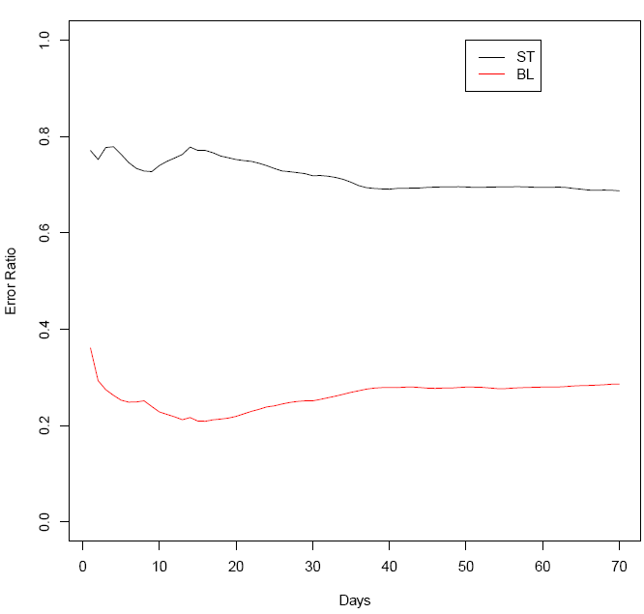
Short-term and Baseline Error Ratios Relative to O₃
2002 Summer
2006 Summer
2005 Summer
The Error Ratio is defined as :
Where c stands for component (either the short-term or baseline)
The error ratios were computed for the starting day (24 hour data points) first, then extends the temporal length (augment the data points) by one day (24 hours) through each calculation until the end day of the time series shown in the figures
Notes:
Three points: 1. At the beginning (<20 days) the error ratios are changing with addition of more data points; 2. the error ratios stabilize when the data series are long enough (> 20 days); 3. the sum of the error ratios of short-term and baseline is close to 1 (with ~3% error).

Slide 14
The Mean Bias Distribution of O₃ and Its Components over Domain
The Mean Bias (MB) of O₃ is almost solely determined by the baseline component. Since all the short-term components are zero-mean processes and their contributions are virtually averaged out during a period of time.
Notes:
To emphasize that the zero mean processes barely contribute to the mean biases.

Slide 15
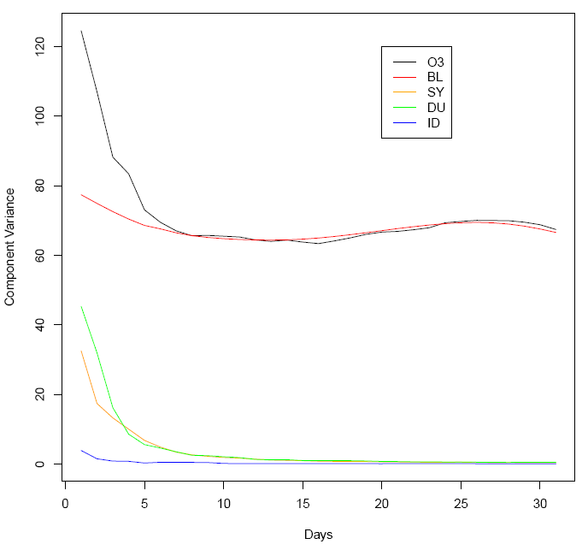
Variation of Component MB Variance with time
The variance of MB of the short-term components quickly converges to zero after about 15 days, while the variance of BL MB converges to the same of O₃ MB in about 7 days. In fact, the variance of ID MB reaches to zero in about 1 to 2 days. This indicates that if evaluating the model performance on mean O₃ mixing ratios over a week, only the BL component is relevant.
(Following previous slides, the spatial variance of each component was computed for the starting day (24 hours data points), then extends the temporal length (augment the data points) by one day (24 hours) at each calculation until 31 days)
Notes:
Inspired by previous slide, this slide is looking at the component contribution to the MB with addition of one day’s data points (24 hour) to the calculation at one time until long enough over the spatial variance to examine the temporal variation of component MB values.

Slide 16
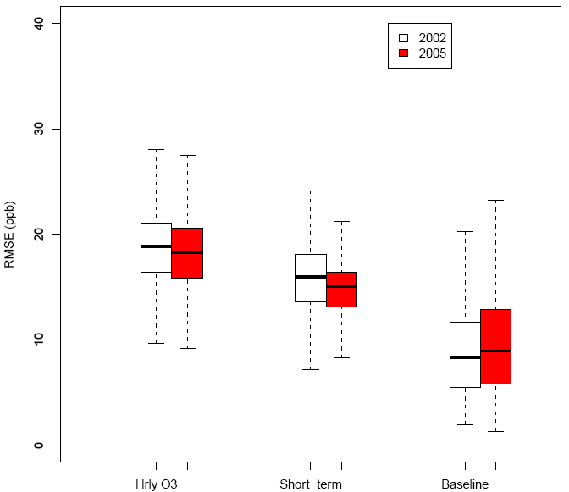
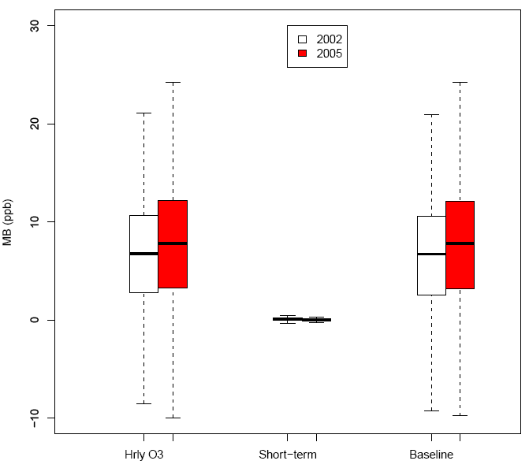
Simulation Errors of 2002 versus 2005
RMSE of O₃ and components
O₃ and component MB
Compared 2005 to 2002, the errors of short-term component decreased, but the baseline errors increased, while the mean biases were increased for hourly O₃ simulations which resulted almost solely from the baseline component.
Notes:
For this slide on, examine the 2002 and 2005 simulations using the concepts introduced by earlier slides and emphasize that the short-term component doesn’t contribute to the mean bias at all.

Slide 17
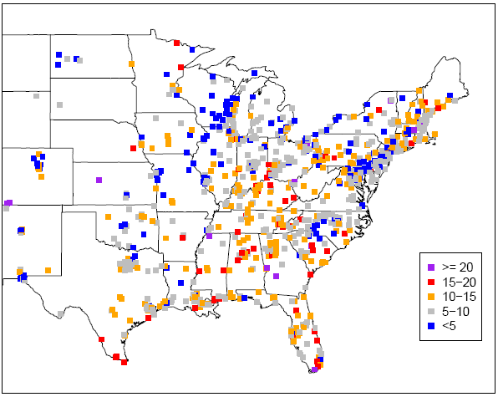
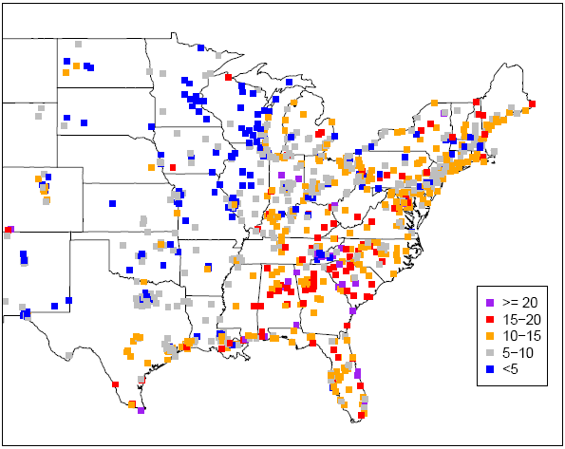
The Baseline RMSE values (ppb) over Space
2002
2005
The same model configuration for both years but with different boundary and emissions. Compare 2005 to 2002, the significant increase in baseline RMSEs in the circled area may indicate that the simulations in 2005 didn’t capture the change of emissions well resulted from the implementation of the NOx State SIP Call program during this period.
Notes:
Look at the spatial pattern of the Baseline RMSE and indicates that the SIP states have larger RMSEs in 2005 than in 2002.

Slide 18
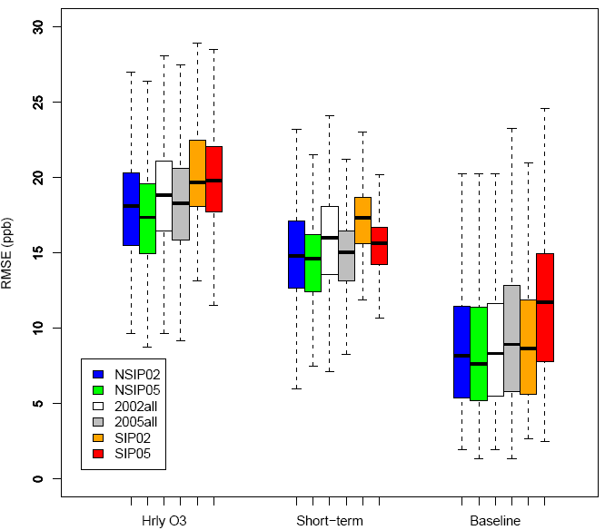
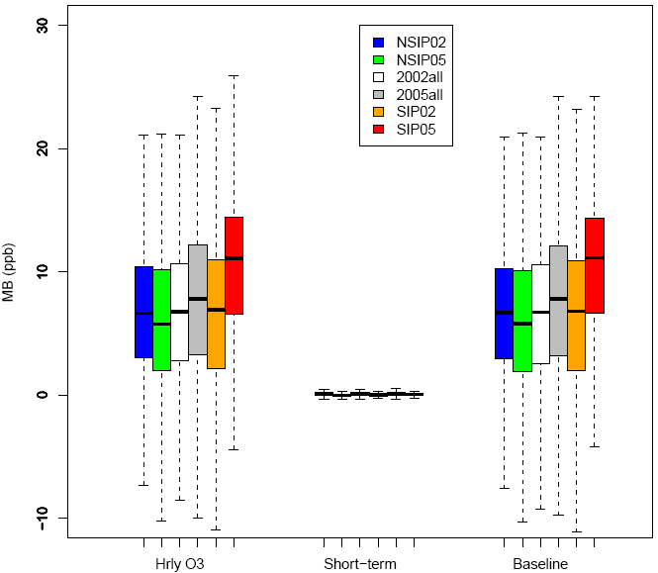
RMSE and MB Values in All, NO_{X} SIP-call, and Non NO_{X} SIP-call States
SIP sites: 342 (2002) and 335 (2005)
Non SIP: 536 (2002) and 555 (2005)
Comparison of 2005 to 2002 indicates that
in States that didn’t implement NO_{X} SIP-call, both short-term and baseline errors decreased, and so for the mean biases
in States where NO_{X} SIP-call was implemented, short-term errors decreased, while baseline errors increased significantly. The mean biases reflected only by the baseline component also significantly increased
Notes:
If we assume that the model has the same response to emissions at SIP states and non-SIP states, the significant increase of baseline errors and mean biases in 2005 must indicate that the emissions input was not properly captured in this year.

Slide 19
Summary
One Prove:
Two Findings:
(when O₃ time series > 7 days)
One Application in dynamical evaluation to resolve model response to emissions and meteorology separately →revealed that the emissions input for the 2005 simulation in the NOx SIP-call States was not properly captured when compared with that in 2002.

Slide 20
Implications
The separation of short-term and baseline components can greatly facilitate performance evaluations upon parameter modifications or version to version comparison of the same CTM to investigate impacts of model configurations.
The separation of short-term and baseline components can be potentially used to discern primary factors in determining model performance (e.g. emissions, boundary conditions, or model configuration problems) at hot spots.
In regulatory applications, modeling of control strategies should be evaluated using baseline analysis (reflect the impact of emission changes)

Slide 21
Acknowledgements
Christian Hogrefe, David Wong, Shawn Roselle, Brian Eder, Wyat Appel, George Pouliot, Kathy Brehme, Charles Chang, and Ryan Cleary
Disclaimer
The United States Environmental Protection Agency through its Office of Research and Development funded and managed the research described here. It has been subjected to Agency’s administrative review and approved for presentation.

Slide 22
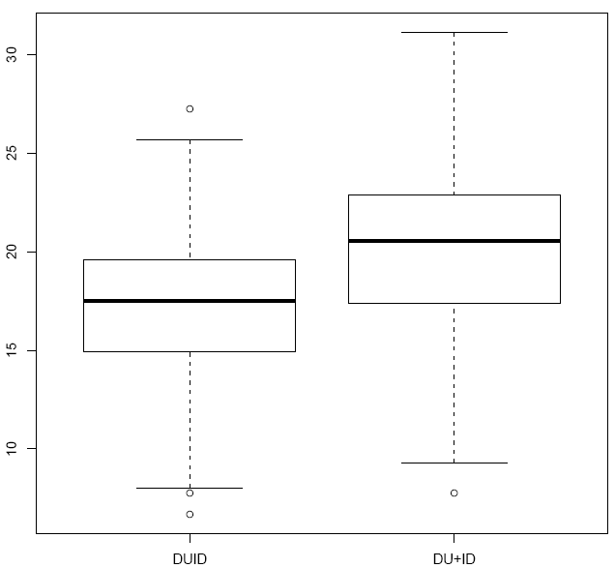
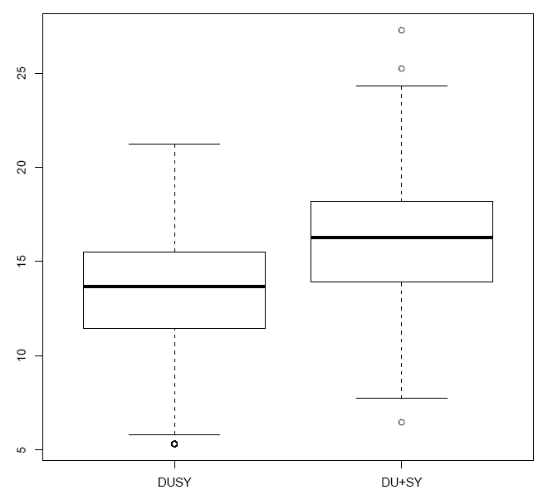
Boxplots of Component RMSE
Component RMSE (ppb)
IDDU
ID+DU
DUSY
DU+SY
SYBL
SY+BL
Component RMSE (ppb)
Component RMSE (ppb)
Note: O3 = ID+DU+SY+BL
= ST+BL
IDDU = ID + DU
DUSY = DU + SY
IDSY = ID + SY
SYBL = SY + BL
IDSY
ID+SY
O3
ST+BL
Notes:
Use this slide to further demonstrate the spatial distribution of errors for different component combinations and show the contribution of covariance part.

Slide 23
O₃ and BL MB
O₃
BL
O₃
Further demonstrates that the MB values of O₃ mixing ratio are solely determined by the baseline component in space.
BL
Notes:
To examine the spatial pattern, i.e. site by site, of the mean bias and indicating that the conclusion applies to each of the sites.

