Slide 1
Direct radiative forcing of aerosols and tropospheric ozone from specific emissions sectors and locations
CMAS
10/11/2010
Daven K Henze
University of Colorado at Boulder
Farhan Akhtar, Rob Pinder, Dan Laughlin, US EPA
Robert Spurr, RT Solutions
Kevin Bowman, Adetutu Aghedo, Susan Kulawik NASA JPL
Helen Worden, NCAR
Monika Kopacz, Princeton University
Kumaresh Singh, Virgina Tech
With support from US EPA GLIMPSE and
NASA New Investigator Program.

Slide 2
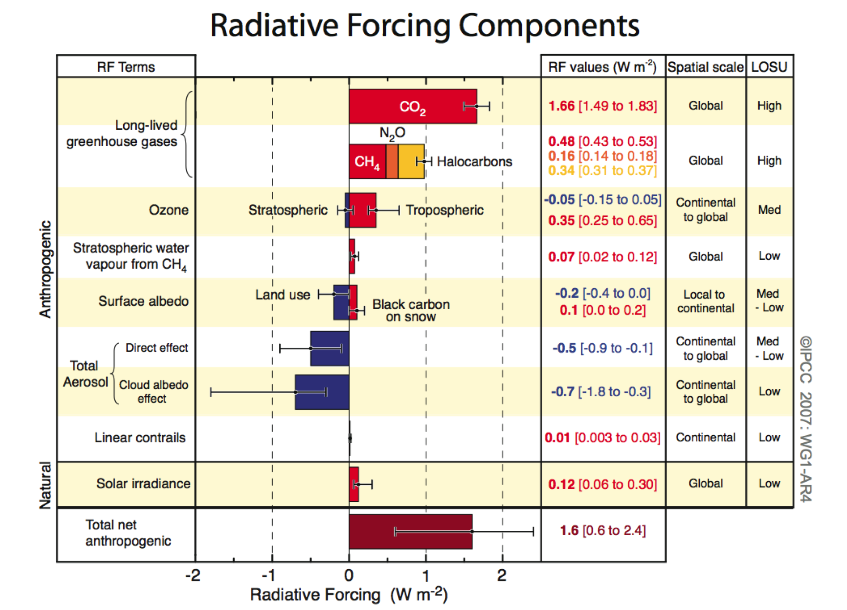
Short Lived Climate Forcing Agents
Past: Important for pre-industrial to present radiative forcing
Focus on
direct effects of
- black carbon
- sulfate
- ozone (trop)
AR4, Forster et al.,
2007
Future: Addressing SLCFAs important for immediate
mitigation efforts as well as air quality.

Slide 3
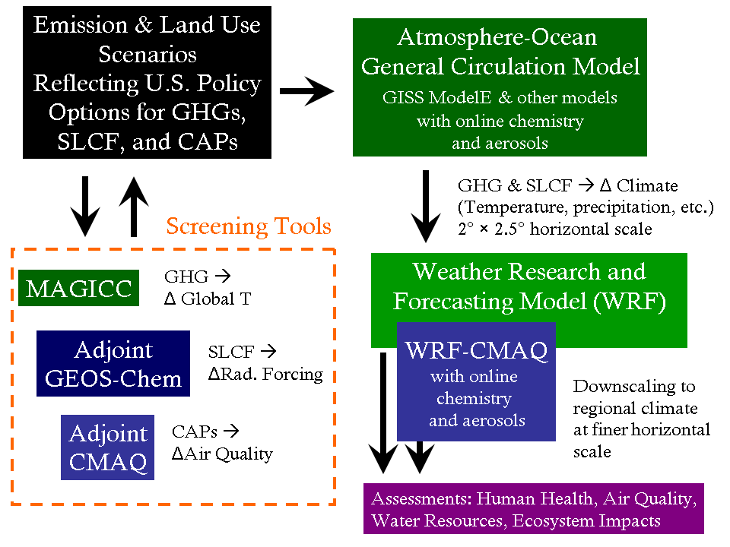
Systems for modeling air quality & climate change

Slide 4
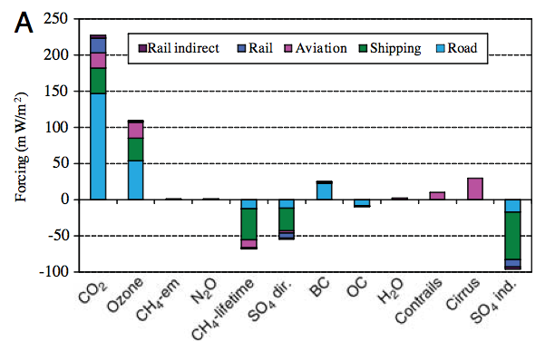
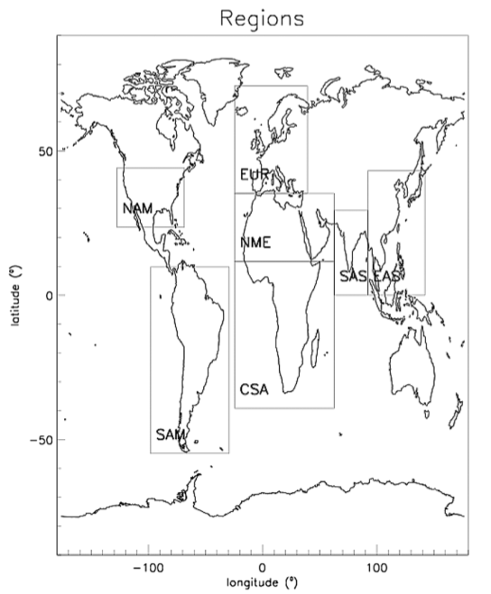
Refining the RF bar chart
Sector specific contributions: Fuglestvedt et al., 2008
Sector and regional specific contributions: Unger et al., 2008
Unger et al., 2008

Slide 5
Systems for modeling air quality & climate change

Slide 6
Radiative Forcing Transfer Functions
How to calculate the radiative forcing change for
a given change in emissions?
Using transfer function T:

Slide 7
Radiative Forcing Transfer Functions
How to calculate the radiative forcing change for
a given change in emissions?
Using transfer function T:
Approximate T using adjoint:

Slide 8
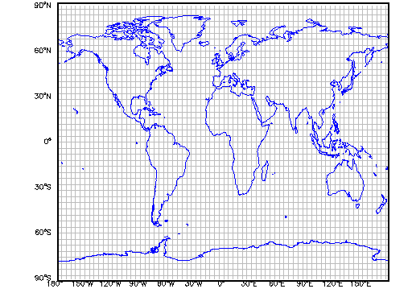
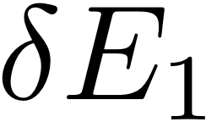
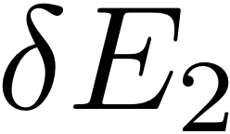
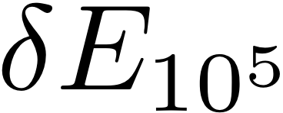
Aerosols and Radiative Forcing
Sensitivities from every sector and region:
Calculated very efficiently using GEOS-Chem adjoint
(Henze et al., 2007 and LIDORT (Spurr, 2002)

Slide 9
Important Approximations
Macro
- Clear sky
- Only direct effects
- Only SO₄-NO₃-NH₄-H₂O and BC aerosol
Micro
- Refractive index of SO₄-NO₃-NH₄-H₂O is that of SO₄.
- Assumed dry size
- External mixture
Conveniance
- Only July conditions

Slide 10
Radiative Forcing potential
The % change in radiative forcing per change in emission:
%RF / [kg box]
%RF / [kg box]
note: per change in any emission. This shows variation
in efficiency of emissions forcing.

Slide 11
Radiative Forcing sensitivities
The sensitivity of pre-industrial to present RF
with respect to scaling factors for individual emission
sectors
Results for different SO2 emissions, E_{i}, for July 2008:
anthropogenic SO₂
anthropogen NH₃
[%]

Slide 12
Radiative Forcing sensitivities
The sensitivity of pre-industrial to present RF
with respect to scaling factors for individual emission
sectors
Results for different BC emissions, E_{i}, for July 2008:
fossil fuel BC
biofuel BC
[%]

Slide 13
Applying to global future scenarios: regional and sector-based analysis
Consider future CLE scenario for 2030 (Kloster et al., 2008)
% of aerosol direct RF
(CLE 2030 – present) owing to BC emissions

Slide 14
Applying to detailed US scenarios see Farhan Akhtar’s poster
Consider estimates of US energy usage from MARKAL
Apply RF estimates to BC and SO2 sources
WARMING
COOLING

Slide 15
Validation

Slide 16
Radiative forcing of tropospheric ozone
3rd most important GHG for pre-industrial to present
radiative forcing
This estimate (0.35 +/-0.15 W/m²) relatively
unchanged since 2nd IPCC
AR4, Forster et al.,
2007

Slide 17
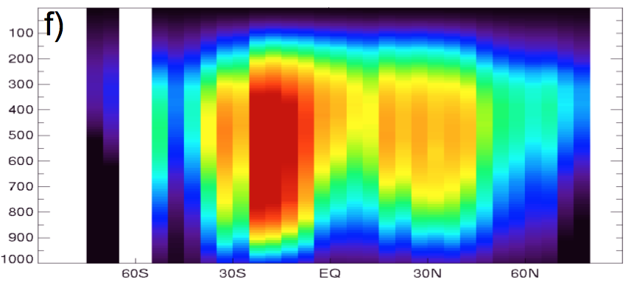
O₃ radiative effect observed from TES
All-sky tropospheric Instantaneous Radiative Forcing
Kernel, IRFK, is change in OLR per change in O3 [ppb]
Aug 2006, land, daytime
see Helen Worden’s papers (2008 Nature Geo; JGR submitted)

Slide 18
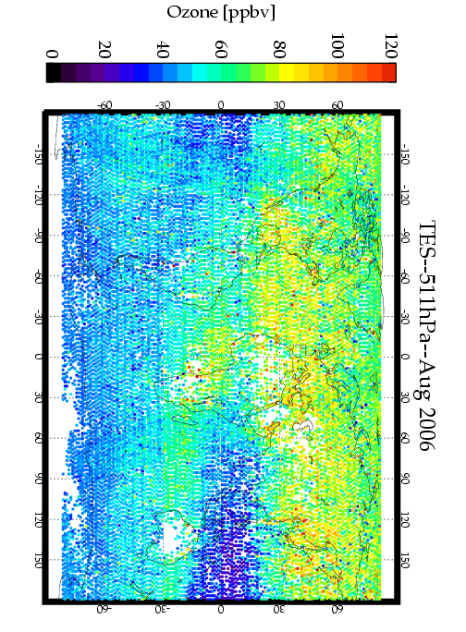
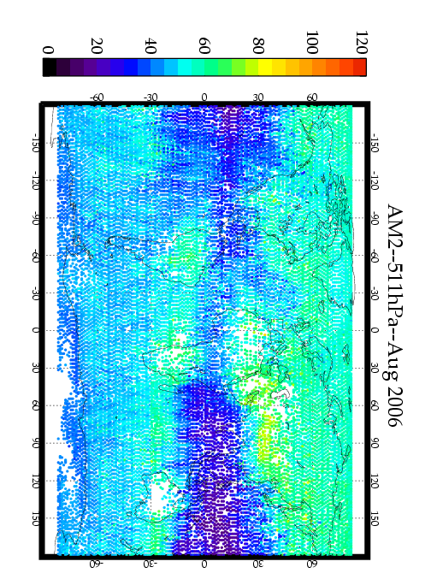
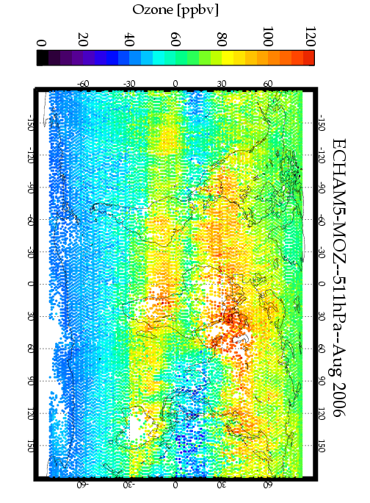
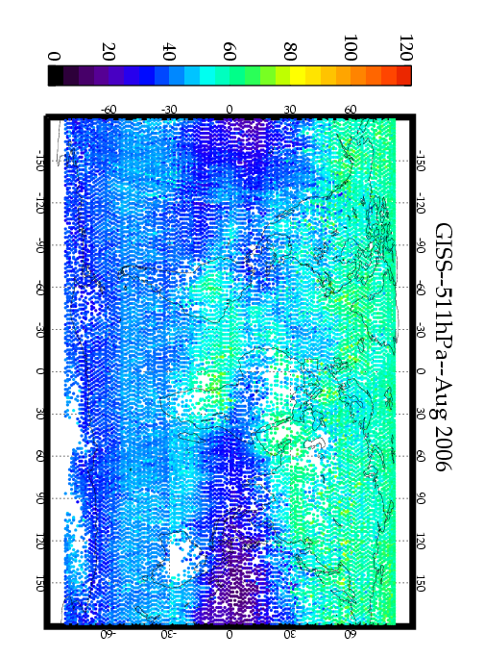
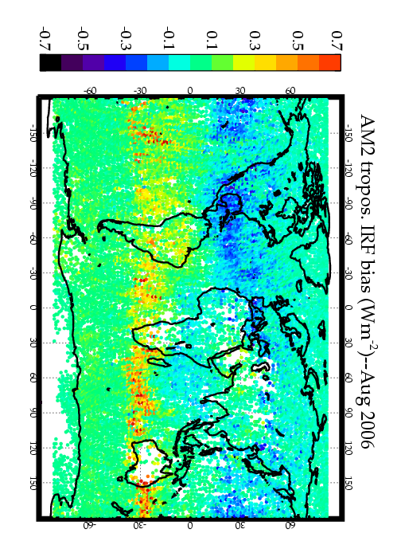
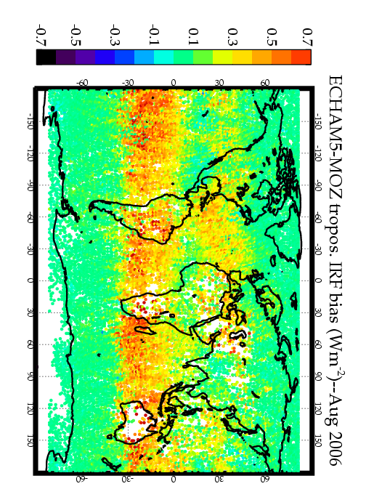
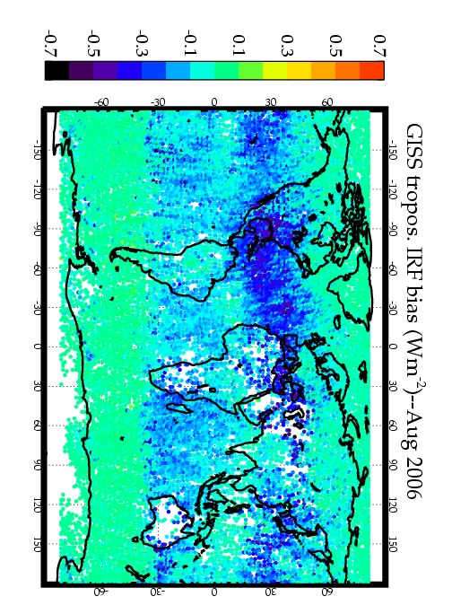
Radiative forcing of tropospheric O₃: uncertainty
Variability in model estimated O3 at 511 hPa:
TES
AM2-Chem
ECHAM5-MOZ
GISS
leads to large biases in OLR relative to TES
AM2-Chem
ECHAM5-MOZ
GISS
(Aghedo et al., under review JGR)

Slide 19
Ozone radiative effect sensitivities
Combine TES IRFK’s with GEOS-Chem sensitivities
TES
IRFK
GC-adjoint (Henze et al., 2007)
results for different emissions, E_{i}, for Aug 2006:
anthropogenic NO_{x}
aircraft NO_{x} (x 10)
[%]
Notes:
\frac{\partial \mbox{radiative effect}}{\partial E_i(x)}=\frac{\partial \mbox{O}_3(z)}{\partial E_i(x)} \times \frac{\mbox{radiative effect}}{\partial \mbox{O}_3(z)}

Slide 20
Radiative effect efficiencies
Combine O₃ sensitivities with RE sensitivities to map
efficiency
Results show amount by which anthropogenic NO_{x} influences O₃ that is radiatively important:
Aug, 2006

Slide 21
Future applications
Consider additional months, seasons.
Focus on radiative forcing rather than effects:
- how much of the influence comes from
anthropogenic emissions?
- what is the RF for different emissions scenarios?
--> integrate with GLIMPSE screening tool

Slide 22
Final Remarks
Application of rapid screening tools can help us
understand the relationship between specific policy actions
and the radiative forcing from short lived species.
GEOS-Chem Adjoint
LIDORT radiative transfer model
Integrated with
MARKAL for the purpose of
Scenario
Exploration
GLIMPSE:
Farhan Akhtar
Rob Pinder
MARKAL:
Dan Loughlin
GEOS-Chem/LIDORT Adjoint:
Daven Henze

Slide 23
the end
Focus on radiative forcing rather than effects:
- how much of the influence comes from
anthropogenic emissions?
- what is the RF for different emissions scenarios?
--> potential as screening tool

Slide 24
Validation: BC
CLE 2030 – 2000 perturbation
Looks good

Slide 25
Validation: SO₂
CLE 2030 – 2000 perturbation
Looks OK, but adjoint-approach biased?

Slide 26
Validation: SO₂
Check: does reducing perturbation reduce nonlinearity?
CLE 2030 – 2000 perturbation
10% perturbations
Yes. The adjoint code is accurate.

Slide 27
Validation: SO₂
E’’₂₀₃₀
E₂₀₀₀
E’₂₀₃₀
E_{SO2}
RF
|ADJ| < |FD|
|ADJ| > |FD|
Can we anticipate bias?

Slide 28
Validation: SO₂
Yes, bias can be anticipated.
Also, overall ordering remains the same.
E₂₀₃₀ < E₂₀₀₀ (Europe )
E₂₀₃₀ > E₂₀₀₀ (China, India)
CLE 2030 – 2000 perturbation
Conclusion: adjoint sensitivities provide a rapid means of exploring the effect of specific emissions changes on aerosol DRF.

Slide 29
Ozone sensitivities using GEOS-Chem adjoint
Quickly calculate sensitivity of model response w.r.t.
numerous parameters (Henze et al., 2007)
- response J = global average tropospherice O₃ column
- parameters E_{i} = all emissions in all locations
For example, sensitivity w.r.t. anthropogenic NO_{x} emissions:
indicate regions of largest influence
source attribution for small changes to emissions
[%]

Slide 30
Refining the RF bar chart
Sector specific contributions:
Fuglestvedt et al., 2008

Slide 31
Refining the RF bar chart
Sector and regional specific contributions:
Unger et al., 2008

