Slide 1
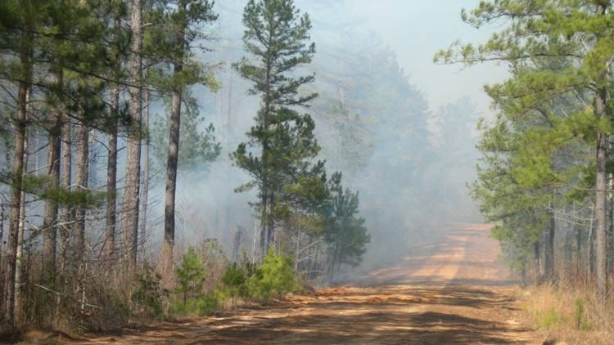

Georgia Chapter of the Air & Waste Management Association Annual Conference:
Improved Air Quality Modeling for Predicting the Impacts of Controlled Forest Fires
9th Annual CMAS Conference:
Evaluation of Air Quality Models Applied to Wildland Fire Impact Simulation
Fernando Garcia-Menendez
Aika Yano
Yongtao Hu
M. Talat Odman
Georgia Institute of Technology
10/19/2010
Fernando Garcia Menendez
Georgia Institute of Technology
10/8/2009
Notes:
1

Slide 2
Evaluation of Smoke Models and Sensitivity Analysis for Determining Emissions Related Uncertainties
Objective 1: Evaluate performance of a range of AQ models with data from prescribed burn and wildfire events in the Southeast.
Objective 2: Quantify the uncertainties in model outputs generated from uncertainties in emission inputs.

Slide 3
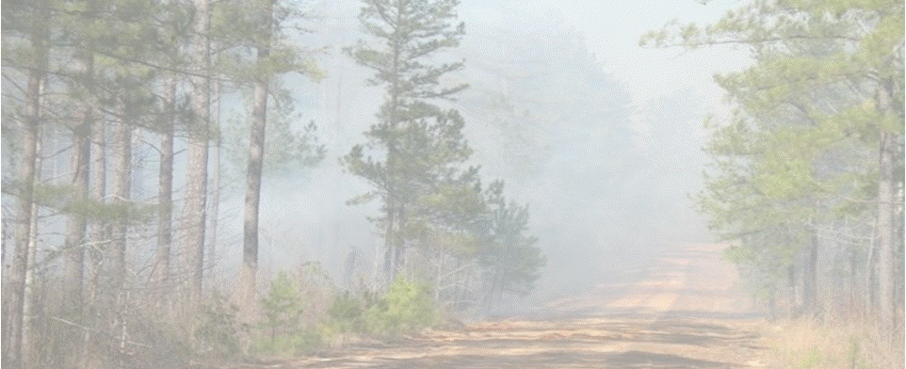
Wildland Fires & Air Quality
*Bernard & Sabo, 2003
Wildland fires may have detrimental impacts on air quality, health & visibility.
Air Quality Modeling can be used as a basis for decision-making.
Informed decisions require knowledge of model’s capabilities & uncertainties.
Notes:
Add reference

Slide 4
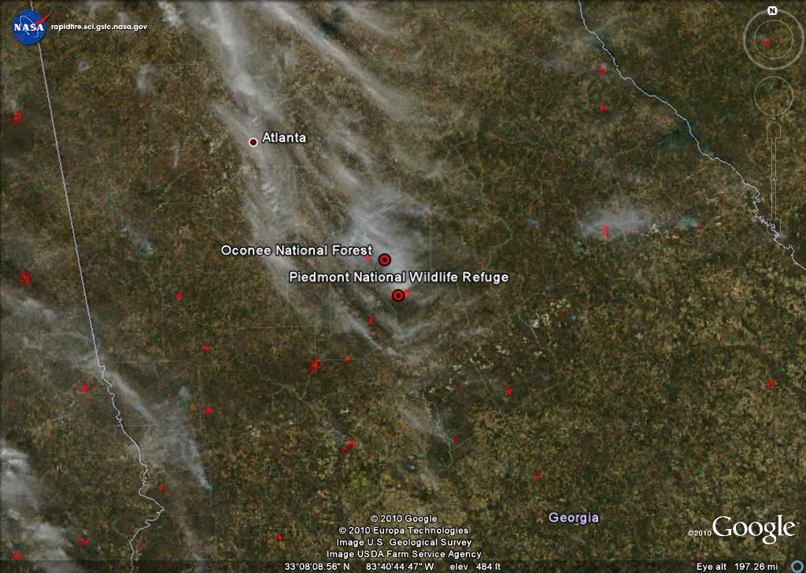
Episode: February 28, 2007

Slide 5
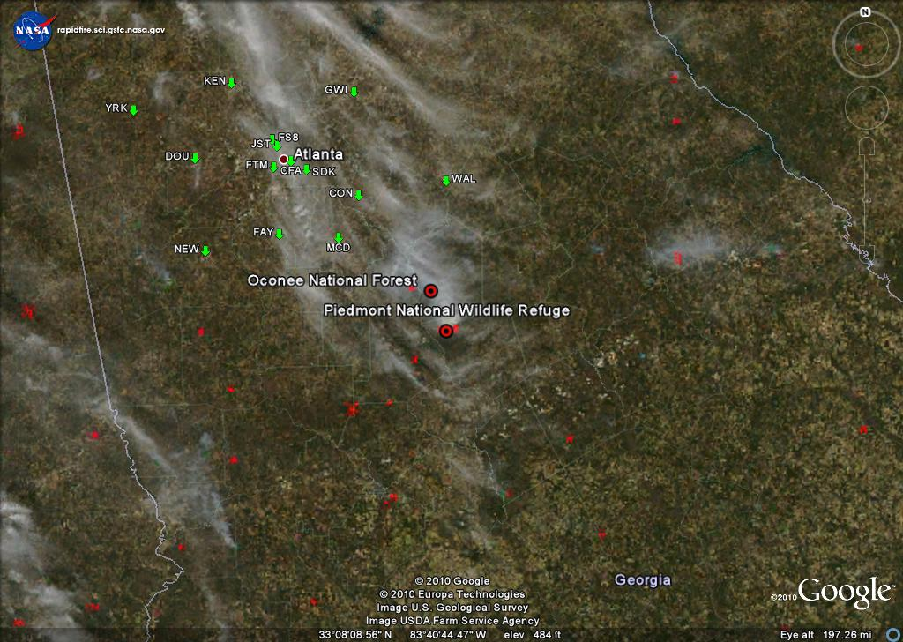
Measurement Sites

Slide 6
Recorded Observations

Slide 7
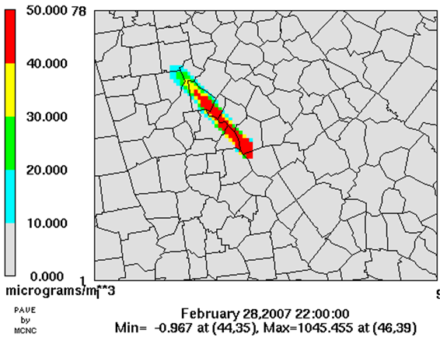
Air Quality Modeling

Slide 8
Air Quality Modeling
Pave Pic

Slide 9
Model Performance
Pave Pic

Slide 10
Performance Comparison
Pave Pic

Slide 11
Statistical Evaluation

Slide 12
Statistical Comparison
✓
✓
✓
✓
Large amount of information is generated but only a small fraction is analyzed!
Opportunities for model insight are lost:
- Model strengths and weaknesses
- Sensitivity to inputs and uncertainty in results
- Better guidance for future model development

Slide 13
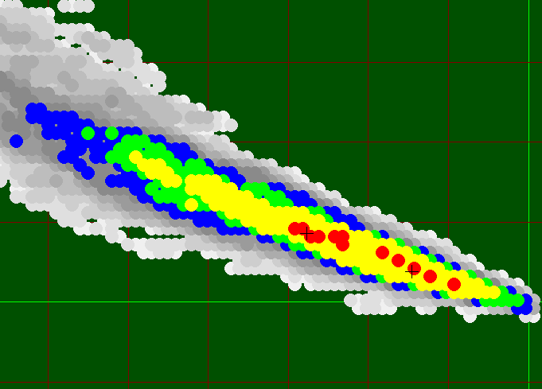
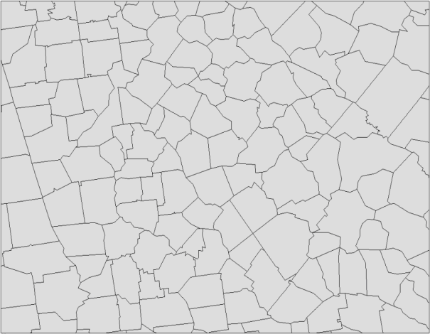

Model: DAYSMOKE-CMAQ
DAYSMOKE:
- Developed by US Forest Service
- Stochastic plume model
- Inert model, PM_{2.5} only
- Typical scales < 10 km
DAYSMOKE-CMAQ:
Uses DAYSMOKE as an emissions injector into CMAQ

Slide 14
Model: AG-CMAQ
Dynamic, solution-adaptive grid algorithm.
Variable t-step algorithm.
Conserves original CMAQ grid structure.
*Garcia-Menendez, et al. (2010): An Adaptive Grid Version of CMAQ for Improving the Resolution of Plumes, Atmospheric Pollution Research, 1, 239-249

Slide 15
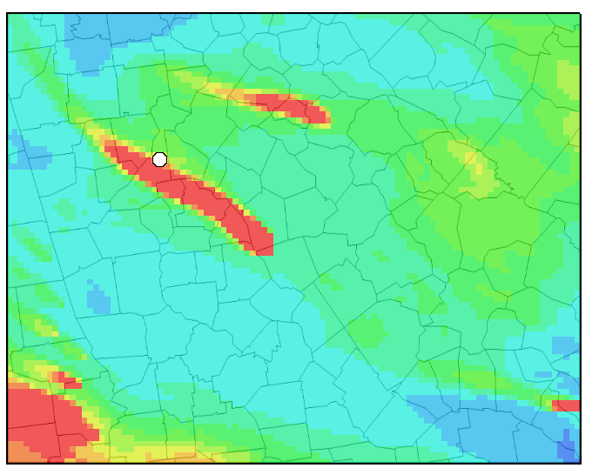
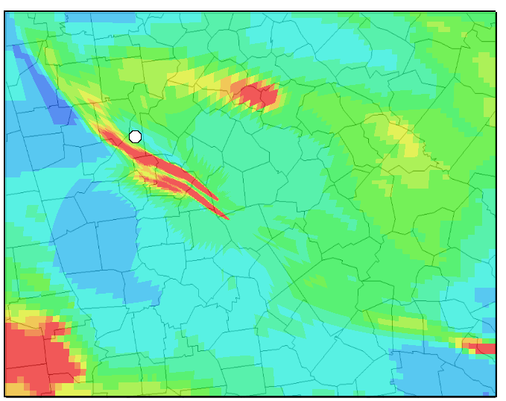
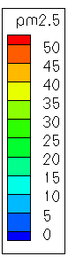
Model Evaluation: AG-CMAQ & DAYSMOKE-CMAQ
Episode: Feb. 2007 Fires near Atlanta, GA
Fire Emissions: Fire emissions Production Simulator (FEPS)
Background Emissions: SMOKE with projected 2002 “typical year” inventory
Meteorology: Weather Research & Forecasting model (WRF)
Plume Rise & Vertical Profile: DAYSMOKE
DAYSMOKE-CMAQ
AG- CMAQ
Notes:
Maybe use animations

Slide 18
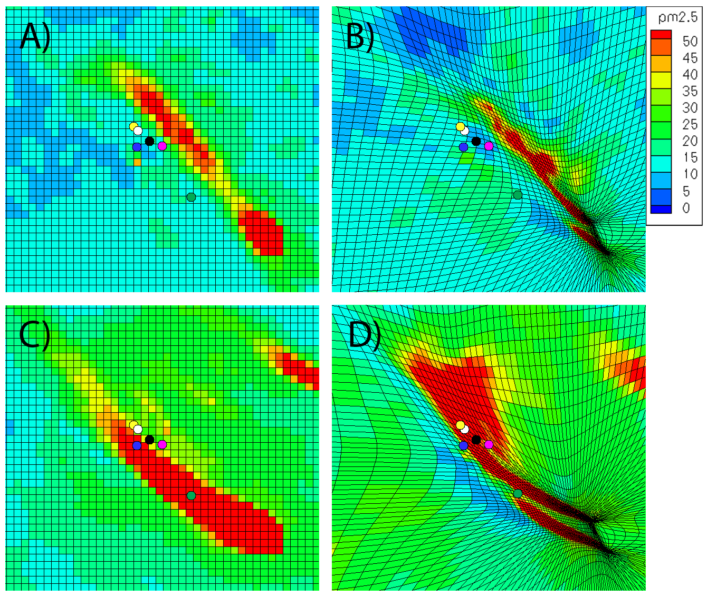
DAYSMOKE-CMAQ
AG-CMAQ
Feb. 28, 2007 22:30 Z
DAYSMOKE-CMAQ
AG-CMAQ
Mar. 1, 2007
02:00 Z

Slide 19
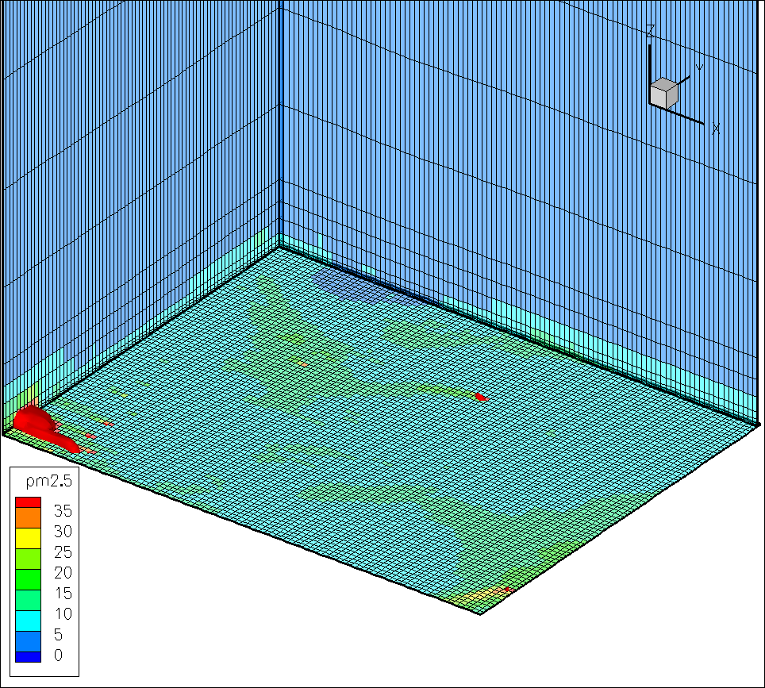

Slide 20
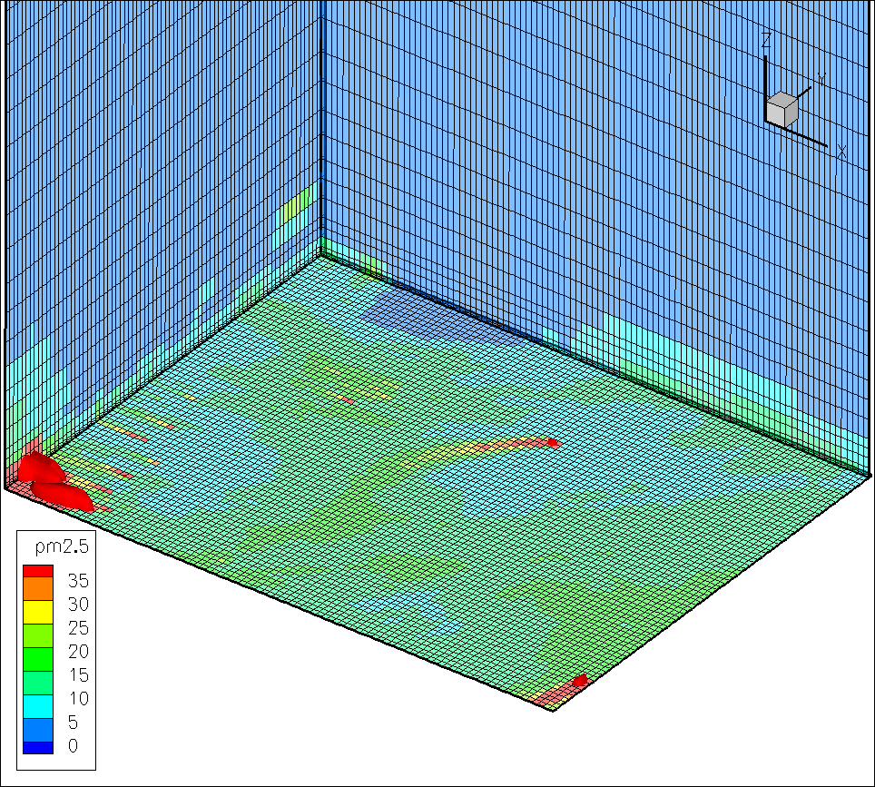

Slide 21
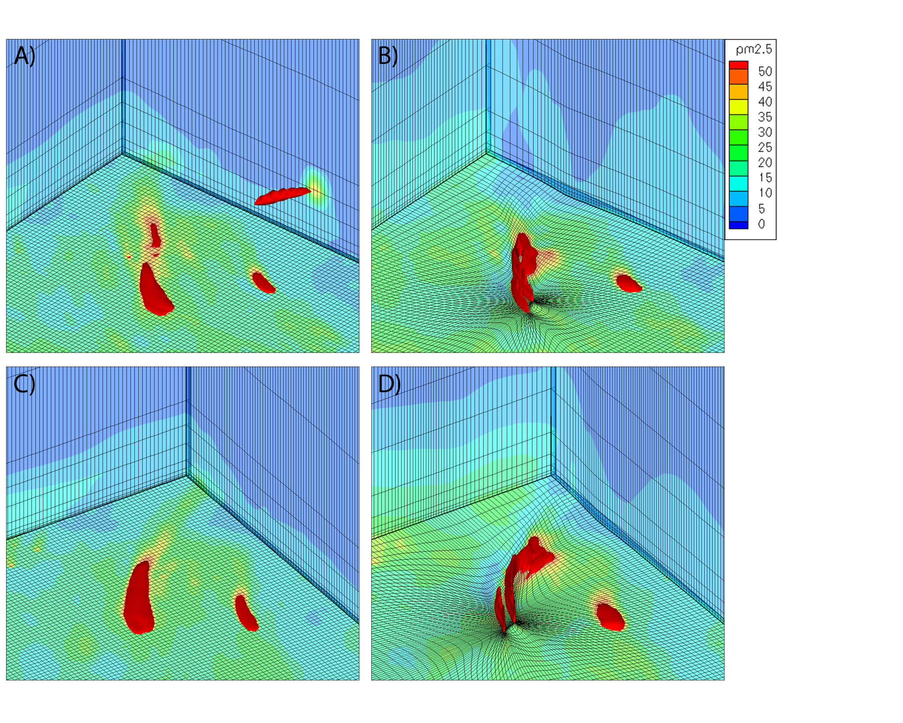
DAYSMOKE-CMAQ
AG-CMAQ
Mar. 1, 2007 00:30 Z
DAYSMOKE-CMAQ
AG-CMAQ
Mar. 1, 2007
02:15 Z

Slide 22
11 % average improvement in Mean Fractional Error with AG-CMAQ.
Better performance in 5 of 6 stations.
Much more insight into model performance gained beyond that achieved from statistical comparison only.

Slide 23
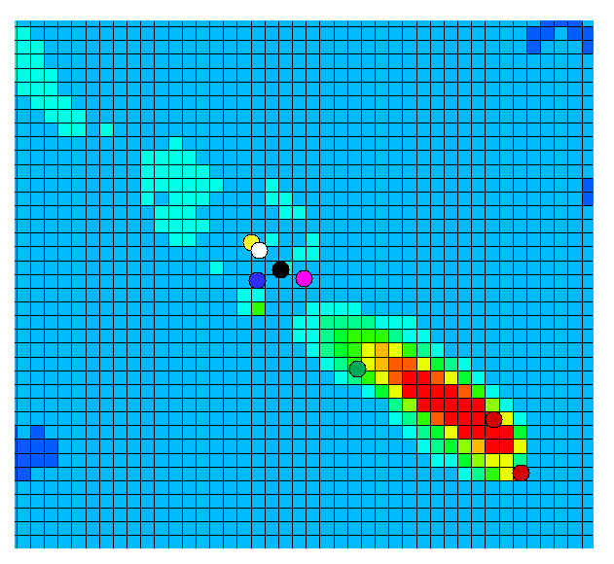
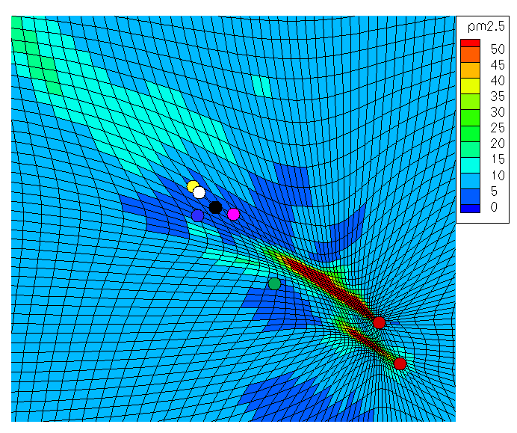
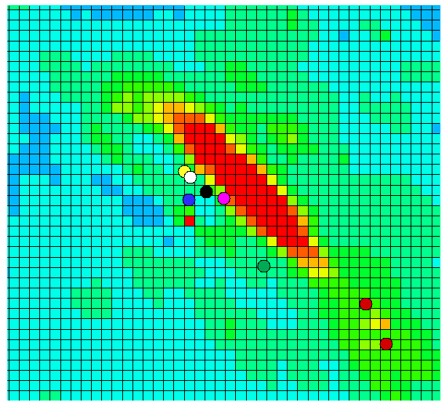
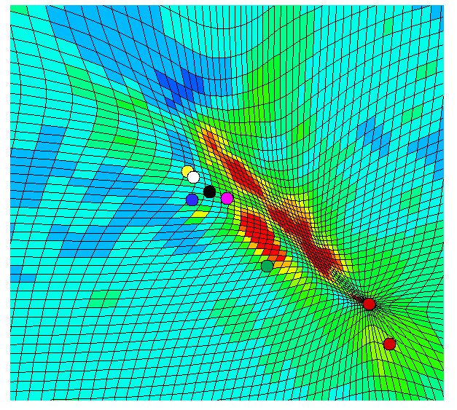
CMAQ
AG-CMAQ
DAYSMOKE-CMAQ
AG-CMAQ
Feb. 28, 2007 19:30 Z
CMAQ
AG-CMAQ
DAYSMOKE-CMAQ
AG-CMAQ
Feb. 28, 2007
22:45 Z

Slide 24
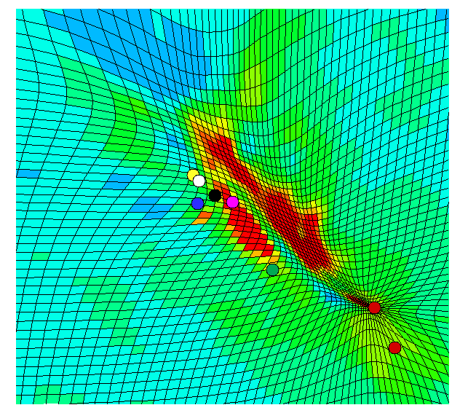
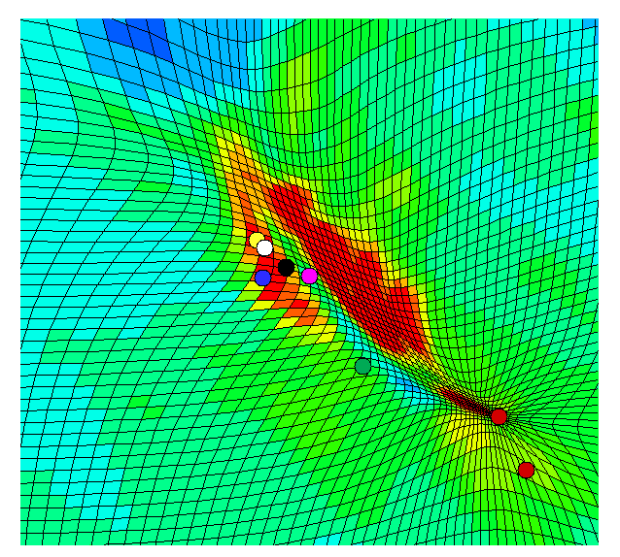
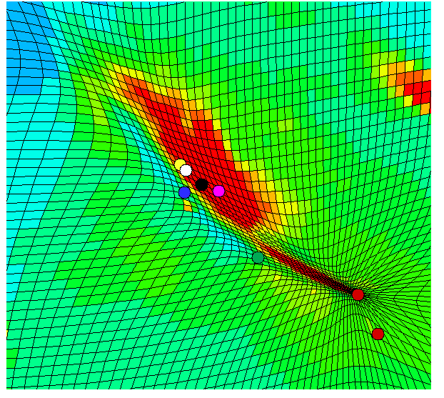
23:15 Z
00:00 Z
01:15 Z

Slide 25
5⁰ Degree
Shift in Wind Field
23:15 Z
00:00 Z
01:15 Z

Slide 26
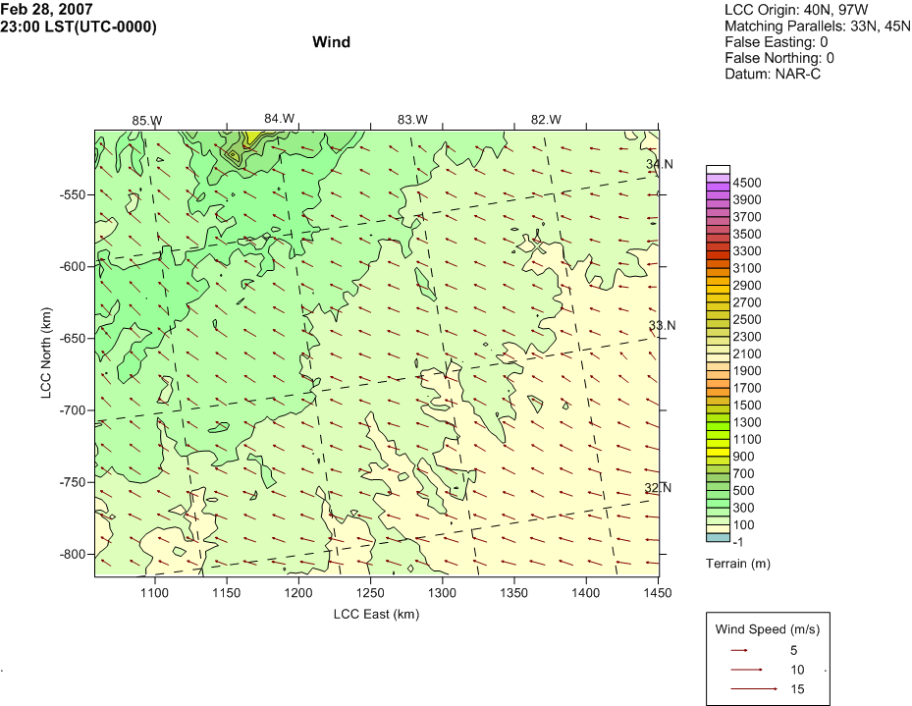
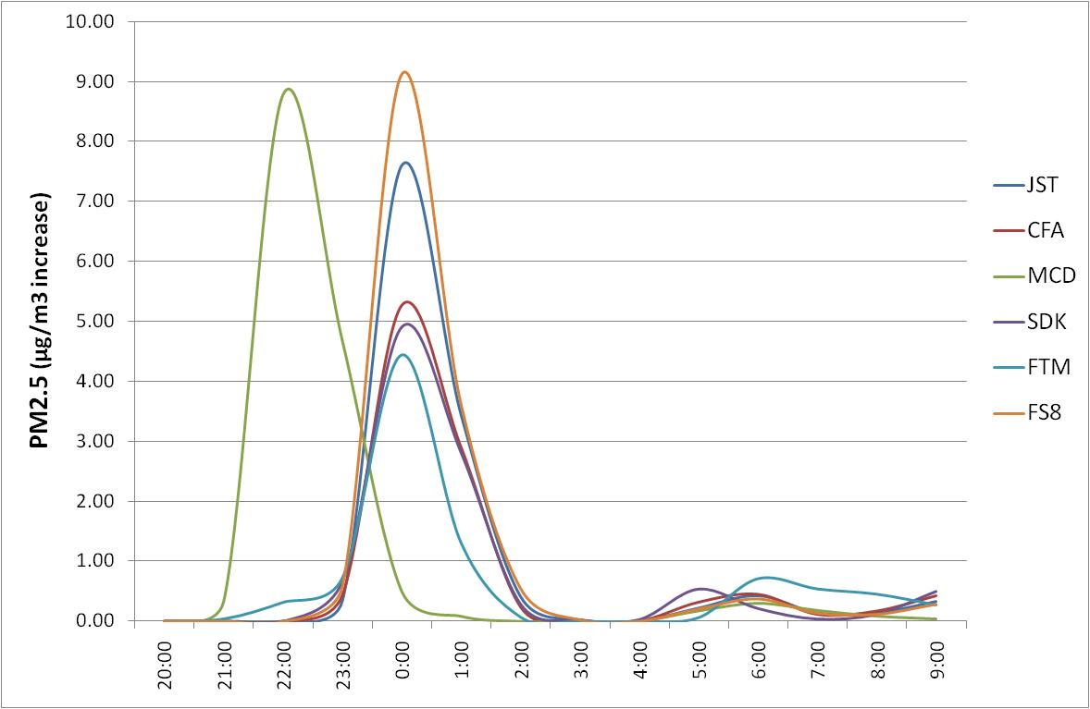
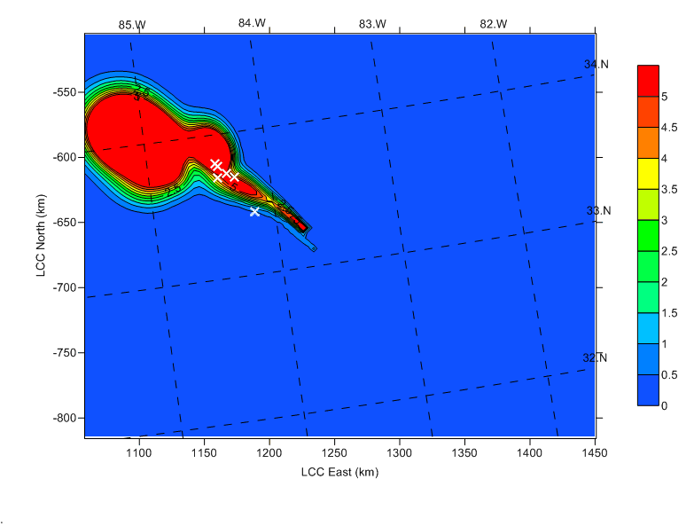
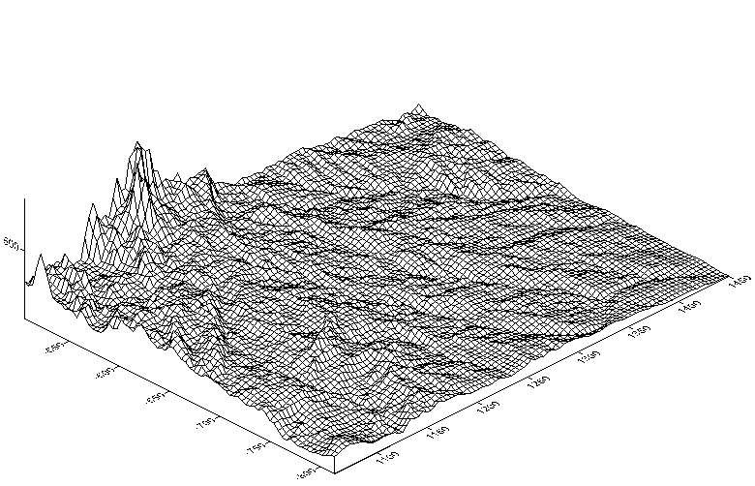
Model: CALPUFF
Gaussian dispersion model.
Simulates pollution as a series of puffs interacting with terrain & meteorological fields.
Typical scales < 100 km

Slide 27
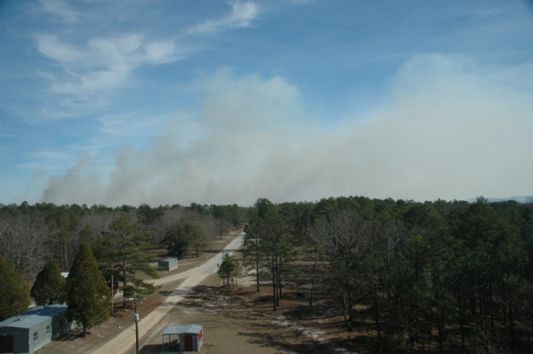
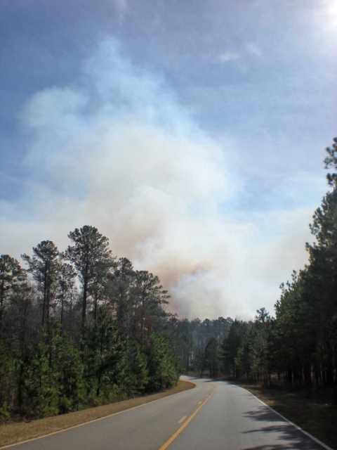
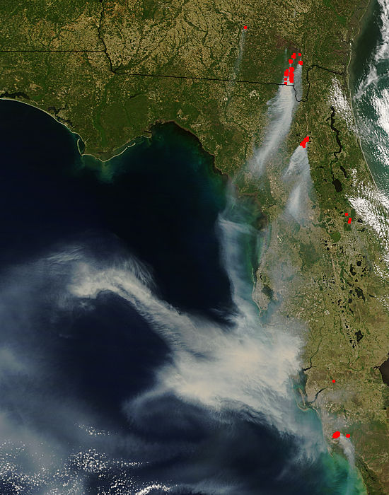
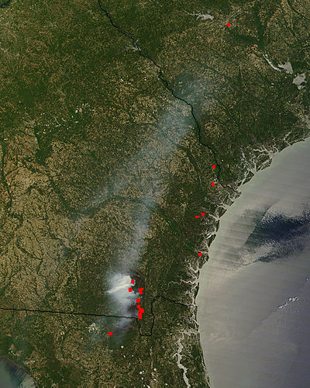
Future Work: Model Evaluations
Explore other fire emissions and plume rise options available for CMAQ & SMOKE.
Further explore Advanced Plume Treatment (APT) in CMAQ.
Future episodes to evaluate:
  Prescribed burn episodes at Fort Benning, GA
  Florida-Georgia wildfires May-June 2007
Sensitivity analysis with Direct Decoupled Method of fire related parameters.

Slide 28
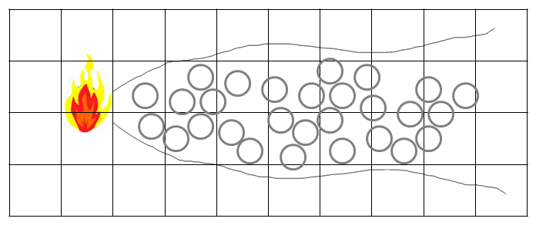
Future Work: Model Development
Adaptive-Grid-Daysmoke CMAQ:
  Daysmoke-CMAQ hybrid model
  Currently inert
Reactive Daysmoke-CMAQ:
Chemical treatment of smoke plume will require 3 considerations:
  Plume Volume
  Level of Chemical Interaction
  Reacted Mass Redistribution

Slide 29
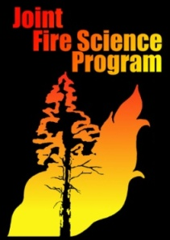

Thank you!
Acknowledgements:

