Slide 1
The Contribution of Marine Organic Emissions to Coastal Air Quality
Brett Gantt
Advisor: Nicholas Meskhidze
Co-Author: Annmarie Carlton (EPA)
North Carolina State University
9th Annual CMAS Conference
October 12, 2010

Slide 2
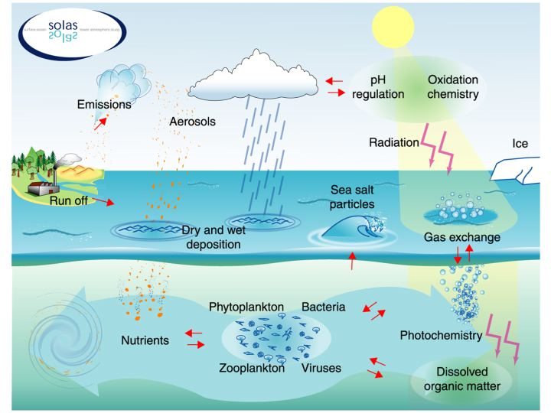
How Marine Organics get into the Atmosphere
Primary organics associated with sea spray emissions
Secondary organics associated phytoplankton BVOC emissions
Image created by SOLAS (http://solas-int.org/)

Slide 3
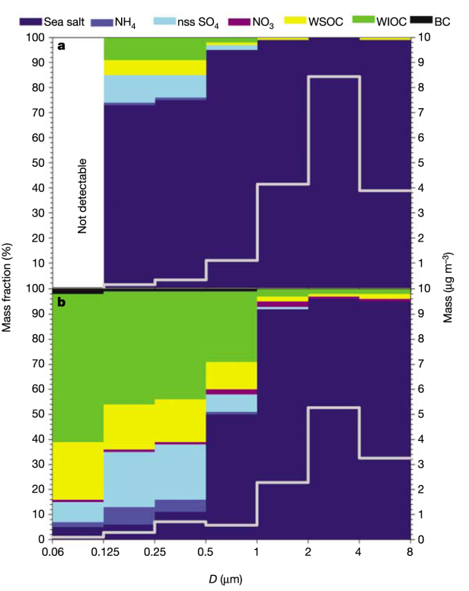
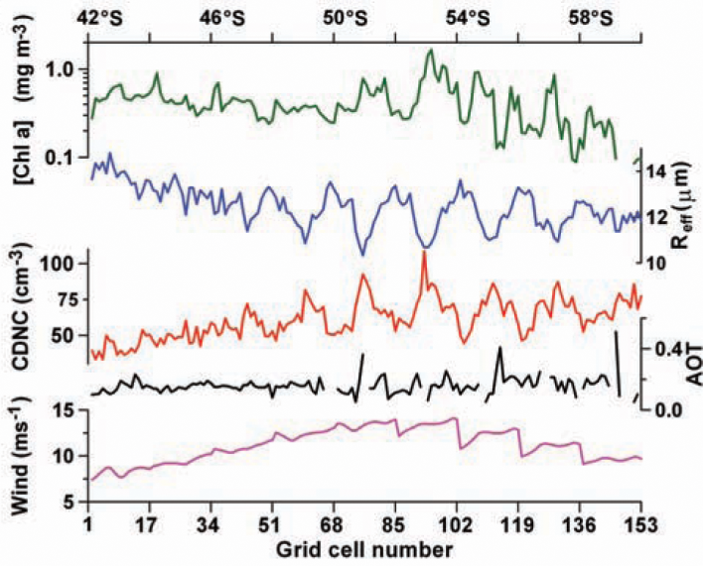
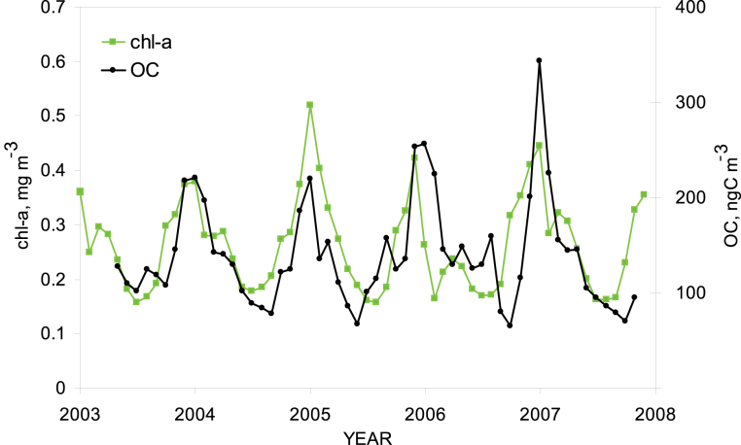
Why They Matter
Near productive oceans, the following have been observed:
High concentration of organic carbon aerosols (O’Dowd et al., 2004; Sciare et al., 2009)
New particle formation/growth (Vaattovaara et al., 2006)
Cloud microphysical changes (Meskhidze and Nenes, 2006)
O’Dowd et al. (2004)
Sciare et al. (2009)
Meskhidze and Nenes (2006)

Slide 4
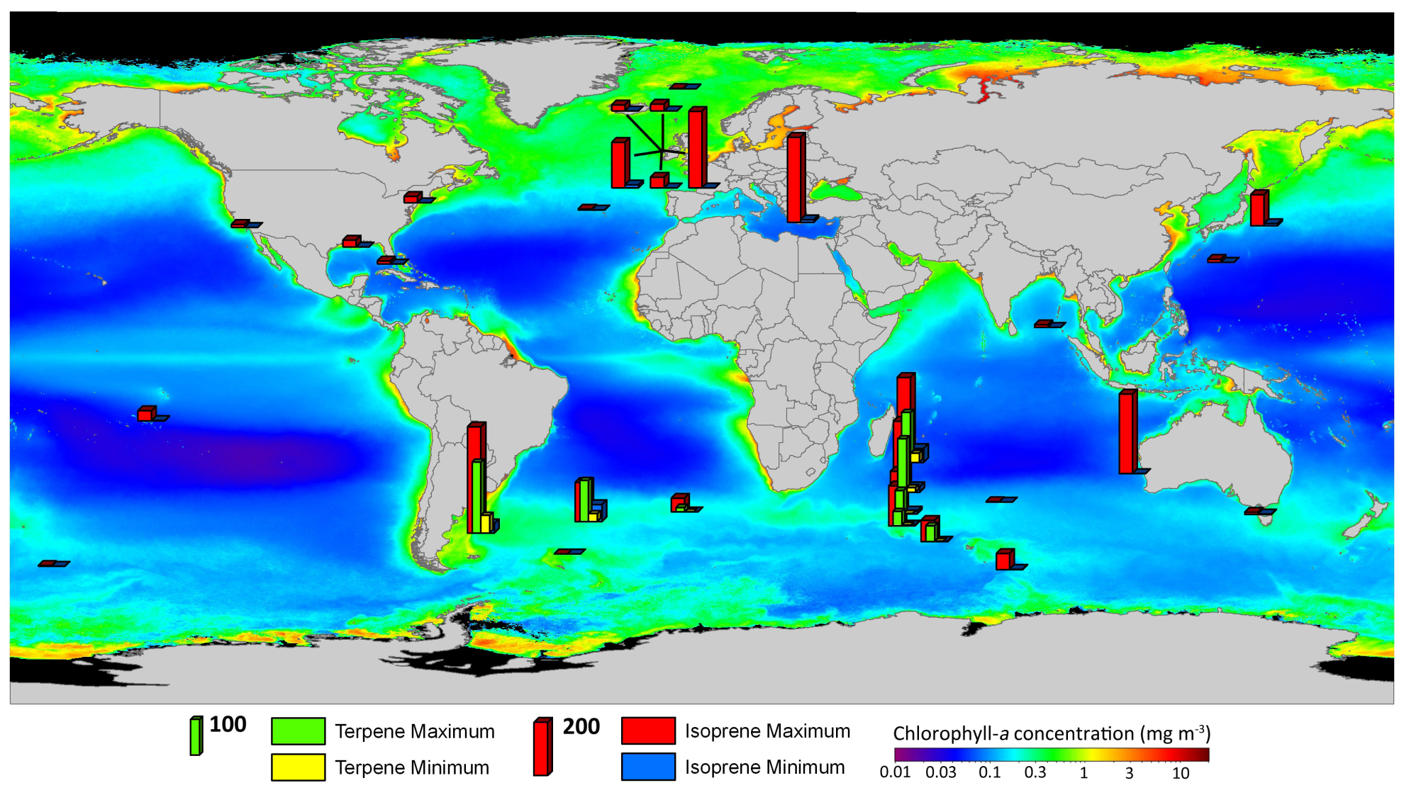
Observed Marine Boundary Layer Hydrocarbon Concentrations
(ppt)
(ppt)
Shaw, Gantt, and Meskhidze (2010)

Slide 5
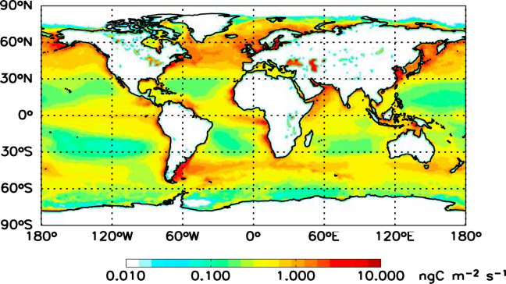
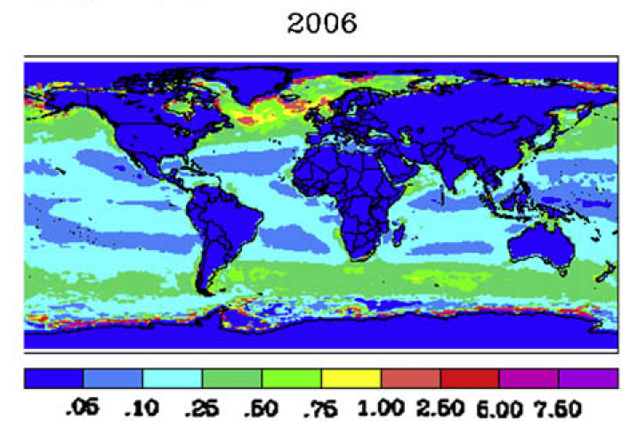
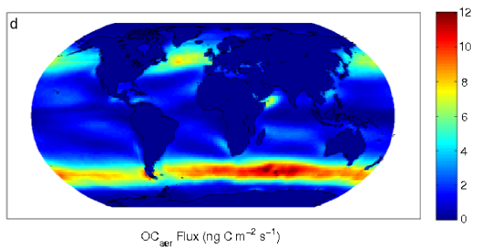
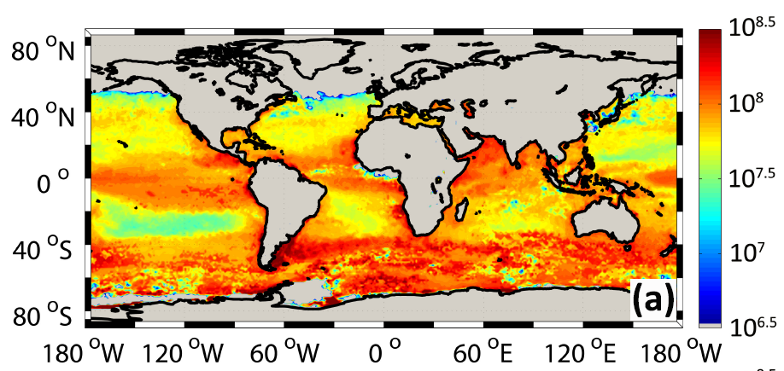
Recent Global Emission Inventories
Marine Primary Organic Aerosols
Poster in Emission Inventories
Spracklen et al. (2008)
Langmann et al. (2008)
Long et al. (2010)
Marine Isoprene
Palmer and Shaw (2005)
Gantt et al. (2009)

Slide 6
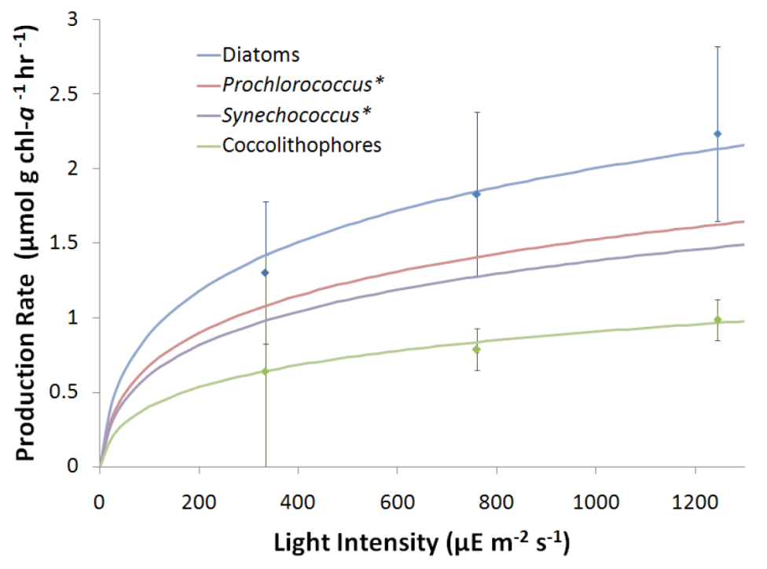
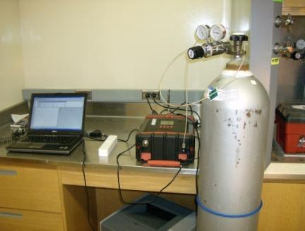
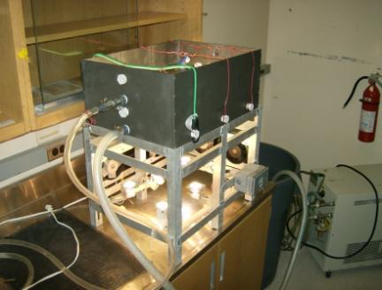
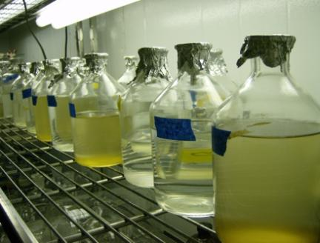
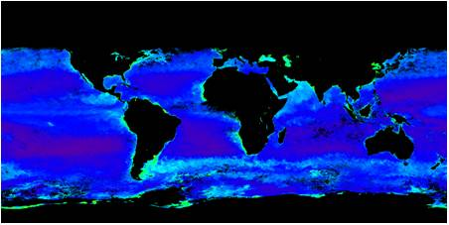
Our Marine Isoprene Emissions
Gantt et al. (2009)
Phytoplankton Speciation
Chlorophyll-a Concentration
10 meter Winds
Solar Radiation
Diffuse Attenuation

Slide 7
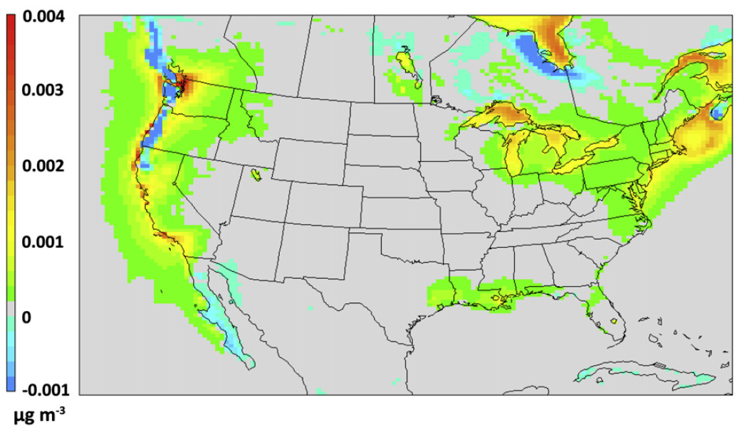
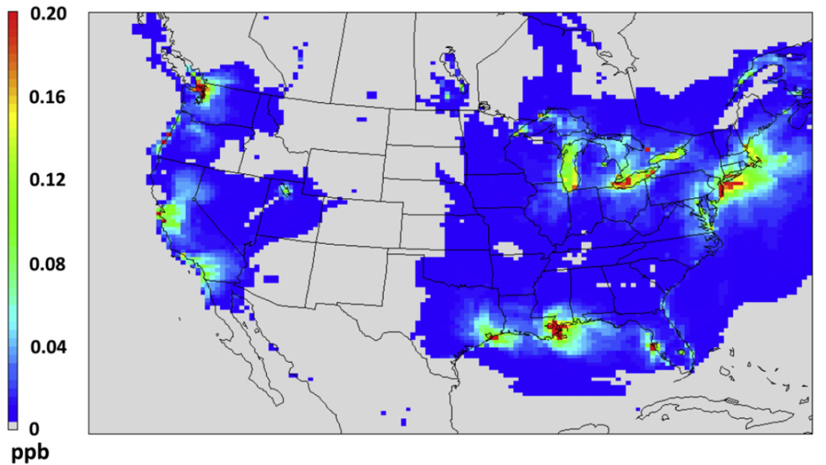
Modeling Marine Isoprene and Air Quality
Emission rate
Isoprene Concentration Change
SOA concentration change
8-hour max. O₃ concentration change
Gantt et al. (2010a)

Slide 8
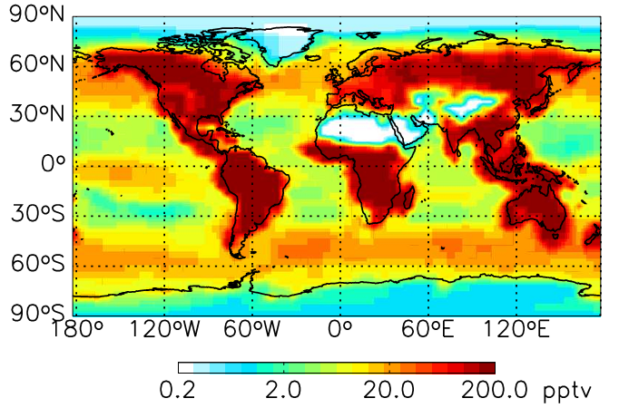
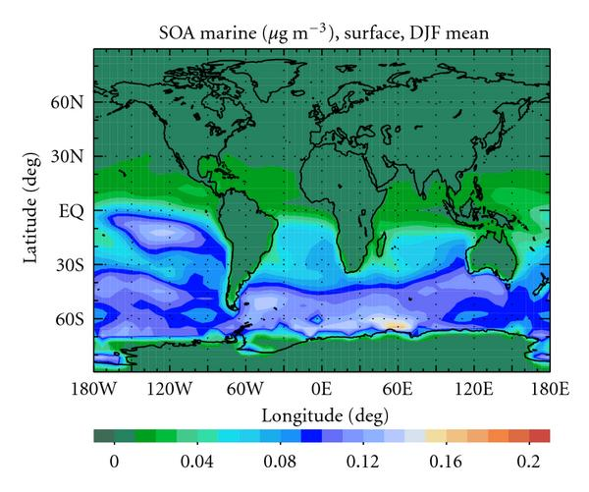
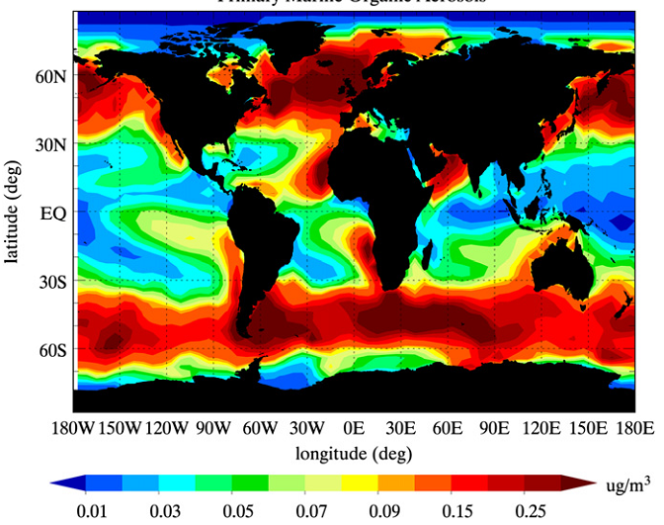
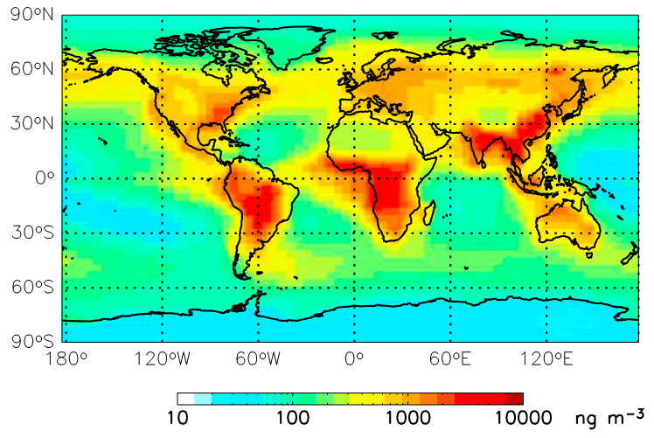
Other Recent Marine Modeling Efforts
Isoprene
α-pinene
(ppt)
(ppt)
Arnold et al. (2009)
Luo and Yu (2010)
Luo and Yu (2010)
SOA
Primary Organic Aerosols
Total Organic Aerosols
Myriokefalitakis et al. (2010)
Vignati et al. (2009)
Spracklen et al. (2008)

Slide 9
Model Setup
Model | CMAQ v. 4.7
Time Period | June-August 2005
Domain | Western US, Pacific coast
Horizontal Resolution | 12 x 12 km²
Vertical Resolution | 14 layers from the surface to 100mb
Emissions | Anthropogenic: 2005 NEI Natural: BEIS
Meteorology | MM5
Chemistry | CB05
Simulations | Baseline without marine emissions “Bottom-up” isoprene (Gantt et al., 2009) and primary organic emissions (O’Dowd et al., 2008) “Top-down” simulation using higher BVOC emissions derived from Southern Ocean measurements (Colomb et al., 2009)

Slide 10
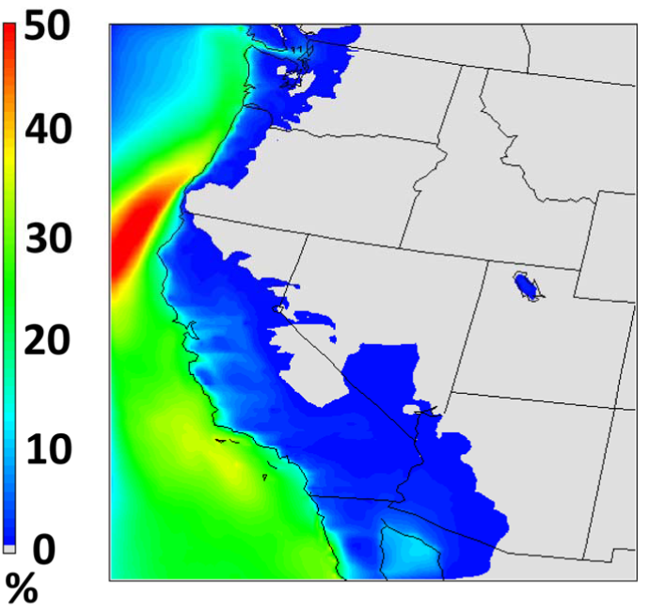
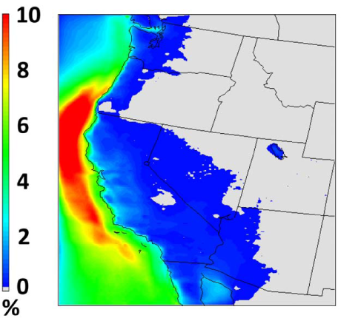
Marine Organic Aerosol Contribution
Up to 50% of surface organic carbon and 10% of PM_{2.5} (0.3 µg m⁻³) is composed of marine organics
% change in organic carbon
% change in PM_{2.5}
Gantt et al. (2010b)

Slide 11
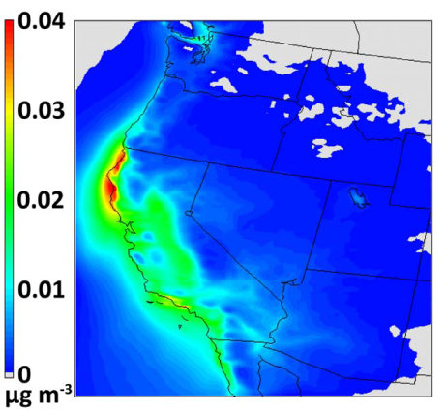
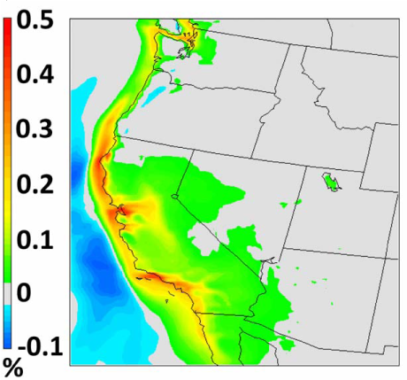
Impact of Marine Hydrocarbon Emissions
Graphs illustrate the “top down” emission rates derived from Southern Ocean
Only small changes in SOA and O₃ occur
Marine SOA/Marine OA < 20%
Increase in marine SOA
% change in O₃
Gantt et al. (2010b)

Slide 12
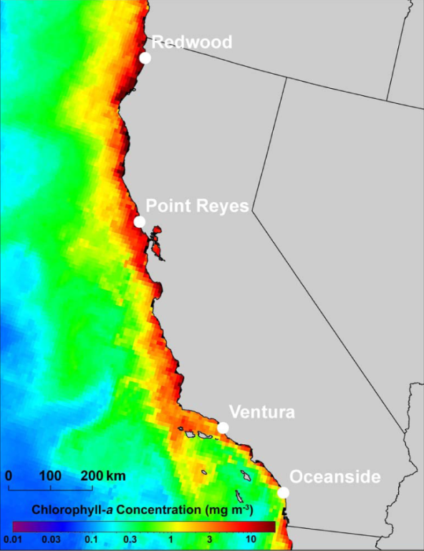
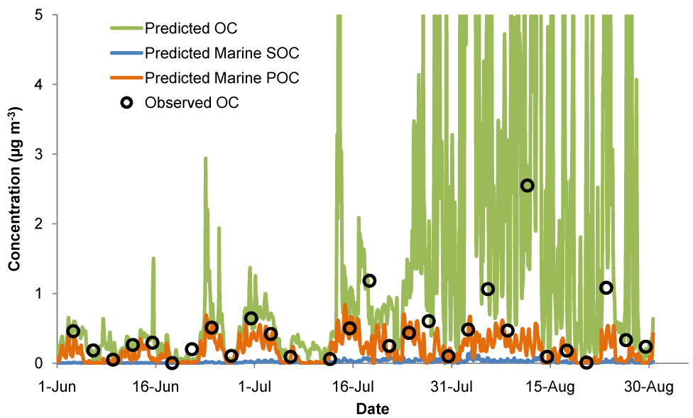
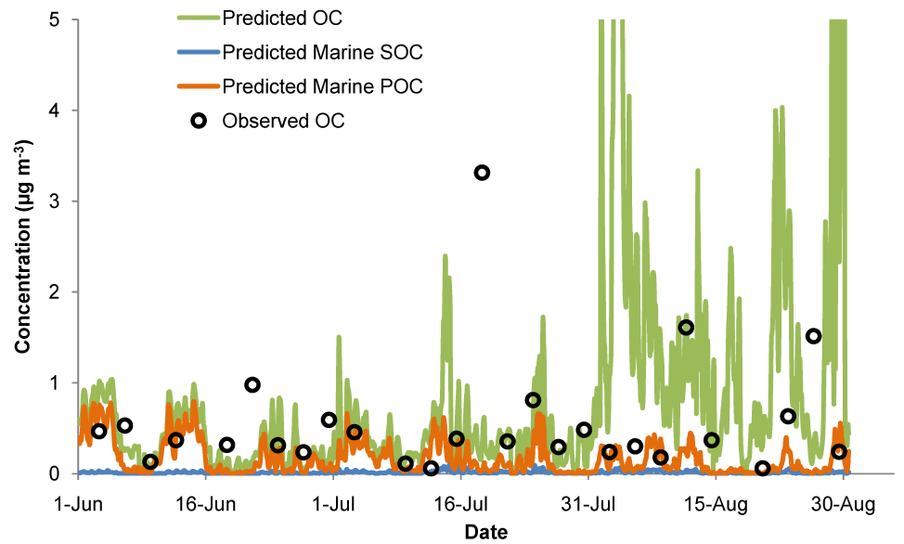
Comparison with Observations
Marine primary OC concentrations similar to IMRPOVE OC
Up to ~1 µg m⁻³ of marine OC is predicted
Gantt et al. (2010b)

Slide 13
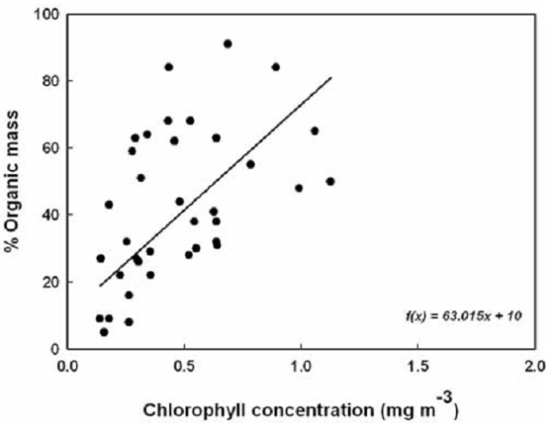
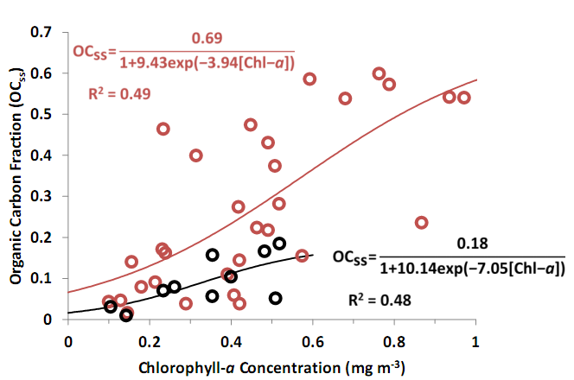
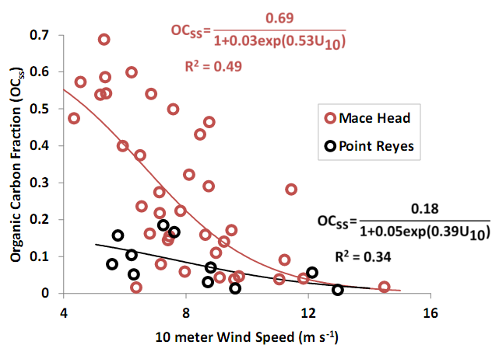
Some Important Unknowns
Global marine emission estimates differ immensely
Factor of 30 difference for isoprene and 2000 for α-pinene (Luo and Yu, 2010)
Factor of 10 difference for primary organic aerosols
Impacts of other gases
DMS, Amines, Halocarbons
See Smith and Mueller (2010) for additional discussion
Factors affecting the organic fraction of sea spray
O’Dowd et al. (2008)
Gantt and Meskhidze (submitted)

Slide 14
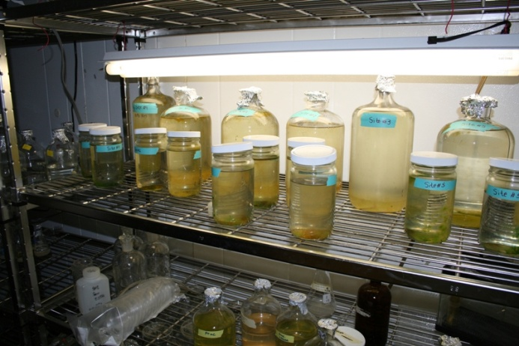
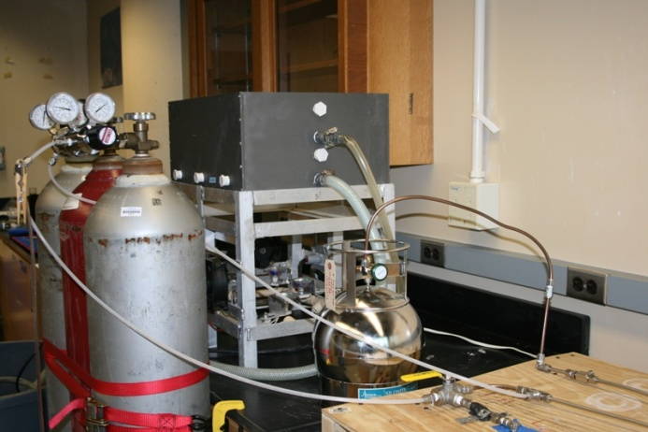
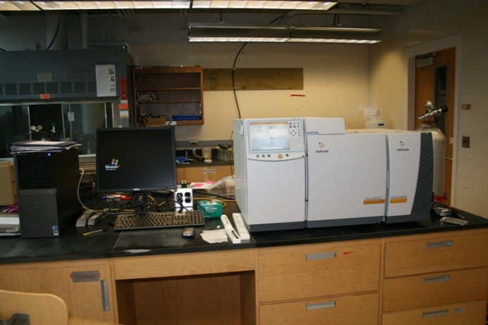
What’s Next
Extensive lab measurements for phytoplankton-emitted biogenic hydrocarbons and organic aerosols from bubble bursting under different environmental conditions
Recently, our lab has…
Measured ~25 different VOCs emitted from phytoplankton
Measured aerosol size/composition from bubble-bursting
Additional modeling studies looking into the impact of marine organics on climate and global air quality

Slide 15
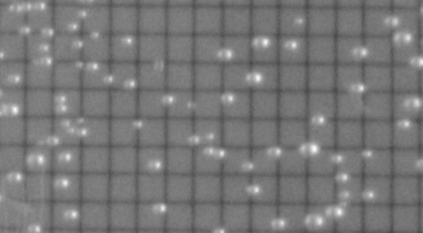
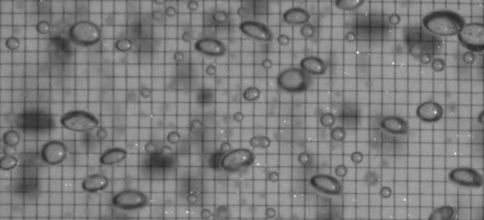
Experimental Set-up
organic fraction
size distribution + number conc.
CCN number vs. supersaturation
mixing state
filtered air
CPC
dryer+
neutralizer
DMA
CCN
Instrument
Tiny amount: 1/10000000 makes a very large difference in aerosol chemical properties
optical bubble sizing
55 cm
Flow rate: bubble number flux
Diffuser porosity: bubble size
variable
injection
depth
DMA: differential mobility analyzer
CPC: condensation particle counter
CCN: cloud condensation nuclei
Rectangular bubble tank

Slide 16
Thanks for your attention
and the opportunity to speak
Any questions???

Slide 17
Additional Slides

Slide 18
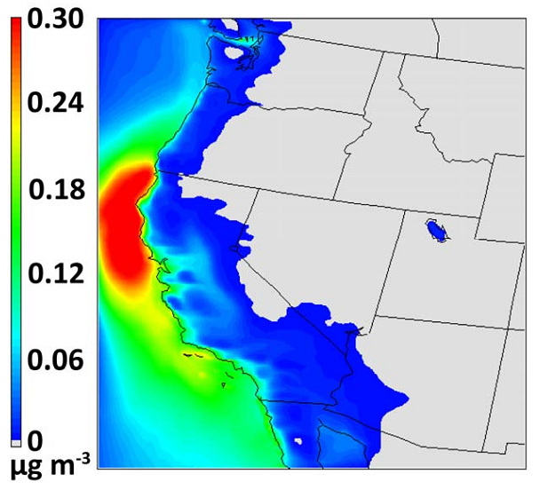
Increase in PM2.5 from marine organics
Gantt et al. (2010b)

