Slide 1
Standard images are available on the intranet
For more specific images please contact Matthew Hart
For PowerPoint help please contact Elizabeth Leishman
Air Quality Forecasting using WRF and CMAQ
Andrea Fraser, Geoff Dollard, Paul Willis, Trevor Davies, Justin Lingard
AEA, Harwell, UK
9th CMAQ conference October 2010

Slide 2
Overview
AEA - Air Quality Forecasting
WRF-CMAQ UK Air Quality Forecasting
Summary

Slide 3
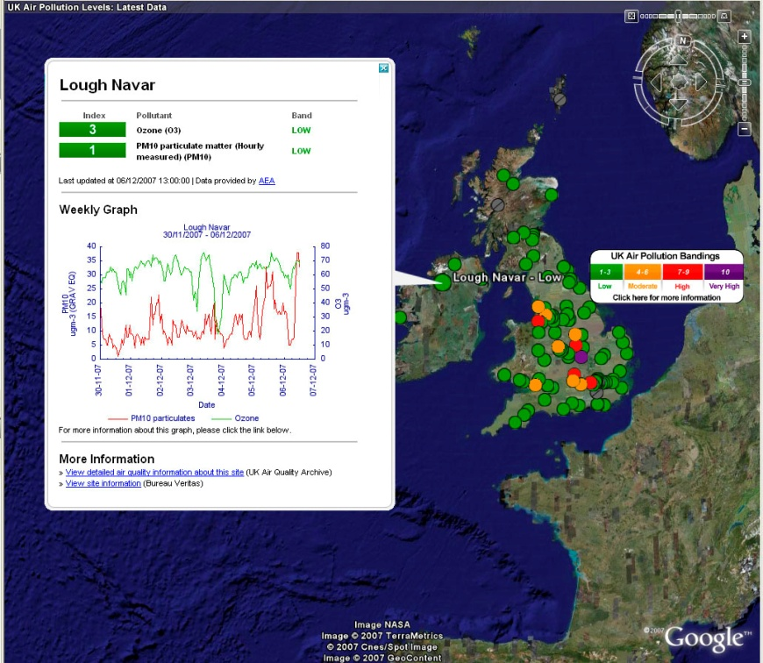
AEA - Air Quality Forecast
AEA have been providing daily forecasts since 1990.
Defra and the Devolved Administrations require a daily UK Air Quality Forecast to both protect public health and to meet specific EC Directive Requirements.
The Directive requires publication of:
The likely geographical extent of periods of high concentrations.
The expected change in pollution (improvement, stabilisation or deterioration) and reasons for those changes.

Slide 4
AEA - Air Quality Forecast
In 2009 a new 3-year contract was let to AEA to provide these daily forecasts.
The new proposal included developing a WRF-CMAQ forecasting model.
Other aspects of the contract include the need to:
Keep abreast of advances in forecasting air quality and advise Defra and the DAs on possible approaches to improve the forecasts.
Enhance understanding of the value and role of air quality forecasting in air quality management and public information services

Slide 5
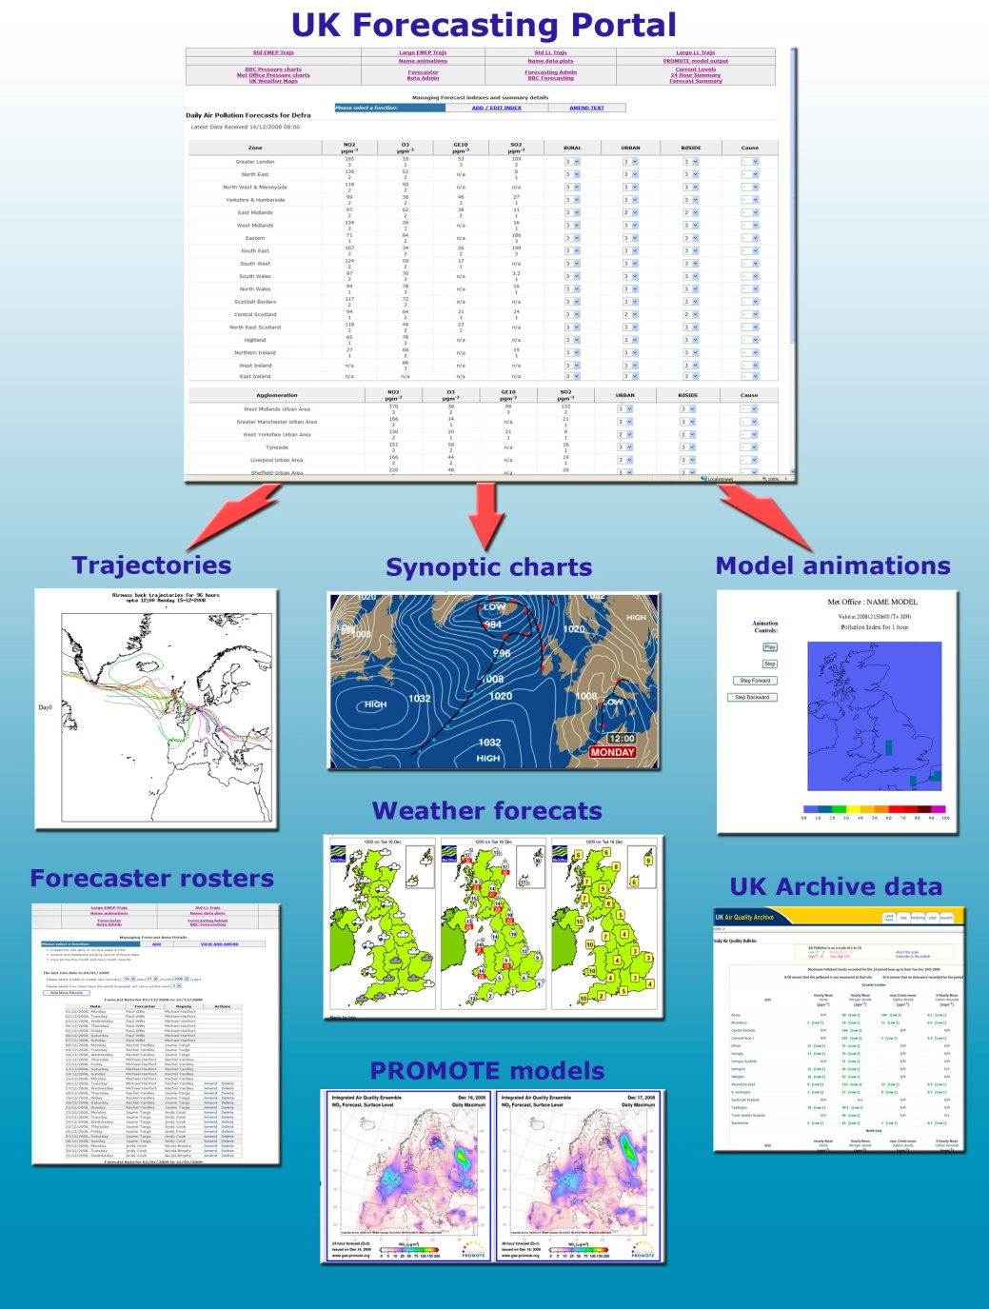
AQ Forecast Methodology
AEA’s approach is to use a team of air quality experts to compile the forecasts based on a portfolio of inputs.
The team use a daily forecasting protocol and a web-based portal to deliver forecasts 365 days a year.
The inputs include:
UK optimised AQ forecasting models.
Pan-European model results.
Latest UK & European monitoring data.
Weather forecasts.
Satellite imagery.
Expert judgement based on analyses of historical air pollution episodes.

Slide 6
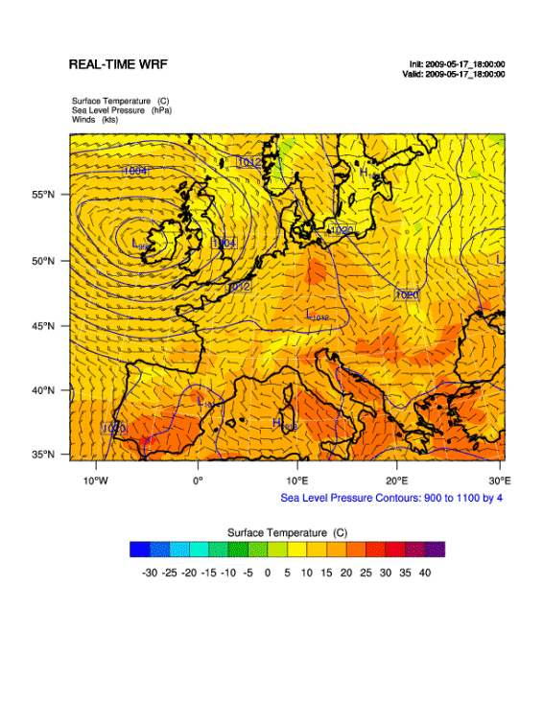
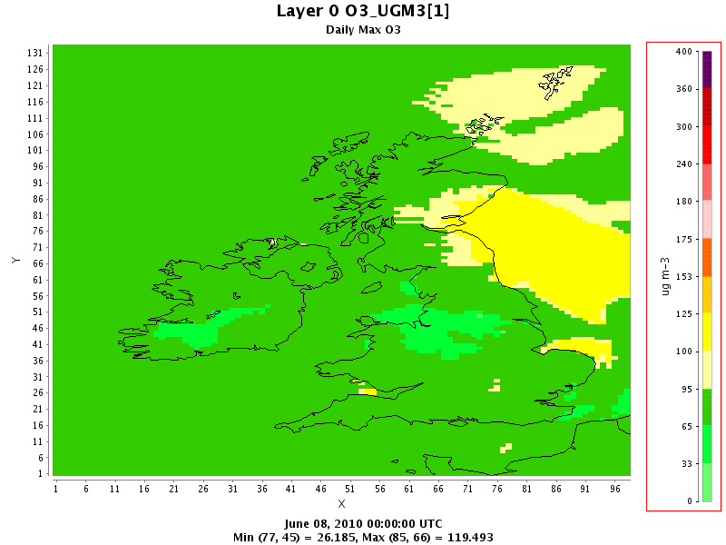
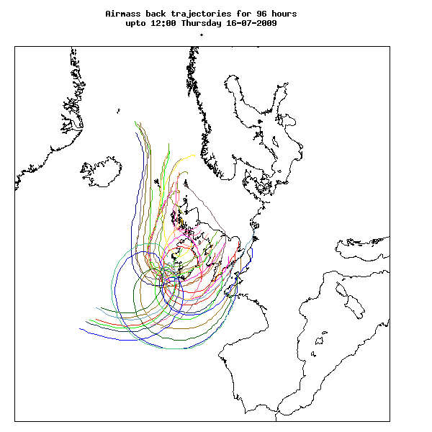
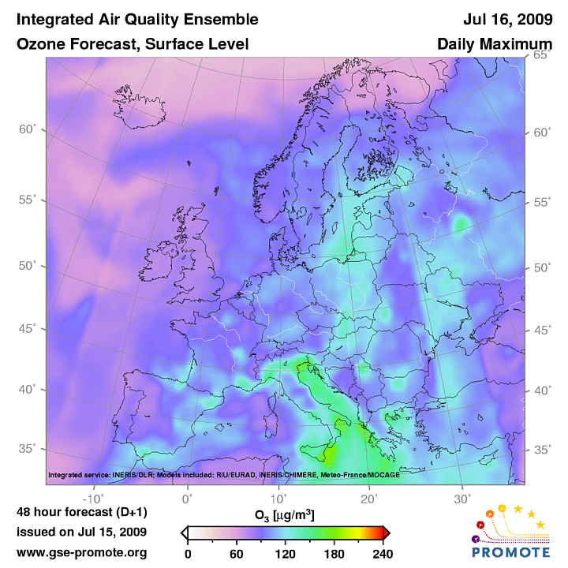
UK Air Quality Forecast Models
Ozone Daily max
AEA currently uses the WRF- CMAQ to produce daily air quality forecasts for Ozone, PM₁₀, PM_{2.5}, NO₂, SO₂ and CO. PM_{2.5} is not yet formally part of the UK AQ Forecasting service.
96 hour air mass back-trajectories are automatically obtained from HYSPLIT each day for UK and cross-channel locations. To assist with source attribution of pollutants during long-range transport episodes.
The UK forecast is compared daily for consistency with the forecasts produced by other European groups.

Slide 7
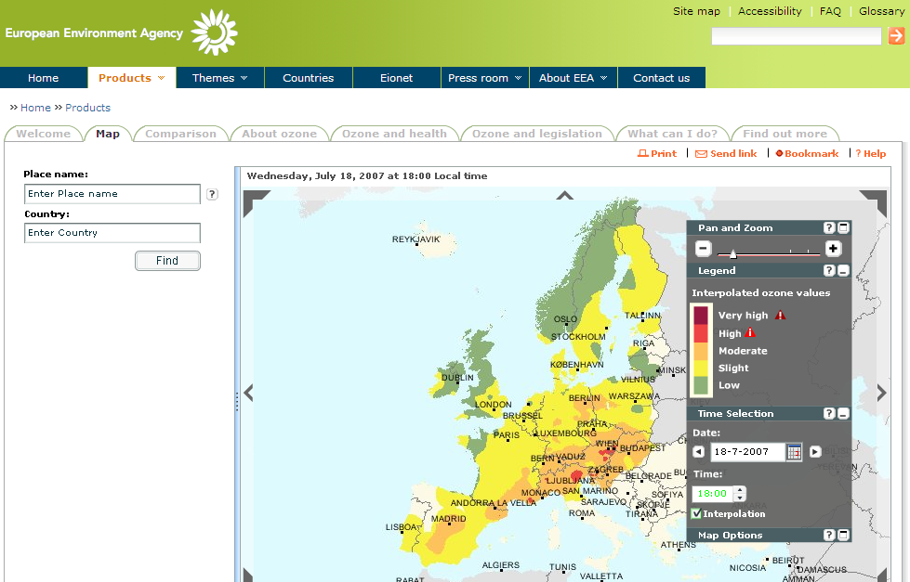
Check current conditions
Latest weather forecasts may be 12 hours or more after those used to initiate the model runs so divergence from an earlier forecast is not unexpected.
UK and European monitoring data for the current conditions and the previous 24 hrs. May indicate any unexpected divergence from forecasts which require more investigation

Slide 8
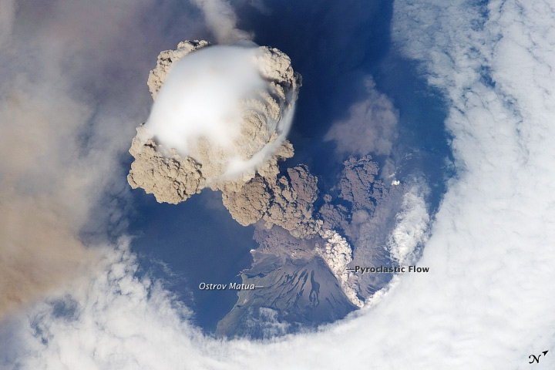
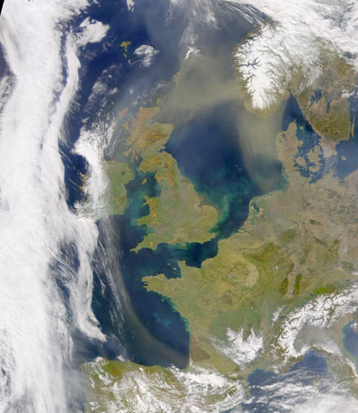
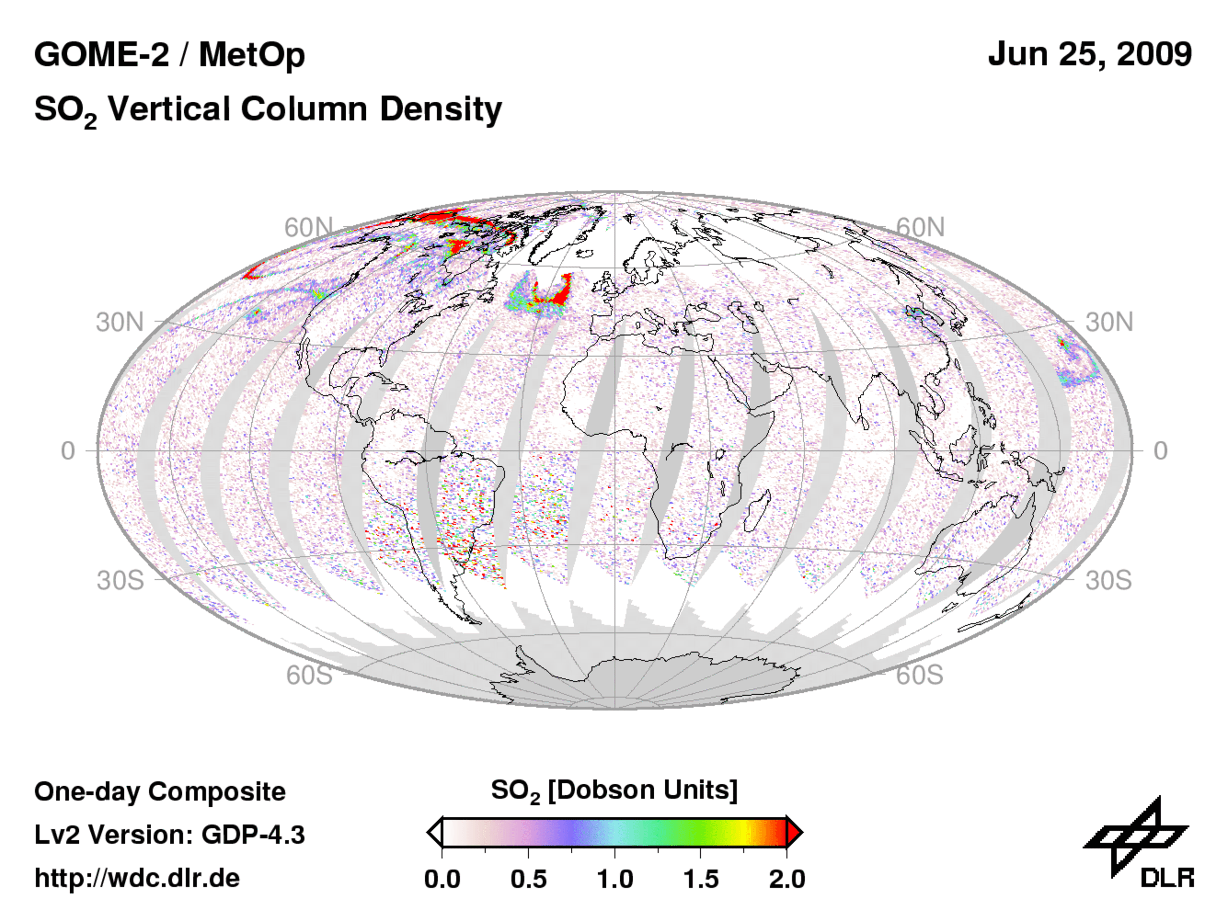
Satellite Imagery
Useful for identifying the likely source of a pollution episode, or tracking the progress of any unusual events towards the UK.

Slide 9
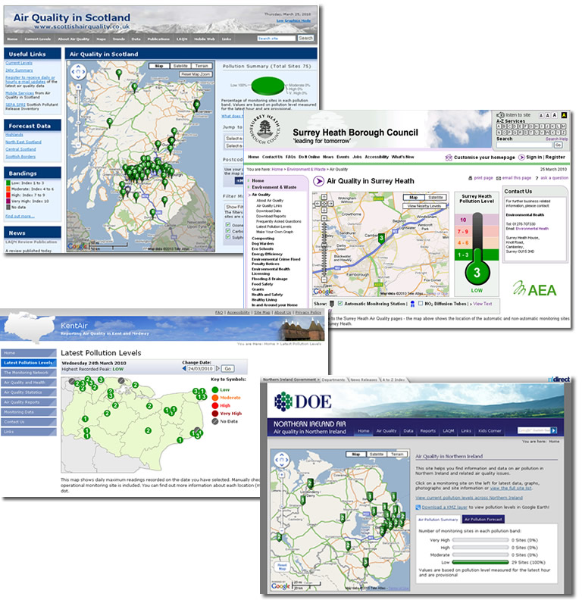
Communication
Forecasts are disseminated via the internet , media bulletins and a freephone information service.
Websites are maintained for:
UK
Devolved Administrations of Scotland, Wales and N. Ireland
Local Authorities e.g. Kent and Surry Heath
The forecast is based on the Air Quality Index (1-10) for low-moderate-high- very high
Alert Service

Slide 10
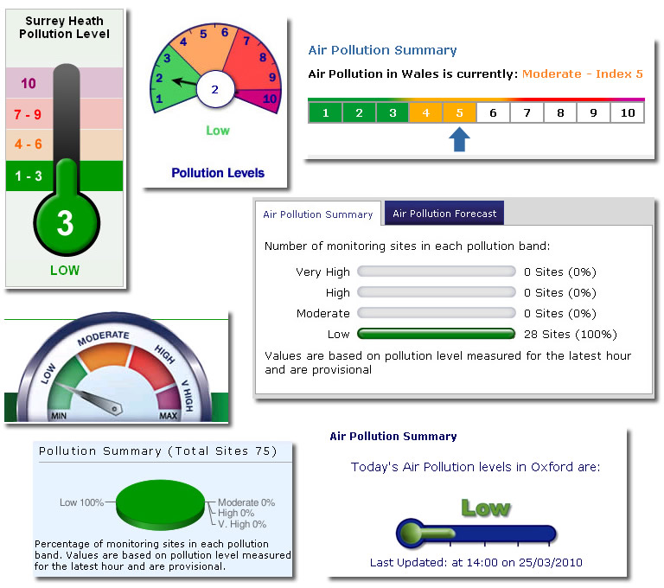
Communication
Forecasts are disseminated via the internet , media bulletins and a freephone information service.
Websites are maintained for:
UK
Devolved Administrations of Scotland, Wales and N. Ireland
Local Authorities e.g. Kent and Surry Heath
The forecast is based on the Air Quality Index (1-10) for low-moderate-high- very high
Alert Service

Slide 11
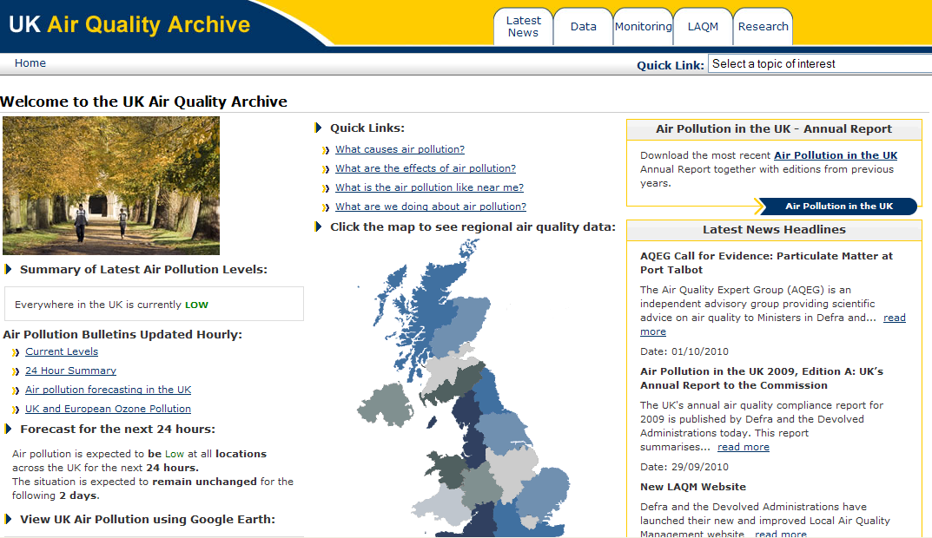
Communication - UK

Slide 12
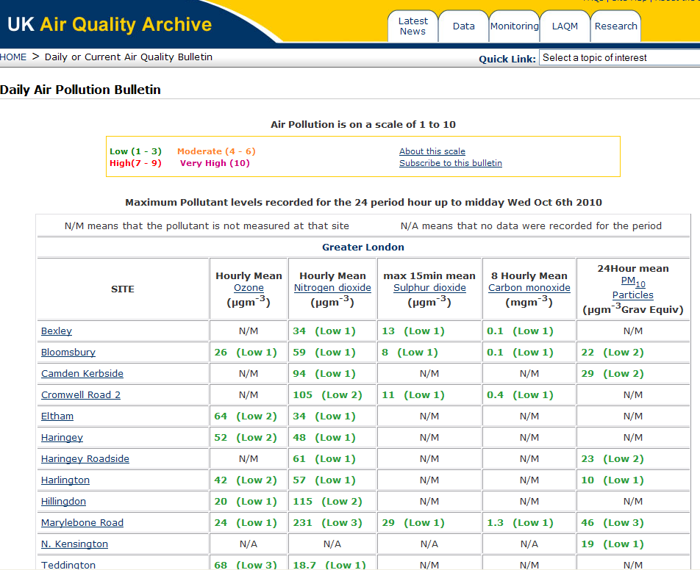
Communication - UK

Slide 13
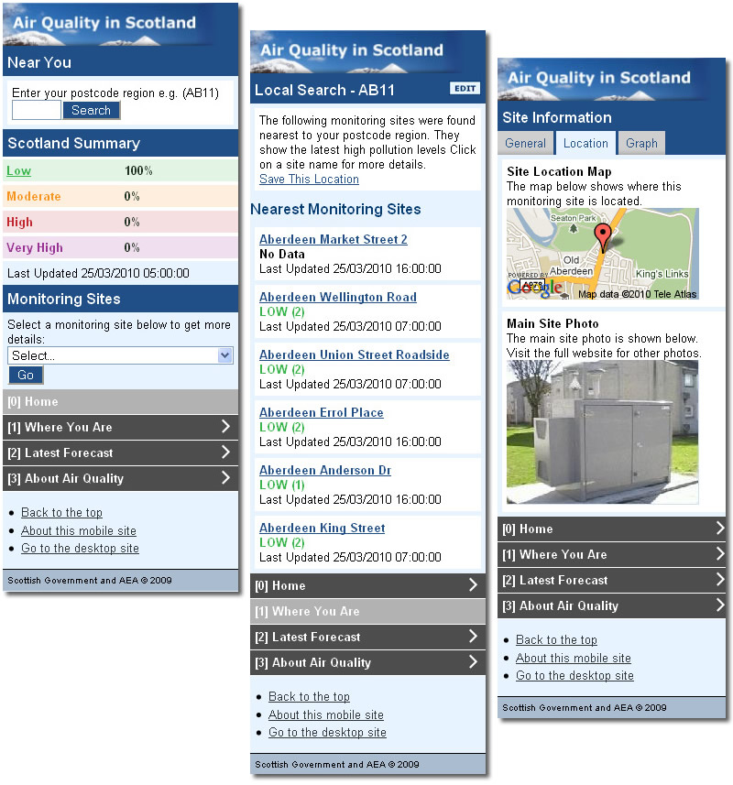
Communication
Kids corner N. Ireland
Forecast for mobile phones Scotland

Slide 14
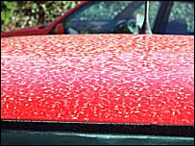
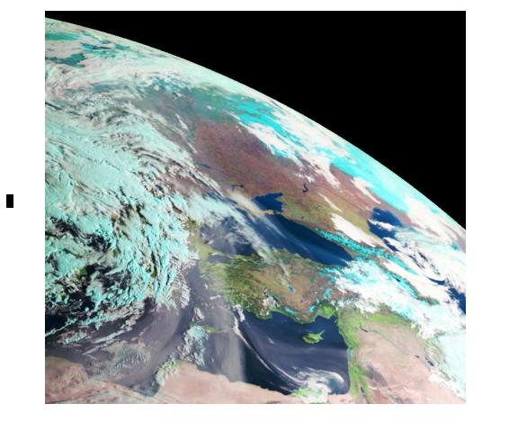
Rapid Response to “Emergency” Situations
Dedicated e-mail and phone contacts for the team.
Carrying out ad-hoc model runs and analysis to investigate the situation
Assisting in drafting press notices or dealing with press enquiries as they happen.
Post event analysis and reporting through short reports for the AQ Archive.

Slide 15
WRF – CMAQ UK Air Quality Forecast

Slide 16
WRF – CMAQ UK Air Quality Forecast
AIM:
10:00 Update the AQ forecast for Today
14:00 AQ forecast for tomorrow
Operation:
May 2009 European (48km) 24hr and 48hr forecast
October 2009 European (48km) and UK (12km) 24hr and 48hr forecast
January 2010 Started the 50km European and 10km UK forecast
February 2010 Daily forecasts for both configurations

Slide 17
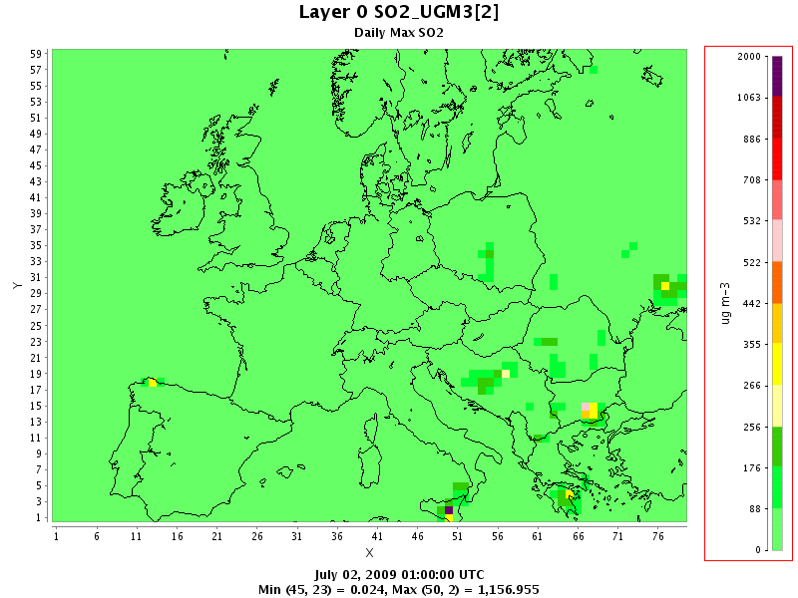
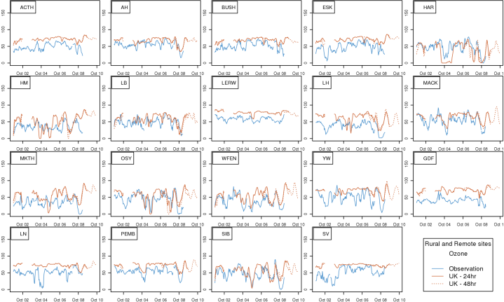
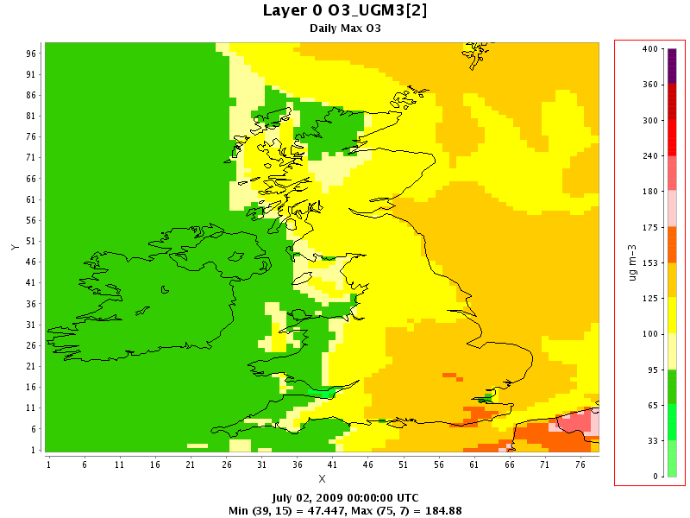
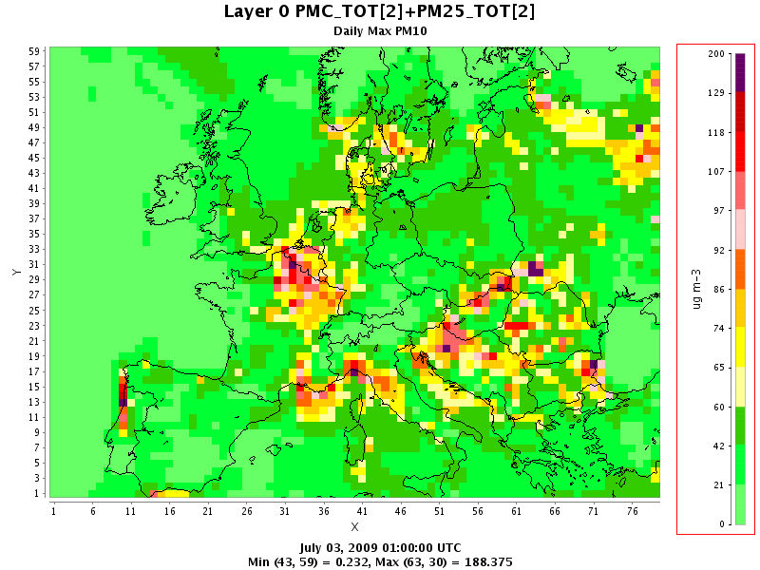
WRF-CMAQ Air Quality modelling system
Meteorology Data produced using WRF
(Weather Research and Forecasting) Model
Original 48km and 12km resolution for Europe and the UK.
Now 50km and 10km resolutions
All with 48 vertical layers.
Using GFS initial and boundary conditions
Emissions data
Europe – EMEP - 50km
UK - NAEI - 1km
Biogenic Potential Inventory - 50km
CMAQ (Community Multiscalar Air Quality) Model
Version 4.7
CB05 Chemistry with aerosol and aqueous extensions
Boundary conditions are from the STOCHEM global model
CMAQ uses the same resolution as WRF, with a slightly smaller grid
and 25 vertical layers, with 12 layer below 800M
Create Images
Animations and plots of daily maximum
– O₃ NO₂ SO₂ CO PM₁₀ PM_{2.5}
Extract values at monitoring stations
Daily and Monthly evaluation with monitoring data
Ozone Daily max
PM₁₀ Daily Max
SO₂ Daily Max
Notes:
GFS – global forecast system – a US model available through NCAR

Slide 18
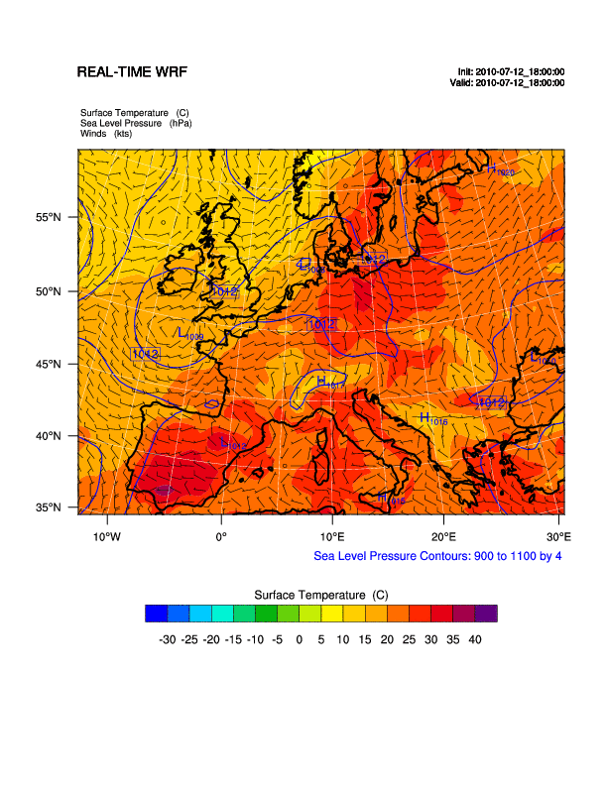
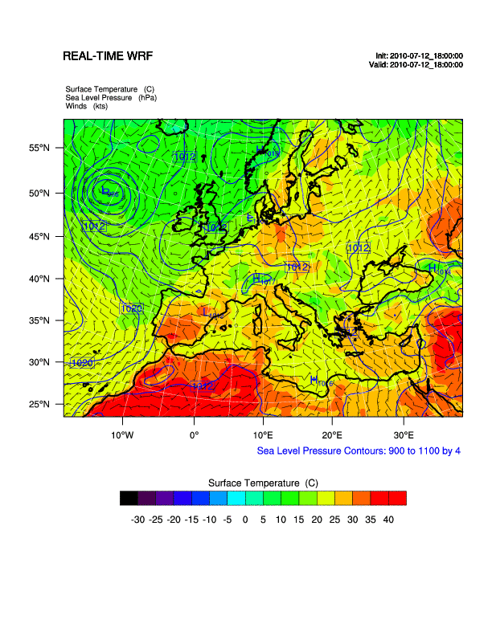
European Grid – Surface Conditions
48km European Grid 50km European Grid

Slide 19
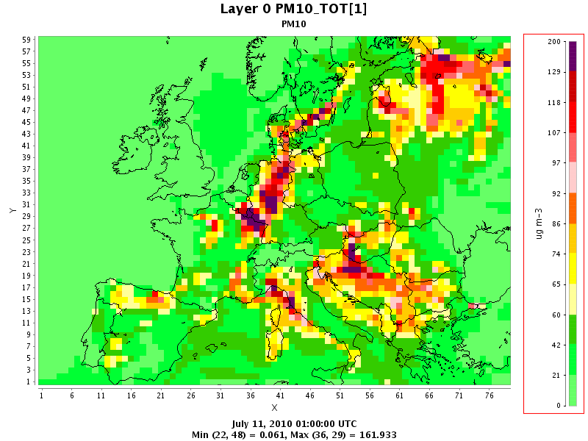
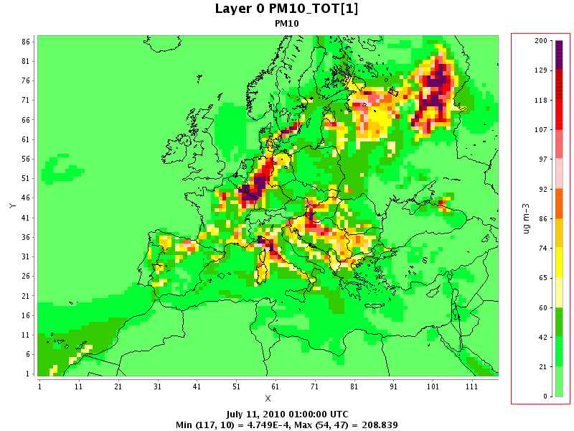
European Grid – PM₁₀
48km European Grid 50km European Grid
2006 emissions 2007 emissions

Slide 20
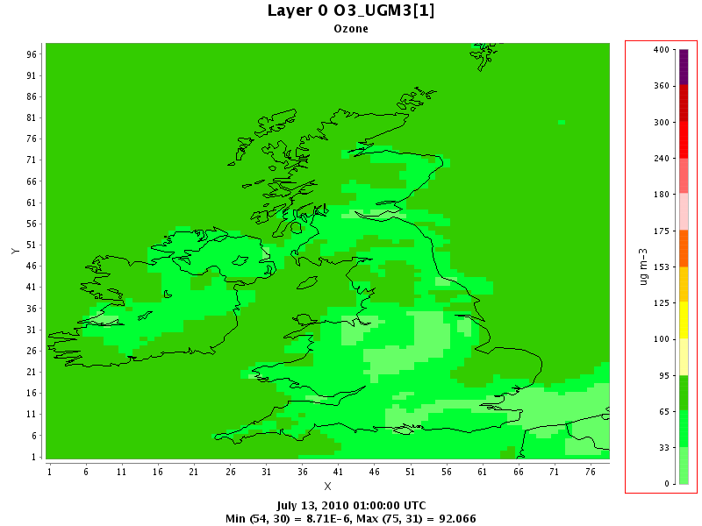
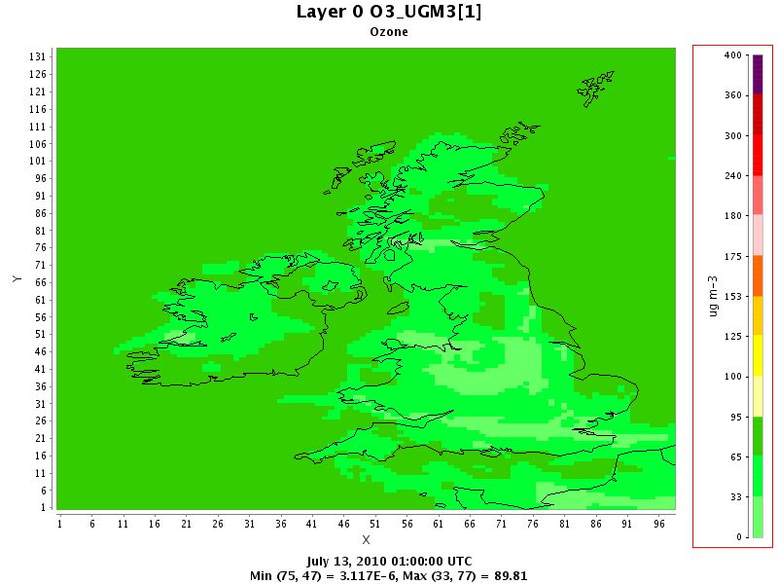
UK Grid - Ozone
12km UK Grid - 2006 emissions 10km UK Grid – 2007 emissions
AQ Index
10 V. High
9
8 High
7
6
5 Moderate
4
3
2 Low
1
V. High
High
Moderate
Low

Slide 21
Evaluation of CMAQ AQ Forecast
Daily
To provide a daily update on model performance for the duty forecaster
A line plot of provisional observations vs. model for the previous 7 days along with the 24hr and 48hr forecast
A skill plot to show how well CMAQ has performed in the previous 14 days
For Rural, Urban Background and Urban monitoring sites.
Monthly
A monthly evaluation of model performance over the previous month based on provisional observations.
Quarterly
A repeat of the monthly evaluation based on ratified observations.
The Monthly and Quarterly evaluations build up a seasonal profile.

Slide 22
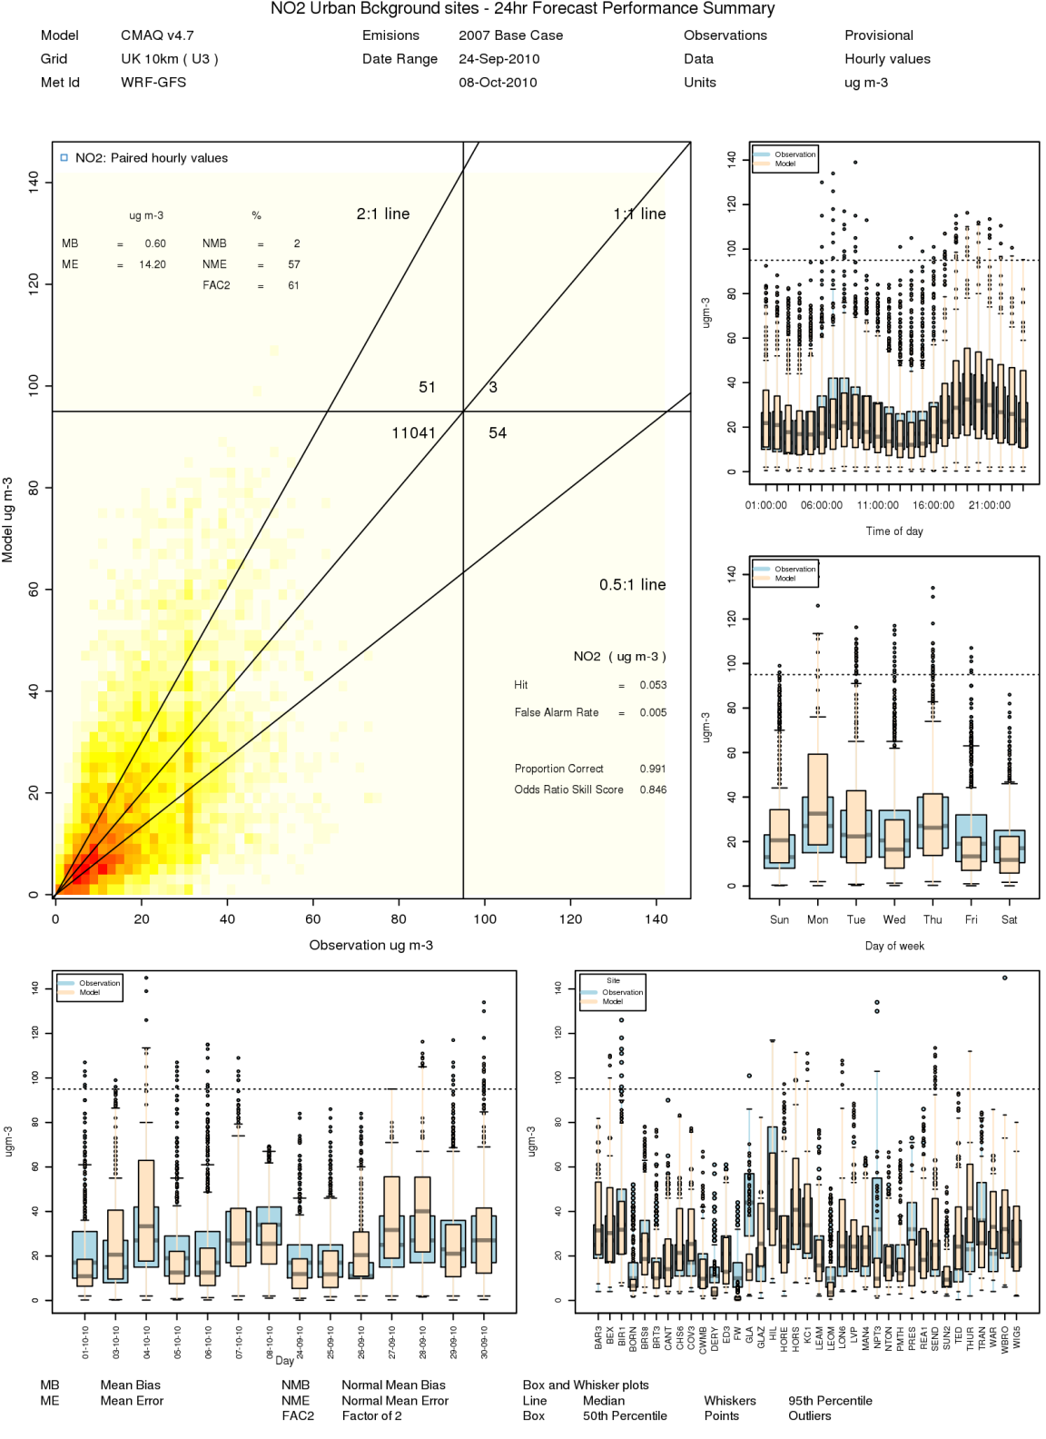
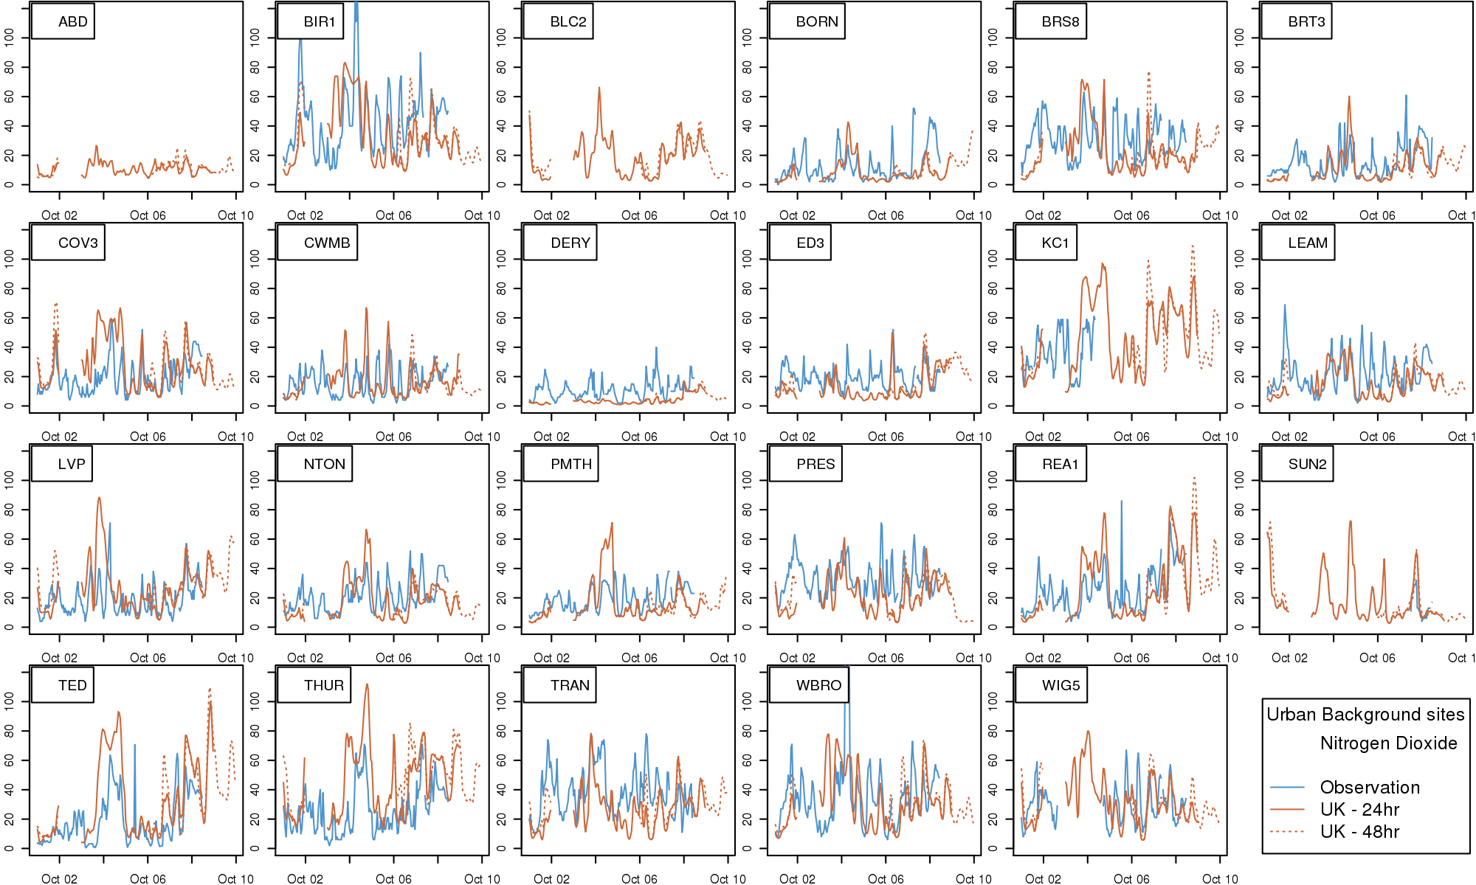
Daily Evaluation
NO₂ – Urban Background Sites

Slide 23
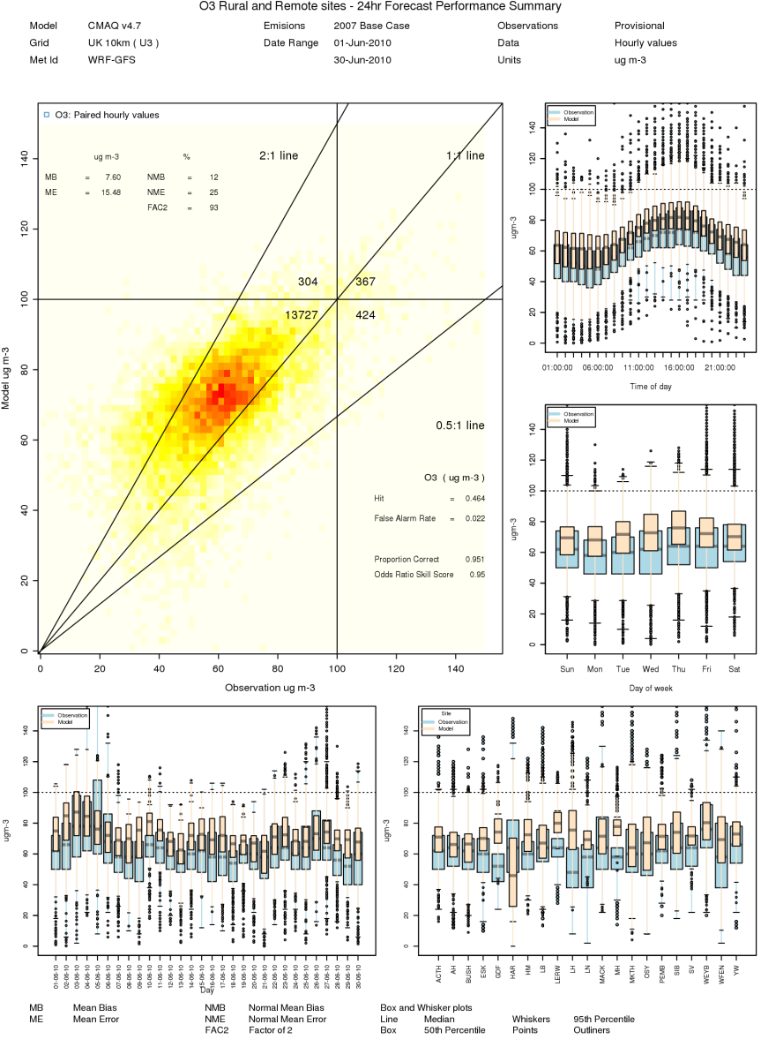
Monthly Evaluation
Rural Ozone - June 2010

Slide 24
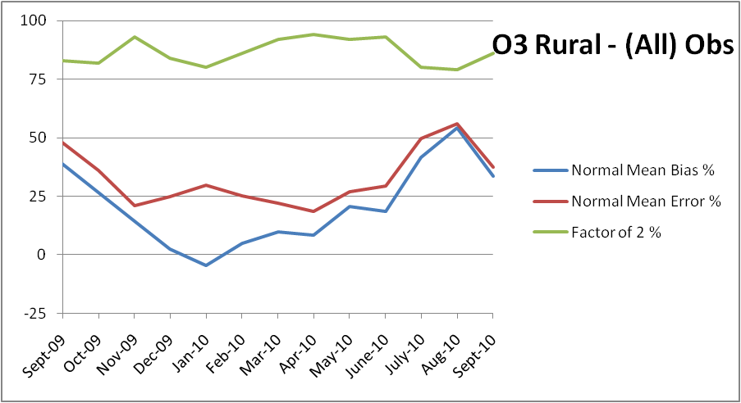
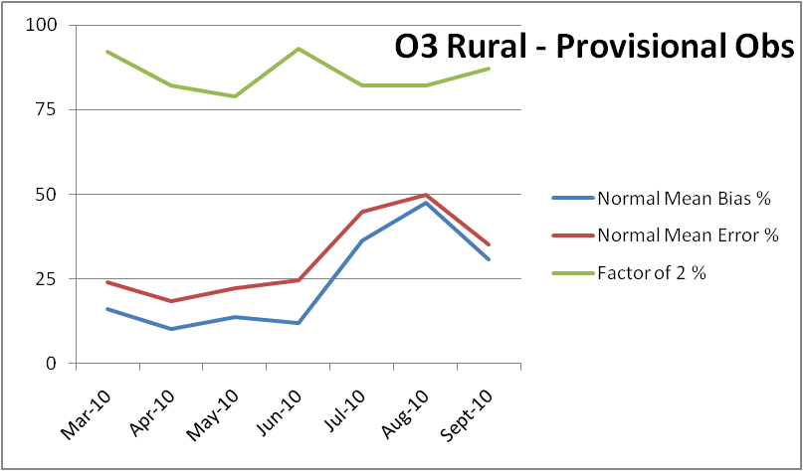
Monthly Evaluation
Rural Ozone - June 2010
UK - 12km resolution, 2006 emissions
UK - 10km resolution 2007 emissions

Slide 25
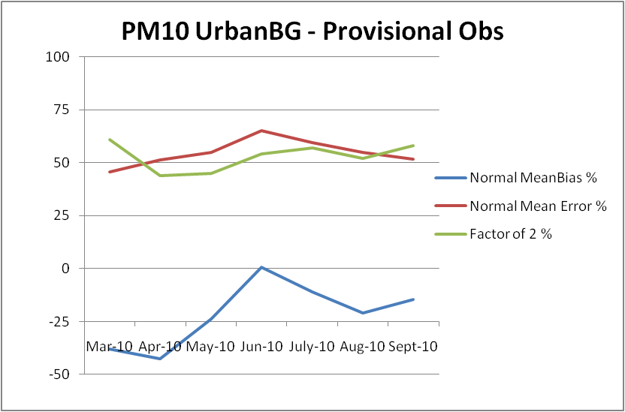
PM₁₀ – Urban Background sites
June 2010

Slide 26
WRF-CMAQ summary
To date
AEA run a daily 24hr and 48hr WRF-CMAQ Air Quality Forecast
This is used by the duty forecaster as one of the tools to produce the UK Air Quality Forecast on behalf of Defra and the DA’s
The evaluation shows that there is a tendency to overestimate ozone and underestimate PM₁₀.
Next stage
Currently moving to a new cluster
Update the emission processes
Inline emissions
Point sources emissions
A method to introduce additional sources of emissions
Extended evaluation
Europe, speciated PM, and deposition
Look at other opportunities to use the forecast
Options to downscale the forecast to ADMS or Aermod
Extend to more days at times of poor air quality

Slide 27
Summary
AEA have been producing the UK AQ forecast for 20 years.
It is an ‘expert’ forecast using several sources of information.
WRF- CMAQ forecasts for O₃, SO₂, NO₂, CO, PM₁₀ and PM_{2.5} is one of the tools used by the duty forecaster.

Slide 28
Thanks to:
The air quality forecasting team
Defra and the DA for there support
Models and Data:
CMAQ
WRF
NCEP – GFS
EMEP
UK – NAEI

Slide 29
Standard images are available on the intranet
For more specific images please contact Matthew Hart
For PowerPoint help please contact Elizabeth Leishman
Thank you
Any Questions?
Andrea Fraser
andrea.fraser@aeat.co.uk

Slide 30
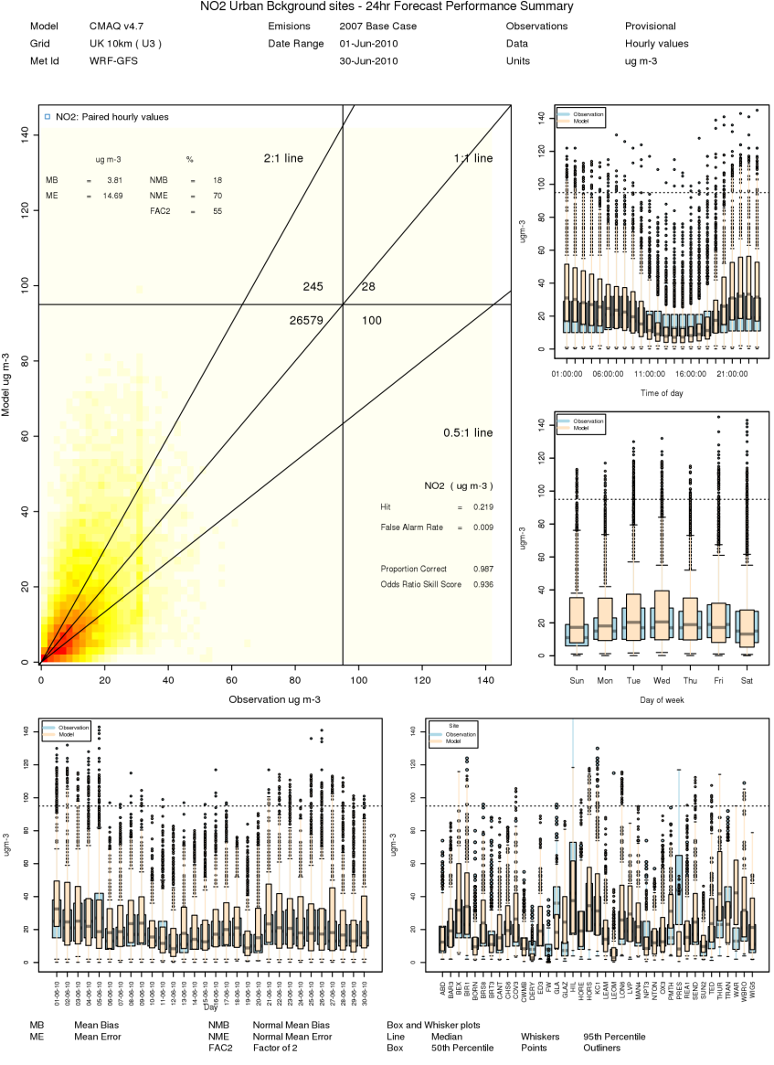
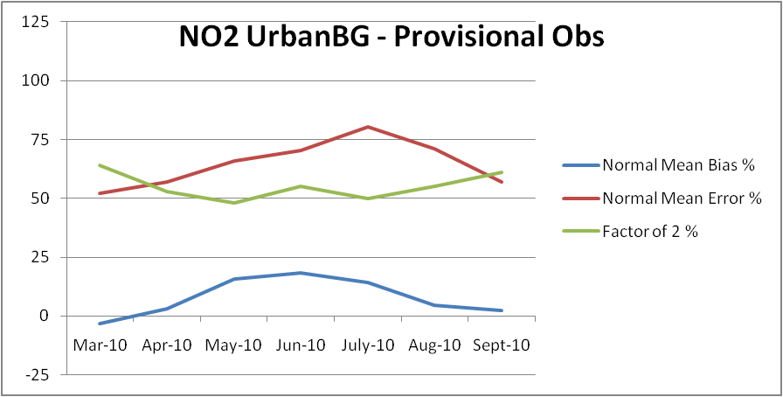
Monthly Evaluation
Urban Background NO2 – June 2010

