Slide 1
UNCERTAINTIES INFLUENCING HEALTH-BASED PRIORITIZATION OF OZONE ABATEMENT OPTIONS
9th Annual CMAS Conference
11-13th October, 2010
Daniel S. Cohan, Antara Digar & Wei Tang
Rice University
Michelle L. Bell
Yale University

Slide 2
Decision Support Context
Two objectives of ozone attainment planning
  Attain standard at monitors
  Benefits to human health, agriculture, ecosystems
Health benefits rarely quantified, but could inform prioritization of control measures
Uncertainties in health benefit estimates
  Uncertain model sensitivities (∆Emissions → ∆O₃)
  Uncertain epidemiological functions (∆O₃ → ∆Health)

Slide 3
Context: AQ model uncertainties
Sensitivities cannot be directly evaluated
Three sources of uncertainty
  Structural: Numerical representation of physical and chemical processes
  Parametric: Input parameters for emission rates, reaction rate constants, deposition velocities, etc.
  Model/User error
New methods to efficiently quantify parametric uncertainty (Tian et al., 2010; Digar and Cohan 2010)

Slide 4
Parametric Uncertainty of Sensitivities
ΔE
RJs
R(NO2+OH)
R(NO+O3)
Emis BVOC
BC (O3)
Emis AVOC
Emis NOx
BC (NOy)
Reduced form models for efficient Monte Carlo
Probability distribution of pollutant response (ΔC) to emission control (ΔE)
ΔC

Slide 5
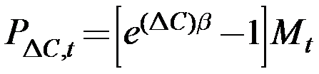
Context: Health effect uncertainties
Ozone linked to respiratory illness, hospital admissions, and mortality
  Mortality link established by three meta-studies (Epidemiology, 2005)
Various concentration-response functions
  Typical form:
  Magnitude and uncertainty of β vary by study
  Reported on 1-, 8-, and 24-hour metrics
No clear evidence of thresholds (Bell et al., 2006)

Slide 6
Linking Uncertain Sensitivities and C-R Functions
Uncertain
Pollutant Reduction
ΔC
Uncertain Health Impact
P_{ΔC,t}
β
Uncertain
Beta Distribution
Averted Mortalities per ΔE
Uncertain health impact due to uncertain ozone impact (∆C) and C-R function (β)

Slide 7
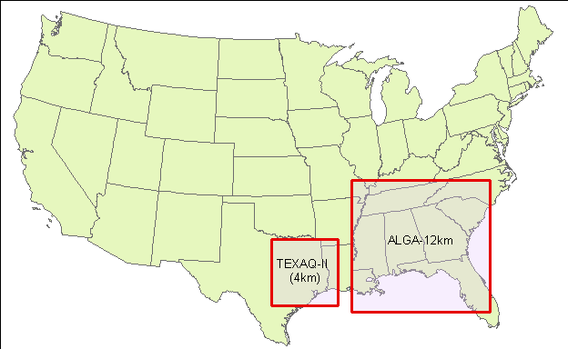
Two Case Studies
Texas
Episode: Aug 30 – Sept 5, 2006
ΔE: -1 tpd NO_{x} or VOC
4 Emission Regions: Houston Ship Channel (elevated/surface), and Rest of Houston (elevated/surface)
Georgia
Episode: July 30 – Aug 15, 2002/9
ΔE: -1 tpd NO_{x} only (ΔO₃/ΔE_{VOC} small)
5 Emission Regions: Atlanta, Macon, Rest of Georgia, and 2 power plants

Slide 8
Input Parameter Uncertainties (φ_{k})
Parameter | Uncertainty | Sigma | Reference
Domain-wide NOx | ± 40% (1σ) | 0.336 | a
Domain-wide Anthropogenic VOC | ± 40% (1σ) | 0.336 | a
Domain-wide Biogenic VOC | ± 50% (1σ) | 0.405 | a
All Photolysis Rates | Factor of 2 (2σ) | 0.347 | b
R(All VOCs+OH) | ± 10% (1σ) | 0.095 | a, b
R(OH+NO2) | ± 30% (2σ) | 0.131 | c
R(NO+O3) | ± 10% (1σ) | 0.095 | b
Boundary Cond. O3 | ± 50% (2σ) | 0.203 | a
Boundary Cond. NOy | Factor of 3 (2σ) | 0.549 | a
References: ªDeguillaume et al. 2007; ^{b}Hanna et al. 2001; ^{c}JPL 2006
Note: All distributions are assumed to be log-normal

Slide 9
Computing sensitivity under uncertainty
Compute concentrations & sensitivities in base case
Use Taylor series expansions with cross-sensitivities to adjust sensitivities for uncertain inputs:
10,000 Monte Carlo samplings of ϕ_{k} to generate probability distribution of s_{j}^{(1)*}
(Cohan et al., ES&T 2005)
(Digar and Cohan, ES&T 2010)

Slide 10
Computing ΔHealth due to ΔO₃
Averted mortality is function of ozone change (ΔC), β, and baseline mortality M_{t}:
Estimates of β and its uncertainty taken from ozone-mortality meta-analysis (Bell et al., JAMA 2004)
Baseline mortality incidence rates M_{t} (US CDC) and population distributions extracted from BenMAP
Scale by 153/365 for ozone season only benefits
10,000 Monte Carlo samplings of β
Metric | β (ppb⁻¹) | σ(β) (ppb⁻¹)
Daily (24-hour) | 5.18E-04 | 1.25E-04
Daily 1-hour maximum | 3.33E-04 | 6.32E-05
Daily 8-hour maximum | 4.22E-04 | 7.76E-05

Slide 11
Probability Distribution of Health Benefits
Probability density (averted mortalities⁻¹)
Results Based on 8-hour max
Houston Ship Channel surface NOx
Atlanta NOx
Averted mortalities per ozone season per -1 tpd ΔE
(results averaged over episode and integrated over domain; 8-hour metric)
Uncertain AQ model parameters (phi) generate more uncertainty than uncertain C-R function (β) if temporal metric fixed.

Slide 12
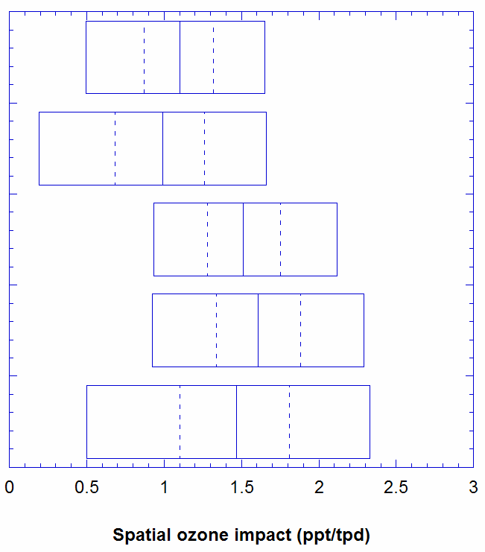
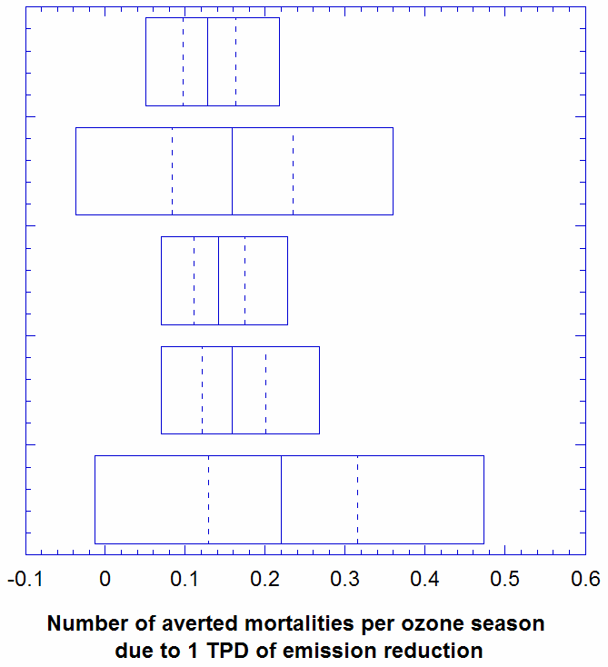
Rankings on spatial O₃ and health metrics
Ranking
Spatial Impact Health Impact
Ranking
4
Plant Scherer
5
5
3
Plant McDonough
2
Rest of Georgia
4
1
2
Macon
3
5%
25%
50%
75%
95%
1
Atlanta
Impacts based on 8-hour metric
Deterministic

Slide 13
Uncertainty Of Health Benefits
Averted mortalities per O₃ season per tpd
Georgia NOx
Houston NOx
Houston VOC
Uncertainties are large relative to median impacts
Outliers driven by uncertainty in E_{NOx}, E_{bioVOC}, and photolysis rates
(Results based on 8-hour metric, with uncertain φ and β)

Slide 14
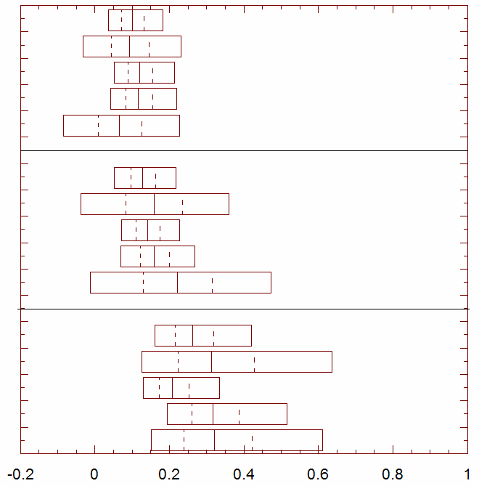
Choice of temporal metric influences rankings
Ranking
Plant Scherer
3
Plant McDonough
4
Rest of Georgia
1
24-hr
Macon
2
Atlanta
5
Plant Scherer
5
Plant McDonough
3
Rest of Georgia
4
8-hr
Macon
2
Atlanta
1
Plant Scherer
4
Plant McDonough
3
Rest of Georgia
5
1-hr
Macon
2
Atlanta
1
Averted mortalities per ozone season per 1 tpd ΔE

Slide 15
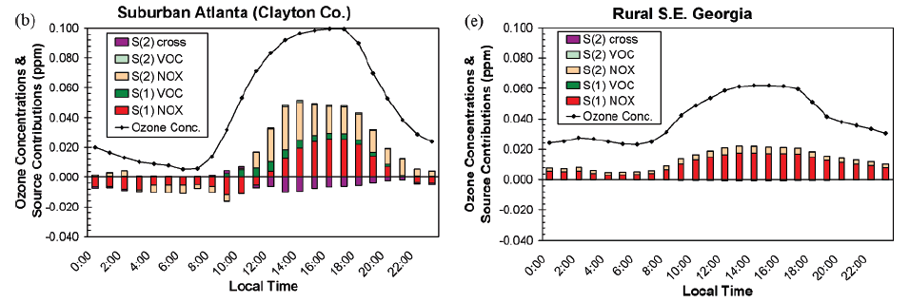
Why does temporal metric matter??
Diurnal trends in ozone sensitivities
Urban NO_{x} can titrate surface ozone at night in populated area, reducing 24-hour impacts and leading to the ranking reversals
VOC and elevated or rural NO_{x} yield little nocturnal disbenefit
Cohan et al., ES&T 2005

Slide 16
Conclusions
Jointly considered how uncertainty in AQ model (parametric) and C-R functions generate uncertainty in ozone health benefit estimates
AQ model uncertainties are leading driver of overall uncertainty in benefit estimation
  Key parameters: E_{NOx}, E_{bioVOC}, and photolysis rates
Urban NO_{x} emissions tend to have larger and more uncertain health impacts
Choice of temporal metric for C-R function can reverse the rankings of per-ton benefits

Slide 17

Acknowledgments
Funding:
Baseline modeling and emissions data provided by Georgia Environmental Protection Division (B.-U. Kim and J.W. Boylan) and University of Houston (D.W. Byun)
U.S. EPA – Science To Achieve Results (STAR) Program
Grant # R833665

