Slide 1
Evaluation of Modeled Ozone Biases Using Satellite Data and Surface Measurements
Yunsoo Choi¹², Daewon Byun¹, Pius Lee¹, Rick Saylor¹, Ariel Stein¹², Daniel Tong¹², Hyun-Cheol Kim¹², Fantine Ngan¹³, Tianfeng Chai¹⁴, Marina Tsidulko⁵, and Ivanka Stajner⁶
¹NOAA/OAR/ARL, 1315 East West Hwy, Room 3461, Silver Spring, MD 20910.
² Earth Resources & Technology ,Inc, Annapolis Junction, MD
³ University Corporation for Atmospheric Research, Boulder, CO.
⁴Science and Technology Corporation, Hampton, VA.
⁵ NCEP/EMC, Camp Springs, MD.
⁶ Office of Science and Technology, National Weather Service, Silver Spring, MD.

Slide 2
Motivation
Summer daytime O₃ overprediction of CMAQ model over the Eastern US: Perspective from the space with GOME-2
CMAQ overpredicts surface O₃ during summer over the CONUS region, particularly over the southeastern and northeastern US for August 2009.
Which factor can explain O₃ overprediction over the region? Amounts of NOx or VOCs?
How CMAQ-simulated NOx is compared with AIRNow NO₂ and GOME-2 NO₂ columns?
How CMAQ-simulated VOCs (e.g., isoprene and HCHO) is compared with PAMS isoprene and GOME-2 HCHO columns?
How NOx-sensitive and NOx-saturated regions from satellite products and CMAQ are different?
How chemically defined regions (according to VOCs/NOx ratios) are different from CMAQ and satellite products?

Slide 3
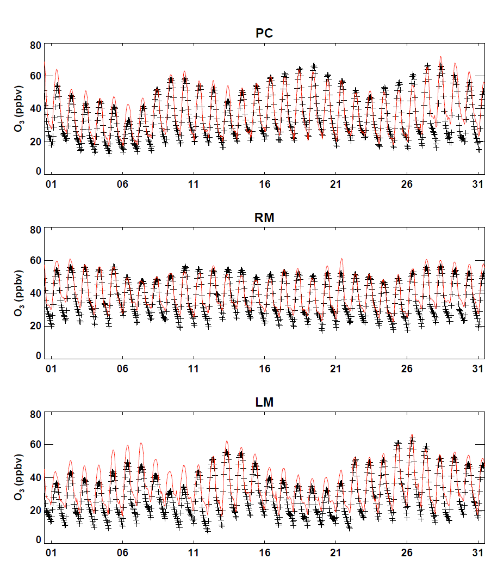
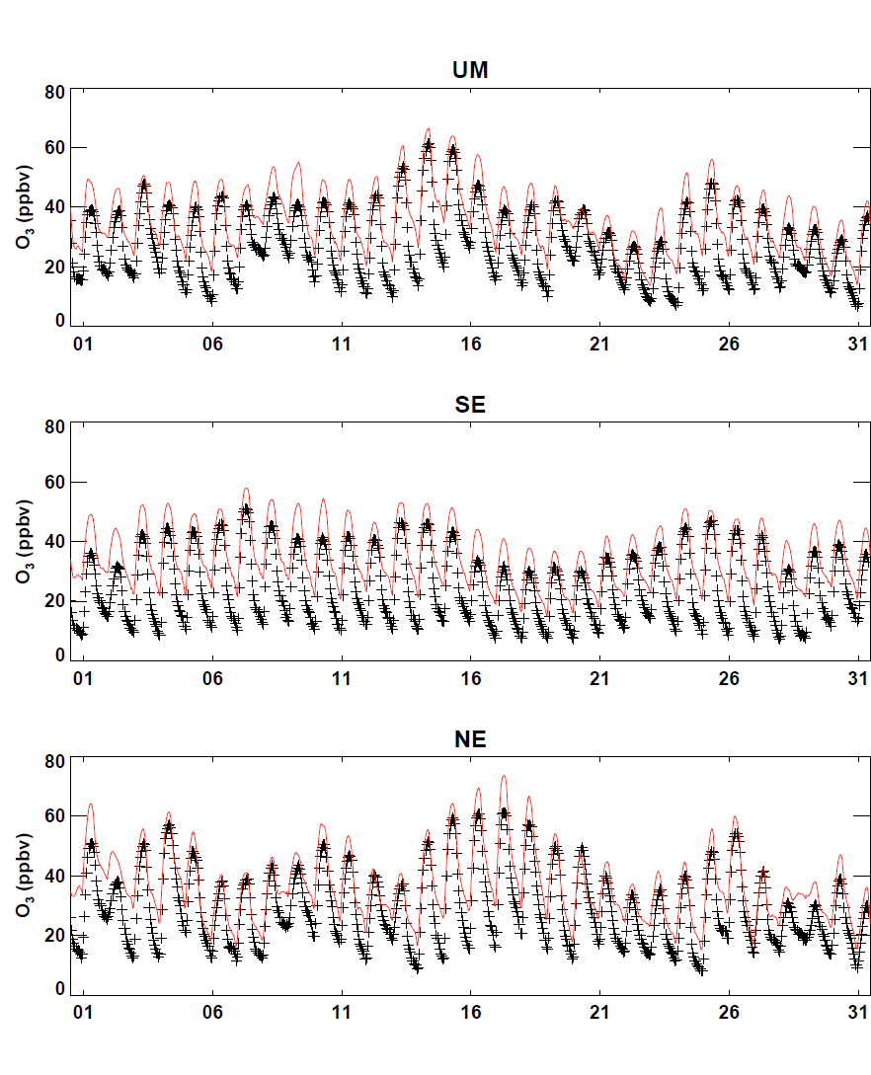
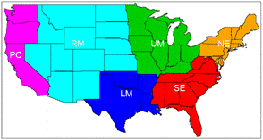
AIRNow and Model: surface O₃
Black line: O₃ observation from AIRNow
Red line: O₃ simulation from CMAQ
O₃ overpredictions are shown over the CONUS region, but particularly over the Southeastern and Northeastern US.

Slide 4
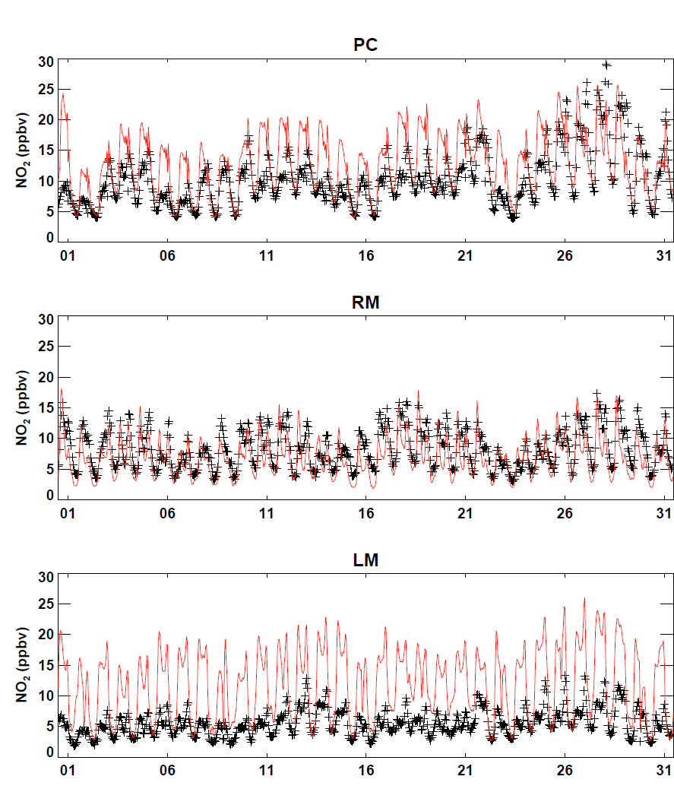
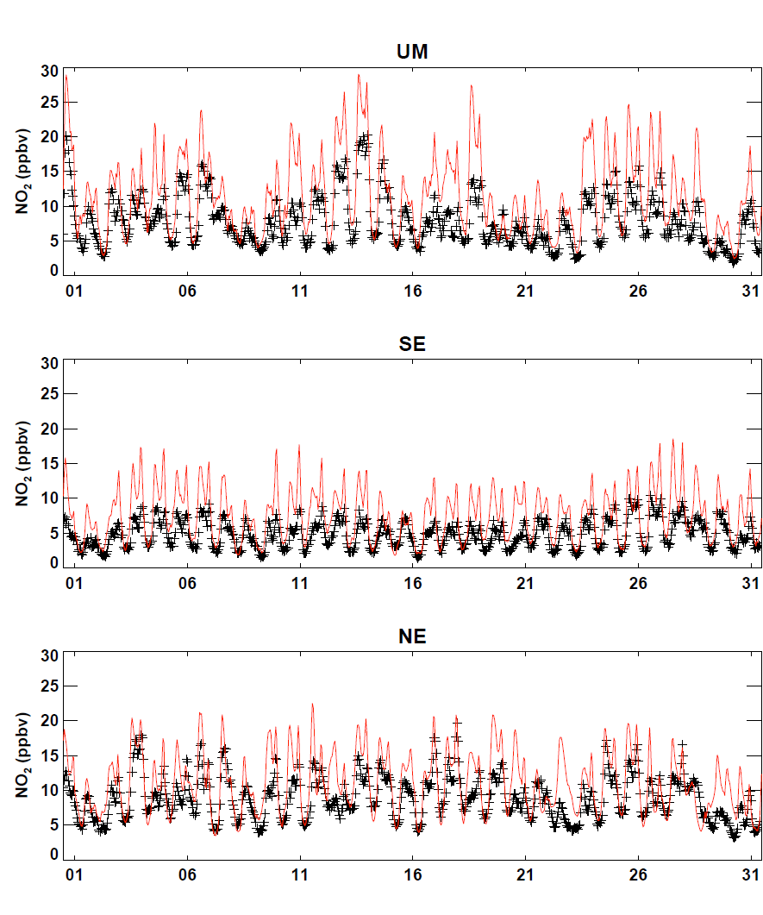
AIRNow and Model: surface NO₂
Black line: NO₂ observation from AIRNow
Red line: NO₂ simulation from CMAQ
Except LM (large overprediction) region, the model reasonably simulates the surface NO₂ variation with some biases.

Slide 5
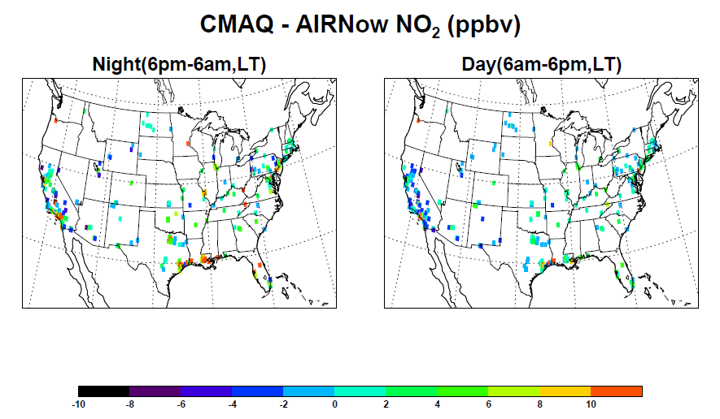
Surface NO₂ difference

Slide 6
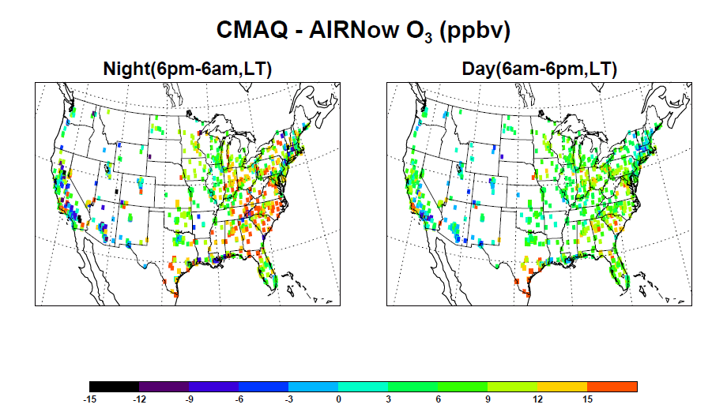
Surface O₃ difference

Slide 7
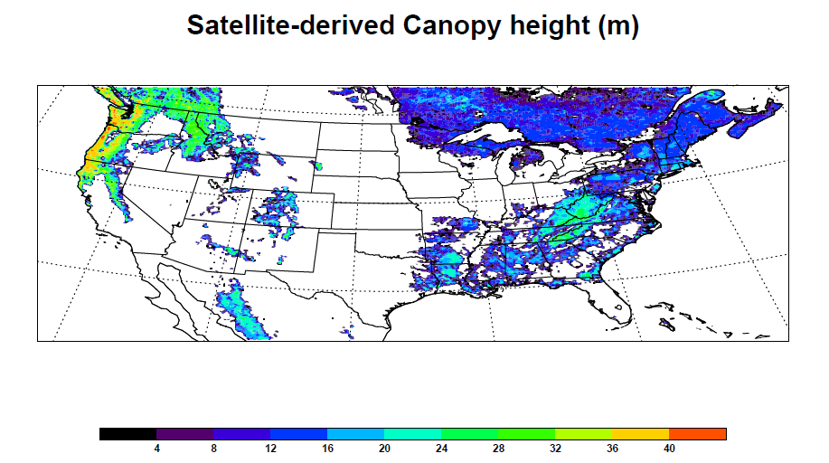
Forest canopy heights over the US
Forest canopy heights based on data collected by NASA’s ICESat, Terra and Aqua satellites [M. Lefsky et al., 2010].
Some O₃ overpredictions are shown over the forested regions.

Slide 8
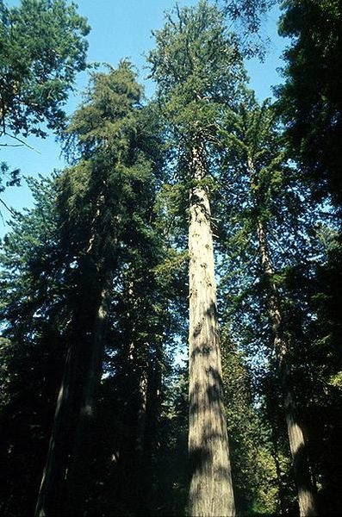
O₃ deposition
Z1: Roughness length
Z2: Height of the first layer
U: Surface friction velocity
Ψ: Stability function
The deposited distance is reduced (Z1 increase), thus the estimated ra values are reduced.

Slide 9
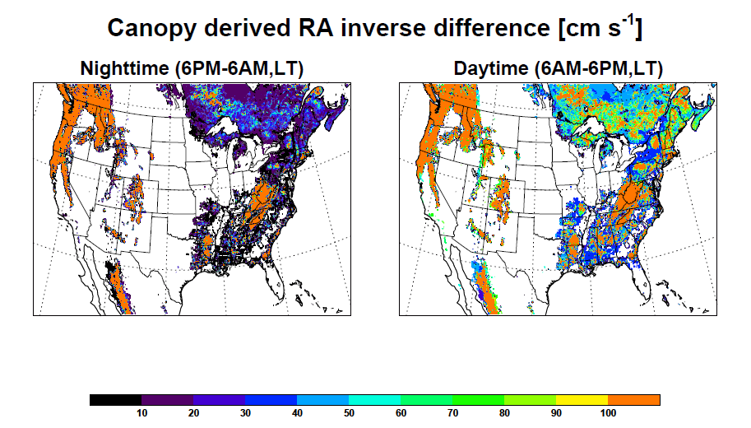
Canopy height-derived Ra difference
The estimated Ra values from the model implementing canopy heights are significantly reduced, so that surface O₃ is efficiently deposited over the forested regions.

Slide 10
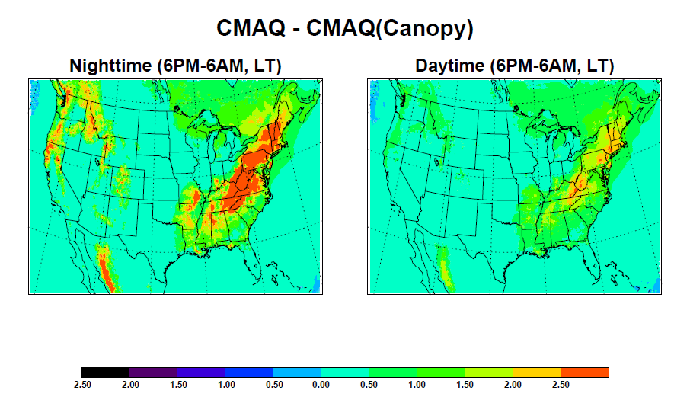
Surface O₃ change
The surface O₃ is reduced over the forested regions and its outflow regions (<5 ppbv over the forested regions).
The reduced O₃ amounts during the nighttime are larger than those during the daytime.

Slide 11
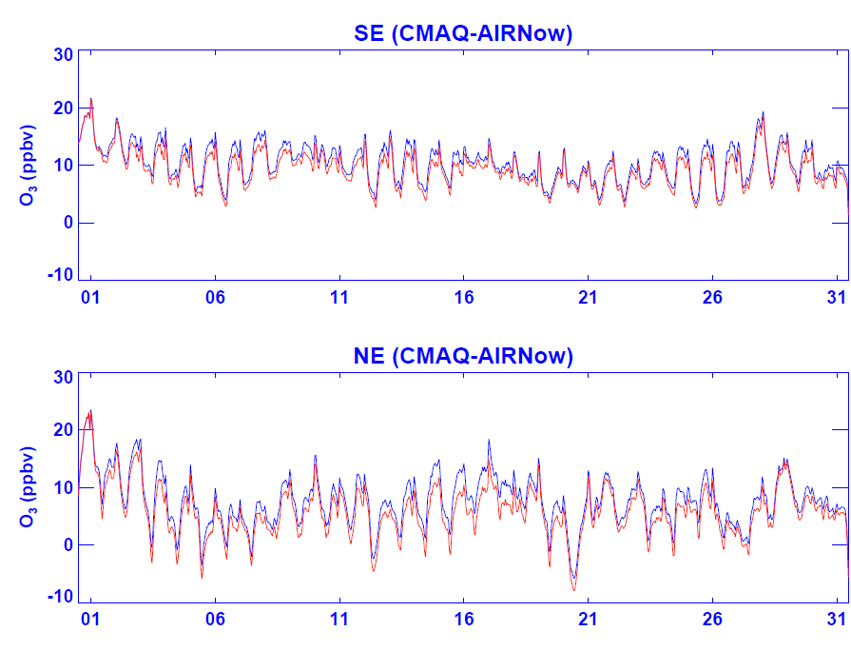
O₃ biases from two CMAQ runs
Blues lines: Standard Model-AIRNow
Red lines: Canopy Model-AIRNow
Model simulated O₃ is reduced over the Southeastern and Northeastern US by implementing satellite-derived canopy heights, but the model still significantly overpredicts surface O₃ concentrations over the southeastern US. Why? How is the chemical environment different from two regions?

Slide 12
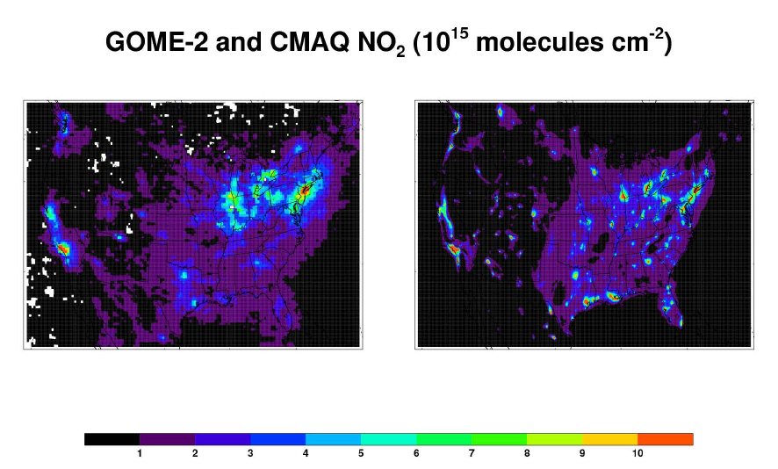
GOME-2 NO₂ column
GOME-2 data [Boersma, et al., 2004] have cell-size 0.25 degree and are from the site, http://www.temis.nl/airpollution/no2.html.
CMAQ -simulated NO₂ columns are averaged for the local overpassing hours (9-10 a.m. LT).
Model overpredicts NO₂ columns over the urban regions, but the comparisons between model and GOME-2 reasonably match over the rural region

Slide 13
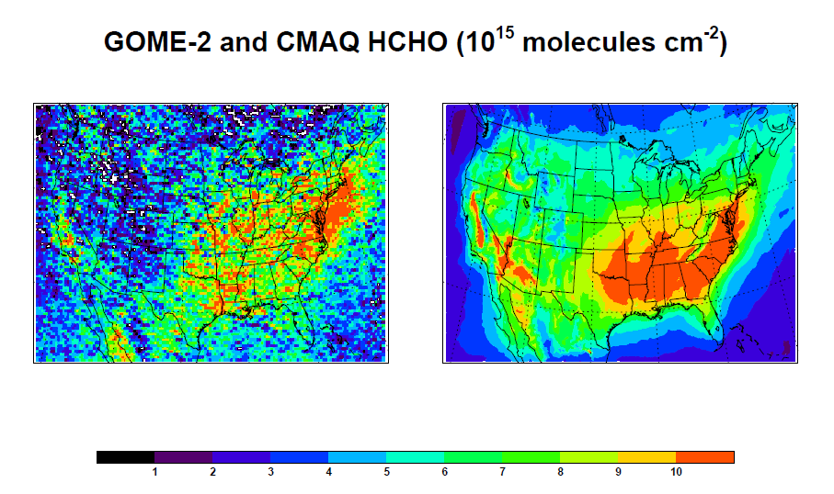
GOME-2 HCHO column
GOME-2 data [Smedt et al., 2008] have 0.25 degree cell size, are filtered out (cloud fraction <=40%) and are from the site, http://www.temis.nl/airpollution/ch2o.html.
CMAQ HCHO columns are averaged for the local overpassing hours (9-10 a.m., LT).
Model overpredicts HCHO column over the SE (biogenic signal) of US, but GOME-2 HCHO columns are larger than those of model over the NE coastal regions (anthropogenic signal).

Slide 14
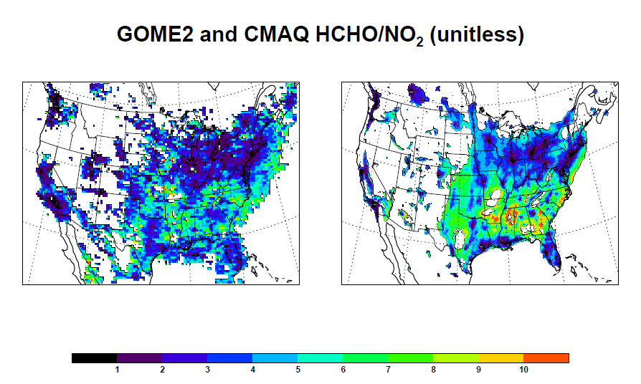
GOME-2 HCHO/NO₂
GOME-2 NO₂ Data (having <10¹⁵ molecules/cm²) are filtered out.
HCHO/NO₂ (proxy for VOC/NOx) from satellite (GOME-2) and model (CMAQ) gives NOx-sensitive (high HCHO/NO₂ >2.0) and NOx-saturated (low HCHO/NO₂ < 1.0 [Martin et al, 2004; Duncan et al, 2010]) regions.

Slide 15
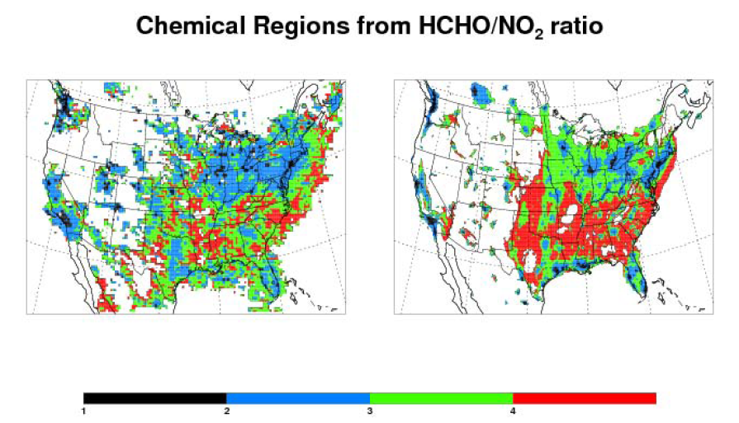
Chemical regions: 4 categories
Category 1: HCHO/NO₂ < 1, Black-colored
Category 2: 1 < HCHO/NO₂ < 3, Blue-colored
Category 3: 3 < HCHO/NO₂ < 5, Green-colored
Category 4: HCHO/NO₂ > 5, Red-colored
GOME-2 NO₂ data (having <10¹⁵ molecules/cm²) are filtered out.
High NOx-sensitive regions in CMAQ are broader than satellite-determined regions.

Slide 16
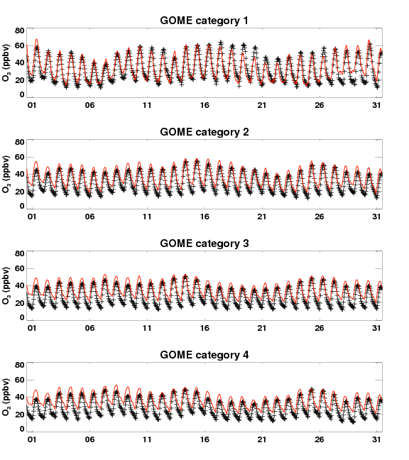
Chemical regions: 4 categories
Category 1: HCHO/NO₂ < 1, Black-colored
Category 2: 1 < HCHO/NO₂ < 3, Blue-colored
Category 3: 3 < HCHO/NO₂ < 5, Green-colored
Category 4: HCHO/NO₂ > 5, Red-colored
CMAQ reasonably captures the daily variation over satellite-derived category 1 region, but CMAQ overpredicts surface O₃ over the category 2-4 regions. Multi-day variations over the category regions (1 and 2) are different from over category regions (3 and 4).

Slide 17
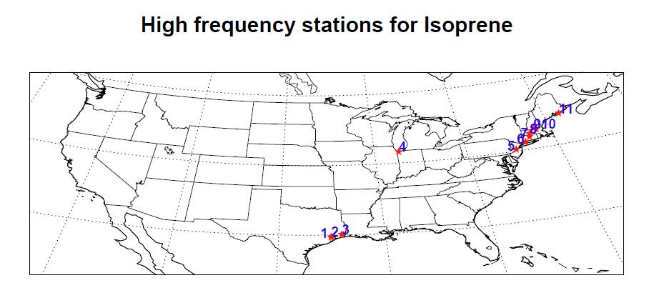
PAMS sites over Houston and Beaumont

Slide 18
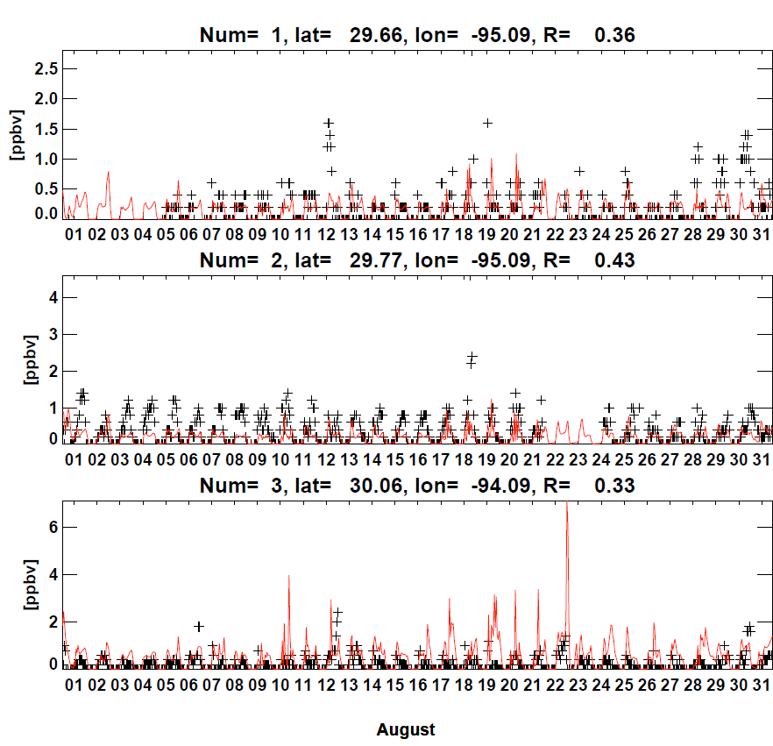
Isoprene over Houston and Beaumont
CMAQ slightly underpredicts isoprene over Hourston, but overpredicts it over Beaumont, compared with PAMS isoprene observations. GOME-2-derived categories give higher NOx-sensitive regions compared with model-derived ones (2, 2, 3 versus 1, 1, 1).

Slide 19
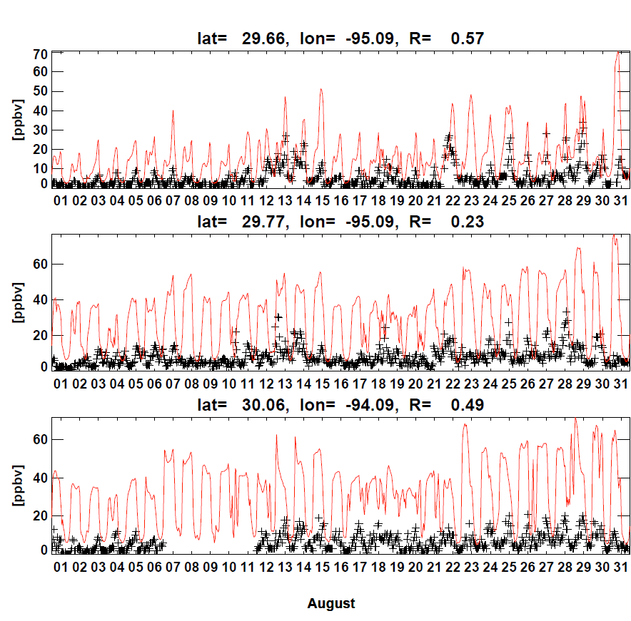
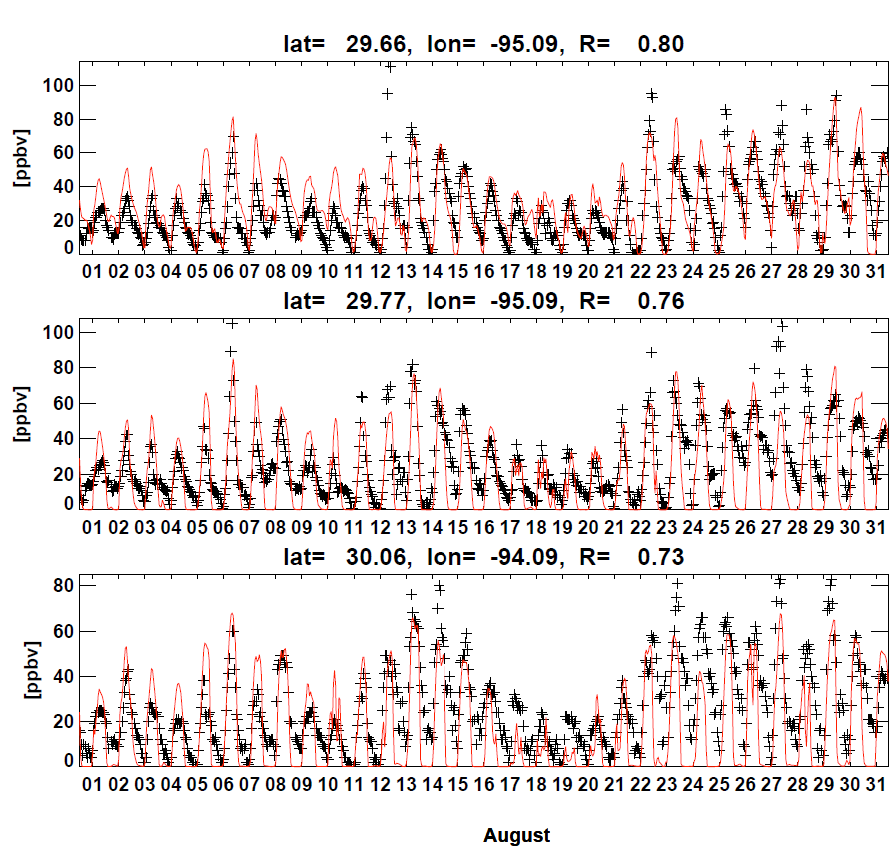
NO₂ and O₃ over Houston and Beaumont
CMAQ overpredicts NO₂ over Houston and Beaumont, but don’t show any overpredictions of surface O₃ over the regions because model identifies theses regions as NOx-saturated region.

Slide 20
Conclusion and plan
CMAQ overpredicts surface O₃ over the Eastern US during summer.
Canopy height reduces the deposited distance and in turn reduce aerodynamic resistance and surface O₃ over the forested regions.
O₃ overpredictions are larger over the Eastern US partly due to the simulation of more NOx-sensitive region in CMAQ.
More NOx-sensitive regions might be more biogenic VOC emissions (particularly over the Southeastern US).
Detailed O₃(aerosol) chemistry study is being (will be) studied over the chemical regions.

