Slide 1
Assimilation of MODIS Aerosol Optical Depth for Improving CMAQ PM2.5 Simulation
Tianfeng Chai ^{1,2}, Hyun-Cheol Kim ^{1,2}, Daniel Tong ^{1,2},
Pius Lee ², Daewon W. Byun ²
1, Earth Resources Technology, Laurel, MD
2, NOAA OAR/ARL, Silver Spring, MD

Slide 2
Introduction
CMAQ PM2.5 predictions are much worse than ozone predictions during the NAQFC experimental runs
At the current stage, constraining the model input parameters such as emissions, initial conditions, and boundary conditions is important, while CMAQ model itself, including its chemical mechanism and aerosol dynamics, needs improvement
Satellite data provides near real time observations with good spatial resolution and coverage.

Slide 3
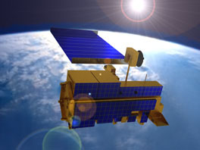
MODIS (Moderate Resolution Imaging Spectroradiometer)
Orbit: | 705 km, 10:30 a.m. descending node (Terra) or 1:30 p.m. ascending node (Aqua), sun-synchronous, near-polar, circular
Swath Dimensions: | 2330 km (cross track) by 10 km (along track at nadir)
Spatial Resolution: | 250 m (bands 1-2) 500 m (bands 3-7) 1000 m (bands 8-36)
http://terra.nasa.gov/About/

Slide 4
Data Assimilation Methods
Optimal interpolation (OI)
  Easy to apply, computationally efficient
3D-Var
  Adjusts all variables in the whole domain simultaneously. Currently, GSI is being developed at NOAA/NASA/NCAR
4D-Var
  Provides more flexibility, requires adjoint model
Kalman Filter

Slide 5
Optimal Interpolation (OI)
OI is a sequential data assimilation method. At each time step, we solve an analysis problem
We assume observations far away (beyond background error correlation length scale) have no effect in the analysis
In the current study, the data injection takes place at 1700Z daily

Slide 6
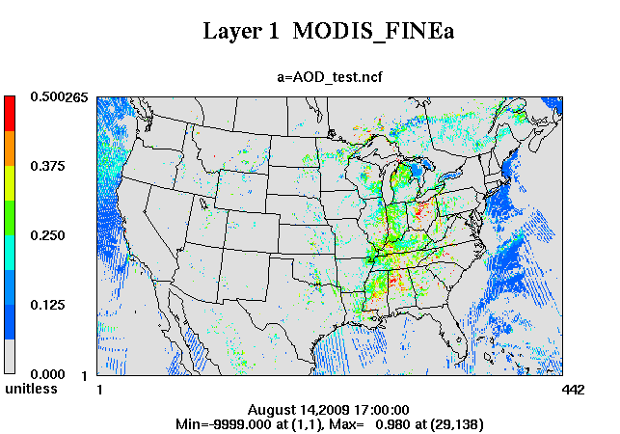
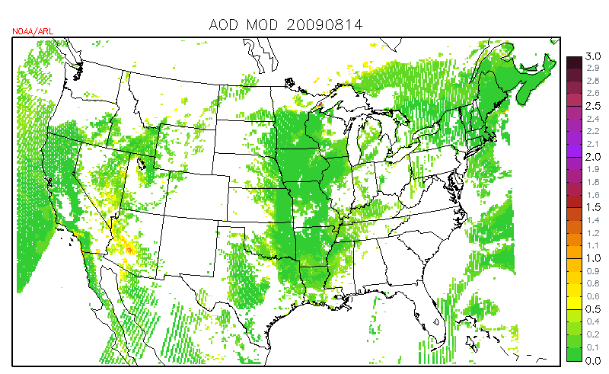
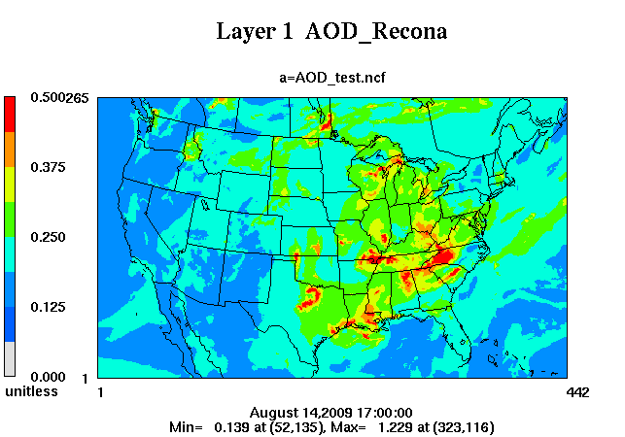
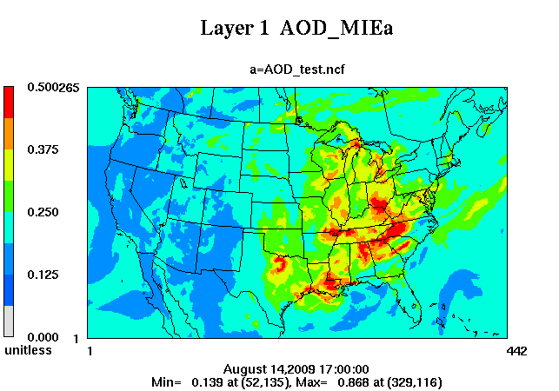
MODIS & CMAQ AOD

Slide 7
AOD Comparison

Slide 8
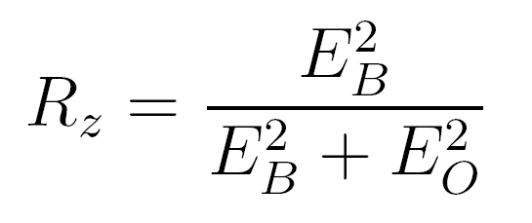
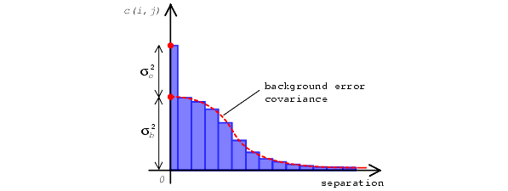
Estimate Model Error Statistics w/ Hollingsworth-Lonnberg Method
At each data point, calculate differences between forecasts (B) and observations (O)
Pair up data points, and calculate the correlation coefficients between the two time series
Plot the correlation as a function of the distance between the two stations,
Notes:
Calculate differences between forecasts (B) and observations (O) at each AIRNOW station as a time series
Pair up AIRNOW stations, and calculate the correlation coefficients between the two time series at the paired stations
Plot the correlation as a function of the distance between the two stations,
Intercept Rz can be used to calculate the ratio between model error (EB) and and observational error (including representative error)
Horizontal length scale can be inferred as well

Slide 9
Horizontal Error Statistics
Rz:
~ 0.9
E_{B}²/ Eo²:
~ 9
Correlation length:
~ 160 km

Slide 10
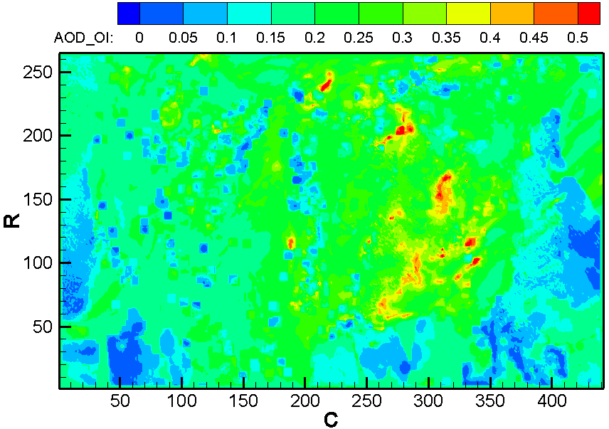
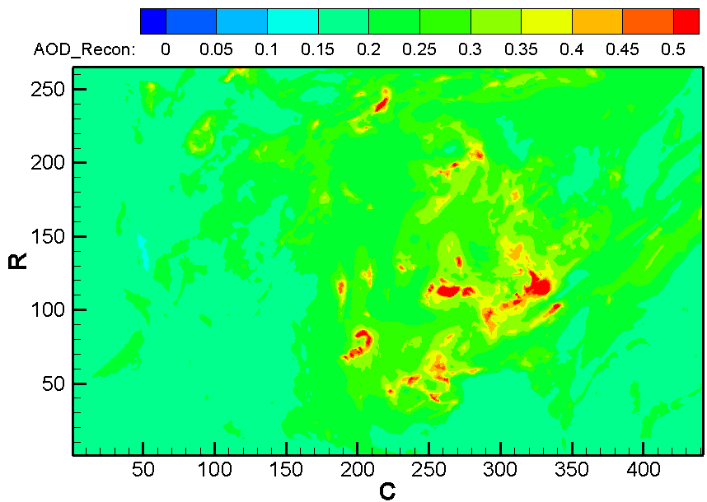
8/14/2009
Observation Input
OI
Background Input
Analysis output

Slide 11
Use AOD Analysis/Background as Scaling Factors
Variables to be adjusted:
VSO4AI, VSO4AJ,
VNO3AI, VNO3AJ, VNH4AI, VNH4AJ, VORGAI, VORGAJ, VORGPAI, VORGPAJ, VORGBAI, VORGBAJ,
VECI, VECJ,
VP25AI, VP25AJ

Slide 12
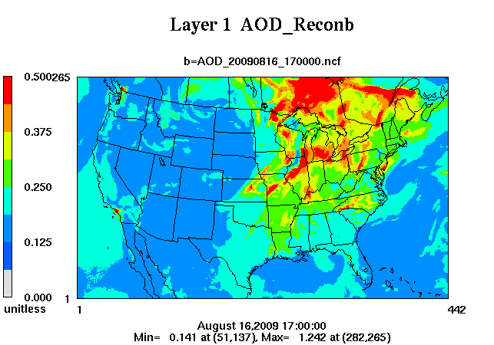
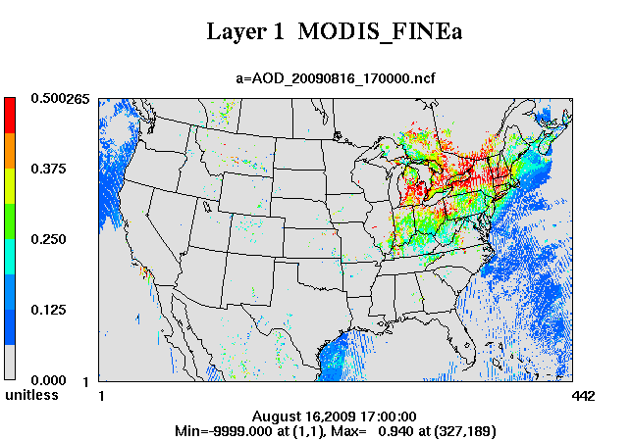
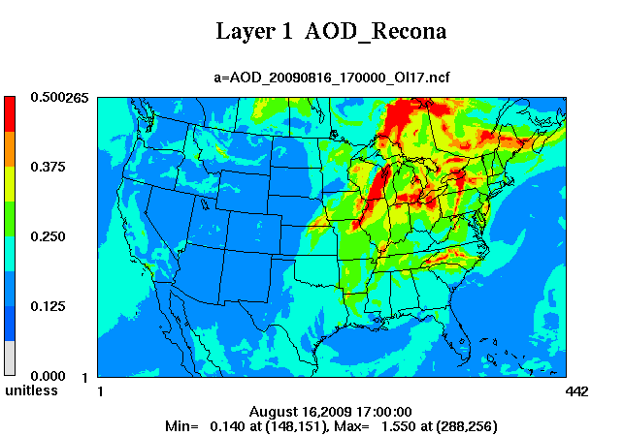
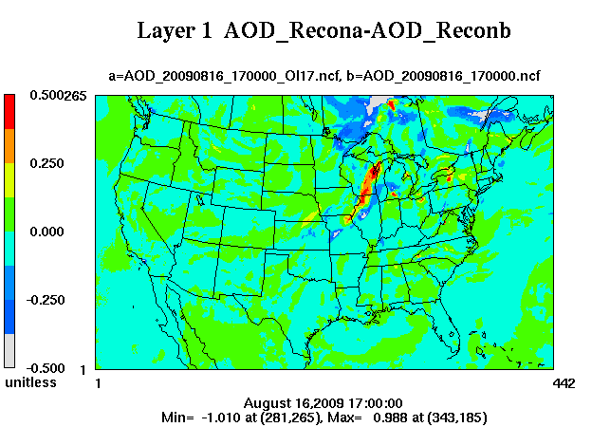

Slide 13
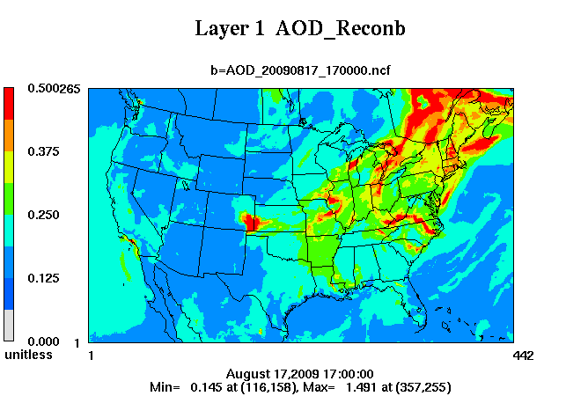
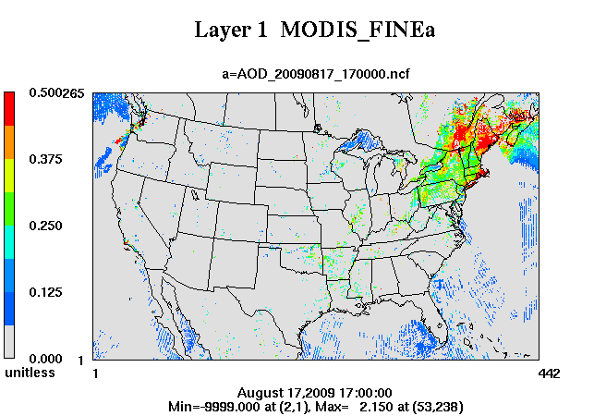
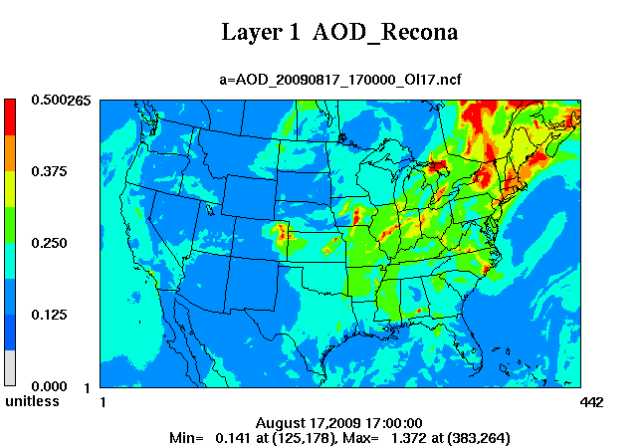
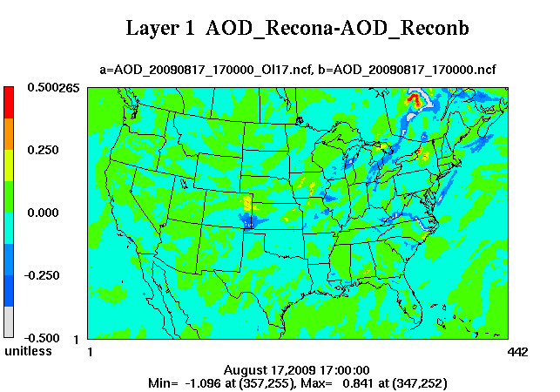

Slide 14
8/16/2009
Base: R²=0.605
OI: R²=0.573
8/17/2009
Base: R²=0.445
OI: R²=0.504
Notes:
Red: base, blue: OI17
Top: 8/16, bottom 8/17

Slide 15
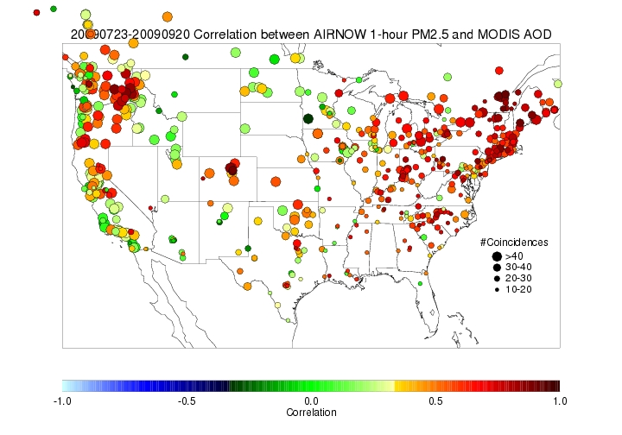
MODIS AOD and AIRNOW PM2.5 Correlation
http://www.star.nesdis.noaa.gov/smcd/spb/aq/

Slide 16
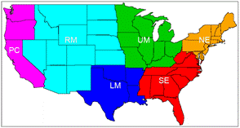
Rock Mountain Region | Upper Midwest | Northeast US
Pacific Coast Region | Lower Midwest | Southeast US

Slide 17
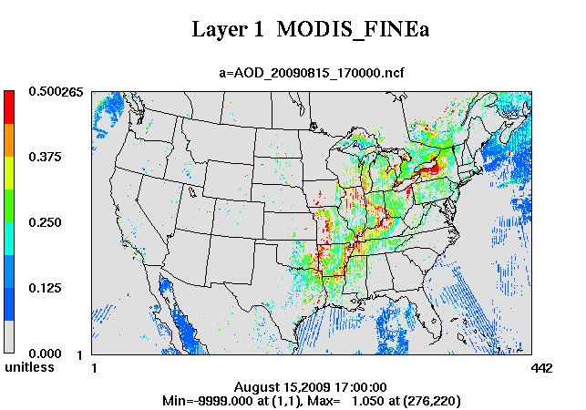
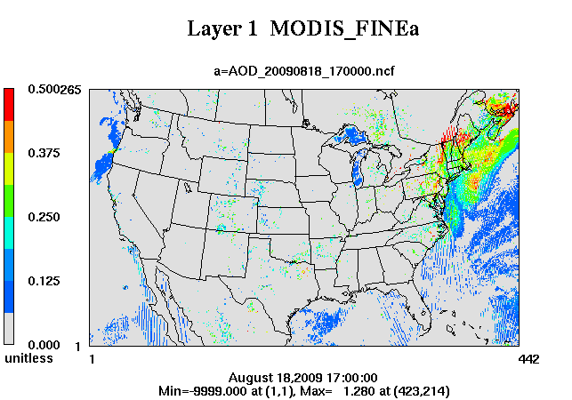
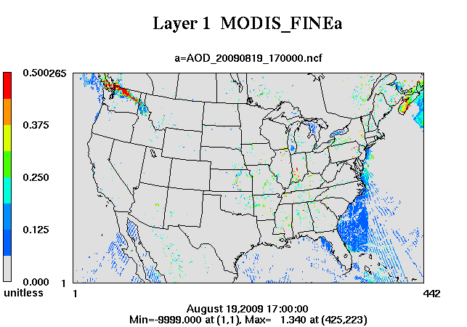
Availability of MODIS data during 8/14-19, 2009

Slide 18
Correlation between predicted and observed PM2.5 at 17Z in Upper Midwest
R² | 8/15/09 | 8/16/09 | 8/17/09 | 8/18/09 | 8/19/09 | 8/20/09
Base | 0.420 | 0.138 | 0.355 | 0.154 | 0.234 | 0.021
OI | 0.399 | 0.178 | 0.311 | 0.180 | 0.270 | 0.041
Correlation between predicted and observed PM2.5 at 17Z in Northeast US
R² | 8/15/09 | 8/16/09 | 8/17/09 | 8/18/09 | 8/19/09 | 8/20/09
Base | 0.253 | 0.416 | 0.097 | 0.070 | 0.156 | 0.217
OI | 0.306 | 0.367 | 0.110 | 0.207 | 0.171 | 0.206

Slide 19
Summary and future work
Assimilating MODIS AOD using OI method is able to improve AOD and PM2.5 predictions in selected regions. The improvement is not significant.
Assimilating both MODIS AOD and AIRNow PM2.5 is expected to have better results and will be tested.
Using data assimilation methods to adjusting emissions will be studied in the future.
The same method will be tested with CMAQ 4.7
3D-Var and 4D-Var methods will be explored

