Slide 1
Simulation of Deep Water Horizon
Gulf of Mexico Oil Spill Impact on Air Quality:
Estimating air emissions with incomplete information
NOAA ARL Air QUality and Emissions Sciences Team
Daewon W. Byun
Hyun-Cheol Kim, Pius lee, Daniel Tong, Yunsoo Choi, Yunhee Kim
Fong Ngan, Rick Saylor, Ariel Stein, Tianfeng Chai
NOAA ESRL CSD
Tom Ryerson, Jim Roberts, Ravishankara, others
Acknowledgment:
Oil burn data and the pictures from US Coast Guard & BP

Slide 2
Background
Oil spilt from a well at the ocean floor following the explosion of Deep Water Horizon offshore oil platform and subsequent sinking from April 20, 2010 for 87 days
~1 mile below sea level, ~ 40 miles off Louisiana coast
Location: Latitude: 28° 44.20' N, Longitude: 88° 23.23' W
Large uncertainties related with oil budget components
Air quality concerns are due to smoke from burning of skimmed oil, flaring of the fuels directly from well pipe, and evaporative emissions from oil slick

Slide 3
Research Objectives
Understand importance of atmospheric pathways compared to other degradation and removal routes of oil spilt
Develop methods to prepare emission inputs associated with DWH incident
Simulate over the entire oil spill event to study impact on regional air quality over SE US
Study distribution and fate of oil spill related air pollutants
subject to uncertainties in emission inputs

Slide 4
Issues
What emission sources must be considered?
What information is available for estimating emissions for air quality modeling?
How to handle uncertain information from unconventional sources?
What to prepare for the future incidents?
observation data needed
Readiness of modeling and analysis systems
Objectives of Today’s presentation
Share preliminary air quality modeling effort
Solicit helps to improve emission estimates and analyses

Slide 5
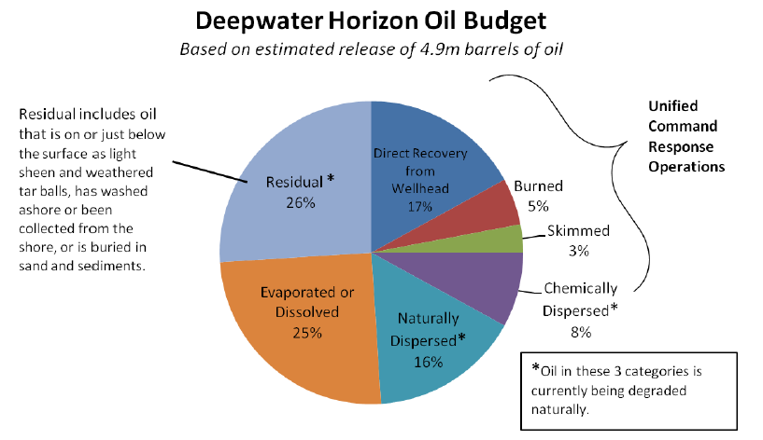
DWH Oil Budget – Controversies…
Including “flared”
From “working paper” by National Commission on DWH oil spill
Still we do not know how much came out, where they went, and how much remaining…

Slide 6
Non-regular emission inputs for DWH air quality modeling
Regular AQ model inventory plus
Evaporation from oil slick
Skimmed oil burn
Burner flares (Q4000 & Discovery Enterprise)
-------------------------------------------
Wildfire emissions in US
---------------<<below not treated yet>> ----------------
Ship emissions for the DWH activities
Natural seepage in GOM (~4,000-17,000 t/yr) (1 b/d = 50 t/yr)
Initial explosion (~700,000 gallons of diesel + unknown amount of natural gas) (1 barrel = 42 gallons)
Mexican/Central American wildfire

Slide 7
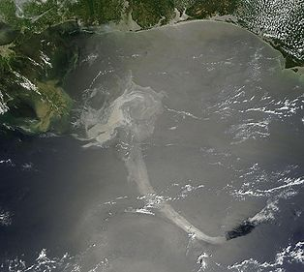
Estimating evaporative emissions from oil slick
NOAA NOS OR&R (National Ocean Service / Office of Response and Restoration) oil slick trajectory model results, initialized with satellite data
May 17, 20C10
Near Shore map
Off Shore map
SHAPEfiles available

Slide 8
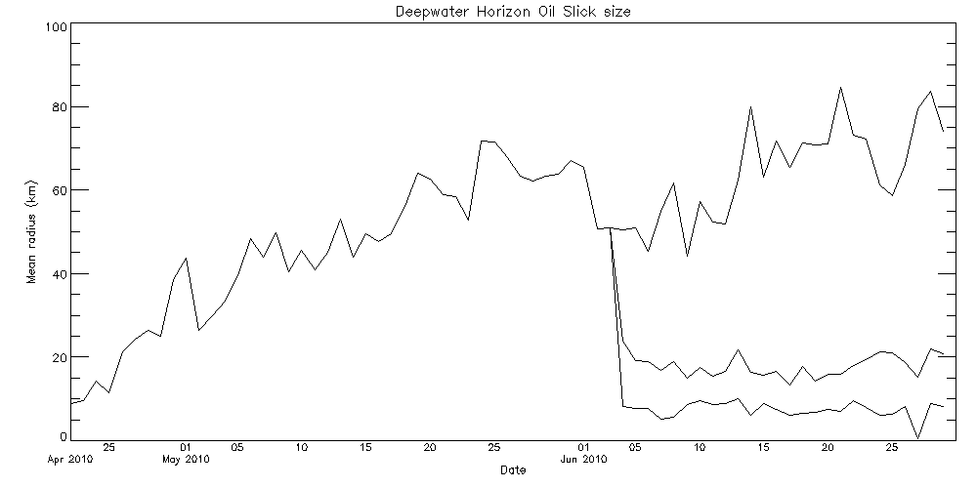
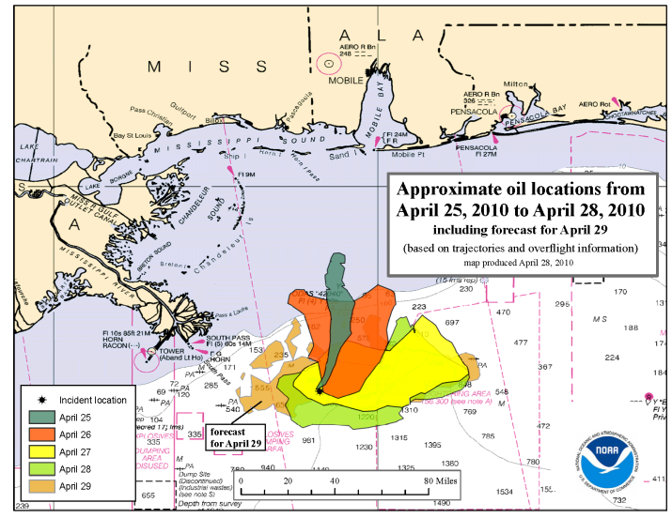
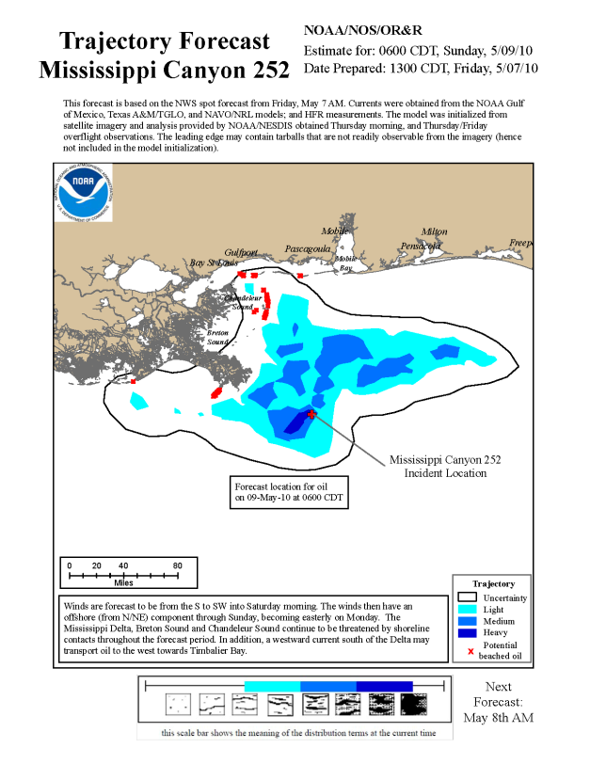
Daily Change of DWH oil slick size estimated from the oil slick map
Equivalent area of half circle radius (April 22- June 30)
Approach:
Estimated fresh oil amount in the slicks for different slick types
Approximate evaporation ratios: 90: 9: 1
Distributed 25% of 4.9M bbl over daily
slick areas
heavy, medium, light

Slide 9
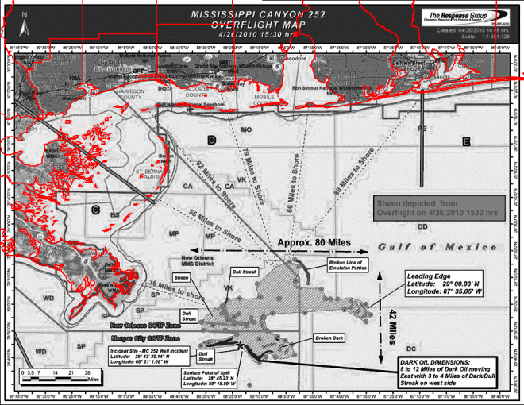
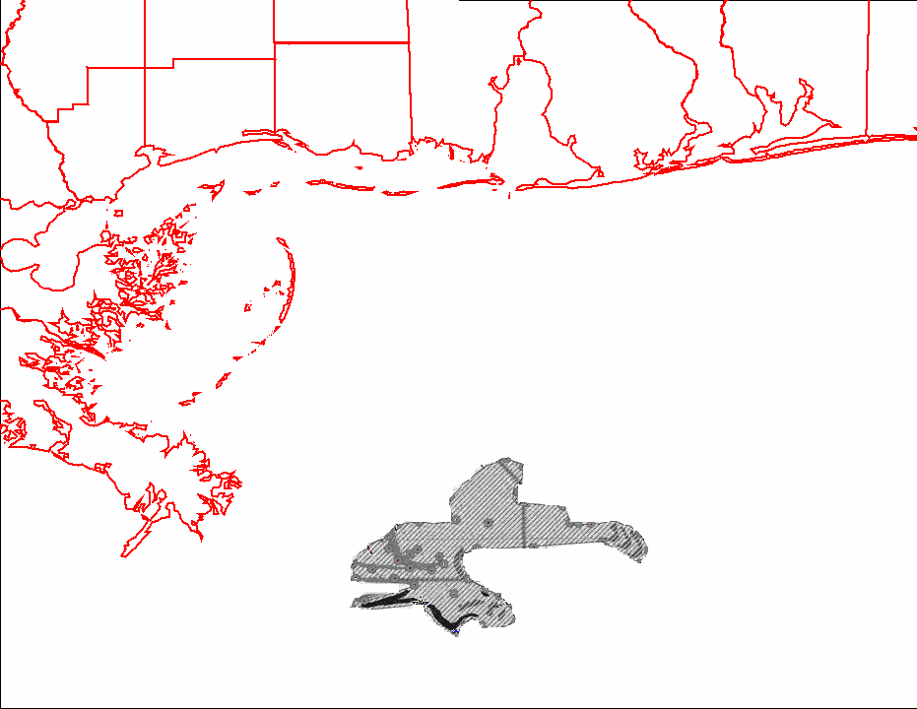
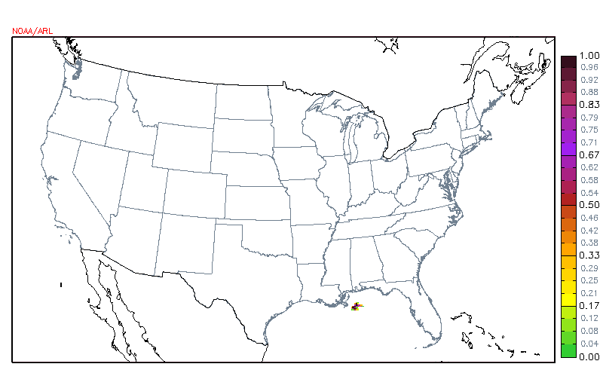
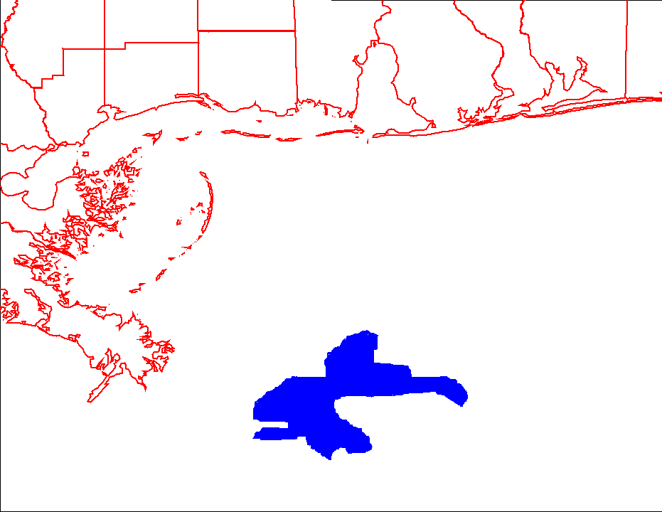
Processing of evaporative emissions using the geospatial data and emission factors
Overlaying shape files on target map projection
Prepare Gridded
Fraction of oil spill shapes
Approach:
Assume 25% of daily discharge is evaporated;
Use a constant mass ratio of toluene over different oil spills (based on literature reviews);
Scale up emission factors of individual species using measurements from NOAA P-3 Flights over the Gulf of Mexico.
Lump emission species into CB05 mechanism species to match the CMAQ model configuration.
Multiply with emission factors for species
Combine with “routine” emissions for AQ modeling

Slide 10
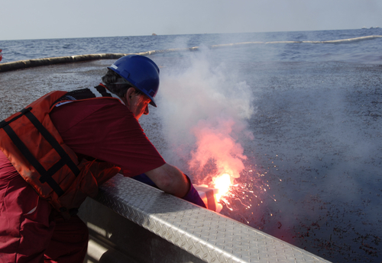
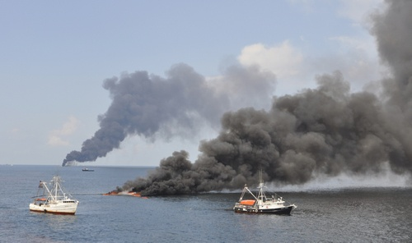
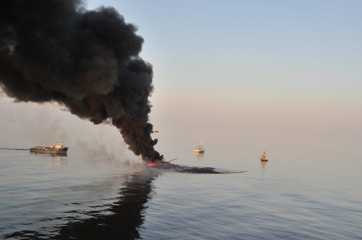
Emissions from controlled burn
Gulf of Mexico (GOM) marine PBL: ~300-500 m
Acknowledgment:
All pictures from USCG!

Slide 11
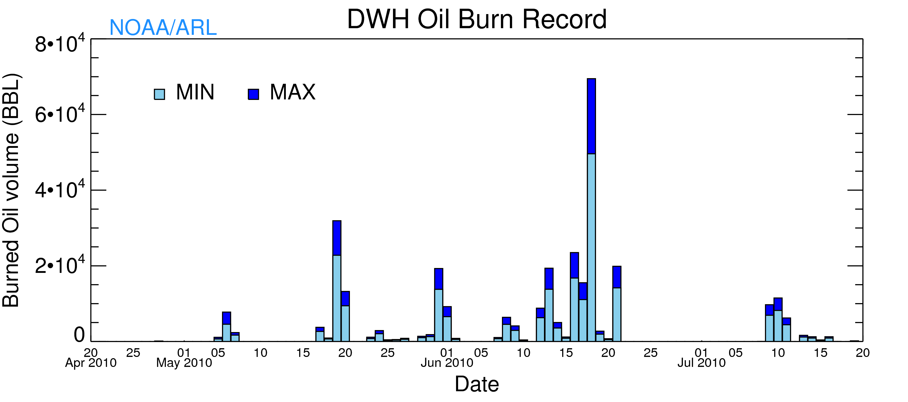
DWH Oil burn amount
Original data from USCG & BP
Total estimation : 219,986 BBL (min) 309,457 BBL (max)

Slide 12
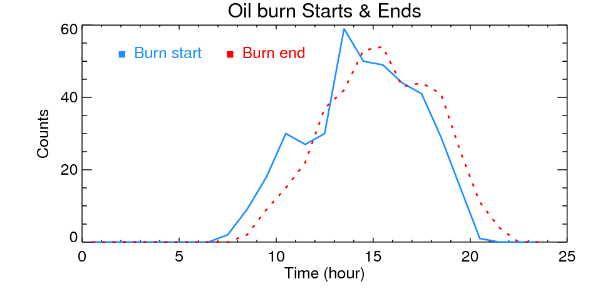
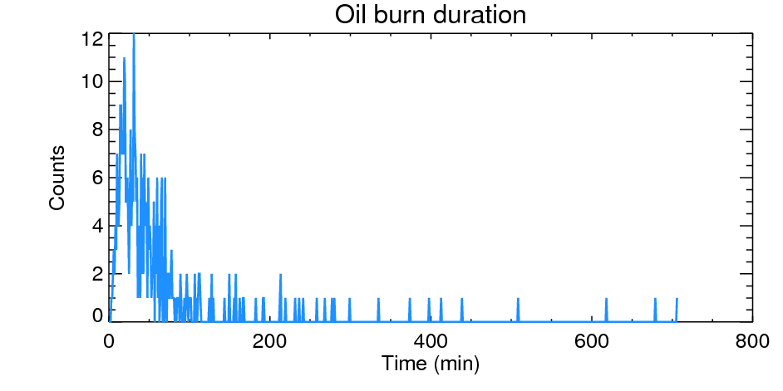
Oil burn start & end times
Emission factors of the control burn
CO₂: 770g carbon per kg oil burn (Ross et al., 1996; Andreae & Merlet 2001);
NOx: use NOx to CO₂ ratio (Ross et al., 1996);
VOCs: 5g VOCs per kg oil burn (Ross et al., 1996);
SO2: use SO2 to CO2 ratio from EPA (1998);
PM_{2.5}: reanalyzed data from Ross et al, 1996.

Slide 13
Chemical Splitting emissions from oil burn
VOC speciation
PM2.5 speciation
Compound | MW-comp | CB05 Species | MW-spec | Mass
Benzene | 84 | Benz | 97.67 | 251
Formaldehyde | 30 | FORM | 30 | 139
acetaldehyde | 44 | ALD2 | 46.75 | 32
acrolein | 58 | ALDX | 38.6 | 11
methyl-ethy-ketone | 83 | UNR | 25.88 | 7
benzaldehyde | 112 | ALDX | 38.6 | 44
isovaleraldehyde | 72.11 | ALDX | 38.6 | 5
p-tolualdehyde | 120 | ALDX | 38.6 | 13
PM2.5; PEC; 75.9%
PM2.5; PMFINE; 10.4%
PM2.5; PNO3; 0.2%
PM2.5; POC; 8.5%
PM2.5; PSO4; 5.5%
(reanalysis from EPA 2002)
Ross et al., 2002
EPA speciate

Slide 14
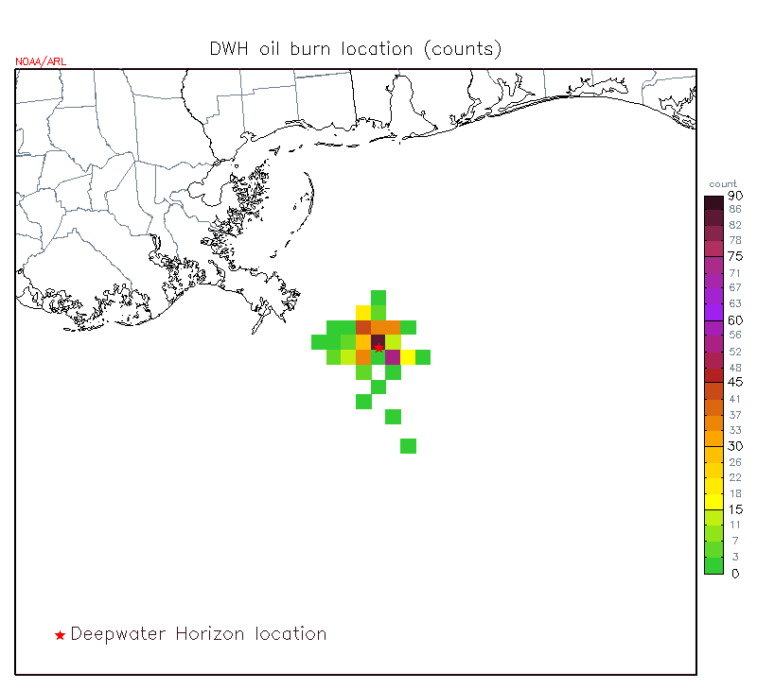
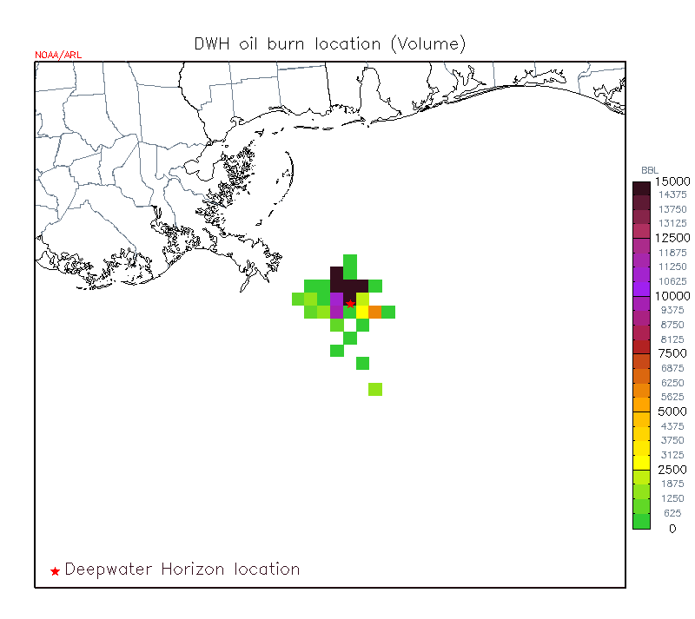
Oil burn locations used for air quality modeling
Burn Counts at each 12x12 km cell
Burn volume (barrels)
90
15000
barrels
60
10000
30
Well location
5000
*within 3 km quarantined
Numbers are gridded into the NAQFC 12km CONUS domain

Slide 15
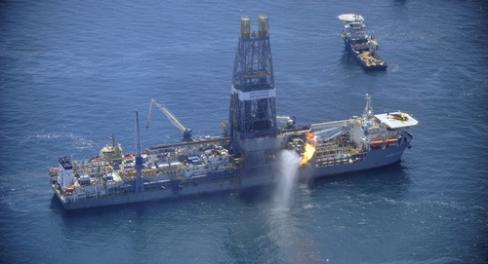
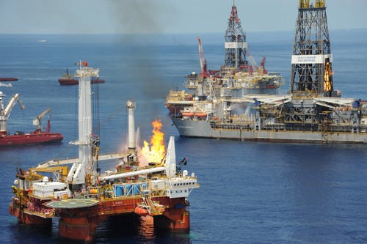
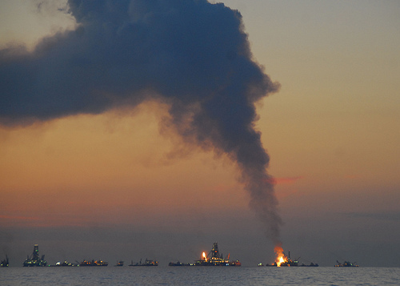
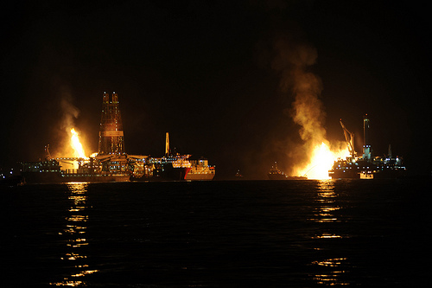
Emissions from flares
Flare from Discovery Enterprise
Flare from Q4000
Flares from Discovery Enterprise & Q4000

Slide 16
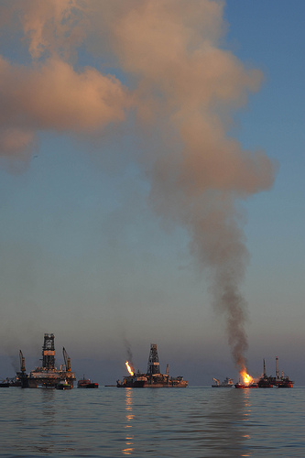
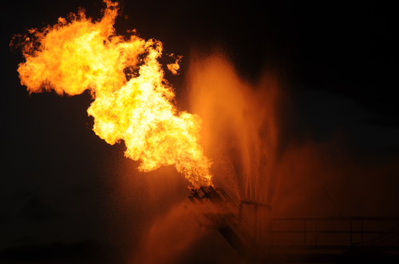
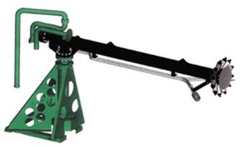
Emissions from flares
Flares – gas & oil burn, mostly clean
Evergreen burner on Q4000– designed to burn at 95% efficiency
Assume most emission are NOx and CO emissions (Ap42, based on BTU estimates)
5% as incomplete burn emission – use the same emission factors as control burns (potential overestimation)

Slide 17
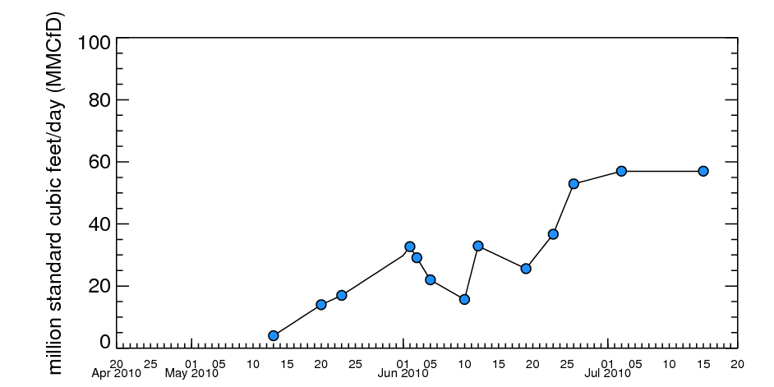
Daily amount of gases flared (from daily briefing, incomplete info.)—interpolated for modeling
Emissions from flares
EF_{NOx} = 0.138 lb / MMBtu = 0.138*1030 lb/MMcf
EF_{CO} = 35 lb / MMscf = 567 mole/MMcf
NOx = 90% NO + 10% NO2
Others: 5% of incomplete burn oil estimated with Barrel (oil) / MMCF (gas) flared (from daily log estimated to be = ~ 150 bbl oil/ MMCF gas)

Slide 18
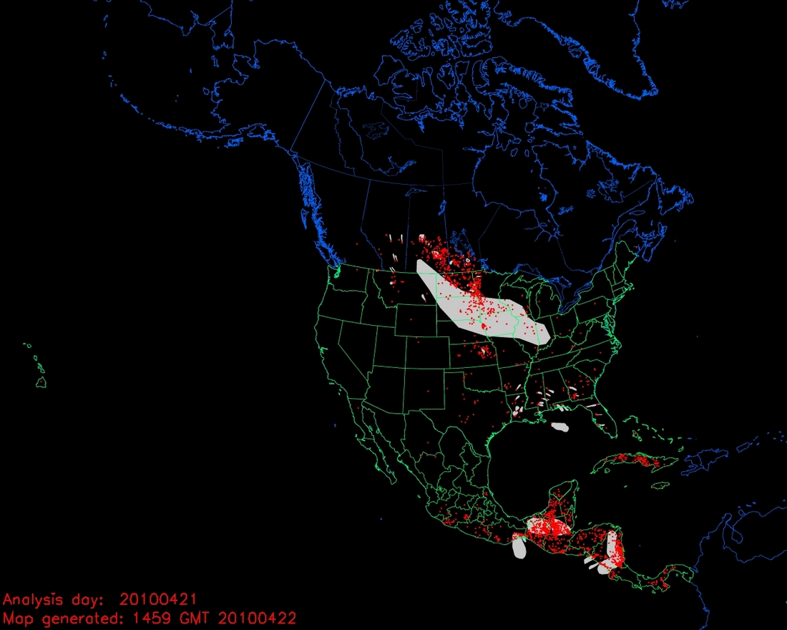
Emissions from other intermittent sources
Frequent forest fires during the DWH oil spill incident: NOAA HMS satellite detected fire data and USDA BlueSky-based emissions utilized
Wildfire (included)
DWH incident
Mexican/Central America wildfires
(not included)
April 21, 2010

Slide 19
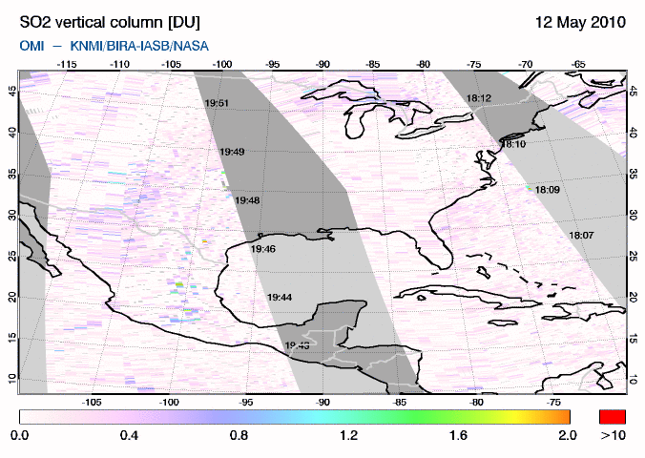
Could we see DWH emissions from satellite?
NESDIS/HMS
OMI
MODIS
How to distinguish contribution from forest fires in Central America?
NA : non absorbing aerosol (e.g., sulfate)
From Yonsei Univ., S. Korea

Slide 20
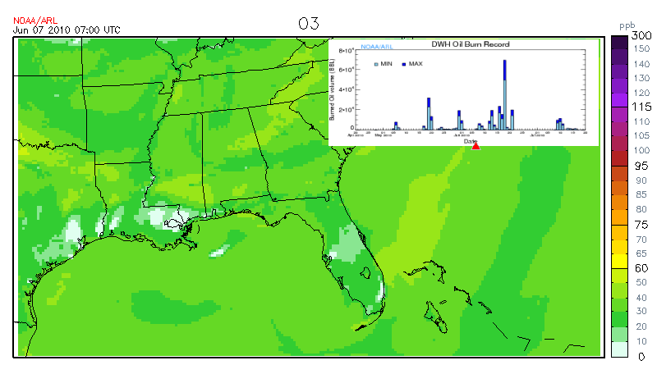
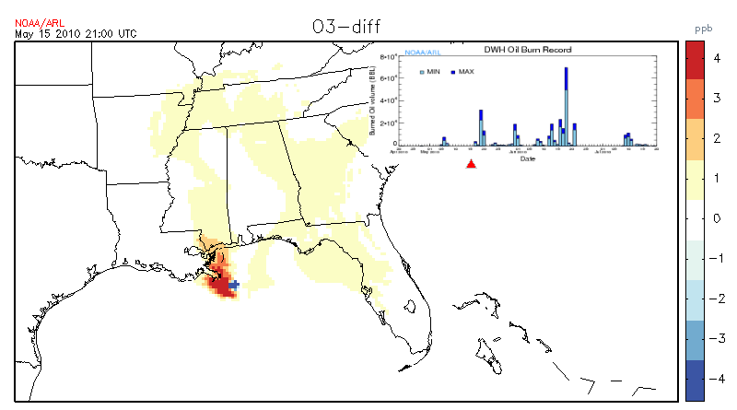
Examples of Preliminary AQ Simulation Results
CMAQ4.7.1 with NMM meteorology (12-km)
Ozone
Nighttime titration
Difference from no episodic emission case
(daytime)

Slide 21
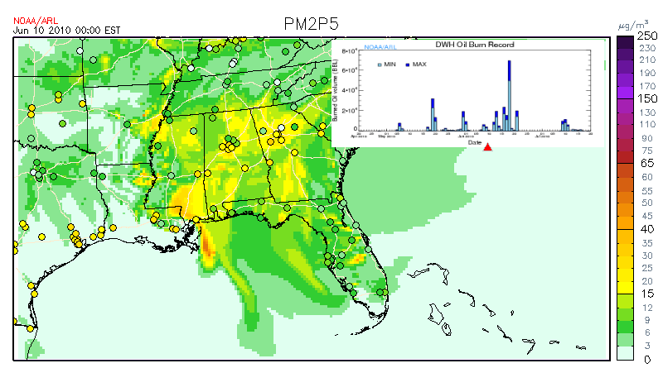
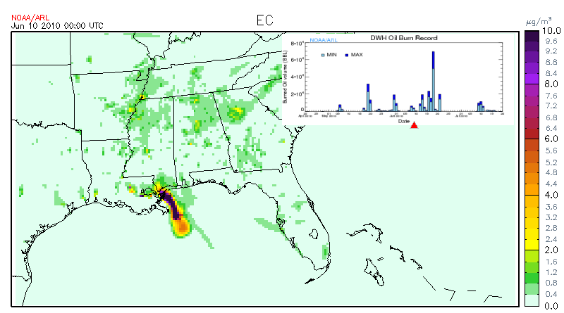
Examples of Preliminary Simulation Results
PM2.5
Elemental Carbon
(soot)

Slide 22
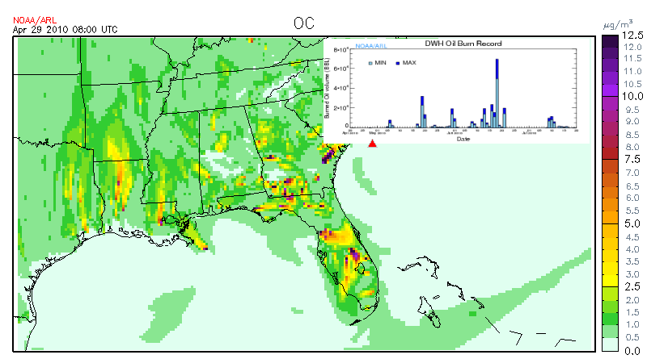
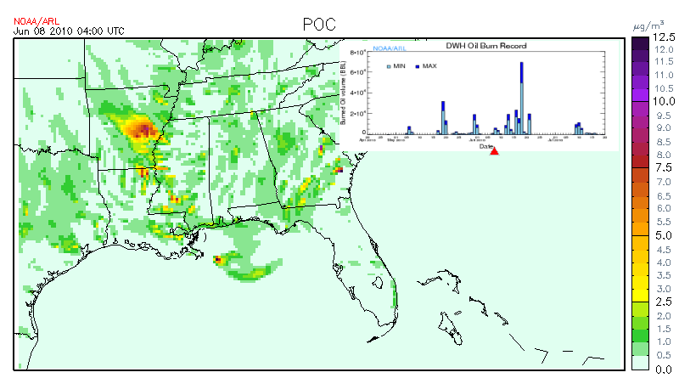
Preliminary Simulation Examples
Organic Carbon
Primary
organic carbon

Slide 23
Conclusive Remarks
(Things to be done)
Showed initial preparations done to study impact of DWH oil spill event on regional air quality
Need to gather additional information and refine methods to estimate emission inputs
Develop multiple emission scenarios to address uncertainties
Compare simulation results with available air quality measurements over the entire oil spill event
Study distribution and fate of oil spill related air pollutants
subject to uncertainties in emission inputs

Slide 24
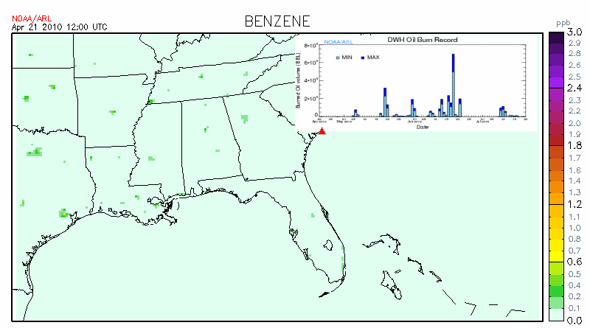
Animation of Simulated Benzene (ppb)

