Slide 1
Evaluation of a Combined Air Quality and Exposure Modeling Study for Detroit, MI
J. Burke¹, K. Wesson², W. Appel¹, A. Vette¹, R. Williams¹
¹US EPA ORD, National Exposure Research Laboratory, Research Triangle Park, NC
²US EPA OAR, Office of Air Quality Planning and Standards, Research Triangle Park, NC

Slide 2
Objectives
Evaluate a combined air quality and exposure model application using measurements from human exposure study in Detroit
Spatial scale to characterize intra-urban variability
CMAQ output
Monitoring data
Determine whether CMAQ captured spatial and temporal variability in measured concentrations, and for which pollutants
Better understand model limitations in accurately predicting air pollutant concentrations and exposures

Slide 3
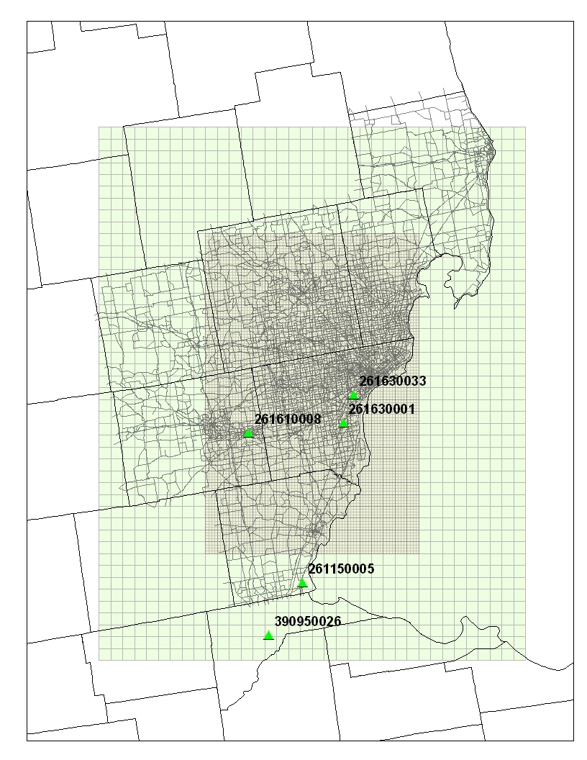
Methods: CMAQ Modeling
4 km domain
CMAQ v4.71 for nested domains across Detroit metropolitan area
12km, 4km & 1km
Criteria & toxic pollutants
2005 emissions and meteorology
Emissions included:
Updates for Detroit urban area processed with SMOKE
Link-based mobile emissions for PM and toxics (CONCEPT)
Spatially allocated 4km & 1km nonpoint emissions using Surrogate Tool
MM5 meteorological data
12km & 4km processed with MCIP v4.3
1km data disaggregated from the 4km MCIP output
Detroit
1 km domain
STN Monitor Locations

Slide 4
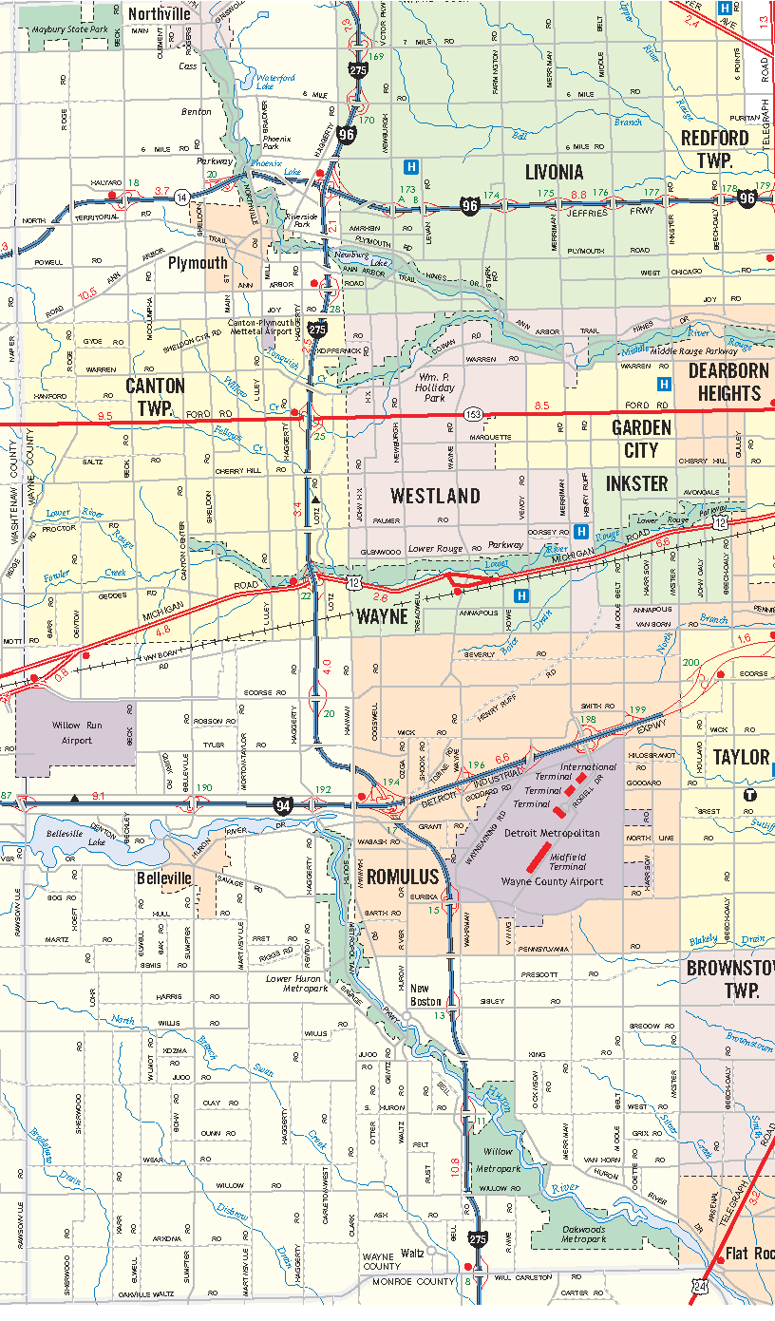
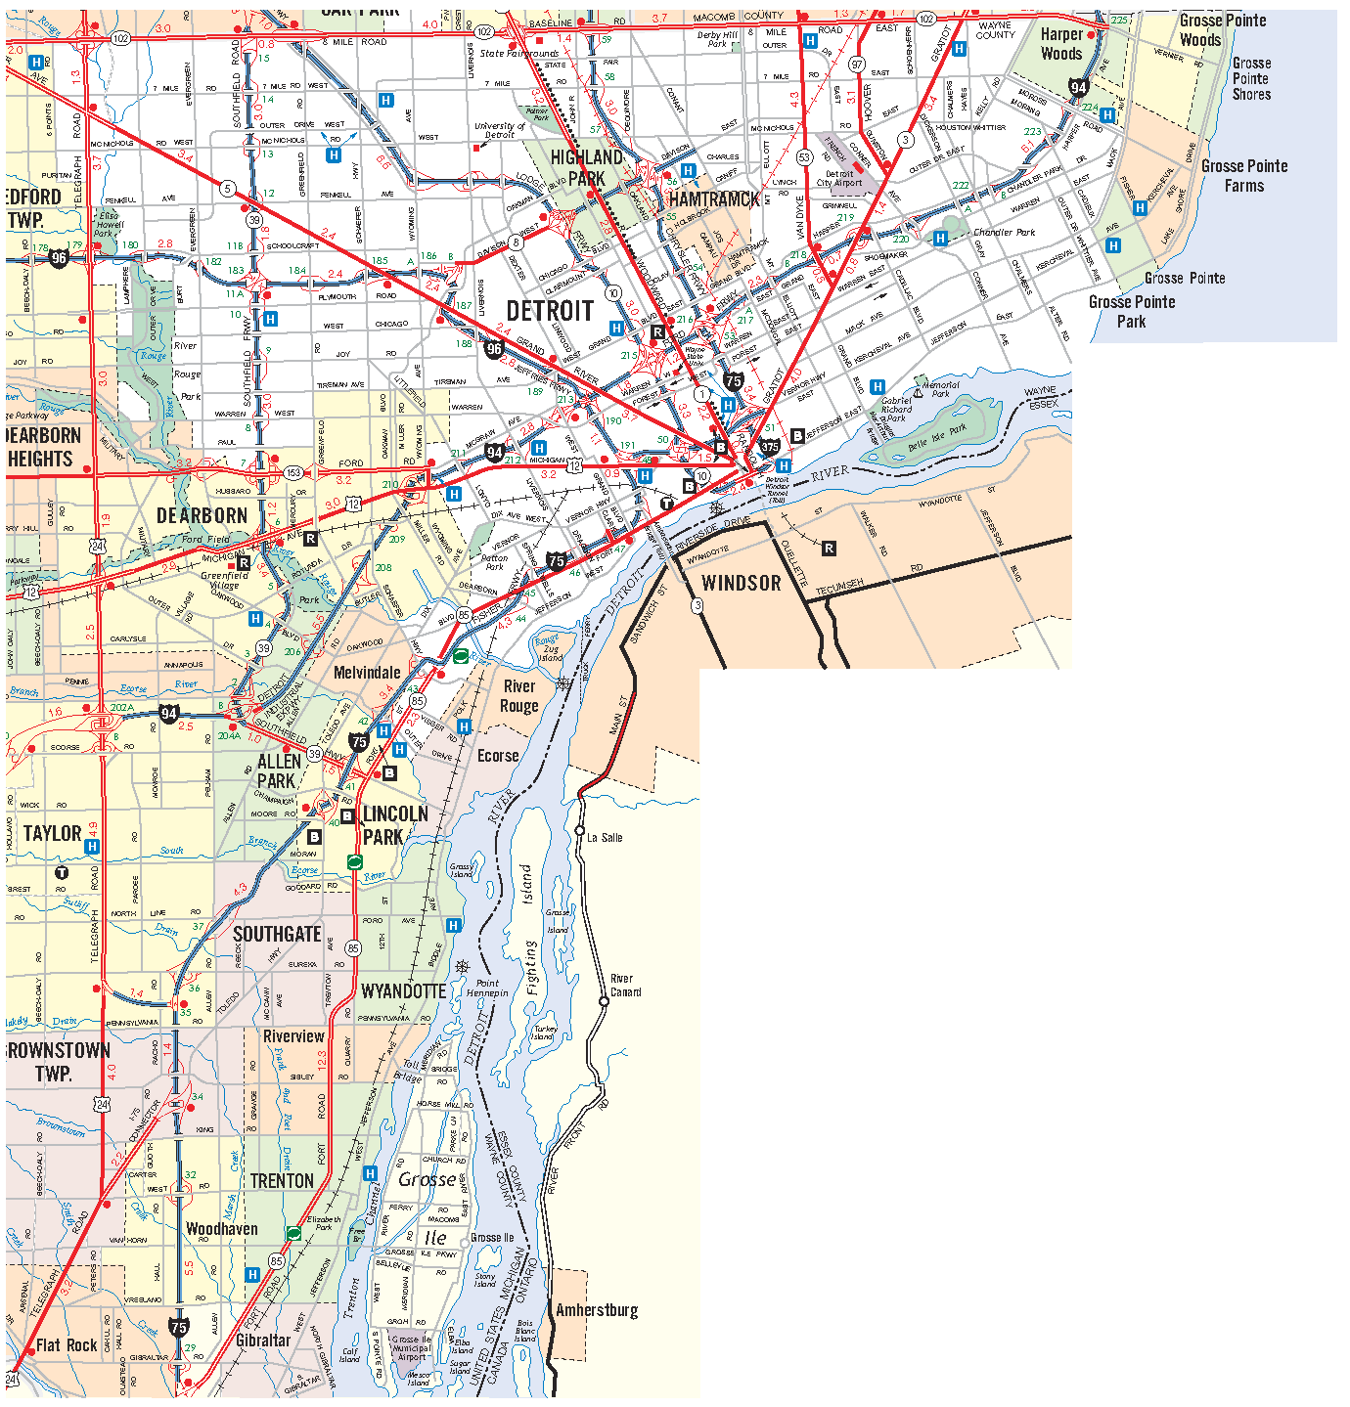
Methods: Exposure Measurements
Detroit Exposure and Aerosol Research Study (DEARS)
Daily (24h) measurements
Residential indoor/outdoor and personal exposures
PM mass and species
VOCs, aldehydes
O₃, NO₂, SO₂
2004 to 2007
Summer/winter seasons
Exposure monitoring areas (EMAs)
5 source-impacted
1 regional background
Allen Park CSN
EMA 4
EMA 6
EMA 3
EMA 5
EMA 1
Allen Park
EMA 7

Slide 5
Methods: Exposure Modeling
Stochastic Human Exposure and Dose Simulation for Particulate Matter (SHEDS-PM)
Estimates population distribution of exposures for location of interest
Time series of PM concentrations for location
Simulates representative population of individuals based on census demographics
Uses human activity diaries to characterize variability in time spent indoors, outdoors, in vehicles
Individual
#1
2
3
4
5
…

Slide 6
CMAQ Average PM_{2.5} Concentration

Slide 7
Results: CMAQ 4 km vs. 1 km

Slide 8
Results: CMAQ 4 km vs. 1 km

Slide 9
Results: CMAQ vs. DEARS

Slide 10
Results: CMAQ vs. DEARS

Slide 11
Results: CMAQ vs. DEARS

Slide 12
Results: CMAQ vs. DEARS

Slide 13
Results: CMAQ vs. DEARS

Slide 14
Results: CMAQ vs. DEARS

Slide 15
Results: CMAQ vs. DEARS

Slide 16
Results: SHEDS Exposure

Slide 17
Results: SHEDS Exposure

Slide 18
Summary
CMAQ 4 km vs. 1 km
Greater spatial resolution in urban center may be important, especially for industrial urban areas
CMAQ vs. DEARS
Larger differences between CMAQ and DEARS compared to difference between 4 km and 1 km CMAQ
Seasonal biases for PM need to be accounted for before using in exposure model

Slide 19
Disclaimer: Although this work was reviewed by EPA and approved for publication, it may not necessarily reflect official Agency policy.

