Slide 1
Western Air Quality Issues and Photochemical Modeling -
An Industrial Perspective
Doug Blewitt, CCM
AQRM
Dana Wood, PE
BP

Slide 2
Western Air Quality Uses of Photochemical Grid Models
Photochemical grid models are routinely being used for regional air quality analyses to project potential consequences of oil and gas infill development
Preconstruction photochemical modeling is being conducted as part of NEPA (EIS)
NEPA is not NSR modeling and is not constrained by Appendix W– use best science
Need to predict impacts of NO₂, PM, Class I visibility, Class I deposition and O₃
Modeling approach:
  Model performance evaluation (visibility, deposition and O₃)
  Model base case impacts
  Model incremental change from base case as a result of development
Regional air quality control strategy development

Slide 3
Oil and Gas 101
Infill development refers to drilling new natural gas wells in an existing field
Much of the purpose of infill drilling is to offset the rate of decline of existing wells
It is not accurate to simply add new emissions to current existing conditions for modeling future year conditions

Slide 4
Unique Properties of Western Ozone
Three ozone seasons
  Winter
    Dominated by local sources
    Very specific meteorological conditions
    Very light wind speeds
    Fresh snow cover
    Strong ground-based inversion
    Terrain issues
  Spring
    Events occur very frequently especially in elevated terrain
    Local and regional sources have minimal or no impact
    Dominated by natural or international sources
    May result in exceedances of NAAQS
  Summer
    Typical SIP analysis – local, regional and boundary conditions are important

Slide 6
Issues Related to
Spring Ozone Events
Possible causes
  Global sources
  Impacts from Mexico and Canada
  Natural events (downward mixing of stratospheric ozone)
States and Tribes need to be able to conduct detailed analyses to identify such events on a routine basis
States and Tribes likely have no control over reducing springtime ozone events

Slide 7
Photochemical Modeling
Technical Issues
Vertical mixing –resulting in model over prediction in elevated terrain (modification to CAMx CMAQ?)
Accuracy of boundary conditions
Source apportionment tools – critical from a user perspective
Accuracy of prognostic meteorological modeling in complex terrain – MM5 (even at 4 km grid size) may not replicate actual flows
Use of model in a relative mode in monitoring data sparse regions – O₃ and visibility
As photochemical model use is becoming more routine, broad based peer review is needed

Slide 8
OSAT: Running 8-Hour Average O3 – Summer
4km Bio
O&G
O&G
BC
12 km Anthro
BC
Fire
EGU
Maximum BC ~ 70 ppb spring ~ 50 ppb summer
Oil and Gas Contribution Maximum ~10-15 ppb

Slide 9
Policy Issues
Modeled exceedances of the standard
  Base case
  Alternative action (significance is not defined)
Need to establish a modeling platform outside a single project that can be used as a starting point
  NEPA is a poor process to conduct such analyses
  Broad based technical support
  Assist agencies that have no technical experience
  WRAP Jumpstart Project
  Used for SIP development as part of non attainment
States and Tribes dealing with O₃ exceedances related to STE and international transport

Slide 10
Questions ?

Slide 11
Extra Slides

Slide 12
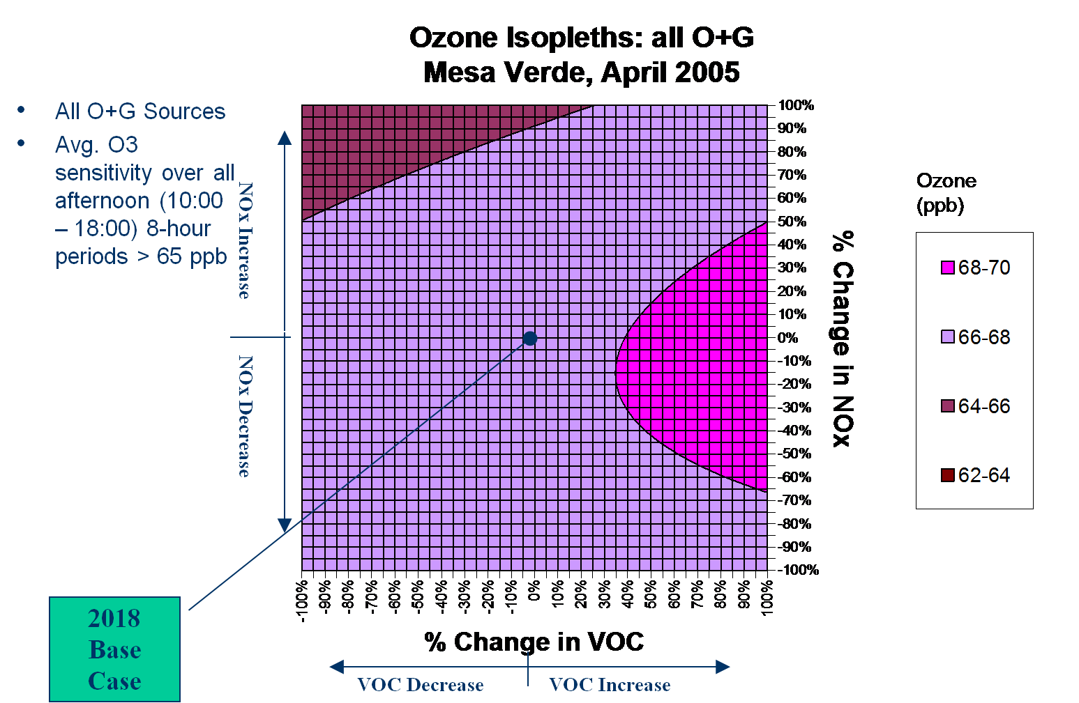
HDDM Modeling Results
Predicted concentrations insensitive to changes in local emissions
Consistent with monitoring data

Slide 13
Hourly time series of inert ozone at western CASTNET sites throughout the second quarter (March – May) of 2005 from the CAMx run using monthly averaged 2002 BCs (green) and the CAMx run using 3-hourly 2005 BCs (red).

Slide 14
Hourly time series of the relative cumulative inert BC tracer contributions to total surface tracer concentrations at western CASTNET sites during April 2005.

Slide 15
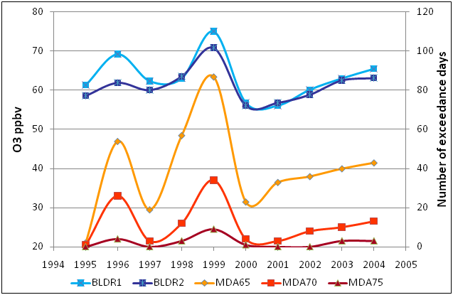
Number of days each year in April and May that exceed an MDA8 value of 65, 70 or 75 ppbv for the 7 CASTNET sites considered (right axis) and April-May free tropospheric O₃ concentration as measured by the ozonesondes from Boulder, Colorado.
Jaffe, 2010

