Slide 1
SMOKE-MOVES Integration Tool
B.H. Baek and Catherine Seppanen
Institute for the Environment-UNC at Chapel Hill
Allison DenBleyker, Chris Lindhjem and Michele Jimenez
ENVIRON International Corporation
Marc Houyoux, Alison Eyth and Rich Mason
OAQPS US EPA
Notes:
, Christian E. Lindhjem, Michele Jimenez

Slide 2
Introduction
MOVES2010 is released on December 2009
MOVES2010a is released on August 2010
SMOKE-MOVES Integration Tool is released on July 2010
(1) Meteorological Preprocessor (Met4moves)
(2) MOVES Processing Scripts
  MOVES Driver Script
  MOVES Post-processing Script
(3) SMOKE Modeling System

Slide 3
SMOKE-MOVES Integration Tool

Slide 4
Reference County
To reduce the computational burden of running MOVES on every county in your modeling domain
Represent a set of similar counties (i.e., inventory counties) called a county group.
Key emission rates for the single reference county in MOVES can be utilized to estimate emissions for all counties in the county group through SMOKE.
Criteria : Similar fuel parameters, fleet age distribution and I/M programs.

Slide 5
Fuel Month
Similar to the reference county, the fuel month reduces the computational time of MOVES by using a single month to represent a set of months.
Represent a particular set of fuel properties over the months used in MOVES
Example: If January and February use the similar fuel types, model only one of the months
Criteria : The State-provided fuel supply data in the MOVES database for each reference county

Slide 6
Met. Preprocessor: Met4Moves

Slide 7
Met4Moves output for SMOKE

Slide 8
Met4Moves output for MOVES

Slide 9
Normalized Diurnal Temperature Profiles
    Geographic average → normalized 24-hour temperature profile
    Normalized shape fitted with binned range of min/max temperatures

Slide 10
MOVES Processing Scripts
MOVES Driver Script
  RatePerDistance : PD_TEMP_INCREMENT
  RatePerVehicle: PV_TEMP_INCREMENT
  RatePerProfile: PP_TEMP_INCREMENT & Met4moves diurnal temperature profiles
MOVES Post-processing Script
  Convert MOVES tables to SMOKE-ready MOVES lookup tables
  Support MOVES2010 and MOVES2010a
  MOVES2010 version performs SCC mapping (≈1.5d/county/mon)
  MOVES2010a version requires SCC field in MOVES output tables

Slide 11
Emission Processes

Slide 12
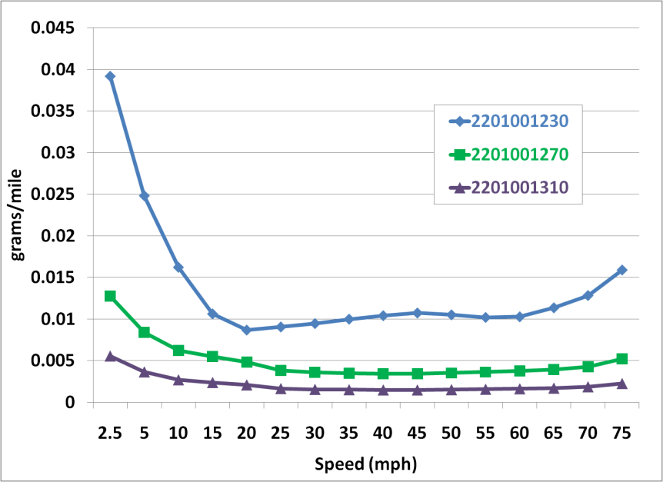
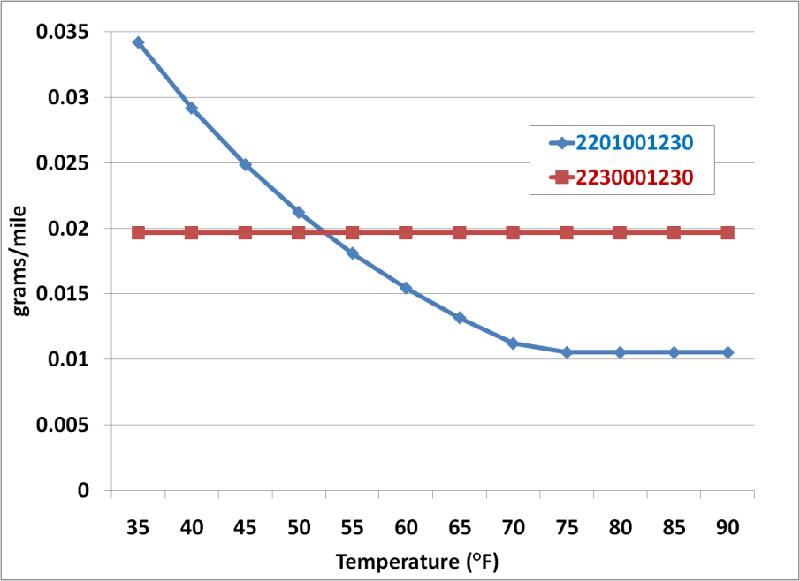
RatePerDistance (RPD) Approach
Running Exhaust PM2.5 OC
from Gasoline Cars
Running Exhaust PM2.5 OC
from Gas and Diesel Cars
Diesel
Urban Interstate
Urban Principal Arterial
Gasoline
Urban Collector
Temperature = 75 F Relative Humidity = 63.5 %
Speed = 50 mph Relative Humidity = 63.5 %
Assigns binned temperatures to hours of the day
RatePerDistance emission rates depend on :
  - Temperature - Speed - Humidity
From ENVIRON

Slide 13
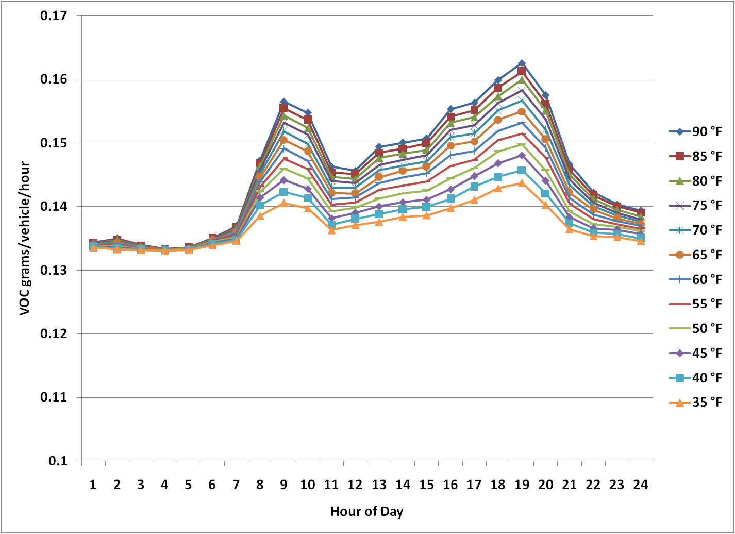
RatePerVehicle (RPV) Approach
Off-Network Evaporative Fuel Leaks
VOC from Gasoline Cars
From ENVIRON
Assigns each binned temperature to all hours of a run day
RatePerVehicle emission rates depend on
  - Temperature - Humidity - Hour - Day type

Slide 14
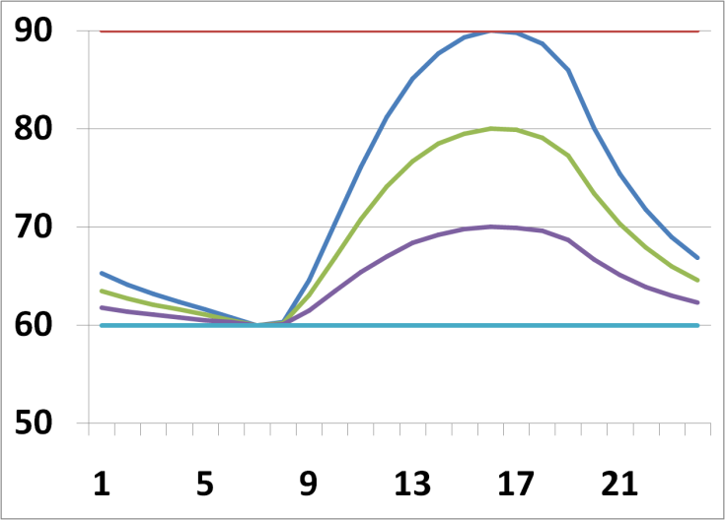
RatePerProfile (RPP) Approach
Evaporative Fuel Vapor Venting emissions affected by temperatures in previous hours
  When the vehicle is parked Including diurnal (when the vehicle is parked during the day) and hot soak (immediately after a trip when the vehicle parks) emissions types
(min, max) temperatures:
(30, 30) (40, 40) (50, 50) (60, 60) (70, 70) (80, 80) (90,90)
(30, 40) (40, 50) (50, 60) (60, 70) (70, 80) (80, 90)
(30, 50) (40, 60) (50, 70) (60, 80) (70, 90)
(30, 60) (40, 70) (50, 80) (60, 90)
(30, 70) (40, 80) (50, 90)
(30, 80) (40, 90)
(30, 90)
T (°F)
From ENVIRON
Hour (Local Time)

Slide 15
MOVES Post-processing Script

Slide 16
MOVES Post-processing Script

Slide 17
Chemical Speciation in SMOKE
MEPROC Input file for SMOKE Speciation (Spcmat)
Example: EXR__CO, EXR__NOX, EXR__TOG, EFV__TOG,,,,

Slide 18
SMOKE Modeling System
RPD (grams/miles) : On-roadway Emission Process EFs
  Lookup Fields: Speed (optional 24-hr Speed profiles), Fuel month, and Temperature.
RPV (grams/vehicle-hr) : Off-network Emission Process EFs
  Lookup Fields: Fuel month, Temperature, Local time hourID.
RPP (grams/vehicle-hr) : Off-network Vapor Venting Evap. EFs
  Lookup Fields: Fuel month, Temperature profiles, Local time hourID.

Slide 19
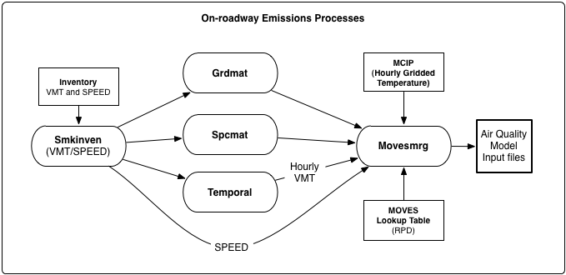
SMOKE: Onroad-way Processing (RPD)

Slide 20
MOVESMRG: Onroad-way (RPD)
Stores EFs by SCC, speed bin, temperature value, process, and pollutant
Estimates emissions hourly emissions for every grid cell in the domain using hourly gridded MCIP files
Gridded/hourly/speciated Emission = EF * hourly VMT * Grid cell fraction * Speciation fraction
Notes:
Loop over time steps in the episode
Determine if current day is a weekday or weekend
RPD mode: read hourly VMT
RPD/RPV mode: read hourly met data
Loop over reference counties
Determine fuel month for the current time step and reference county (using MFMREF file)
Read emission factors for the appropriate mode, reference county, and fuel month
RPD mode: store factors by SCC, speed bin, temperature value, process, and pollutant
RPV mode: store factors by weekday vs. weekend, SCC, local hour, temperature value, process, and pollutant
RPP mode: store factors by weekday vs. weekend, SCC, local hour, temperature profile, process, and pollutant
RPD/RPV mode: store list of temperature values
RPP mode: sort and store list of min and max temperatures associated with each temperature profile
Loop over sources in the current reference county
RPD mode: get hourly VMT and average speed for current source
RPD mode: determine appropriate speed bin interpolation factor
RPV/RPP mode: get vehicle population for current source, determine local hour
RPP mode: get temperature profile min and max for current inventory county from METMOVES file
RPP mode: determine appropriate temperature profile interpolation factors
Loop over grid cells for the current source
RPD/RPV mode: convert hourly temperature for current grid cell into Fahrenheit, determine appropriate temperature interpolation factor
Loop over pollutant-species combinations
skip emission process/pollutant combinations that are not valid for the current processing mode
calculate interpolated emission factor for the current source, grid cell, hour (RPV/RPP modes), process, and pollutant
RPD mode: calculate hourly emissions using emission factor and hourly VMT
RPV/RPP mode: calculate hourly emissions using emission factor and vehicle population data
Emissions value = emission factor * hourly VMT * grid cell fraction * speciation fraction * unit conversion
store speciated emissions value for current grid cell
store speciated emissions value for current county
End loop
End loop
End loop
End loop

Slide 21
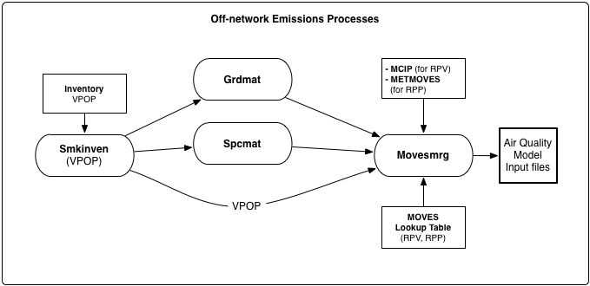
SMOKE: Off-network Processing (RPV, RPP)

Slide 22
MOVESMRG: Off-network (RPV and RPP)
RPV mode : Store EFs by weekday/weekend, SCC, local hour, temperature value, process, and pollutant
RPP mode : Store EFs by weekday/weekend, SCC, local hour, temperature profile, process, and pollutant
RPV estimates hourly emissions for every grid cell in the domain using hourly gridded MCIP files
RPP estimates emissions by inventory county using appropriate temperature profile interpolation factors based on Met4Moves profiles
Gridded/hourly/speciated Emission = EF * Vehicle populations * Grid cell fraction * Speciation fraction
Notes:
Loop over time steps in the episode
Determine if current day is a weekday or weekend
RPD mode: read hourly VMT
RPD/RPV mode: read hourly met data
Loop over reference counties
Determine fuel month for the current time step and reference county (using MFMREF file)
Read emission factors for the appropriate mode, reference county, and fuel month
RPD mode: store factors by SCC, speed bin, temperature value, process, and pollutant
RPV mode: store factors by weekday vs. weekend, SCC, local hour, temperature value, process, and pollutant
RPP mode: store factors by weekday vs. weekend, SCC, local hour, temperature profile, process, and pollutant
RPD/RPV mode: store list of temperature values
RPP mode: sort and store list of min and max temperatures associated with each temperature profile
Loop over sources in the current reference county
RPD mode: get hourly VMT and average speed for current source
RPD mode: determine appropriate speed bin interpolation factor
RPV/RPP mode: get vehicle population for current source, determine local hour
RPP mode: get temperature profile min and max for current inventory county from METMOVES file
RPP mode: determine appropriate temperature profile interpolation factors
Loop over grid cells for the current source
RPD/RPV mode: convert hourly temperature for current grid cell into Fahrenheit, determine appropriate temperature interpolation factor
Loop over pollutant-species combinations
skip emission process/pollutant combinations that are not valid for the current processing mode
calculate interpolated emission factor for the current source, grid cell, hour (RPV/RPP modes), process, and pollutant
RPD mode: calculate hourly emissions using emission factor and hourly VMT
RPV/RPP mode: calculate hourly emissions using emission factor and vehicle population data
Emissions value = emission factor * hourly VMT * grid cell fraction * speciation fraction * unit conversion
store speciated emissions value for current grid cell
store speciated emissions value for current county
End loop
End loop
End loop
End loop

Slide 23
SMOKE: Final Merging
Run 3 times (Onroad-RPD, Offroad-RPV, Offroad-RPP)
RPD, RPV are running for every day using hourly gridded MCIP files
RPP are running for average day (one day per month) using averaged meteorological output file from Met4Moves
Computation time is a function of number of sources, size of grid cell, and domain
Two reference counties in GA and 43*32 grid cells
  RPD : 4-5 min/day, RPV : 2-3 min/day, RPP : 1 min/day

Slide 24
Future Enhancements
Supporting weekday/weekend hourly speed profiles for RPD [ongoing]
New SCCs based on a combination of vehicle/road/emissionProcess
Create various types of QA reports from Movesmrg
  County-SCC, Non-speciated reports
Updating Emission Processing Input Data
  Chemical speciation profiles and cross-reference input files
  Temporal profiles and cross-reference files
  Surrogates
Integrations with Smkreport (SMOKE QA program)

Slide 25
Acknowledgement
US EPA Office of Air Quality Planning and Standards (OAQPS)
ENVRION International Corporation
US EPA Office of Transportation and Air Quality (OTAQ)
QUESTIONS?

